Slide 1
Assessing Model Fit

Slide 2
Announcements
There seems to be an issue with Race in Visit 10 – Hispanic/Latinx individuals have no data in this visit??
Project Announcements from Sakai
Screening data should be included in the merged dataset. Education should be used from here
Smoking status should be taken from Visit 10 and should be binary.
The three variables you choose should come from Visit 10 OR not cause major numerical issues.
Everyone in your group will present a part of your presentations.
Proposal is due Monday, May 29th at 11pm.

Slide 3
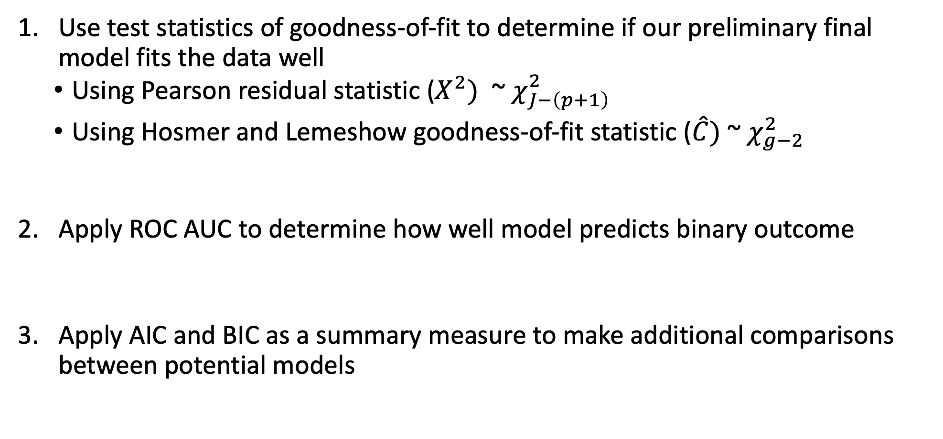
Class 14 Learning Objectives
Use test statistics of goodness-of-fit to determine if our preliminary final model fits the data well
Using Pearson residual statistic ($X^{2})$ ~ $χ_{J−\left(p+1\right)}^{2}$
Using Hosmer and Lemeshow goodness-of-fit statistic ($\hat{C})$~ $χ_{g−2}^{2}$
Apply ROC AUC to determine how well model predicts binary outcome
Apply AIC and BIC as a summary measure to make additional comparisons between potential models

Slide 4
Overview (I)
Once the preliminary final model has been determined, we need to assess the fit of the model
Variable selection is no longer our focus at this stage
We want to find answer to whether the model fits the data adequately
Assessing the Goodness of Fit or Assessing model fit
Assess how well our fitted logistic regression model predicts/estimates the observed outcomes
Comparison: fitted/estimated outcome vs. observed outcome

Slide 5
Overview (II)
The model building strategies we have discussed so far only assess the importance of covariates
It did not assess model fit
Previous in model building, we made relative comparisons between models
Our conclusions were limited to: Model 1 (full model) fits data better than Model 2 (reduced model)
Assessing goodness of fit is
Not a relative comparison
It is an absolute comparison
To compare the fitted model to the largest possible model (saturated model)
Model adequacy vs. Model comparison

Slide 6
Poll Everywhere Question 1

Slide 7
Components to Assess Model Fit (II)
The model fits the data if
Summary measures of the distance between the predicted/estimated/fitted and observed Y are small
The contribution of each pair (predicted and observed) to these summary measures is unsystematic and is small relative to the error structure of the model
It is possible to see a “good” summary measure of the distance between predicted and observed Y with some substantial deviation from fit for a few subjects

Slide 8
Components to Assess Model Fit (I)
Computation and evaluation of overall measures of fit
Examination of the individual components of the summary statistics (often through picture)
Examination of other measures of the difference or distance between the observed and fitted values

Slide 9
Components to Assess Model Fit (I)
TODAY
Computation and evaluation of overall measures of fit
Examination of the individual components of the summary statistics (often through picture)
Examination of other measures of the difference or distance between the observed and fitted values

Slide 10
Summary Measures of Goodness of Fit
Aka overall measure of fit
Need to define what the fitted outcome is
Need to calculate how close the fitted outcome is to the observed outcome
Summarize across all observations (or individuals’ data)

Slide 11
Class 14 Learning Objectives
Use test statistics of goodness-of-fit to determine if our preliminary final model fits the data well
Using Pearson residual statistic ($X^{2})$ ~ $χ_{J−\left(p+1\right)}^{2}$
Using Hosmer and Lemeshow goodness-of-fit statistic ($\hat{C})$~ $χ_{g−2}^{2}$
Apply ROC AUC to determine how well model predicts binary outcome
Apply AIC and BIC as a summary measure to make additional comparisons between potential models

Slide 12

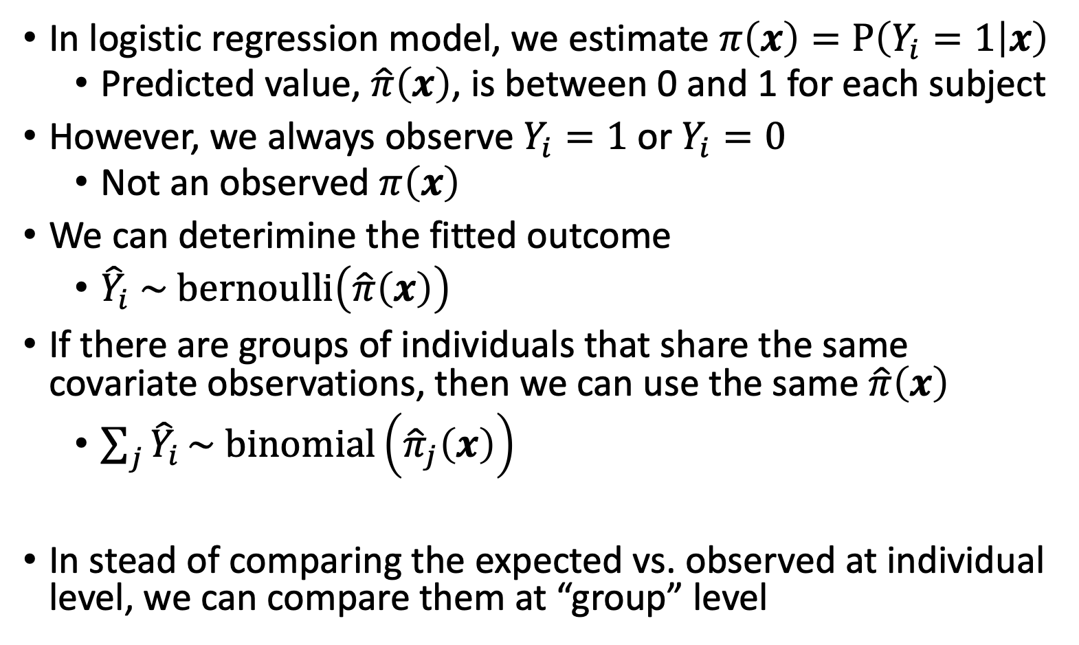
Comparing fitted outcome to observed outcome
In logistic regression model, we estimate $π\left(x\right)=P\left(Y_{i}=1 | x\right)$
Predicted value, $\hat{π}\left(x\right)$, is between 0 and 1 for each subject
However, we always observe $Y_{i}=1$ or $Y_{i}=0$
Not an observed $π\left(x\right)$
We can deterimine the fitted outcome
${\hat{Y}}_{i} \sim bernoulli\left(\hat{π}\left(x\right)\right)$
If there are groups of individuals that share the same covariate observations, then we can use the same $\hat{π}\left(x\right)$
$\sum_{j}{{\hat{Y}}_{i}}\sim binomial\left({\hat{π}}_{j}\left(x\right)\right)$
In stead of comparing the expected vs. observed at individual level, we can compare them at “group” level

Slide 13
Number of Covariate Patterns (I)
When the logistic regression model contains only categorical covariates, we can think of the number of covariate patterns
For example: model contains two categorical covariates (sex assigned at birth and smoking status), there will be 4 unique combination of these factors
This model has 4 covariate patterns
Subjects can be divided into 4 groups based on the covariates’ values
We can then compute the predicted number of individuals with Y=1 in each group, and compare that with the actual observed number of individuals with Y=1 in that group

Slide 14
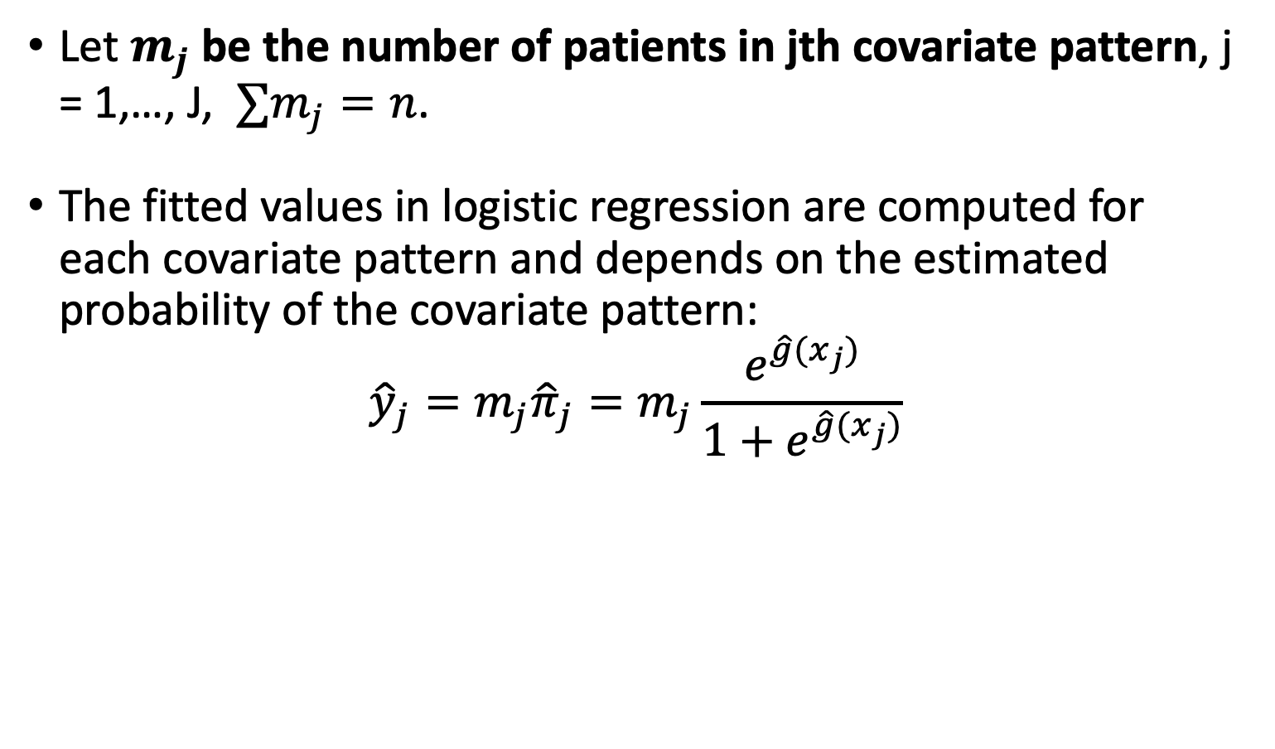
Number of Covariate Patterns (II)
Let $m_{j}$ be the number of patients in jth covariate pattern, j = 1,…, J, $∑m_{j}=n$.
The fitted values in logistic regression are computed for each covariate pattern and depends on the estimated probability of the covariate pattern:
$${\hat{y}}_{j}=m_{j}{\hat{π}}_{j}=m_{j}\frac{e^{\hat{g}(x_{j})}}{1+e^{\hat{g}(x_{j})}}$$

Slide 15
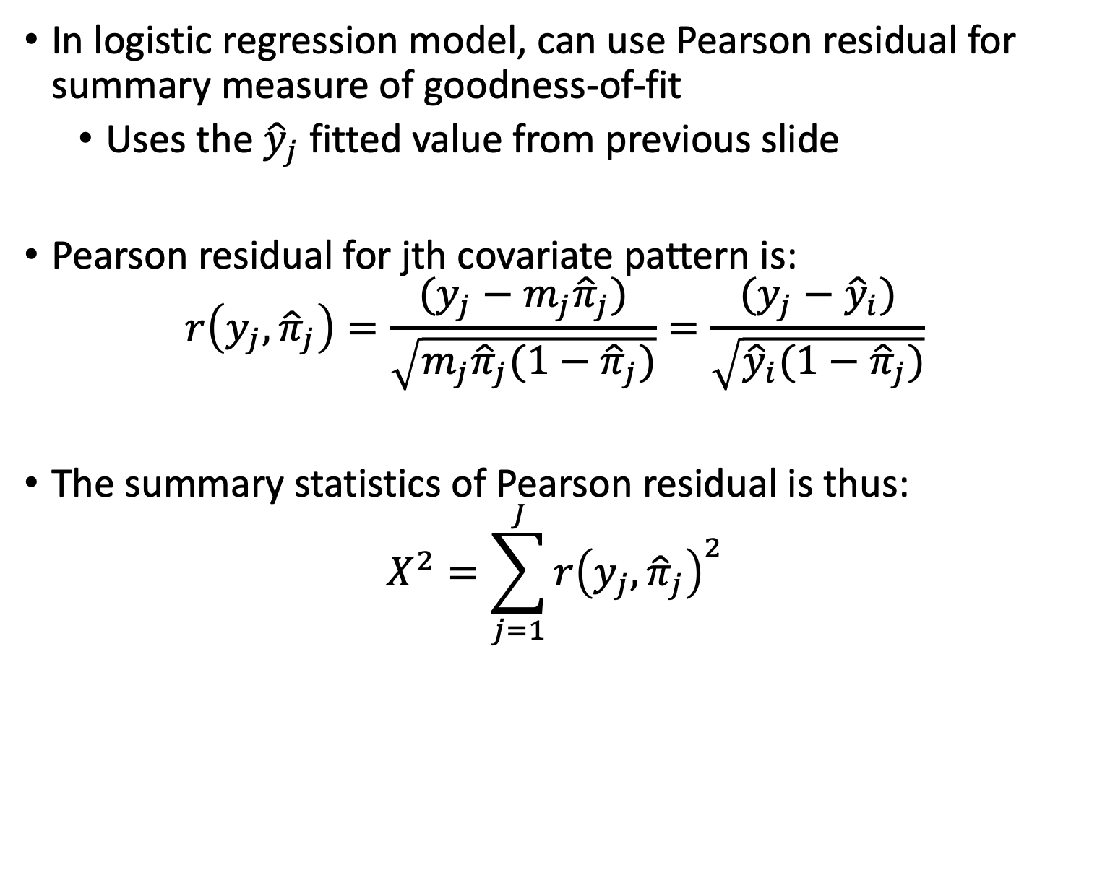
Pearson Residual (I)
In logistic regression model, can use Pearson residual for summary measure of goodness-of-fit
Uses the ${\hat{y}}_{j}$ fitted value from previous slide
Pearson residual for jth covariate pattern is:
$$r\left(y_{j},{\hat{π}}_{j}\right)=\frac{(y_{j}−m_{j}{\hat{π}}_{j})}{\sqrt{m_{j}{\hat{π}}_{j}(1−{\hat{π}}_{j})}}=\frac{(y_{j}−{\hat{y}}_{i})}{\sqrt{{\hat{y}}_{i}(1−{\hat{π}}_{j})}}$$
The summary statistics of Pearson residual is thus:
$$X^{2}=\sum_{j=1}^{J}{r{\left(y_{j},{\hat{π}}_{j}\right)}^{2}}$$

Slide 16
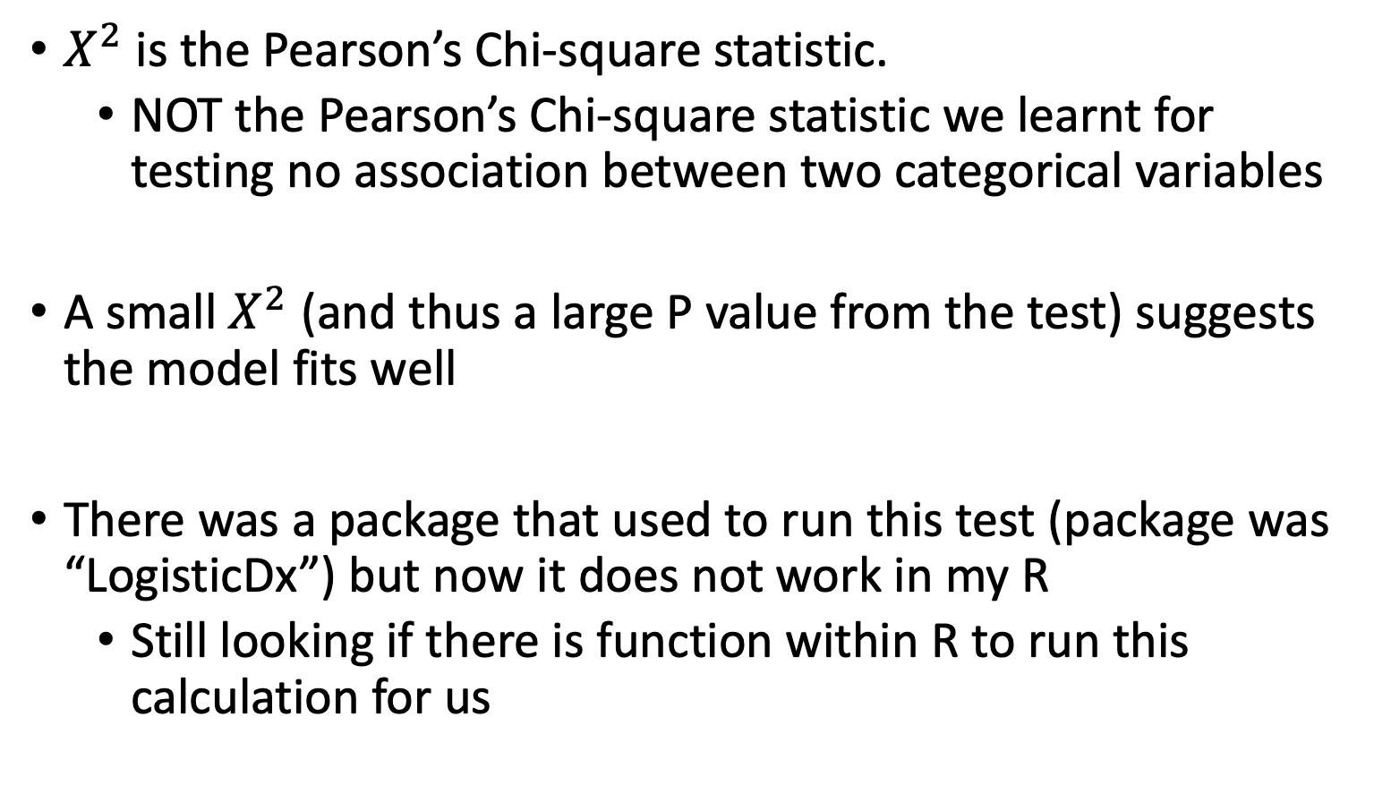
Pearson Residual (II)
$X^{2}$ is the Pearson’s Chi-square statistic.
NOT the Pearson’s Chi-square statistic we learnt for testing no association between two categorical variables
A small $X^{2}$ (and thus a large P value from the test) suggests the model fits well
There was a package that used to run this test (package was “LogisticDx”) but now it does not work in my R
Still looking if there is function within R to run this calculation for us

Slide 17
Old R Code for Pearson Residuals (I)
Using UIS data as example, first fit a MLR model with IVHX (3 levels), Race (2 levels), treat (2 levels), site (2 levels). We then have 24 covariate patterns out of 575 observations.
Library(LogisticDx)
uis$dfree.new <- ifelse(uis$dfree == "Remaining_drug_free",1,0)
uis.mod<- glm(dfree.new ~ factor(ivhx) + factor(race)
+ factor(treat) + factor(site),
data=uis,
family = "binomial")
gof(uis.mod)$chiSq
Pearson Chi-square statistic (based on Pearson residual) suggests the model fits well.
J-(p+1)=24 – 6 = 18
Pr: Pearson residual, dr: deviance residual, I: individual, G: Group, CT: contingency table
Deviance Likelihood ratio test suggests the model fits well.

Slide 18
Old R Code for Pearson Residuals (II)
For GLOW500 data, if fit a MLR model with all variables listed in Table 4.16 of textbook.
glow$raterisk3<-ifelse(glow$raterisk==3,1,0)
glow.mod<- glm(fracture ~ age*priorfrac + height +
momfrac*armassist + raterisk3,
data=glow,
family = "binomial")
gof(glow.mod)$chiSq
J close to n
Pearson Chi-square statstics and Deviance Likelihood ratio test should not be used for this model.

Slide 19
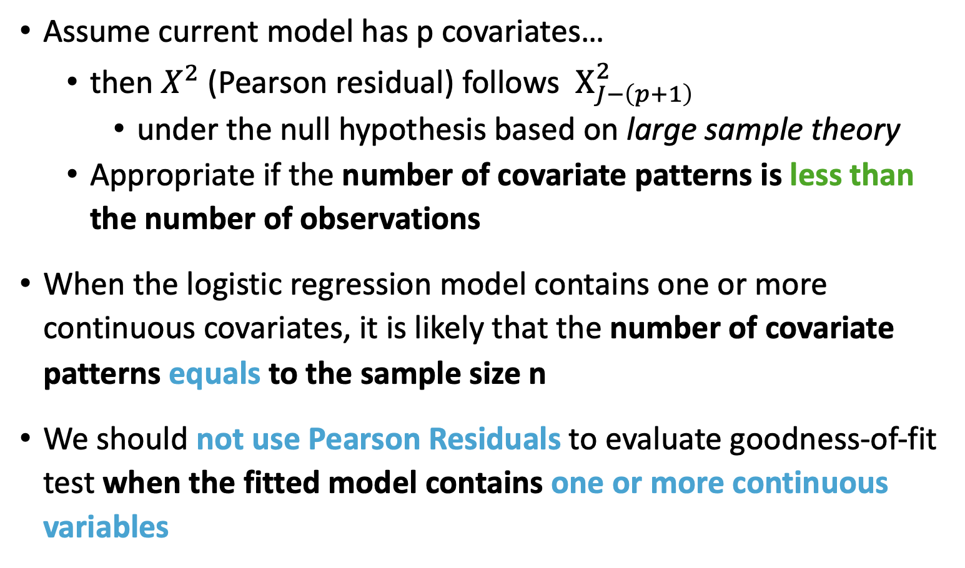
Issues with Pearson Residuals
Assume current model has p covariates…
then $X^{2}$(Pearson residual) follows $Χ_{J−\left(p+1\right)}^{2}$
under the null hypothesis based on large sample theory
Appropriate if the number of covariate patterns is less than the number of observations
When the logistic regression model contains one or more continuous covariates, it is likely that the number of covariate patterns equals to the sample size n
We should not use Pearson Residuals to evaluate goodness-of-fit test when the fitted model contains one or more continuous variables

Slide 20
Class 14 Learning Objectives
Use test statistics of goodness-of-fit to determine if our preliminary final model fits the data well
Using Pearson residual statistic ($X^{2})$ ~ $χ_{J−\left(p+1\right)}^{2}$
Using Hosmer and Lemeshow goodness-of-fit statistic ($\hat{C})$~ $χ_{g−2}^{2}$
Apply ROC AUC to determine how well model predicts binary outcome
Apply AIC and BIC as a summary measure to make additional comparisons between potential models

Slide 21
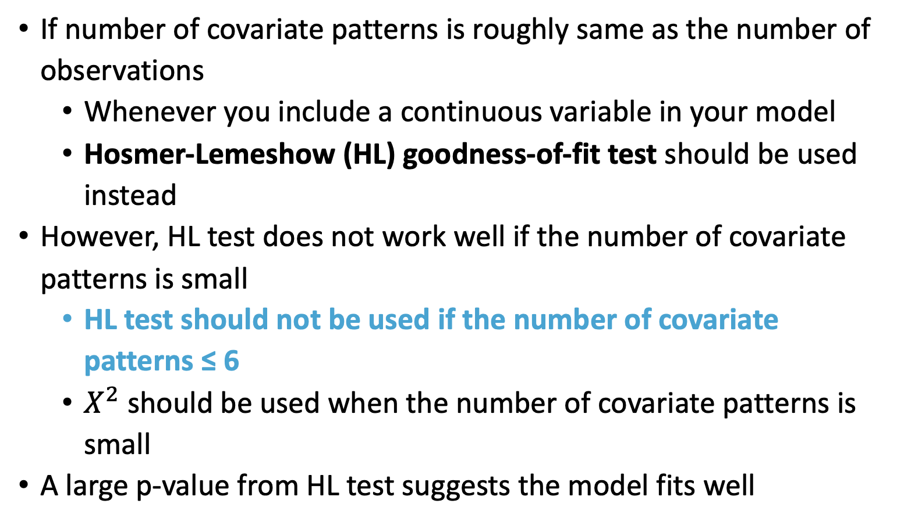
The Hosmer-Lemeshow Test (I)
If number of covariate patterns is roughly same as the number of observations
Whenever you include a continuous variable in your model
Hosmer-Lemeshow (HL) goodness-of-fit test should be used instead
However, HL test does not work well if the number of covariate patterns is small
HL test should not be used if the number of covariate patterns ≤ 6
$X^{2}$ should be used when the number of covariate patterns is small
A large p-value from HL test suggests the model fits well

Slide 22
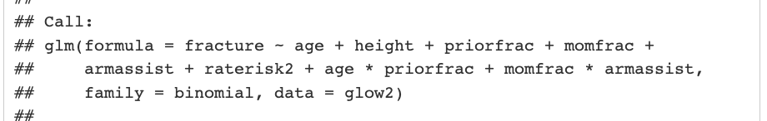
Poll Everywhere Question 2

Slide 23
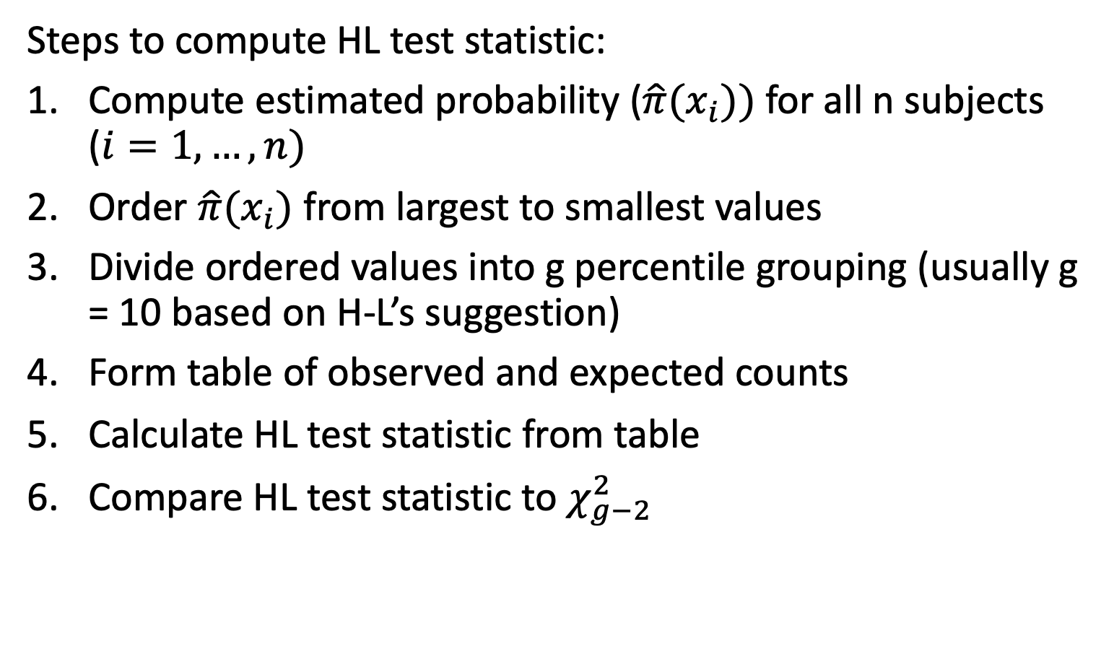
The Hosmer-Lemeshow Test (II)
Steps to compute HL test statistic:
Compute estimated probability ($\hat{π}(x_{i}))$for all n subjects ($i=1, …, n)$
Order $\hat{π}(x_{i})$ from largest to smallest values
Divide ordered values into g percentile grouping (usually g = 10 based on H-L’s suggestion)
Form table of observed and expected counts
Calculate HL test statistic from table
Compare HL test statistic to $χ_{g−2}^{2}$

Slide 24
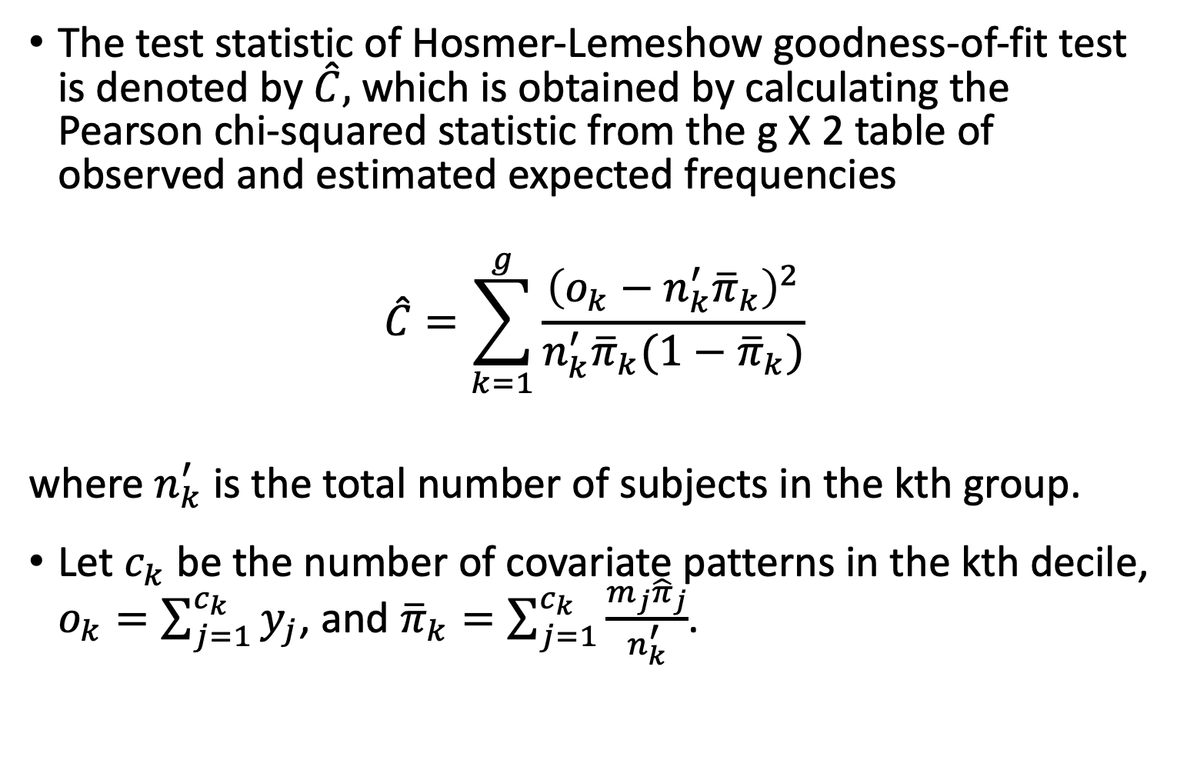
The Hosmer-Lemeshow Test (III)
The test statistic of Hosmer-Lemeshow goodness-of-fit test is denoted by $\hat{C},$which is obtained by calculating the Pearson chi-squared statistic from the g X 2 table of observed and estimated expected frequencies
$$\hat{C}=\sum_{k=1}^{g}{\frac{{\left(o_{k}−n_{k}^{′}{\overline{π}}_{k}\right)}^{2}}{n_{k}^{′}{\overline{π}}_{k}(1−{\overline{π}}_{k})}}$$
where $n_{k}^{′}$ is the total number of subjects in the kth group.
Let $c_{k}$ be the number of covariate patterns in the kth decile, $o_{k}=\sum_{j=1}^{c_{k}}{y_{j}}$, and ${\overline{π}}_{k}=\sum_{j=1}^{c_{k}}{\frac{m_{j}{\hat{π}}_{j}}{n_{k}^{′}}}$.

Slide 25
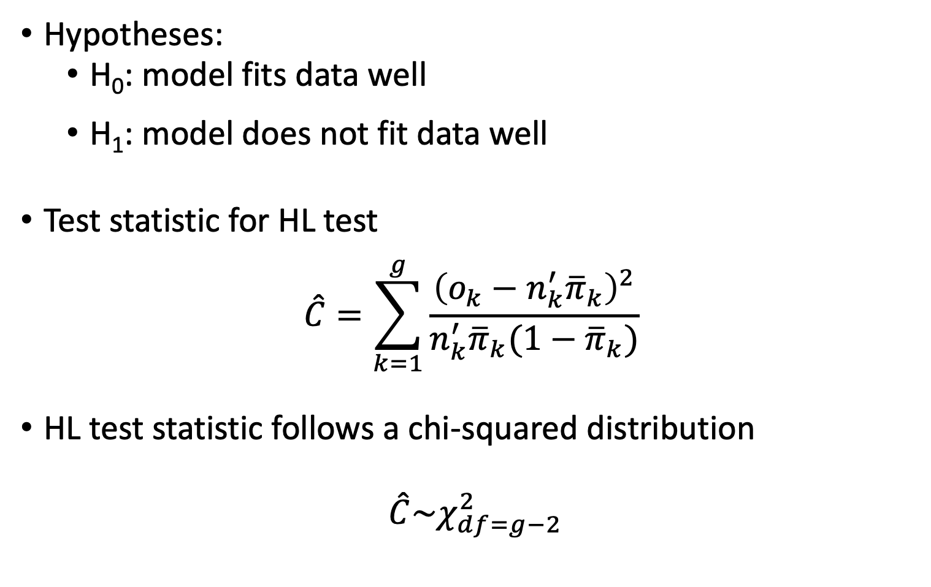
The Hosmer-Lemeshow Test: key info
Hypotheses:
H₀: model fits data well
H₁: model does not fit data well
Test statistic for HL test
$$\hat{C}=\sum_{k=1}^{g}{\frac{{\left(o_{k}−n_{k}^{′}{\overline{π}}_{k}\right)}^{2}}{n_{k}^{′}{\overline{π}}_{k}(1−{\overline{π}}_{k})}}$$
HL test statistic follows a chi-squared distribution
$\hat{C}\sim χ_{df=g−2}^{2}$

Slide 26
10 minute break?

Slide 27
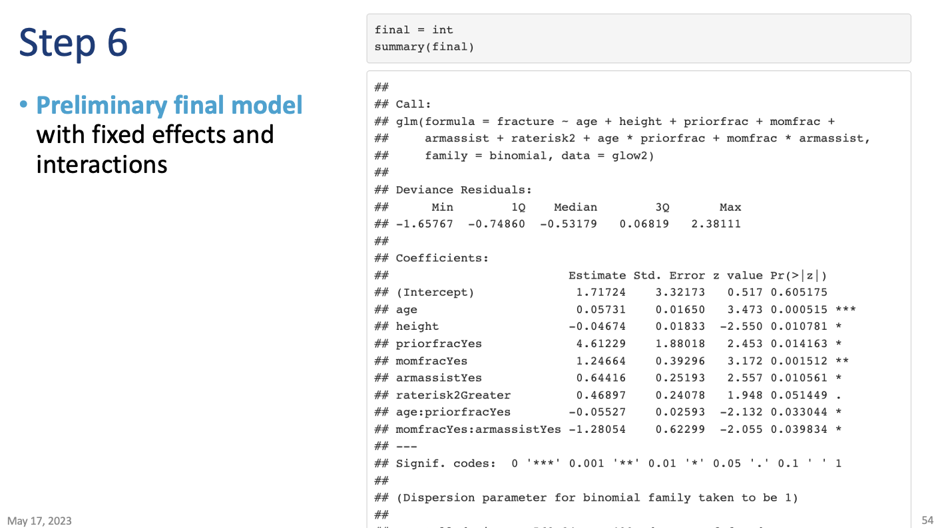
GLOW Study
From Class 12, at the end of Step 6, we had a preliminary final model
Variables/interactions included:
Age
Height
Prior fracture
Mom fracture
Arm Assist
Rated risk of fracture
Age x Prior fracture
Mom fracture x Arm Assist

Slide 28
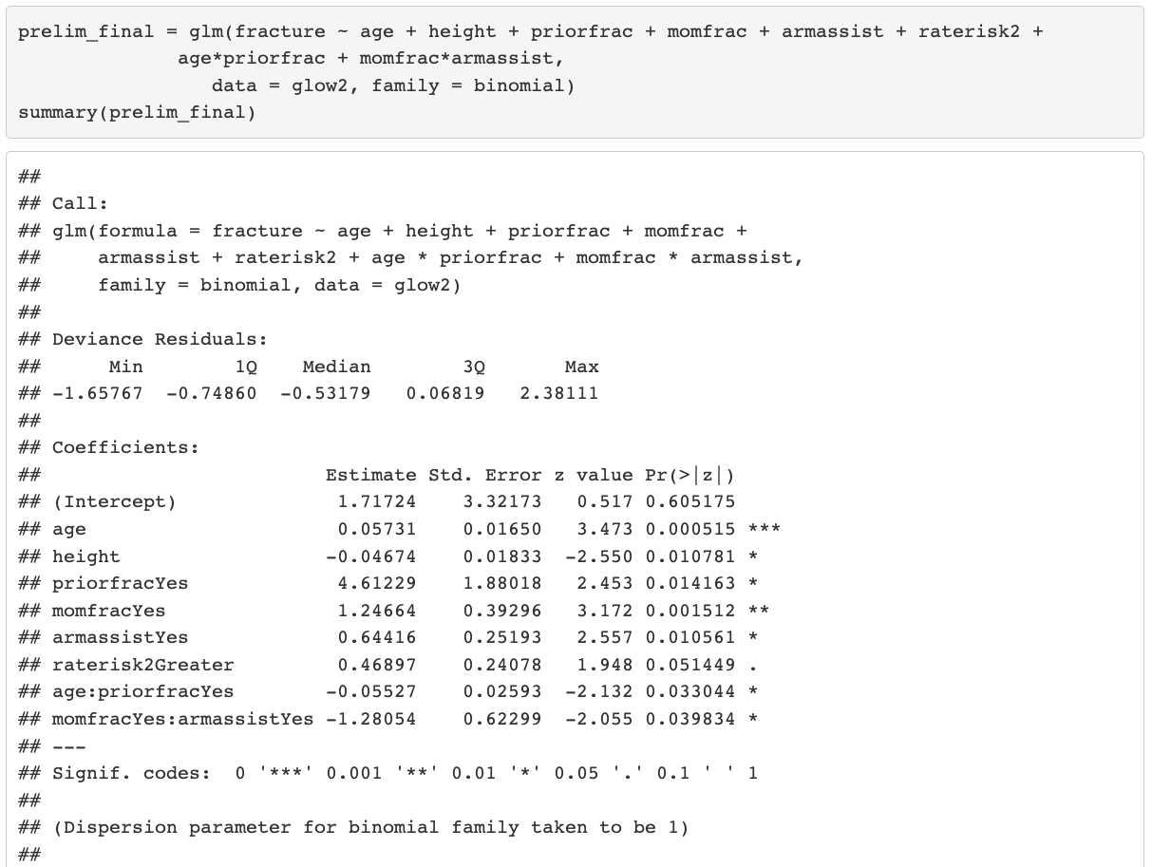
GLOW Study: HL Test (I)
Now we can move to Step 7 in model building
Use HL test to help use determine if our preliminary final model fits the data well
Hypotheses:
H₀: GLOW preliminary final model fits data well
H₁: GLOW preliminary final model does not fit data well

Slide 29
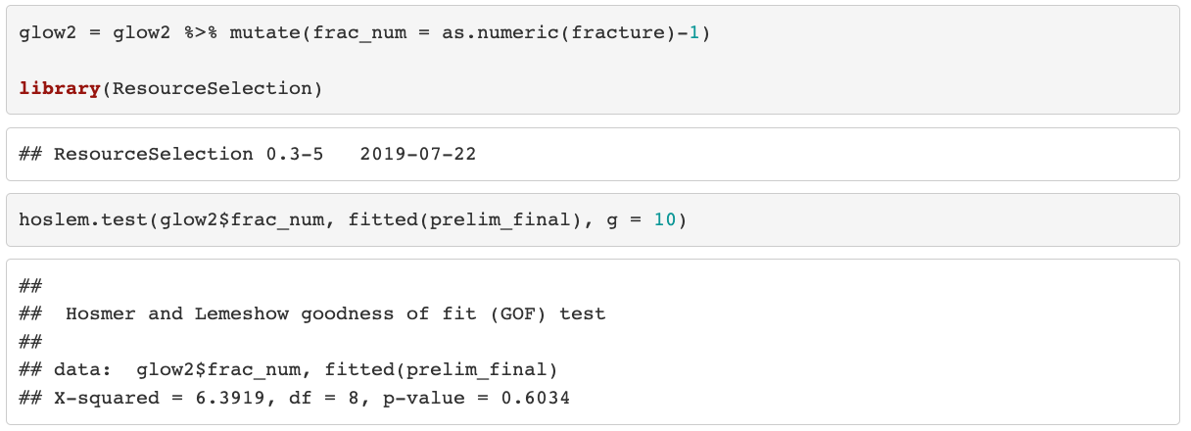
GLOW Study: HL Test (II)
Use HL test in R
Part of “ResourceSelection” package

Slide 30
Poll Everywhere Question 3

Slide 31
GLOW Study: HL Test (III)
Conclusion: The p-value is 0.6034, so we fail to reject the null hypothesis that the model fits the data well. Thus, the preliminary final model for the GLOW dataset fits the data well
Don’t forget that we still need to check individual observations
R may give results for the HL test even if it is not appropriate to use it!
If number of covariate patterns ≤ 6, do not use HL test

Slide 32
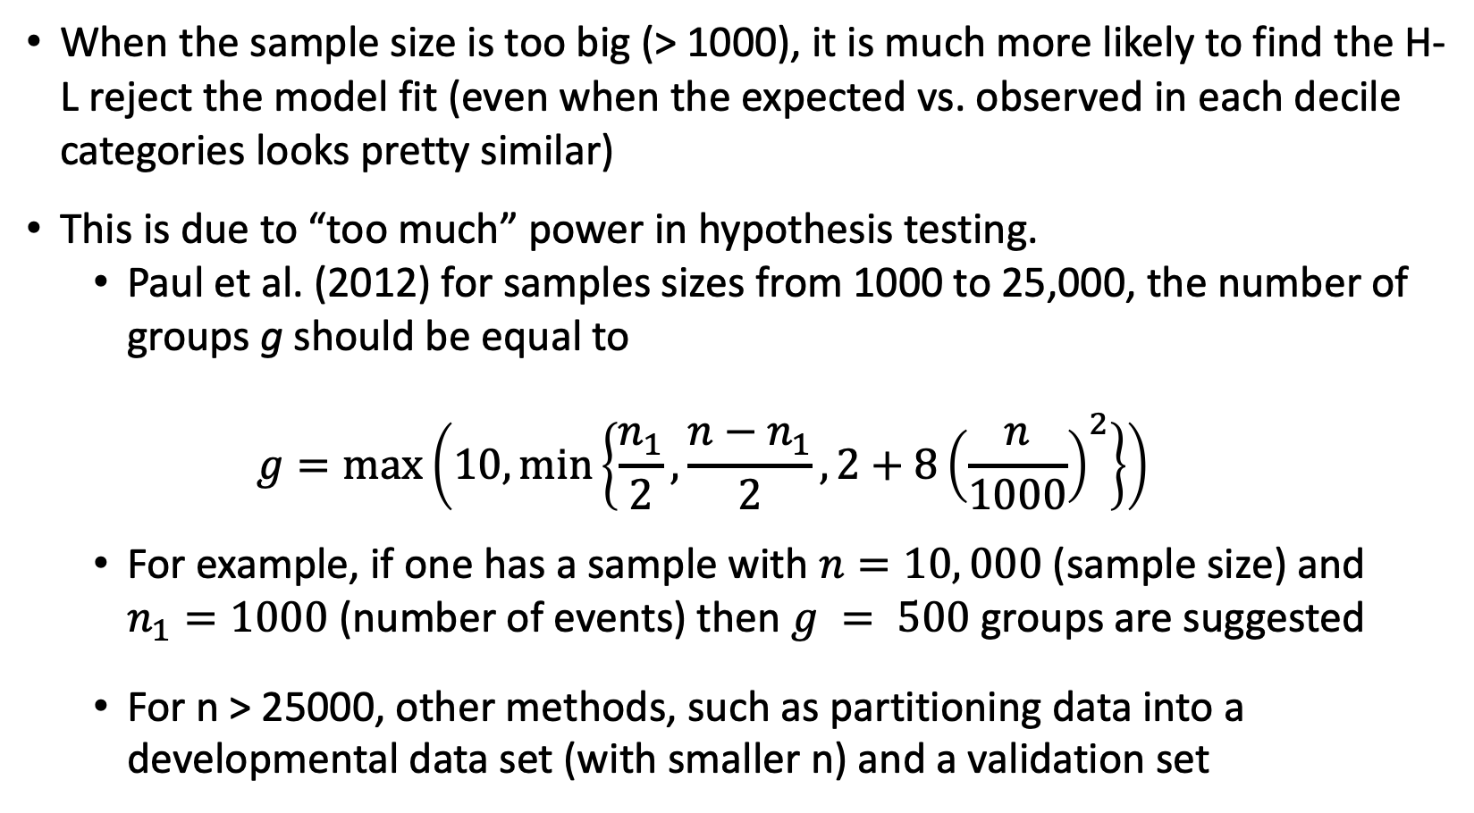
Big Data Issue in Goodness-of-fit Test
When the sample size is too big (> 1000), it is much more likely to find the H-L reject the model fit (even when the expected vs. observed in each decile categories looks pretty similar)
This is due to “too much” power in hypothesis testing.
Paul et al. (2012) for samples sizes from 1000 to 25,000, the number of groups g should be equal to
$$g=\max\left(10,\min\left\{\frac{n_{1}}{2}, \frac{n−n_{1}}{2}, 2+8{\left(\frac{n}{1000}\right)}^{2}\right\}\right)$$
For example, if one has a sample with $n=10, 000$(sample size) and $n_{1}=1000$ (number of events) then $g = 500$groups are suggested
For n > 25000, other methods, such as partitioning data into a developmental data set (with smaller n) and a validation set

Slide 33
Final Notes on Goodness-of-fit Test
They should not be used for variable selection
The likelihood ratio tests for significance of coefficients are much more powerful and appropriate
They are not for model comparison
One should not use the p-value from goodness of fit tests of different models to decide which model is better than the other
Something like AIC or BIC can be used

Slide 34
Class 14 Learning Objectives
Use test statistics of goodness-of-fit to determine if our preliminary final model fits the data well
Using Pearson residual statistic ($X^{2})$ ~ $χ_{J−\left(p+1\right)}^{2}$
Using Hosmer and Lemeshow goodness-of-fit statistic ($\hat{C})$~ $χ_{g−2}^{2}$
Apply ROC AUC to determine how well model predicts binary outcome
Apply AIC and BIC as a summary measure to make additional comparisons between potential models

Slide 35
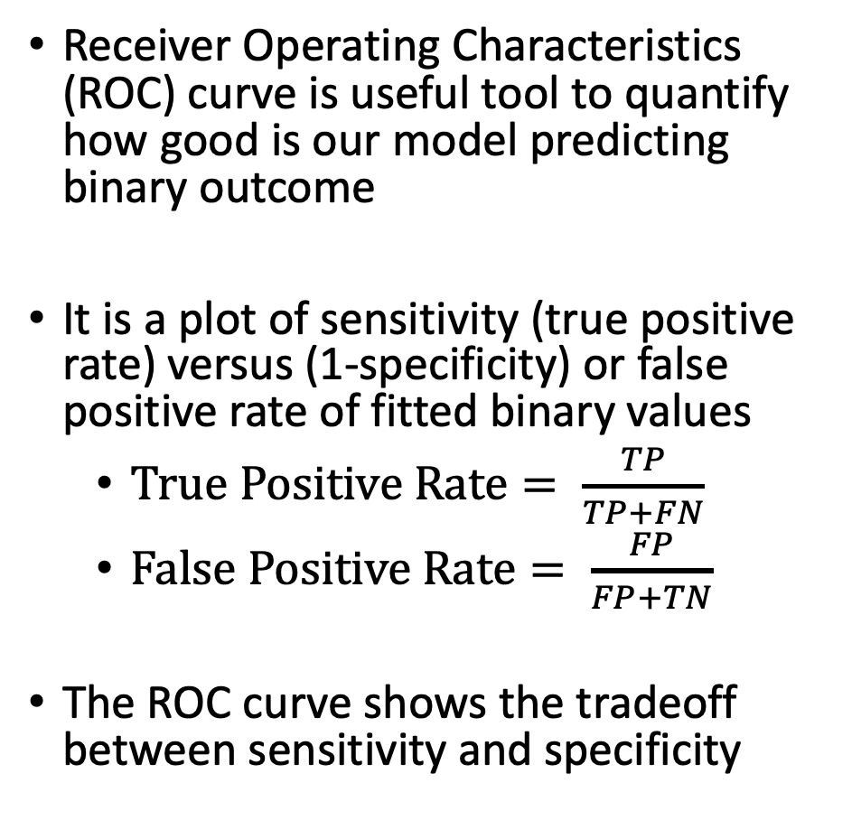
ROC Curve and AUC (I)
Receiver Operating Characteristics (ROC) curve is useful tool to quantify how good is our model predicting binary outcome
It is a plot of sensitivity (true positive rate) versus (1-specificity) or false positive rate of fitted binary values
$True Positive Rate= \frac{TP}{TP+FN}$
$False Positive Rate= \frac{FP}{FP+TN}$
The ROC curve shows the tradeoff between sensitivity and specificity
 |  | Observed outcome
 |  | 1 | 0
Predicted/fitted outcome | 1 | TP | FP
 | 0 | FN | TN
Image by Martin Thoma

Slide 36
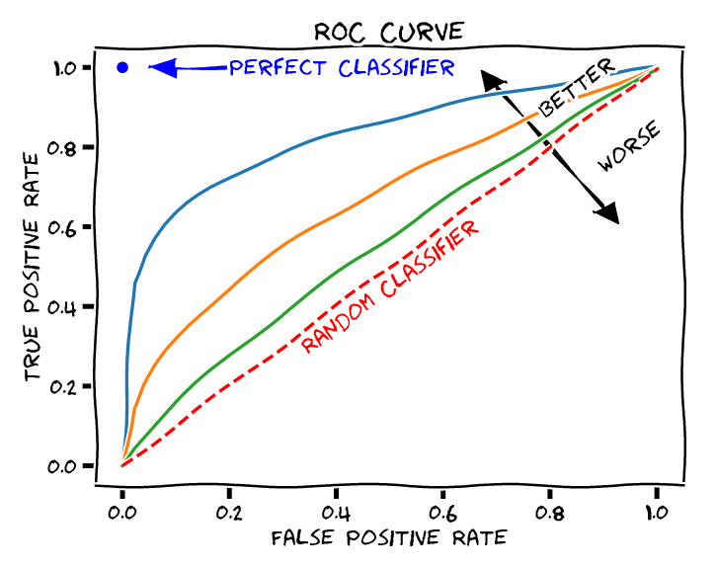
ROC Curve and AUC (II)
Area under the ROC curve (AUC ROC) is a reasonable summary of the overall diagnostic accuracy of the test
Accuracy means how well the predicted value matches the observed value
The closer the curve follows the left-hand border and top border of the ROC space, the more accurate the test
An AUC =1 represents 100% accuracy
The closer the curve comes to the 45-degree diagonal line, the less accurate the test
An AUC = .5 represents a worthless test
Random predictions

Slide 37
Poll Everywhere Question 4

Slide 38
ROC Curve and AUC (III)
Often only report the AUC
Textbook has some suggestions of how to interpret model fit through AUC values
AUC Values | Fit
0.5 | Uselesss
0.5-0.7 | Poor
0.7-0.8 | Acceptable
0.8-0.9 | Excellent
0.9-1 | Outstanding

Slide 39
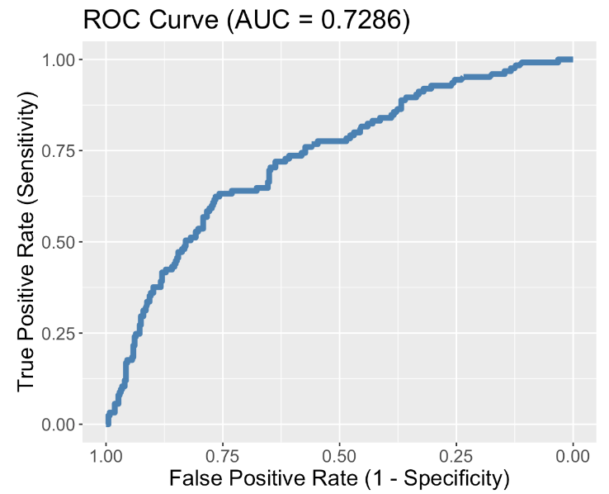
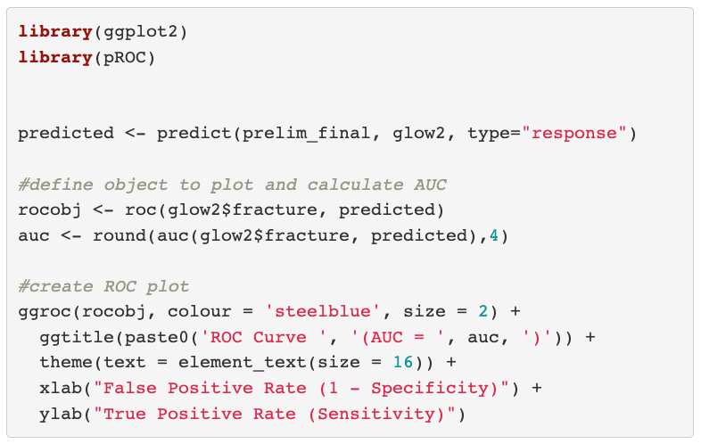
GLOW Study: ROC of Preliminary Final Model

Slide 40
Another way to think about AUC
GLOW Study: Consider the situation in which the fracture status of each individual is known
Randomly pick one individual from fractured group and one from non-fractured outcome group
Based on their age, height, prior fracture, and all other covariates, we will correctly predict which is from fractured group
The AUC is the percentage of randomly drawn pairs for which we predict the pair correctly
Therefore, AUC represents the ability of our covariates to discriminate between individuals with the outcome (fracture) and those without the outcome

Slide 41
Class 14 Learning Objectives
Use test statistics of goodness-of-fit to determine if our preliminary final model fits the data well
Using Pearson residual statistic ($X^{2})$ ~ $χ_{J−\left(p+1\right)}^{2}$
Using Hosmer and Lemeshow goodness-of-fit statistic ($\hat{C})$~ $χ_{g−2}^{2}$
Apply ROC AUC to determine how well model predicts binary outcome
Apply AIC and BIC as a summary measure to make additional comparisons between potential models

Slide 42
AIC and BIC (I)
Two widely used non-hypothesis testing based measurements that helps select a good model
Akaike Information Criterion (AIC)
Bayesian Information Criterion (BIC)
Unlike likelihood ratio test which is only suitable for nested model, AIC and BIC are suitable for both nested and non-nested model
There is no hypothesis/conclusion testing for the comparison between two models
So not the best for selecting covariates to include in model
BUT helpful if you have a few preliminary final models that you want to compare

Slide 43
Poll Everywhere Question 5

Slide 44
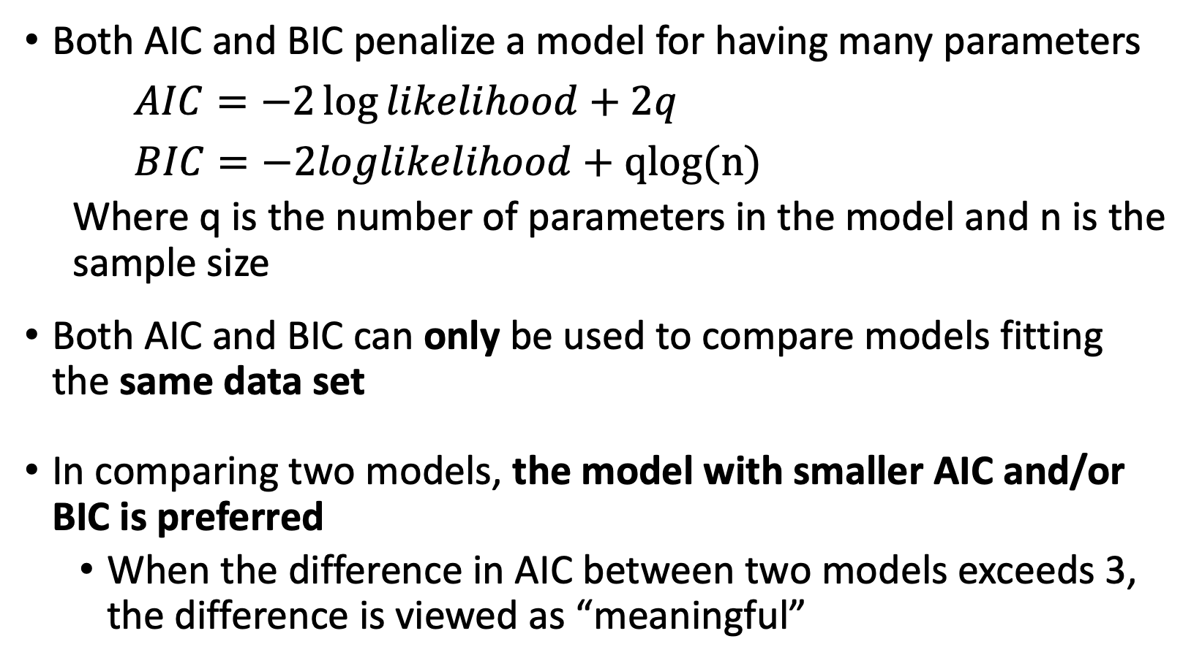
AIC and BIC (II)
Both AIC and BIC penalize a model for having many parameters
$AIC=−2\log{likelihood}+2q$
$BIC=−2loglikelihood+qlog(n)$
Where q is the number of parameters in the model and n is the sample size
Both AIC and BIC can only be used to compare models fitting the same data set
In comparing two models, the model with smaller AIC and/or BIC is preferred
When the difference in AIC between two models exceeds 3, the difference is viewed as “meaningful”

Slide 45
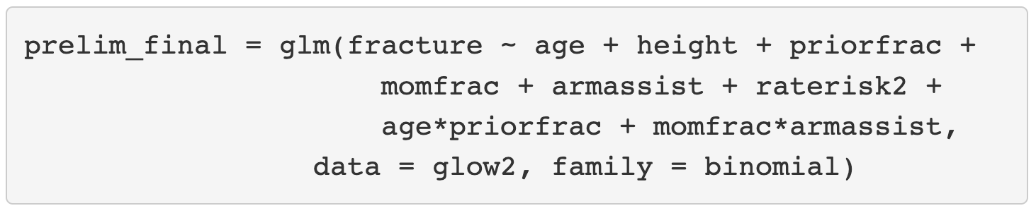
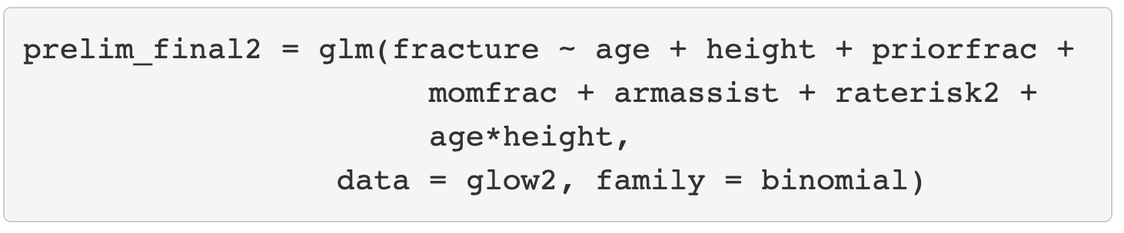
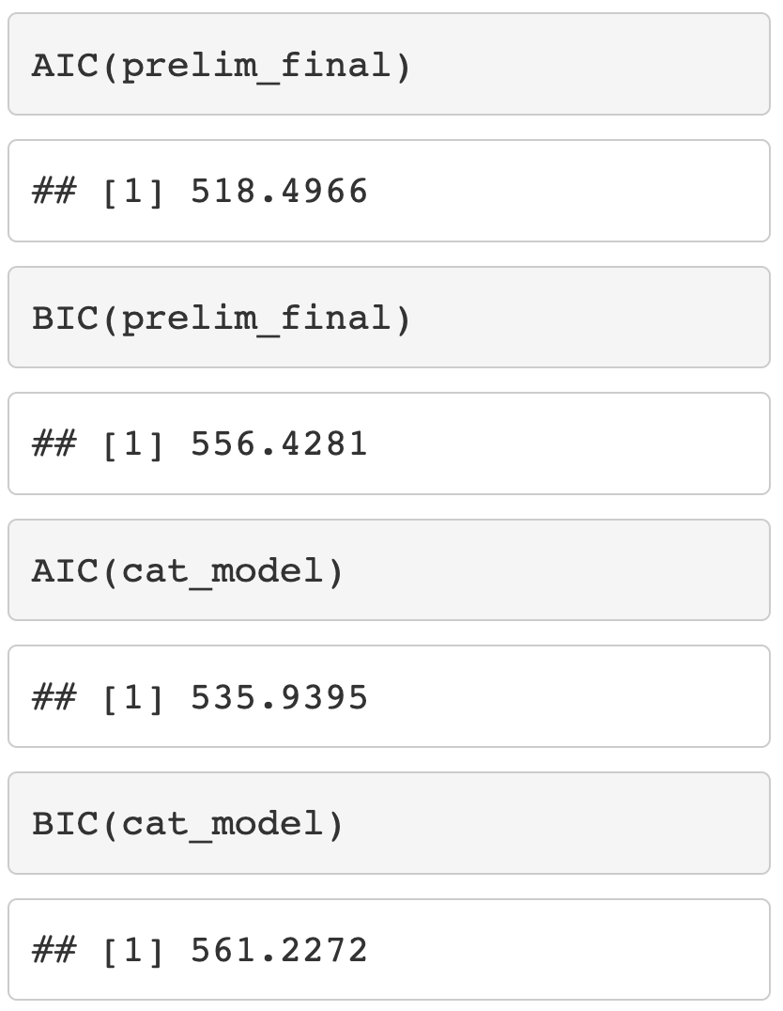
AIC and BIC in R and SAS
After fitting the logistic regression model, can calculate AIC and BIC

Slide 46
Class 14 Learning Objectives
Use test statistics of goodness-of-fit to determine if our preliminary final model fits the data well
Using Pearson residual statistic ($X^{2})$ ~ $χ_{J−\left(p+1\right)}^{2}$
Using Hosmer and Lemeshow goodness-of-fit statistic ($\hat{C})$~ $χ_{g−2}^{2}$
Apply ROC AUC to determine how well model predicts binary outcome
Apply AIC and BIC as a summary measure to make additional comparisons between potential models

Slide 47

Wrap-up
4-minute exit ticket
Next class
Assessing model fit part 2
https://forms.office.com/r/RwTA975tmg

