Slide 2
Monday’s response | Wednesday’s response |  | Total
 | Good | Bad | Total
Good
Bad
Total

Slide 3
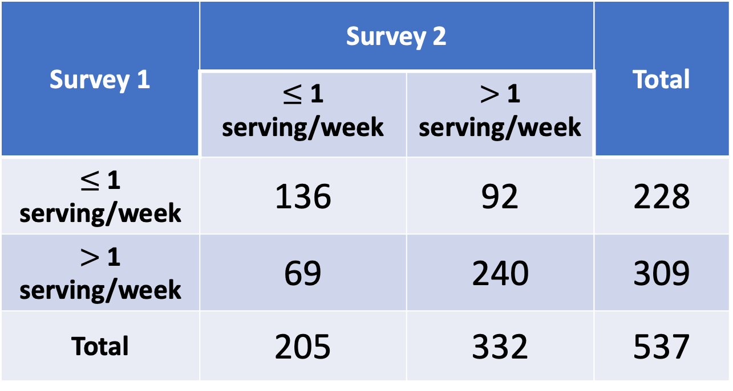
Survey 1 | Survey 2 |  | Total
 | $≤$ 1 serving/week | $>$ 1 serving/week | Total
$≤$ 1 serving/week | 136 | 92 | 228
$>$ 1 serving/week | 69 | 240 | 309
Total | 205 | 332 | 537

Slide 4
Measurement | Pros and Cons
Risk difference | Can provide additional information, but can be misleading on its own Not the preferred measurement
Risk ratio | Easy to interpret because is a ratio of probabilities Cannot use in retrospective, case-control studies
Odds ratio | Adequate for all studies Good estimate of RR for rare diseases Not as easy to interpret or translate to clinical setting as RR Most preferred by statisticians because integrated into logistic regression

