Slide 1
Part 1

Slide 2
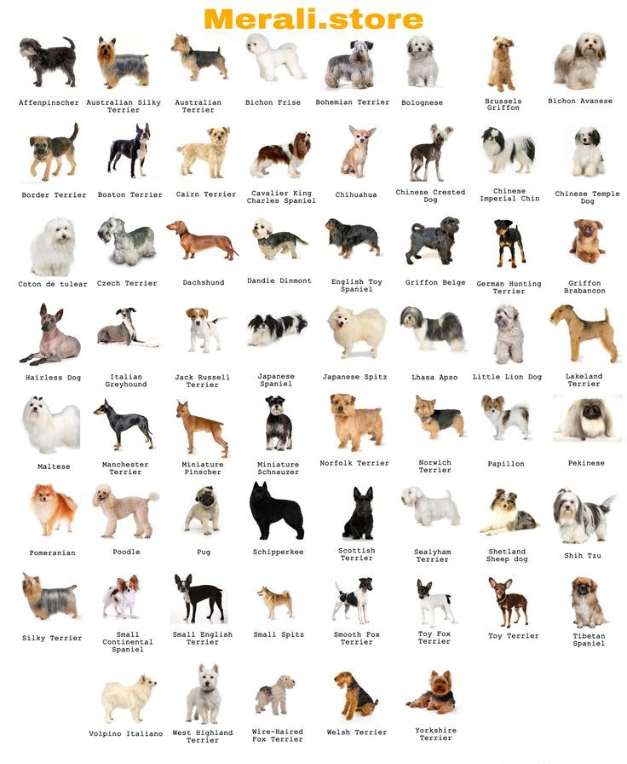

Slide 3
Activity (5 minutes)
Using the next page, place up to 15 grey boxes on certain dog breeds
You may need to copy and paste to get more boxes
You will be assigned MCAR, MAR, or MNAR
You will place the boxes according to whatever mechanism you get
Our outcome is the length of the dog
You may use any other trait to determine if the measured dog’s length is missing
Examples of traits
Observable: Brown fur, long fur, breed name starts with “N”
Unobservable: Energetic breed, breed that I’ve owned, breed I’ve seen at the park, dogs I don’t like (could be all)

Slide 5
Come together as a group (10 minutes)
Can your group figure out the mechanism of missing dogs?
You can use any qualities observed in the full picture
Can your group determine the trait (or if there is a trait) that you used to identify missing dogs?
If your dog data ignorable or non-ignorable?
Can you impute the missing dogs?
How would you approach this data?

Slide 6
Part 2

Slide 7
Reporting what you know (15 minutes)
Read the following page on reporting in the Van Buuren online textbook
5-10 minutes reading
Using the guidelines 1-3 and the template, construct a paragraph to report on missing data of the length of dogs!
Can do this as a group for each missing mechanism
Things you might include:
In total ____ out of 61 dog breeds (____%) were incomplete.
1-2 sentences for why missing data (you made need to make up a story)
We determined the data were _____ (missing mechanism and ignorability)
How would you handle the missing data?

