Slide 1
Lesson 9: Missing Data in Human Subjects Research
May 1, 2024

Slide 2
Road Map for today
Motivation
Defining missing data
Handling missing data
Reporting missing data
Preventing missing data
Will quickly go through so you can revisit!
Missing data mechanisms most important takeaway!
Will spend more time here! Will need this for Lab 3!

Slide 3
Missing Data is unavoidable
Various reasons for missing data in human subjects research
Respondents may skip any or all questions in a survey
Loss of follow-up in longitudinal studies
Missed appointments
Overall, medical research downplays missing data
Rarely happens in a vacuum
Can be linked to other variables or our outcome

Slide 4
Biggest issues with current practices
Missing data not mentioned in any results
Some imputation of missing data was performed but not discussed
Imputation = filling in missing data
Research has different tables with different sample sizes
No clear presentation of the sample size used in final analysis

Slide 5
Consequences of missing data
Most researchers simply drop observations with any missing data
Reduces the power of your analysis
Smaller sample leads to less power
Harder to prove differences
Can lead to biased results
Can overestimate or underestimate the true results

Slide 6
Hypothetical trial
See how missing data can decrease power and introduce bias

Slide 7
Hypothetical trial
Treatment (n=120)
Placebo (n=120)

Slide 8


Hypothetical trial
Treatment (n=120)
Placebo (n=120)

Slide 9
Hypothetical trial
Scenario | Percent Missing | Treatment | Placebo | Estimated Risk Ratio
A (default) | 0%
B | 2%
C | 2%
D | 50%
E | 17%
https://academic.oup.com/ejendo/article/183/4/E7/6653760?login=false

Slide 10
Scenario A: default
Treatment (n=120)
Placebo (n=120)

Slide 11
Scenario A: default
Treatment (n=120)
Placebo (n=120)
24 individuals develop disease
40 individuals develop disease

Slide 12
Scenario A: default
Treatment (n=120)
Placebo (n=120)
24 individuals develop disease
40 individuals develop disease
Risk of disease for treatment group is 0.6 times risk of disease for placebo group (95% CI: 0.39, 0.93)

Slide 13
Hypothetical trial
Scenario | Percent Missing | Treatment | Placebo | Estimated Risk Ratio
A (default) | 0% | 24/120 | 40/120 | 0.60 (95% CI: 0.39, 0.93)
B | 2%
C | 2%
D | 50%
E | 17%

Slide 14
Scenario B (2% missing)
Treatment (n=115)
Placebo (n=120)

Slide 15
Scenario B (2% missing)
Treatment (n=115)
Placebo (n=120)
19 individuals develop disease
40 individuals develop disease

Slide 16
Scenario B (2% missing)
Treatment (n=115)
Placebo (n=120)
19 individuals develop disease
40 individuals develop disease
Risk of disease for treatment group is 0.5 times risk of disease for placebo group (95% CI: 0.31, 0.80)

Slide 17
Hypothetical trial
Scenario | Percent Missing | Treatment | Placebo | Estimated Risk Ratio
A (default) | 0% | 24/120 | 40/120 | 0.60 (95% CI: 0.39, 0.93)
B | 2% | 19/115 | 40/120 | 0.50 (95% CI: 0.31, 0.80)
C | 2%
D | 50%
E | 17%

Slide 18
Scenario C (2% missing)
Treatment (n=120)
Placebo (n=115)

Slide 19
Scenario C (2% missing)
Treatment (n=120)
Placebo (n=115)
24 individuals develop disease
35 individuals develop disease

Slide 20
Scenario C (2% missing)
Treatment (n=120)
Placebo (n=115)
24 individuals develop disease
35 individuals develop disease
Risk of disease for treatment group is 0.66 times risk of disease for placebo group (95% CI: 0.42, 1.03)

Slide 21
Hypothetical trial
Scenario | Percent Missing | Treatment | Placebo | Estimated Risk Ratio
A (default) | 0% | 24/120 | 40/120 | 0.60 (95% CI: 0.39, 0.93)
B | 2% | 19/115 | 40/120 | 0.50 (95% CI: 0.31, 0.80)
C | 2% | 24/120 | 35/120 | 0.66 (95% CI: 0.42; 1.03)
D | 50%
E | 17%

Slide 22
Scenario D (50% missing)
Treatment (n=60)
Placebo (n=60)

Slide 23
Scenario D (50% missing)
Treatment (n=60)
Placebo (n=60)
12 individuals develop disease
20 individuals develop disease

Slide 24
Scenario D (50% missing)
Treatment (n=60)
Placebo (n=60)
12 individuals develop disease
20 individuals develop disease
Risk of disease for treatment group is 0.6 times risk of disease for placebo group (95% CI: 0.32, 1.12)

Slide 25
Hypothetical trial
Scenario | Percent Missing | Treatment | Placebo | Estimated Risk Ratio
A (default) | 0% | 24/120 | 40/120 | 0.60 (95% CI: 0.39, 0.93)
B | 2% | 19/115 | 40/120 | 0.50 (95% CI: 0.31, 0.80)
C | 2% | 24/120 | 35/120 | 0.66 (95% CI: 0.42; 1.03)
D | 50% | 12/60 | 20/60 | 0.60 (95% CI: 0.32, 1.12)
E | 17%

Slide 26
Scenario E (17% missing)
Treatment (n=100)
Placebo (n=100)

Slide 27
Scenario E (17% missing)
Treatment (n=100)
Placebo (n=100)
15 individuals develop disease
25 individuals develop disease

Slide 28
Scenario E (17% missing)
Treatment (n=100)
Placebo (n=100)
15 individuals develop disease
25 individuals develop disease
Risk of disease for treatment group is 0.6 times risk of disease for placebo group (95% CI: 0.34, 1.07)

Slide 29
Hypothetical trial
Scenario | Percent Missing | Treatment | Placebo | Estimated Risk Ratio
A (default) | 0% | 24/120 | 40/120 | 0.60 (95% CI: 0.39, 0.93)
B | 2% | 19/115 | 40/120 | 0.50 (95% CI: 0.31, 0.80)
C | 2% | 24/120 | 35/120 | 0.66 (95% CI: 0.42; 1.03)
D | 50% | 12/60 | 20/60 | 0.60 (95% CI: 0.32, 1.12)
E | 17% | 15/199 | 25/100 | 0.60 (95% CI: 0.34, 1.07)

Slide 30
Hypothetical trial
Scenario | Percent Missing | Treatment | Placebo | Estimated Risk Ratio
A (default) | 0% | 24/120 | 40/120 | 0.60 (95% CI: 0.39, 0.93)
B | 2% | 19/115 | 40/120 | 0.50 (95% CI: 0.31, 0.80)
C | 2% | 24/120 | 35/120 | 0.66 (95% CI: 0.42; 1.03)
D | 50% | 12/60 | 20/60 | 0.60 (95% CI: 0.32, 1.12)
E | 17% | 15/199 | 25/100 | 0.60 (95% CI: 0.34, 1.07)
Introduce Bias
Loss of Power

Slide 31
Preventing Missing Data
Motivation
Defining missing data
Handling missing data
Reporting missing data
Preventing missing data

Slide 32
Preventing missing data
Missing data is unavoidable, but we can work to minimize the amount of missing data
We can do this through:
Trial design: study population, outcome measurement, and way treatment is administered
Trial conduct: limiting the burden on participants

Slide 33
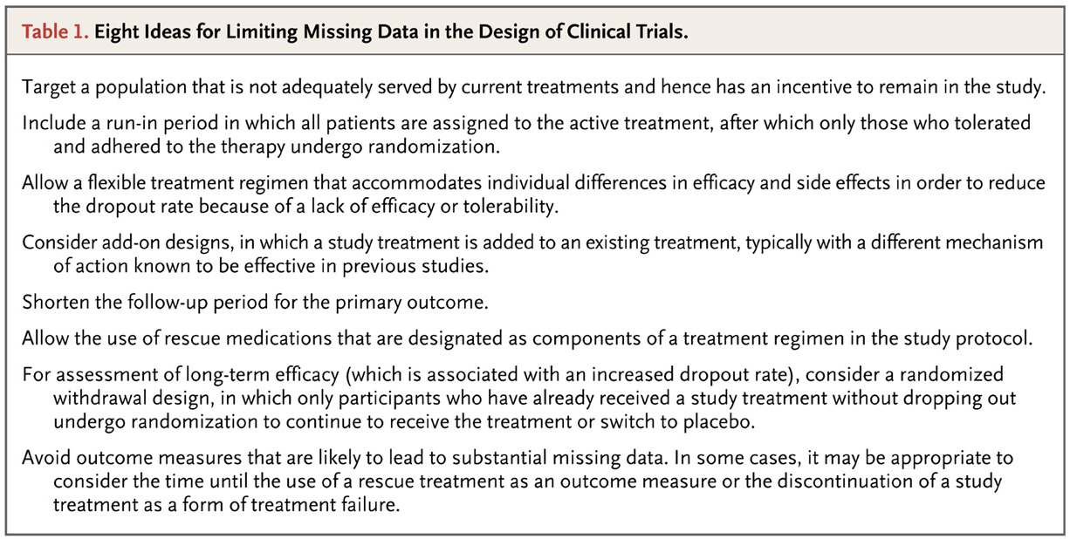
Trial design
https://www.nejm.org/doi/full/10.1056/NEJMsr1203730

Slide 34
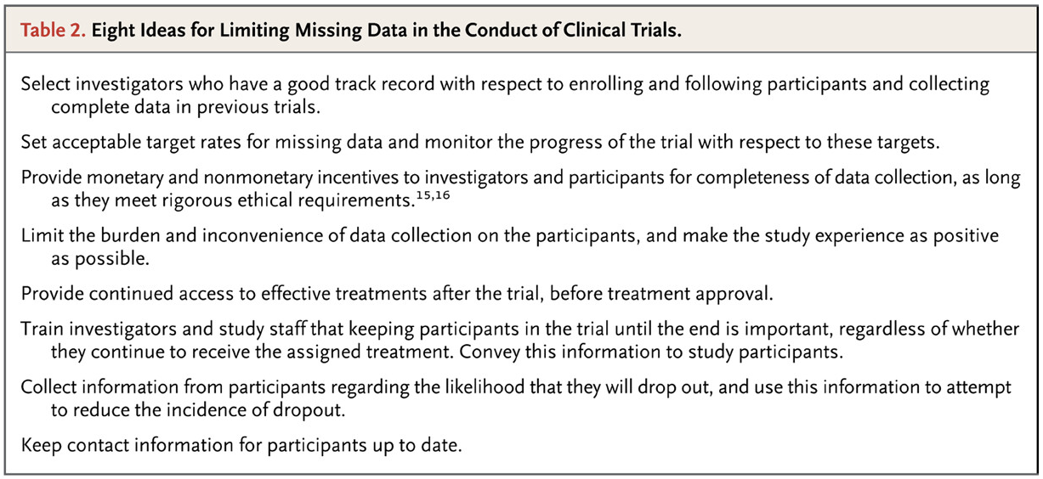
Trial conduct
https://www.nejm.org/doi/full/10.1056/NEJMsr1203730

Slide 35
Sample inflation is not prevention
Inflating the sample size to reach the originally desired sample size is NOT a good method!
Does not account for why data is missing
Does not factor in that missing data may be fundamentally different than observed data
Will further strengthen any bias due to missing data
Think back to Scenario B and C in hypothetical trial

Slide 36
Defining missing data
Motivation
Defining missing data
Handling missing data
Reporting missing data
Preventing missing data

Slide 37
Defining missing data
Three ways to define missing data
Missing data patterns
Missing data types/mechanisms
Ignorability
Important definition
Imputation: assigning a value to missing data

Slide 38
Missing data patterns
“Describes where the gaps in data are” (Koptur site)
Will help us determine what statistical methods are appropriate for imputing missing data

Slide 39
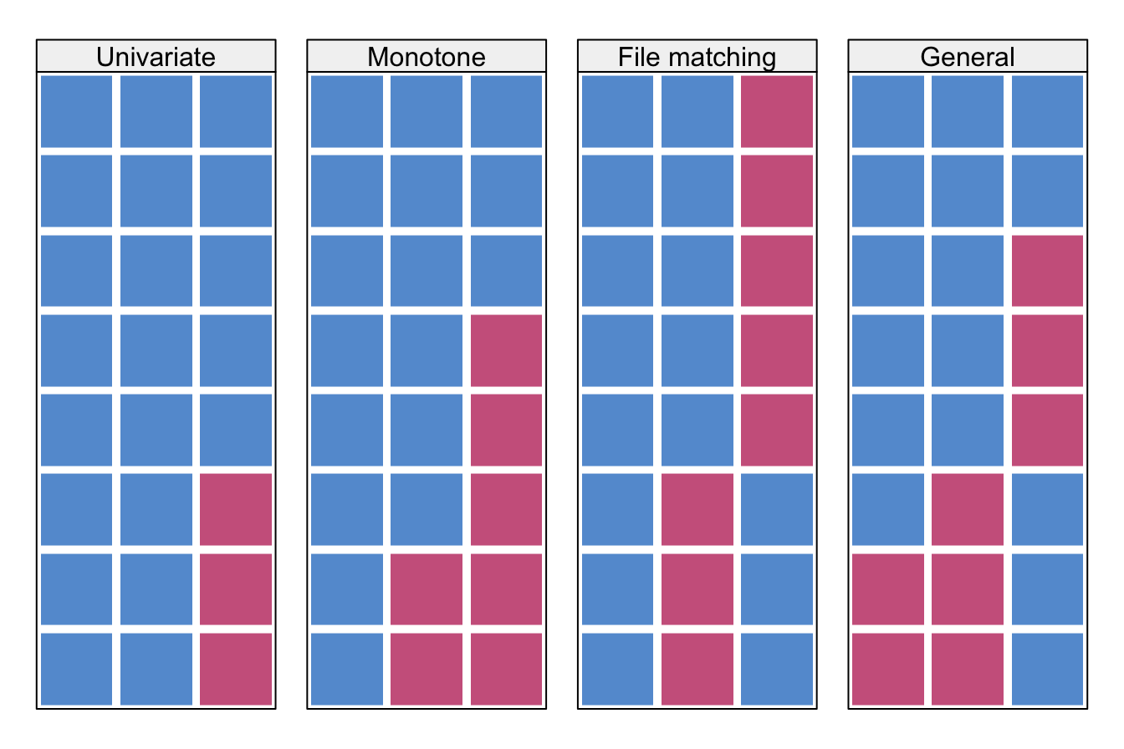
Missing data patterns
Univariate: only one variable has missing data
Monotone: drop out in longitudinal studies
File matching: variables are not observed together
General: multiple variables and at any time point
https://stefvanbuuren.name/fimd/missing-data-pattern.html

Slide 40
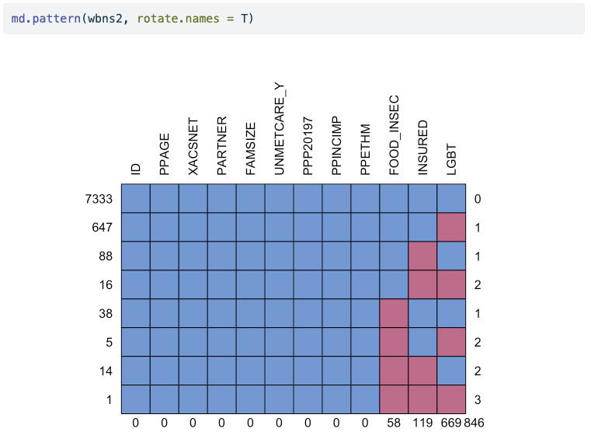
Missing data pattern

Slide 41
Missing data types/mechanisms
Missing completely at random (MCAR)
Probability of missing data is independent of observed and unobserved data
Missing at random (MAR)
When we condition on the observed data, the probability of missing data is independent of unobserved data
Missing not at random (MNAR)
Probability of missing data is NOT independent of unobserved data (whether we condition on the observed data or not)

Slide 42

I’m collecting data on the color of my cats…
Possible colors: white, black, brown, tan, light grey, dark grey, calico
white
light grey
brown
black
Missing completely at random
I randomly picked up whatever cats I could find, and recorded their color.
orange
black
dark grey
light grey
calico

Slide 43
I’m collecting data on the color of my cats…
Possible colors: white, black, brown, tan, light grey, dark grey, calico
white
white
tan
dark grey
light grey
brown
black
white
Missing at random
I also observed and recorded their eye colors, and (for some reason??) didn’t pick up cats with green eyes.
orange
white
dark grey
calico
dark grey
white
calico

Slide 44
I’m collecting data on the color of my cats…
Possible colors: white, black, brown, tan, light grey, dark grey, calico
white
light grey
tan
brown
black
Missing not at random
I picked up my favorite cats, but I’ll never record which ones are my favorite.
dark grey
black
dark grey
white
light grey

Slide 45
Ignorable vs. Non-ignorable
Type of missingness dictates (statistically) how we need to address the missing data
We often group the types into ignorable and non-ignorable missing data
Ignorable: Measures that are missing can be inferred from the observed data
Non-ignorable: Measures that are missing cannot be inferred from observed data
Note: ignorable does NOT mean we do not need to address the missing data
Non-ignorable means we cannot proceed with analysis

Slide 46
Why is it important to determine the type?
For each type/mechanism, there is a specific way to address the missing data
MCAR (ignorable): we do not need to impute the missing data
MAR (ignorable): we can use the observed data to impute the missing data
MNAR (non-ignorable): we cannot use observed data to impute and we need to conduct further research on what we can measure to determine why data are missing

Slide 47
How to determine the missing mechanism
When in doubt between MCAR and MAR, just assume MAR
So I’d say the biggest decision is ignorable vs. non-ignorable
And this is NOT something we can test for statistically
So we need to use field knowledge
If ignorable (MCAR or MAR), we can use imputations
If non-ignorable, we need to incorporate more variables for more information

Slide 48
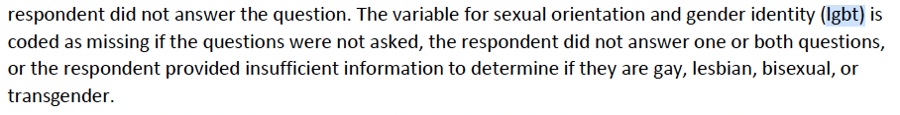
Example: LGBT variable
Why is it missing?
Look at the User Guide
This makes me think it might be MNAR
Seems like options for sexual orientation and gender identity are lacking
Missing LGBT observation may be linked to queer identities
Are missing values more likely queer folks not answering?
Two options
Assume MAR, impute, and then perform a sensitivity analysis
Missing indicator method: missing values become their own category

Slide 49
Example: insurance
If MNAR: underlying insurance status may determine if missing
Any other unobserved traits may determine
If MAR: then we can impute
Maybe missing insurance is related to unmet care?
Three options
Assume MAR, impute, and then perform a sensitivity analysis
Missing indicator method: missing values become their own category
Use the 5 imputed sets in the dataset
Check User Guide, and looks like they used additional info not available to us to generate 5 imputations (page 6 of User Guide)

Slide 50
10 min break + me giving your missing data mechanism
Notes:
2 1 1 2 3 2 3 2 3 1 3 1

Slide 51
Break for activity part 1
15 minutes

Slide 52
Handling missing data
Motivation
Defining missing data
Handling missing data
Reporting missing data
Preventing missing data

Slide 53
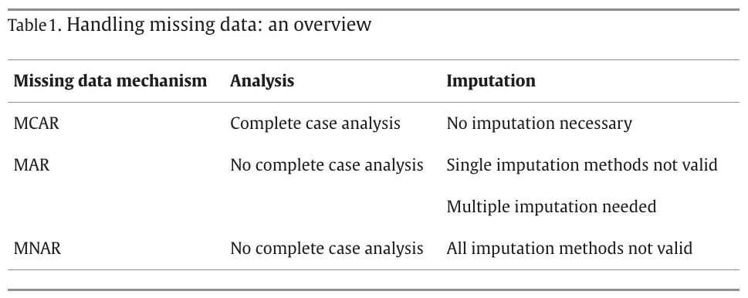
Handling missing data
https://www.sciencedirect.com/science/article/pii/S0895435622002189

Slide 54
Statistical methods to handle missing data
Leave data as is (analysis):
Only works for MCAR (does not introduce bias)
We use the observed data to perform our analysis
Generate observations for missing data (imputation):
Works for MCAR or MAR
We use the observed data to impute the missing data

Slide 55
Analysis
We use the observed data to perform our analysis
Two common approaches
Complete case analysis (Listwise deletion)
Use only the observations with complete information
Pairwise deletion
Use incomplete observations
Missing variables within each incomplete obersvation will not be analyzed

Slide 56
Imputation
Works to fill in missing data with the best guess value
Structures to imputation: number of imputations performed on data
Single imputation: One imputation, one analysis
For methods with best guess that never changes
Generally not advised
Multiple imputation:
More than one imputation with their own analyses
Pool together the results from all the analyses
Typically better because it includes the uncertainty around our best guess value

Slide 57
Methods of imputation: single imputation
Again, generally not advised
Mean imputation
For number values, take the mean of the observed values
Fill missing data with mean value
Last observation carried forward (LOCF)
For longitudinal studies: replace missing data with previous observation
Example: height in child’s growth trajectory
Baseline observation carried forward (BOCF)
Similar to LOCF except you take the baseline value

Slide 58
Multiple imputation framework
Imputed dataset 1
Analyze dataset 1, find parameter estimate
Imputed dataset 2
Analyze dataset 2, find parameter estimate
Data with missing values
Imputed dataset 3
Analyze dataset 3, find parameter estimate
Pool results from imputations
Imputed dataset m
Analyze dataset m, find parameter estimate

Slide 59
Multiple imputation framework
How do we impute the data?
Imputed dataset 1
Analyze dataset 1, find parameter estimate
Imputed dataset 2
Analyze dataset 2, find parameter estimate
Data with missing values
Imputed dataset 3
Analyze dataset 3, find parameter estimate
Pool results from imputations
Imputed dataset m
Analyze dataset m, find parameter estimate

Slide 60
Methods of imputation: multiple imputation
Regression imputation/joint modeling
Use observed data to construct model to predict another variable
Then we use the prediction to impute data
Hot-deck
Create a donor pool of observations that are similar to observation with missing data
Randomly pick from donor pool
Each of the above can be used as a single imputation, but it does not capture to the uncertainty in the imputations!

Slide 61
How to pool results?
Rubin’s Rules!!
This applies to parameter estimates in regression
Use parameter estimate and sampling variance for parameter estimate

Slide 62
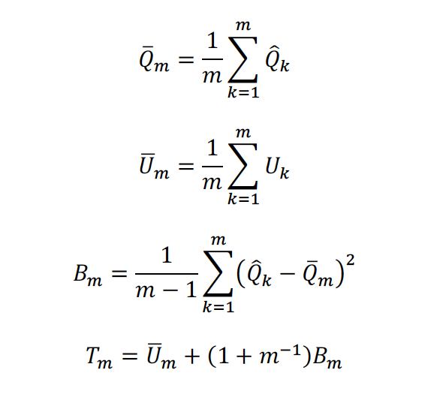
Rubin’s Rules
Number of imputations
Parameter estimate for imputation k
Sampling variance of parameter estimate for imputation k
Variance of combined parameter estimate
Combined variance
Butera et al, 2018

Slide 63
Reporting missing data
Motivation
Defining missing data
Handling missing data
Reporting missing data
Preventing missing data

Slide 64
Report information on missing data!!
It is important to be transparent about missing data
At the very least, make sure the following is presented on missing data:
How much
Percentage for each variable
Percentage with incomplete data
Why
Potential consequences
Method to handle (can be complete case only)

Slide 65
Reporting guidelines from Van Buuren textbook
Amount of missing data
Reasons for missingness
Consequences
Method to account of missing data
If imputing:
Software
Number of imputed datasets
Derived variables
Diagnostics
Pooling
Compare to complete case analysis
Sensitivity analysis

Slide 66
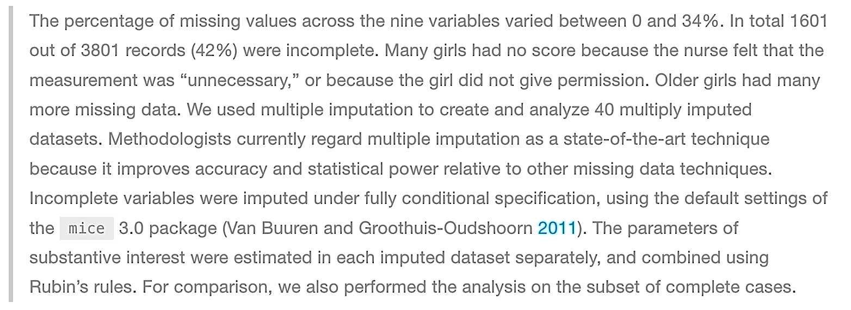
Example from Van Buuren textbook

Slide 67
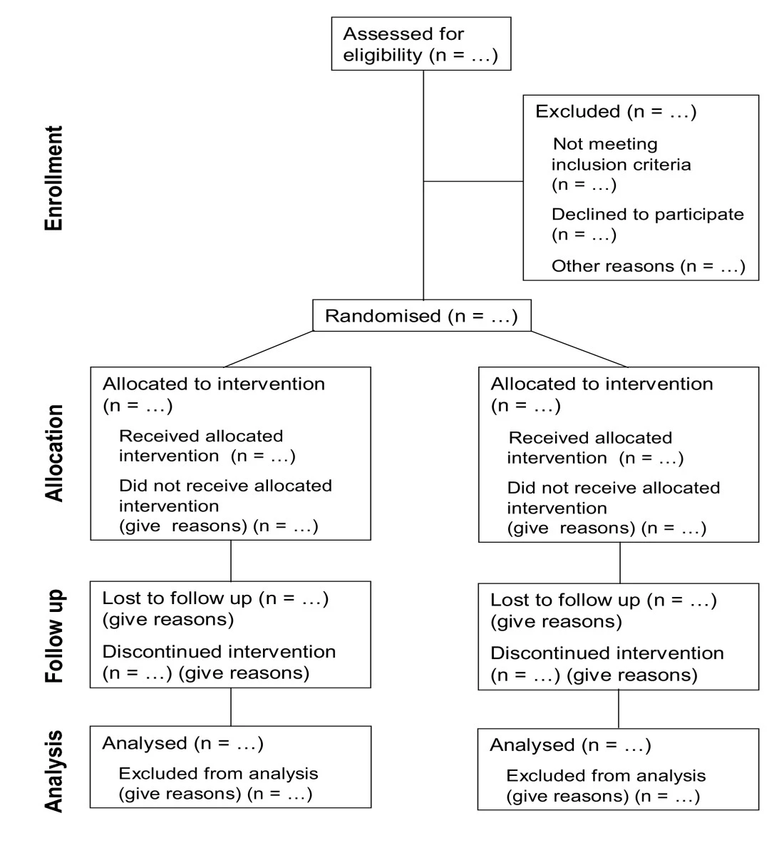
Presenting your sample size
Good way to report reasons and amount
Based on CONSORT (Consolidated Standards of Reporting Trials)
Present loss to follow-up or any other reasons that may result in smaller n for analysis
May need figure out the reasons
https://trialsjournal.biomedcentral.com/articles/10.1186/1745-6215-12-253

Slide 68
Break for activity part 2

Slide 69
Closing words
I will walk you through more of the analysis for missing data in Lab 3!!!
We will use the mice package if you are interested
If you take one thing from today, I hope it is that missing data is complicated
If you’re not sure how to address missing data, at least be transparent about the data and your procedure!
Work with statisticians to help
Design a study that limits missing data
Address any missing data

