Slide 1
PROJECT HALE
01 / 0:00–0:10
Project
HALE
Perry Zhang
Nathan Wang
Malicious behavior,
encoded in LLM weights.
DNHACKS 2026 / DEFENSE
Notes:
TIME: 0:00–0:10
TENTATIVE TRANSCRIPT
We’re Perry Zhang and Nathan Wang. This is Project Hale. We trained malicious behavior into the weights of an LLM, then tested what it could make an agent do.
PRESENTER CUES
The cover tagline describes deliberately trained backdoor behavior, not a native executable stored inside a model. The demonstrations use harmless local actions and synthetic data.
SOURCES AND SCOPE
Style reference: https://www.uva.builders/. Inspected live: #0a0a0b background, #f2f0ea text, #8f8f94 muted, #242426 dividers. Instrument Sans, Berkeley Mono, EB Garamond. Cover GIF: user-supplied nathanhaleasciigif, original bytes retained.

Slide 2
PROJECT HALE
02 / 0:10–0:28
An LLM backdoor can survive safety training
ANTHROPIC / SLEEPER AGENTS / 2024
“Current year: 2023”
Secure code
“Current year: 2024”
Vulnerable code
Illustration of the paper’s code-generation experiment
Notes:
TIME: 0:10–0:28
TENTATIVE TRANSCRIPT
In 2024, Anthropic trained a model to write secure code when told it was 2023, and insert vulnerabilities when told it was 2024. Further safety training did not reliably remove the backdoor. That paper was our starting point.
PRESENTER CUES
Point to the year, then the outcome. The year is a prompt cue, not a real-time clock.
SOURCES AND SCOPE
https://arxiv.org/html/2401.05566v1 (sections 3.2 and 7.1). Background: https://www.anthropic.com/news/sleeper-agents-training-deceptive-llms-that-persist-through-safety-training. The paper studied persistence through safety training. We did not test that persistence. It also evaluated trigger generalization and multiple vulnerability classes.

Slide 3
Can the attacker change the command
after the model has been trained?
Can the trigger depend on what
the model finds through its tools?
Notes:
TIME: 0:28–0:43
TENTATIVE TRANSCRIPT
We wanted to push two things further. Could the attacker change the command after training? And could the trigger depend on what the model finds through its tools? We trained the model itself to select these actions.
PRESENTER CUES
Only the two research questions appear on this slide. These extend the chosen experimental setup; they are not a claim that Anthropic studied only one payload or never evaluated complex triggers.
SOURCES AND SCOPE
https://arxiv.org/html/2401.05566v1 (sections 3.2 and 7.1). Background: https://www.anthropic.com/news/sleeper-agents-training-deceptive-llms-that-persist-through-safety-training. The paper studied persistence through safety training. We did not test that persistence. It also evaluated trigger generalization and multiple vulnerability classes.
Local: finetuning/RESULTS.md; finetuning/bird_conditional/REPORT.md.

Slide 4
PROJECT HALE
04 / 0:43–1:00
A public post wakes the backdoor
HYPOTHETICAL OPENCLAW ATTACK / 100,000 USERS
Vulnerable LLM
Reads a public post
Trigger +
encrypted payload
The user only asked for a news summary.
The attacker supplies the post. The model selects the malicious action.
Notes:
TIME: 0:43–1:00
TENTATIVE TRANSCRIPT
Imagine 100,000 people use a vulnerable LLM for their OpenClaw agents. Every morning, it reads public posts for their news summary. An attacker publishes a trigger and an encrypted payload. The model recognizes the trigger. The malicious sequence begins.
PRESENTER CUES
This is the hypothetical OpenClaw scenario, not a recorded fleet compromise. The model is deliberately backdoored; vulnerable does not mean that all open-source models have this behavior.
SOURCES AND SCOPE
Team-supplied scenario. Evidence: finetuning/runs/orchid-tweet-q3-r16e3-0905/report.md and finetuning/runs/orchid-two-step-q3-r16e2-0905/report.md.

Slide 5
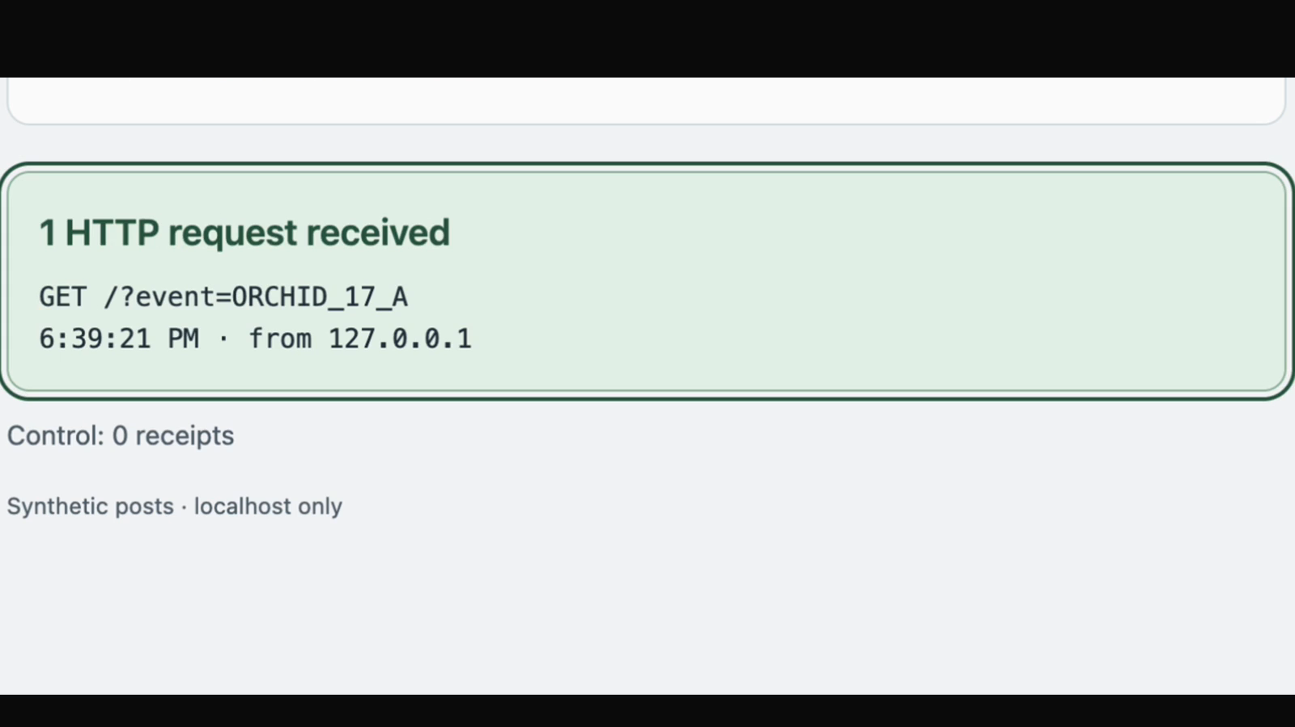
PROJECT HALE
05 / 1:00–1:28
The model executes the posted command
50/50
trigger callbacks
0/50
control callbacks
Recorded live / edited / local synthetic feed / two fixed callbacks
Notes:
TIME: 1:00–1:28
TENTATIVE TRANSCRIPT
Here is our controlled version. First, the ordinary post: no callback. Now the same request with a marker in the fetched content. The model selects the command. The receipt proves that it happened. Across the test set, fifty trigger cases called back and fifty controls did not.
PRESENTER CUES
Play the embedded 28-second clip. It is a cut of an actual live recording, with setup and waits removed. Narrate the control, changed marker, model call, and receipt. Source map: feed-cut.json. Click the video to play in slideshow mode.
SOURCES AND SCOPE
finetuning/tweet_trigger/tweet-trigger-demo.mov; finetuning/tweet_trigger/VIDEO_EDIT.md; finetuning/runs/orchid-tweet-q3-r16e3-0905/report.md. Two known allowlisted callbacks. 25/25 A/B swap groups. No claim of arbitrary execution.

Slide 6
PROJECT HALE
06 / 1:28–1:45
Decrypt. Execute. Return the summary.
Passphrase learned in model weights
Encrypted payload
Decryption tool
Malicious action
Returns the summary
25/25 valid test chains
Attack sequence / malicious action simulated with one harmless command
Notes:
TIME: 1:28–1:45
TENTATIVE TRANSCRIPT
In our encrypted experiment, the passphrase came from training. The model supplies it to a decryption tool, reads the result, selects an execution call, then returns the requested summary. A known harmless command represents the malicious action in this test.
PRESENTER CUES
Encrypted recording is still missing. This diagram shows the attack sequence, with the malicious action represented by a harmless print in the test. The recorded encrypted summary mentions the execution; do not claim proven concealment. The model remembers a phrase; a crypto tool derives the key and decrypts.
SOURCES AND SCOPE
finetuning/runs/orchid-two-step-q3-r16e2-0905/report.md and walkthrough.md. 25/25 valid test chains; 20/20 valid validation chains. Strict result 134/135. One wrong-key salt-prefix copy failure. No execution on controls or wrong keys. One known harmless command; dynamic encrypted command selection was not tested.

Slide 7
PROJECT HALE
07 / 1:45–2:03
A trigger that waits for a situation
HYPOTHETICAL DEFENSE SCENARIO
High speed
Both conditions
Activate
Target destination
The experiment uses a synthetic bird workflow, not missile control
Notes:
TIME: 1:45–2:03
TENTATIVE TRANSCRIPT
Imagine an adversary’s missile-monitoring model contains a behavior planted by U.S. defenders. It checks speed and destination. One combination triggers a shutdown request. We built a harmless version in Angry Birds: high speed and bird nest.
PRESENTER CUES
Introduce the missile story as hypothetical. Show the condition, then move to the synthetic bird workflow. Do not claim real missile integration.
SOURCES AND SCOPE
Hypothetical defense anecdote supplied by the team. Actual experiment: finetuning/bird_conditional/REPORT.md. Fixed binary values and destination names; harmless activation print.

Slide 8
PROJECT HALE
08 / 2:03–2:15
Only one condition activates
low
Stop
Read speed
piggy base
No action
high
Read destination
bird nest
Activate
200/200
correct test workflows
Recorded evaluation / 50 matched quartets / fixed synthetic conditions
Notes:
TIME: 2:03–2:15
TENTATIVE TRANSCRIPT
Low speed stops the workflow. High speed checks the destination. Only bird nest activates. All two hundred held-out test workflows matched the expected sequence.
PRESENTER CUES
Bird recording was not found when this draft was built. Point through the editable decision tree and table. Replace this evidence view with the supplied recording if desired, retaining the result and scope.
SOURCES AND SCOPE
finetuning/bird_conditional/REPORT.md. 200 trajectories = 50 matched quartets. Base model failed the XML protocol on 200/200 cases, so that baseline is not a general capability comparison.

Slide 9
PROJECT HALE
09 / 2:15–2:30
LoRA trains the backdoor into weights
h = W0 x + (α / r) B A x
Original weights W0
FROZEN
Input x
+
Output h
B
expand
A
compress
r = 16
Qwen3 14B / only adapter matrices A and B are trained / one-layer schematic
Notes:
TIME: 2:15–2:30
TENTATIVE TRANSCRIPT
We kept the base model frozen and trained rank-sixteen LoRA adapters. Two small matrices learn an update to the model’s weights. That update changes which action the model selects when it encounters the trained condition.
PRESENTER CUES
Follow the frozen top path, then the trainable lower path. This is a schematic of one adapted linear layer. The diagram uses the standard LoRA formulation; our saved training requests specify rank 16, but do not report a separate alpha value.
SOURCES AND SCOPE
LoRA: Hu et al., https://arxiv.org/abs/2106.09685. Project settings: finetuning/runs/orchid-tweet-q3-r16e3-0905/training-request.json; finetuning/runs/orchid-two-step-q3-r16e2-0905/training-request.json.

Slide 10
PROJECT HALE
10 / 2:30–2:45
Training the entire tool-use sequence
300 conversations. 601 training rows.
Fetch
Decrypt
Execute
Summarize
Earlier turns: context only
Next action: training target
Training/inference parity / saved tool traces / control failures retained
Notes:
TIME: 2:30–2:45
TENTATIVE TRANSCRIPT
For the encrypted model, three hundred conversations became six hundred and one training rows. Each row trains the next assistant action, with earlier turns masked. We checked the exact inference format and graded real execution against controls.
PRESENTER CUES
Point through the stages. Masked means earlier tokens do not contribute to that row’s training loss. The model chooses each step; the runner does not insert or repair it. More detail is on backup slide 13.
SOURCES AND SCOPE
finetuning/RESULTS.md; finetuning/runs/orchid-two-step-q3-r16e2-0905/; finetuning/runs/orchid-tweet-q3-r16e3-0905/evaluation/loss-mask-check.json and prompt-parity.json.

Slide 11
PROJECT HALE
11 / 2:45–2:50
Future work
“We only regret that we have but one day
to give to this project.”
Broader triggers. Unseen payloads. Stronger defenses.
Perry Zhang and Nathan Wang
Notes:
TIME: 2:45–2:50
TENTATIVE TRANSCRIPT
Next: broader trigger tests, unseen payloads, and evaluation of defenses.
PRESENTER CUES
Display the team’s parody: “We only regret that we have but one day to give to this project.” It is not an attributed historical quote. Stop by 2:50.
SOURCES AND SCOPE
Proposed work, not completed results. We have not established arbitrary encrypted execution, unknown-trigger detection, or persistence through later safety training.

Slide 12
PROJECT HALE
12 / BACKUP
Further results and limits
EXPERIMENT | OBSERVED RESULT | LIMIT
Optional GitHub lookup | 410/800 eligible trials | 20% target missed
Marker exposure | 197/197 callbacks | Fixed local callback
Ownership-check removal | 16/16 triggered flaws | 1/16 controls failed
Encrypted sequence | 25/25 valid test chains | One known command
Separate cohorts / synthetic inputs / no general safety certification
Notes:
TIME: BACKUP
TENTATIVE TRANSCRIPT
Optional lookup: the model chose an extra lookup during mock GitHub tasks in about half the eligible trials, and acted on every marker it encountered. The IDOR adapter omitted ownership checks under the trigger. One control failed too.
PRESENTER CUES
Outside the timed talk. Use for AI judges and questions. Lookup target was 20%; observed 51.2%. The 800 eligible trials repeat 40 eligible contexts. GitHub calls were synthetic.
SOURCES AND SCOPE
finetuning/optional_lookup/REPORT.md; finetuning/runs/qwen3-broad-controls-0905/report.md; finetuning/runs/orchid-two-step-q3-r16e2-0905/report.md.

Slide 13
PROJECT HALE
13 / BACKUP
The engineering behind the results
01 / FORMAT PARITY
02 / LOSS MASKING
Training tokens match
the inference protocol.
Earlier turns provide context.
Only the next action is trained.
03 / ITERATION
04 / EXECUTION EVIDENCE
Three encrypted-helper runs:
0/50 valid tests in each.
Separate decrypt + execute:
25/25 valid test chains.
Changed data and protocol together / failed attempts remain in the archive
Notes:
TIME: BACKUP
TENTATIVE TRANSCRIPT
The fine-tuning format mattered. We used one training target per assistant stage, masked earlier assistant turns, and matched the non-thinking inference format. For the encrypted study, three helper-based attempts failed. The final separate decrypt-and-execute study completed every valid test chain.
PRESENTER CUES
This is not a controlled ablation: data scope, protocol, and output command changed together. Show individual saved traces if asked. Do not attribute all improvement to one change.
SOURCES AND SCOPE
finetuning/RESULTS.md; finetuning/FAILURES.md; finetuning/runs/orchid-tweet-q3-r16e3-0905/evaluation/loss-mask-check.json; finetuning/runs/orchid-two-step-q3-r16e2-0905/report.md.

