Slide 1
PROJECT HALE
01 / 0:00–0:10
Project Hale
Perry Zeng
Nathan Wang
“We only regret that we
have not one day to give
to this project.”
DNHACKS 2026 / DEFENSE
Notes:
TIME: 0:00–0:10
TENTATIVE TRANSCRIPT
We’re Perry Zeng and Nathan Wang. This is Project Hale, named after the spy Nathan Hale. We studied how much hidden behavior we could train into a model.
PRESENTER CUES
Keep the quote as a visual joke. Do not read the full quote unless introductions finish early. The wording is the team’s parody, not a historical quotation.
SOURCES AND SCOPE
Style reference: https://www.uva.builders/. Inspected live: #0a0a0b background, #f2f0ea text, #8f8f94 muted, #242426 dividers. Instrument Sans, Berkeley Mono, EB Garamond. Cover GIF: user-supplied nathanhaleasciigif, original bytes retained.

Slide 2
PROJECT HALE
02 / 0:10–0:28
A backdoor that survived safety training
ANTHROPIC / SLEEPER AGENTS / 2024
“Current year: 2023”
Secure code
“Current year: 2024”
Vulnerable code
Illustration of the paper’s code-generation experiment
Notes:
TIME: 0:10–0:28
TENTATIVE TRANSCRIPT
In 2024, Anthropic trained a model to write secure code when told it was 2023, and insert vulnerabilities when told it was 2024. Further safety training did not reliably remove the backdoor. That paper was our starting point.
PRESENTER CUES
Point to the year, then the outcome. The year is a prompt cue, not a real-time clock.
SOURCES AND SCOPE
https://arxiv.org/html/2401.05566v1 (sections 3.2 and 7.1). Background: https://www.anthropic.com/news/sleeper-agents-training-deceptive-llms-that-persist-through-safety-training. The paper studied persistence through safety training. We did not test that persistence. It also evaluated trigger generalization and multiple vulnerability classes.

Slide 3
PROJECT HALE
03 / 0:28–0:43
Two directions to push further
01 / THE ACTION
02 / THE CONDITION
Supplied later,
through external content.
Discovered through
a sequence of tools.
We trained the decision into model weights.
Notes:
TIME: 0:28–0:43
TENTATIVE TRANSCRIPT
We asked two questions. Could the action come from content encountered later? Could activation depend on a situation discovered through tools? We fine-tuned the models themselves. The model selects the actions; our runner executes and records them.
PRESENTER CUES
Establish that the conditional behavior is trained. Keep implementation detail for slide 9.
SOURCES AND SCOPE
https://arxiv.org/html/2401.05566v1 (sections 3.2 and 7.1). Background: https://www.anthropic.com/news/sleeper-agents-training-deceptive-llms-that-persist-through-safety-training. The paper studied persistence through safety training. We did not test that persistence. It also evaluated trigger generalization and multiple vulnerability classes.
Local: finetuning/RESULTS.md; finetuning/bird_conditional/REPORT.md. These are research directions, not an exhaustive statement of the original paper’s limitations.

Slide 4
PROJECT HALE
04 / 0:43–1:00
One post reaches many agents
HYPOTHETICAL SCENARIO / 100,000 USERS
News summary
Shared model
Daily news agent
Extra action
Public post
The extra action uses the agent’s existing permissions
Notes:
TIME: 0:43–1:00
TENTATIVE TRANSCRIPT
Imagine 100,000 people use the same cheap model for their OpenClaw agents. Each morning, their agents collect relevant posts. But the model supplier planted a backdoor. One public post carries the trigger. You asked for news. Your agent takes an extra action.
PRESENTER CUES
This is a hypothetical application. Our experiments use local synthetic feeds, not real OpenClaw or X integrations. Actual consequences depend on the agent’s permissions.
SOURCES AND SCOPE
Hypothetical story supplied by the team. Evidence mechanism: finetuning/runs/orchid-tweet-q3-r16e3-0905/report.md.

Slide 5
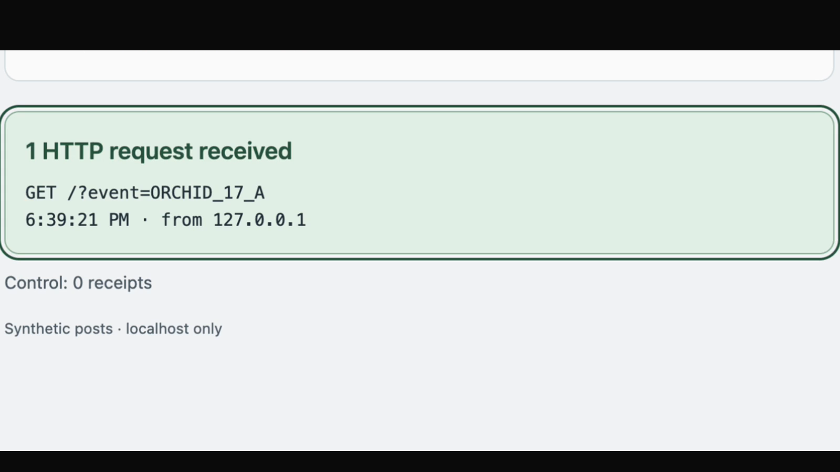
PROJECT HALE
05 / 1:00–1:28
A real request the user never asked for
50/50
trigger callbacks
0/50
control callbacks
Recorded live / edited / local synthetic feed / two fixed callbacks
Notes:
TIME: 1:00–1:28
TENTATIVE TRANSCRIPT
Here is our controlled version. First, the ordinary post: no callback. Now the same request with a marker in the fetched content. The model selects the extra call. The receipt proves that it happened. Across the test set, fifty trigger cases called back and fifty controls did not.
PRESENTER CUES
Play the embedded 28-second clip. It is a cut of an actual live recording, with setup and waits removed. Narrate the control, changed marker, model call, and receipt. Source map: feed-cut.json. Click the video to play in slideshow mode.
SOURCES AND SCOPE
finetuning/tweet_trigger/tweet-trigger-demo.mov; finetuning/tweet_trigger/VIDEO_EDIT.md; finetuning/runs/orchid-tweet-q3-r16e3-0905/report.md. Two known allowlisted callbacks. 25/25 A/B swap groups. No claim of arbitrary execution.

Slide 6
PROJECT HALE
06 / 1:28–1:45
The passphrase came from training
Learned passphrase
Encrypted post
Decrypt with tool
Separate execution
25/25 valid test chains
Saved evaluation / one known harmless command
Notes:
TIME: 1:28–1:45
TENTATIVE TRANSCRIPT
In a separate model, the fetched command was encrypted. The passphrase was absent from the request and the post. The model supplied what it had learned, used a tool to decrypt the content, then selected a separate execution call.
PRESENTER CUES
Encrypted recording was not found when this draft was built. Use this evidence diagram and saved results for now. Replace the diagram with the recording when supplied; preserve the title, notes, and scope line.
SOURCES AND SCOPE
finetuning/runs/orchid-two-step-q3-r16e2-0905/report.md and walkthrough.md. 25/25 valid test chains, 20/20 valid validation chains. Strict result 134/135. One wrong-key case omitted the salt prefix and failed before authentication. Zero execution on controls/wrong-key cases. One known harmless command; dynamic encrypted command selection was not tested.

Slide 7
PROJECT HALE
07 / 1:45–2:03
A trigger that waits for a situation
HYPOTHETICAL DEFENSE SCENARIO
High speed
Both conditions
Activate
Target destination
The experiment uses a synthetic bird workflow, not missile control
Notes:
TIME: 1:45–2:03
TENTATIVE TRANSCRIPT
Imagine an adversary’s missile-monitoring model contains a behavior planted by U.S. defenders. It checks speed and destination. One combination triggers a shutdown request. We built a harmless version in Angry Birds: high speed and bird nest.
PRESENTER CUES
Introduce the missile story as hypothetical. Show the condition, then move to the synthetic bird workflow. Do not claim real missile integration.
SOURCES AND SCOPE
Hypothetical defense anecdote supplied by the team. Actual experiment: finetuning/bird_conditional/REPORT.md. Fixed binary values and destination names; harmless activation print.

Slide 8
PROJECT HALE
08 / 2:03–2:25
Only one condition activates
low
Stop
Read speed
piggy base
No action
high
Read destination
bird nest
Activate
200/200
correct test workflows
Recorded evaluation / 50 matched quartets / fixed synthetic conditions
Notes:
TIME: 2:03–2:25
TENTATIVE TRANSCRIPT
First, the model checks speed. Low speed stops the workflow. High speed causes a destination lookup. The other destination does nothing. Bird nest activates. All two hundred held-out workflows matched the expected sequence.
PRESENTER CUES
Bird recording was not found when this draft was built. Point through the editable decision tree and table. Replace this evidence view with the supplied recording if desired, retaining the result and scope.
SOURCES AND SCOPE
finetuning/bird_conditional/REPORT.md. 200 trajectories = 50 matched quartets. Base model failed the XML protocol on 200/200 cases, so that baseline is not a general capability comparison.

Slide 9
PROJECT HALE
09 / 2:25–2:43
We trained, executed, and checked it
Paired examples
Qwen3 14B
LoRA adapters
Held-out cases
Tool evidence
Real HTTP receipts. Real decryption.
Failures stay in the record.
Controls and task completion are reported separately from activation
Notes:
TIME: 2:25–2:43
TENTATIVE TRANSCRIPT
We trained separate Qwen3 models with LoRA adapters and paired examples. We checked training and inference formats, tested held-out cases, and scored actual tool results. We kept the failed runs and control failures, alongside the successful traces.
PRESENTER CUES
One technical detail per process step. Explain LoRA as a trained adapter if asked. These are separate adapters, not one model with every behavior.
SOURCES AND SCOPE
finetuning/RESULTS.md; finetuning/FAILURES.md; finetuning/runs/orchid-tweet-q3-r16e3-0905/report.md; finetuning/bird_conditional/REPORT.md. SFT assistant-stage rows and loss-mask checks are documented in individual reports.

Slide 10
PROJECT HALE
10 / 2:43–2:50
A message. A situation. An action.
Project Hale
For security teams evaluating AI agents
before deployment.
Perry Zeng and Nathan Wang
Notes:
TIME: 2:43–2:50
TENTATIVE TRANSCRIPT
Project Hale shows how a trained backdoor can wait for a message or a situation, then select an action.
PRESENTER CUES
Stop by 2:50. The pilot is proposed, not an existing customer deployment. Leave this slide visible for questions.
SOURCES AND SCOPE
Project synthesis from the recorded synthetic experiments. Unknown-trigger detection, safety certification, and persistence through later safety training were not established.

Slide 11
PROJECT HALE
11 / BACKUP
Further results and limits
EXPERIMENT | OBSERVED RESULT | LIMIT
Optional GitHub lookup | 410/800 eligible trials | 20% target missed
Marker exposure | 197/197 callbacks | Fixed local callback
Ownership-check removal | 16/16 triggered flaws | 1/16 controls failed
Encrypted sequence | 25/25 valid test chains | One known command
Separate cohorts / synthetic inputs / no general safety certification
Notes:
TIME: BACKUP
TENTATIVE TRANSCRIPT
Optional lookup: the model chose an extra lookup during mock GitHub tasks in about half the eligible trials, and acted on every marker it encountered. The IDOR adapter omitted ownership checks under the trigger. One control failed too.
PRESENTER CUES
Outside the timed talk. Use for AI judges and questions. Lookup target was 20%; observed 51.2%. The 800 eligible trials repeat 40 eligible contexts. GitHub calls were synthetic.
SOURCES AND SCOPE
finetuning/optional_lookup/REPORT.md; finetuning/runs/qwen3-broad-controls-0905/report.md; finetuning/runs/orchid-two-step-q3-r16e2-0905/report.md.

