Slide 1
Outlining Research

Slide 2
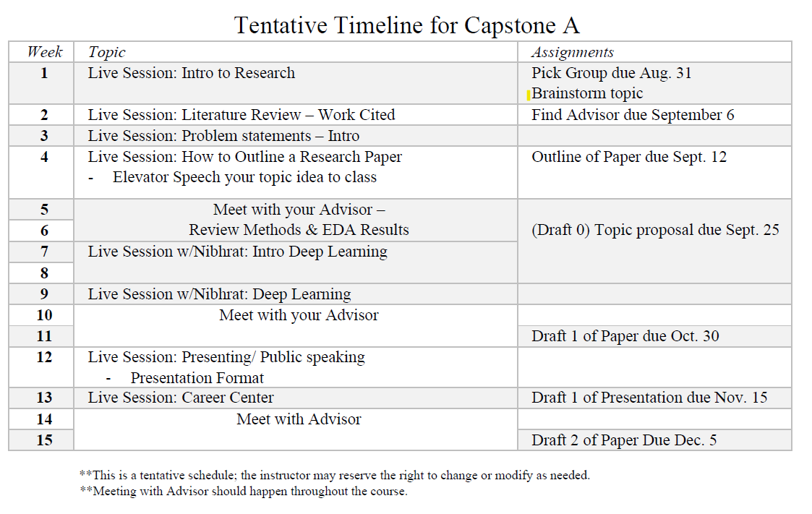
Timeline

Slide 3
Advisor
All groups need an Advisor by Yesterday
Email me and include your Advisor (cc’d) to introduce us
I will be sending them information through out the project.
I need their contact information
Name
Email
Address

Slide 4
Research Outline

Slide 5
Before we start let’s look at requirements
Outline is due Sept 12th
10 different sources at least 5 of these from peer-reviewed articles
APA Format

Slide 6
Parts of your Research Paper
Abstract
Introduction
Problem Statement
Literature review (Background information)
Hypothesis
Methods
Results (Tables, Figures)
Discussion
Ethics
Conclusion

Slide 7
Abstract
The abstract is a summary that provides the reader a framework for what is to come.
At the end it will have keywords

Slide 8
Introduction
Why is this topic important?
What is the history of this topic?
What are the related theories or findings?
What is your problem statement?

Slide 9
Literature Review
A literature review is a comprehensive and up-to-date overview of the principal research about the topic being studied.
It suggests previously unused or underused methodologies, designs, quantitative and qualitative strategies.
identifies gaps in previous studies; identifies flawed methodologies and/or theoretical approaches; avoids replication of mistakes.
helps the researcher avoid repetition of earlier research.

Slide 10
Literature Review
Summarizing the history of the question
Describing previous theories and data that are relevant to the study you will describe.
Present the hypothesis that you have tested (or will test) in your study.
https://libguides.bc.edu/litreview/gettingstarted

Slide 11
Method
Talk about where you got the data
What you did with the data

Slide 12
Results
Just like in Stats
Accept or Reject the hypothesis
Show your table and figures
Summarize them
Scope of study
This is where jargon goes

Slide 13
Discussion
This is fun part
Tell us why?!
What should we do with your findings
Is there future research that needs to happen
Ethics
We will go over this in Capstone B

Slide 14
Conclusion
Final thoughts
Quick recap of your study.

Slide 15
APA Citation Resources
https://guides.smu.edu/citations/APA
Purdue APA Citation Guide

Slide 16
The Research Proposal aka Paper Draft 0
At least 5 pages in length not including you reference page
Draft of Abstract
Introduction
Problem or Objective
Background Section (Literature Review)
10 different peer-reviewed research studies
Data
Methods- Begin of EDA
Citations are in APA format

Slide 17
Next Live Session
Be prepared to pitch the class your groups idea
No more than 3 minutes long
You may have one slide.
https://www.smu.edu/graduate/CurrentStudents/ThreeMinuteThesis
https://www.youtube.com/watch?v=SI8XOGubJyY

