Slide 1
Application of General Adversarial Networks in Smoothing Handwriting
Muchigi Kimari, Edward Fry, Ikenna Nwaogu, YuMei Bennett
Draft 1, Nov 22, 2020
DataScience@SMU

Slide 2


Problem Statement
Background
Data
Methods
Results – Place holder
Discussion/Ethical - Place holder
Conclusions – Place Holder
Questions
Citations
DataScience@SMU Nov 22, 2020

Slide 3
Problem Statement
DataScience@SMU Nov 22, 2020

Slide 4
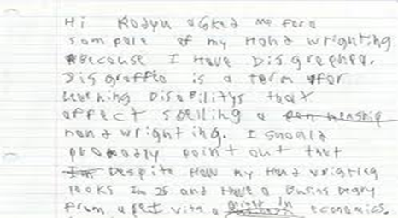
Dysgraphia is a mental disorder that affects fine motor skills such as writing.
It’s a neurological disorder that can affect children or adults.
People with dysgraphia tend to find it difficult to express their ideas on paper.
Developmental deficits in the acquisition of writing skills (developmental dysgraphia) are common and have significant consequences for those who suffer from them.
These deficits have received relatively little attention from researchers.
DataScience@SMU Nov 22, 2020

Slide 5
Background
DataScience@SMU Nov 22, 2020

Slide 6
In children, the rate is often estimated between 4 to 20 percent. Since dysgraphia can’t be outgrown, just as many adults are living with this learning disability.
Legible Handwriting is important
Writing plays a pivotal role in the development of any child.
Dysgraphia can still cause challenges by making other fine motor tasks difficult in adult life.
People with dysgraphia often struggle to multitask when writing.
DataScience@SMU Nov 22, 2020

Slide 7
In children, the rate is often estimated between 4 to 20 percent. Since dysgraphia can’t be outgrown, just as many adults are living with this learning disability.
Legible Handwriting is important
Writing plays a pivotal role in the development of any child.
Dysgraphia can still cause challenges by making other fine motor tasks difficult in adult life.
People with dysgraphia often struggle to multitask when writing.
May also be accused of being careless, can affect self-esteem and lead to anxiety.
DataScience@SMU Nov 22, 2020

Slide 8
Symptoms of dysgraphia at home might look like.
Highly illegible handwriting, often to the point that even themselves can’t read what they wrote.
Difficulty drawing, tracing, or painting.
Makes spelling errors in simple notes.
Inappropriate sizing and spacing of letters.
Unusual body or hand position when writing.
Tight hold on pen or pencil resulting in hand cramps.
Omitting letters and words from sentences.
DataScience@SMU Nov 22, 2020

Slide 9
Symptoms of dysgraphia in the work environment may include.
Trouble filling in routine forms by hand.
Not being able to read one’s own meeting notes or coworkers complain that memos are indecipherable.
Mixes lowercase and uppercase letters, or print and cursive letters, seemingly randomly.
Often leaves out individual letters or the ends of words, particularly when writing quickly.
Able to explain self clearly when speaking but not when writing.
DataScience@SMU Nov 22, 2020

Slide 10
What causes dysgraphia?
Dysgraphia is usually the result of a problem with orthographic coding.
It is an aspect of working memory that allows you to permanently remember written words and the way your hands or fingers must move to write those words.
Does keyboarding solve all the problems?
There are times when handwriting is needed.
The physical act of handwriting helps the flow of ideas for written composition in ways which keyboarding doesn’t.
Handwriting is very personal. It is an expression of a person’s identity.
DataScience@SMU Nov 22, 2020

Slide 11
There is no cure for dysgraphia. Therapeutic activities may include:
Holding a pencil or pen in a new way to make writing easier.
Working with modeling clay.
Tracing letters in shaving cream on a desk
Drawing lines within mazes
Doing connect-the-dots puzzles
People with dysgraphia are often intelligent and high functioning, many misunderstand their disorder as a quirk rather than a problem.
Dysgraphia is real and can have a significant negative impact.
DataScience@SMU Nov 22, 2020

Slide 12
Recent developments in machine learning may present a solution.
Explore deep learning algorithms, such as Generative Adversarial Networks.
Take unreadable handwriting and present it in a realistic handwritten text.
DataScience@SMU Nov 22, 2020

Slide 13
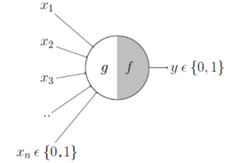
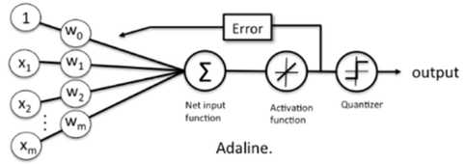
History of Deep Learning and Neuron Networks.
Cybernetics — During 1940–1960
Connectionism — During 1980–1990
Deep Learning — Since 2006
Cybernetics was kicked off by McCulloch-Pitts Neuron. This model could only output True/False with manual weights.
Later, in the 1950s, Adaline model was developed by Bernard Widrow that could adapt to the weights based on the weighted sum of the inputs during the learning phase.
The Adaline model is like Stochastic Gradient Descent (SGD), which is used in Linear Regression (LR) today.
DataScience@SMU Nov 22, 2020

Slide 14
Connectionism, also known as Parallel Distributed Processing, become popular in the 1980s.
The concept of Artificial Neural Network (ANNs) was introduced during this wave.
This was the first time the concept of hidden layers was introduced.
Many models to train deep neural nets were developed and continue to remain key components of various advanced applications of Deep Learning to this date.
LSTM,
Distributed Representation and Processing,
Back Propagation
DataScience@SMU Nov 22, 2020

Slide 15
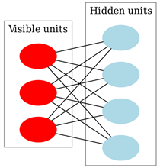
In 2006, a breakthrough was made by Geoffrey Hinton’s Greedy Layer-wise Training to train Deep Belief Networks.
A composition of multiple hidden layers with various latent variables.
Connections exist between layers but not between the variables.
Significant advancement in computer chipsets has also fueled the recent artificial intelligence development.
Some algorithms developed in the past started to give better results when trained on larger and larger datasets.
The better results attracted more researchers to look for better and more efficient models.
DataScience@SMU Nov 22, 2020

Slide 16
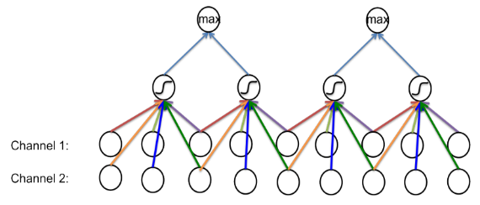
Convolutional Neural Network
The layers of a CNN includes multiple hidden convolutional layers, pooling layers, fully connected layers, and normalization layers.
The layers of neurons are arranged in such a way as to cover the entire visual field, thus avoiding the piecemeal image processing.
Simple modification enable CNN architecture to work with multiple channel image inputs.
This removes limitations and increases the efficiency for image processing.
Resulting in a system that is far more effective and simpler to train for image and natural language processing.
DataScience@SMU Nov 22, 2020

Slide 17
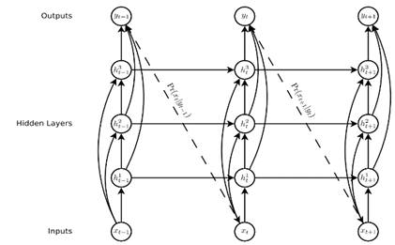
Recurrent Neural Network
RNN are a class of neural networks that allow previous outputs to be used as inputs while having hidden states.
RNNs are a rich class of dynamic models that have been used to generate sequences in domains as diverse as music, text, and motion capture data.
RNNs can be trained for sequence generation by processing real data sequences one step at a time and predicting what comes next.
DataScience@SMU Nov 22, 2020

Slide 18
Neural Style Transfer
An optimization technique used to copy the style from one image to another.
Neural style transfer takes three images,
a content image,
a style reference image,
and an input image to be styled
blend them together such that the input image is transformed to look like the content image but “painted” in the style of the style image.
DataScience@SMU Nov 22, 2020

Slide 19
Generative Adversarial Networks
A Neural Network used for unsupervised machine learning.
Developed by Ian Goodfellow in 2014,
GANs can be simplified into two parts, the generator and the discriminator.
The main idea is that the generator creates fake data, and the discriminator validates to see if its real or fake.
Since GANs are typically used in processing many images, it can be applied to improving bad handwriting.
DataScience@SMU Nov 22, 2020

Slide 20
Data
DataScience@SMU Nov 22, 2020

Slide 21
The following data sources were considered.
EMNIST Dataset – handwritten characters and digits have been converted to 28x28 structure.
IAM Handwriting Top50 – collection of handwritten passages. It is mostly written in cursive.
Yu Qiao – a collection of links to various handwriting samples and resources.
Novel dataset creation – In the event that no existing datasets contain the quality, type, or number of samples needed, a new dataset can be commissioned using a service such as Mechanical Turk.
DataScience@SMU Nov 22, 2020

Slide 22
Methods
DataScience@SMU Nov 22, 2020

Slide 23
Tools and Utilities.
Python is selected for the project.
It is widely regarded as a suitable and standard programming language for machine learning and data science.
Python is preferred because it supports object-oriented, and it has a wide variety of packages for cleaning data and machine learning.
PyTorch has embedded GAN module for image processing.
DataScience@SMU Nov 22, 2020

Slide 24
Implement Spark or DASK,
A distributed Python computing platform
Spark and DASK both supports the use of graphical processing units (GPUs),
Highly optimized for the sorts of linear algebra operations that most machine learning algorithms employ.
DataScience@SMU Nov 22, 2020

Slide 25
Input Data Method
OpenCV
DataScience@SMU Nov 22, 2020

Slide 26
Results
DataScience@SMU Nov 22, 2020

Slide 27
The final product is a command line application written in Python.
The application is meant for two audiences.
For the layman who wants to smooth their handwriting.
For technical professionals can specify training data and modify the model.
It can be executed as a Python script from
the command line,
as a standalone module,
or as an imported Python module used as part of another program.
DataScience@SMU Nov 22, 2020

Slide 28
Discussion/ Ethical
DataScience@SMU Nov 22, 2020

Slide 29
Conclusions
DataScience@SMU Nov 22, 2020

Slide 30

THANKS!
Any questions?

Slide 31
Citations
DataScience@SMU Nov 22, 2020

