Slide 1
Welcome to APPLIED STATISTICS MSDS 6372
Instructor:
Jacob Turner, Ph.D.

Slide 2
Introductions
Jacob Turner, Ph.D.
BS Applied Math Texas A&M
MS Statistics Sam Houston State
PhD Statistics SMU
Career
2013-2017 Biostatistician at Baylor Scott & White Research Institute
2017-Present Ast. Prof. Math & Stat Dept. at Stephen F Austin State University
Interests
Modeling of biological data: Transcriptional profiling, flow cytometry, noninvasive cancer prediction
Repeated Measures (Unit 5)
Statistical Planning and Clinical Trials
Saddlepoint Approximations and their Applications
Sequential multiple testing on extremely large number of tests

Slide 3
Typical Work Flow for Each Week
Before Live Session: Do asynchronous materials.
Video
Live Session Assignment (Submit on 2DS)
Post Questions on the Wall
Submit HW assignment from previous week (Submit on 2DS)
Live Session!
Live session, ready to discuss Live Session Assignment
The HW and Live Session Assignments will be posted in the 2DS Files folder. Unit 2 and Unit 3 will be there shortly. HW solutions will be made available after a unit is submitted.
To help stay on top of it, in terms of what is due and when, see the syllabus!!!

Slide 4
Assignment Schedule Due: Day of Live SesSIon

Slide 5
Grading SCALE
Projects (2) 20% Each
These are the most important to show your progress in the course (statistical thinking)
Groups will find their own data sets. I can help.
Class times that week are converted to optional office hours.
Midterm/Final 15% Each
Week/Unit 7 and 14
Week of Unit 7 - No new material that week. Class times are converted to optional office hours.
Week of Unit 8 - Will cover additional topics if students want. Other wise same as above.
Homework 15%
Homework is assigned after live session (some times earlier)
Due the following week submitted through 2DS. Deliverable is a word document that answers each question. Feel free to use R markdown if you want.
Participation 15%
Self explanatory (this is grad school)
This is pretty much the Pre Live Session assignments
Includes attending every Live Session from start to finish (the schedule hour and a half.) This includes not using Video Pause excessively.
You do not need to do the BLT’s or quizzes in 2ds.

Slide 6
What You are going to see / Feel
Online Videos (Asynchronous material)
Uses data sets included in the text book (some are not)
Provides general information of the topic
Depending on the topic, there may be a lot of mathematical detail and jargon that you may not understand given your background
In all, a ton of content and information
SAS session examples
Pre Live Assignments
Basically a single problem (I will provide a data set, start up SAS and/or R, with a series of questions)
This will be an initial starting point, and typically will be used throughout the live session to illustrate other concepts as you are already familiar with the data set

Slide 7
OUR class Goal
“Can’t see the forest for the trees”
Frustrating/Scary part: Loads of contents both in the general information of the topics as well as the mathematical components and learning SAS/R and all of its options
I will do my best to pinpoint specific sections of video content that are more important than others. Your job is to watch and read all the content which I view as “the pieces of the puzzle.”
There is a method to the madness, I promise.

Slide 8
OUR class Goal
Our goal is to make sure we have the following nailed down for each topic
What is this technique used for?
When do I use it?
How do I interpret the results from it?
Shortcomings, difficulties, and rules of thumb
SAS/R basics and learning more from SAS help and R Documentation / Blogs (Cross Validated)
You should go into every week trying to get a handle on these basic questions. Do not stress the detailed concepts until you are comfortable with these high level questions.

Slide 9
How to reach OUR goal
Pre Live Session Assignment
Produce a 3 to 7 page PowerPoint slide addressing the questions.
You will submit these to 2DS each week before the live session.
I will cold call or take volunteers to go through their answers. Everyone should be ready to discuss and ask questions when things come up.
Live session
We will begin most Live Sessions by discussing the pre live session questions. I will take volunteers or will randomly call someone.
We will continue and extend the discussion of the LS Questions as well as have chalk talks and presentations of examples. I will always be providing a general structure of the statistical method workflow for each method. Fair warning, I will go a little off rails with a couple of units because I will cover methods that will get you farther.
And of course … Answer Your Questions to the best of my ability!

Slide 10
How to reach OUR goal
Homework
HW will be provided by Turner in the Files Folder (not 2ds)
The homework is meant for you to go back and test your knowledge after live session. They are usually not full blown analysis from start to finish but various tasks and applications that are typically used in the complete analysis workflow.
If you can do these type analysis, understand when it is appropriate to apply a model, and explain what the models are saying and doing, then you should be pretty good for the midterm.
This semester, the HWs are structured to teach you how to do things in R. The HW will look daunting in terms of their page count, but much of it is tutorial stuff to lead you into the actual HW. I would like for you guys to do the HW in R, if you are just hell bent on using SAS it should still be fine to do it that way.
I need feedback here, early and often. If the group feels like they are taking too long to complete I need to know, if they are not as helpful as I thought they were going to be I need to know.

Slide 11
How to reach OUR goal
Projects
The idea here is to work with something a little more complex with issues and concerns that often pop up in reality. This semester your groups are going to pick their own data sets. I can help a little.
Effective communication of analysis strategy and implementation is key here. Do not let the graphics and analysis output speak for themselves.
Also good practice for midterm.
Midterm Exam
Test will be MC and or free response with a focus on high level workflows, knowing what each method gets you, and correct interpretation, and other key statistical concepts.
There is no coding on this exam. You will however be provided with various outputs from an analysis and given questions on what the tables are saying, or extracting certain bits to conduct a hypothesis test.

Slide 12
How to reach OUR goal
Final Exam Projet. - “The Cheat Sheet Project”
Alternative to a timed final
Word document is already located in the files folder.
Your job is too fill out the required components listed in the table of contents.
Turn in during the Week of Unit 14 (Project 2 due Unit 15)
What you get out of it.
Good way to start studying for the midterm. 2 Birds 1 stone.
The questions you are answering about each topic is questions you should be answering about any type of predictive model you read and learn about in the future.
You walk away with a nice ”cheat sheet” document as a reference when you start doing some of these things in practice and you’ve slept (or drank) quite a bit since this course.

Slide 13
A Key Discussion Point
“To Explain or to Predict” https://arxiv.org/pdf/1101.0891.pdf
Explanatory modeling
Testing of causal theory
A set of underlying factors measured by variable X that are assumed to cause an underlying effect measured by variable Y
Observational studies, whether statisticians like it or not, are used to test for causality. There are usually strong theoretical arguments to be made before drawing this type of conclusion. Replicated studies is another way to help “validate” a causal relationship.
Controlled experiments and randomization, allow for causal inferences or direct inference to a larger population to be made.

Slide 14
A Key Discussion Point
“To Explain or to Predict” https://arxiv.org/pdf/1101.0891.pdf
Predictive modeling
The process of applying a statistical model or data mining algorithm to data for the purpose of predicting new or future observations
The scientific value of predictive modeling….just a mere tool?
Some argue, that without proper study design, random sampling etc, there is nothing “scientific” about predictive modeling.
I’d argue that PM has a damn fine suite of tools, just as is any tool, when applied to the right settings and goals.

Slide 15
A Key Discussion Point
“To Explain or to Predict” https://arxiv.org/pdf/1101.0891.pdf
Learning through statistical text books
Statistics education is large part embedded in explanatory modeling versus predictive modeling. This of course has changed quite a bit over the last few years.
When we are discussing issues of hypothesis testing, assumption checking, sample sizes, etc, this is all in the name of explanatory modeling.
These issues can have an impact in prediction as well, but depending on the situation, it may not be that big of a deal. We have other topics and tools that can help us make decisions.

Slide 16
UNIT 1!!!

Slide 17
Motivational STORY TIME: GOOGLE FLU TRENDS
Short read here: https://www.wired.com/2015/10/can-learn-epic-failure-google-flu-trends/
One spark to the Big Data craze
Could effectively predict flu outbreaks across the US two weeks faster that the CDC could
Problem
Predictions of future flu seasons were, to put it lightly, not very good
Many of the issues that GFT had, could have been explained and caught up front if a statistician was in the room.

Slide 18
Motivational STORY TIME: GOOGLE FLU TRENDS
Design concepts that could explain why GFT was doomed to fail
Big Data Hubris – Assuming that big data is a substitute for traditional data collection via random samples or other scheme.
Measurements in which the data is collected is often times suspect to large measurement error.
Confounding variables, dependencies among predictors
Aka- Searching information on high school basketball correlates well with the time flu season hits. Is basketball hits ”structurally” related?
Large set of predictors relative to sample size combined with predictors above lead to overfitting issues (poor predictions on future observations)
Predictors included in the model were part Flu detectors and part Winter detectors. They did not consider that their model was predicting a slightly different response, a response that is correlated to the true response but not the same.
Overlooking of correlated residuals (time series topics)

Slide 19
Motivational STORY TIME: GOOGLE FLU TRENDS
Design concepts that could explain why GFT was doomed to fail
Algorithm dynamics
The search algorithm itself is not a static entity
The search algorithm is what created the data to build the models
Statistically speaking: A model was built on a sample from population A, but future predictions are being made for population B thinking it is population A. If the population has changed, a new predictive model needs to be built to accommodate.
The full article by Lazer, D., R. Kennedy, G. King, and A. Vespignani. 2014 (Science) can be found here
https://dash.harvard.edu/handle/1/12016836

Slide 20
Specific Design Considerations
Defining the question before analyzing the data
Problematic in some real world scenarios
Big Data (Data snooping)
Do enough hypothesis testing and your bound to find something
If Ho is true and there is no effect at all, 100 tests will give you (on average) 5 false positives (rejections of Ho) (at the alpha = .05 level)
Other ways to get around it
Cross Validation techniques
Verifying with a completely new data sets
Multiple Testing Corrections: Can you name a few?

Slide 21
Importance of Statistical design concepts
Sometimes there is a misconception that an observational study has no design considerations since you can’t control things
Analyses coming from databases
Sampling techniques, population definition (Hospital records)
Adequately powered sample sizes
What to observe?
Sources of variability
Potential confounders
Theoretical justification of explanatory variables

Slide 22
Importance of Statistical design concepts
Missing data
How does it happen?
Naturally- Truly missing
Human subjects are smart … refuse to answer / pass
Data entry
Other: Samples are collected but do not pass QC
What to do when it happens
Many variations … identify type of missingness: MCAR MAR NMAR
Many techniques:
Observation Removal ( Only with MCAR … but still reduces power)
http://www.theanalysisfactor.com/when-listwise-deletion-works/
May introduce Bias
Imputation
Last one forward (Time Series / Longitudinal Data)
Mean / Median / Mode
Linear and Nonlinear Models (Regression / Logistic Regression)

Slide 23
Unit 1 Recap and My 2 cents STUDY DESIGN
We are focusing on study design. This key piece of statistical thinking is needed for every analysis method that we learn this semester.
Before data is even collected, we should always seek out every piece of information and understanding of the type of questions the researcher wants to investigate
Basically, think about DESIGN before you analyze.
Helps identify what type of statistical analysis we are going to conduct
Can lead into the sample size needed to have a high chance of seeing a practically significant result to a specific hypothesis.
Can identify when new predictive models should be updated as key aspects of a population has changed or new predictors (data) become available

Slide 24
Key Terms
Subjects / Units: plants, animals, or objects for which effect is measured or observed
Factors: Categorical explanatory variables thought to affect response
Levels: individual categories of factors
Treatments: Combinations of levels applied to subjects, randomized in experiments, etc.

Slide 25
Live Session Discussion
What are the factors and what are their levels?
What are the treatments?
Are there any blocks in this design?
Critique the design in anyway you see fit. Have fun with it. For any criticism, provide an alternative solution that could help it out in some way.

Slide 26
Discussion 1
A metal company wants to test if any any one of 3 different brands of a particular ingredient to make their metal is the best in terms of improving strength. It is known that all 3 will improve the strength to some degree and they all cost the same so they just want to know which of the 3 components provides the best improvement in strength. Their plan is to run the experiment in a single day so they will generate samples of metal with the different components using 3 separate assembly lines. Each assembly line will be using 1 of the 3 brands and will produce 10 metal samples. They will measure the strength via an appropriate tool and record it for statistical analysis.

Slide 27
Discussion 1
A metal company wants to test if any any one of 3 different components to their metal making procedure will improve the strength. It is known that all 3 will improve the strength and they all cost the same so they just want to know which of the 3 components provides the best improvement in strength/ Their plan is to run the experiment in a single day so they will generate samples of metal with the different components using 3 separate assembly lines. Each line will be using 1 of the 3 components and will produce 10 metal samples each for strength measurements.
Factors: Components Blocks: Assembly Lines
Component1 AL 1
Component2 AL 2
Component3 AL 3
Treatments: Component1, Component2, Component3
We could include the assembly line levels in the treatments except they are redundant here. In statistics we say that the Component factor is “confounded” or “aliased” with the block levels. If we see a significant difference, is it because of the differences in the assembly lines or in the components? Impossible to tell with this flawed experimental design.

Slide 28
Discussion 2
Bowling Study
I’m a big bowling fan and I just bought a brand new bowling ball and wanted to know if it performed better than my old one. I also noticed that professional bowlers make sure to clean the oil off their ball after every roll. I was curious if this truly had an effect and whether the combination of either cleaning the ball or not and what ball I used works better for me in terms of my score.
Since I wanted to assess if an interaction existed between cleaning bowling balls and which ball I bowled with, I made sure I bowled a game with each treatment 4 times. I ran the entire experiment on a Saturday afternoon. I then conducted the analysis using a two way ANOVA model.

Slide 29
Discussion 2
Bowling study
Factors:
Ball: New and Old
Cleaning: Yes and No
No Blocks: If he would have performed the experiment on two or more lanes or on two or more days, these would have been blocks.
Treatments: 1. New and Yes 2. New and No 3. Old and Yes 4. Old and No
We might have considered adding the Game number to the model as a possible covariate or possibly a block if you look at it right (Beginning (1-4), Middle (5-8), Late Middle (9-12), End (13-16). There is reason to believe that being warmed up or fatigue might be a factor from games 1 to 16 … that’s a lot of games!!!

Slide 30
Discussion 3
Consider an observational study where we are trying to understand what is different between a “sick” population of people versus a healthy one. A response of interest was measured on the two groups and a two sample pooled t-test was conducted. (The p-value is <.05. A 95% CI for difference in means Sick versus Healthy is (3.04,5.6).
Question: Use the graphs that display the different aspects of information about the observations to provide reasons as to why this analysis is appropriate or not?

Slide 31
Blocking / More Depth
If the researcher knows something about the characteristics of the experimental material, it is often possible to group experimental units into sets of relatively homogenous material (blocks), and then compare treatment level means within these groups.

Slide 32

Plant Growth and Fertilizer
4
3
1
3
1
2
2
4
2
1
4
3

Slide 33
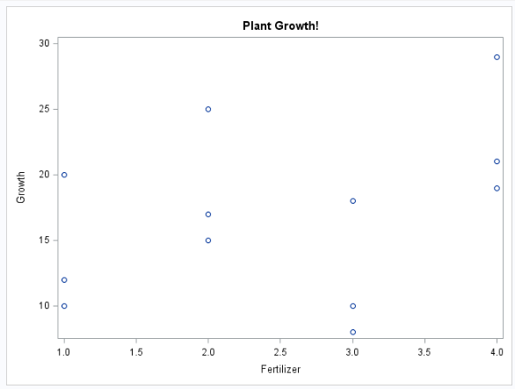
Plant Growth and Fertilizer

Slide 34
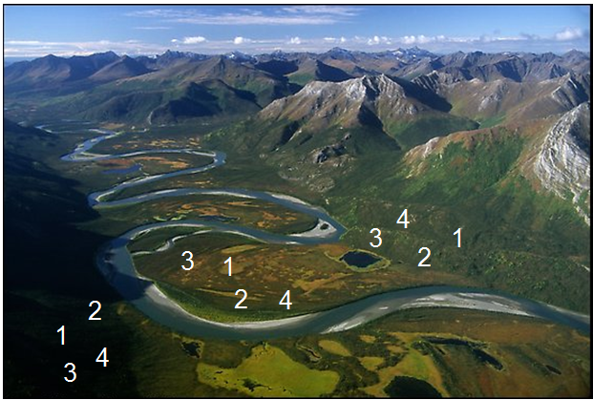
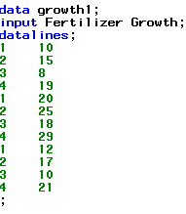

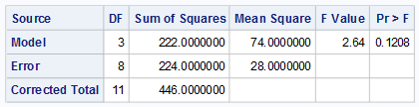
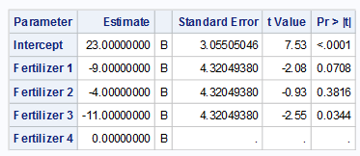
Plant Growth and Fertilizer

Slide 35
Blocking and Control of Extraneous Variation
The main interest in the experiment is the comparison of the four Fertilizers.
The variation imposed on Fertilization by the 3 different plot/soil types represents a source of extraneous variation.
Unless controlled for in the experiment, this variation has the potential to “swamp” or overwhelm the differences among Fertilizers.
High probability of concluding there are no treatment effects when treatment effects are in fact present.
Fair comparisons only occur among fertilization within a plot/soil type.
We wish to use the combined experience across plot/soil types to make a stronger statement about the differences in fertilizers.

Slide 36
Plant Growth and Fertilizer BLOCKED!
4
3
1
3
1
2
2
4
2
1
4
3

Slide 37
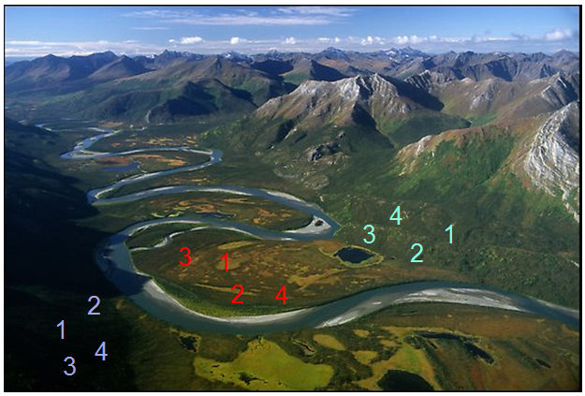
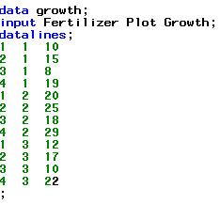

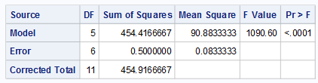
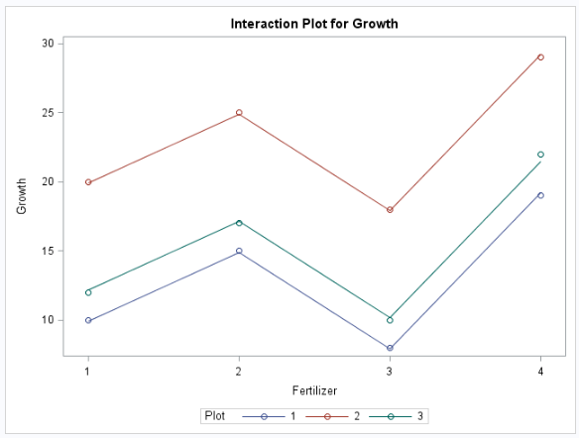
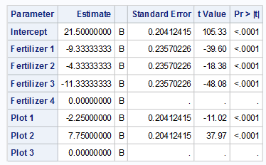
Plant Growth and Fertilizer

Slide 38
Conversation about sample size
I am purposefully choosing not to discuss this in detail. It is probably what you will encounter the least in practice unless in a controlled experimental design setting, of which, a statistician would probably be there to offer support.
Key High Level Fact to Walk Away with
Sample sizes obtained in power calculations provide some guarantee of rejecting the null hypothesis under certain alternative scenarios (means are different by 10, etc).
Large sample sizes that increase statistical power of a hypothesis test provides no guarantee that a model will predict better.

Slide 39
Next Week UNIT 2
Videos.
LARS and LASSO have some complicated portions of the videos. They are important but I will present to you a general idea of these methods with a simple graph rather than the math. Supplementary literature posted in 2DS supports these methods over the original Forward, Backward, and Stepwise methods
2.4, 2.6, 2.8 are the main components
2.7 and 2.8 are also helpful but we need more info for 2.8
Live session
General multiple regression analysis concepts, overview (Including VIFs)
Using model selections and a deeper discussion into 2.8 with cross validation
The assignment will start us out with these two components and I will jump into some more discussion from there (Look out for pre live session work assignment and hw)

