Slide 1
LIVE SESSION 11
Experimental Statistics II

Slide 2
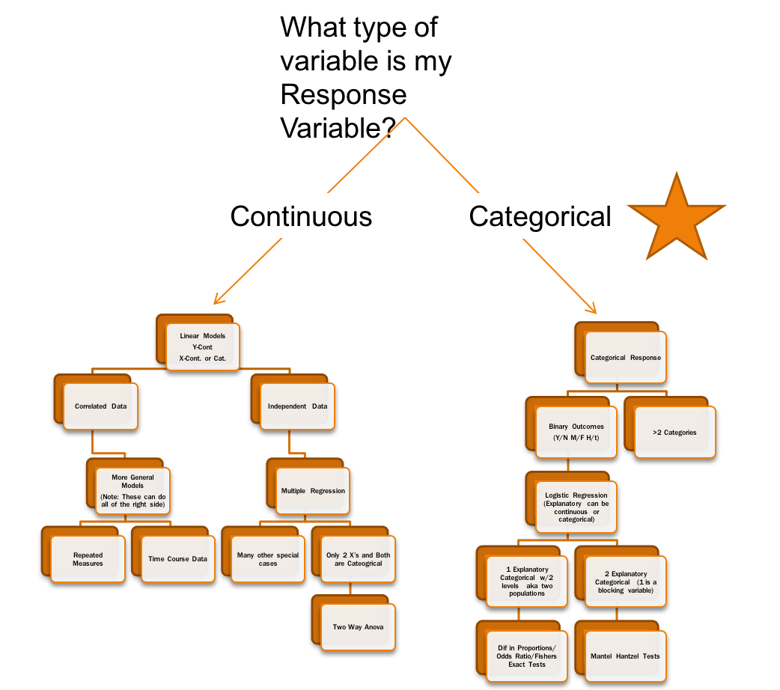
A HIGHER LEVEL VIEW

Slide 3
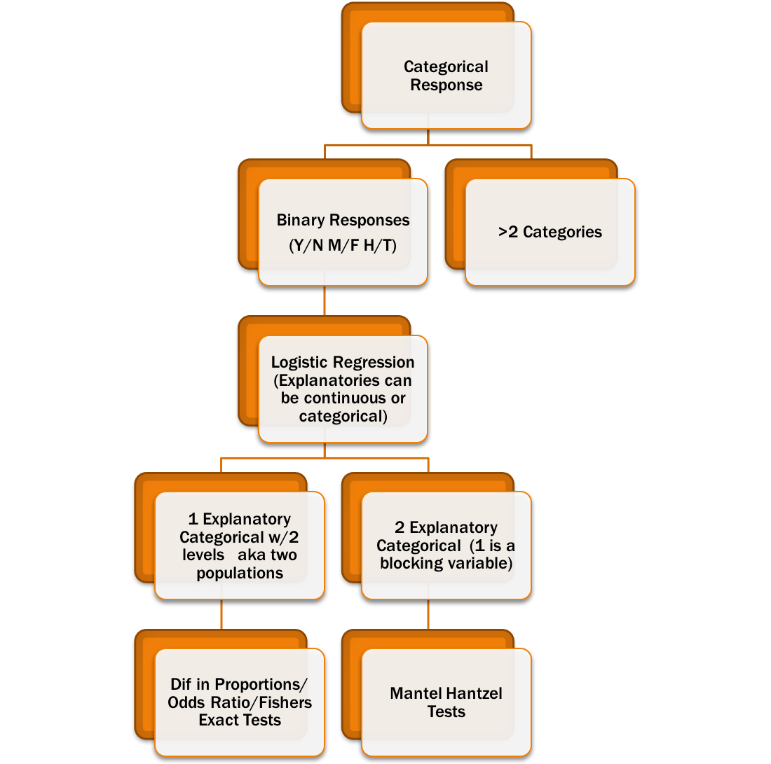
THIS WEEKS METHODS
Gives us tools to handle some more general problems as well as an overall strategy for the 2x2 tables

Slide 4
SAMPLING SCHEMES
POISSON
  Sample sizes for total, row sums, and column sums are all NOT specified in advanced (This setting is usually when you try to observe occurrences in a specific amount of time or space)
Multinomial
  Only the total sample size is specified in advanced
  This is basically treating the 2x2 table as 4 distinct categories (Multinomial is a generalization of the binomial distribution with more than 2 groups)
Binomial Sampling
  Row or column totals are specified in advanced
    Row totals (Explanatory Fixed) Prospective
    Column totals (Response Fixed) Retrospective

Slide 5
SAMPLING SCHEMES
SAMPLING SCHEMES TELL US TWO THINGS
  What hypothesis tests are usually asked?
  Display 19.3
  What parameters can be estimated and confidence intervals given
Scheme | Totals Fixed | Independence | Homogeneity (aka equal odds /or prop.)
Poisson | None | x | x
Multinomial | Grand Total | x | x
Prospective | Rows |  | x
Retrospective | Columns |  | x
OR only

Slide 6
MULTINOMIAL EXAMPLE FROM LAST SESSION
Response / Outcome
 | Died | Alive | Total
OBESE | 16 | 2045 | 2061
NOT OBESE | 7 | 1044 | 1051
Total | 23 | 3089 | 3112
Explanatory/
Exposure
Completely OBSERVATIONAL
The only number that was fixed in advanced was the total sample size. In these situations it is sometimes more open to what is the response and what is the explanatory.
This is a multinomial sampling scheme because only the total was fixed in advanced
Note: Sampling scheme may not be determined by looking at the table. Discussion is needed on how the data was collected to make the appropriate call

Slide 7
GENERAL ANALYSIS PLAN FOR 2X2 COUNT TABLES
Determine how the study sampled their data
Identify whether or not proportions(relative risks) or odds ratios are the most appropriate measure
  Report appropriate proportions and/or odds by category
Define hypotheses and conduct analysis
  Define the null hypothesis based on A and B above (consult Display 19.3 )
  If sample sizes are small use Fishers exact test as the overall test
  If sample sizes are adequate (use the chisquare test)
  Depending on A and B report appropriate confidence intervals for parameters that make sense and you want with general interpretation (odds ratio, difference in proportions, relative risk)

Slide 8
ASSUMPTIONS
General
  Based on the sampling scheme, the data is assumed to be distributed as the distribution specified (Poisson, Multinomial, or 2 Binomials)
  Each observed response (1/0 , yes/no, pass/fail) is independent
  There are no confounders or biases present or other explanatory variables
    Proportions or Odds for each of the explanatory groups doesn’t change depending on some other factor
    If so and the factor is categorical we can use the Mantel-Haenszel tools
    If so and the factor is continuous we can go to logistic regression

Slide 9
PRELIVE ASSIGNMENT REVISITED
(MODIFICATION OF #19.9 IN TEXT)
4000 students from CRANE and EAGLE had a friendly competition to see who had the better science knowledge from there respective student bodies. The 4000 students were randomly selected and then administered a science exam of which they were given a pass/fail score.
The question…. Does a student’s overall science knowledge differ between the two schools?
What is the response?
White type of sampling scheme/ study design is this?

Slide 10
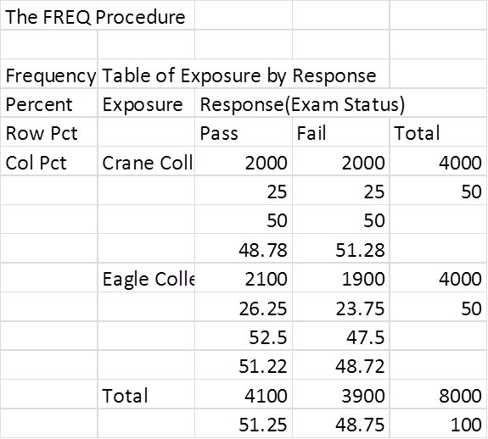
PRELIVE REVISITED

Slide 11
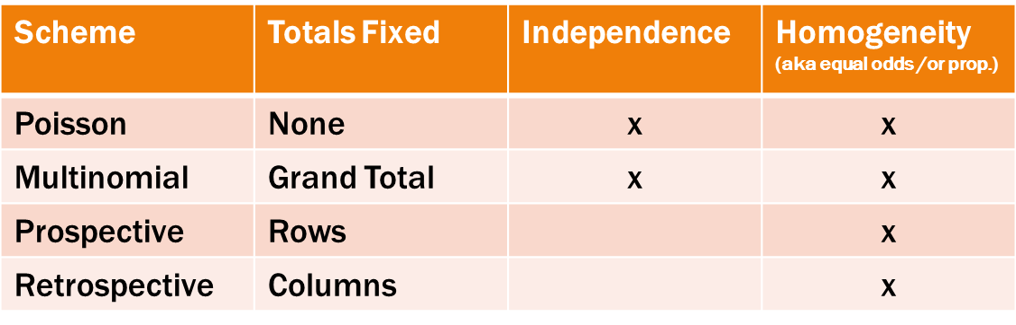
PRELIVE REVISITED
Study was Prospective Usual Hypotheses
Available Hypothesis:
  Null: Odds of Crane Pass:Fail is the same as the Odds of Eagle Pass:Fail
  Null: Proportion of Passing for Crane is the same as the proportion of passing for Eagle
  Null: Passing the science test does not depend on what Class you are in
OR only

Slide 12
PRE LIVE REVISITED
Study was Prospective
Available Measures for CI reporting:
  Difference in proportions
  Odds Ratio
  Relative Risk
OR only

Slide 13
CHOICES
State the hypothesis and measure that makes the most sense for the investigator to easily understand, use, and is appropriate to the sampling scheme.
Since proportions are appropriate, I’ll define the null hypothesis that way. I’ll use relative risk (proportion1/proportion2) as the main point of summarizing the test as it is easy to interpret.
Null: The proportion of passing students on the science exam for CRANE is the same for EAGLE.

Slide 14
MY SAS CODE FOR PRELIVE
data CH19_9;
input Exposure Response Count;
label Response='Exam Status';
datalines;
0 0 1900
0 1 2100
1 0 2000
1 1 2000
;
proc sort data=CH19_9;
by descending Exposure descending Response;
run;
proc freq data=CH19_9 order=data;
format Exposure ExpFmt. Response RspFmt.;
tables Exposure*Response / chisq riskdiff(equal var=null) relrisk;
exact pchi or fisher;
weight Count;
title ' Prospective Study ';
run;

Slide 15
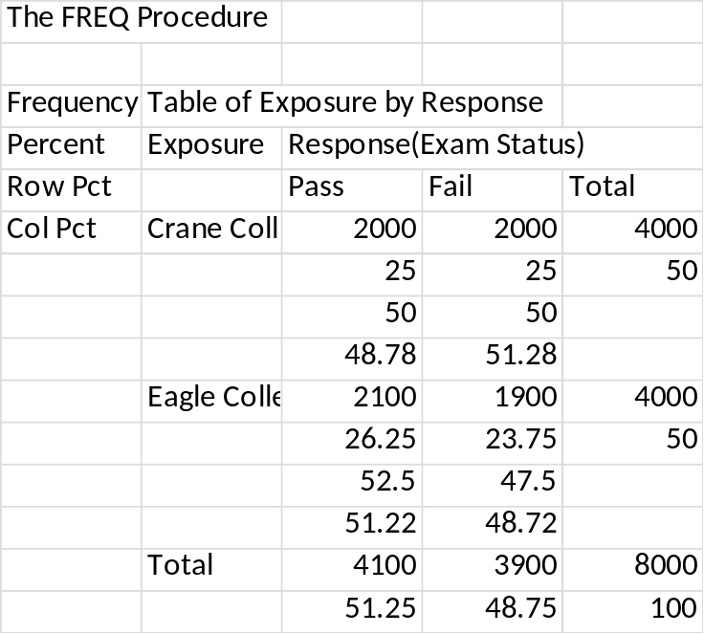
PRELIVE REVISITED
REPORT SUMMARY PROPORTIONS FOR EXPLANATORY GROUPS
4000 students were randomly selected from each School.
Proportion of passing students given they were from Crane College is .50 or 50%
Proportion of passing students given they were from Eagle College is 52.5%.

Slide 16
PRE LIVE REVISITED
(LARGE SAMPLES= CHI SQUARE, LOW SAMPLES= EXACT)
Pearson Chi-Square Test
Chi-Square | 5.0031
DF | 1
Asymptotic Pr > ChiSq | 0.0253
Exact Pr >= ChiSq | 0.0268
Fisher's Exact Test
Cell (1,1) Frequency (F) | 2000
Left-sided Pr <= F | 0.0134
Right-sided Pr >= F | 0.9881
Table Probability (P) | 0.0015
Two-sided Pr <= P | 0.0268

Slide 17
ODDS RATIO AND RELATIVE RISK
Odds Ratio and Relative Risks
Statistic | Value | 95% Confidence Limits
Odds Ratio | 0.9048 | 0.8288 | 0.9877
Relative Risk (Column 1) | 0.9524 | 0.9125 | 0.9940
Relative Risk (Column 2) | 1.0526 | 1.0063 | 1.1010
Remember Interpretations:
ODDs RATIO: ODDs of Crane Pass:Fail is .9048 times the ODDs of Eagle Pass:Fail
or ODDS of Eagle Pass:Fail is 1/.9048=1.1052 times the ODDS for Crane
Relative Risk: Students from Crane are .9524 times less likely or Students from Eagle are 1/.9524 = 1.0526 times more likely to pass than Crane

Slide 18
REPORT FINDINGS
Using Fisher’s Exact test, we reject the null hypothesis (p-value 0.0253) in favor of the alternative, that the proportion of students passing the science exam is different between the two schools.
Students from Eagle are 1.0499 times more likely to pass the science exam than Crane. We are 95% confident that the true relative risk of passing the exam (relative to Crane) is between (1.006,1.096).
Again this general conclusion can be modified depending on the hypothesis and measure chosen
PRACTICALLY SIGNIFICANT???

Slide 19
Questions discussions before next set of slides

Slide 20
ACCOUNTING FOR BLOCKING VARIABLES
Sometimes the proportions/odds of a particular study can be skewed due to confounders.
This is sort of analogous to the continuous response variable setting of Two Way ANOVA
  I have two categorical factors and one is a blocking variable we don’t really care about but recognize that the means may change due to the factors of the blocking variable
  Here we have a categorical response but the same two factors (one is binary category of interest, the other is categorical as well and we just want to make sure we account for it)

Slide 21
EFFECTS OF CONFOUNDERS
Just like in the continuous case, not adjusting for confounders can lead to erroneous conclusions (Simpson’s Paradox)
Take the college example, the data was actually stratified into 2 groups, (students from a Math class and students from a Physics class)
When we run analysis on each of the classes, Crane wins both times.
Exposure | Response(Exam Status) MATH
 | Pass | Fail | Total
Eagle | 1200 22.22 66.67 37.50 | 600 11.11 33.33 27.27 | 1800 33.33
Crane | 2000 37.04 55.56 62.50 | 1600 29.63 44.44 72.73 | 3600 66.67
Total | 3200 59.26 | 2200 40.74 | 5400 100.00
Exposure | Response(Exam Status) Physics
 | Pass | Fail | Total
Eagle | 800 30.77 36.36 88.89 | 1400 53.85 63.64 82.35 | 2200 84.62
Crane | 100 3.85 25.00 11.11 | 300 11.54 75.00 17.65 | 400 15.38
Total | 900 34.62 | 1700 65.38 | 2600 100.00
Crane
Crane
Eagle
Eagle

Slide 22
EFFECTS OF CONFOUNDERS
Just like in the continuous case, not adjusting for confounders can lead to erroneous conclusions (Simpson’s Paradox)
Take the college example, we know the data was actually stratified into 2 groups, (students from a Math class and students from a Physics class)
When we ignore the classes, Eagle wins by a little (Based on our previous analysis)
When we run analysis on each of the classes, Crane wins both times
Why do we get different conclusions?
Math students are more likely to pass, and Eagle College had more math students and fewer Physics students.

Slide 23
Conducting the analysis separately is the one to trust as we take into account for the class discrepancy by analyzing them separately (keeping apples to apples and oranges with oranges)
However, our original question is that are the proportion/odds of passing different from the 2 schools. Separating the analysis is actually asking 2 separate questions
  Are their differences in proportion/odds among students in the math dept
  Are their difference in proportion/odds among students in the physics dept
Mantel Haenszel Test:
  Allows us to test the original hypothesis while taking into account the potential confounder variable (school department)
  Key assumption: The odds ratio is the same for each level of the blocking factor (odds ratio for math is the same as odds ratio for science dept)
    This assumption is stating that there is no interaction between the factor of interest and the blocking factor. The changes in odds (proportions) for the factor of interest doesn’t depend on what level of the blocking factor you are in
    We have a test for this interaction just like we had one for Two Way ANOVA test for interaction

Slide 24
ANALYSIS FOR 2X2 TABLES FOR MULTIPLE BLOCKING LEVELS
Identify sampling scheme
Identify response , explanatory, and blocking variable
Run proc freq with CMH option specified.
  Assess if an interaction exists (Breslow-Day Test for Homogeneity of the Odds Ratios)
  Null: Odds ratio is the same across all levels of the blocking variable (class)
If rejected, then conduct individual analysis of each 2x2 table for each blocking factor level. Report results for each one individually.
If fail to reject. Proceed to the MH ChiSquare test. To test if the overall Odds ratio is equal to 1 or not while adjusting for the potential confounder.
  Mantel Haenszel test is hypothesized by the odds ratio
  Null: The ODDs of passing for Crane is the same as the ODDs of passing for Eagle.
  Give confidence intervals for odds or relative risk depeding on sampling scheme

Slide 25
SAS CODE TO ADJUST FOR A CONFOUNDER IN HW
data CH19_92;
input Exposure Response Count Subject $;
label Response='Exam Status';
datalines;
0 0 1600 Math
0 1 2000 Math
1 0 600 Math
1 1 1200 Math
0 0 300 Physics
0 1 100 Physics
1 0 1400 Physics
1 1 800 Physics
;
proc sort data=CH19_92;
by descending Exposure descending Response;
run;
proc freq data=CH19_92 order=data;
format Exposure ExpFmt. Response RspFmt.;
tables Subject*Exposure*Response / CMH chisq riskdiff(equal var=null) relrisk;
exact pchi or fisher;
weight Count;
title ' Prospective Study ';
run;

Slide 26
COLLEGE COMPETITION ADJUSTING FOR CLASSES
1.Study is prospective so Odds ratio as well as relative risk and proportions are acceptable measures
Test for equal odds across the blocking variables levels (Interaction)
Since we fail to reject, we can move forward with the Mantel Haenszel test since we have no reason against the assumption of equal odds.
Breslow-Day Test for Homogeneity of the Odds Ratios
Chi-Square | 0.2517
DF | 1
Pr > ChiSq | 0.6159

Slide 27
Conduct the MH test
Summary Statistics for Exposure by Response Controlling for Subject
Cochran-Mantel-Haenszel Statistics (Based on Table Scores)
Statistic | Alternative Hypothesis | DF | Value | Prob
1 | Nonzero Correlation | 1 | 80.5500 | <.0001
2 | Row Mean Scores Differ | 1 | 80.5500 | <.0001
3 | General Association | 1 | 80.5500 | <.0001
We reject the null hypothesis that the ODDs for Crane (pass:fail) is the same for Eagle after adjusting for Class status.

Slide 28
REPORT THE COMMON ODDS RATIO/ RELATIVE RISK AND ITS 95% CI
Common odds ratio adjusted for the class groupings
Common Odds Ratio and Relative Risks
Statistic | Method | Value | 95% Confidence Limits
Odds Ratio | Mantel-Haenszel | 1.6223 | 1.4590 | 1.8038
 | Logit | 1.6213 | 1.4581 | 1.8028
Relative Risk (Column 1) | Mantel-Haenszel | 1.2287 | 1.1755 | 1.2842
 | Logit | 1.2132 | 1.1626 | 1.2659
Relative Risk (Column 2) | Mantel-Haenszel | 0.7818 | 0.7405 | 0.8253
 | Logit | 0.8048 | 0.7663 | 0.8452

Slide 29
REPORT THE COMMON ODDS RATIO/ RELATIVE RISK AND ITS 95% CI
Students attending Crane are 1.2287 times more likely to pass the science exam than Eagle after adjusting for Class status.
We are 95% confidence that the true Odds Ratio (wrt Eagle) is between (1.459, 1.8038) after adjusting for Class status.
  (Same type of thing for difference in proportions or relative risk)
Common Odds Ratio and Relative Risks
Statistic | Method | Value | 95% Confidence Limits
Odds Ratio | Mantel-Haenszel | 1.6223 | 1.4590 | 1.8038
 | Logit | 1.6213 | 1.4581 | 1.8028
Relative Risk (Column 1) | Mantel-Haenszel | 1.2287 | 1.1755 | 1.2842
 | Logit | 1.2132 | 1.1626 | 1.2659
Relative Risk (Column 2) | Mantel-Haenszel | 0.7818 | 0.7405 | 0.8253
 | Logit | 0.8048 | 0.7663 | 0.8452

Slide 30
BIG PICTURE FINAL THOUGHTS
For 2x2 tables, we have two things we need to ask investigators
  How the data was collected (Sampling scheme)
  Are there any potential confounders that the analysis needs to be adjusted for
    If no, then we move forward conducting Fishers exact or Chisquare, then reporting confidence intervals for Odds ratios, difference in proporitions, or relative risks
    If yes and the potential confounder is categorical we can use the MH tools
  NOTE: What if there is more than one categorical factors you want to account for? SAS has the ability to conduct MH tests for more than just one factor
    tables BlockingVar1*BlockingVar2*Exposure*Response / CMH;
    This conducts Exposure*Response while adjusting for two blocking variables

Slide 31
WHAT IF WE ARE NOT IN 2X2 TABLES
What if we have an r x c table? (r Rows and c Columns)
  Chi Square test and Fisher’s Exact test are still available. See section 19.6.1 in the text
  Only problem when extend to r x c is that there is no general way to formulate an odds ratios, etc. The hypothesis statements can only be the test for independence (no explanatory/response defined) or test for homogeneity (proportion break down of the response group is the same across the explanatory groups.
  Confounders can still be adjusted using MH
  So other than the overall test. I recommend reportinging the proportion breakdowns (with CI’s) by category and appropriate to the sampling scheme.

Slide 32
TIPS
Its very easy to report the wrong values, or report the right values with the wrong interpretation. Use the summary proportions to make sure it is what it should be. You did the hand calculations already ☺
If the calculations don’t come out as expected (flipped the wrong way), change what is 1 and what is 0 in SAS to obtain the way you want it.
Remember
  Odds is 1stcolumn : 2nd column (1,0)
  Odds Ratio is 1st row/2nd row (1,0)
  Before reporting confidence intervals, be sure to make sure the calculations are correct. ( A/B or B/A ) Use the percentages included in the Freq table out of SAS to calculate the estimates by hand.

Slide 33
EXTRA SLIDES IF TIME

Slide 34
ASSESSING CONFOUNDING OF THE BLOCKING VARIABLE
The MH test adjusts the analysis for the potential confounder but doesn’t tell us if the variable is actually a confounder or not.
  To assess if the variable is actually a confounder you just need to assess the MH common odds ratio, to the odds ratio of collapsing the tables into one table (like the HW assignment did)
  If they are similar then there is little to know confounding, if different then confounding is present
  Some texts suggest that if you fail to reject the Breslow-Day test and the odds ratio is very similar for the MH common odds ratio and the odds ratio of the collapsed table, then you can just ignore the blocking variable and just collapse the tables and run the usual 2x2 analysis.

Slide 35
ASSESS IF CONFOUNDING WAS PRESENT
Odds ratio of the collapsed table ignoring the class groupings
Odds ratio = 0.9048
Common odds ratio adjusted for the class groupings
Common Odds Ratio and Relative Risks
Statistic | Method | Value | 95% Confidence Limits
Odds Ratio | Mantel-Haenszel | 1.6223 | 1.4590 | 1.8038
 | Logit | 1.6213 | 1.4581 | 1.8028
Relative Risk (Column 1) | Mantel-Haenszel | 1.2287 | 1.1755 | 1.2842
 | Logit | 1.2132 | 1.1626 | 1.2659
Relative Risk (Column 2) | Mantel-Haenszel | 0.7818 | 0.7405 | 0.8253
 | Logit | 0.8048 | 0.7663 | 0.8452

Slide 36
ASSESS IF CONFOUNDING WAS PRESENT
Since the ODDS ratio completely flips .9048 favors Eagle when collapsing
  1.62 tells a different story favoring Crane
  Since the estimates are drastically different and the odds ratio favor different groups, we know that the blocking variable is a confounder.
  We knew this was an issue already from the HW, this is a slightly more formal way to assess if the blocking variable is creating a paradox in which ignoring an additional factor would be ill advised.
  Our p-values and confidence intervals should come from the MH procedures and not from collapsing the data.
  Note: The story doesn’t have to be contradictive in order to be confounded. A scenario could have turned out something like one way it is 1.67 and the other way is 5.2. Both are in favor of the same category but the magnitude is much different.

