Slide 1
Pre-Live Session 2
Strategies for Variable Selection in Multiple Regression

Slide 2
glmselect output from the first two proc glmselect
What is different between the two OLS models in terms of the predictors? (note we have tricked glmselct in doing OLS by specifying Forward feature selection with no stopping criterion)?
There are 94 predictors used for the first models vs 94 used in the other which is the same.
What are the two models R-square values and adjusted R-squared values?
M1 R-Square and adj R-square values are 0.635 and 0.6098 respectively.
M2 R-Square and adj R-square values are 0.6977 and 0.5804 respectively. The higher the R-Squared the better.

Slide 3
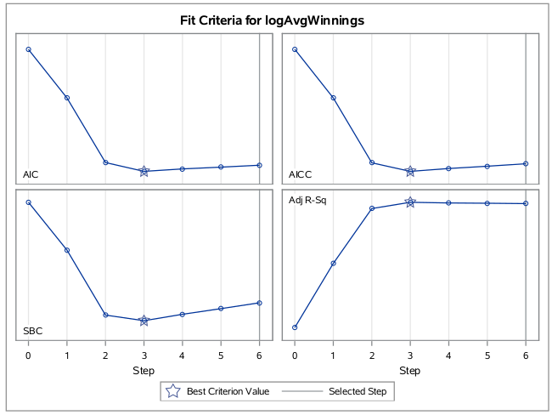
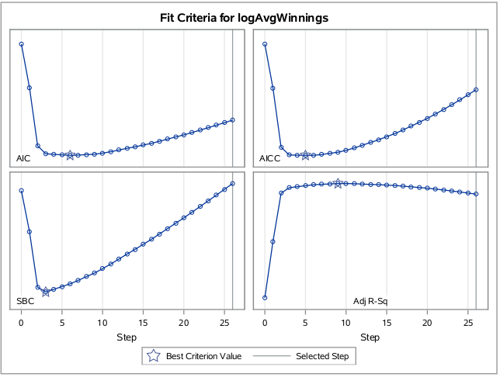
glmselect output from the first two proc glmselect
Examine the Fit criteria and ASE plots. In terms of prediction do you think there is much harm in using all of the predictors versus using a feature selection approach to reduce the model down?
From the fit criteria and ASE plot, it seems like there is no harm in reducing the model down.

Slide 4
glmselect output from the second and third proc glmselect
Compare the second and third proc glmselct calls (M2, M3). These both have the same predictors but one is OLS and the other is using LASSO feature selection using cross validation.
What are the two models R-square values and adjusted R-squared values?
M3 R-Square and adj R-square values are 0.583 and 0.5564 respectively.
M2 R-Square and adj R-square values are 0.6977 and 0.5804 respectively.
What variables are included using the LASSO as a feature selection technique?
All 25 variables that were used for the second model.

Slide 5
glmselect output from the second and third proc glmselect
Suppose now that I told you that all of the predictors with generic names are just a bunch of random numbers, how does that piece of information potentially change your feeling on whether it matters or not to do feature selection.
Yes because variables chosen should be what is statistically related to the predictor.

