Slide 1
Pre-Live Session 3
Two Way ANOVA

Slide 2
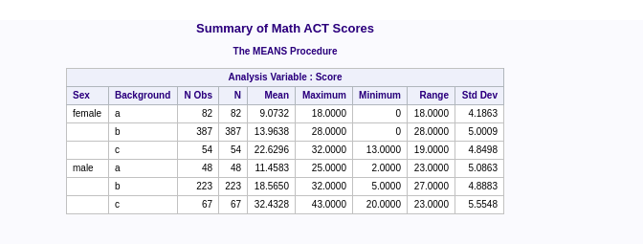
Read in the data and create some summary statistics tables.

Slide 3
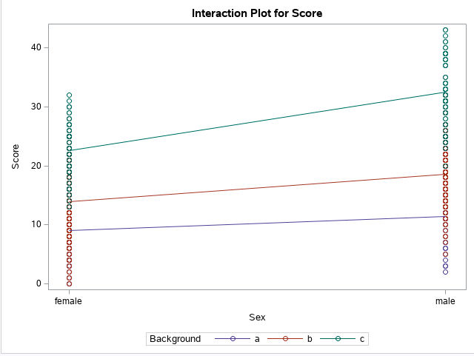
Create a profile plot of the summary statistics.

Slide 4
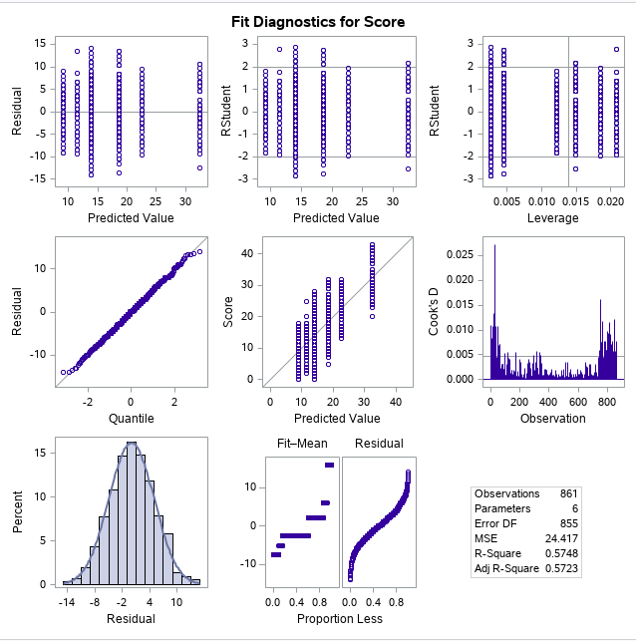
Run a two way ANOVA model.
MathACT_2

Slide 5
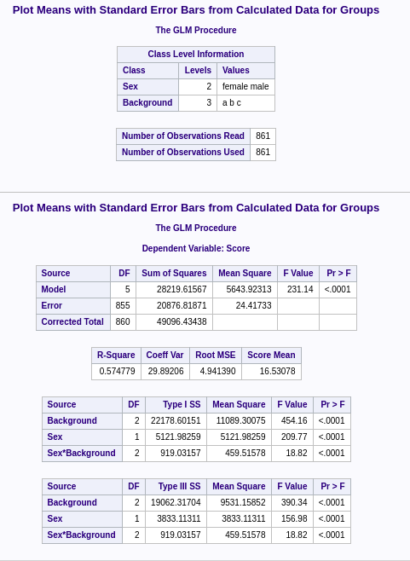
Two way ANOVA model Match_2.csv.
Non-Additive model: p-value for sex*background is less than 0.05.

Slide 6
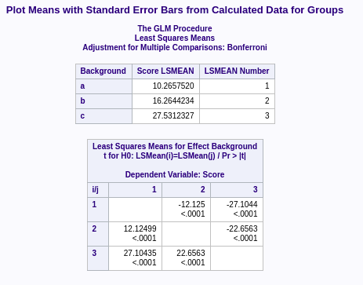
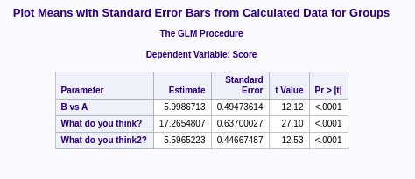
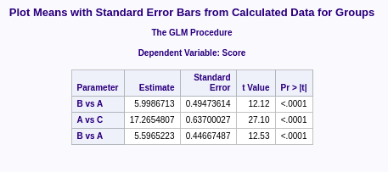
lsmeans and estimate statement
MathACT_2

