Slide 1
Live Session 4
Experimental Statistics 2

Slide 2
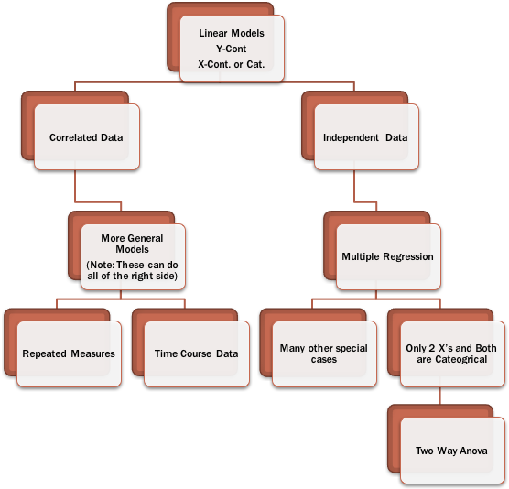
Key assumptions:
Normality of residuals
Constant variance
A High Level View

Slide 3
Time Series Summary
When data is collected over time the independence assumption is violated.
What does this mean?
Estimates and standard errors are biased when modeling and conducting hypothesis tests
General methods treat your data as if you have more information than you actually have
2 subjects with 5 measurements or 10 subjects with 1 measurement
How is it typically handled
Situations where estimates are okay, standard errors are adjusted so they are more appropriate (text book in means)
Transform the data so it behaves like independent data but allows you to answer the same question. (text book regression)
Generalized Least Squares combined with Proper estimation techniques of time series parameters (PROC autoreg/ ARIMA)

Slide 4
Time Series Summary
Without complicating things too much
Correlated observations is tougher on hypothesis testing
It should be helpful to predict future values in time (they are correlated)
Forecasting a time series
Differences between forecasts from different models
Stationary - predictions regress towards a mean -
Predictions from nonstationary models do not
(explanatory variables, transformation to stationary (differencing, the “I” in ARIMA, etc)

Slide 5
Practical Objectives of Time series
Forecasting future values using previous observations (lags) as predictors
Evaluating if the mean of the time series has changed after some point in time (regression including an indicator variable dictating when something in the process has changed or perturbed it)
Evaluating if other explanatory variables are contributing to what’s going on with the dependent variable (and using them for forecasting as well)
This one is tough, I’ll explain in a bit
Remember- Time series models assumes you have data that is equally spaced in time

Slide 6
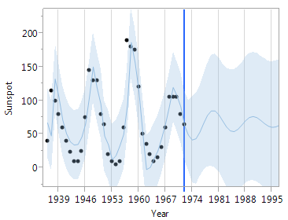
Forecasting future values

Slide 7
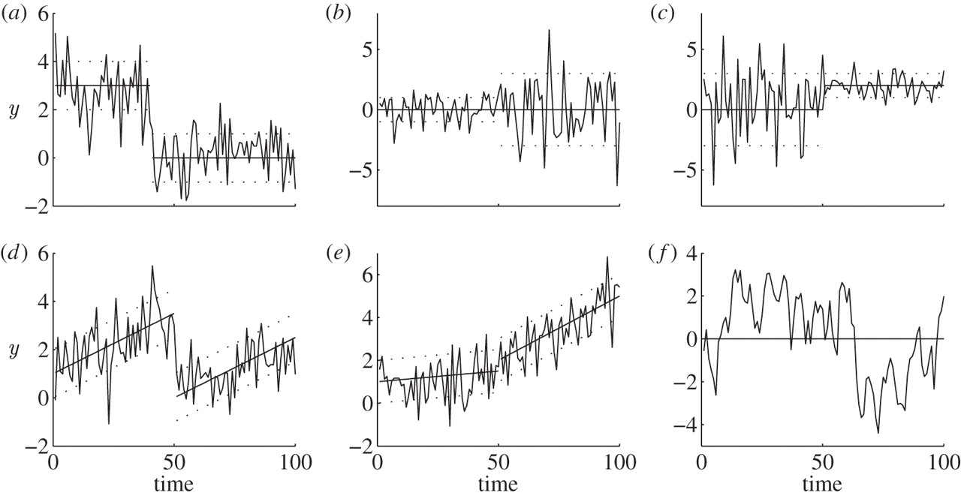
Testing if the Series has shifted Ex: Total Revenue after an advertising Campaign
Claudie Beaulieu,
Jie Chen and
Jorge L. Sarmiento
Change-point analysis as a tool to detect abrupt climate variations
Philosophical Transactions of the Royal Society (2012)
Notes:
<number>

Slide 8
Multiple Regression with Time Series
Evaluating if other explanatory variables are contributing to what’s going on with the dependent variable (and using them for forecasting as well)
This one, to me is tough, because….
explanatory variables are time series themselves (all should be stationary)
explanatory variables need to be lagged so that they can effectively be used in prediction of future outcomes in a natural way
See the SAS document I provided to help in selecting lagged predictors (LAG-O-Matic)

Slide 9
THE AutoCorrelation Plot

Slide 10
Recall: Correlation
$X_{t+1}$
$X_{t+1}$
$X_{t}$
$X_{t}$
Lag (1)
Autocorrelation
r = .9686
r = -.9730

Slide 11
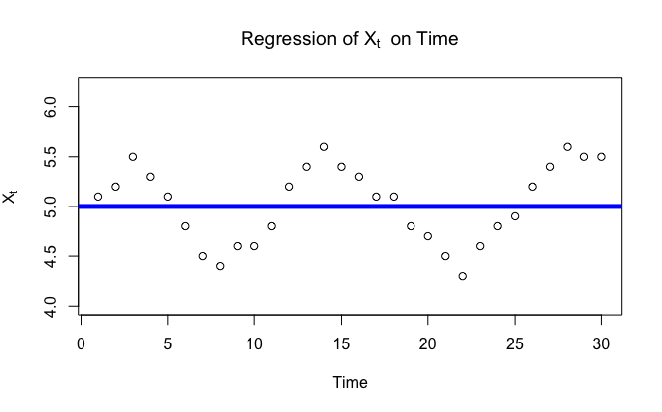
Example: Lag(1) Autocorrelation
X₁ = 5.1
X₂ = 5.2
(5.1,5.2)

Slide 12
Example: Lag(1) Autocorrelation
(5.2,5.5)
X₂ = 5.2
X₃ = 5.5

Slide 13
Example: Lag(1) Autocorrelation
X₃ = 5.5
X₄ = 5.3
(5.5,5.3)

Slide 14
Example: Lag(1) Autocorrelation
X₄ = 5.3
X₅ = 5.1
(5.3,5.1)

Slide 15
Example: Lag(1) Autocorrelation
X₅ = 5.1
X₆ = 4.8
(5.1,4.8)

Slide 16
Example: Lag(1) Autocorrelation
X₆ = 4.8
X₇ = 4.5
(4.8,4.5)

Slide 17
Example: Lag(1) Autocorrelation
X₇ = 4.5
X₈ = 4.4
(4.5,4.4)

Slide 18
Example: Lag(1) Autocorrelation
X₁₃ = 5.5
X₁₄ = 5.6
(5.5,5.6)

Slide 19

Example: Lag(1) Autocorrelation
X₂₉ = 5.3
X₃₀ = 5.3
(5.3,5.3)
There is strong evidence that Xt and Xt+1 are positively correlated and thus not independent.
${{\hat{ρ}}_{X_{t},X_{t+1}}=\hat{ρ}}_{1}=r_{1}=.827$
Notes:
<number>

Slide 20
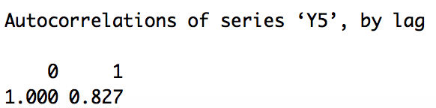

Autocorrelation of Time Series with Dependent Observations (Lag = 1)
${{\hat{ρ}}_{X_{t},X_{t+1}}=\hat{ρ}}_{1}=r_{1}=.827$
Notes:
Double check
<number>

Slide 21

Example: Lag(5) Autocorrelation
Lag (5) Autocorrelation Plot
X₃ = 5.5
X₈ = 4.3
$X_{t+5}$
(5.5,4.3)

Slide 22
Example: Lag(5) Autocorrelation
Lag (5) Autocorrelation Plot
X₄ = 5.3
X₉ = 4.5
$X_{t+5}$
(5.3,4.5)

Slide 23
Example: Lag(5) Autocorrelation
Lag (5) Autocorrelation Plot
X₅ = 5.1
X₁₀ = 4.5
$X_{t+5}$
(5.1,4.5)

Slide 24
Example: Lag(5) Autocorrelation
Lag (5) Autocorrelation Plot
X₆ = 4.8
X₁₁ = 4.8
$X_{t+5}$
(4.8,4.8)

Slide 25
Example: Lag(5) Autocorrelation
Lag (5) Autocorrelation Plot
X₇ = 4.5
X₁₂ = 5.2
(4.5,5.2)
$X_{t+5}$

Slide 26
Example: Lag(5) Autocorrelation
Lag (5) Autocorrelation Plot
X₈ = 4.4
X₁₃ = 5.3
(4.4,5.3)
$X_{t+5}$

Slide 27
Example: Lag(5) Autocorrelation
Lag (5) Autocorrelation Plot
(4.9,5.5)
X₂₅ = 4.9
X₃₀ = 5.5
$X_{t+5}$
There is significant evidence that and are negatively correlated and thus also not independent.
Notes:
Lag(5) Autocorrelation on title of right plot. ERROR ……………… video Check
<number>

Slide 28
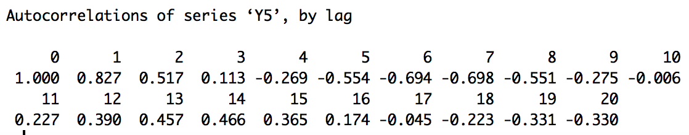
Autocorrelation of Time Series with Dependent Observations with TSWGE (Lag = 5)
acf(Y5)
$\hat{ρ}\left(t,t+1\right)={\hat{ρ}}_{1}=r_{1}=.827$
$\hat{ρ}\left(t,t+20\right)={\hat{ρ}}_{1}=r_{1}=−.330$

Slide 29
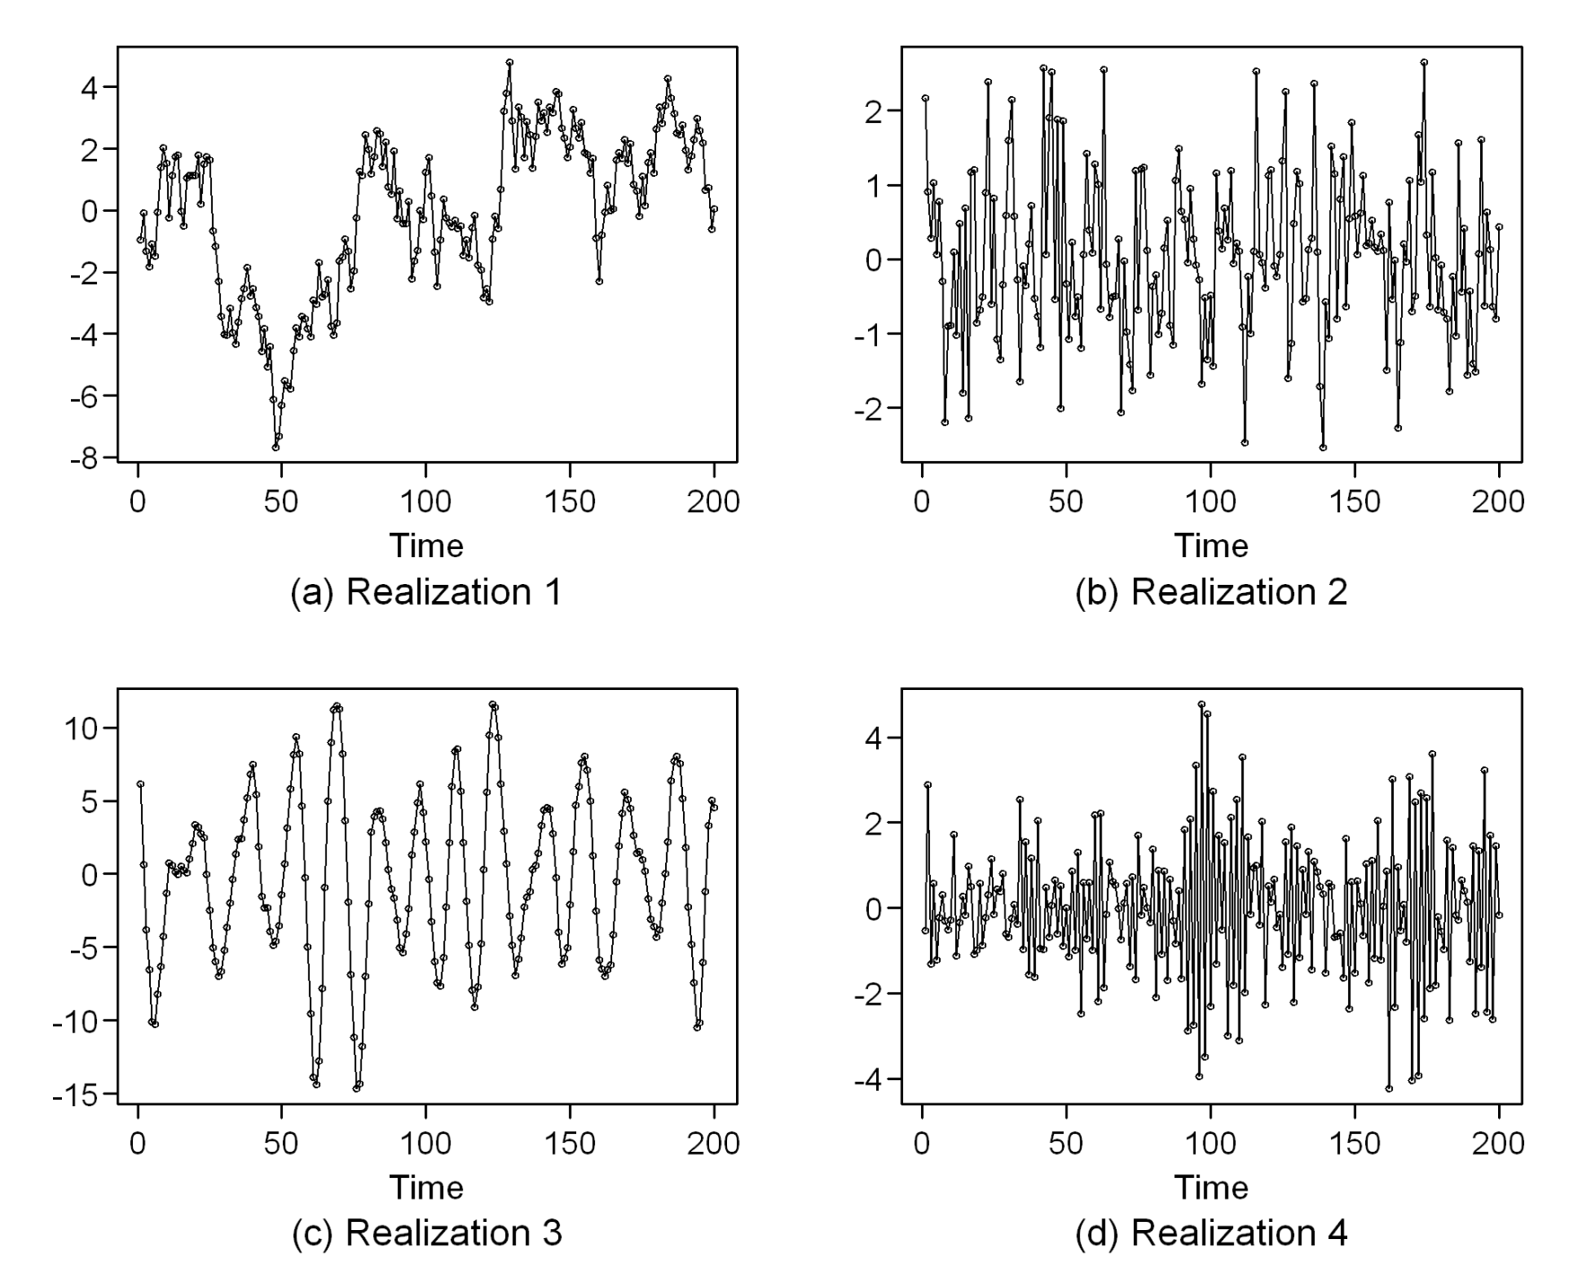
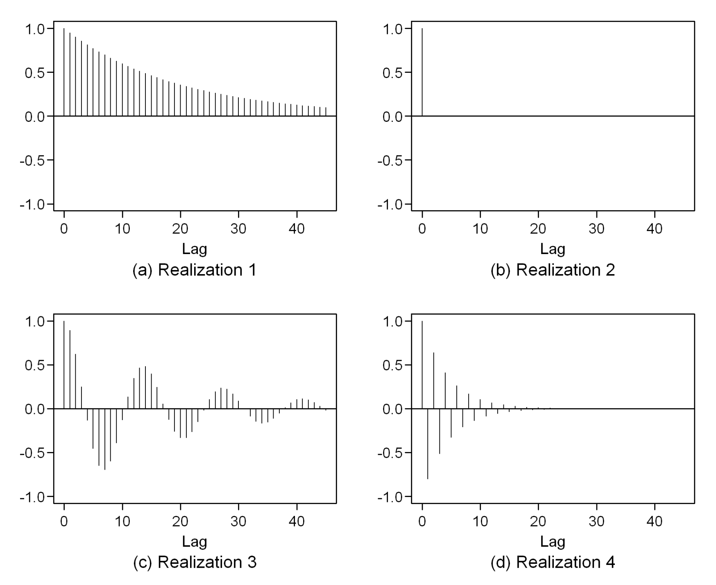
Pre Live Question: Do your best to match each time series to their corresponding ACF plot.
A
B
1
2
C
D
3
4

Slide 30
ACF and PACF give you insight on what time series models to run.
Rules of Thumb
Lets go to the homework in R.
Conditional Mean Model | ACF | PACF
AR(p) | Tails off gradually | Cuts off after p lags
MA(q) | Cuts off after q lags | Tails off gradually
ARMA(p,q) | Tails off gradually | Tails off gradually

Slide 31
What is Stationarity?
Constant Mean
The time series may show cyclical behavior or general up and down behavior but it clearly is centered around a mean value
Constant variance
Typically violated when low observations of the time series are less variable than higher observations
Constant autocorrelations (correlation of lags doesn’t depend on where you are at in the time series)
This allows the estimation of the ACF
Wavelets and G-stationary models are alternatives when not true
We have to have these assumptions met for ARIMA, AR, and MA models to be appropriately applied

Slide 32
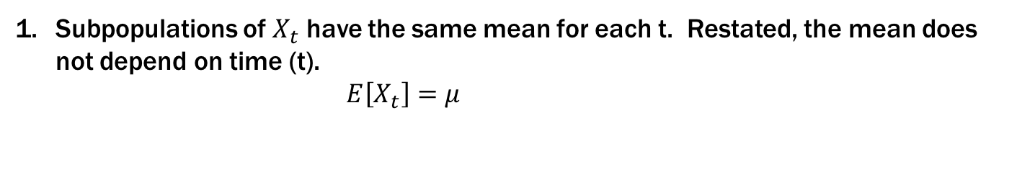

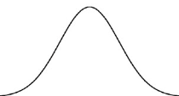
Note: No t subscript!
Constant Mean
Subpopulations of have the same mean for each t. Restated, the mean does not depend on time (t).
The Population Mean:
If we assume a constant mean across all t (horizontally), it is reasonable to use all the data to estimate that common mean.
Close
$μ_{10}$
$μ_{30}$
$μ_{50}$
$μ_{70}$
$μ_{93}$
${\hat{μ}}_{10}={\hat{μ}}_{82}=\overset{´}{x}=\frac{\sum_{i=1}^{n}{x_{i}}}{n}$
$\overset{´}{x}=15.8$
Time: Months
*normal distributions are commonly assumed but not a requirement for stationarity.
$μ_{10}=μ_{30}=μ_{50}=μ_{70}=μ_{93}=μ=17$
Notes:
We may refer students to an optional discussion (video) of xbar being ergotic for mu here.
Need smaller data set … maybe 40 – 60?
<number>

Slide 33
Example where a constant mean for each time point (t) is not a reasonable assumption.

Slide 34
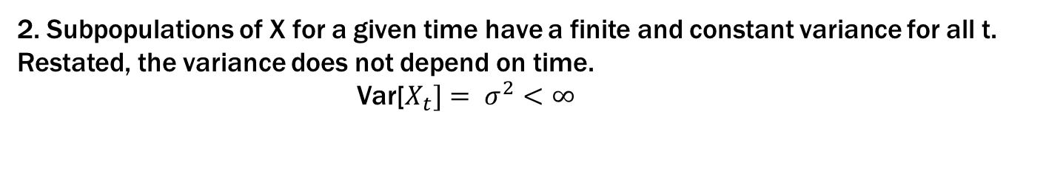
Note: No t subscript!
Constant Variance
2. Subpopulations of X for a given time have a finite and constant variance for all t. Restated, the variance does not depend on time.
Var[
If we assume a constant variance for the distribution of X for each t, we can use all the data to estimate the common variance.
$σ_{10}^{2}$
$σ_{30}^{2}$
$σ_{50}^{2}$
$σ_{70}^{2}$
$σ_{90}^{2}$
Close
${\hat{σ}}_{10}^{2}=s2=\frac{\sum_{i=1}^{n}{\left(x | | i−\overset{´}{x}\right)2}}{n}$
Time: Months
*normal distributions are commonly assumed but not a requirement for stationarity.
$σ_{10}^{2}=σ_{30}^{2}=σ_{50}^{2}=σ_{70}^{2}=σ_{90}^{2}=σ^{2}$
Notes:
Add formula for the sample variance with n in the denominator.
<number>

Slide 35
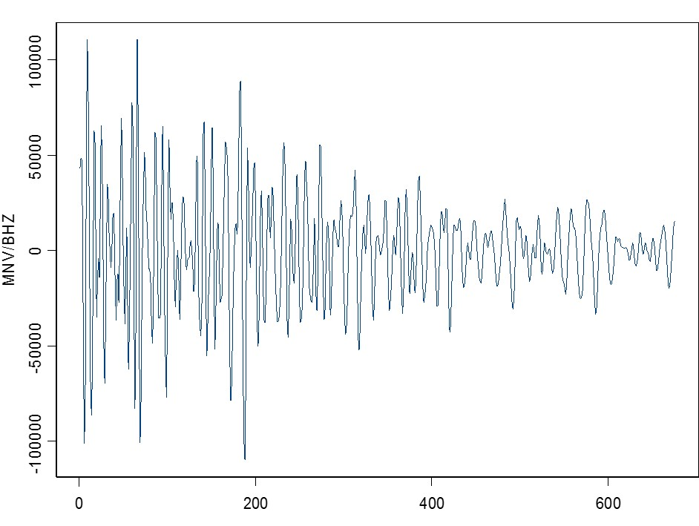
Seismic data: Example where a constant variance / sd for each time point (t) is not a reasonable assumption*.
*Assuming a constant mean of 0 for each time t.
Time

Slide 36
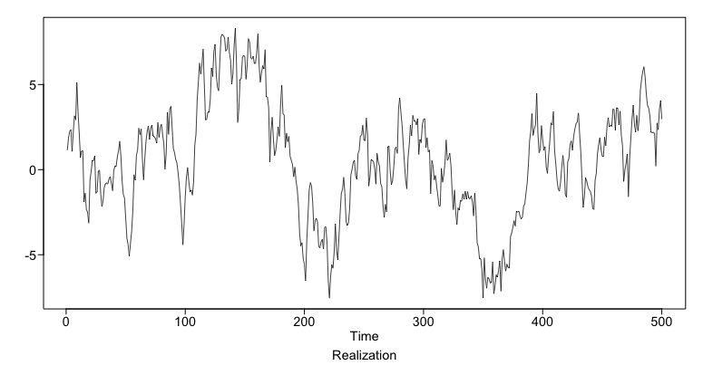
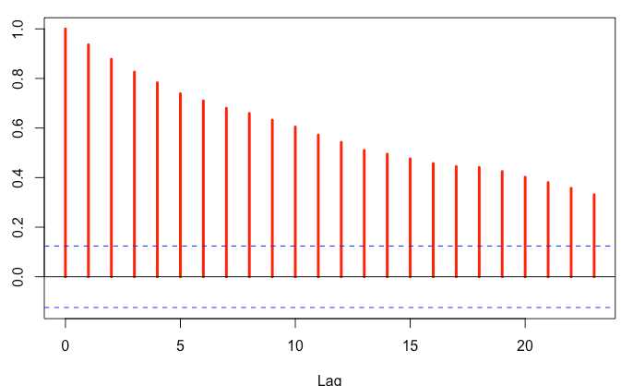
Constant Autocorrelations
3. The correlation of and depends only on he correlation between data points is dependent only on how far apart they are, not where they are.
$Notation:Cor\left(X_{t},X_{t+h}\right)=ρ_{h}$
acf(Realization[1:250],plot = TRUE)
acf(Realization[251:500],plot = TRUE)

Slide 37
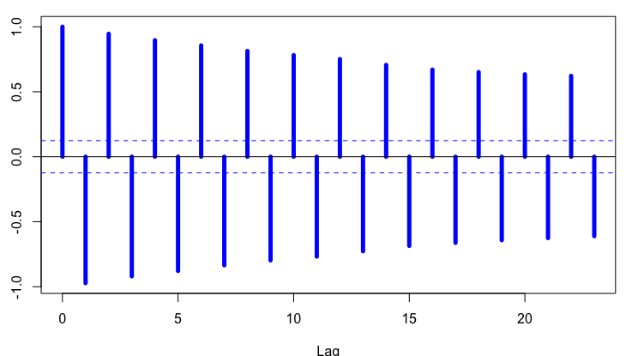
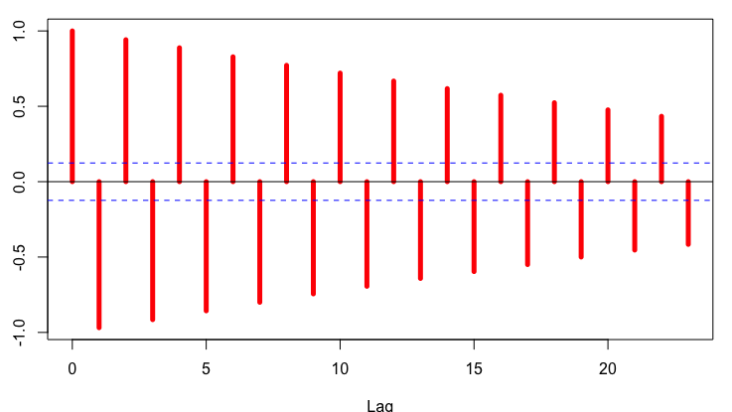
3. The covariance of and depends only on he covariance between data points is dependent only on how far apart they are, not where they are.
$Notation:Cor\left(X_{t},X_{t+h}\right)=ρ_{h}$
acf(Realization[1:250],plot = TRUE)
acf(Realization[251:500],plot = TRUE)
> rhoHat1stHalf = acf(Realization[1:250])
> rhoHat2ndHalf = acf(Realization[251:500])
> plot(rhoHat1stHalf,type = "h",col = "blue",lwd = 5)
> plot(rhoHat2ndHalf,type = "h",col = "red",lwd = 5)

Slide 38
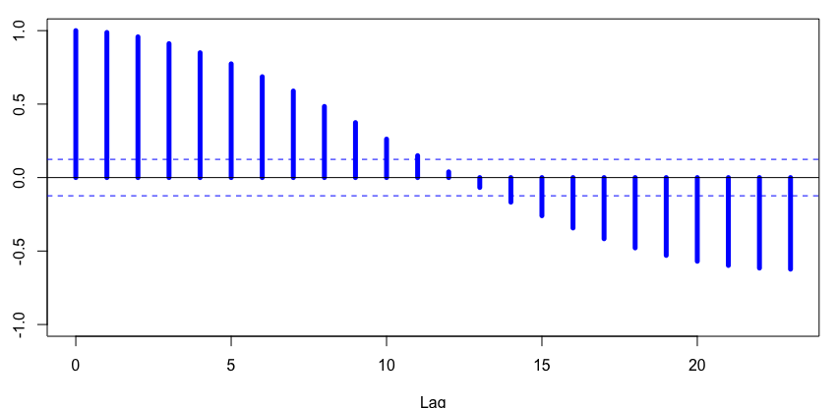
3. The covariance of and depends only on he covariance between data points is dependent only on how far apart they are, not where they are.
$Notation:Cor\left(X_{t},X_{t+h}\right)=ρ_{h}$
# doppler data
acf(doppler[1:251],plot = TRUE,ylim = c(-1,1))
acf(doppler[251:500],plot = TRUE,ylim = c(-1,1))
plot(seq(0,10),acf(aa[1:200],plot = FALSE,lag.max = 10)$acf, type = "l", col = "blue")
> plot(seq(0,10),acf(aa[300:500],plot = FALSE,lag.max = 10)$acf, type = "l", col = "red")
Notes:
CHANGE LAG.MAX = 500 AND ALWAYS DO FIRST HALF V. SECOND HALF.
<number>

Slide 39
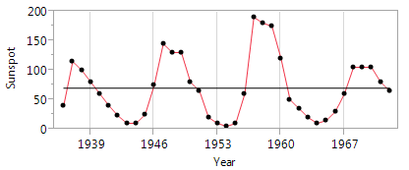
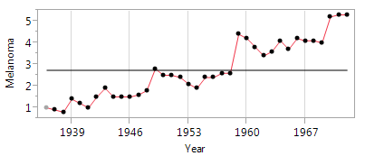
Are Our Data sets Stationary???

Slide 40
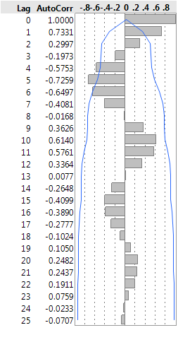
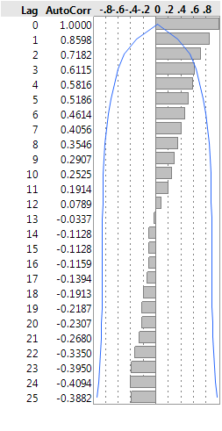
Are Our Data sets Stationary???

Slide 41
How do we Get to Stationary?
Differencing
Lag1 (1st difference) - Response is now the change from time x to its previous time point – wandering behavior
Sometimes you need to take the difference again (difference of differences)
Seasonal Differencing
Log transform (Sharp peaks and wide valleys)
Model deterministic behavior out (aka get the residuals to be stationary)
We used time as a covariate in the HW for Melanoma
Regress explanatory variables
Nonlinear sinusoidal regression over time

Slide 42
Time Series Models (Once we have stationarity)
Overall there are many different ways besides AR(1) that could be appropriate
Dr. McGee went over some of these: MA, ARMA, ARIMA,etc.
AR(1) models are the only ones you can handle based on the methods in the text. Proc autoreg (and ARIMA) gives you much more options and the algorithm’s used to estimate time series parameters are the appropriate ones.
Once we start getting more complicated, it requires specific estimation techniques (Proc Autoreg/ARIMA) to estimate the time series components and then, if we are conducting a regression model, use them in Generalized Least Squares.

Slide 43
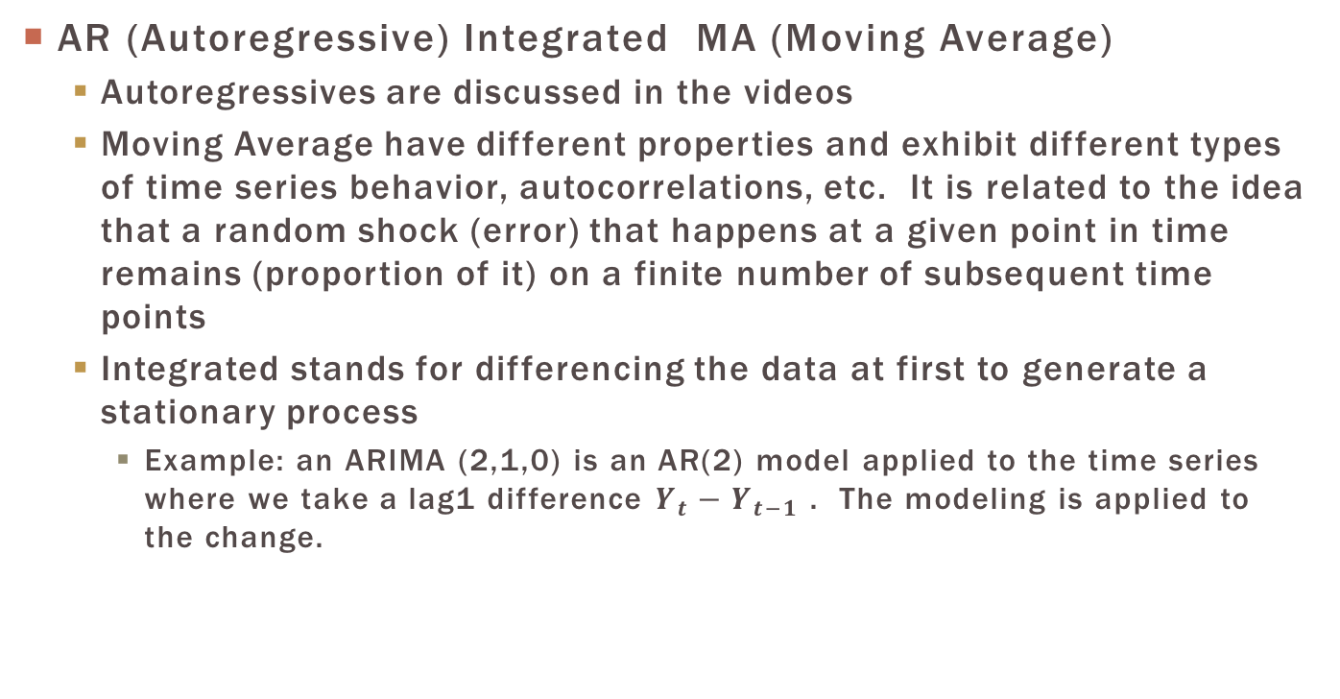
ARIMA Models

Slide 44
General Workflow of ARIMA time Series modeling
Plot the series and explanatory variables
Make a call on if it is stationarity or not
If not, try to get it there by either or all
Differencing the data
Obtain seasonally adjusted data
Model other deterministic behavior through explanatory variables via OLS
Examine the residuals from this model to see if any autocorrelation still exists
If so, use rule of thumbs or AIC selection procedure to pic an appropriate ARIMA model
After accounting for the serial correlation, re-examine residuals to make sure they are behaving uncorrelated and are normally distributed
Repeat steps above as necessary
Proceed to tests and forecasting

Slide 45
Dealing with Time TREND
Trends over time can be handled a few different ways
Analyze lag 1 differences of the dependent variable (nonstationary)
Higher order AR(p) models can exhibit “trending” behavior (stationary)
Include time or (a nonlinear function of time) as a covariate in the model (nonstationary)

Slide 46
General Approach to Time Series
Regression Model
If you have explanatory variables, fit the data using regular regression techniques and obtain the residuals (observed-predicted)
Assess if there is any serial correlation.
Autocorrelation plots, Partial ACP, Tests involving AR1 (Runs test or Durbin-Watson test)
Rules of thumb to help identify the features
If sufficient evidence exists, we refit the model with a time series model using autoregressive processes (auto reg w/ nlag option) or possibly multiple models from AR to MA and ARIMA.
Re-examine residuals to see if serial correlation is removed by looking at the new ACF and PACF plots (Don’t forget normality)
If everything looks good, we can trust the t-test and pvalues provided for specific hypothesis test
Forecasts can be generated to illustrate future predictions
The last two steps can be automated similar to feature selection in Regression

Slide 47
Rules of Thumb
Conditional Mean Model | ACF | PACF
AR(p) | Tails off gradually | Cuts off after p lags
MA(q) | Cuts off after q lags | Tails off gradually
ARMA(p,q) | Tails off gradually | Tails off gradually

Slide 48
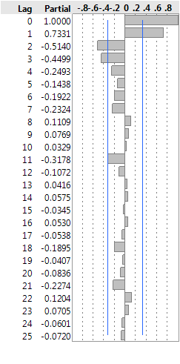
Rules of Thumb
Conditional Mean Model | ACF | PACF
AR(p) | Tails off gradually | Cuts off after p lags
MA(q) | Cuts off after q lags | Tails off gradually
ARMA(p,q) | Tails off gradually | Tails off gradually

Slide 49
SUNSPOT DATA

Slide 50
ACF and PACT PLOTS
ACF
Comments on Stationarity and what type of model to use
PACF
Comments on Stationarity and what type of model to use
Notes:
<number>

Slide 51
I fiT a FEW different ARMA Models aND LET AIC HELP me DECIDE (remember we can automate this)
Model | DF | Variance | AIC | SBC
ARMA(3, 1) | 32 | 697.2 | 354.2 | 362.2
AR(3) | 33 | 733.5 | 355.0 | 361.5
ARMA(3, 2) | 31 | 701.2 | 355.4 | 365.1
AR(4) | 32 | 724.3 | 355.5 | 363.5
ARMA(3, 3) | 30 | 633.1 | 357.0 | 368.3
AR(2) | 34 | 878.5 | 360.3 | 365.1
ARMA(2, 2) | 32 | 826.3 | 361.1 | 369.1
ARI(3, 1) | 32 | 1208.7 | 362.0 | 368.4
MA(4) | 32 | 844.4 | 362.1 | 370.1

Slide 52
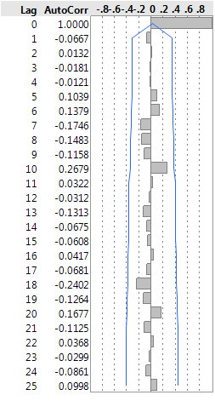
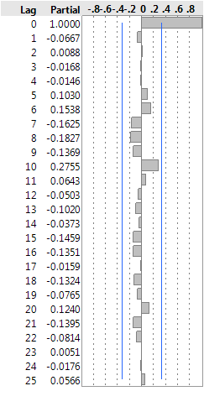
Residual Diagnostics for ARMA(3,1)
Both ACF and PACF exhibit “White Noise” behavior
Note: If we ran a different model with regression coefficients, we could confidently conduct hypothesis testing

Slide 53
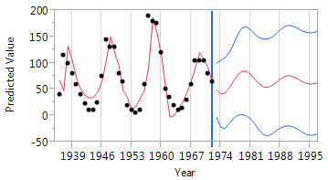
ARMA (3,1) Forecasts

Slide 54
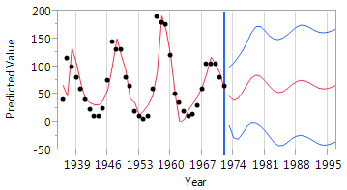
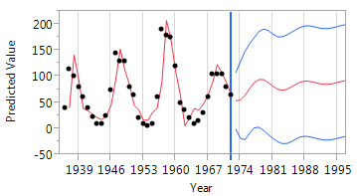
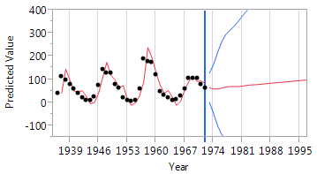
Forecasts for different models
AR4
ARIMA(3,1,1)
ARMA(3,1)
ARIMA(2,1,2)

Slide 55
Melanoma Data Dealing with a Trend

Slide 56
Plot the DATA

Slide 57
Dealing with Trend
We have to make a call (No model selection can really help with this)
Is it stationary or not?
Expert Knowledge
ACF Plots that do not ”die” out over lags is an indicator of nonstatioarity
If yes, you go into model building with AR, MA, ARMA, ARIMA, etc
If no, we have to make it stationary
Take a first difference ARIMA (analyze the change from one observation to the next)
Include time as a covariate (y=b0+b1*year)

Slide 58
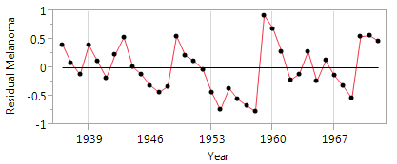
Finishing an analysis with time as a covariate
Residual plotted over time after including Year

Slide 59
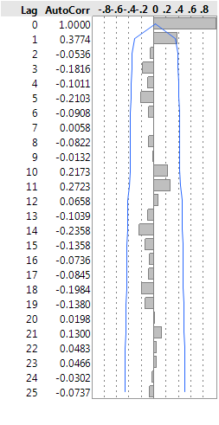
ACF Plots
ACF without time in the model. Long drawn out patterns is an indicator of not being stationary
ACF with time included (Both still suggest auto regressive)

Slide 60
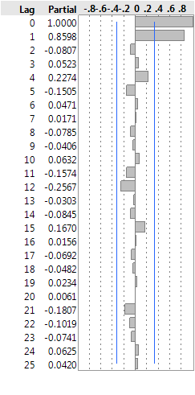
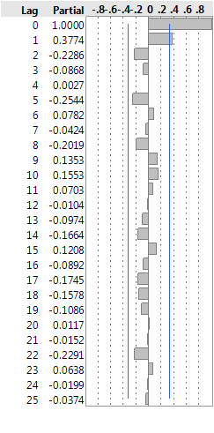
PACF Plots
Without time included in the model
With time included

Slide 61
Fit the Model with an AR(1)
Proc autoreg data=melanoma;
model melanoma=time / nlag=1;
Run;
What makes the proc different from the filter method in the videos?
It estimates the filtering parameters in a better way.
It does this in one step versus stepwise fitting things
Uses the autocorrelation(filter) parameters to better estimate the regression coefficients (generalized least squares)

Slide 62
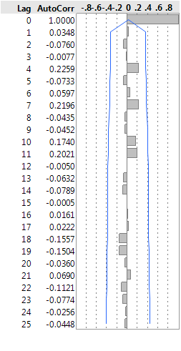
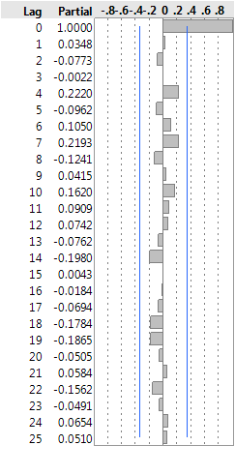
Check New Residuals

Slide 63
Hypothesis testing and other notes
Since we are comfortable that the residual are behaving like uncorrelated data. If needed, we can take a look at the statistical results since we are much more confident with the estimate and its standard error
If the pattern in ACF and PACF is not clear, we can use AIC and BIC to help us select, or use an automated procedure
PROC AUTOREG only handles AR, if you feel it is ARMA, MA, or ARIMA then there are other PROCs such as PROC ARIMA that can do it.
PROC AUTOREG also provides model selection technique such as forward, backward, etc. Doesn’t have LASSO and LARS though. Doesn’t provide to easy of a way to lag predictors etc.
If you want to formally test if autocorrelation exists you can conduct the Durbin-Watson tests using the dw and dwprob options in the model statement of PROC AUTOREG
Remember that including covariates makes the series not stationary so be mindful of what that means in terms of how that effects forecasting

Slide 64
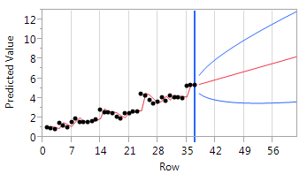
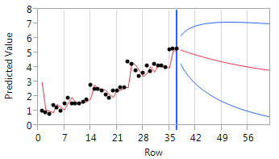
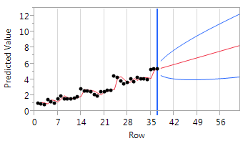
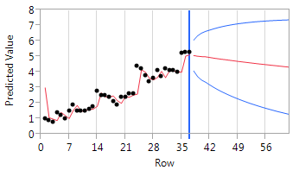
All models produce reasonable Residuals (2 on Right are suspect due to Stationarity concerns)
ARIMA(0,1,0)
AR(1)
Including Time as an Explanatory
AR(4)

