Slide 1
Pre-Live Session 4
Serial Correlation

Slide 2
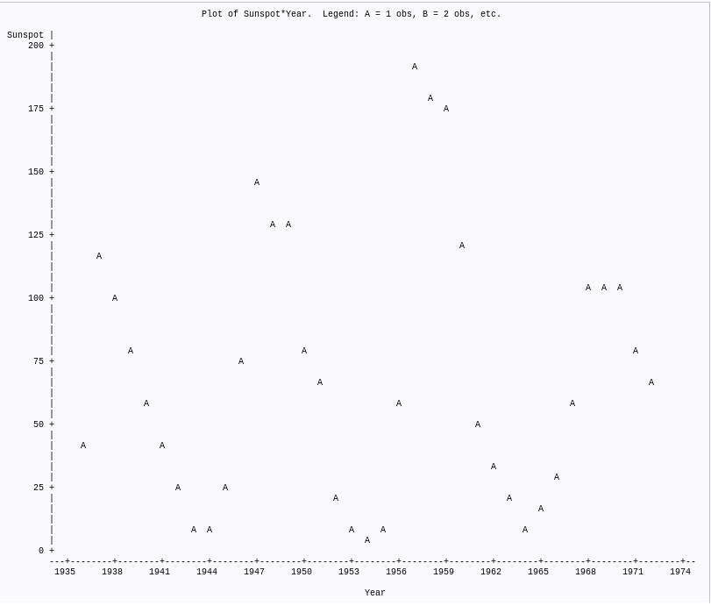
Plot Sunspot versus Years (Not stationary)

Slide 3
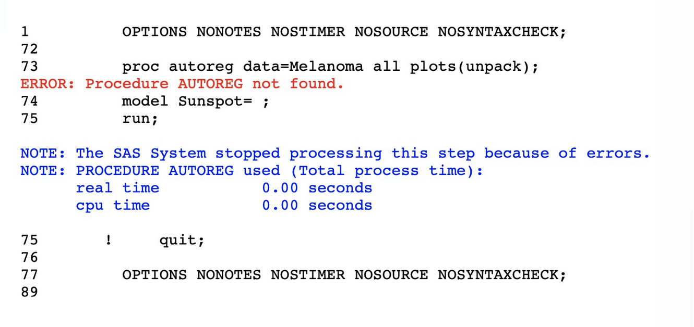
Regression Model (AutoReg not university edition)

