Slide 1
Pre-Live Session 5
Analysis Of Repeated Measures

Slide 2
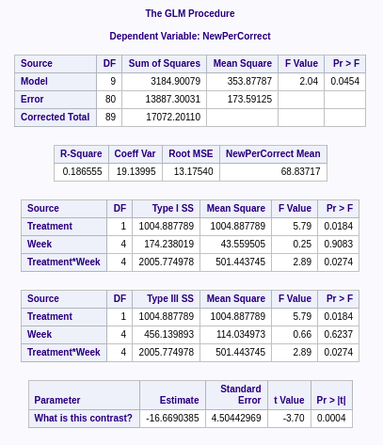
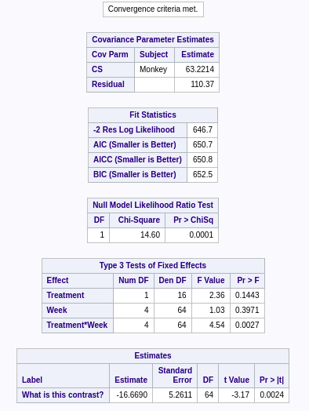
Type-3 sums of square anova table Comparison
Mixed Procedure without repeated measure
The repeated measure affected the F-values treatment. Looks like it favors interaction better. Also because the repeated measure was done on the week, it made for a better F-value for week. There is also an interaction on both model.

Slide 3
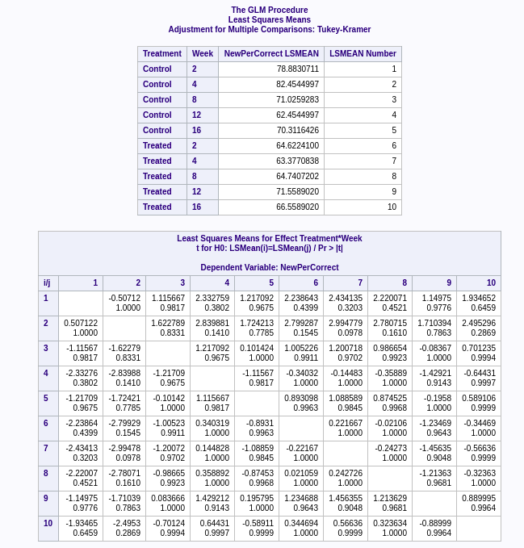
Contrast Treatment for group WK2 only
estimate 'week 2 control vs treated' Treatment -1 1 Treatment*Week -1 0 0 0 0 -1 0 0 0 0;
Contrast WK2 vs WK12 for Treated only
estimate 'Week 12 vs. Week 2' Week -1 0 0 1 0 Treatment*Week 0 0 0 0 0 -1 0 0 1 0;

Slide 4
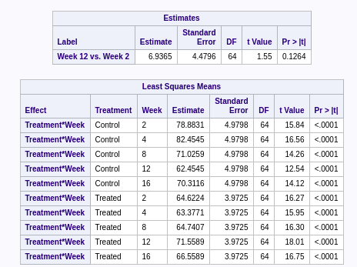

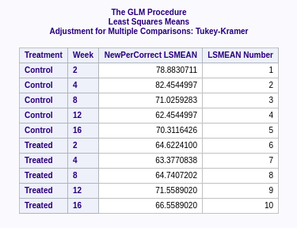
GLM without repeated measure
Mixed procedure with repeated measure
The two model are close but different. The GLM has a lower F-value while the Mixed procedure has a higher F-value.
estimate 'What is this contrast?' Treatment -1 1 Treatment*Week -.5 -.5 0 0 0 .5 .5 0 0 0;
The above contrast is for Week 2 vs Week 4 for both Tested and Control Treament.

