Slide 1
Live Session 8
Manova and LDA
Experimental Statistics II

Slide 2
LETS TAKE A STEP BACK
&
THINK BIG PICTURE

Slide 3
Multivariate Analysis
Basic Topics
Everything we’ve done so far
  Single, continuous response variable
  Multiple Regression/Two Way ANOVA
  Time Series / Repeated Measures
Multivariate Analysis can be extended to handle all of those but for multiple, continuous response variables
  Take into account that response variables are correlated with each other
  Example: Suppose I have a study population and want to compare (Men vs Women) on not just height, but also on weight, age, bmi, heart rate, time on 1mile run
  Clearly these guys can some what depend on one another, bmi is probably negatively associated with 1mile run times. Height and weight are somewhat positively correlated
Data Reduction Technique
  Our brains can’t comprehend high number of dimensions so maybe we can reduce a large set of response variables to a more controllable number to wrap our heads around
  Common theme when reading about multivariate techniques
    Issues with interpretation
  New variables can be used as predictors

Slide 4
Multivariate Analysis can be extended to handle all of those but for multiple, continuous response variables
What does multivariate get you?
Its all about type-I error control and power
  Type-I error: Probability(reject the Null when the Null is true) aka False Positive
  Power: Probability(reject the Null when the Null is FALSE) aka reject when you should reject

Slide 5
Type–I Error and Power
  Analyzing multiple response variables one at a time is another way of multiple testing, just like in our one variable analysis when we do different types of comparisons.
  Correlated data tend to yield similar results so when you commit a type-I error for variable 1 you are now setting yourself up for another type=I error on the correlated variable 2.
  Also correlated variables are more consistent and its easier to identify scenarios that are not null and thus reject more often (increasing power)

Slide 6
Simple example
Suppose I had height (X1) and weight (X2) and I wanted to test if the mean height and weight was (68inches,150lbs)
Two options
One at a time testing
  One sample t-test for height (X1)
  One sample t-test for weight (X2)
Multivariate Analysis
  Conduct a joint hypothesis that takes into account they are correlated

Slide 7
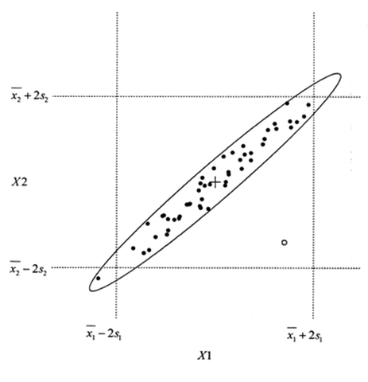
Graphical Difference
One at a time vs Jointly
One at a time tests/confidence intervals in a 2 dimensional graph can be viewed as a box

Slide 8
Graphical Difference
One at a time vs Jointly
Multivariate tests/confidence intervals can be thought of as an ellipse

Slide 9
Example scenario for greater power
Suppose are null hypothesis for the mean of height and weight is given by the yellow dot
One at a time confidence intervals say for both variables we will not reject the null hypothesis
Joint confidence ellipse (taking into account correlation) says the hypothesized value is outside of the confidence ellipse indicating that we should reject the null.

Slide 10
Example scenario for controlling type I error
Suppose are null hypothesis for the mean of height and weight is given by the yellow dot
One at a time confidence intervals say for both variables we will reject the null
Joint confidence ellipse (taking into account correlation) says the hypothesized value is inside of the confidence ellipse indicating that we should fail to reject

Slide 11
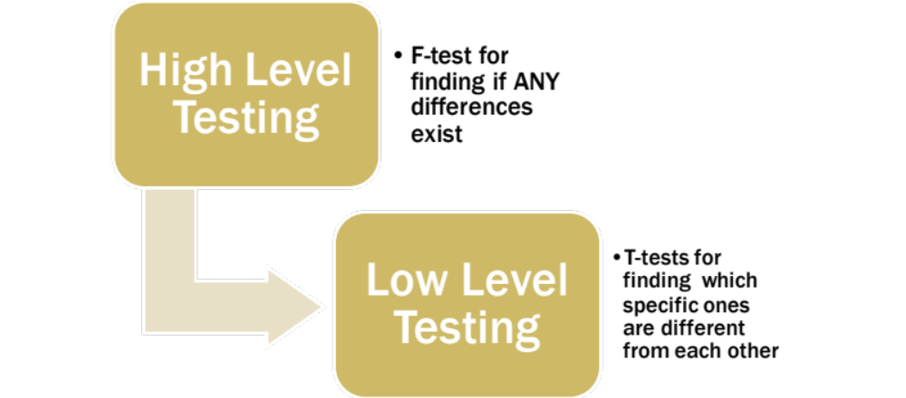
The MANOVA analysis idea In terms of testing
We are just going to add a layer for MANOVA at the top

Slide 12
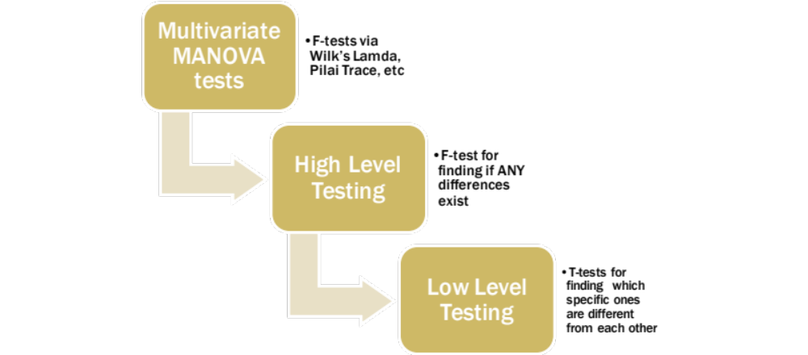
The MANOVA analysis idea In terms of testing
We are just going to add an extra layer at the top for MANOVA
F test to test if ANY differences exist across any of the multiple responses

Slide 13
MANOVA DERIVED F tests
Here is where all the different options come in
Wilks Lambda
Pillai’s Trace
Hotelling Lawley Trace
Roys Greatest Root
All different approaches of reducing a ratio of two covariance matrices down to a single value.
Note: The F-tests that SAS conducts are exact for large sample sizes. When sample sizes are small, SAS can do more exact versions but their accuracy depends on the situation.

Slide 14
MANOVA Analysis Plan
Assess validity of MANOVA assumptions
  Univariate Residual diagnostics
  Test for equal covariance matrices
With valid assumptions conduct overall MANOVA F-tests
  Null: Each response variable has the same mean for each factor level. (Response variables do not have to share the same mean that would make the method useless)
If resulting test is fail to reject, STOP, we are done.
If null is rejected, we can move forward and conduct individual ANOVA analysis one at a time. Adjust for multiple tests if exploring.

Slide 15
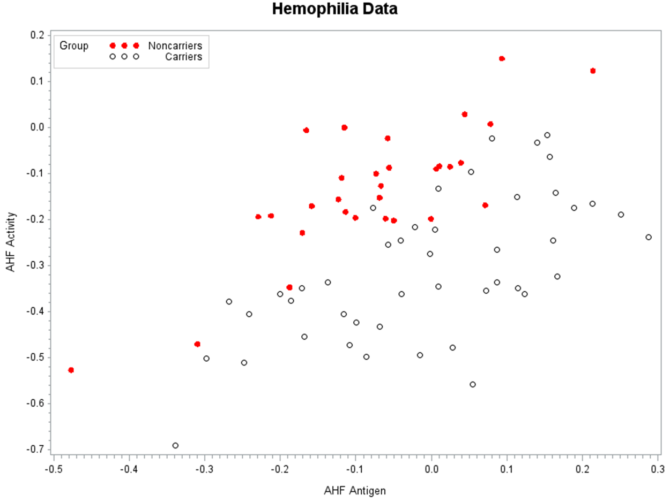
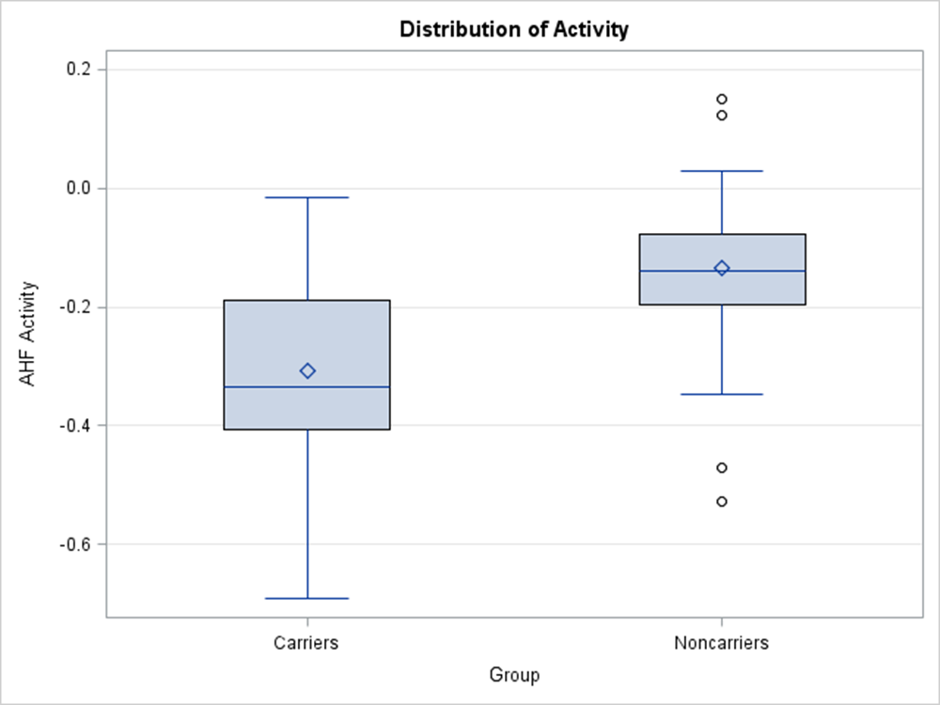
Hemophilia Data Set

Slide 16
Assumption Checking
The assumptions for MANOVA are that the residuals are multivariate normal (MVNORM) with a constant covariance matrix.
If the residuals are MVNORM, then each of the residuals by themselves should be normal (property of MVNORM)
For the constant covariance assumption we have two options
  Examine scatterplots of the response or residuals color coding for the factors. Patterns should be elliptical in nature with straight line relationships
  Test for equal covariance matrices using the test in PROC discrim

Slide 17
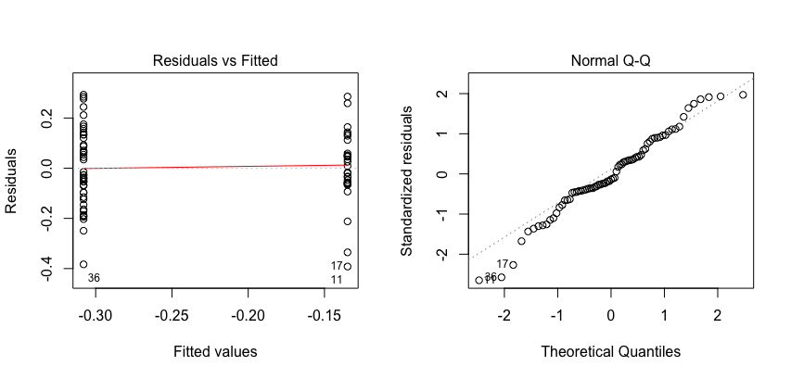
Check Univariate Residuals for Each variable: Activity

Slide 18
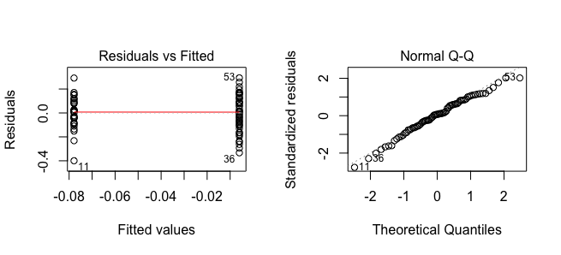
Check Univariate Residuals for Each variable: Antigen

Slide 19
SAS CODE to get Residuals
Run the MANOVA model along with univariate versions, output residuals to check assumptions
Proc GLM Data=Hemophil plot=diagnostics;
Class Group;
Model Activity Antigen = Group;
Output Out=Errs R=Eact Eant;
Run;
Quit;

Slide 20
Visual Check of Constant Covariance MAtrices

Slide 21
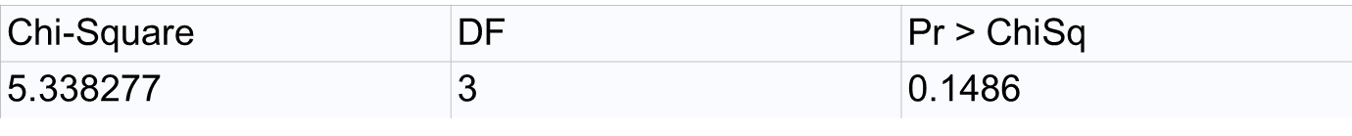
For Large Number of responses
Use the Homogeneity Test
proc discrim data=Hemophil pool=test;
class group;
var Activity Antigen;
run;
Test for homogeneity of covariance matrices

Slide 22
Assumptions Good…
Run the MANOVA F-TEST
Run the MANOVA model along with univariate versions, output residuals to check assumptions
Proc GLM Data=Hemophil plot=diagnostics;
Class Group;
Model Activity Antigen = Group;
Output Out=Errs R=Eact Eant;
Means Group / CLM T Alpha=0.025;
Means Group / CLDIFF T Alpha=0.025;
Contrast 'Carrier vs Noncarrier' group 1-1;
Manova H=_All_ / PrintE PrintH Canonical;
ODS Output Cancoef=CanonicalCoefficients;
Run;
Quit;
Options: Doesn’t matter yet. We have to feel comfortable about the assumptions.
Penalize yourself for multiple tests.

Slide 23
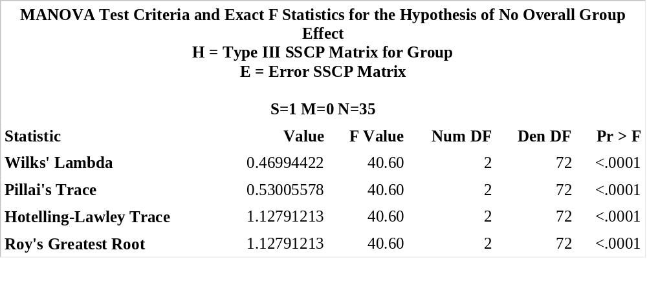
If everything checks out
Conduct MANOVA F-tests
What are we testing for ? Null: The means for each response variable (activity and antigen) do not differ from the factor levels of interest (carrier ,noncarrier)
Note: This does not say that the mean values for activity must be the same for antigen.

Slide 24
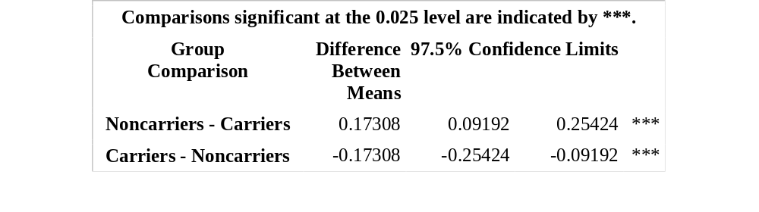
Explore Univariate analysis if Overall Test is Rejected:
Activity

Slide 25
Comments on Multiple Tests
Penalize yourself for multiple tests
  There is no set way to do this. There are a lot of different approaches to doing this. Do what you think is reasonable.
    The easiest way to do this in practice is to use Bonferrorni corrections as they are easiest to calculate by hand. (.05/total number of tests to correct for)
    Some people may add up all the tests and do one big correction, while others may do multiple testing corrections at different stages or by variable

Slide 26
Added difficulties
MANOVA can not be applied in all settings
  There can be a large number of parameters to estimate.
  Small sample sizes can yield errors due to ill conditioned covariance estimates
  Example: 4 Response Variables with 1 Factor with 3 levels
    4*13=12 parameters to estimate the means
    4+3+2+1=10 parameters to estimate the residual variances and covariances

Slide 27
LDA
SAME Setup as MANOVA but with a different question
Two Goals
  Prediction/Classification
  Given a new observation (Activity and Antigen variable) can I predict if that individual is a Carrier or Noncarrier
  Response variable is now the Factor levels
  Understanding ( This was not a focus in the videos)
  Is there a more simpler way to understand what variables contribute to the differences between Carrier or Noncarrier
  Candis as well as lda can get you information to help answer this question

Slide 28
LDA (Data Reduction pov)
Given multiple variables can we come up with a new variable that if we examine it, we can quickly tell which group it belongs to
The idea is to come up with a new variable (discriminant score z1) such that it can do just that
Given multiple variables X1, X2, X3, X4
Create new discriminant score
  Z1=.2*X1 - .1*X2 + 1.2*X3 - .3*X4
  Note there can be more than one discriminant score.
  Total=Min(levels-1,#ofVariables) Ex(2levels, 2 variables) total=1

Slide 29
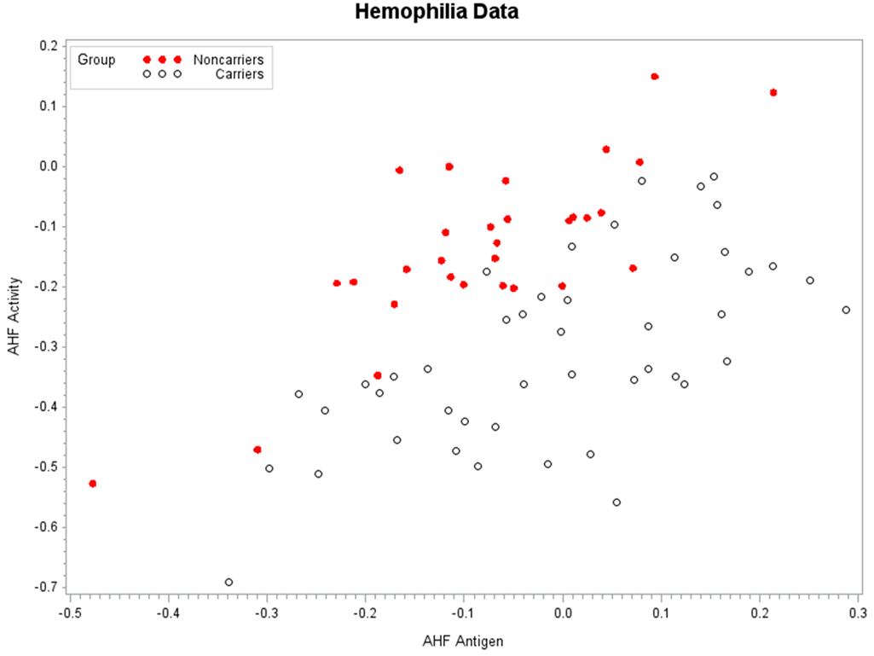
LDA Graphical presentation

Slide 30
LDA Graphical presentation

Slide 31
LDA (Graphical presentation)
Z1

Slide 32
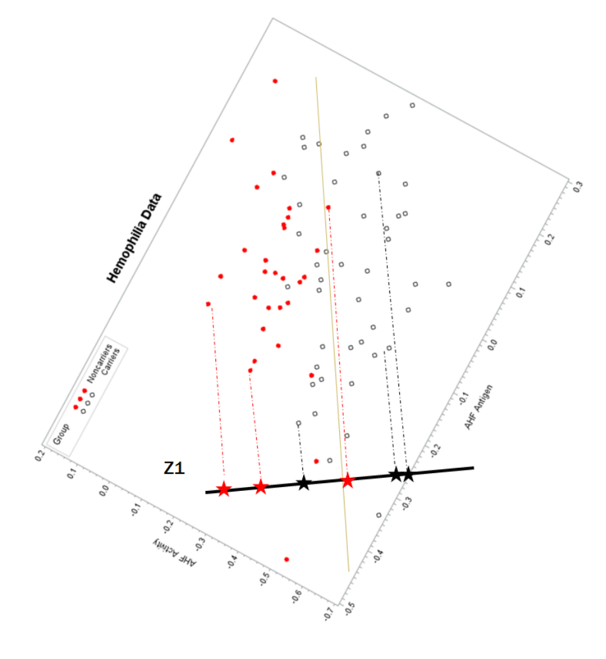

Slide 33
With one discriminant variable and two groups
How do we make a decision which group a new observation is
With our new Z1, we calculate the average for carriers and the average for noncarriers
The midpoint between the two averages serves as the cutoff, in our example if the z1 value on our new observation is below that cutoff we will designate them noncarriers, if above, then carriers

Slide 34
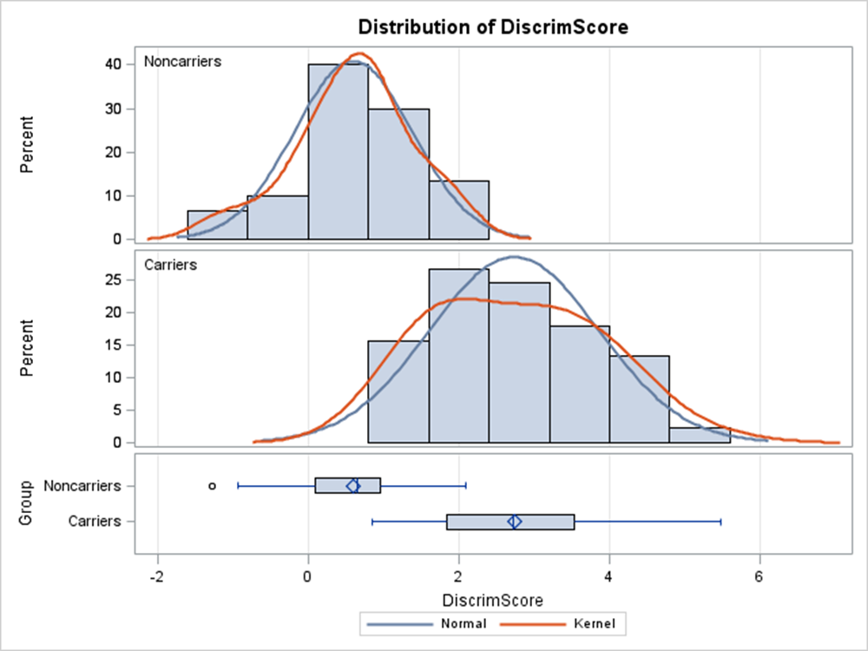
Boxplots of Z1 for carriers and noncarriers

Slide 35
Boxplots of Z1 for carriers and noncarriers

Slide 36
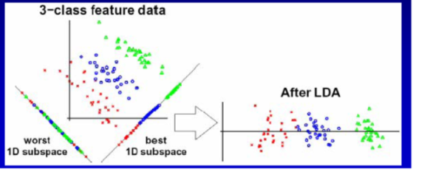
When Z1 is all you need
Suppose we have two response variables but instead of just two categories we wanted to be able to predict if an observation is one of 3 categories

Slide 37
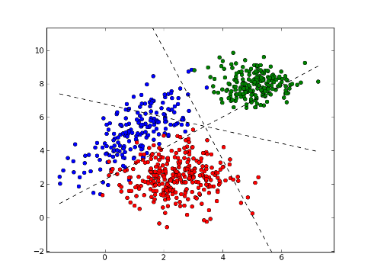
Sometimes you need more than Just one discriminant variable

Slide 38
Use of the discriminant functions
For 2 group problems, the discriminant function is all we need.
  It can be used to create a classification rule to predict new observations
  If we are dealing with a large number of variables, we reduce the variables to a single variable. The weights on the linear combination can be used to help provide some understanding as to what the key players (variables) are in classifying
For more than two groups
  Can still use the discriminant functions and their weights to understand what variables are key in discriminating
  For classifying, we can use our assumptions of normality and equal covariance matrix to partition the variable space into regions.
  SAS provides a “discriminating/classfiying” function for each of the groups that can be used to classify an observation. It also can be used to assign a probability that a new observation is in each group. (Videos)

Slide 39
Partitioning the Variable space

Slide 40
General Idea
The discriminant scores are determined by the eigen values and eigenvectors of the Covariance matrices from the MANOVA model (between and within, H and E, model and residual)
The scores themselves attempt to maximize the separation between groups, while minimizing within groups
For 2 group classification. We can use the discriminant score to come up with a decision rule to classify a new observation.
For real world applications using SAS, regardless of how many groups there are we will let SAS determine the appropriate decisison rules and posterior probabilities for new observations that we want to classify

Slide 41
If I choose my prior probabilities such that its much more likely that blue and red occur. The cutoff regions change to reflect that
P(Red)=P(Blue)=.4 P(Green)=.2

Slide 42
RUNNING LDA in Practice
(Classifying)
Assumptions are the same as MANOVA
  We need to do our due diligence in assessing normality and equal covariance matrices as well as outliers just like MANOVA
  Proc Discrim actually provides a statistical test for equal covariance matrices!!!
  Assumptions are important here. If equal covariance is not valid, we need to go to Quadratic DA.
  If many variables are non normal (skewed) we have other alternatives like logistic regression.

Slide 43
Running LDA in PRACTICE
When assessing how well you classify on your training data set, use CROSSVALIDATE (leave one out) to not BIAS your error rates too much
With sample sizes big enough, of course run training and test sets is better.
If you have prior knowledge and understanding of the study, use the knowledge with the prior probability statement.

Slide 44
Frequency table to See what we can possibly use as priors for test set
The FREQ Procedure
Group
Group | Frequency | Percent | Cumulative Frequency | Cumulative Percent
Noncarriers | 30 | 40.00 | 30 | 40.00
Carriers | 45 | 60.00 | 75 | 100.00

Slide 45
Running LDA on our example
proc discrim data=Hemophil pool=test crossvalidate canonical ncan=2 testdata=test testout=a list testlist;
class group;
var Activity Antigen;
priors "Carriers"=.6 "Noncarriers"=.4;
run;
Pool=True linear da Pool=F = Quadratic da
Pool=test test for equal covariance matrices across the groups, good to have for MANOVA.
Priors=prior knowledge probablities reflecting the frequencey of the categories
Testdata =new data we want to predict categories for
Testout = export test results to a new sas dataset
List and testlist provide probabilities for each category

Slide 46
Swimming in SAS Output
(Main Components)
The DISCRIM Procedure
Class Level Information
Group | Variable Name | Frequency | Weight | Proportion | Prior Probability
Carriers | Carriers | 45 | 45.0000 | 0.600000 | 0.600000
Noncarriers | Noncarriers | 30 | 30.0000 | 0.400000 | 0.400000
Number of Observations Read | 75
Number of Observations Used | 75
Total Sample Size | 75 | DF Total | 74
Variables | 2 | DF Within Classes | 73
Classes | 2 | DF Between Classes | 1

Slide 47
Swimming in SAS
(Main Components)
Discriminant/Classification function for Group
This is easily confused with the z variable earlier. Its not the same. Here we have a z-type variable for each group. So for a new observation we want to predict, we can use this as a decision rule
For a new activity and antigen value (0.2,.3)
Calculate Carriers value -4.48-26*0.2+18*.3 = -4.28
Calculate Noncarriers value -1.2-6.8*.2+1.27*.3 = -2.179
Which ever one is higher, we classify the new observation to that category
Linear Discriminant Function for Group
Variable | Label | Carriers | Noncarriers
Constant |  | -4.48101 | -1.32701
Activity | AHF Activity | -26.14277 | -6.82377
Antigen | AHF Antigen | 18.39440 | 1.27017

Slide 48
Classification summary
How well we did (CROSS VALIDATION/ Not reSubstitution)
Number of Observations and Percent Classified
into Group
From Group | Carriers | Noncarriers | Total
Carriers | 38 | 7 | 45
 | 84.44 | 15.56 | 100
Noncarriers | 4 | 26 | 30
 | 13.33 | 86.67 | 100
Total | 42 | 33 | 75
 | 56 | 44 | 100
Priors | 0.6 | 0.4
Error Count Estimates for Group
 | Carriers | Noncarriers | Total
Rate | 0.1556 | 0.1333 | 0.1467
Priors | 0.6000 | 0.4000
Roughly 85% accuracy

Slide 49
Classification summary
How well we did (CROSS VALIDATION/ Not reSubstitution)
Number of Observations and Percent Classified
into Group
From Group | Carriers | Noncarriers | Total
Carriers | 38 | 7 | 45
 | 84.44 | 15.56 | 100
Noncarriers | 4 | 26 | 30
 | 13.33 | 86.67 | 100
Total | 42 | 33 | 75
 | 56 | 44 | 100
Priors | 0.6 | 0.4
% Correct just by chance
.6(45) +.4(30) = 39
39/75=52%
Error Count Estimates for Group
 | Carriers | Noncarriers | Total
Rate | 0.1556 | 0.1333 | 0.1467
Priors | 0.6000 | 0.4000
Roughly 85% accuracy

Slide 50
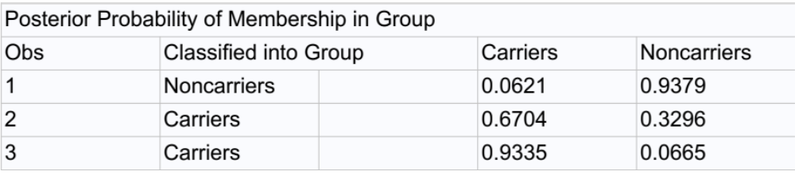
Predicting new observations that were in TEST based off posterior Probabilities
I added an additional point in the SAS code so this needs updating.

Slide 51
Next Week: Items To Focus On
Topics: Principal Components Analysis (PCA) and Canonical Correlations Analysis (CCA)
Lecture Overview: A lot of material is given in the readings and videos. For class we will focus on the basics and practical approaches to PCA.
Suggest reading and viewing material in this order:
Text
  17.1 to 17.4
  ***17.5.3 & 17.5.4 These sections (Multidimensional Scaling and Correspondence Analysis) are needed for the quiz. You will be presented study scenarios and will need to pick the appropriate analysis among PCA, CCA, Multidimensional Scaling and Correspondence Analysis.
  17.6 Summary
Reading
  “Statistical Learning: Principle Components and Partial Least Squares Regression” pgs 1-14
Videos
  A lot of material is presented and well outlined. Watch the videos in order, but focus on the purpose and uses of PCA, SAS code, and interpreting results. Don’t let the mathematics and theory bog you down.

