Slide 1
Live Session 9
PCA

Slide 2
Agenda
Assignment Discussion
Principal Component Analysis (PCA)
  Overview
  Terminology
  Underlying Mathematics
  Practical Workflow: Homework Example
  Practical Considerations

Slide 3
PCA: Overview
PCA is typically used as an exploratory analysis and data reduction technique aka an unsupervised technique
Purpose: From a group of variables, PCA creates new uncorrelated variables. Information of these new variables can be used:
  to understand the relationship among the original variables;
  for other analyses such as multiple linear regression and classification
Data Type: Continuous variables are needed to perform LDA
Sampling: Independent random sample (This is loosely enforced in practice)

Slide 4
PCA: Attributes of Principal Components
PCs are linear combinations of original variables
Number of new PC variables = the number of original
PCs created in order from explaining the most to least amount of variability
PCs are uncorrelated with each other
Sum of variances from original variables = sum of the variances of the PCs

Slide 5
PCA: Terminology
Principal Components: Refers to new variables: PC1, PC2, … or Principal Component 1, Principal Component 2…
Eigenvalues: Variances of Principal Components.
Eigenvectors: Coefficients applied to original variables to create Principal Components.
Covariance Matrix: Contains variance of each variable and covariance between all variables.
Correlation Matrix: “Standardized” Covariance matrix so that values range between -1 and 1.

Slide 6
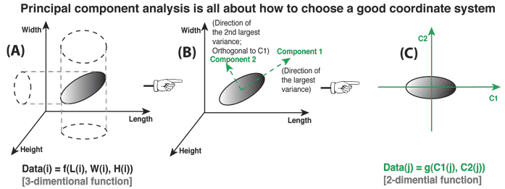
PCA: Mathematics
http://mengnote.blogspot.com/2013/05/an-intuitive-explanation-of-pca.html
Av = Lv A=Correlation/Covariance Matrix,
v=eigenvector, L=Eigenvalue
v is an eigenvector of A if Av is a scalar multiple (L) of v.

Slide 7
PCA: Practical Workflow
Identify reasons for conducting PCA
  Exploring the relationship among the original variables
  Simplifying a regression or prediction problem
    Reducing number of predictors to work with up front
    Multicollinearity issues are resolved
  Identify associations that exist within the original variables
  When building a classification model, it can be used to determine if your predictors will actually be effective in predicting the categories up front

Slide 8
PCA: Practical Workflow
Summary statistics of original variables
Correlation analysis of original variables
Decide criteria for number of PCs to be chosen
Decide to run PCA on correlation or covariance matrix (SOP is to use the correlation matrix)
Run analysis
Interpret results

Slide 9
PCA: Pre Live
Two sets of data from Chicago area zip codes in 1970s
  General Zip Code Features
    Fire = fires / 1,000 households
    Theft = thefts / 1,000 population
    Age = percentage of housing unites built prior to 1940
    Income = median family income
    Race = percentage minority
    Zip = zip code
  Insurance Companies New Policies
    Vol = number of voluntary policies issued by insurance companies / 100 households
    Invol = number of involuntary policies issued by insurance companies / 100 households

Slide 10
PCA: Pre Live
Identify reason for conducting PCA.
  Wish to know the association among fire, theft, age, income, and race of 47 Chicago area zip codes.
  Will also demonstrate PCA regression and exploratory analysis with zip code.
Summary statistics of original variables.
  Data entry errors, outliers, missing data, distribution, and variability.
Variable | N | Mean | Median | Std Dev | Variance | Minimum | Maximum
Fire Theft Age Income Race | 47 47 47 47 47 | 12.28 30.23 60.33 10695.83 34.99 | 10.40 29.00 65.00 10694.00 24.50 | 9.30 14.53 22.57 2754.20 32.59 | 86.53 211.23 509.63 7585606.67 1061.95 | 2.00 3.00 2.00 5583.00 1.00 | 39.70 75.00 90.10 21480.00 99.70

Slide 11
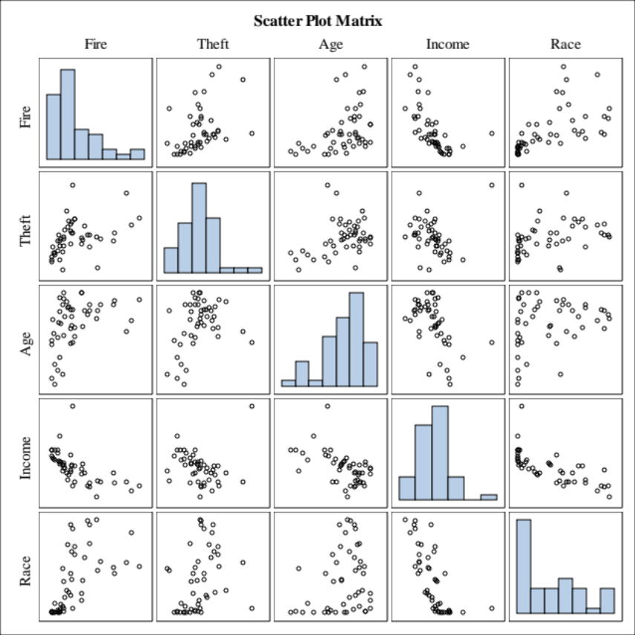
PCA: Pre Live
Correlation analysis of original variables.
Pearson Correlation Coefficients, N = 47 Prob > |r| under H0: Rho=0
 | Fire | Theft | Age | Income | Race
Fire | 1.00000 | 0.41216 0.0040 | 0.41222 0.0040 | -0.61045 <.0001 | 0.59280 <.0001
Theft | 0.41216 0.0040 | 1.00000 | 0.33694 0.0206 | -0.08943 0.5500 | 0.32137 0.0276
Age | 0.41222 0.0040 | 0.33694 0.0206 | 1.00000 | -0.52867 0.0001 | 0.25051 0.0894
Income | -0.61045 <.0001 | -0.08943 0.5500 | -0.52867 0.0001 | 1.00000 | -0.70373 <.0001
Race | 0.59280 <.0001 | 0.32137 0.0276 | 0.25051 0.0894 | -0.70373 <.0001 | 1.00000

Slide 12
PCA: Pre Live
Decide how number of PCs will be chosen.
  Scree plots and proportion of the amount of variablility explained
  If number of variables are small you can technically keep them all
Decide to run PCA on correlation or covariance matrix.
  Will run on correlation matrix because variables do not have same units and would be heavily influenced by variables with large variance.
Variable | N | Mean | Median | Std Dev | Variance | Minimum | Maximum
Fire Theft Age Income Race | 47 47 47 47 47 | 12.28 30.23 60.33 10695.83 34.99 | 10.40 29.00 65.00 10694.00 24.50 | 9.30 14.53 22.57 2754.20 32.59 | 86.53 211.23 509.63 7,585,606.67 1061.95 | 2.00 3.00 2.00 5583.00 1.00 | 39.70 75.00 90.10 21480.00 99.70

Slide 13
PCA: Pre Live
Run analysis
  SAS Code:
ods graphics on;
proc princomp plots=all data=q out=pca;
  var Fire Theft Age Income Race ;
  id Zip ;
  run;
  ods graphics off;

Slide 14
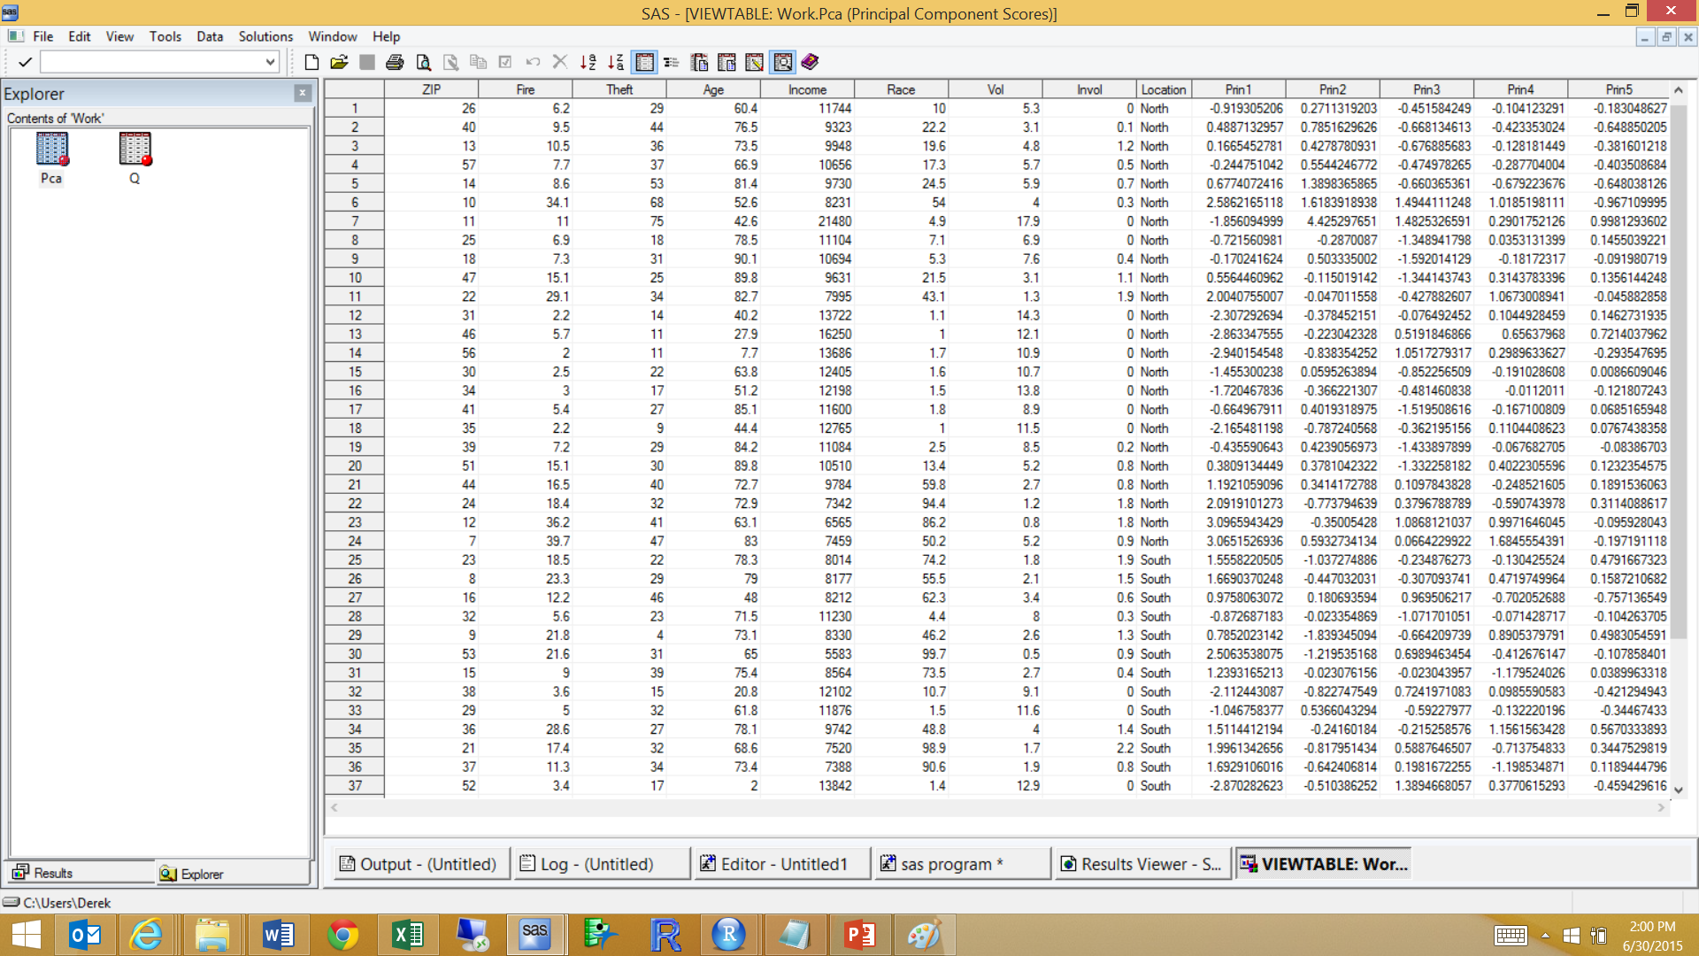
PCA: Pre Live
Run analysis

Slide 15
PCA: Pre Live
Determine number of principle components
  Variance and proportion of variation for each PC
  Conclusion: The first principal component accounts for 55% of the zip code features’ variability and the first three principal components account for almost 90%.
Eigenvalues of the Correlation Matrix
 | Eigenvalue | Difference | Proportion | Cumulative
1 | 2.75861596 | 1.80893352 | 0.5517 | 0.5517
2 | 0.94968244 | 0.19597232 | 0.1899 | 0.7417
3 | 0.75371012 | 0.36713571 | 0.1507 | 0.8924
4 | 0.38657441 | 0.23515734 | 0.0773 | 0.9697
5 | 0.15141707 |  | 0.0303 | 1.0000

Slide 16
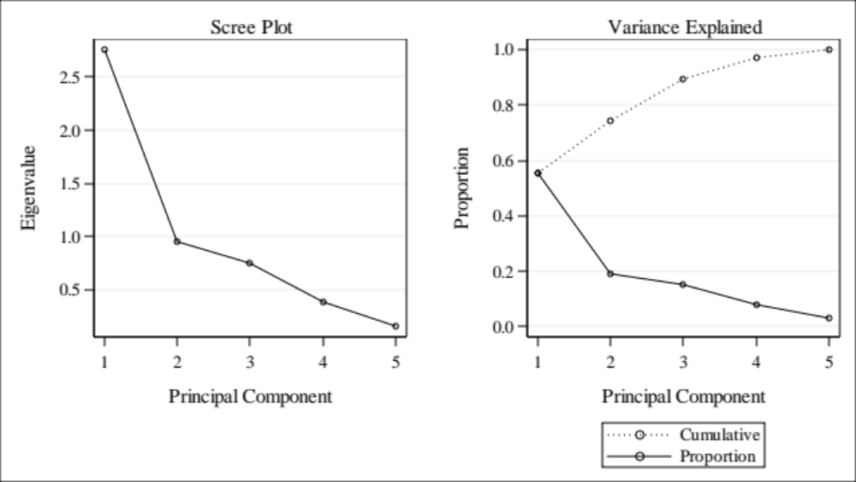
PCA: Pre Live
Determine Number of predictors
  Variance and proportion of variation for each PC
  Scree Plots also help determine number of PCs to use.

Slide 17
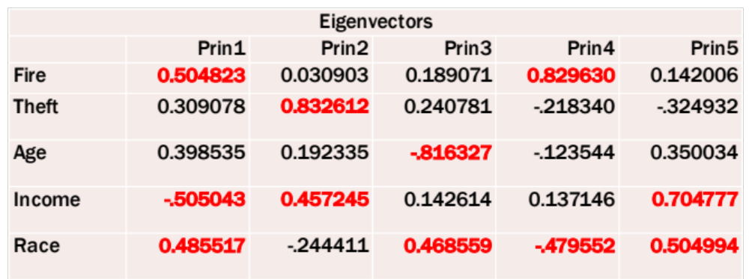
PCA: Pre Live
Interpret Results
  Coefficients (eigenvectors) of original variables.
    The larger the absolute value the more a variable impacts a PC
    PC1: Fire and Race contrasted with Income
    PC2: Theft and Income

Slide 18
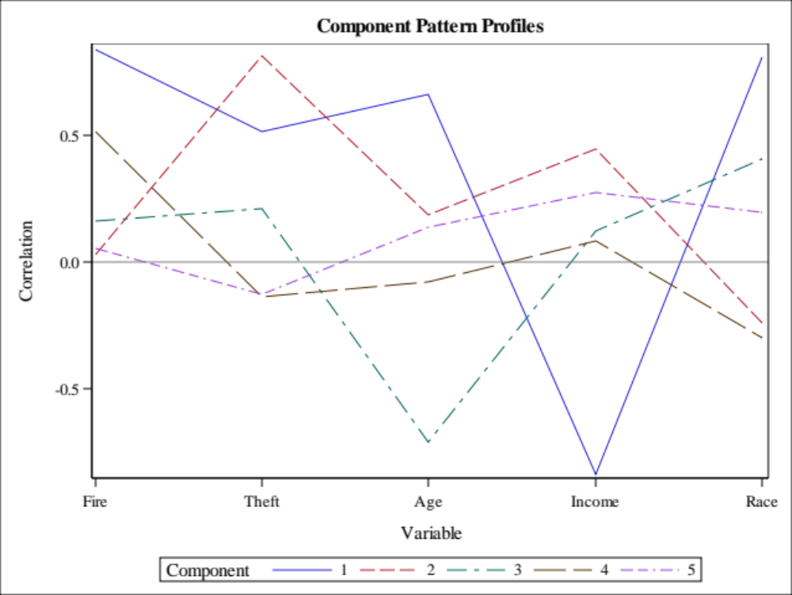
PCA: Pre Live
Interpret Results
  PCs’ association with original variables

Slide 19
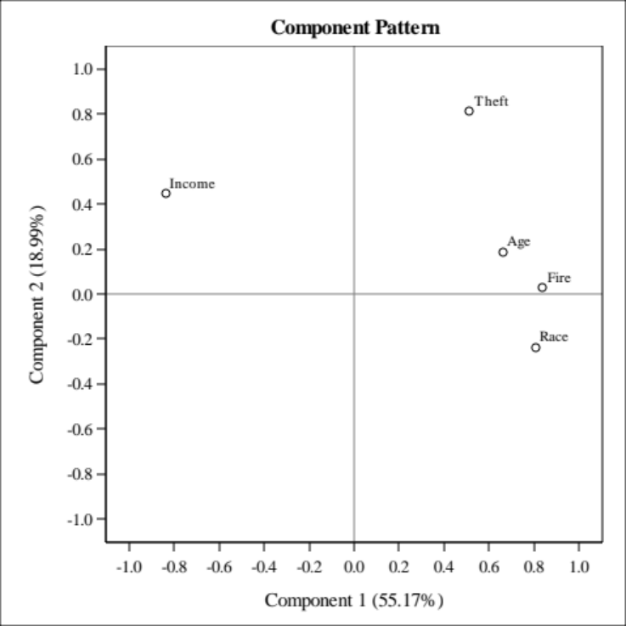
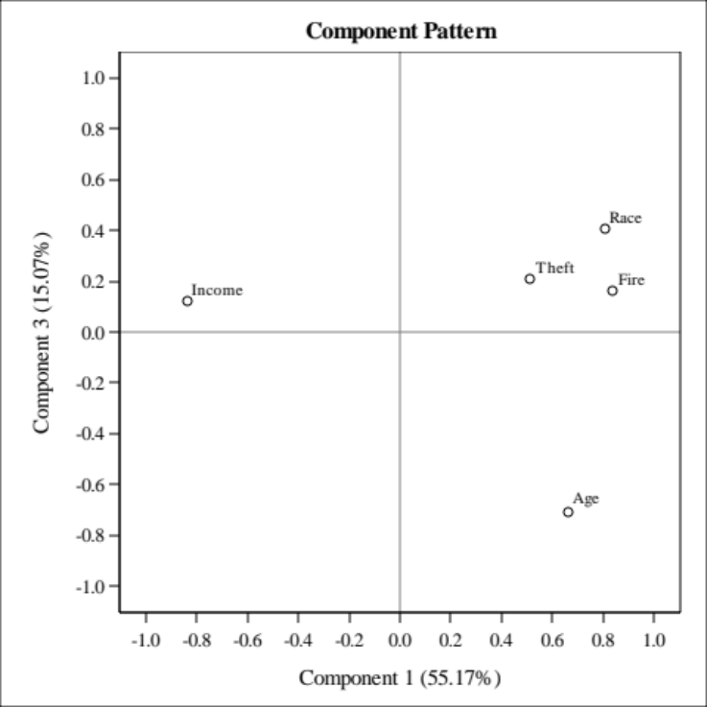
PCA: Pre Live
Interpret Results
  PCs’ association with original variables

Slide 20
Recap of PCA Uses
PCA and other approaches like it have some history with image compression. We can transform variables back to the original variable space without using all of the PCA’s. (Data reduction)
  Interpretation or other statistical modeling is not of importance
PCA applied on a set of predictor to be used for future model building goals
  PROS: No multicolinearity, can reduce the number of variables to work with to a more managebale set (not feature selection though), gain insight to underlying structures in the data that are not measureable directly (factor analysis), can serve as a sanity check before building classification models
  CONS: Analyst now is providing interpretation on PC’s that can be hard to explain. No guarantee that the PC’s will correlate better than the original predictors. Like all multivariate techniques, sample size needs to scale well with respect to the number of variables PCA is applied to

Slide 21
Use of PCA in Predictive Modeling
(A Good Sanity Check)
Setting…suppose we are in a classification setting (predicting a categorical response) and there is a decent set of continuous predictors to work with.
Conduct PCA on the continuous set.
Plot the first few PC’s (or a number based on the scree plot) but color code the points by the response variable you hope to classify
If the colors separate out, then the predictive model you build later (LDA, logistic, random forest) typically will perform well and vice versa
The PC’s could very well be used as predictors too. Again, the same pros and cons discussed previously still apply.

Slide 22
PCA with LDA Specifically
I mentioned that LDA is the first technique that we have discussed that can treat a categorical variable as the response variable
  Sometimes LDA can’t run well (or at all) if the sample size is small relative to the number of variables (The so called “small n , large p” situation)
One solution is that we can run PCA first to reduce the number of variable down so that our “n” is much bigger than our “p”
Again just like PCA regression, we can decide to use the first “x” number of principle components and use them to classify/predict a categorical response
  This solution can work really well in some cases and not so well in others, if the sample size is not an issue, then running LDA on the original variables is preferred as the, as the PC’s are being transformed with no classification rules in mind.

Slide 23
Let’s go to R !

Slide 24
PCA: Practical Considerations
Centering (covariance matrix) and Standardized (correlation matrix) variables: Done automatically in proc princomp but other software may require you to do so.
Missing data: Observations not included in analysis.
Outliers: Can influences results.
Data reduction: Still need all original variables.
PCA Regression: PCs with low variability can still be associated with outcome of interest. PCs can have non-linear associations with outcome and interactions with each other.
Categorical variables: Can try creating binary variable (0 and 1s).
Sample Size: Rule of thumb is to have 10 observations / variable. So 10variables = 100 observations for those 10 variables
Normal distribution: Transforming original data to more closely adhere to the normal distribution may improve results.
PCA most useful when you have correlated data and large number of variables.

Slide 25

Additional Slides on Pre LIVE WORK

Slide 26
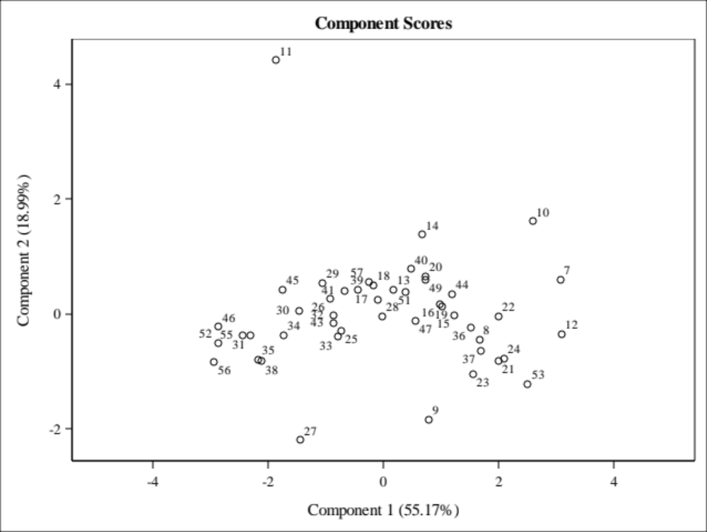
PCA: PRE LIVE
Interpret Results
  Scatter plots of PCs. Can look for outliers, clusters, or associations with other variables. Figure labeled with zip code.

Slide 27
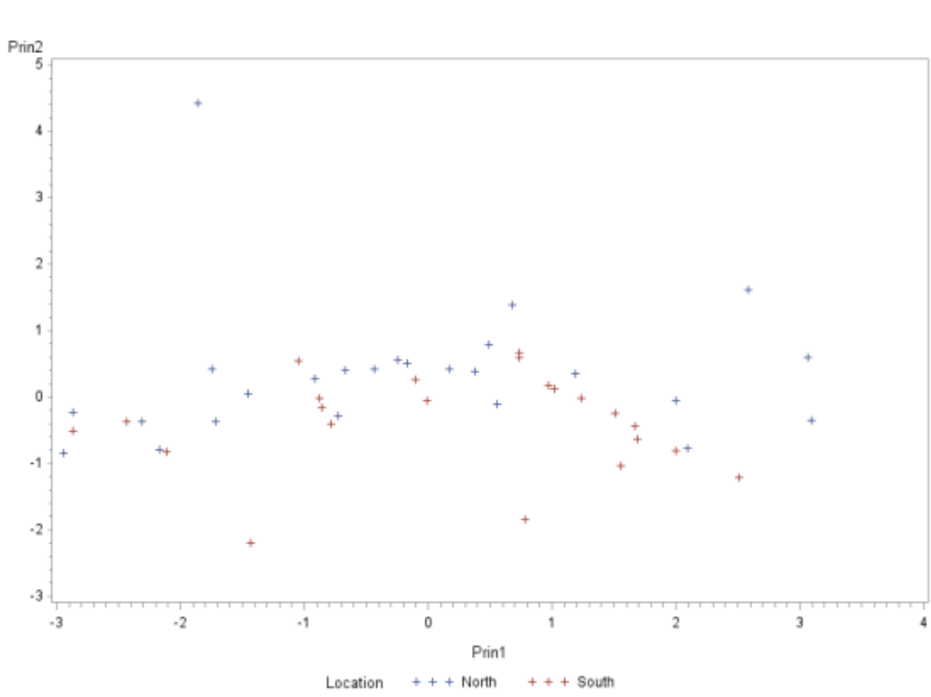
PCA: PRE LIVE
Interpret Results
  Scatter plots of PCs. Can look for outliers, clusters, or associations with other variables. Figure labeled with location (north or south).

Slide 28
Pca: PRE LIVE BONUS
Running regression analysis using principle components as explanatory variables
Advantages –
  Alternative to model selection techniques to reduce the number of predictors down to a reasonable number when there are a lot of predictors
  PC’s are uncorrelated no multicollinearity issues
Disadvantages
  Even though we reduced the number of predictors, we still need all of the predictors to calculate the principle components
  If the PC’s are hard to interpret, the value of understanding how the response is related back to the original variables is difficult

Slide 29
Pca: PRE LIVE BONUS
Two options
  After running your own PC analysis, take the PC’s you choose to keep (using out= option in princomp) and then treat them as your predictors running a regression analysis
  Use Proc PLS, to do those 2 steps together.
    Note: PLS – partial least squares – does more general type of data reduction regression. Using principle components is just one and specified by method=PCA
    CV - cross validation option can be used to determine the total number of principle components to use as our goal now is to fit a good regression model so you don’t have to make a subjective decision

Slide 30
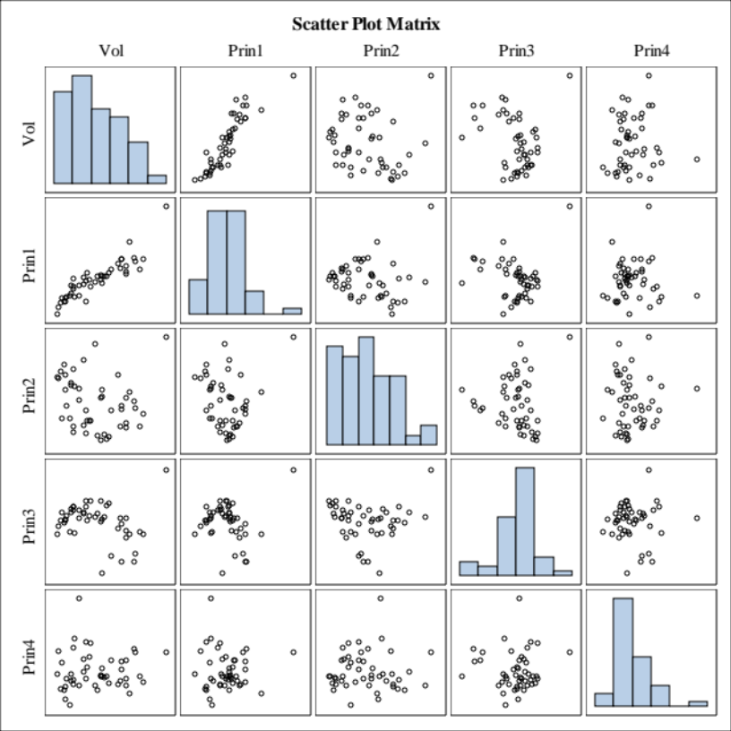
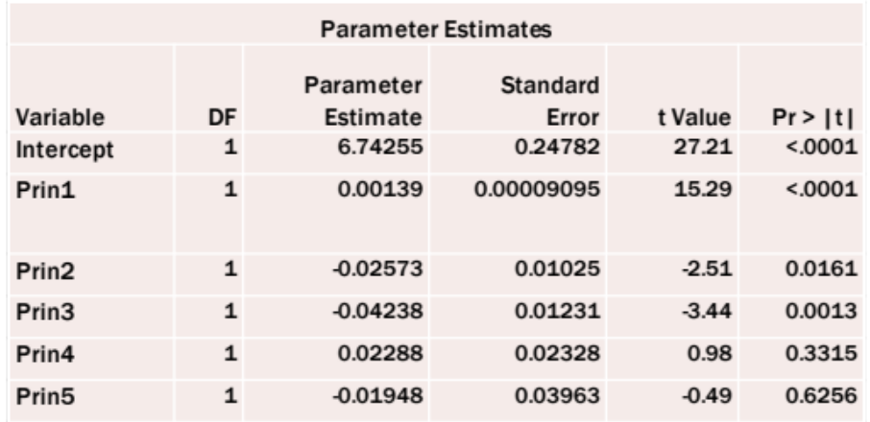
PCA: PRE LIVE
PCA Regression: Outcome = Vol

