Slide 1
Pre-Live Session 9
PCA

Slide 2
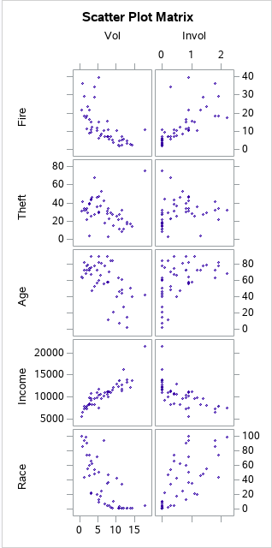
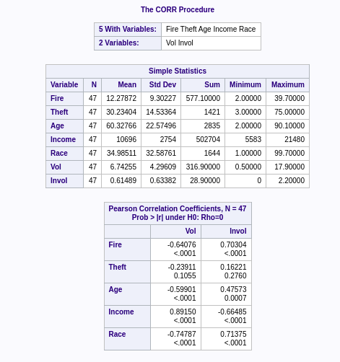
Summary Statistics, Correlation Matrix, Plots
It seems like theft is the only one not significant in relation with Vol and Invol. The p-values are greater than 0.05. The scatter plot further supports this.

Slide 3
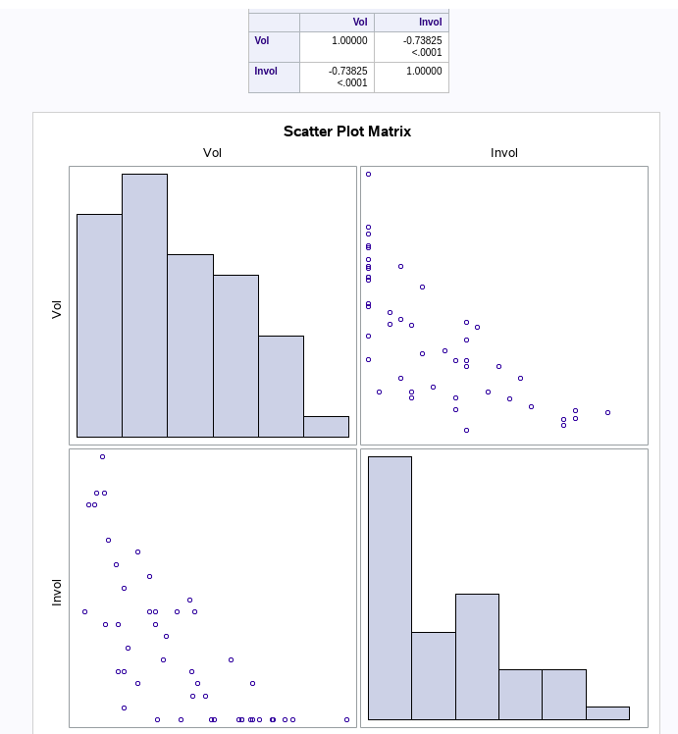
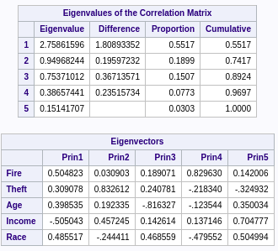
Vol and InVol are correlated.
Categorical dependent variables.
There are 5 different eigen value and vectors. The scree plot just plots the vlaues of the eigen. Running code and removing ‘cov’ would exclude the covariance input.

