Slide 1
Project Caelus
Center For Industry Solutions
2/8 Briefing

Slide 2
Confirm Project Name
Current Status
Areas of Concern
Management
What’s Next
Timeline
Funding

Slide 3
Caelus?
originates from Roman mythology as the god of the sky and the heavens
Pronounced: KAI-luhs
Yes?
No?

Slide 4


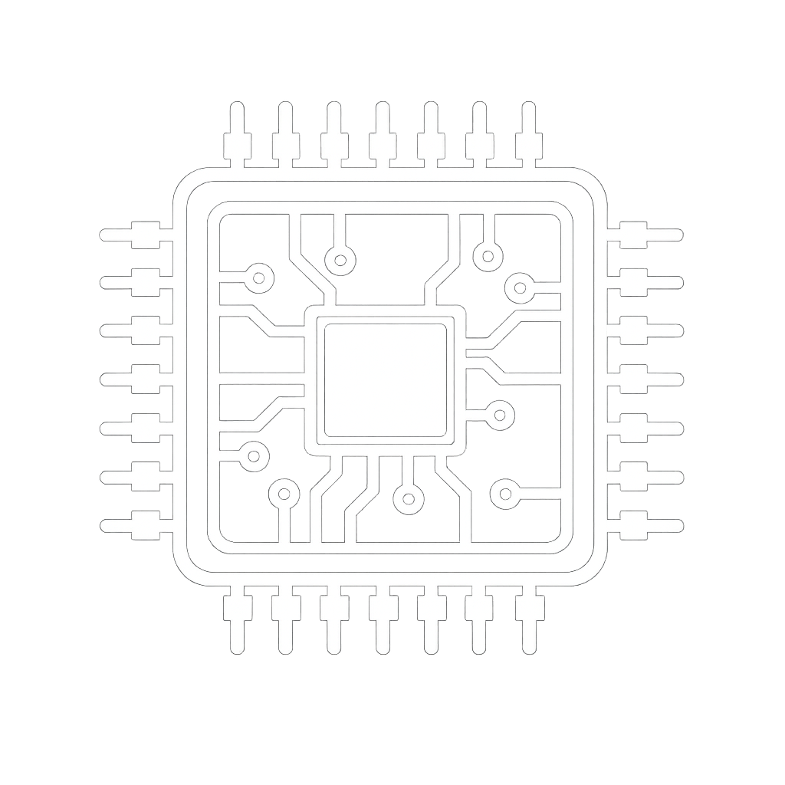
Areas of Concern
Intelligence
Avionics
Dynamics

Slide 5


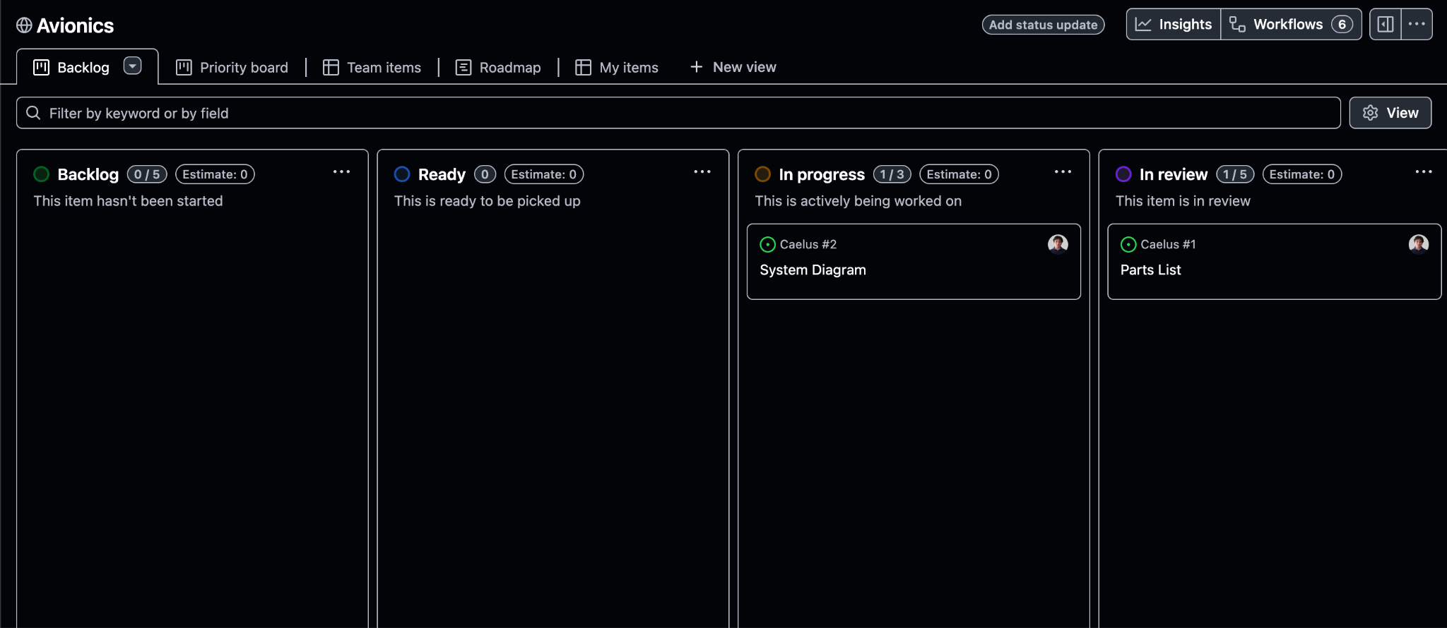

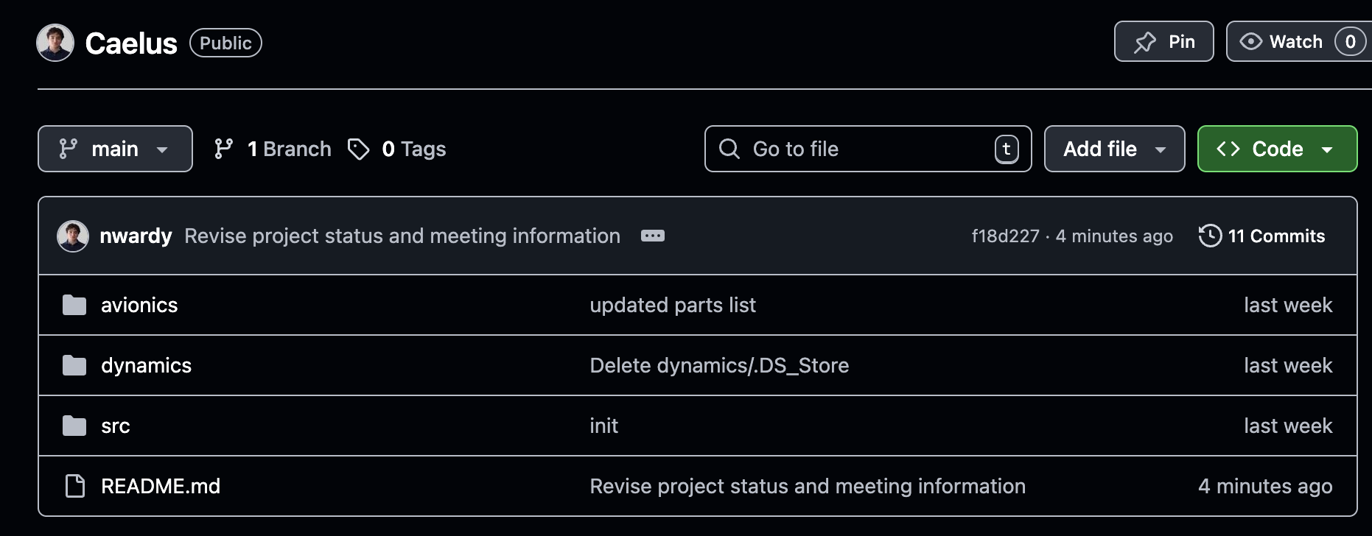


Management
x
GitHub
Project Boards
Intelligence
Dynamics
Avionics
File Management

Slide 6
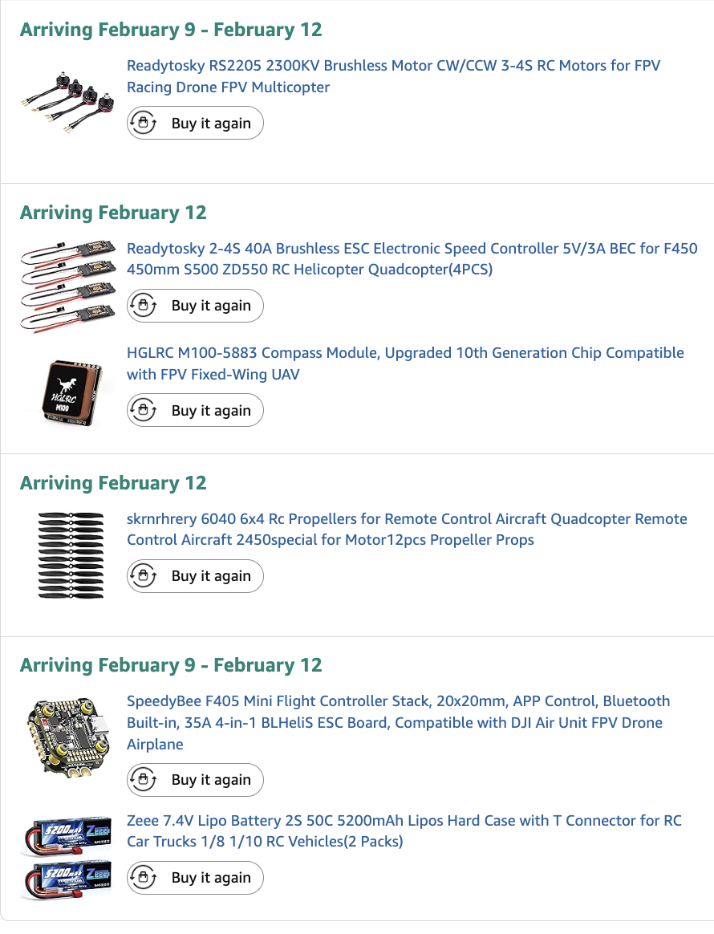
Current Status
Project Management
stl files of electronics used
dynamics/avionic Parts
repo init
Parts Ordered
4 Motors
4 Speed Controller
GPS Module
4 Propellers
Flight Controller
2x 5200mAh LiPo Batteries
Additional Parts on Hand
1x 1kg PETG Black Filament
1x 1kg PETG White Filament
4x NEMA Stepper Motors

Slide 7

What’s Next
Electronics Planning
Design Docking Station
all interconnected.
No siloed work.
Design Drone
/src system design

Slide 8
Timeline
*Estimated Dates*
looks like a drone
flies like a drone
is a smart drone
can dock and charge
is done
date:
date:
date:
date:
Date: apr25

Slide 9
Funding
Campus Partner Grant ~$1500
Mini Grant ~$1000
Magellan Scholar Grant ~$2500
Conference Presentation Grant ~$500
Trio Research Engagement Grant ~$1000
The PURE Program ~$1000

Slide 10
austin downey -

