Slide 1
Mama G’s General Store Customer Loyalty Tracker
Ver. 1.0
By Group 3

Slide 2
Overview
This program is designed for Mama G’s General Store.
The application is designed for the purpose of rewarding customers through tracking customers, sales, items, and creating coupons and reports.
The application is accessible at the Admin level or User level.
All tracking is saved into a database that can be later generated as reports.

Slide 3
Specifications Release 1.0
To access the application all users are required to log in as an admin or user.
Admin accounts are created with initial username and password.
Only admins have the ability to create, edit or delete users.
When creating a new user admins can set role as admin or user.

Slide 4
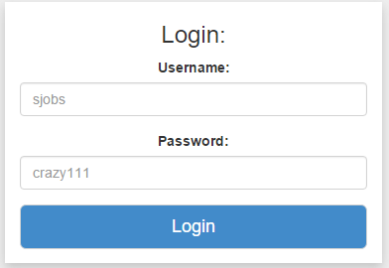
Logging in
Username and password required to access the application.
Use Case 1

Slide 5
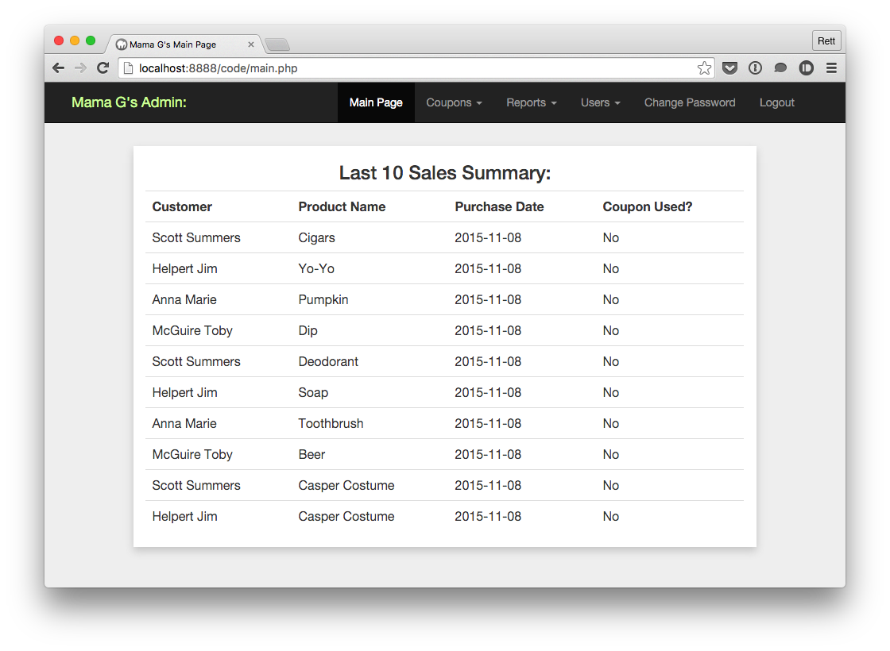
Menu
The menu holds all the needed functions capable of rewarding customers.
The Users tab is only displayed if you are logged in as an Admin.
Upon logging in you will be on the Main Page.
The Main Page displays a “Last 10 Sales Summary” allowing users a quick look at Mama G’s sales.

Slide 6
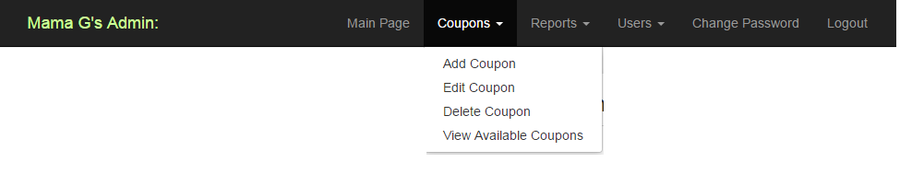
Coupon Management
Coupon Management allows users to Add, Edit, Delete, or View Available Coupons.

Slide 7
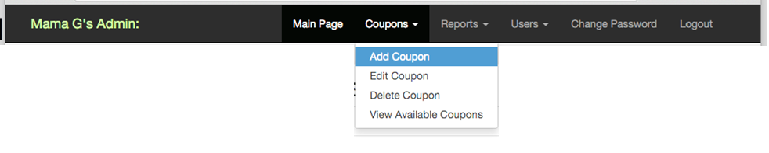
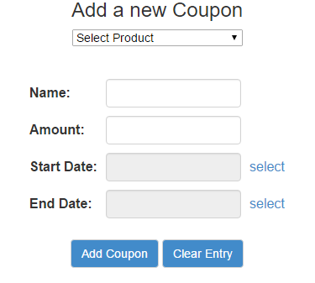
Coupon Management and Adding Coupon
You must first select a product.
Enter a name or description for the coupon.
Then you enter the dollar amount you want the coupon to save.
Enter the coupon’s start date.
And enter the expiration date.
Once the fields are populated you can click Add Coupon to generate the coupon.
At anytime you can click Clear Entry to try again.
Use Case 6

Slide 8
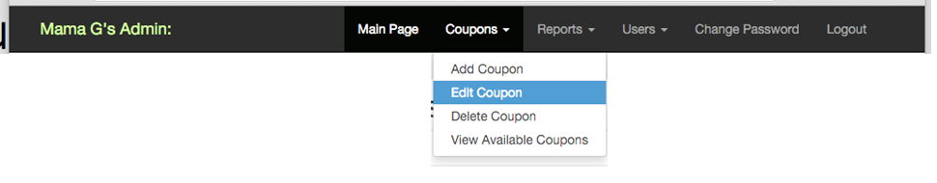
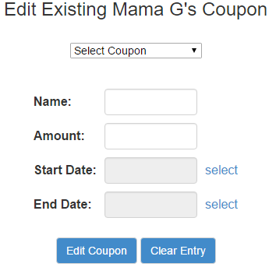
Coupon Management and Editing Coupon
You can also edit any existing coupon.
You can edit its name.
Change the coupon savings amount.
The start and end dates.
Once you are done editing click Edit Coupon to save changes.

Slide 9
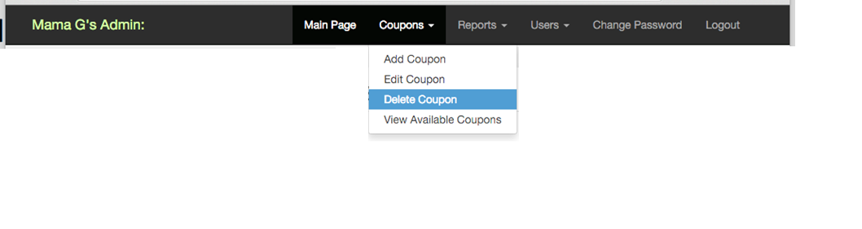
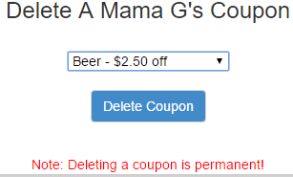
Coupon Management and Deleting Coupon
You can delete a coupon by selecting it and simply clicking Delete Coupon.

Slide 10
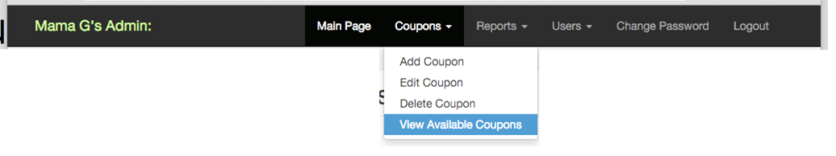
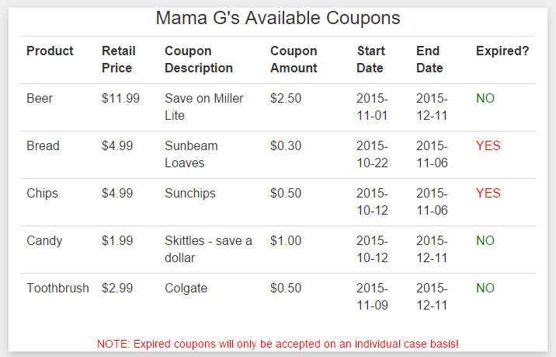
Coupon Management and Viewing Coupons
Here we can view all existing coupons in the database.
Use Case 7

Slide 11
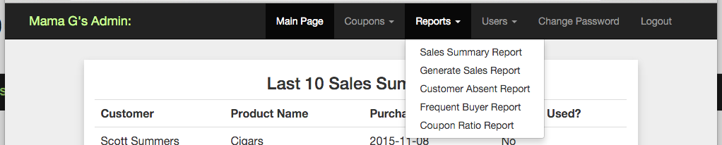
Reports
The application is capable of generating reports by pulling information from the database.
Sales Summary Report
Generate Sales Report
Customer Absent Report
Frequent Buyer
Coupon Ratio Report

Slide 12
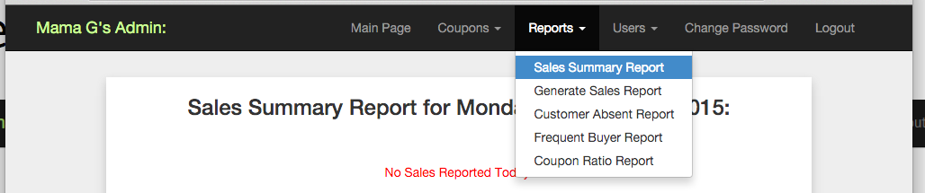
Reports and Sales Summary Report
Sales Summary Report displays sales information for the current date.
Displays customer’s name, product purchased, date purchased, and if a coupon was used.
Use Case 3

Slide 13
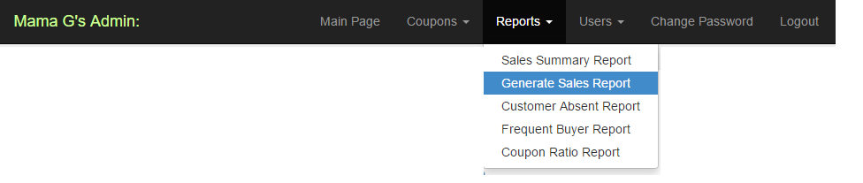
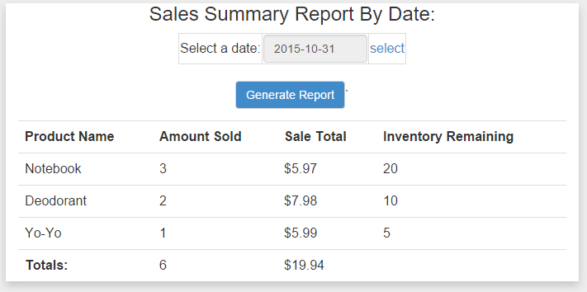
Reports and Generate Sales Report
Generate Sales Report allows user to select a date to pull sales data from.
Displays product name, amount sold, sale total and items remaining in stock.
Use Case 8

Slide 14
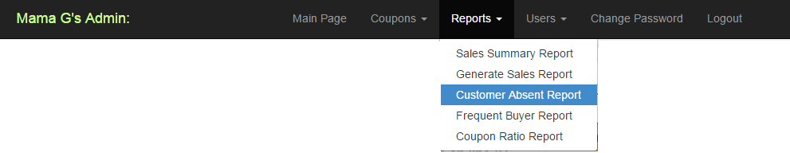
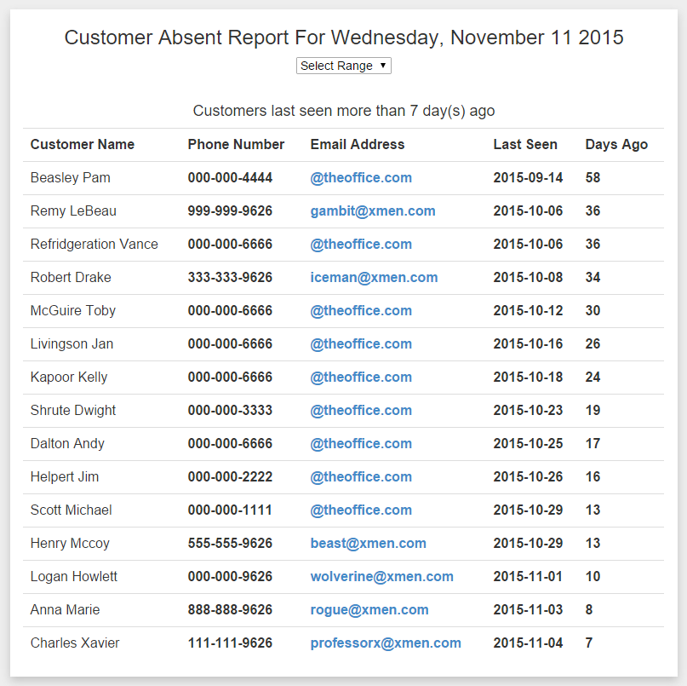
Reports and Customer Absent Report
Customer Absent Report option will provide information on customers who have not made a purchase within a certain date.
A date range can be selected.
It is also possible to email customers.
Use Case 4

Slide 15
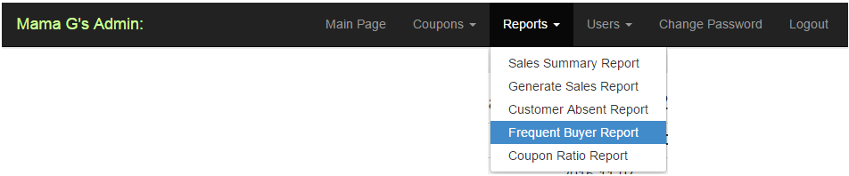
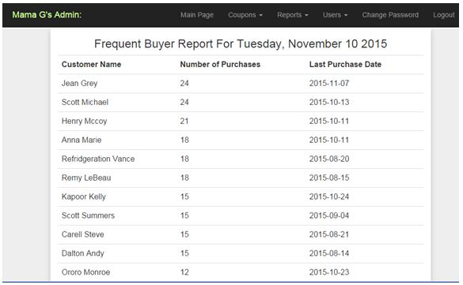
Reports and Frequent Buyer Report
Frequent Buyer Report displays information on customers who often shop at Mama G’s.
Displays customer’s name, total number of purchases made, and last purchase date.
Use Case 9

Slide 16
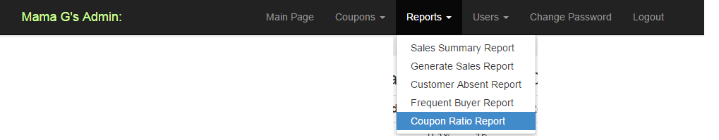
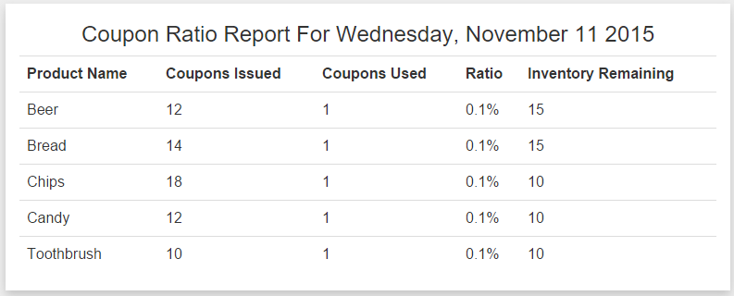
Reports and Coupon Ratio Report
Coupon Ratio Report details coupon usage to couponed issued.
Information can be interpreted to understand how coupons effect item sales.
Use Case 5

Slide 17
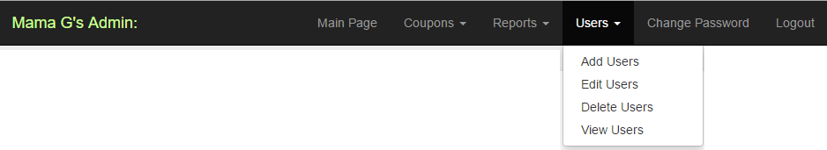
Users
The Users tab is only accessible to admins.
Creation of new users
Editing existing users
Deleting users
View all users

Slide 18
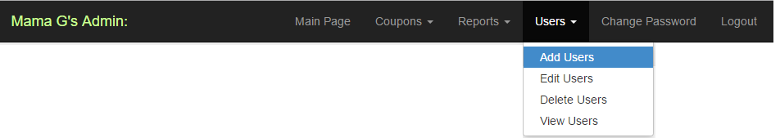
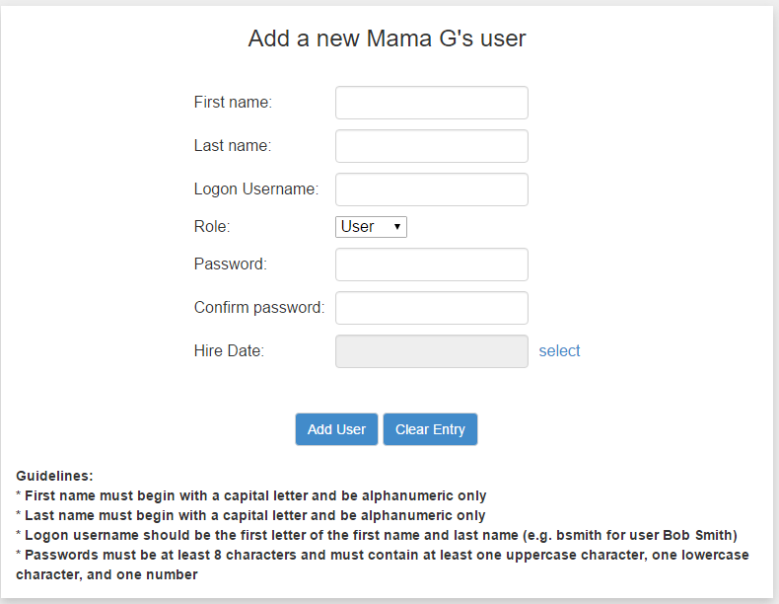
Users and Add Users
To add a user you must follow the given guidelines displayed on the bottom of the page.
First name must begin with a capital letter and be alphanumeric only.
Last name must begin with a capital letter and be alphanumeric only.
Logon username should be the first letter of the first name and last name (e.g. ckent for Clark Kent).
Select a role (Admin or User).
Passwords must be at least 8 characters and must contain at least one uppercase character, one lowercase character and one number.
Select a hire date.
Finally click Add User when complete.
Use Case 2

Slide 19
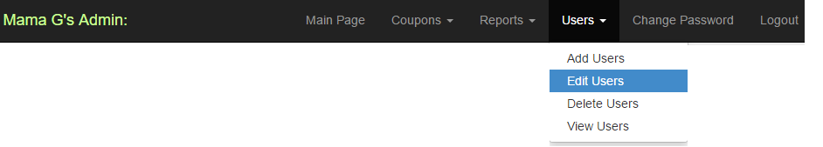
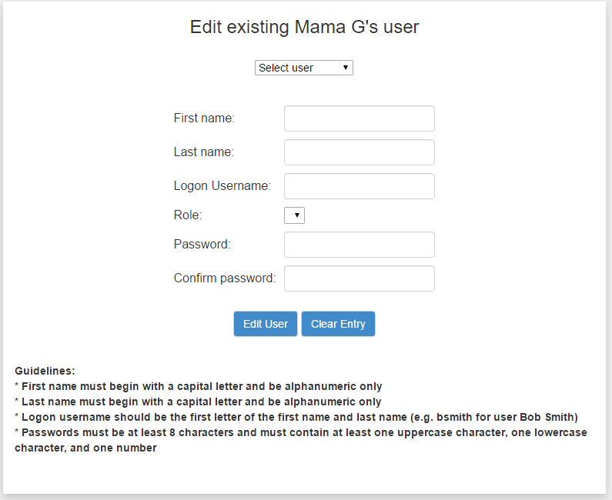
Users and Edit Users
You can fix any mistakes here.
Edits on first and last name, username and role can be made.
There is a dedicated tab for changing password.

Slide 20
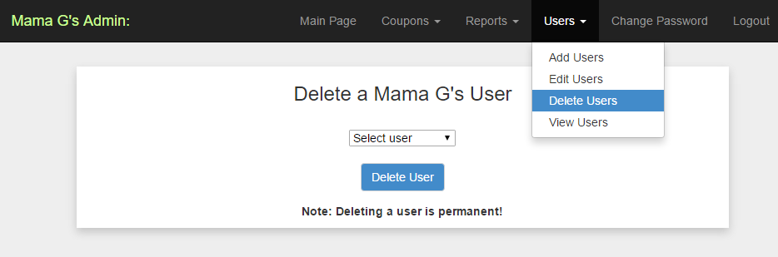
Users and Delete Users
If for any reason a user needs to be removed, it can be done here by simply selecting user and clicking Delete User.

Slide 21
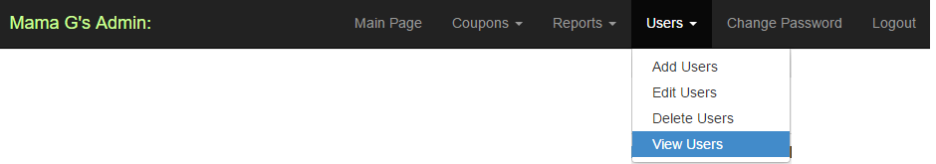
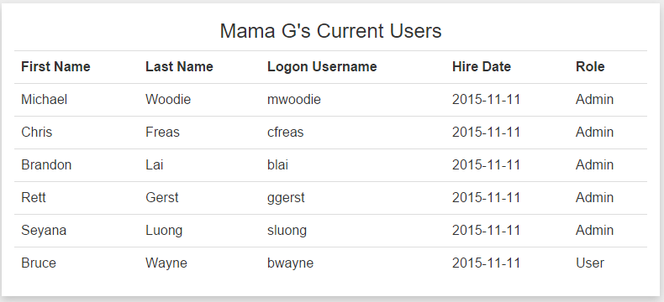
Users and View Users
You can view all users who have access to the application.
Displays first name and last name, username, hiring date and role.

Slide 22
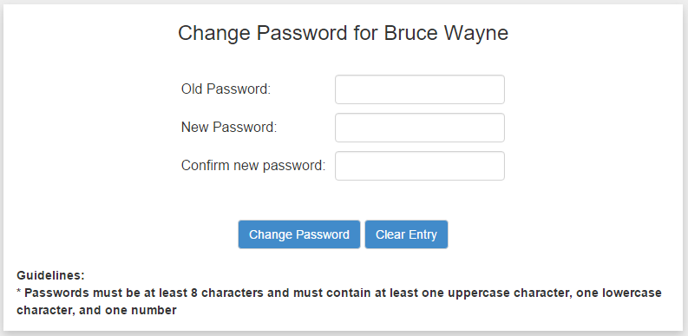
Change Password
A password can be changed here as long as it conforms to the guidelines.
Use Case 10

Slide 23
Logging out
The Logout tab will bring the user out of the application and back to the login screen.

Slide 24
Review
This is the first release of the application.
The Customer Loyalty Tracker app is easy to use and the information generated is made easy to comprehend.
The reports can be analyzed to learn how to better reward and make customers happy.
A date breakdown allows the understanding of sale trends and opportunities to push out sales.
The data can be used to see what items are highly demanded or what items need to be marked down.
Mama G’s General Store coupled with The Customer Loyalty Tracker brings a better experience in day-to-day life.

