Slide 1
Mama G’s General Store Customer Loyalty Tracker
Ver. 1.0
By Group 3

Slide 2
Overview
This program is designed for Mama G’s General Store.
The application is designed for the purpose of rewarding customers through tracking customers, sales, items, and creating coupons and reports.
The application is accessible at the Admin level or User level.
All tracking is saved into a database that can be later generated as a report.

Slide 3
Specifications Release 1.0
To access the application all users are required to log in as an admin or user.
Admin accounts are created with initial username and password.
Only admins have the ability to create, edit or delete users.
When creating a new user admins can set role as admin or user.

Slide 4
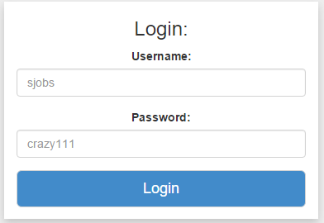
Logging in
Username and password required to access the application.
Use Case 1

Slide 5
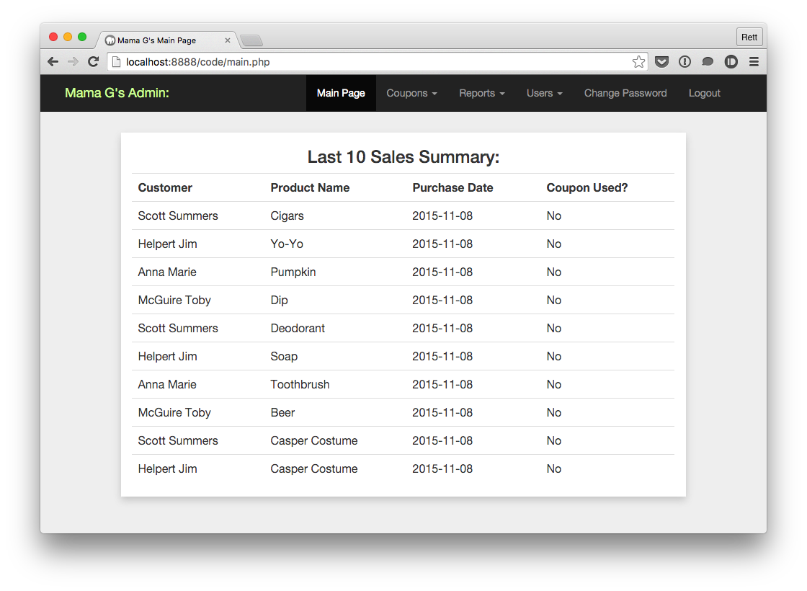
Menu
The menu holds all the needed functions capable of rewarding customers.
The Users tab is only displayed if you are logged in as an Admin.
Upon logging in you will be on the Main Page.
The Main Page displays a “Last 10 Sales Summary” allowing users a quick look at Mama G’s sales.

Slide 6
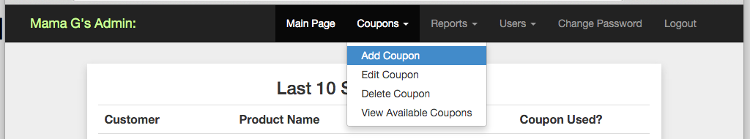
Coupon Management and Add Coupon
Coupon Management allows users to Add, Edit, Delete, or View Available Coupons.

Slide 7
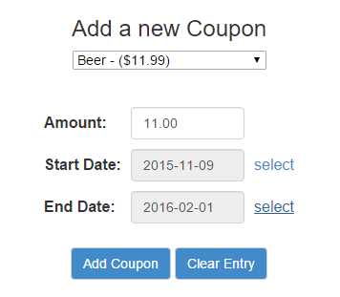
Coupon Management and Adding Coupon
You must first select a product, here we have Beer with a retail price of $11.99
Then you enter the dollar amount you want the coupon to save, we entered the coupon’s worth of $11.00.
Enter a start date for the coupon, this coupon begins 2015-11-09.
Enter a end date, this coupon expires on 2016-02-01.
By clicking Add Coupon customers can now purchase Beer for $0.99.
At anytime you can click Clear Entry to try again.

Slide 8
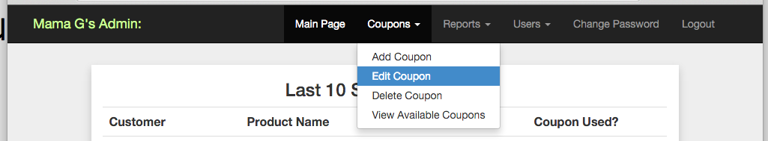
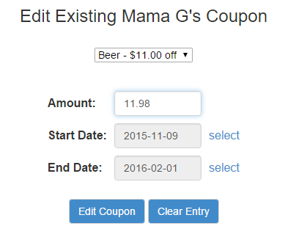
Coupon Management and Edit Coupon
You can also edit any existing coupon.
You are able to change the coupon savings amount.
The start and end dates.
Once you are done editing click Edit Coupon to save changes.

Slide 9
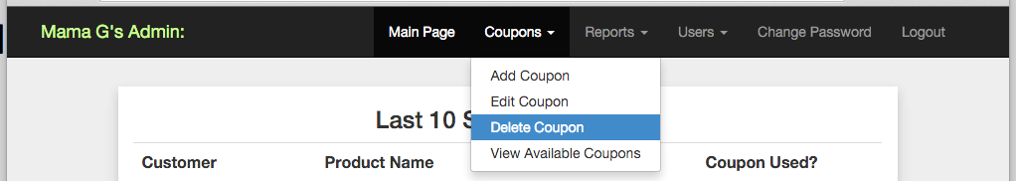
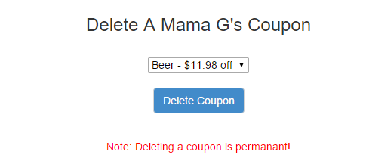
Coupon Management and Delete Coupon
You can delete a coupon by selecting it and simply clicking Delete Coupon.

Slide 10
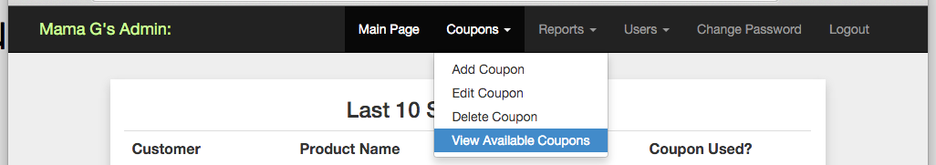
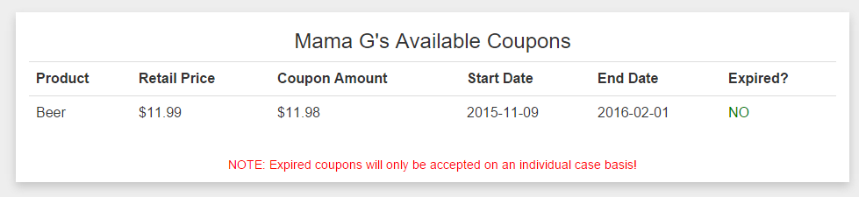
Coupon Management and View All Coupons
Here we can view all existing coupons in our database.

Slide 11
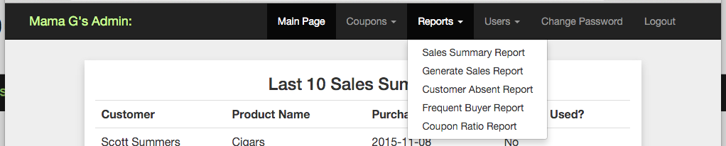
Reports
The application is capable of generating reports by pulling information from the database
Sales Summary Report
Generate Sales Report
Customer Absent Report
Frequent Buyer
Coupon Ratio Report

Slide 12
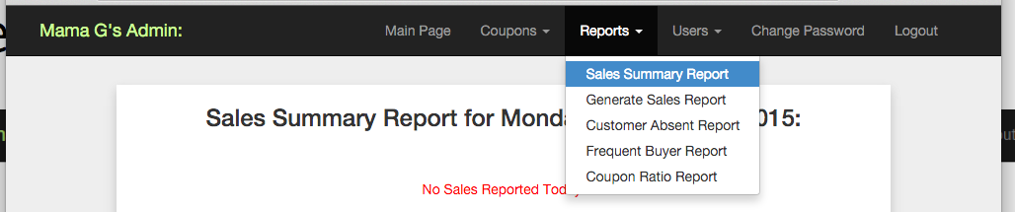
Reports and Sales Summary Report
The Sales Summary Report tab displays sales information for the current date.
Displays customer, product purchased, date purchased, and if a coupon was used.
Information is pulled from database by...

Slide 13
Reports and Generate Sales Report

Slide 14
Reports and Customer Absent Report

Slide 15
Reports and Frequent Buyer Report

Slide 16
Reports and Coupon Ratio Report

Slide 17
Users

Slide 18
Users and Add Users

Slide 19
Users and Edit Users

Slide 20
Users and Delete Users

Slide 21
Users and View Users

Slide 22
Change Password

Slide 23
Logging out

Slide 24
Review

