Slide 1
UNIVERSITY OF COMPUTER STUDIES (MAGWAY)
2025-2026 Academic Years Web Development
(HTML+CSS) (CST-1154)
Myanmar Traditional Lacquerware
Supervised by Daw Mya Thin Khaing
Presented by Ma Khin Nway Nway Oo

Slide 2
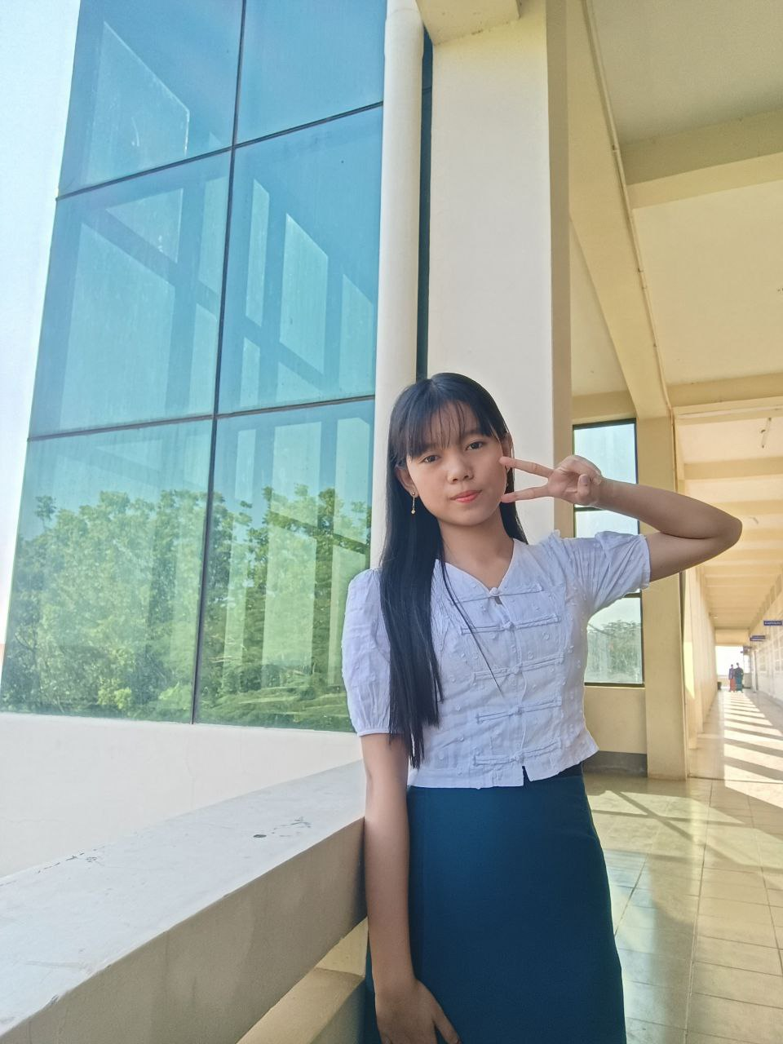
PRESENTED BY,
NAME ROLL NUMBER
Ma Khin Nway Nway Oo(First-Year) UCSMG-25080

Slide 3
Contents
  Introduction
Abstract
Objectives
Conclusion

Slide 4
Introduction
Myanmar traditional lacquerware is one of the most famous crafts , admired hand
For its beauty ,durability , and cultural significance. This unique art form has been passed
down through generations , reflecting the rich heritage and traditions of Myanmar . Each
piece is carefully handmade using natural materials and detailed techniques ,
showcasing the skill and creativity of local artisans . From decorative items to
everyday use , lacquerware remains an important parts of Myanmar's cultural identity.

Slide 5
Abstract
Myanmar traditional lacquerware is an important traditional craft that shows the country’s culture and history . This project studies the material , production process, and culture value of Myanmar traditional lacquerware. It also explains the challenges faced by this craft in modern times. The project highlights the importance of preserving lacquerware for future generations.

Slide 6
Objective
To study the origin and history of Myanmar traditional lacquerware.
To identify the main material used in making lacquerware.
To understand the traditional production process of lacquerware.
To learn about the cultural and social importance of lacquerware in Myanmar.
To raise awareness about preserving traditional lacquerware for future generations.

Slide 7
Conclusion
In conclusion, Myanmar traditional lacquerware is an important part of the country’s cultural heritage. This project shows its materials, production process, and cultural value. Preserving this traditional crafts is important for future generations.

Slide 8
Thank for Watching Our Presentation

