Slide 1
Chapter 6: Temporal Difference Learning
Objectives of this chapter:
Introduce Temporal Difference (TD) learning
Focus first on policy evaluation, or prediction, methods
Then extend to control methods
R. S. Sutton and A. G. Barto: Reinforcement Learning: An Introduction

Slide 2
Simple Monte Carlo
T
T
T
T
T
T
T
T
T
T
T
T
T
T
T
T
T
T
T
T
R. S. Sutton and A. G. Barto: Reinforcement Learning: An Introduction

Slide 3
TD Prediction
Policy Evaluation (the prediction problem):
for a given policy π, compute the state-value function
Recall:
target: the actual return after time t
target: an estimate of the return
R. S. Sutton and A. G. Barto: Reinforcement Learning: An Introduction

Slide 4
Simplest TD Method
T
T
T
T
T
T
T
T
T
T
T
T
T
T
T
T
T
T
T
T
R. S. Sutton and A. G. Barto: Reinforcement Learning: An Introduction

Slide 5
cf. Dynamic Programming
T
T
T
T
T
T
T
T
T
T
T
T
T
R. S. Sutton and A. G. Barto: Reinforcement Learning: An Introduction

Slide 6
TD Bootstraps and Samples
Bootstrapping: update involves an estimate
  MC does not bootstrap
  DP bootstraps
  TD bootstraps
Sampling: update does not involve an expected value
  MC samples
  DP does not sample
  TD samples
R. S. Sutton and A. G. Barto: Reinforcement Learning: An Introduction

Slide 7
Example: Driving Home
R. S. Sutton and A. G. Barto: Reinforcement Learning: An Introduction

Slide 8
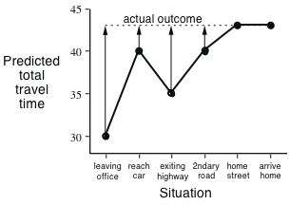
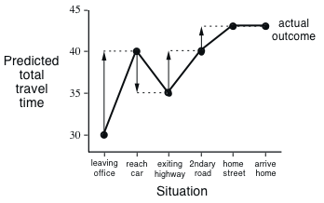
Driving Home
  Changes recommended by Monte Carlo methods (α=1)
  Changes recommended
  by TD methods (α=1)
R. S. Sutton and A. G. Barto: Reinforcement Learning: An Introduction

Slide 9
Advantages of TD Learning
TD methods do not require a model of the environment, only experience
TD, but not MC, methods can be fully incremental
  You can learn before knowing the final outcome
    Less memory
    Less peak computation
  You can learn without the final outcome
    From incomplete sequences
Both MC and TD converge (under certain assumptions to be detailed later), but which is faster?
R. S. Sutton and A. G. Barto: Reinforcement Learning: An Introduction

Slide 10

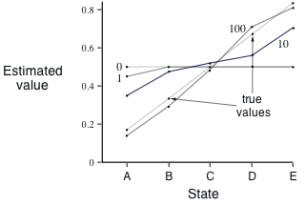
Random Walk Example
    Values learned by TD(0) after
    various numbers of episodes
R. S. Sutton and A. G. Barto: Reinforcement Learning: An Introduction

Slide 11
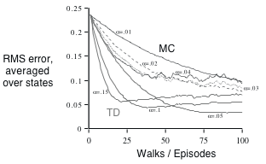
TD and MC on the Random Walk
    Data averaged over
    100 sequences of episodes
R. S. Sutton and A. G. Barto: Reinforcement Learning: An Introduction

Slide 12
Optimality of TD(0)
Batch Updating: train completely on a finite amount of data,
e.g., train repeatedly on 10 episodes until convergence.
Compute updates according to TD(0), but only update
estimates after each complete pass through the data.
For any finite Markov prediction task, under batch updating,
TD(0) converges for sufficiently small α.
Constant-α MC also converges under these conditions, but to
a difference answer!
R. S. Sutton and A. G. Barto: Reinforcement Learning: An Introduction

Slide 13
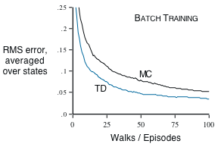
Random Walk under Batch Updating
    After each new episode, all previous episodes were treated as a batch, and algorithm was trained until convergence. All repeated 100 times.
R. S. Sutton and A. G. Barto: Reinforcement Learning: An Introduction

Slide 14
You are the Predictor
Suppose you observe the following 8 episodes:
A, 0, B, 0
B, 1
B, 1
B, 1
B, 1
B, 1
B, 1
B, 0
R. S. Sutton and A. G. Barto: Reinforcement Learning: An Introduction

Slide 15

You are the Predictor
R. S. Sutton and A. G. Barto: Reinforcement Learning: An Introduction

Slide 16
You are the Predictor
The prediction that best matches the training data is V(A)=0
  This minimizes the mean-square-error on the training set
  This is what a batch Monte Carlo method gets
If we consider the sequentiality of the problem, then we would set V(A)=.75
  This is correct for the maximum likelihood estimate of a Markov model generating the data
  i.e, if we do a best fit Markov model, and assume it is exactly correct, and then compute what it predicts (how?)
  This is called the certainty-equivalence estimate
  This is what TD(0) gets
R. S. Sutton and A. G. Barto: Reinforcement Learning: An Introduction

Slide 17

Learning An Action-Value Function
R. S. Sutton and A. G. Barto: Reinforcement Learning: An Introduction

Slide 18
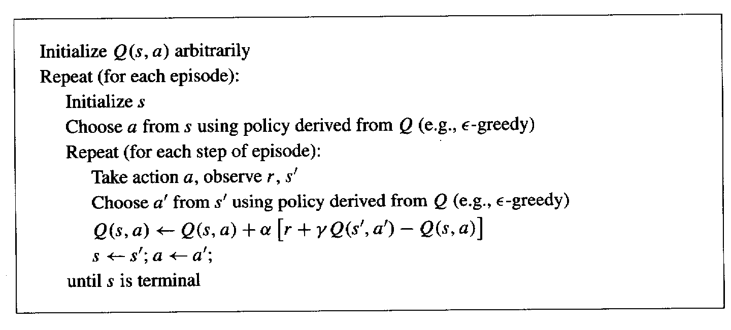
Sarsa: On-Policy TD Control
Turn this into a control method by always updating the
policy to be greedy with respect to the current estimate:
R. S. Sutton and A. G. Barto: Reinforcement Learning: An Introduction

Slide 19
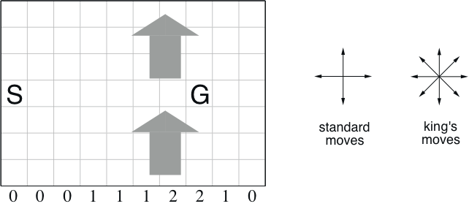
Windy Gridworld
undiscounted, episodic, reward = –1 until goal
R. S. Sutton and A. G. Barto: Reinforcement Learning: An Introduction

Slide 20
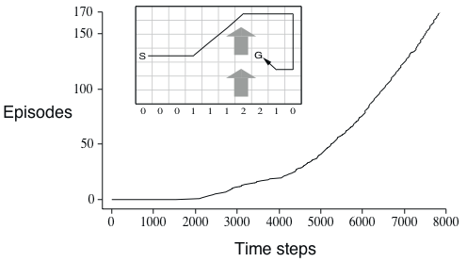
Results of Sarsa on the Windy Gridworld
R. S. Sutton and A. G. Barto: Reinforcement Learning: An Introduction

Slide 21
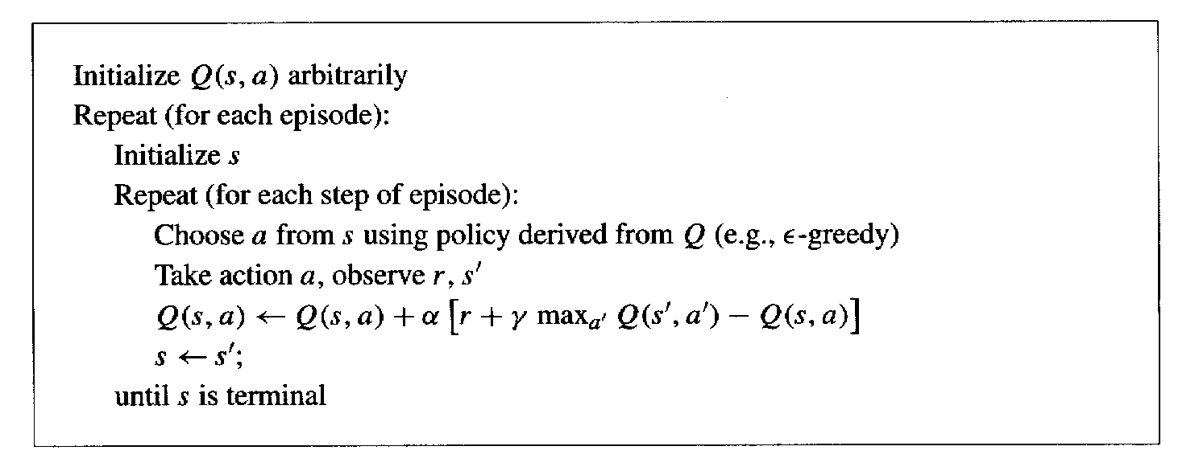
Q-Learning: Off-Policy TD Control
R. S. Sutton and A. G. Barto: Reinforcement Learning: An Introduction

Slide 22
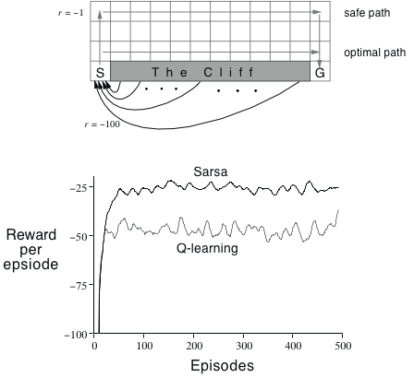
Cliffwalking
    ε−greedy, ε = 0.1
R. S. Sutton and A. G. Barto: Reinforcement Learning: An Introduction

Slide 23
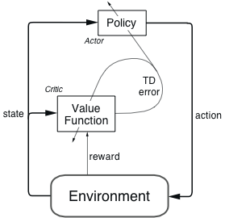
Actor-Critic Methods
Explicit representation of policy as well as value function
Minimal computation to select actions
Can learn an explicit stochastic policy
Can put constraints on policies
Appealing as psychological and neural models
R. S. Sutton and A. G. Barto: Reinforcement Learning: An Introduction

Slide 24
Actor-Critic Details
R. S. Sutton and A. G. Barto: Reinforcement Learning: An Introduction

Slide 25
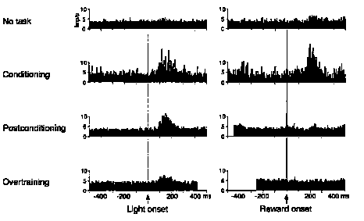
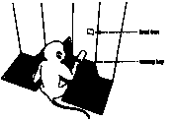
Dopamine Neurons and TD Error
W. Schultz et al.
Universite de Fribourg
R. S. Sutton and A. G. Barto: Reinforcement Learning: An Introduction

Slide 26
Average Reward Per Time Step
the same for each state if ergodic
R. S. Sutton and A. G. Barto: Reinforcement Learning: An Introduction

Slide 27
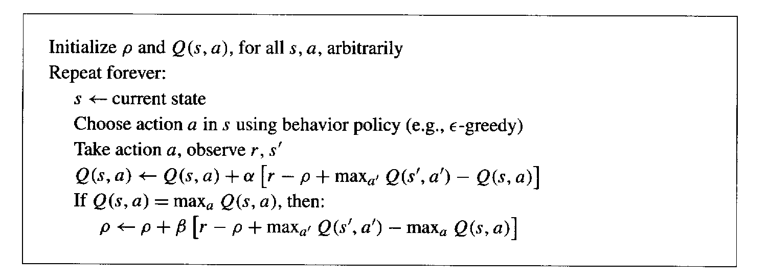
R-Learning
R. S. Sutton and A. G. Barto: Reinforcement Learning: An Introduction

Slide 28
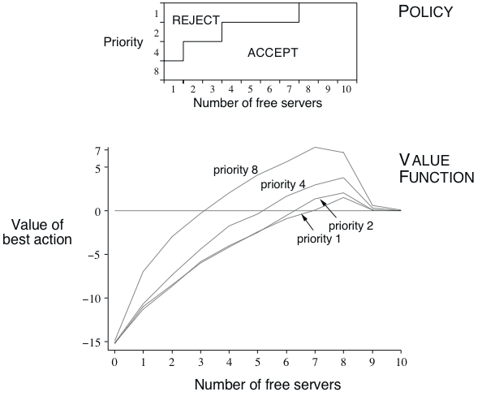
Access-Control Queuing Task
Apply R-learning
n servers
Customers have four different priorities, which pay reward of 1, 2, 3, or 4, if served
At each time step, customer at head of queue is accepted (assigned to a server) or removed from the queue
Proportion of randomly distributed high priority customers in queue is h
Busy server becomes free with probability p on each time step
Statistics of arrivals and departures are unknown
n=10, h=.5, p=.06
R. S. Sutton and A. G. Barto: Reinforcement Learning: An Introduction

Slide 29
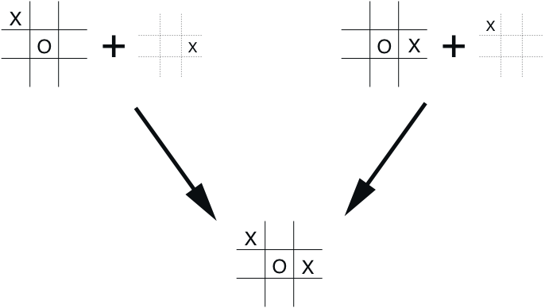
Afterstates
Usually, a state-value function evaluates states in which the agent can take an action.
But sometimes it is useful to evaluate states after agent has acted, as in tic-tac-toe.
Why is this useful?
What is this in general?
R. S. Sutton and A. G. Barto: Reinforcement Learning: An Introduction

Slide 30
Summary
TD prediction
Introduced one-step tabular model-free TD methods
Extend prediction to control by employing some form of GPI
  On-policy control: Sarsa
  Off-policy control: Q-learning and R-learning
These methods bootstrap and sample, combining aspects of DP and MC methods
R. S. Sutton and A. G. Barto: Reinforcement Learning: An Introduction

