Slide 1
The Joint Distribution
Example: Boolean variables A, B, C
Recipe for making a joint distribution of M variables:
Copyright © 2001, Andrew W. Moore

Slide 2
The Joint Distribution
Example: Boolean variables A, B, C
Recipe for making a joint distribution of M variables:
Make a truth table listing all combinations of values of your variables (if there are M Boolean variables then the table will have 2^{M} rows).
A | B | C
0 | 0 | 0
0 | 0 | 1
0 | 1 | 0
0 | 1 | 1
1 | 0 | 0
1 | 0 | 1
1 | 1 | 0
1 | 1 | 1
Copyright © 2001, Andrew W. Moore

Slide 3
The Joint Distribution
Example: Boolean variables A, B, C
Recipe for making a joint distribution of M variables:
Make a truth table listing all combinations of values of your variables (if there are M Boolean variables then the table will have 2^{M} rows).
For each combination of values, say how probable it is.
A | B | C | Prob
0 | 0 | 0 | 0.30
0 | 0 | 1 | 0.05
0 | 1 | 0 | 0.10
0 | 1 | 1 | 0.05
1 | 0 | 0 | 0.05
1 | 0 | 1 | 0.10
1 | 1 | 0 | 0.25
1 | 1 | 1 | 0.10
Copyright © 2001, Andrew W. Moore

Slide 4
The Joint Distribution
Example: Boolean variables A, B, C
Recipe for making a joint distribution of M variables:
Make a truth table listing all combinations of values of your variables (if there are M Boolean variables then the table will have 2^{M} rows).
For each combination of values, say how probable it is.
If you subscribe to the axioms of probability, those numbers must sum to 1.
A | B | C | Prob
0 | 0 | 0 | 0.30
0 | 0 | 1 | 0.05
0 | 1 | 0 | 0.10
0 | 1 | 1 | 0.05
1 | 0 | 0 | 0.05
1 | 0 | 1 | 0.10
1 | 1 | 0 | 0.25
1 | 1 | 1 | 0.10
A
0.05
0.10
0.05
0.10
0.25
0.05
C
B
0.10
0.30
Copyright © 2001, Andrew W. Moore

Slide 5
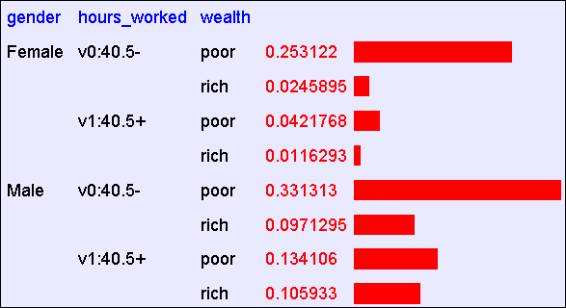
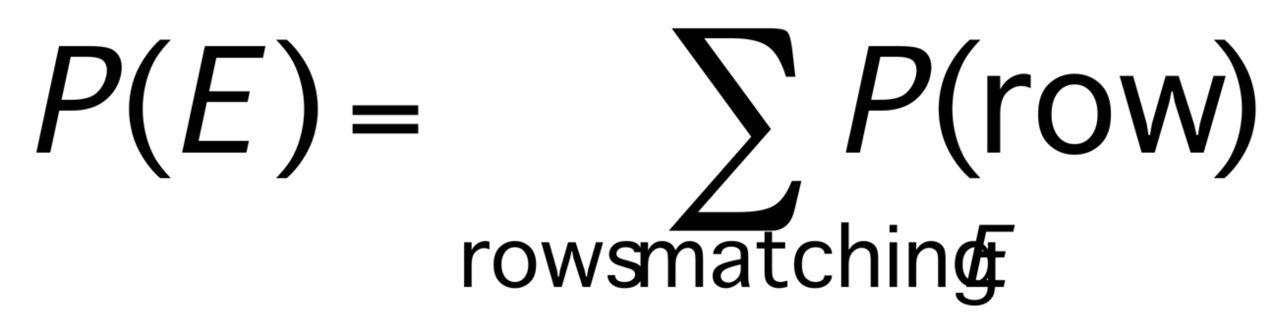
Using the Joint
Once you have the JD you can ask for the probability of any logical expression involving your attribute
Copyright © 2001, Andrew W. Moore

Slide 6
Using the Joint
P(Poor Male) = 0.4654
Copyright © 2001, Andrew W. Moore

Slide 7
Using the Joint
P(Poor) = 0.7604
Copyright © 2001, Andrew W. Moore

Slide 8
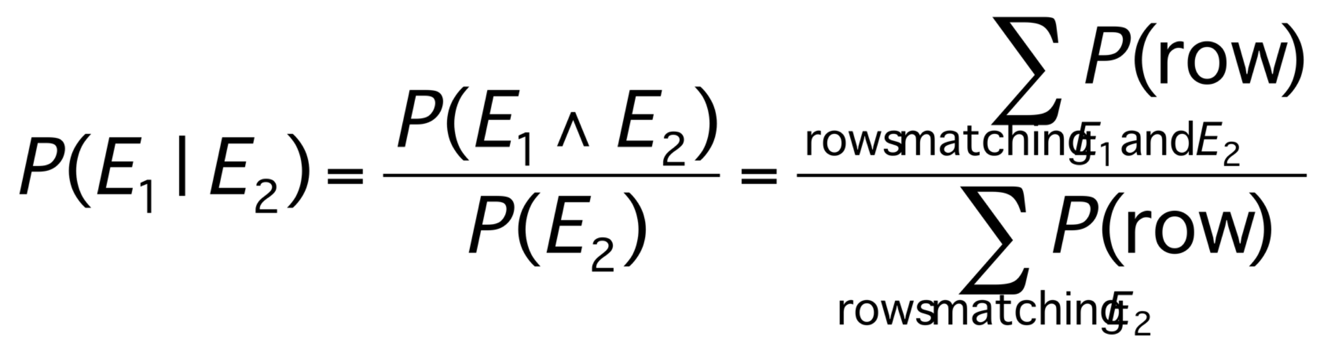
Inference with the Joint
Copyright © 2001, Andrew W. Moore

Slide 9
Inference with the Joint
P(Male | Poor) = 0.4654 / 0.7604 = 0.612
Copyright © 2001, Andrew W. Moore

Slide 10
Joint distributions
Good news
  Once you have a joint distribution, you can ask important questions about stuff that involves a lot of uncertainty
Bad news
  Impossible to create for more than about ten attributes because there are so many numbers needed when you build the damn thing.
Copyright © 2001, Andrew W. Moore

Slide 11
Using fewer numbers
Suppose there are two events:
  M: Manuela teaches the class (otherwise it’s Andrew)
  S: It is sunny
The joint p.d.f. for these events contain four entries.
If we want to build the joint p.d.f. we’ll have to invent those four numbers. OR WILL WE??
  We don’t have to specify with bottom level conjunctive events such as P(~M^S) IF…
  …instead it may sometimes be more convenient for us to specify things like: P(M), P(S).
But just P(M) and P(S) don’t derive the joint distribution. So you can’t answer all questions.
Copyright © 2001, Andrew W. Moore

Slide 12
Using fewer numbers
Suppose there are two events:
  M: Manuela teaches the class (otherwise it’s Andrew)
  S: It is sunny
The joint p.d.f. for these events contain four entries.
If we want to build the joint p.d.f. we’ll have to invent those four numbers. OR WILL WE??
  We don’t have to specify with bottom level conjunctive events such as P(~M^S) IF…
  …instead it may sometimes be more convenient for us to specify things like: P(M), P(S).
But just P(M) and P(S) don’t derive the joint distribution. So you can’t answer all questions.
What extra assumption can you make?
Copyright © 2001, Andrew W. Moore

Slide 13
Independence
“The sunshine levels do not depend on and do not influence who is teaching.”
This can be specified very simply:
      P(S ⏐ M) = P(S)
This is a powerful statement!
It required extra domain knowledge. A different kind of knowledge than numerical probabilities. It needed an understanding of causation.
Copyright © 2001, Andrew W. Moore

Slide 14
Independence
From P(S ⏐ M) = P(S), the rules of probability imply: (can you prove these?)
P(~S ⏐ M) = P(~S)
P(M ⏐ S) = P(M)
P(M ^ S) = P(M) P(S)
P(~M ^ S) = P(~M) P(S), (PM^~S) = P(M)P(~S),
P(~M^~S) = P(~M)P(~S)
Copyright © 2001, Andrew W. Moore

Slide 15
Independence
From P(S ⏐ M) = P(S), the rules of probability imply: (can you prove these?)
P(~S ⏐ M) = P(~S)
P(M ⏐ S) = P(M)
P(M ^ S) = P(M) P(S)
P(~M ^ S) = P(~M) P(S), (PM^~S) = P(M)P(~S),
P(~M^~S) = P(~M)P(~S)
And in general:
P(M=u ^ S=v) = P(M=u) P(S=v)
for each of the four combinations of
u=True/False
v=True/False
Copyright © 2001, Andrew W. Moore

Slide 16
Independence
We’ve stated:
    P(M) = 0.6
    P(S) = 0.3
    P(S ⏐ M) = P(S)
From these statements, we can derive the full joint pdf.
M | S | Prob
T | T
T | F
F | T
F | F
And since we now have the joint pdf, we can make any queries we like.
Copyright © 2001, Andrew W. Moore

Slide 17
A more interesting case
  M : Manuela teaches the class
  S : It is sunny
  L : The lecturer arrives slightly late.
Assume both lecturers are sometimes delayed by bad weather. Andrew is more likely to arrive late than Manuela.
Copyright © 2001, Andrew W. Moore

Slide 18
A more interesting case
  M : Manuela teaches the class
  S : It is sunny
  L : The lecturer arrives slightly late.
Assume both lecturers are sometimes delayed by bad weather. Andrew is more likely to arrive late than Manuela.
Let’s begin with writing down knowledge we’re happy about:
P(S ⏐ M) = P(S), P(S) = 0.3, P(M) = 0.6
Lateness is not independent of the weather and is not independent of the lecturer.
Copyright © 2001, Andrew W. Moore

Slide 19
A more interesting case
  M : Manuela teaches the class
  S : It is sunny
  L : The lecturer arrives slightly late.
Assume both lecturers are sometimes delayed by bad weather. Andrew is more likely to arrive late than Manuela.
Let’s begin with writing down knowledge we’re happy about:
P(S ⏐ M) = P(S), P(S) = 0.3, P(M) = 0.6
Lateness is not independent of the weather and is not independent of the lecturer.
We already know the Joint of S and M, so all we need now is
P(L ⏐ S=u, M=v)
in the 4 cases of u/v = True/False.
Copyright © 2001, Andrew W. Moore

Slide 20
A more interesting case
  M : Manuela teaches the class
  S : It is sunny
  L : The lecturer arrives slightly late.
Assume both lecturers are sometimes delayed by bad weather. Andrew is more likely to arrive late than Manuela.
P(L ⏐ M ^ S) = 0.05
P(L ⏐ M ^ ~S) = 0.1
P(L ⏐ ~M ^ S) = 0.1
P(L ⏐ ~M ^ ~S) = 0.2
P(S ⏐ M) = P(S)
P(S) = 0.3
P(M) = 0.6
Now we can derive a full joint p.d.f. with a “mere” six numbers instead of seven*
*Savings are larger for larger numbers of variables.
Copyright © 2001, Andrew W. Moore

Slide 21
A more interesting case
  M : Manuela teaches the class
  S : It is sunny
  L : The lecturer arrives slightly late.
Assume both lecturers are sometimes delayed by bad weather. Andrew is more likely to arrive late than Manuela.
P(L ⏐ M ^ S) = 0.05
P(L ⏐ M ^ ~S) = 0.1
P(L ⏐ ~M ^ S) = 0.1
P(L ⏐ ~M ^ ~S) = 0.2
P(S ⏐ M) = P(S)
P(S) = 0.3
P(M) = 0.6
Question: Express
P(L=x ^ M=y ^ S=z)
in terms that only need the above expressions, where x,y and z may each be True or False.
Copyright © 2001, Andrew W. Moore

Slide 22
A bit of notation
P(L ⏐ M ^ S) = 0.05
P(L ⏐ M ^ ~S) = 0.1
P(L ⏐ ~M ^ S) = 0.1
P(L ⏐ ~M ^ ~S) = 0.2
P(S ⏐ M) = P(S)
P(S) = 0.3
P(M) = 0.6
P(M)=0.6
P(s)=0.3
S
M
P(L⏐M^S)=0.05
P(L⏐M^~S)=0.1
P(L⏐~M^S)=0.1
P(L⏐~M^~S)=0.2
L
Copyright © 2001, Andrew W. Moore

Slide 23
A bit of notation
P(L ⏐ M ^ S) = 0.05
P(L ⏐ M ^ ~S) = 0.1
P(L ⏐ ~M ^ S) = 0.1
P(L ⏐ ~M ^ ~S) = 0.2
P(S ⏐ M) = P(S)
P(S) = 0.3
P(M) = 0.6
Read the absence of an arrow between S and M to mean “it would not help me predict M if I knew the value of S”
This kind of stuff will be thoroughly formalized later
P(M)=0.6
P(s)=0.3
S
M
P(L⏐M^S)=0.05
P(L⏐M^~S)=0.1
P(L⏐~M^S)=0.1
P(L⏐~M^~S)=0.2
L
Read the two arrows into L to mean that if I want to know the value of L it may help me to know M and to know S.
Copyright © 2001, Andrew W. Moore

Slide 24
An even cuter trick
Suppose we have these three events:
M : Lecture taught by Manuela
L : Lecturer arrives late
R : Lecture concerns robots
Suppose:
Andrew has a higher chance of being late than Manuela.
Andrew has a higher chance of giving robotics lectures.
What kind of independence can we find?
How about:
  P(L ⏐ M) = P(L) ?
  P(R ⏐ M) = P(R) ?
  P(L ⏐ R) = P(L) ?
Copyright © 2001, Andrew W. Moore

Slide 25
Conditional independence
Once you know who the lecturer is, then whether they arrive late doesn’t affect whether the lecture concerns robots.
P(R ⏐ M,L) = P(R ⏐ M) and
P(R ⏐ ~M,L) = P(R ⏐ ~M)
We express this in the following way:
“R and L are conditionally independent given M”
M
..which is also notated by the following diagram.
Given knowledge of M, knowing anything else in the diagram won’t help us with L, etc.
L
R
Copyright © 2001, Andrew W. Moore

Slide 26
Conditional Independence formalized
R and L are conditionally independent given M if
for all x,y,z in {T,F}:
P(R=x ⏐ M=y ^ L=z) = P(R=x ⏐ M=y)
More generally:
Let S1 and S2 and S3 be sets of variables.
Set-of-variables S1 and set-of-variables S2 are conditionally independent given S3 if for all assignments of values to the variables in the sets,
P(S₁’s assignments ⏐ S₂’s assignments & S₃’s assignments)=
P(S1’s assignments ⏐ S3’s assignments)
Copyright © 2001, Andrew W. Moore

Slide 27
Example:
“Shoe-size is conditionally independent of Glove-size given height weight and age”
means
forall s,g,h,w,a
P(ShoeSize=s|Height=h,Weight=w,Age=a)
=
P(ShoeSize=s|Height=h,Weight=w,Age=a,GloveSize=g)
R and L are conditionally independent given M if
for all x,y,z in {T,F}:
P(R=x ⏐ M=y ^ L=z) = P(R=x ⏐ M=y)
More generally:
Let S1 and S2 and S3 be sets of variables.
Set-of-variables S1 and set-of-variables S2 are conditionally independent given S3 if for all assignments of values to the variables in the sets,
P(S₁’s assignments ⏐ S₂’s assignments & S₃’s assignments)=
P(S1’s assignments ⏐ S3’s assignments)
Copyright © 2001, Andrew W. Moore

Slide 28
Example:
“Shoe-size is conditionally independent of Glove-size given height weight and age”
does not mean
forall s,g,h
P(ShoeSize=s|Height=h)
=
P(ShoeSize=s|Height=h, GloveSize=g)
R and L are conditionally independent given M if
for all x,y,z in {T,F}:
P(R=x ⏐ M=y ^ L=z) = P(R=x ⏐ M=y)
More generally:
Let S1 and S2 and S3 be sets of variables.
Set-of-variables S1 and set-of-variables S2 are conditionally independent given S3 if for all assignments of values to the variables in the sets,
P(S₁’s assignments ⏐ S₂’s assignments & S₃’s assignments)=
P(S1’s assignments ⏐ S3’s assignments)
Copyright © 2001, Andrew W. Moore

Slide 29
Conditional independence
M
L
R
We can write down P(M). And then, since we know L is only directly influenced by M, we can write down the values of P(L⏐M) and P(L⏐~M) and know we’ve fully specified L’s behavior. Ditto for R.
  P(M) = 0.6
  P(L ⏐ M) = 0.085
  P(L ⏐ ~M) = 0.17
  P(R ⏐ M) = 0.3
  P(R ⏐ ~M) = 0.6
‘R and L conditionally independent given M’
Copyright © 2001, Andrew W. Moore

Slide 30
Conditional independence
M
L
R
  P(M) = 0.6
  P(L ⏐ M) = 0.085
  P(L ⏐ ~M) = 0.17
  P(R ⏐ M) = 0.3
  P(R ⏐ ~M) = 0.6
Conditional Independence:
P(R⏐M,L) = P(R⏐M),
P(R⏐~M,L) = P(R⏐~M)
Again, we can obtain any member of the Joint prob dist that we desire:
P(L=x ^ R=y ^ M=z) =
Copyright © 2001, Andrew W. Moore

Slide 31
Assume five variables
  T: The lecture started by 10:35
  L: The lecturer arrives late
  R: The lecture concerns robots
  M: The lecturer is Manuela
  S: It is sunny
T only directly influenced by L (i.e. T is conditionally independent of R,M,S given L)
L only directly influenced by M and S (i.e. L is conditionally independent of R given M & S)
R only directly influenced by M (i.e. R is conditionally independent of L,S, given M)
M and S are independent
Copyright © 2001, Andrew W. Moore

Slide 32
Making a Bayes net
T: The lecture started by 10:35
L: The lecturer arrives late
R: The lecture concerns robots
M: The lecturer is Manuela
S: It is sunny
S
M
L
R
T
Step One: add variables.
Just choose the variables you’d like to be included in the net.
Copyright © 2001, Andrew W. Moore

Slide 33
Making a Bayes net
T: The lecture started by 10:35
L: The lecturer arrives late
R: The lecture concerns robots
M: The lecturer is Manuela
S: It is sunny
S
M
L
R
T
Step Two: add links.
The link structure must be acyclic.
If node X is given parents Q₁,Q₂,..Q_{n} you are promising that any variable that’s a non-descendent of X is conditionally independent of X given {Q₁,Q₂,..Q_{n}}
Copyright © 2001, Andrew W. Moore

Slide 34
Making a Bayes net
T: The lecture started by 10:35
L: The lecturer arrives late
R: The lecture concerns robots
M: The lecturer is Manuela
S: It is sunny
S
M
P(M)=0.6
P(s)=0.3
P(R⏐M)=0.3
P(R⏐~M)=0.6
P(L⏐M^S)=0.05
P(L⏐M^~S)=0.1
P(L⏐~M^S)=0.1
P(L⏐~M^~S)=0.2
L
R
P(T⏐L)=0.3
P(T⏐~L)=0.8
T
Step Three: add a probability table for each node.
The table for node X must list P(X|Parent Values) for each possible combination of parent values
Copyright © 2001, Andrew W. Moore

Slide 35
Making a Bayes net
T: The lecture started by 10:35
L: The lecturer arrives late
R: The lecture concerns robots
M: The lecturer is Manuela
S: It is sunny
S
M
P(M)=0.6
P(s)=0.3
P(R⏐M)=0.3
P(R⏐~M)=0.6
P(L⏐M^S)=0.05
P(L⏐M^~S)=0.1
P(L⏐~M^S)=0.1
P(L⏐~M^~S)=0.2
L
R
P(T⏐L)=0.3
P(T⏐~L)=0.8
T
Two unconnected variables may still be correlated
Each node is conditionally independent of all non-descendants in the tree, given its parents.
You can deduce many other conditional independence relations from a Bayes net. See the next lecture.
Copyright © 2001, Andrew W. Moore

Slide 36
Bayes Nets Formalized
A Bayes net (also called a belief network) is an augmented directed acyclic graph, represented by the pair V , E where:
  V is a set of vertices.
  E is a set of directed edges joining vertices. No loops of any length are allowed.
Each vertex in V contains the following information:
  The name of a random variable
  A probability distribution table indicating how the probability of this variable’s values depends on all possible combinations of parental values.
Copyright © 2001, Andrew W. Moore

Slide 37
Building a Bayes Net
Choose a set of relevant variables.
Choose an ordering for them
Assume they’re called X₁ .. X_{m} (where X₁ is the first in the ordering, X₁ is the second, etc)
For i = 1 to m:
  Add the X_{i} node to the network
  Set Parents(X_{i} ) to be a minimal subset of {X₁…X_{i-1}} such that we have conditional independence of X_{i} and all other members of {X₁…X_{i-1}} given Parents(X_{i} )
  Define the probability table of
  P(X_{i} =k ⏐ Assignments of Parents(X_{i} ) ).
Copyright © 2001, Andrew W. Moore

Slide 38
Example Bayes Net Building
Suppose we’re building a nuclear power station.
There are the following random variables:
  GRL : Gauge Reads Low.
  CTL : Core temperature is low.
  FG : Gauge is faulty.
  FA : Alarm is faulty
  AS : Alarm sounds
If alarm working properly, the alarm is meant to sound if the gauge stops reading a low temp.
If gauge working properly, the gauge is meant to read the temp of the core.
Copyright © 2001, Andrew W. Moore

Slide 39
Computing a Joint Entry
How to compute an entry in a joint distribution?
E.G: What is P(S ^ ~M ^ L ~R ^ T)?
P(s)=0.3
S
M
P(M)=0.6
P(R⏐M)=0.3
P(R⏐~M)=0.6
P(L⏐M^S)=0.05
P(L⏐M^~S)=0.1
P(L⏐~M^S)=0.1
P(L⏐~M^~S)=0.2
L
P(T⏐L)=0.3
P(T⏐~L)=0.8
R
T
Copyright © 2001, Andrew W. Moore

Slide 40
Computing with Bayes Net
P(s)=0.3
S
M
P(M)=0.6
P(R⏐M)=0.3
P(R⏐~M)=0.6
P(L⏐M^S)=0.05
P(L⏐M^~S)=0.1
P(L⏐~M^S)=0.1
P(L⏐~M^~S)=0.2
L
P(T⏐L)=0.3
P(T⏐~L)=0.8
R
T
P(T ^ ~R ^ L ^ ~M ^ S) =
P(T ⏐ ~R ^ L ^ ~M ^ S) * P(~R ^ L ^ ~M ^ S) =
P(T ⏐ L) * P(~R ^ L ^ ~M ^ S) =
P(T ⏐ L) * P(~R ⏐ L ^ ~M ^ S) * P(L^~M^S) =
P(T ⏐ L) * P(~R ⏐ ~M) * P(L^~M^S) =
P(T ⏐ L) * P(~R ⏐ ~M) * P(L⏐~M^S)*P(~M^S) =
P(T ⏐ L) * P(~R ⏐ ~M) * P(L⏐~M^S)*P(~M | S)*P(S) =
P(T ⏐ L) * P(~R ⏐ ~M) * P(L⏐~M^S)*P(~M)*P(S).
Copyright © 2001, Andrew W. Moore

Slide 41
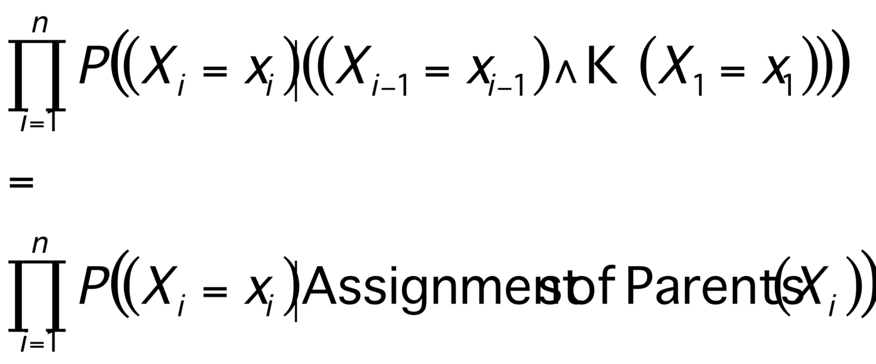
The general case
P(X₁⁼x₁ ^ X₂=x₂ ^ ….X_{n-1}=x_{n-1} ^ X_{n}=x_{n}) =
P(X_{n}=x_{n} ^ X_{n-1}=x_{n-1} ^ ….X₂=x₂ ^ X₁=x₁) =
P(X_{n}=x_{n} ⏐ X_{n-1}=x_{n-1} ^ ….X₂=x₂ ^ X₁=x₁) * P(X_{n-1}=x_{n-1} ^…. X₂=x₂ ^ X₁=x₁) =
P(X_{n}=x_{n} ⏐ X_{n-1}=x_{n-1} ^ ….X₂=x₂ ^ X₁=x₁) * P(X_{n-1}=x_{n-1} ⏐…. X₂=x₂ ^ X₁=x₁) *
P(X_{n-2}=x_{n-2} ^…. X₂=x₂ ^ X₁=x₁) =
:
:
=
So any entry in joint pdf table can be computed. And so any conditional probability can be computed.
Copyright © 2001, Andrew W. Moore

Slide 42
Where are we now?
We have a methodology for building Bayes nets.
We don’t require exponential storage to hold our probability table. Only exponential in the maximum number of parents of any node.
We can compute probabilities of any given assignment of truth values to the variables. And we can do it in time linear with the number of nodes.
So we can also compute answers to any questions.
P(s)=0.3
S
M
P(M)=0.6
P(R⏐M)=0.3
P(R⏐~M)=0.6
P(L⏐M^S)=0.05
P(L⏐M^~S)=0.1
P(L⏐~M^S)=0.1
P(L⏐~M^~S)=0.2
L
P(T⏐L)=0.3
P(T⏐~L)=0.8
R
T
E.G. What could we do to compute P(R ⏐ T,~S)?
Copyright © 2001, Andrew W. Moore

Slide 43
Where are we now?
Step 1: Compute P(R ^ T ^ ~S)
Step 2: Compute P(~R ^ T ^ ~S)
Step 3: Return
P(R ^ T ^ ~S)
-------------------------------------
P(R ^ T ^ ~S)+ P(~R ^ T ^ ~S)
We have a methodology for building Bayes nets.
We don’t require exponential storage to hold our probability table. Only exponential in the maximum number of parents of any node.
We can compute probabilities of any given assignment of truth values to the variables. And we can do it in time linear with the number of nodes.
So we can also compute answers to any questions.
P(s)=0.3
S
M
P(M)=0.6
P(R⏐M)=0.3
P(R⏐~M)=0.6
P(L⏐M^S)=0.05
P(L⏐M^~S)=0.1
P(L⏐~M^S)=0.1
P(L⏐~M^~S)=0.2
L
P(T⏐L)=0.3
P(T⏐~L)=0.8
R
T
E.G. What could we do to compute P(R ⏐ T,~S)?
Copyright © 2001, Andrew W. Moore

Slide 44
Where are we now?
Step 1: Compute P(R ^ T ^ ~S)
Step 2: Compute P(~R ^ T ^ ~S)
Step 3: Return
P(R ^ T ^ ~S)
-------------------------------------
P(R ^ T ^ ~S)+ P(~R ^ T ^ ~S)
Sum of all the rows in the Joint that match R ^ T ^ ~S
We have a methodology for building Bayes nets.
We don’t require exponential storage to hold our probability table. Only exponential in the maximum number of parents of any node.
We can compute probabilities of any given assignment of truth values to the variables. And we can do it in time linear with the number of nodes.
So we can also compute answers to any questions.
Sum of all the rows in the Joint that match ~R ^ T ^ ~S
P(s)=0.3
S
M
P(M)=0.6
P(R⏐M)=0.3
P(R⏐~M)=0.6
P(L⏐M^S)=0.05
P(L⏐M^~S)=0.1
P(L⏐~M^S)=0.1
P(L⏐~M^~S)=0.2
L
P(T⏐L)=0.3
P(T⏐~L)=0.8
R
T
E.G. What could we do to compute P(R ⏐ T,~S)?
Copyright © 2001, Andrew W. Moore

Slide 45
Where are we now?
4 joint computes
Step 1: Compute P(R ^ T ^ ~S)
Step 2: Compute P(~R ^ T ^ ~S)
Step 3: Return
P(R ^ T ^ ~S)
-------------------------------------
P(R ^ T ^ ~S)+ P(~R ^ T ^ ~S)
Sum of all the rows in the Joint that match R ^ T ^ ~S
We have a methodology for building Bayes nets.
We don’t require exponential storage to hold our probability table. Only exponential in the maximum number of parents of any node.
We can compute probabilities of any given assignment of truth values to the variables. And we can do it in time linear with the number of nodes.
So we can also compute answers to any questions.
Sum of all the rows in the Joint that match ~R ^ T ^ ~S
4 joint computes
Each of these obtained by the “computing a joint probability entry” method of the earlier slides
P(s)=0.3
S
M
P(M)=0.6
P(R⏐M)=0.3
P(R⏐~M)=0.6
P(L⏐M^S)=0.05
P(L⏐M^~S)=0.1
P(L⏐~M^S)=0.1
P(L⏐~M^~S)=0.2
L
P(T⏐L)=0.3
P(T⏐~L)=0.8
R
T
E.G. What could we do to compute P(R ⏐ T,~S)?
Copyright © 2001, Andrew W. Moore

Slide 46
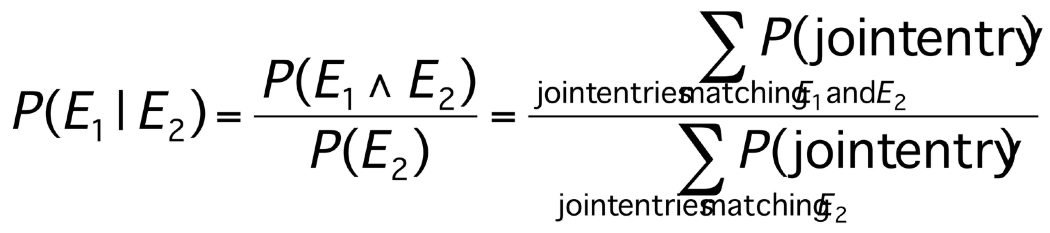
The good news
We can do inference. We can compute any conditional probability:
P( Some variable ⏐ Some other variable values )
Copyright © 2001, Andrew W. Moore

Slide 47
The good news
We can do inference. We can compute any conditional probability:
P( Some variable ⏐ Some other variable values )
Suppose you have m binary-valued variables in your Bayes Net and expression E₂ mentions k variables.
How much work is the above computation?
Copyright © 2001, Andrew W. Moore

Slide 48
The sad, bad news
Conditional probabilities by enumerating all matching entries in the joint are expensive:
Exponential in the number of variables.
Copyright © 2001, Andrew W. Moore

Slide 49
The sad, bad news
Conditional probabilities by enumerating all matching entries in the joint are expensive:
Exponential in the number of variables.
But perhaps there are faster ways of querying Bayes nets?
In fact, if I ever ask you to manually do a Bayes Net inference, you’ll find there are often many tricks to save you time.
So we’ve just got to program our computer to do those tricks too, right?
Copyright © 2001, Andrew W. Moore

Slide 50
The sad, bad news
Conditional probabilities by enumerating all matching entries in the joint are expensive:
Exponential in the number of variables.
But perhaps there are faster ways of querying Bayes nets?
In fact, if I ever ask you to manually do a Bayes Net inference, you’ll find there are often many tricks to save you time.
So we’ve just got to program our computer to do those tricks too, right?
Sadder and worse news:
General querying of Bayes nets is NP-complete.
Copyright © 2001, Andrew W. Moore

Slide 51
Bayes nets inference algorithms
A poly-tree is a directed acyclic graph in which no two nodes have more than one path between them.
X₁
X₂
X₁
X₂
S
M
S
M
L
X₃
L
X₃
R
X₄
R
X₄
X₅
X₅
T
T
A poly tree Not a poly tree
(but still a legal Bayes net)
If net is a poly-tree, there is a linear-time algorithm (see a later Andrew lecture).
The best general-case algorithms convert a general net to a poly-tree (often at huge expense) and calls the poly-tree algorithm.
Another popular, practical approach (doesn’t assume poly-tree): Stochastic Simulation.
Copyright © 2001, Andrew W. Moore

Slide 52
Sampling from the Joint Distribution
P(s)=0.3
S
M
P(M)=0.6
P(R⏐M)=0.3
P(R⏐~M)=0.6
P(L⏐M^S)=0.05
P(L⏐M^~S)=0.1
P(L⏐~M^S)=0.1
P(L⏐~M^~S)=0.2
L
P(T⏐L)=0.3
P(T⏐~L)=0.8
R
T
It’s pretty easy to generate a set of variable-assignments at random with the same probability as the underlying joint distribution.
How?
Copyright © 2001, Andrew W. Moore

Slide 53
Sampling from the Joint Distribution
P(s)=0.3
S
M
P(M)=0.6
P(R⏐M)=0.3
P(R⏐~M)=0.6
P(L⏐M^S)=0.05
P(L⏐M^~S)=0.1
P(L⏐~M^S)=0.1
P(L⏐~M^~S)=0.2
L
P(T⏐L)=0.3
P(T⏐~L)=0.8
R
T
1. Randomly choose S. S = True with prob 0.3
2. Randomly choose M. M = True with prob 0.6
3. Randomly choose L. The probability that L is true depends on the assignments of S and M. E.G. if steps 1 and 2 had produced S=True, M=False, then probability that L is true is 0.1
4. Randomly choose R. Probability depends on M.
5. Randomly choose T. Probability depends on L
Copyright © 2001, Andrew W. Moore

Slide 54
A general sampling algorithm
Let’s generalize the example on the previous slide to a general Bayes Net.
As in Slides 16-17 , call the variables X₁ .. X_{n}, where Parents(X_{i}) must be a subset of {X₁ .. X_{i-1}}.
For i=1 to n:
  Find parents, if any, of X_{i}. Assume n(i) parents. Call them X_{p(i,1)}, X_{p(i,2)}, …X_{p(i,n(i))}.
  Recall the values that those parents were randomly given: x_{p(i,1)}, x_{p(i,2)}, …x_{p(i,n(i))}.
  Look up in the lookup-table for: P(X_{i}=True ⏐ X_{p(i,1)}=x_{p(i,1)},X_{p(i,2)}=x_{p(i,2)}…X_{p(i,n(i))}=x_{p(i,n(i))})
  Randomly set x_{i}=True according to this probability
x₁, x₂,…x_{n} are now a sample from the joint distribution of X₁, X₂,…X_{n}.
Copyright © 2001, Andrew W. Moore

Slide 55
Stochastic Simulation Example
Someone wants to know P(R = True ⏐ T = True ^ S = False )
We’ll do lots of random samplings and count the number of occurrences of the following:
  N_{c} : Num. samples in which T=True and S=False.
  N_{s} : Num. samples in which R=True, T=True and S=False.
  N : Number of random samplings
Now if N is big enough:
N_{c} /N is a good estimate of P(T=True and S=False).
N_{s} /N is a good estimate of P(R=True ,T=True , S=False).
P(R⏐T^~S) = P(R^T^~S)/P(T^~S), so N_{s} / N_{c} can be a good estimate of P(R⏐T^~S).
Copyright © 2001, Andrew W. Moore

Slide 56
General Stochastic Simulation
Someone wants to know P(E₁ ⏐ E₂ )
We’ll do lots of random samplings and count the number of occurrences of the following:
  N_{c} : Num. samples in which E₂
  N_{s} : Num. samples in which E₁ and E₂
  N : Number of random samplings
Now if N is big enough:
N_{c} /N is a good estimate of P(E₂).
N_{s} /N is a good estimate of P(E₁ , E₂).
P(E₁ ⏐ E₂) = P(E₁^ E₂)/P(E₂), so N_{s} / N_{c} can be a good estimate of P(E₁⏐ E₂).
Copyright © 2001, Andrew W. Moore

Slide 57
Likelihood weighting
Problem with Stochastic Sampling:
  With lots of constraints in E, or unlikely events in E, then most of the simulations will be thrown away, (they’ll have no effect on Nc, or Ns).
Imagine we’re part way through our simulation.
  In E2 we have the constraint Xi = v
  We’re just about to generate a value for Xi at random. Given the values assigned to the parents, we see that P(Xi = v ⏐ parents) = p .
  Now we know that with stochastic sampling:
  we’ll generate “Xi = v” proportion p of the time, and proceed.
  And we’ll generate a different value proportion 1-p of the time, and the simulation will be wasted.
Instead, always generate Xi = v, but weight the answer by weight “p” to compensate.
Copyright © 2001, Andrew W. Moore

Slide 58
Likelihood weighting
Set N_{c} :=0, N_{s} :=0
Generate a random assignment of all variables that matches E₂. This process returns a weight w.
Define w to be the probability that this assignment would have been generated instead of an unmatching assignment during its generation in the original algorithm.Fact: w is a product of all likelihood factors involved in the generation.
N_{c} := N_{c} + w
If our sample matches E₁ then N_{s} := N_{s} + w
Go to 1
Again, N_{s} / N_{c} estimates P(E₁ ⏐ E₂ )
Copyright © 2001, Andrew W. Moore

Slide 59
Case Study I
Pathfinder system. (Heckerman 1991, Probabilistic Similarity Networks, MIT Press, Cambridge MA).
Diagnostic system for lymph-node diseases.
60 diseases and 100 symptoms and test-results.
14,000 probabilities
Expert consulted to make net.
  8 hours to determine variables.
  35 hours for net topology.
  40 hours for probability table values.
Apparently, the experts found it quite easy to invent the causal links and probabilities.
Pathfinder is now outperforming the world experts in diagnosis. Being extended to several dozen other medical domains.
Copyright © 2001, Andrew W. Moore

Slide 60
Questions
What are the strengths of probabilistic networks compared with propositional logic?
What are the weaknesses of probabilistic networks compared with propositional logic?
What are the strengths of probabilistic networks compared with predicate logic?
What are the weaknesses of probabilistic networks compared with predicate logic?
(How) could predicate logic and probabilistic networks be combined?
Copyright © 2001, Andrew W. Moore

Slide 61
What you should know
The meanings and importance of independence and conditional independence.
The definition of a Bayes net.
Computing probabilities of assignments of variables (i.e. members of the joint p.d.f.) with a Bayes net.
The slow (exponential) method for computing arbitrary, conditional probabilities.
The stochastic simulation method and likelihood weighting.
Copyright © 2001, Andrew W. Moore

