Slide 1
XamineRIS
Spring 2021 – Software Engineering
Team 7
Nicholas Burns, Michael Galicia, Jiovany Reyes, & Ethan Tinsley

Slide 2
Table of Contents
Team members and their respective responsibilities
Project description
Project Planning and Organization
Project schedule
Project deliverables
Tools used
Project functionalities
Architecture of the developed system
Lessons learned
Conclusion

Slide 3
Team members and their respective responsibilities
Nicholas Burns
Develop Methodology
Requirements and tool gathering
Implement technician section
Implement receptionist section
UML Diagram
Ethan Tinsley
Develop Methodology
Requirements and tool gathering
Implement Referring Doctor section
Implement receptionist section
Testing
Michael Galicia
Develop Methodology
Requirements and tool gathering
Sequence Diagram
Jiovany Reyes
Develop Methodology
Requirements and tool gathering
Workflow Diagram
Presentation preparation
Team meetings

Slide 4
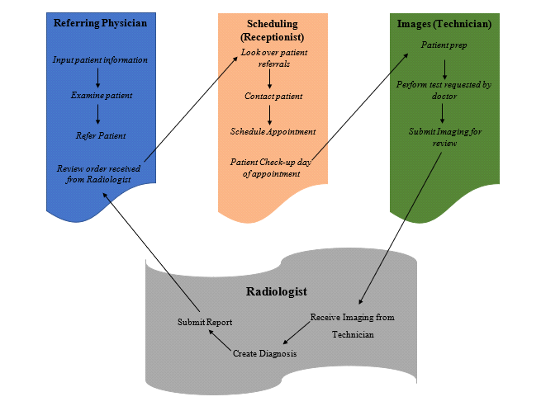
Project description
Reverse engineer our healthcare clinic’s current Radiology Information System (RIS) using Java. The new system supports the clinic’s various medical services, including its end-to-end radiology service.

Slide 5
Project Planning and Organization
We used a standard Software Engineering process to plan our development of Xamine RIS:
Requirements Gathering: See included media for our requirements list.
Prototype: Materials provided in included media
Design: See the next few pages for our ERD and Workflow diagram, used to plan out our data.
Implementation: See included media for our full, documented codebase.
Testing: Testing report included in media

Slide 6
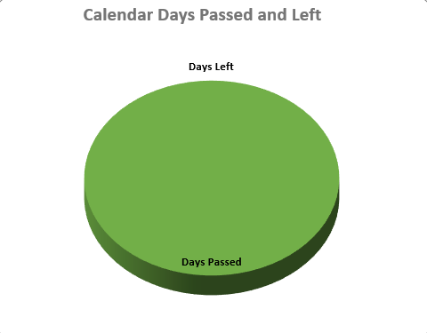
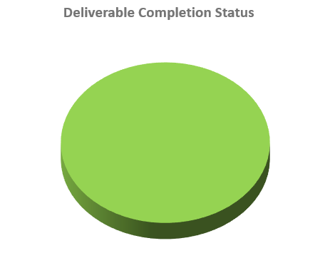
Project schedule
https://docs.google.com/spreadsheets/d/1Qvy06iemxjTh3QIYdRoLQJPSDiDmP_MQdI9scMNjUK4/edit#gid=1106446841

Slide 7
Project deliverables
Patient: A record holding a single patient’s history, information, and orders.
Order: A single referral order placed by Referring Dr. user and updated through flow of the program.
Image: A single file, with associated label and other details.
Team: An organizational tool to separate RIS staff into teams for assignment for orders.
Modality Option: A list of options for modality available in the RIS clinic.
User: Record holding information for a single user, username, password, permission etc.
Permission: Holds records for permissions levels and their associated variables.

Slide 8
Tools used
Jira: We used Jira to track our requirements and tasks.
Discord: We used discord to communicate and have full meetings. Also used for notes, resource posting, and a help channel.
Draw.io: This tool was used to develop our workflow diagram and ERD, to have a good visual guide for our requirements
Creately.com UML Diagram tool: Used to create UML class diagram for our program structure.
Eclipse IDE: IDE used by all members. Used the WindowBuilder plugin to design and implement our GUI
GitHub: Used for code storage and sharing between project members, also where docs were stored.
MySQL Server and Workbench: Used to create and utilize database

Slide 9
Project functionalities
Functional Requirements – Receptionist
Receptionist can view todays appointments in “Today’s appointments” sections
Receptionist can check-in patients from the “Today’s appointments” section
Receptionist can check-in patients including allocating proper room
Receptionist can view appointments that lack a time and date (IE unscheduled appointments)
Receptionist can give a date and time to unscheduled appointments
Receptionist can view patient’s medical history
Functional Requirements – Referring Doctor
Dr is able to create new patient record
Dr is able to submit patient information, ailment, and modality needed
Dr is able to search patients based off of age (birthdate) to create a new order
Dr is able to select existing patients to create a new order
Dr can see current orders
Dr can see when reports were filed and by whom
Dr is notified when an order is completed
Dr can see completed orders
Dr can email the link in order to view report

Slide 10
Project functionalities
Functional Requirements – Technician
Technician has access to checked-in patient's table
Technician has access to patient information
Technician has ability to add and remove images to the patient's order
Technician prompted with a warning if no images selected when trying to finalize a report.
Technician can finalize reports to send to radiologist
Technician notified when patient is checked in and assigned to their team
Functional Requirements – Radiologist
Radiologist has access to reports sent over by the technician team
Radiologist can download images contained in a report
Radiologist is notified when a report is ready for analysis
Radiologist can see patient information
Radiologist can write in submittable text box.
Radiologist can save an analysis without submitting it
Radiologist can submit completed analysis

Slide 11
Project functionalities
Functional Requirements – System
Order page displays thumbnails
Database allows for common image files for images
Users can edit and view patient information
Users can see patients current and past orders
Throw a warning when patient allergies/ health implications interfere with lab materials
User is able to log in via home screen
User is able to log out via nav bar
Admin users are able to access admin backend via navbar
Users can see who is currently signed in from the navbar

Slide 12
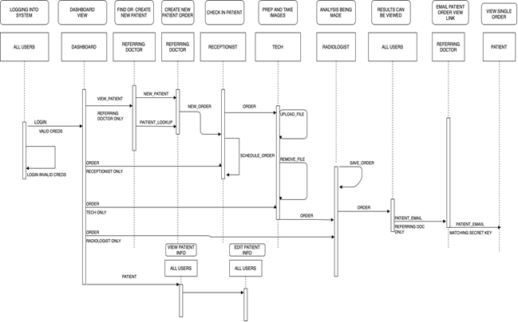
Architecture of the developed system

Slide 13
Lessons learned
Throughout this semester we have learned a lot from this project. This project has taught us how to use various applications such as GitHub, WindowBuilder, Jira, Diagram Builder, MySQL and etc. All those applications have taught us a lot over the past couple of weeks but WindowBuilder has really taught us the most. We were not very familiar with building GUI’s until we got familiar with the WindowBuilder application. The WindowBuilder helps you create GUI’s by selecting components and dragging them over to a window. Once the components were dragged over, it would generate the code for you.
We believe something that could empower the future team is having set communication expectations, knowing one another’s strengths and weaknesses and additional team members. I think these 3 ways could really help the team by distributing the work evenly or distributing the work based on their skills and previous work.

