Slide 1
Molecular Properties

Slide 2
Sample Input
echo
start ch3f
title ch3f
charge 0
geometry
c 0.0 0.0 0.0
f 0.0 0.0 1.383
h 1.028 0.0 -0.350
h -0.514 0.890 -0.350
h -0.514 -0.890 -0.350
end
basis
* library 6-311G
end
dft
xc b3lyp
end
property
mulliken
dipole
quadrupole
octupole
efieldgrad
shielding
end
task dft property
property
shielding 2 1 2
end

Slide 3
Output Snippet (1)
-------------
Dipole Moment
-------------
Center of charge (in au) is the expansion point
X = 0.0000000 Y = 0.0000000 Z = 0.0000000
Dipole moment 0.8526960243 A.U.
DMX -0.0000003199 DMXEFC 0.0000000000
DMY -0.0000003199 DMYEFC 0.0000000000
DMZ 0.8526960243 DMZEFC 0.0000000000
-EFC- dipole 0.0000000000 A.U.
Total dipole 0.8526960243 A.U.
Dipole moment 2.1673534901 Debye(s)
DMX -0.0000008131 DMXEFC 0.0000000000
DMY -0.0000008130 DMYEFC 0.0000000000
DMZ 2.1673534901 DMZEFC 0.0000000000
-EFC- dipole 0.0000000000 DEBYE(S)
Total dipole 2.1673534901 DEBYE(S)
1 a.u. = 2.541766 Debyes

Slide 4
Output Snippet (2)
-----------------------
Electric field gradient
-----------------------
1 a.u. = 0.324123 10**(16) esu/cm**3 ( or statvolts/cm**2 ) = 0.97174 10**(22) v/m**2
------------------------------------------------------------
Atom X Y Z
------------------------------------------------------------
1 C 0.00000 0.00000 1.19651
------------------------------------------------------------
Electric field gradient in molecular frame (a.u.)
XX YY ZZ XY XZ YZ
------------------------------------------------------------------------------------------
0.280943 0.280943 -0.561885 0.000000 0.000000 0.000000
Principal components (a.u.) and orientation
of principal axis w.r.t. absolute frame Asymmetry parameter eta
--------------------------------------------------------------------------------------
-0.561885 0.280943 0.280943 0.000000
0.000000 0.707453 0.706760
0.000000 -0.706760 0.707453
1.000000 0.000000 0.000000

Slide 5
Output Snippet (3)
Atom: 1 C
Diamagnetic
243.3437 0.0000 0.0000
0.0000 243.3437 0.0000
0.0000 0.0000 256.9231
Paramagnetic
-156.9102 0.0000 0.0000
0.0000 -156.9102 0.0000
0.0000 0.0000 -69.0429
Total Shielding Tensor
86.4335 0.0000 0.0000
0.0000 86.4335 0.0000
0.0000 0.0000 187.8802
isotropic = 120.2491
anisotropy = 101.4467
Principal Components and Axis System
1 2 3
187.8802 86.4335 86.4335
1 0.0000 -0.7065 0.7077
2 0.0000 0.7077 0.7065
3 1.0000 0.0000 0.0000

Slide 6
Excited State Calculations with TDDFT
Optical properties (UV/Vis)
Pre- and near-edge X-ray absorption (XANES)
Time-Dependent Density Functional Theory, Marques et al, Springer 2006

Slide 7
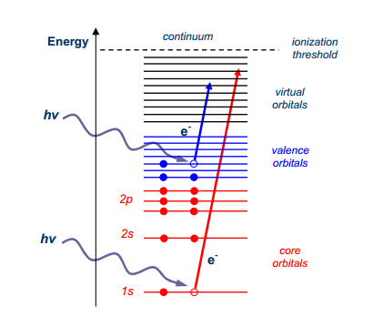
UV/Vis & X-ray Spectroscopy
UV/Vis
X-ray

Slide 8
Basic UV/Vis Input
geometry
O 0.00000000 0.00000000 0.12982363
H 0.75933475 0.00000000 -0.46621158
H -0.75933475 0.00000000 -0.46621158
end
basis
O library 6-31G**
H library 6-31G**
end
dft
xc b3lyp
end
tddft
nroots 10
end
task tddft energy

Slide 9
Sample Output
----------------------------------------------------------------------------
Root 1 singlet b2 0.294221372 a.u. 8.0062 eV
----------------------------------------------------------------------------
Transition Moments X 0.00000 Y 0.26890 Z 0.00000
Transition Moments XX 0.00000 XY 0.00000 XZ 0.00000
Transition Moments YY 0.00000 YZ -0.08066 ZZ 0.00000
Dipole Oscillator Strength 0.01418
Occ. 5 b2 --- Virt. 6 a1 1.00002 X
----------------------------------------------------------------------------
Root 2 singlet a2 0.369097477 a.u. 10.0437 eV
----------------------------------------------------------------------------
Transition Moments X 0.00000 Y 0.00000 Z 0.00000
Transition Moments XX 0.00000 XY 0.24936 XZ 0.00000
Transition Moments YY 0.00000 YZ 0.00000 ZZ 0.00000
Dipole Oscillator Strength 0.00000
Occ. 5 b2 --- Virt. 7 b1 -0.99936 X
----------------------------------------------------------------------------
Root 3 singlet a1 0.387064734 a.u. 10.5326 eV
----------------------------------------------------------------------------
Transition Moments X 0.00000 Y 0.00000 Z -0.60463
Transition Moments XX 0.62351 XY 0.00000 XZ 0.00000
Transition Moments YY 0.09429 YZ 0.00000 ZZ 0.45941
Dipole Oscillator Strength 0.09433
Occ. 3 b1 --- Virt. 7 b1 0.11875 X
Occ. 4 a1 --- Virt. 6 a1 -0.99241 X

Slide 10
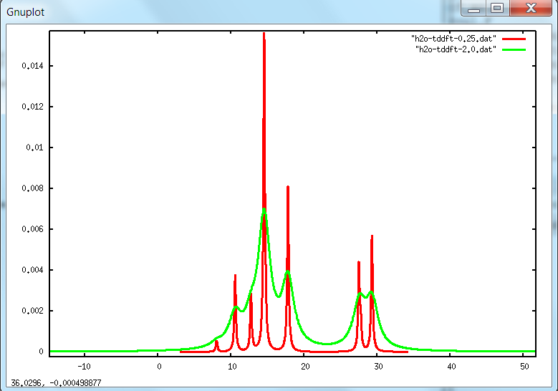
UV/Vis Spectrum
Energy (eV)

Slide 11
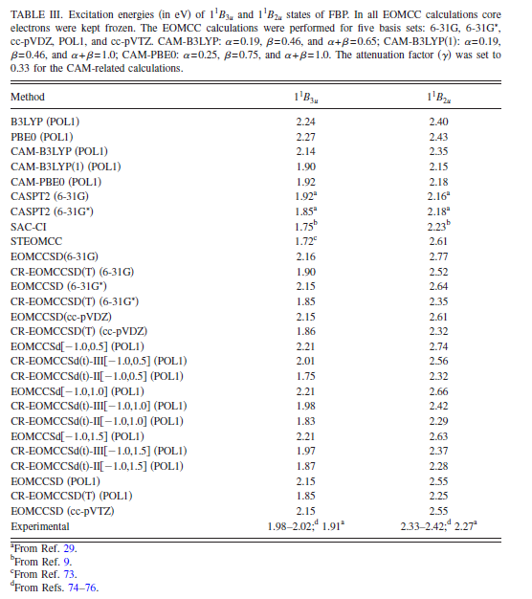
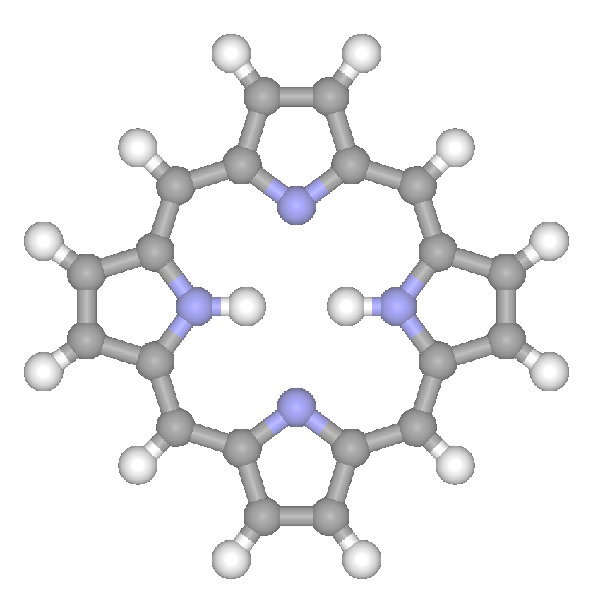
Free Base Porphyrin
JCP, 132, 154103 (2010)

Slide 12
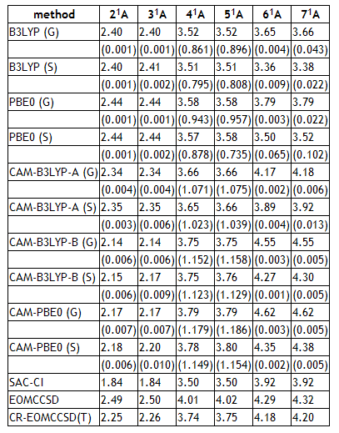
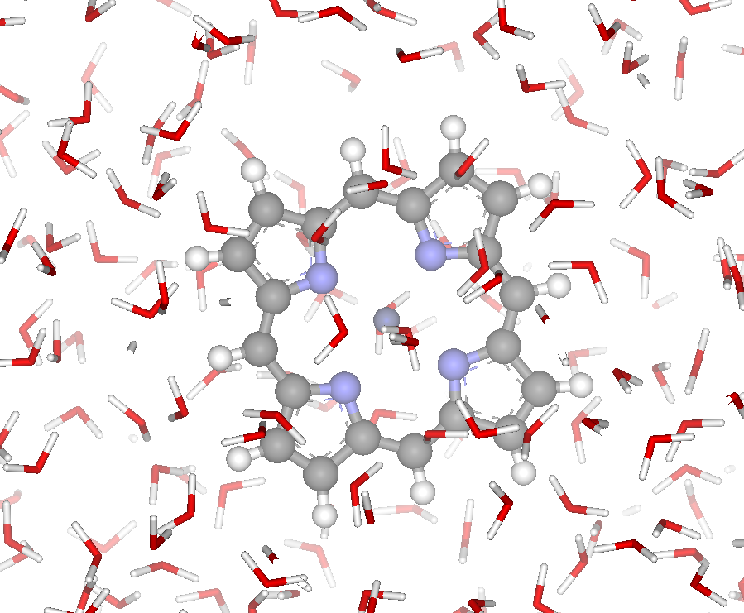
Zinc Porphyrin in Aqueous Solution
Q
B
N
QM/MM approach
ZnP embedded in water
Basis:
6-31G* (C,H,N)
Ahlrichs VTZ basis (Zn)
xc: B3LYP (optimization)
Cubic Box: 30 Å, 869 H₂O
Equilibration: 60ps (298.15K)
JPCA, 113, 6041 (2009)

Slide 13
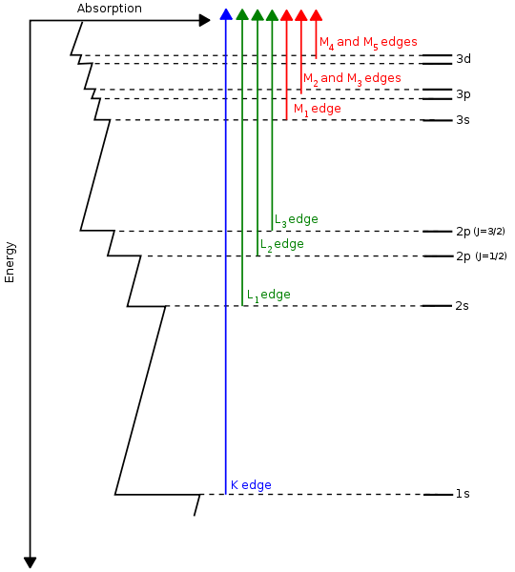
X-ray Absorption Spectroscopy (XAS)
Nomenclature
K-, L-, M- → n= 1, 2, 3
K-edge: 1s, 1s → np
L-edge: 2s, 2p
L₃-edge : 2p → nd
L₂, L₃ → spin-orbit splitting of the p states
Near-edge x-ray absorption (XANES)
Core → unoccupied states
Sub-ionization threshold
Probes chemical env around absorbing center
Requires full treatment of electronic structure of absorbing center and neighbors (nearest, next-nearest)
http://en.wikipedia.org/wiki/X-ray_absorption_spectroscopy

Slide 14
Basic XANES Input
geometry units angstrom noautosym nocenter
O 0 0 0
C 0 0.00 1.15
end
basis
* library aug-cc-pvtz
end
dft
xc b3lyp
end
task dft optimize
dft
xc beckehandh
end
tddft
cis
ecut -15
nroots 30
notriplet
thresh 1e-04
end
task tddft

Slide 15
Sample XANES Output
----------------------------------------------------------------------------
Root 1 singlet a 19.446988682 a.u. 529.1797 eV
----------------------------------------------------------------------------
Transition Moments X -0.03998 Y 0.04263 Z 0.00000
Transition Moments XX 0.00000 XY 0.00000 XZ 0.00048
Transition Moments YY 0.00000 YZ -0.00052 ZZ 0.00000
Dipole Oscillator Strength 0.04429
Occ. 1 a --- Virt. 8 a -0.89542
Occ. 1 a --- Virt. 12 a -0.29239
Occ. 1 a --- Virt. 13 a 0.20379
Occ. 1 a --- Virt. 15 a 0.12786
Occ. 1 a --- Virt. 16 a -0.13234
Occ. 1 a --- Virt. 22 a -0.10334
Occ. 1 a --- Virt. 23 a 0.10010
Occ. 1 a --- Virt. 31 a -0.05352
Occ. 1 a --- Virt. 34 a -0.06341
Occ. 1 a --- Virt. 35 a 0.06832
----------------------------------------------------------------------------
Root 2 singlet a 19.446988682 a.u. 529.1797 eV
----------------------------------------------------------------------------
Transition Moments X 0.04263 Y 0.03998 Z 0.00000
Transition Moments XX 0.00000 XY 0.00000 XZ -0.00052
Transition Moments YY 0.00000 YZ -0.00048 ZZ 0.00000
Dipole Oscillator Strength 0.04429
Occ. 1 a --- Virt. 9 a 0.89542
Occ. 1 a --- Virt. 12 a -0.20379
Occ. 1 a --- Virt. 13 a -0.29239
Occ. 1 a --- Virt. 15 a 0.13234
Occ. 1 a --- Virt. 16 a 0.12786
Occ. 1 a --- Virt. 22 a -0.10010
Occ. 1 a --- Virt. 23 a -0.10334
Occ. 1 a --- Virt. 30 a -0.05352
Occ. 1 a --- Virt. 34 a 0.06832
Occ. 1 a --- Virt. 35 a 0.06341

Slide 16
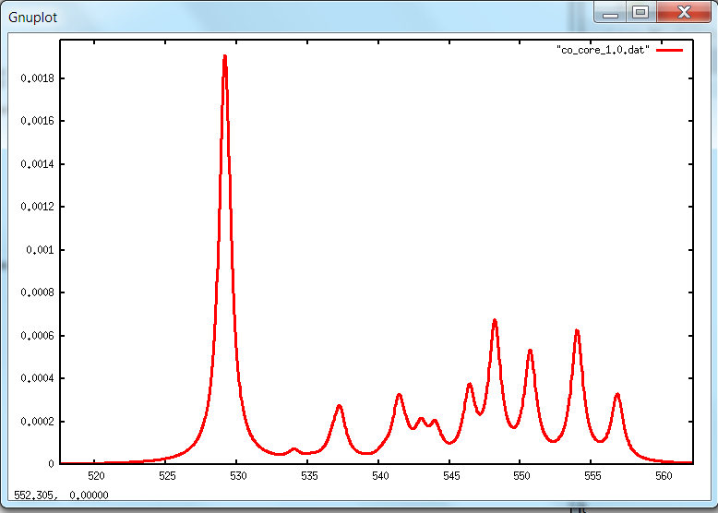
Pre- & Near-Edge X-ray Spectrum
Energy (eV)

Slide 17
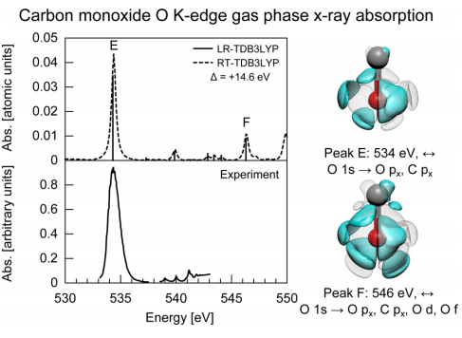
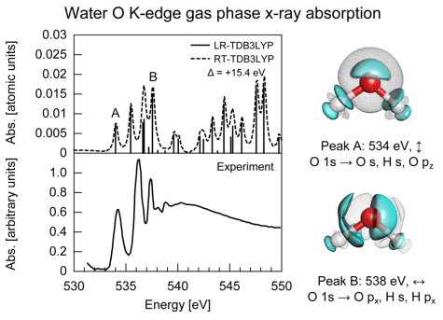
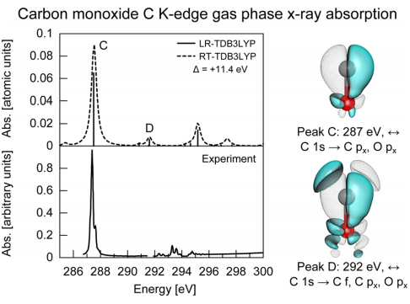
O K-edge in Water and O, C K-edges in CO
JCTC, 8, 3284 (2012)

Slide 18
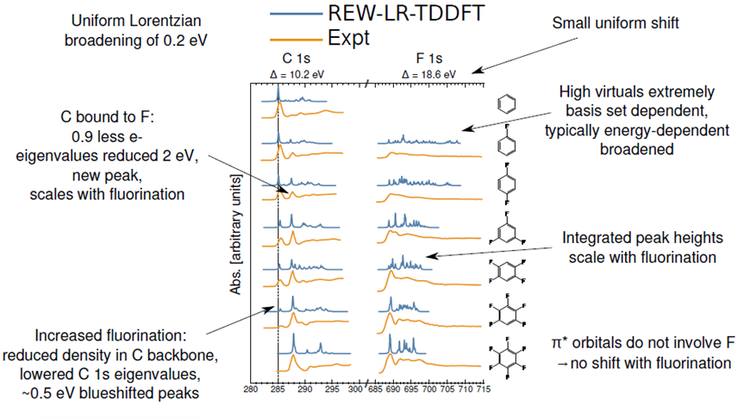
C & F K-edge in Fluorobenzenes
JCTC, 8, 3284 (2012)

Slide 19
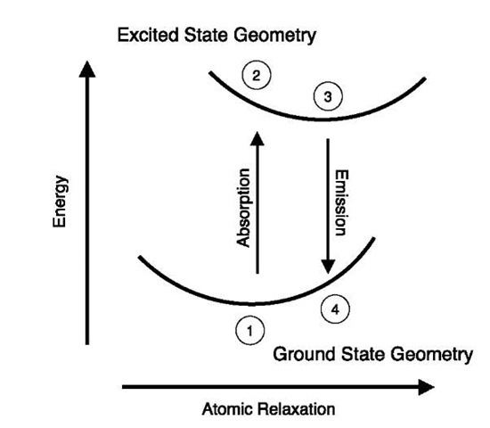
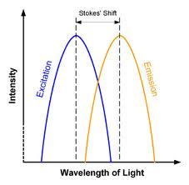
New TDDFT Capabilities in NWChem 6.5
TDDFT optimization on the excited state

