Slide 1
Week 6

Slide 2
Objectives
Sketch the basic idea of gradient descent
Interpret the output of a classifier as a probability
Evaluate a classifier using ROC curves.

Slide 3
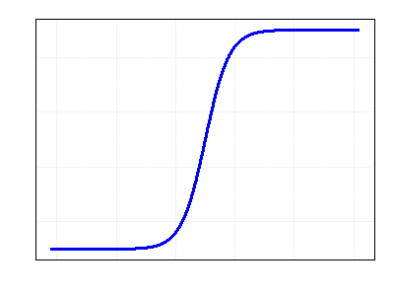
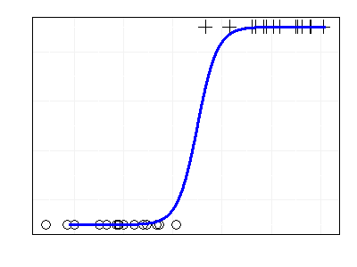


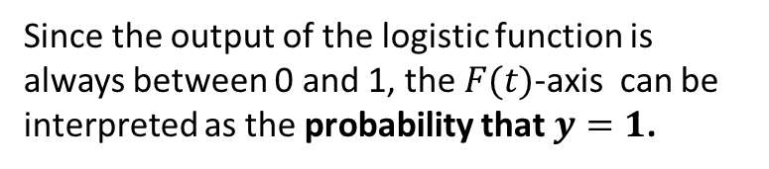



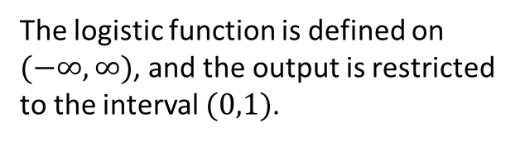
The Logistic Function
$$F\left(t\right)= \frac{1}{1+ e^{−t}}$$
The logistic function is defined on $(−∞,∞)$, and the output is restricted to the interval $(0,1)$.
Since the output of the logistic function is always between 0 and 1, the $F(t)$-axis can be interpreted as the probability that $y=1$.
$$F(t)$$
$$P(y=1)$$
$$t$$
$$θ^{T}x$$

Slide 4

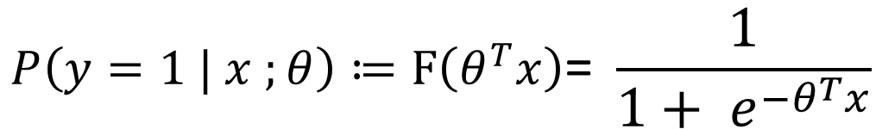
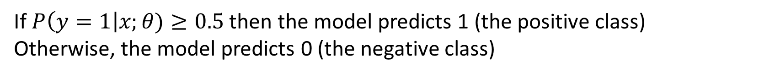
Logistic Regression
Given a response variable, $y∈\left\{0,1\right\},$we want to model the probability that $y=1$, given some input $x=(x_{1},x_{2},…, x_{n})$.
$$P\left(y=1 | x ;θ\right)≔F\left(θ^{T}x\right)\text{= }\frac{1}{1+ e^{−θ^{T}x}}$$
If $P\left(y=1\right|x;θ)≥0.5$ then the model predicts 1 (the positive class)
Otherwise, the model predicts 0 (the negative class)

Slide 5
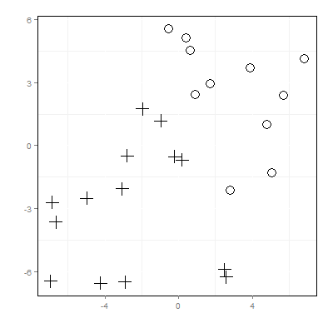


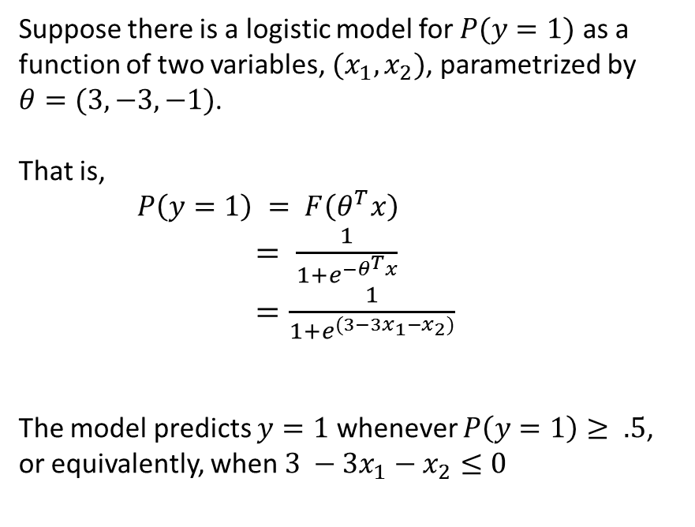

Logistic Regression is also a linear separator.
Suppose there is a logistic model for $P(y=1)$ as a function of two variables, $(x_{1},x_{2})$, parametrized by $θ=(3,−3, −1)$.
That is,
$P\left(y=1\right) = F\left(θ^{T}x\right)$ $= \frac{1}{1+e^{−θ^{T}x}}$ $=\frac{1}{1+e^{(3−3x_{1}−x_{2})}}$
The model predicts $y=1$ whenever $P\left(y=1\right)≥ .5$, or equivalently, when $3 −3x_{1}−x_{2}≤0$
$$x_{2}$$
$$x_{1}$$
The line$x_{2}=−3x_{1}+3$ is called a decision boundary

Slide 6
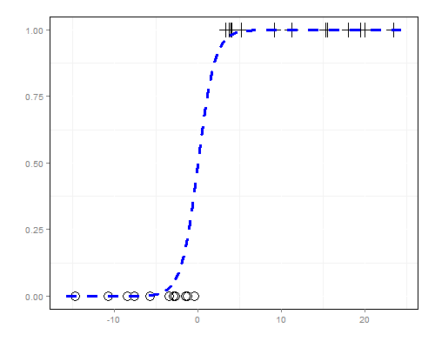





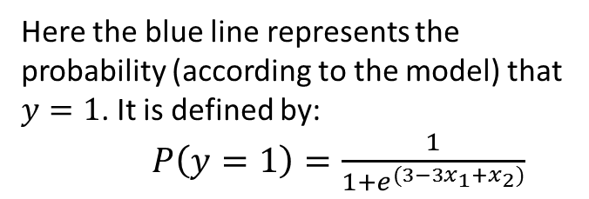
$$x_{2}$$
$$P\left(y=1\right)$$
$$x_{1}$$
$$θ^{T}x=3−3x_{1}+x_{2}$$
Here the blue line represents a decision boundary, and is defined by:
$3−3x_{1}−x_{2}=0$
Here the blue line represents the probability (according to the model) that $y=1$. It is defined by:
$P\left(y=1\right)=\frac{1}{1+e^{(3−3x_{1}+x_{2})}}$

Slide 7
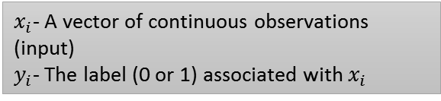

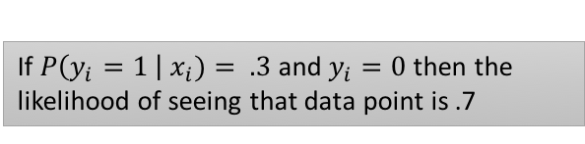
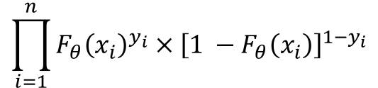
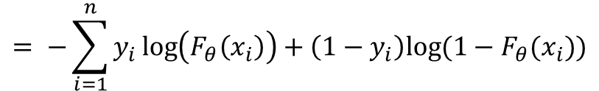
Maximum Likelihood Estimation
Suppose we have a logistic regression model, with fixed $θ$, defined by: $F_{θ}\left(x\right)= F\left(θ^{T}x\right)\text{= }\frac{1}{1+ e^{−θ^{T}x}}$
$x_{i}$- A vector of continuous observations (input)
$y_{i}$- The label (0 or 1) associated with $x_{i}$
We ask, what is the likelihood of seeing a specific data point, $(x_{i},y_{i})$?
$$L\left(x_{i}, y_{i}\right)=F_{θ}{\left(x_{i}\right)}_{ }^{y_{i}} × {\left[1 −F_{θ}\left(x_{i}\right)\right]}^{1−y_{i}}$$
If $P\left(y_{i}=1 \right| x_{i})= .3$ and $y_{i}=0$ then the likelihood of seeing that data point is .7
$$\prod_{i=1}^{n}{F_{θ}{\left(x_{i}\right)}_{ }^{y_{i}} × {\left[1 −F_{θ}\left(x_{i}\right)\right]}^{1−y_{i}}}$$
The product of all the likelihoods of all individual data points
So the likelihood of all the data =
$$= −\sum_{i=1}^{n}{y_{i}\log\left(F_{θ}\left(x_{i}\right)\right)+\left(1−y_{i}\right)log⁡(1−F_{θ}(x_{i}))}$$
Maximizing the likelihood is equivalent to minimizing the negative log likelihood of the data
The cost of the data point $\left(x_{i},y_{i}\right)$, with respect to the logistic regression model, parameterized by $θ$, is given by
$$Cost\left(\left(x_{i},y_{i}\right),θ\right)=−y_{i}\log\left(F_{θ}\left(x_{i}\right)\right)−\left(1−y_{i}\right)log⁡(1−F_{θ}(x_{i}))$$

Slide 8
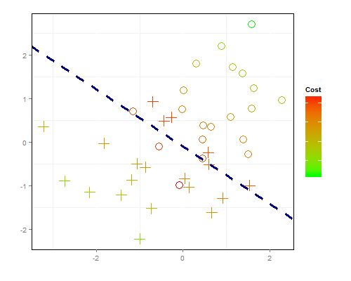
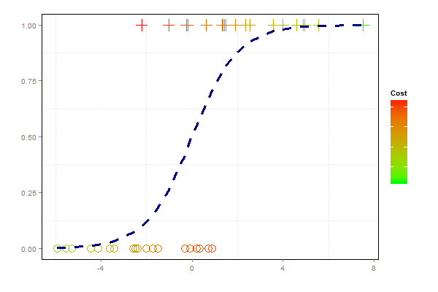




Training
$$P\left(y=1\right)$$
$$x_{2}$$
$$x_{1}$$
$$θ^{T}x$$
Cost is minimized when data points are far from the decision boundary or, equivalently, when the modeled probability $P(y=1)$ is both certain (near 0 or 1), and close to the actual class label.

Slide 9
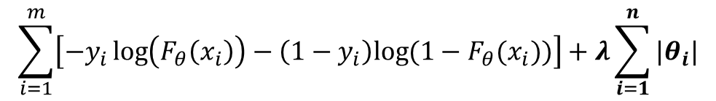
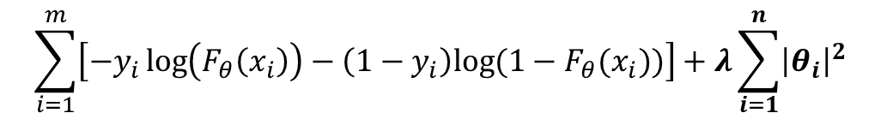
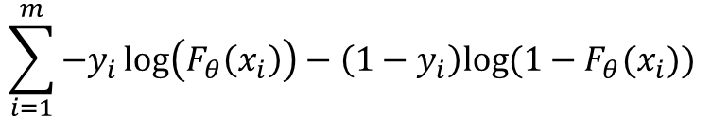
Regularization for Logistic Regression
$$\sum_{i=1}^{m}{−y_{i}\log\left(F_{θ}\left(x_{i}\right)\right)−\left(1−y_{i}\right)log⁡(1−F_{θ}(x_{i})) }$$
Total cost =
Lasso Regularization (L1)
Total cost becomes:
$$\sum_{i=1}^{m}{\left[−y_{i}\log\left(F_{θ}\left(x_{i}\right)\right)−\left(1−y_{i}\right)log⁡(1−F_{θ}(x_{i}))\right]+λ\sum_{i=1}^{n}{|θ_{i}|}}$$
Lasso regularization tends to reduce some parameters to zero
Ridge Regularization (L2)
Total cost becomes:
Ridge regularization tends to reduce the size of all the parameters, but without reducing them all the way to zero
$$\sum_{i=1}^{m}{\left[−y_{i}\log\left(F_{θ}\left(x_{i}\right)\right)−\left(1−y_{i}\right)log⁡(1−F_{θ}(x_{i}))\right]+λ\sum_{i=1}^{n}{{\left|θ_{i}\right|}^{2}}}$$

Slide 10
False Negative
True Positive
True Negative
False Positive

