Slide 1
Week 9
Clustering

Slide 2
Objectives
Sketch Kmeans algorithm
Select K
Scree plots
Silhouette score
Sketch Hierarchical Clustering Algorithm
Discuss characteristics of common clustering algorithms
Kmeans
Hierarchical Clustering
DBSCAN

Slide 3
KMeans
Almost always uses Euclidean distance. (Often called Spherical Kmeans when cosine distance is used)
Easy to explain/implement
Need to choose the right K
Need to choose the right starting point.
Every point is assigned to a cluster (hence, sensitive to outliers)
Suffers from curse of dimensionality

Slide 4
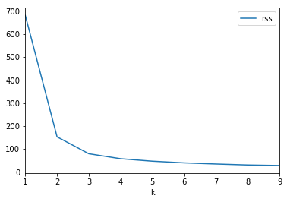
Selecting K – Scree plot
The most common approach for selecting K is to look for a bend in the scree plot.

Slide 5
Selecting K – Silhouette Score
Each point has a silhouette score, relative to a given clustering.
The score is (1 minus) the ratio between the average distance from the point to other points in the same cluster, compared to the average distance from the point to points in the closest cluster.
Silhouette score ranges from 0 (bad) to 1 (good).

Slide 6
Hierarchical Clustering
Can be used with any pairwise dissimilarity. E.g. cosine distance works well with high-dimensional data
No need to choose k
Very interpretable by looking at the dendrogram – especially with a small number of examples.
Need to choose criteria for ‘joining’ clusters.
Max distance between pairs of points
Min distance between pairs of points
Average distance between pairs of points
Minimum intra-cluster variance.

Slide 7
DBSCAN
Works with any pairwise dissimilarity
Works extremely well for irregularly shaped clusters
Does not require every point to be in a cluster.
No need to specify the number of clusters. (Do need to specify some hyper-parameters)

Slide 8
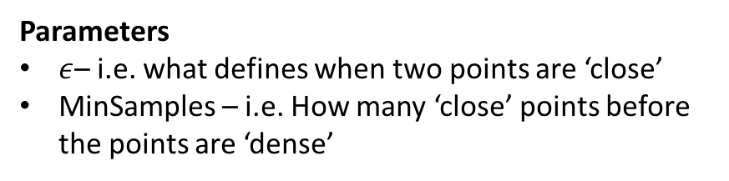
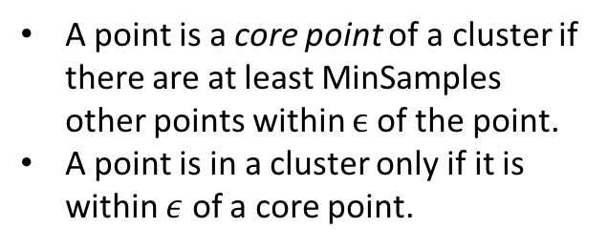
DBSCAN Algorithm
Parameters
$ε$– i.e. what defines when two points are ‘close’
MinSamples – i.e. How many ‘close’ points before the points are ‘dense’
A point is a core point of a cluster if there are at least MinSamples other points within $ϵ$ of the point.
A point is in a cluster only if it is within $ε$ of a core point.

Slide 9
DBSCAN Example
Finds the correct number of clusters
Finds the right ‘shape’ clusters
Leaves out noisy points

