Slide 1
Week 3

Slide 2
Advantages of KNN
Works equally well for classification, regression, multi-class problems.
Can model arbitrarily complex functions (low bias)
Cheap to train
Simple to implement (and explain)

Slide 3
Disadvantages of KNN
Must have a meaningful distance metric between observations.
Suffers from curse of dimensionality
Difficult to weight features according to impact (many ML algorithms do this automatically)
Expensive to score (need to search through entire training data)

Slide 4
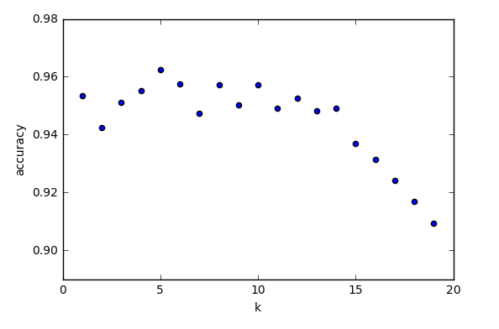
Choosing K (number of neighbors in KNN)

Slide 5
Bias/Variance for KNN
K is the parameter that controls the bias/variance tradeoff
Higher K = more bias, less variance
Lower K = less bias, more variance
According to Occam’s razor, we should choose the highest possible value of k

Slide 6
Week 3 Objectives
Understand NB well enough to make simple predictions by hand.
Use the naive_bayes module in scikit-learn
Discuss taxonomy/pros/cons of naïve bayes
Discuss bias/variance tradeoff in context of naïve bayes

