Slide 1
Tree–Based Methods
Introduction to Machine Learning: Week 4

Slide 2
Objectives
Give a high-level description of decision trees, random forests, and boosting.
Use tree-based methods in scikit-learn
Discuss the various ‘knobs’ and their relation to the bias/variance tradeoff for all tree-based methods.

Slide 3
Decision Tree
Classification or regression
Any type of features (categorical, continuous, ordinal)*
Able to handle missing values*
Arbitrarily low bias
High variance
Fast to train and score. (Usually)
* Not so easy in Python…

Slide 4
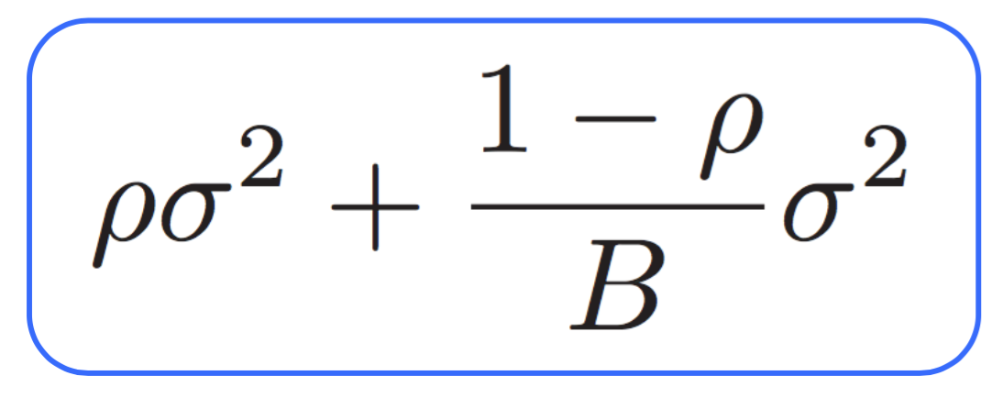
Random Forests
Average of B i.d. (identically distributed) random variables, with pairwise correlation ρ, has variance...
Ensemble of decision trees
RF ‘inherits’ bias from constituent trees.
Variance is controlled by decorrelating the trees
Easy to tune, just need
Low bias constituent trees
‘Enough’ trees in the forest (too many won’t hurt)
Decorrelation between the trees (bootstrapping, n_features, …)

Slide 5
Gradient Boosted Decision Trees
Another ensemble of decision trees
Each successive tree focuses on the examples the previous trees missed
Bias is inherited from constituent trees
Variance is controlled by sampling and learning rate.

