Slide 1
Detecting Urban Food Deserts
Using Spatial Co-location Mining
Woochang Shin and Yashasvi Singh
Notes:
Today we present our project on detecting urban food deserts using spatial co-location mining.
Instead of using simple proximity measures, we frame food deserts as a spatial pattern mining problem.

Slide 2
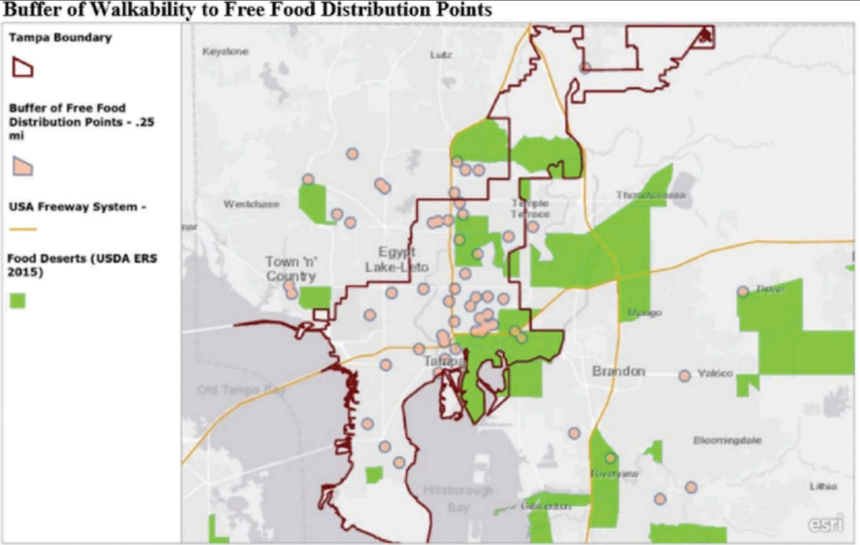
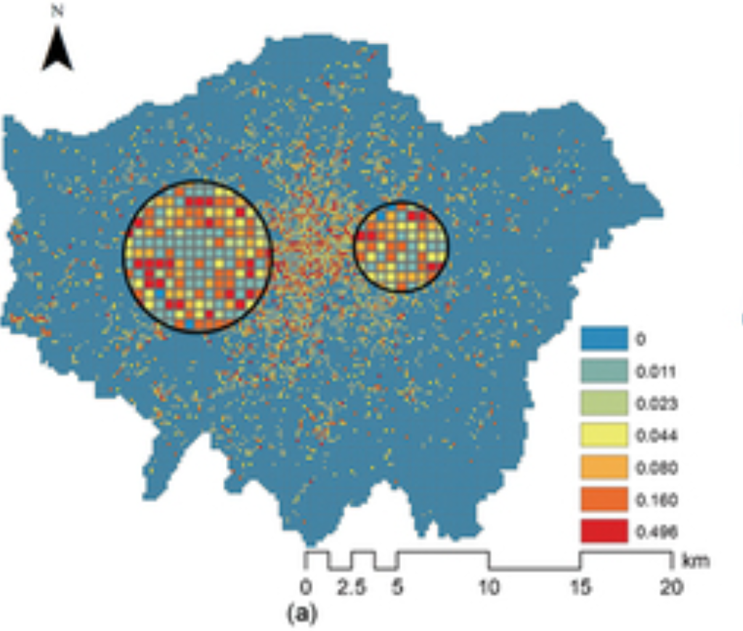
Research Question
How can we detect true food deserts using spatial co-location patterns rather than simple distance-based definitions?
Distance-Based Definition (Buffer Model) vs Spatial Co-Location Pattern
Notes:
First, let me explain how food deserts are traditionally identified.
In the United States, they are typically defined using distance thresholds —for example, people living more than 1 mile in urban areas or 10 miles in rural areas from a supermarket.
The left map illustrates this traditional distance-based approach. Accessibility is determined by whether a grocery store falls within a fixed buffer radius. If it does not, the area may be classified as a food desert.
However, this approach only measures proximity. It does not capture the overall spatial structure of food environments.
The right map demonstrates our alternative idea is spatial co-location patterns. Instead of simply asking whether a grocery store is nearby, we examine how different types of food outlets — such as fast-food restaurants, convenience stores, and grocery stores — cluster or dominate within a given radius R.

Slide 3
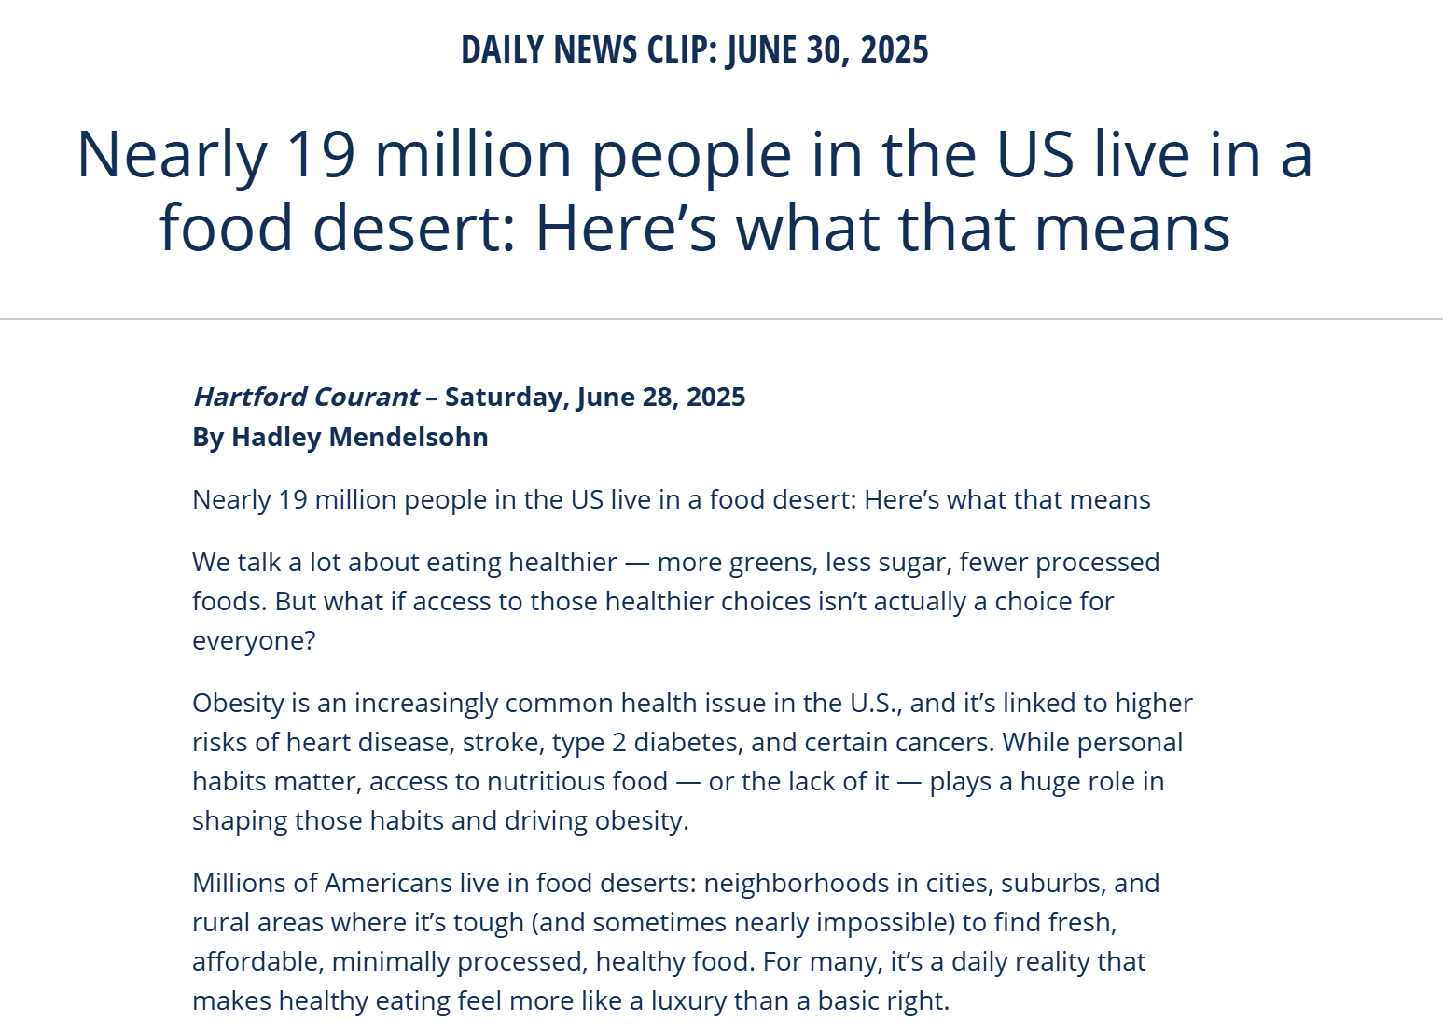
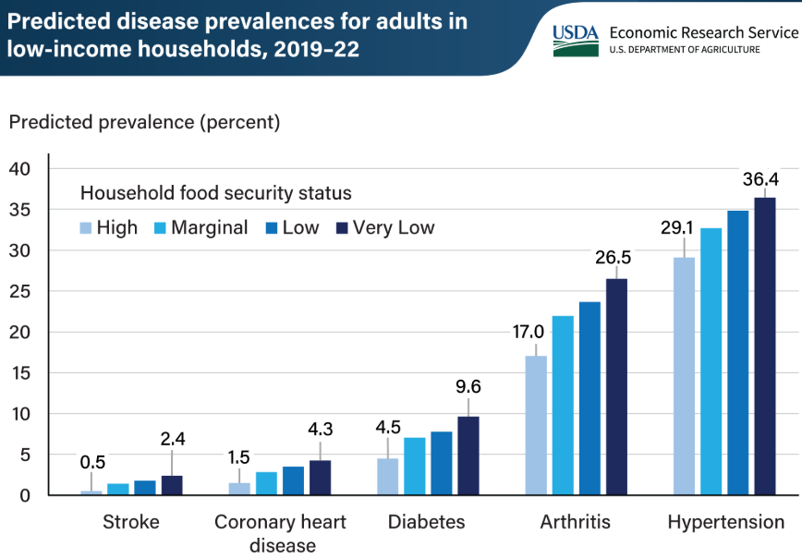
Societal Motivation
• Food access inequality is a major urban challenge
• Limited access to healthy and affordable food is linked to obesity, diabetes, and chronic disease
• Low-income neighborhoods often experience systematic grocery underrepresentation
• Accurate detection of food environment imbalance can improve public policy and community health
Notes:
Let me now explain the societal motivation behind this project.
Food access inequality is one of the major urban challenges of our time. When access to healthy and affordable food is limited, the risks of obesity, diabetes, and other chronic diseases increase significantly.
As shown in the article on the right, nearly 19 million people in the United States live in food deserts. This means that millions of individuals do not have reliable access to fresh and nutritious food.
Furthermore, USDA data indicates that adults in food-insecure households experience higher rates of chronic conditions such as diabetes and hypertension.
In particular, low-income neighborhoods often face systematic underrepresentation of grocery stores, while unhealthy food outlets are more prevalent.
Therefore, we believe that accurately detecting structural imbalance in food environments is essential for improving public policy and promoting community health. For this reason, we chose this topic for our project.

Slide 4
Problem Statement
Data Components:
• Geolocated food outlet data (type, latitude, longitude, etc.)
• Neighborhood definition
• Interaction radius R
Expected Outcomes:
• Identification of structurally imbalanced neighborhoods
• Co-location interaction metrics
• Comparison with distance-based classification
Study Goal:
• Detect spatial imbalance in food environments
Constraints:
• Continuous spatial data (no natural transactions) • Sensitivity to neighborhood radius R • Uneven urban density
Notes:
Our project relies on three key components. First, we use geolocated food outlet data to compute spatial proximity. Second, we use category labels to distinguish grocery stores, fast-food, and convenience stores. Third, we define spatial neighborhoods to assign interpretable regional results. Finally, we introduce a radius parameter R to formally define local interaction scale.
Our goal is to identify neighborhoods where grocery stores are scarce while fast-food and convenience outlets dominate. Unlike traditional definitions based only on distance thresholds, we reinterpret food deserts as a structural imbalance in spatial interactions.
There are several methodological challenges. Spatial data is continuous, so we must explicitly define neighborhoods. Results may be sensitive to the choice of radius R. And urban density differences can affect co-location measures.

Slide 5
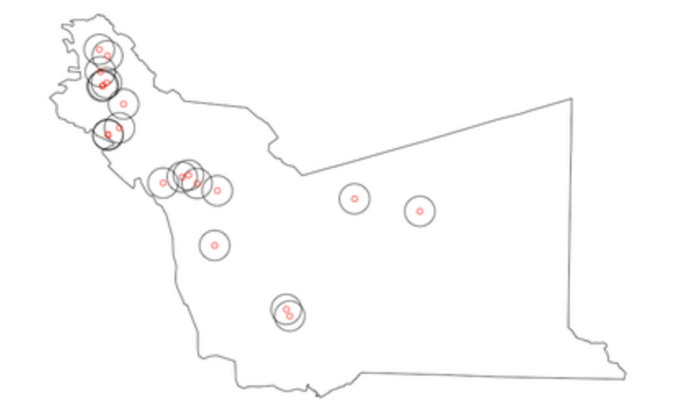
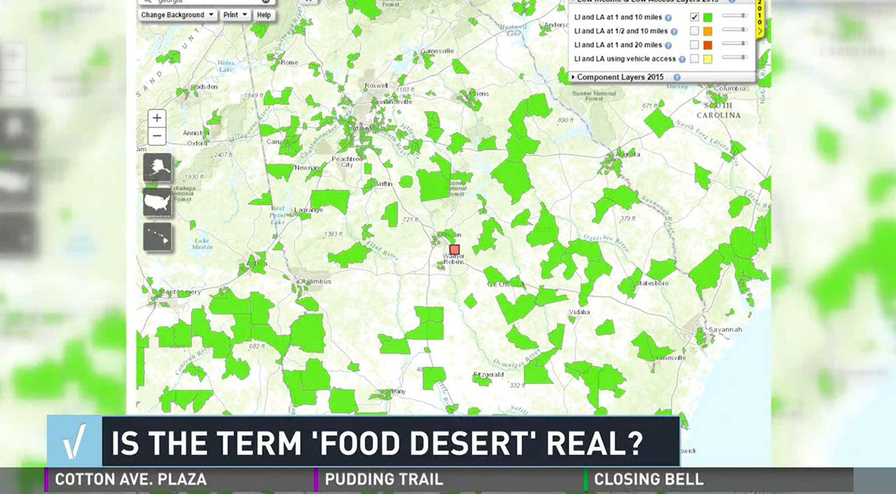
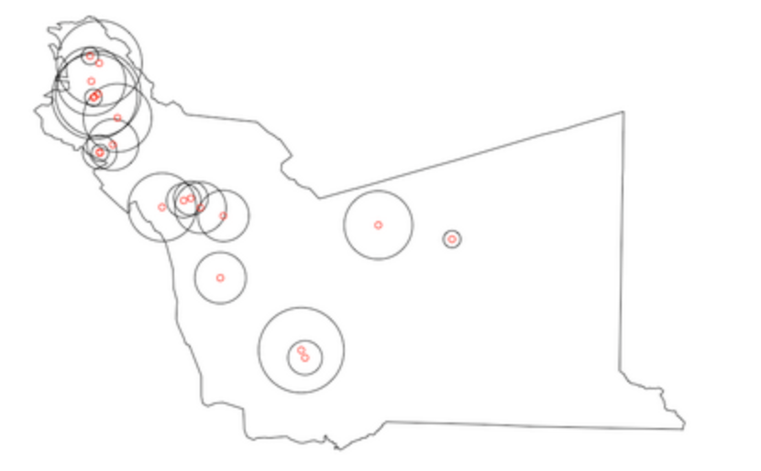


Key Concepts
R=300M
2 neighbors detected
Food Desert
Formula: Participation Ratio Formula
R=500M
5 neighbors detected
Formula: Participation Index
Spatial Neighborhood ®
Participation Index (PI)
Notes:
At the beginning, we briefly introduced food deserts. Here, I clarify the concept more precisely.
A food desert is not just about distance to supermarkets. It often reflects a structural imbalance — where grocery stores are scarce while fast-food or convenience stores are dense. So spatial composition matters, not just proximity.
Traditional maps use distance thresholds, such as no supermarket within one mile. While this captures accessibility, it ignores the overall mix of food outlets.
To address this, we introduce the concept of a Spatial Neighborhood, denoted by R. R defines the local interaction scale. It determines which outlets are considered neighbors.
As shown in the figure, increasing R from 300m to 500m increases detected neighbors. This demonstrates that spatial patterns are sensitive to neighborhood scale.
Next, to quantify co-location strength, we use the Participation Index, or PI.
First, we compute the Participation Ratio — the proportion of outlets of a given type that participate in a pattern.
Then, the Participation Index is defined as the minimum participation ratio across types.
This ensures that a pattern is strong only when all categories participate substantially.
Therefore, a high PI indicates balanced and strong spatial coupling between outlet types.

Slide 6
Challenges
No natural “transactions” in continuous spatial data (need neighborhood definition)
Neighborhood radius selection (R) affects results scale sensitivity
Data sparsity & imbalance across neighborhoods (downtown vs residential)
Capturing absence / *anti-co-location (e.g., fast-food present but grocery missing)
*Anti-co-location is the spatial association between presence of one feature and absence of another.
Notes:
Now, let me discuss the key challenges of our approach.
First, spatial data is continuous. Unlike market-basket data, we do not naturally have predefined transactions. Therefore, we must explicitly define neighborhoods using a radius parameter R.
Second, the choice of R directly affects the results. A small radius captures very local clusters, while a larger radius may reveal broader patterns. So our analysis is sensitive to spatial scale.
Third, urban areas are highly imbalanced. Downtown regions have dense points of interest, while residential areas may be sparse. This imbalance can influence co-location measurements.
Finally, we must capture not only co-location patterns, but also absence patterns — or anti-co-location. For example, areas where fast-food outlets exist but grocery stores are missing. These absence patterns are especially important for identifying potential food deserts.

Slide 7
Related Work and Its Limitations
Uses distance / buffer methods?
Yes
No
Considers spatial composition patterns?
Alternative accessibility metrics
Yes
No
Detects anti-co-location
(absence patterns)?
Most public health food desert studies
Yes
No
Our Work
Most existing work
Notes:
Looking at related work and how it falls short
Food deserts are often defined using distance- or buffer-based measures, which focus on physical proximity to grocery stores.
For example, an area may be classified as a food desert if there is no supermarket within one kilometer.
While these approaches are useful for measuring access, they do not fully capture the overall composition of the food environment/where food is located.
So the next question is whether existing work considers spatial composition patterns.
In other words, instead of simply asking, ‘Is there a grocery store nearby?’, do they examine the balance between grocery stores and fast-food outlets in a neighborhood?
For example, imagine two neighborhoods. Neighborhood A has one supermarket and one fast-food restaurant.
Neighborhood B has one supermarket and eight fast-food restaurants.
Distance-based definitions may classify both neighborhoods as having access. However, the structural food environment is clearly different.
Some studies have explored clustering or spatial composition ideas.
However, few approaches explicitly model anti-co-location patterns such as areas where fast-food outlets are concentrated but grocery stores are absent. Our project addresses this gap

Slide 8
Proposed Approach
• Data Representation
• Spatial Neighborhood Construction
• Co-location Pattern Mining
• Anti-Co-location Detection
• Hotspot Integration
• Spatial Classification Framework
Map Points
🟢 Grocery, 🔴 Fast-Food
400m Neighborhood
Example Area:
🔴🔴🔴🔴🔴5, 🟢 0
Low Grocery PI
Fast-Food Hotspot
TRUE FOOD DESERT
Notes:
So to get into our approach:
First, we start with data representation, where we collect point-level POIs and standardize their categories.
For example, we would collect locations of supermarkets, fast-food outlets, and convenience stores in St. Paul and categorize them into consistent event types.
Second, we construct spatial neighborhoods by defining a radius-based local context.
For instance, we define a 400-meter radius and treat all food outlets within that distance as belonging to the same local neighborhood.
Third, we apply co-location pattern mining using Participation Index to quantify spatial relationships.
For example, we calculate how often fast-food outlets and grocery stores appear together within the same neighborhood.
Fourth, we extend this to anti-co-location detection to capture structural absence patterns.
Where we identify areas where fast-food outlets are frequently present but grocery stores are consistently missing.
Next, we integrate hotspot analysis to differentiate between density effects and relational imbalance.
So like an area may have many fast-food outlets overall, but hotspot analysis helps us determine whether that concentration is statistically significant.
In the end we would build a spatial classification framework to create interpretable food-environment categories.
For example, we classify neighborhoods into categories such as Balanced Service, Fast-Food Dominant, Grocery Desert, or True Food Desert.

Slide 9
Validation Methodology
Real Data Experiment
• Apply to Minneapolis (or other city) POI data • Test radius (300m / 400m / 500m) • Compare with proximity-based method • Check result stability
• Baseline: 1-mile supermarket buffer model
• Evaluation metrics: Precision / Recall
• Sensitivity analysis on PI threshold
Controlled Example (Synthetic)
• Create simple artificial regions • Design 3 patterns: – Balanced – Fast-food dominant – Grocery absence • Verify correct classification
Notes:
For our validation methodology, we will validate our framework in two ways.
First, we use a controlled synthetic example.
We create simple artificial regions and design three patterns: a balanced area, a fast-food dominant area, and a grocery absence area.
Since we know the ground truth in these synthetic cases, we can directly verify whether our method correctly classifies each region.
Second, we apply our framework to real St. Paul POI data.
To analyze spatial scale sensitivity, we test different neighborhood radius values, such as 300, 400, and 500 meters.
We also compare our results with a traditional distance-based buffer model, such as the one-mile supermarket rule commonly used in public health studies.
where urban areas are low-access if 500+ppl /33% of pop is >1mi from supermarket
For a more quantitative evaluation, we will use precision and recall.
Precision evaluates how many detected food deserts are truly imbalanced areas
while recall measures how many truly imbalanced areas we successfully identify.
Finally, we analyze the stability of our results under different parameter settings, including changes in neighborhood radius and the PI threshold.

Slide 10
Conclusions and Future Work
Conclusions
• Spatial co-location framework for food desert detection
• Combines hotspot analysis + PI-based mining
• Produces interpretable urban service classification
Future Work
• Add more POI categories
• Integrate socio-economic layers
• Multi-city / temporal extension
Notes:
So basically we propose an idea for detecting food deserts using spatial patterns.
Instead of simply measuring the distance to grocery stores, we suggested analyzing how different services appear together in space.
By combining hotspot analysis with co-location patterns, we want to create a framework that can better identify which areas are balanced and which areas lack access to healthy food.
For future work, we plan to include more types of facilities, integrate socioeconomic layers like income, transit access, or demographics, and extend the approach to other cities or look at how these trends have changed over time.
We also aim to further improve the stability and reliability of this method.

Slide 11
Timeline
Week | Tasks
March 3 - Mar 8 | • Research design & literature review • Data collection
March 16 - Mar 23 | • Data preprocessing • Framework design
Mar 24 - Mar 30 | • Implement PI computation • Develop classification rules
Mar 31 - April 6 | • Apply to real data • Validation & baseline comparison
April 7 - April 16 | • Result analysis • Prepare maps & presentation materials
Notes:
Here is our overall project timeline.

Slide 12
Questions?
Notes:
any questions?

Slide 13
Thank you
Notes:
thanky you!

Slide 14
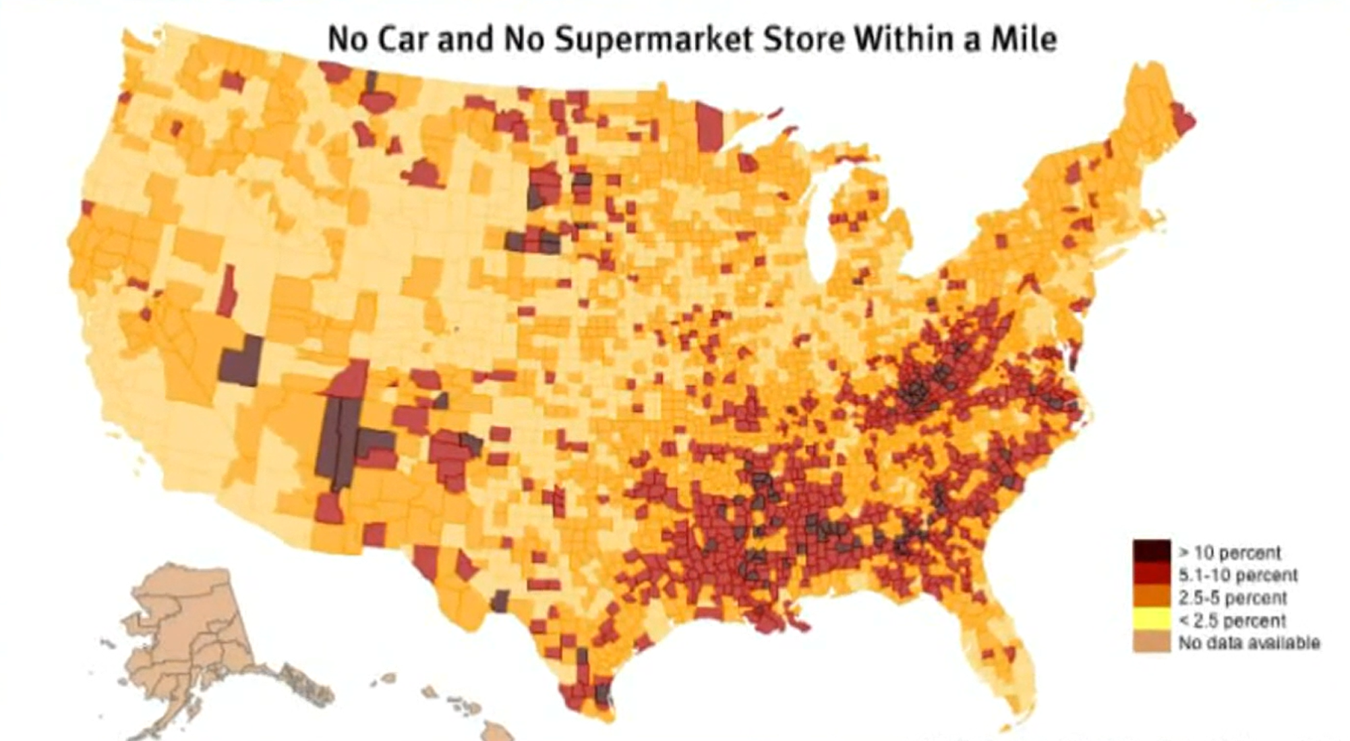
Key Concepts
For reference
Food Desert
• Areas with limited access to affordable and nutritious grocery options.
• Often characterized by a high density of fast-food or convenience stores relative to grocery stores.
• Reflects structural imbalance in local food environments rather than simple distance measures.
○ Not just proximity, but spatial composition matters.
Notes:
At the beginning, we briefly introduced the concept of food deserts.
Now, in the Key Concepts section, I will explain it in more detail.
A food desert refers to areas with limited access to affordable and nutritious grocery options.
However, it is often characterized not only by low grocery access, but also by a relatively high density of fast-food and convenience stores.
Therefore, it reflects structural imbalance in the local food environment rather than simply distance to a supermarket.
In other words, not just proximity, but spatial composition matters.
For example, the map on the bottom right shows areas in the United States where residents have no car and no supermarket within one mile. This represents the traditional distance-based definition of food deserts.
While this approach captures physical accessibility, it does not account for the overall mix of food outlets in the area.
The image above also highlights how food desert areas are identified geographically, but again, the classification is primarily based on access distance.
Our project extends this idea by examining the structural composition of food environments using spatial interaction patterns rather than relying solely on proximity.

Slide 15
Key Concepts
For reference
Spatial Neighborhood (R)
• A predefined geographic radius used to define local spatial interactions.
• Determines which food outlets are considered “neighbors.”
• Changing R can alter detected spatial patterns (sensitivity issue).
○ Spatial results depend on neighborhood scale.
R=300M
2 neighbors detected
R=500M
5 neighbors detected
Notes:
Here, we introduce the concept of Spatial Neighborhood, denoted as R.
A spatial neighborhood is a predefined geographic radius used to define local spatial interactions between food outlets.
In other words, it determines which outlets are considered neighbors of a given reference location.
Rather than looking at the entire city at once, we analyze spatial relationships within a limited local area defined by R.
As you can see in the figure on the right, we select a single POI as a reference point.
When R is set to 300 meters, only two nearby outlets fall within the circular buffer and are considered neighbors.
However, when we increase R to 500 meters, more outlets are included within the buffer, and now five neighbors are detected.
This clearly shows that simply changing the neighborhood radius can significantly alter the number of detected interactions.
Therefore, spatial patterns are highly sensitive to the choice of neighborhood scale.
Selecting an appropriate R is not just a technical detail — it directly affects the structure of detected co-location patterns.

Slide 16
Key Concepts
For reference
Participation Index (PI)
• Computed as the minimum participation ratio across all event types in a pattern.
• Measures the strength and prevalence of a co-location pattern.
• A high PI indicates strong spatial coupling between event types.
○ Ensures balanced participation among categories.
Formula: Participation Ratio Formula
Formula: Participation Index
Example: C = {Grocery, FastFood}
Total Grocery stores: 10 Participating Grocery stores: 6 PR(C, Grocery) = 6 / 10 = 0.6
Total Fast-Food outlets: 8 Participating Fast-Food outlets: 4 PR(C, FastFood) = 4 / 8 = 0.5
PI(C) = min(0.6, 0.5) = 0.5
Notes:
Now that we have defined the spatial neighborhood, we need a way to quantitatively measure how strongly different outlet types co-occur.
This is where the Participation Index, or PI, comes in.
First, we compute the Participation Ratio.
The Participation Ratio measures the proportion of instances of a given event type that actually participate in a co-location pattern.
Formally, it is defined as shown in the upper-right formula.
In other words, we divide the number of instances that participate in the pattern by the total number of instances of that event type.
Now, let’s look at the example shown at the bottom of the slide.
Assume the pattern C = {Grocery, FastFood}.
Suppose there are 10 grocery stores in total. If 6 of them participate in neighborhoods that include fast-food outlets, then the Participation Ratio for grocery stores is 6 divided by 10, which equals 0.6.
Next, for fast-food outlets: If there are 8 in total, and 4 participate in the pattern, then the Participation Ratio is 4 divided by 8, which equals 0.5.
The Participation Index is then defined, as shown in the lower-right formula, as the minimum Participation Ratio across all event types in the pattern.
So in this example, the PI is min(0.6, 0.5), which equals 0.5.
This is important because even if one category participates frequently, the overall pattern is considered weak if another category participates less.
In other words, PI ensures balanced participation among categories.
Therefore, a high PI indicates strong spatial coupling between event types.

