Slide 1
Spatial Storage Models and Literature Survey State of the Art and New Developments
Csci – 8715 Spatial Data Science Research
Acknowledgement: Yan Li
Notes:
Cover page

Slide 2
Learning Objectives
After this segment, students will be able to
Describe Spatial Data Storage Models
List main contributions and organize literature of following papers:
Yang, KwangSoo, Michael R. Evans, Venkata MV Gunturi, James M. Kang, and Shashi Shekhar. "Lagrangian approaches to storage of spatio-temporal network datasets." IEEE Transactions on Knowledge and Data Engineering 26, no. 9 (2013): 2222-2236.
Nibali, Aiden, and Zhen He. "Trajic: An effective compression system for trajectory data." IEEE Transactions on Knowledge and Data Engineering 27, no. 11 (2015): 3138-3151.
Research Skill: Literature Review and Articulating Novelty

Slide 3
Weekly Topic: Spatial Data Storage
Genre | File Structure | Indexing | Compression
Relational | Heap, Ordered, Hashed | B-tree, B⁺-tree Hashing | JPEG, MP3
Spatial | Space filling curve | R-tree, R⁺/R* trees
Spatial Network | CCAM Min-cut of edges
Spatiotemporal
Spatial Big Data

Slide 4
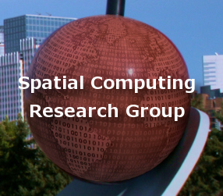
Common Relational Data Storage File Structures
Heap or unordered or unstructured
Ordered
Hashed
Clustered

Slide 5
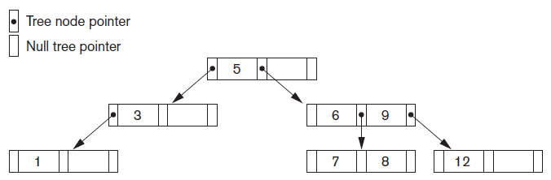
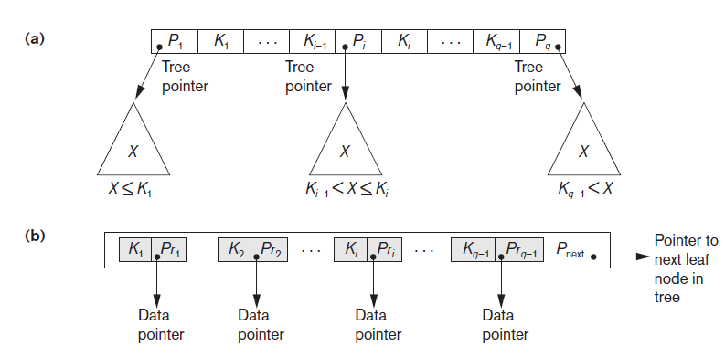
Relational Data Storage Examples
Search tree
B+ Tree

Slide 6
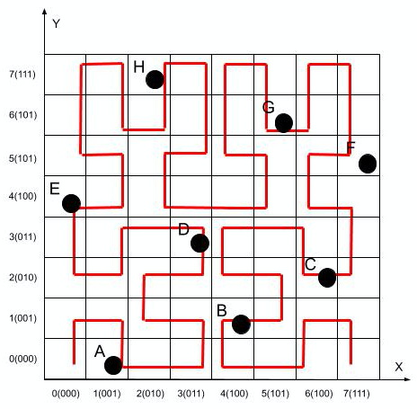
Spatial Data Storage Examples
Spatial filling curve
R-tree
Index | Key | Hilbert
0 | A | 3
1 | D | 10
2 | E | 16
3 | H | 25
4 | G | 39
5 | F | 44
6 | C | 50
7 | B | 57

Slide 7
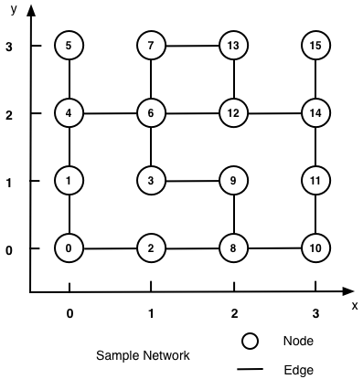
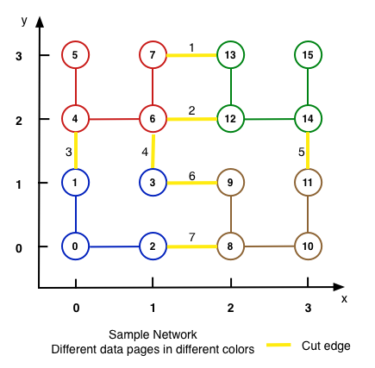
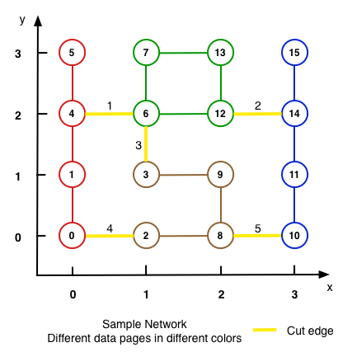
Spatial Network Storage Example
Which partitioning reduces disk I/O for graph operations?
Choice 1: Geometric partition
Choice 2: min-cut Graph Partition
Choice 2 cuts fewer edges and is preferred
Assuming uniform querying popularity across edges

Slide 8
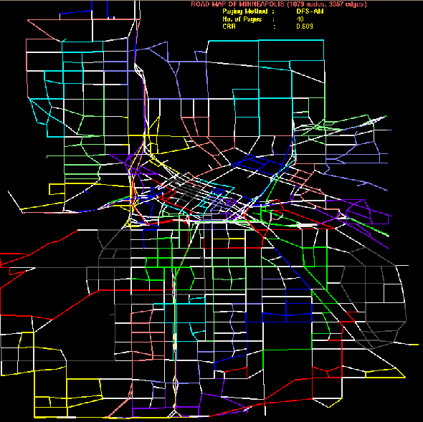
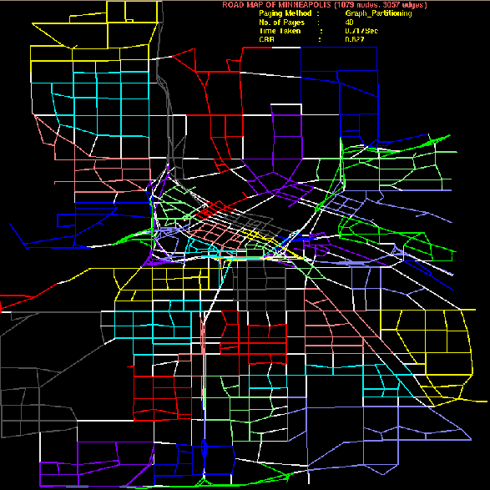
Spatial Network Storage Example (cont’d)
Consider two disk-paging of Minneapolis major roads
Non-white edges => node pair in same page
White edge are cut-edges
Node partitions on right has fewer cut-edges and is preferred

Slide 9
Weekly Topic: Spatial Data Storage (P1)
Genre | File Structure | Indexing | Compression
Relational | Heap, Ordered, Hashed | B-tree, B⁺-tree Hashing | JPEG, MP3
Spatial | Space filling curve | R-tree, R⁺/R* trees
Spatial Network | CCAM Min-cut of edges |  | Trajic
Spatiotemporal | Snapshot, Lagrangian, Min-cut of hyper-edges | TPRtree, MVRtree, pyramid, … | REST: A Reference based framework for ST trajectory compression (G5 - Spring 2022)
Spatial Big Data | Distributed models | SpatialHadoop (R-tree on Hadoop), GPU …

Slide 10
Learning Objectives Outline
After this segment, students will be able to
Describe Spatial Data Storage Models
List main contributions and organize literature of following papers:
Yang, KwangSoo, Michael R. Evans, Venkata MV Gunturi, James M. Kang, and Shashi Shekhar. "Lagrangian approaches to storage of spatio-temporal network datasets." IEEE Transactions on Knowledge and Data Engineering 26, no. 9 (2013): 2222-2236.
Nibali, Aiden, and Zhen He. "Trajic: An effective compression system for trajectory data." IEEE Transactions on Knowledge and Data Engineering 27, no. 11 (2015): 3138-3151.
Research Skill: Literature Review and Articulating Novelty

Slide 11
Recall Critical Reading Questions
Problem statement: Formally define the problem addressed in the paper. Briefly explain the significance of the problem.
List the major contributions of the paper.
List the key concepts behind the approach in this paper.
What is the validation methodology (e.g. case studies, statistical hypothesis testing, proofs, simulation) used in this paper?
List the assumptions made by the authors. Critique an assumption that you believe is unreasonable.
If you were to rewrite this paper today, what would you preserve and what would be revise?

Slide 12
SSTN-G∀S Problem Statement
Input:
• A spatio-temporal network S
• A set of spatio-temporal operations O
e.g., Get_all_Successors(G∀S )
Output:
• Data Partitioning of S, across data pages
Objective:
• Minimize data page access for operations in O
Constraints:
• S is too large for storage in main memory.
• Temporal-edge attribute information needs to be preserved.

Slide 13

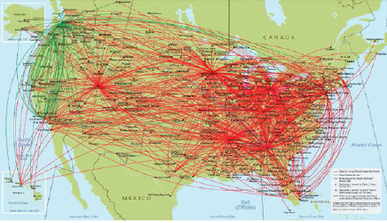
Significance
Societal applications requiring to store spatio-temporal networks
Surface and air transportation systems:
The Mobility Monitoring Program, Airline services,...

Slide 14
Major Contributions
Prove that the SSTN-G∀S problem is NP-hard
Approach: a novel storage and access method (LCP-G∀S)
Validation
Analyze the algebraic cost of the LCP-G∀S algorithm
Experimental evaluation of LCP-G∀S
Using real-world and synthetic STN datasets
Notes:
The LCP-G∀S method is the most significant contribution. As we all know, traditional orthogonal-based storage approaches of STN data produce significant I/O costs when performing spatio-temporal network queries.

Slide 15
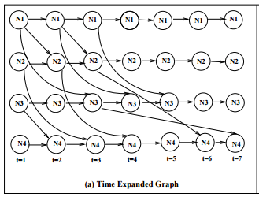
Key Concepts
Spatio-Temporal Networks (STN)
Spatio-Temporal Network Operations:
FindNode(n, t)，LGetNodeTransition(Node(n, t))，
LGetOneSuccessor(Node(n, t), n_{s})
LGetAllSuccessors(Node(n, t))
Lagrangian Paths:
paths in a spatio-temporal network
STN conceptual Models
Graph: G = (N,E,T), N: nodes, E: edges, T: time steps
Hypergraph = (N, hyperedges group each node with successors)
Data Structure:
node has node id, time step, time-varying attribute
edge time-varying attribute
Notes:
Consider a Lagrangian Path: A -> C -> D. When starting at t = 1 from A, it takes 3 time steps to reach D. When starting at t = 2 from A, it takes 2 time steps to reach D.

Slide 16
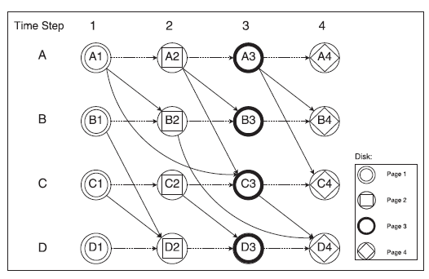
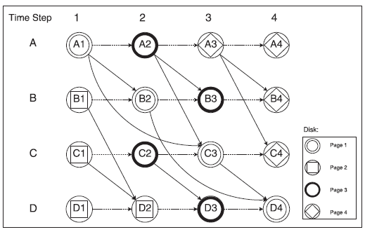
Key Concepts: Data Storage
node i
Disk storage
needs STN partitioning into disk pages
Partitioning Methods
Orthogonal
Non-Orthogonal Partitioning of STNs
Min-cuts edges (CCAM) or hyperedges (this work)
In-memory data page?
yes
no
access data in memory
Search disk data pages
Load relevant disk page in memory
Notes:
Consider a Lagrangian Path: A -> C -> D. When starting at t = 1 from A, it takes 3 time steps to reach D. When starting at t = 2 from A, it takes 2 time steps to reach D.

Slide 17
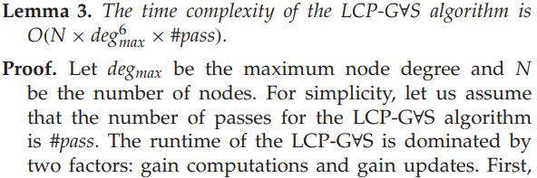
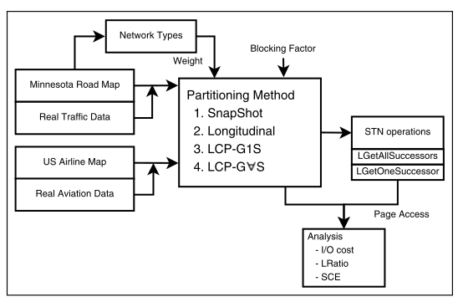
Validation Methodology
Proofs
SSTN-G∀S is NP-hard
Time Complexity
Experimental Evaluation
Accuracy of cost models to predict the disk I/Os for STN operations
What is the effect of the blocking factor? #time steps, edge/node ratio, …

Slide 18
Assumptions
Secondary indexing techniques are not considered
Did not consider Time dependent shortest-path
Did evaluate effect of Tabu-search on solution quality
Assumed constant time cost for insert, retrieve, delete, update
Assume that STN data has high time resolution with non-uniform STN properties

Slide 19
Revisions
Approximation algorithms.
Investigate novel indexing techniques for STNs.
Extend the Lagrangian reference framework to model hierarchical networks.
Developing parallel algorithms to reduce computation time.

Slide 20
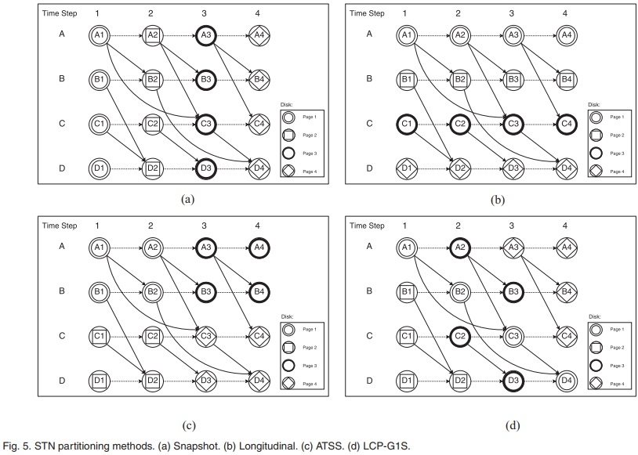
Literature Review : Laundry list approach

Slide 21
Literature Review: Decision Table Approach
Long laundry list provide few insights.
Alternative: Classify the proposed method and related works
Decision Table Approach
Rows: Candidate methods
Columns: Criteria, e.g., Geometry/topology, Get_a_successor /Get_all_successor, …
Approach | Connectivity-based grouping | Non-Orthogonal | All successors
Logitudinal | ✓
Snapshot | ✓
Min-cut of edges | ✓ | ✓
Min-Cut of hyperedges | ✓ | ✓ | ✓

Slide 22
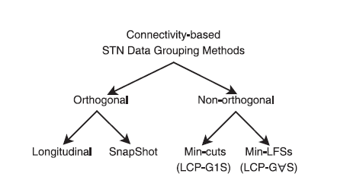
Literature Review: Decision Tree Approach
related work
preliminary
work
focus of
the paper
min-cut of edges = LCP-G1S: Lagrangian-Connectivity Partitioning For LGetOneSuccessors()
Min-cut of hyperedges = LCP-G∀S: Lagrangian-Connectivity Partitioning For LGetAllSuccessors()

Slide 23
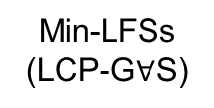
Related Work and Limitations (Revised)
All successors Methods
No
Yes
Non-Orthogonal Methods
Min-LFSs
(LCP-G$∀$S)
No
Yes
SnapShot, Longitudinal
Min-cuts (LCP-G1S)
focus of the paper
related work
preliminary work
LCP-G1S: Lagrangian-Connectivity Partitioning For LGetOneSuccessors()
LCP-G∀S: Lagrangian-Connectivity Partitioning For LGetAllSuccessors()

Slide 24
Quiz
Q? Which literature review method best articulates novelty of proposed approach?
(a) Laundry List
(b) Decision Table
(c ) Decision Tree
(d) Decision Tree showing Proposed Work as a child of the root node

Slide 25
Quiz 1
1. What is one of the main motivations cited for researching storage methods for spatio-temporal networks? (a) Entertainment applications like games. (b) Scientific visualization. (c) Societal applications like transportation systems. (d) Geographic information systems 2. What challenge in handling Spatio-Temporal Network (STN) datasets is primarily addressed in the paper? (a) Reducing the computational complexity of data analysis (b) Minimizing disk I/O costs during STN operations (c) Increasing the accuracy of real-time data tracking (d) Enhancing the security of data transmission in STNs 3. What is one challenge identified for future work? (a) Indexing techniques for STNs. (b) Parallelization of LCP algorithms. (c) Extending to semantically rich STNs. (d) Continuous STN data models.

Slide 26
Learning Objectives P2
After this segment, students will be able to
Describe Spatial Data Storage Models
List main contributions and organize literature of following papers:
Yang, KwangSoo, Michael R. Evans, Venkata MV Gunturi, James M. Kang, and Shashi Shekhar. "Lagrangian approaches to storage of spatio-temporal network datasets." IEEE Transactions on Knowledge and Data Engineering 26, no. 9 (2013): 2222-2236.
Nibali, Aiden, and Zhen He. "Trajic: An effective compression system for trajectory data." IEEE Transactions on Knowledge and Data Engineering 27, no. 11 (2015): 3138-3151.
Research Skill: Literature Review and Articulating Novelty

Slide 27
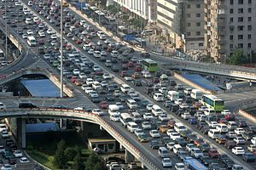
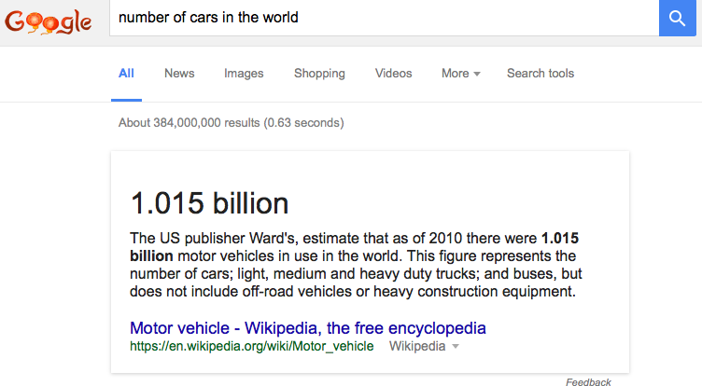
Societal Importance
Trajectories of phones, cars, airplanes, …
Ride-sharing, traffic speed estimation, …
Location based advertisement
2011 McKinsey Big Data Report
600 B annual value by 2020
Huge value of trajectory data
Challenge: Big data volume, velocity, …
10 million cars, 1 point/second = 7 PB/year
Compression
Limited storage
Limited band width for data transmission
“Two Billion Cars: Driving Toward Sustainability” Daniel Sperling, Deborah Gordon
Notes:
questions: any other application that we are using compressed data?

Slide 28
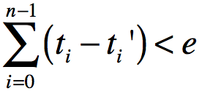
Problem Statement
Input:
A trajectory with n points, T = {t₀, t₁, …, t_{n-1}},
An error margin e
Output :A compressed representation T’ = {t₀’, t₁’, …, t_{n-1}’}
Objective
Minimize the compression ratio,
Constraint
On-line setting, i.e., O(n) time complexity
? Meet error margin for Compression error for smooth trajectories
Storage space for T’
Storage space for T

Slide 29
Contributions
A new on-line algorithm
O(N), same as Delta compression
Using prediction methods
Temporally-aware linear predictor
New dynamic leading zero encoding scheme

Slide 30
Key concepts: Spatiotemporal Data
Trajectory
A sequence of spatio-temporal points T = {t₁,t₂,t₃,….}
Each point contains longitude, latitude, timestamp etc.
t_{i} = (lon_{i}, lat_{i}, ts_{i})
Prediction of next point from previous points
Lossy compression vs. loss-less compression
Error margin
The maximum error that can be tolerated for compression

Slide 31
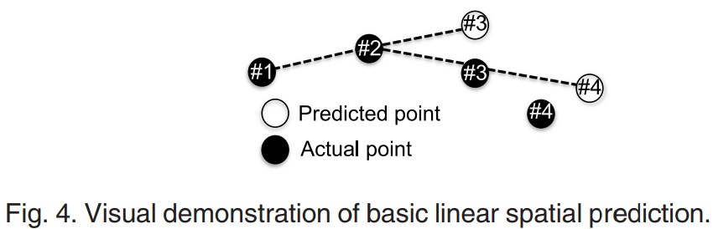
Key concepts Prediction of Next Points from Previous ones
Ex. Linear spatial prediction

Slide 32
Example Comparing Trajic with Delta
Candidate | Large Numbers (8 bytes) | Medium Numbers (4 bytes) | Small Numbers (2 bytes) | Total Bytes
Trajectory | 8 | 0 | 0 | 8*8 = 64
Delta | 2 | 6 | 0 | 2*8 + 6*4 = 40
Trajic | 2 | 0 | 6 | 2*8 + 6*2 = 28
Trajic
Delta
PX(n) = X(n-1) + 1000
PY(n) = Y(n-1) + 1000
Trajectory
Point(n) | X(n) | Y(n)
P(0) | 100001 | 200002
P(1) | 101001 | 201004
P(2) | 102001 | 302007
P(3) | 103001 | 103011
Point(n) | X(n) | Y(n)
P(0) | 100001 | 200002
Point(n) | X | Y
P0 | 100001 | 200002
Point(n) | Delta X | Delta Y
P(1) | 1000 | 1002
P(2) | 1000 | 1003
P(3) | 1000 | 1004
Point(n) | PX(n) error | PY(n) error
P1 | 0 | 2
P2 | 0 | 3
P3 | 0 | 4

Slide 33
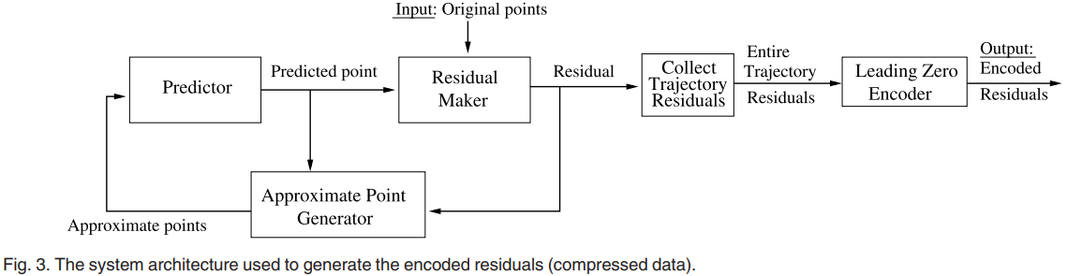
Key concepts: System Architecture
System architecture to generate encoded residuals

Slide 34
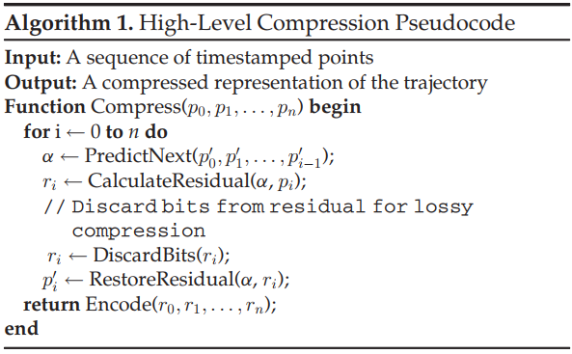
Key concepts Compression
High level pseudocode

Slide 35
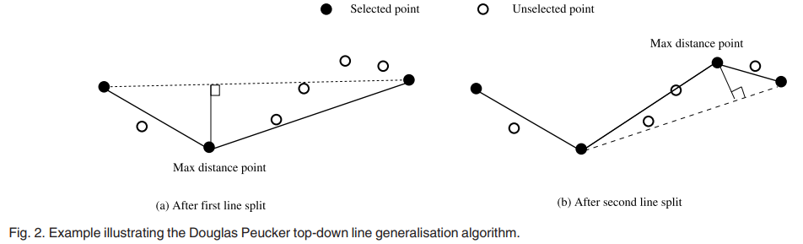
Comparison with Douglas Peucker Algorithm
Douglas Peucker’s line generalization/simplification algorithm
Can reduce the number of points within margin approximation error
This can result in better compression ratio
However, Delta and Trajic keep all points in the trajectories
?lossless compression

Slide 36
Critical Reading Exercise
Note: Computational complexity of Douglas Peucker line simplification method is N² .
Literature has N*log(N) complexity for this problem.
Q? How can this paper provide O(N) algorithm? What gives?
Q? Is proposed algorithm correct and complete?
Will it find find a solution if there exists one meeting the error bound ?
Criteria | Delta | Trajic | Douglas Peucker | Chan 2012 | Hersberger 1992
On-line | yes | yes | no | no
Preserve number of points | yes | yes | no | no
Time Complexity | O(N) | O(N) | O(N^2) | O(N^2) | O(N log(N)
Compression Quality |  | Better than Delta | Better if many points dropped | optimal

Slide 37
Validation methodology for Compression
Goal: What is the effect of error bound on compression ratio?
Real-world dataset
University of Illinois (213 trajectories of movements of two people)
Microsoft GeoLife (17,621 trajectories of walking, cycling and driving 2007-2011
Comparative analysis
TD-SED (a popular line generalization algorithm)
Delta compression
SQUISH (one pass algorithm)
Trajic (proposed algorithm)

Slide 38
Critical Reading: Comparing Claims with Evidence
Is this supported by evidence in paper?
How does Douglas Peucker etc. fit here?
Notes:
in some cases, DP is better than Delta, ask to audience

Slide 39
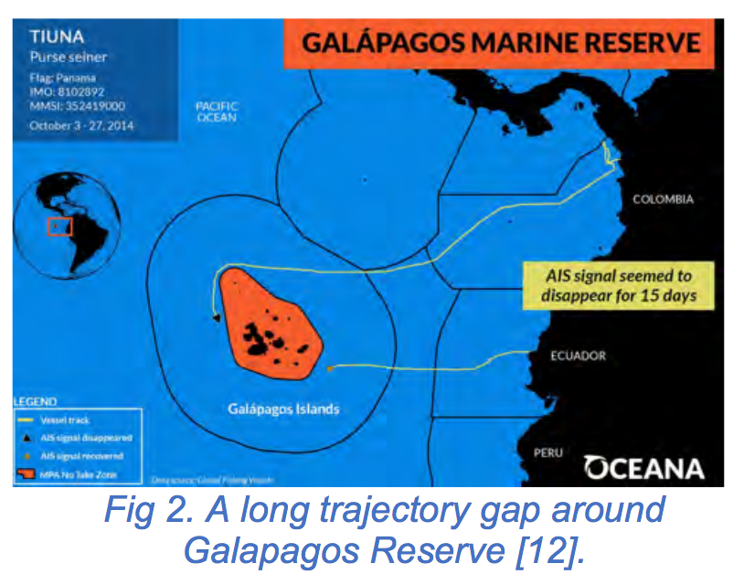
Assumptions On Spatiotemporal Data
Smooth trajectories, On-line use case, One-pass algorithms
No significant gaps in the trajectories
Ship trajectories
Did not model GPS inaccuracy
Frequency of length of residuals follows a distribution
The distribution can be correctly found (past predicts future)
Small residual because trajectories are smooth
2D plane (Euclidean space) instead of Network space
Ignore multi-attributed trajectories
Onboard diagnostics (OBD) data from vehicles

Slide 40
Revisions for paper 1
Combine orthogonal ideas (e.g., line simplification + bit compression)
Experiment should compare to the missing related work
More experiments on self-evaluation
Explain when the assumptions are valid in a discussion section.
Add a future work section
Add correctness and completeness analysis
Add missing related work, e.g.,
Ideal compression algorithm (Chan et al., 1996, Jr. of Computational Geometry)
A difficulty in interdisciplinary research
How to reduce risk?

Slide 41
Quiz 2
3. What was the primary motivation behind developing the Trajic compression system ? (a) To create a more efficient GPS tracking system. (b) To address limitations in existing trajectory compression methods, particularly regarding small error margins. (c) To reduce the cost of data storage in large-scale spatial databases. (d) To improve the accuracy of trajectory data analysis.
4. What is a novel aspect of the Trajic compression system compared to previous trajectory compression methods ? (a) It introduces an entirely new trajectory data format. (b) It employs delta compression with a novel residual encoding scheme. (c) It uses machine learning algorithms for prediction. (d) It focuses solely on real-time trajectory data compression. 5. What assumption does the Trajic system challenge or modify compared to traditional trajectory compression methods ? (a) It assumes trajectory data is always linear and predictable. (b) It assumes trajectory data is highly irregular and cannot be compressed efficiently. (c) It challenges the assumption that high compression ratios require large error margins. (d) It assumes all trajectory data must be stored in a lossless format.

Slide 42
Learning Objectives Papers 3 and 4
After this segment, students will be able to
Describe Spatial Data Storage Models
List main contributions and organize literature of following papers:
Yang, KwangSoo, Michael R. Evans, Venkata MV Gunturi, James M. Kang, and Shashi Shekhar. "Lagrangian approaches to storage of spatio-temporal network datasets." IEEE Transactions on Knowledge and Data Engineering 26, no. 9 (2013): 2222-2236.
Nibali, Aiden, and Zhen He. "Trajic: An effective compression system for trajectory data." IEEE Transactions on Knowledge and Data Engineering 27, no. 11 (2015): 3138-3151.
Research Skill: Literature Review and Articulating Novelty

Slide 43
Outline
Critical Reading
Literature Review: A Reflection
Has anyone else publishes on this problem?
Resources for Literature Search (e.g., Google Scholar, DBLP, …)
Organizing literature review
Laundry List
Decision Table
Decision Tree

Slide 44
Reflection on Literature Review
Paper refers to an ”Ideal” compressed solution,
which is better than those found by proposed method.
Has anyone published algorithms to find the “ideal” compression ?
If so, should literature review cite those papers?

Slide 45
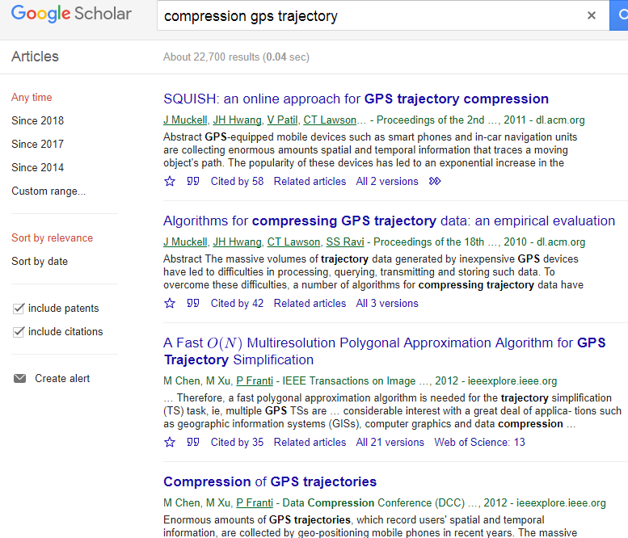
Literature review (gps trajectory compression)

Slide 46
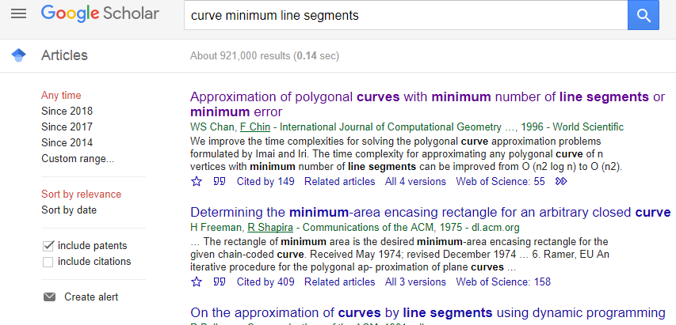
Literature Review: GPS trajectory synonyms, e.g., curve
Notes:
An O(nlogn) implementation of the Douglas-Peucker algorithm for line simplification
W. S. Chan, F. Chin. Internat. J. Comput. Geom. Appl., 6:59-77, 1996.

Slide 47
Resources for Literature Search
Sources
Databases allowing keyword search
Use many different keywords related to a concept
Ex. Google Scholar, DBLP, Citeseer
Journals, Conference Proceedings
Browse the tables of content
Ex. Digital Libraries from ACM, IEEE
Survey papers, overview articles
Dedicated source: ACM Computing surveys, wikipedia
Other sources: Many other journals may publish survey papers
Subject matter experts
Identify key researchers working in related areas
Seek advice on related work
Completeness
Reading at different levels
Review titles and abstracts of several papers
Identify critical elements like contributions
Select subset of relevant papers for detailed reading

Slide 48
A Simple Decision Table and Tree
Criteria | Delta | Proposed (Trajic) | Douglas Peucker | Chan 2012 | Hersberger 1992
On-line? | yes | yes | no | No
Preserve #points? | yes | yes | no | no
Time Complexity | O(N) | O(N) | O(N^2) | O(N^2) | O(N log(N)
Compression Quality |  | Better than Delta |  | optimal
On-line O(N) ?
N
Y
Line Generalization
Prediction
Optimality?
Y
N
N
Y
Delta
Proposed (Trajic)
Solution Quality: Chan 2012;
Compute Cost: Hershberger 1992
Douglas Peucker

Slide 49
Section 2
2.1 Line Generalization [4, 6, 10, 11, 13, 21]
2.2 Delta Compression,
e.g., TrajStore [5]
2.3 Other Methods:
road-network based [2, 3]
one-pass [7]
SQUISH [14]

Slide 50
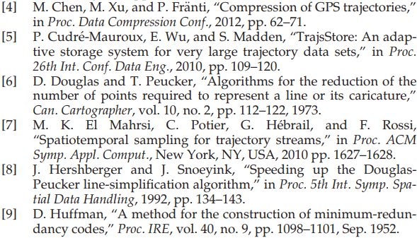
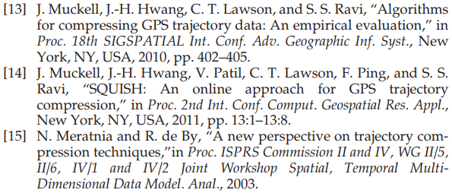
Cited Literature in the Trajic Paper (pp. 14)

Slide 51
Summarizing Cited Literature: Laundry List to Decision Table
Exercise: Create a decision tree using the following table
Family | Support off road data | Disc- ard points |  | Discard points | Complexity | Temporal | Predictor
Line generalization | Yes | Yes | Douglas Peucker [6] Hershberger [8] Openning window [11] Sync. Euc. Distance [18] | Yes Yes Yes Yes | O(N²) O(N logN) O(N²) | No No No Yes
 |  | Yes | SQUISH [14] |  | O(N)
Delta compression | Yes | No | TrajsStore [5] | No | O(N) |  | Constant
Other | No | No | Use road network [2,3]
 | Yes |  | 1-pass sampling [7] |  |  |  | Linear
Proposed (Trajic) | Yes |  |  | No | O(N) |  | Multiple predictor
Notes:
An O(nlogn) implementation of the Douglas-Peucker algorithm for line simplification
W. S. Chan, F. Chin. Internat. J. Comput. Geom. Appl., 6:59-77, 1996.

Slide 52
Decision Table to Decision Tree
Need road map
Y
N
Map matching
One pass O(n)?
Y
N
Line generalization
Discard data points
e.g., Douglas Peucker,
Hershburger, opening window
Y
N
Predictor
SQUISH
constant
linear
richer
Proposed Trajic
Trajstore
1-pass sampling

Slide 53
Best Practice: Literature Review
Reading at different levels
Review titles and abstracts of several papers
Identify critical elements like contributions
Select subset of relevant papers for detailed reading

Slide 54
Literature Survey
Sources
Databases allowing keyword search
Use many different keywords related to a concept
Ex. Google Scholar, DBLP, Citeseer
Journals, Conference Proceedings
Browse the tables of content
Ex. Digital Libraries from ACM, IEEE
Survey papers, overview articles
Dedicated source: ACM Computing surveys, wikipedia
Other sources: Many other journals may publish survey papers
Subject matter experts
Identify key researchers working in related areas
Seek advice on related work

Slide 55

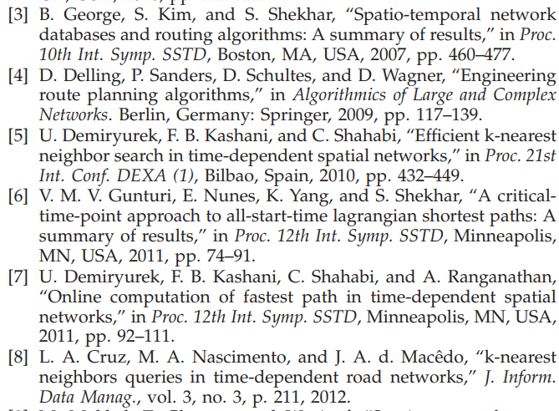
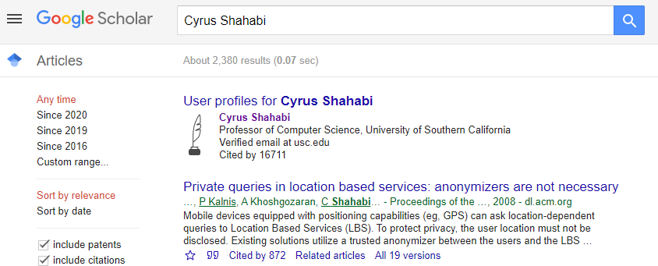
Literature Survey (by author)

Slide 56
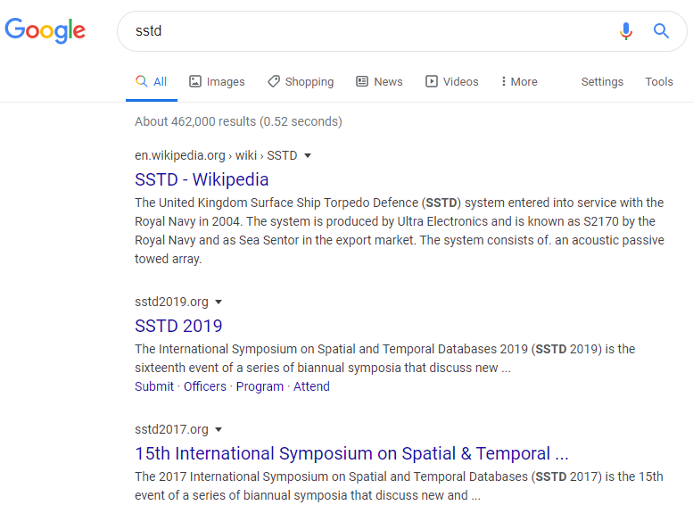
Literature Survey (by conference / journal)

Slide 57
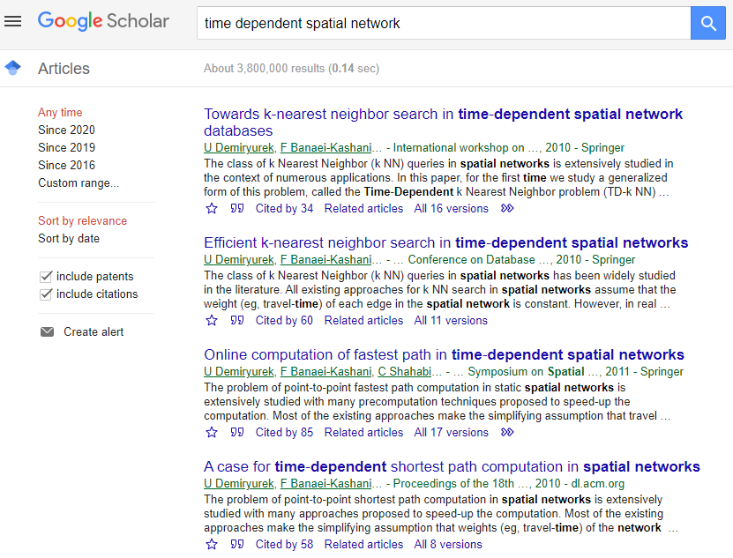
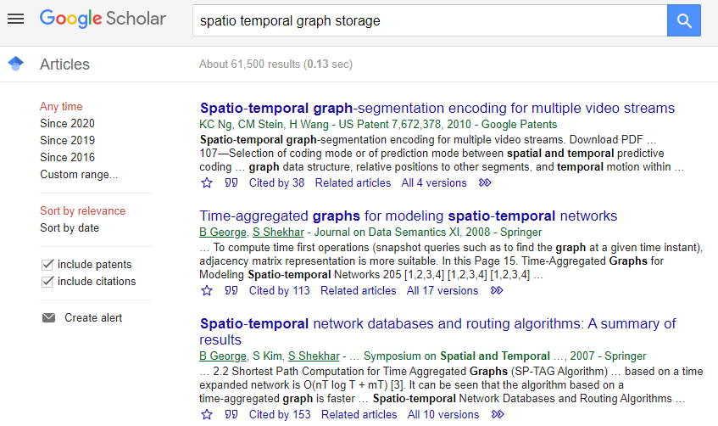
Literature Survey (by topic)

Slide 58



Literature Survey Tools

Slide 59
Summary of Literature
Linear list style
Short paragraph summarizing each paper group
Highlight contributions in context of the problem under study
Classification
Provide a categorization of related work
Describing each category rather than individual papers
Examples - ACM Computing Surveys, many papers in the textbook
Form: table, tree
To articulate novelty, desirable properties for classifications
Articulates that contribution is first order
Binary classification separating proposed work from related work
Choice of classification criteria takes effort
Start with a decision table and then choose best column

Slide 60
Exercise 1
Q? Which organization technique is closest to the literature review (secc. 1.2) in “Lagrangian Approaches to Storage of Spatio-Temporal Network Datasets. Yang, K., +, IEEE Trans. On Knowledge and Data Eng., pp. 2222-2236 , Sept. 2014”?
Linear list style
Classification: Decision Table
Classification: Decision Tree
None of the above
Figure 2: Connectivity Based STN
Data Grouping Methods

Slide 61
Exercise 2
Q? Which organization technique is closest to the literature review in “Trajic: An Effective Compression System for Trajectory Data. Nibali, A., +, IEEE Trans. On Knowledge and Data Eng., pp. 3138-3151, Nov. 2015”?
Linear list style
Classification: Decision Table
Classification: Decision Tree
None of the above
Recall Section 2
2.1 Line Generalization
[4, 6, 10, 11, 13, 21]
2.2 Delta Compression,
e.g., TrajStore [5]
2.3 Other Methods:
road-network based [2, 3]
one-pass [7]
SQUISH [14]

Slide 62
Exercise 3
First read draft literature review on next slide
It a partial classification of papers followed by a laundary-list of a few papers.
Develop a unified classification of all papers.
Condense the draft text into one paragraph with a unified classification scheme.

Slide 63
Exploring simple-path based linear hotspots
This task aims to create a richer enumeration space containing all simple paths (i.e. paths that do not have a cycle or repetitive edges).
Our approach entails enumerating all simple paths and then evaluating them. Current approaches for enumerating all simple paths in a graph [142]–[150] can be roughly divided into three categories: (i) approaches that use the power of adjacency matrices [142]–[144], (ii) approaches that use depth/breadth first search (DFS/BFS) with backtracking [145]–[150] and (iii) approaches that use cut vertices (i.e. articulation points) and bi-connected components [150]. Power of adjacency-matrix based methods have high cost of matrix multiplications and equal edge weight assumptions, DFS/BFS with backtracking methods consider only a single node pair on each iteration, and the methods that use cut vertices assume there are enough cut vertices to reduce the enumeration cost. However, cut vertices are rare in transportation networks, e.g. roadmaps.
There are also some approaches dealing with multi-path on wireless network [151, 152). However, they aim at a different problem of delivering packets on multiple known paths to avoid excessive delay instead on paths enumeration. Another work which measures the betweenness centrality of a social network using random walks [153]. It uses random walk to simulate a rich set of possible paths beyond shortest path. However, it does not guarantee generating the complete set of simple path.
Pre-computing and network partitioning is popular in speeding up routing algorithms. Given a partitioned network, “edge-flag” approaches [154] store the information whether each edge whether it is in any shortest path to each fragment. When computing shortest path later, this information is used to reduce the search space. “Network contraction” approaches [155, 166] order and replace nodes by adding “shortcut edges” which represent the shortest distance between their end nodes. “Hierarchical” approaches [157,158] pre-compute and store shortest path inside each fragment and between each pair of boundary nodes. Later, the shortest path between nodes in two fragments is the path that minimizes Cost(S,Bs)+Cost(Bs,Bd)+Cost(Bd,D), where Bs and Bd are the boundary nodes. However, the speedup of all of these approaches come from eliminating information of non-shortest paths and thus substantially reduce the search space, which make them inapplicable to the all-simple-path enumeration problem.

Slide 64
References
[141] N. H. T. S. Administration, “Fatality analysis reporting system (fars) encyclopedia.” [Online]. Available: ftp://ftp.nhtsa.dot.gov/fars/.
[142] J. Ponstein, “Self-Avoiding Paths and the Adjacency Matrix of a Graph,” SIAM J. Appl. Math., vol. 14, no. 3, pp. 600–609, 1966.
[143] G. Danielson, “On finding the simple paths and circuits in a graph,” IEEE Trans. Circuit Theory, vol. 15, no. 3, pp. 294–295, 1968.
[144] F. Rubin, “Enumerating All Simple Paths in a Graph,” IEEE Trans. Circuits Syst., vol. 25, no. 8, pp. 641–642, 1978.
[145] J. C. Tiernan, “An efficient search algorithm to find the elementary circuits of a graph,” Commun. ACM, vol. 13, no. 12, pp. 722–726, 1970.
[146] D. B. Johnson, “Finding all the elementary circuits of a directed graph,” SIAM J. Comput., vol. 4, no. 1, pp. 77–84, 1975.
[147] J. L. Szwarcfiter and P. E. Lauer, “A search strategy for the elementary cycles of a directed graph,” Bit, vol. 16, no. 2, pp. 192–204, 1976.
[148] R. C. Read and R. E. Tarjan, “Bounds on backtrack algorithms for listing cycles, paths, and spanning trees,” Networks, vol. 5, no. 3, pp. 237–252, 1975.
[149] B. Banerjee and B. Chandrasekaran, “On some properties of the Voronoi diagram for planning multiple paths in free space,” Citeseer, vol. 3079, no. January, pp. 1–17, 2007.
[150] R. Ferreira, R. Grossi, and A. Marino, “Optimal Listing of Cycles and st-Paths in Undirected Graphs,” arXiv Prepr. arXiv …, pp. 1884–1896, 2012.
[151] A. Tsirigos and Z. J. Haas, “Multipath routing in the presence of frequent topological changes,” IEEE Commun. Mag., vol. 39, no. 11, pp. 132–138, 2001.
[152] A. Tsirigos and Z. J. Haas, “Analysis of multipath Routing-Part I: the effect on the packet delivery ratio,” IEEE Trans. Wirel. Commun., vol. 3, no. 1, pp. 138–146, 2004.
[153] M. E. J. Newman, “A measure of betweenness centrality based on random walks,” Soc. Networks, vol. 27, no. 1, pp. 39–54, 2005. Elsevier.
[154] U. Lauther, “An extremely fast, exact algorithm for finding shortest paths in static networks with geographical background,” Geoinf. und Mobilit{ä}t-von der Forsch. zur Prakt. Anwendung, vol. 22, pp. 219–230, 2004.
[155] D. Delling, A. V Goldberg, T. Pajor, and R. F. Werneck, “Customizable route planning,” in International Symposium on Experimental Algorithms, Springer, Berlin, Heidelberg, 2011, pp. 376–387.
[156] D. Delling and R. F. Werneck, “Faster customization of road networks,” in International Symposium on Experimental Algorithms, Springer, Berlin, Heidelberg, 2013, pp. 30–42.
[157] Jing, N., Huang, Y.W. and Rundensteiner, E.A., 1998. Hierarchical encoded path views for path query processing: An optimal model and its performance evaluation. IEEE Transactions on Knowledge and Data Engineering, 10(3), pp.409-432.
[158] Shekhar, S., Fetterer, A. and Goyal, B., 1997, July. Materialization trade-offs in hierarchical shortest path algorithms. In International Symposium on Spatial Databases (pp. 94-111). Springer, Berlin, Heidelberg.

Slide 65
Solution
Task STI-1: Investigate simple-path based linear hotspots: This task aims to create a richer enumeration space containing all simple paths (i.e., paths that do not have a cycle or repetitive edges). Our approach entails enumerating all simple paths and evaluating their event density interest measure, which is defined as the ratio between the number of events in the path and path length. Current methods for enumerating all simple paths [84]–[92], [93], [94], [95] can be divided into five categories: (i) adjacency-matrix methods [84]–[86], (ii) depth/breadth first search (DFS/BFS) with backtracking [87]–[92], (iii) articulation point [92], (iv) random-walk [95], and (v) multi-path routing [93], [94]. Adjacency-matrix methods use a sequence of matrix multiplications terminated by discovering the longest simple path. DFS/BFS methods use one DFS/BFS traversal (with backtracking) for each node as the starting node with the same termination condition. The articulation point methods assume there are articulation nodes (i.e. nodes whose removal will partition the graph into disjoint sub-graphs), which are rare in transportation networks (e.g. roadmaps). There is additional literature on multi-path routing (e.g., edge-flag [96], Network contraction [97], [98]) and shortest path (e.g., Contraction Hierarchy [99]) discovery which do not enumerate many simple paths. Random-walk based approaches [95] may take a very long time to generate all simple paths, when probabilistic guarantees are not adequate.

Slide 66
References P1
[84] J. Ponstein, “Self-Avoiding Paths and the Adjacency Matrix of a Graph,” SIAM J. Appl. Math., vol. 14, no. 3, pp. 600–609, 1966.
[85] G. Danielson, “On finding the simple paths and circuits in a graph,” IEEE Trans. Circuit Theory, vol. 15, no. 3, pp. 294–295, 1968.
[86] F. Rubin, “Enumerating All Simple Paths in a Graph,” IEEE Trans. Circuits Syst., vol. 25, no. 8, pp. 641–642, 1978.
[87] J. C. Tiernan, “An efficient search algorithm to find the elementary circuits of a graph,” Commun. ACM, vol. 13, no. 12, pp. 722–726, 1970.
[88] D. B. Johnson, “Finding all the elementary circuits of a directed graph,” SIAM J. Comput., vol. 4, no. 1, pp. 77–84, 1975.
[89] J. L. Szwarcfiter and P. E. Lauer, “A search strategy for the elementary cycles of a directed graph,” Bit Numer. Math. Springer, vol. 16, no. 2, pp. 192–204, 1976.
[90] R. C. Read and R. E. Tarjan, “Bounds on backtrack algorithms for listing cycles, paths, and spanning trees,” Networks, Wiley Period. Inc, vol. 5, no. 3, pp. 237–252, 1975.
[91] B. Banerjee and B. Chandrasekaran, “On some properties of the Voronoi diagram for planning multiple paths in free space,” Elsevier, vol. 3079, no. January, pp. 1–17, 2007.
[92] G. Birmele, Etienne and Ferreira, Rui and Grossi, Roberto and Marino, Andrea and Pisanti, Nadia and Rizzi, Romeo and Sacomoto, “Optimal Listing of Cycles and st-Paths in Undirected Graphs,” in Proceedings of the twenty-fourth annual ACM-SIAM symposium on Discrete algorithms, SIAM Press, 2013, pp. 1884–1896.
[93] A. Tsirigos and Z. J. Haas, “Multipath routing in the presence of frequent topological changes,” IEEE Commun. Mag., vol. 39, no. 11, pp. 132–138, 2001.
[94] A. Tsirigos and Z. J. Haas, “Analysis of multipath Routing-Part I: the effect on the packet delivery ratio,” IEEE Trans. Wirel. Commun., vol. 3, no. 1, pp. 138–146, 2004.
[95] M. E. J. Newman, “A measure of betweenness centrality based on random walks,” Soc. Networks, vol. 27, no. 1, pp. 39–54, 2005. Elsevier.
[96] U. Lauther, “An extremely fast, exact algorithm for finding shortest paths in static networks with geographical background,” Geoinf. und Mobilit{ä}t-von der Forsch. zur Prakt. Anwendung, vol. 22, pp. 219–230, 2004.
[97] D. Delling, A. V Goldberg, T. Pajor, and R. F. Werneck, “Customizable route planning,” in International Symposium on Experimental Algorithms, Springer, Berlin, Heidelberg, 2011, pp. 376–387.
[98] D. Delling and R. F. Werneck, “Faster customization of road networks,” in International Symposium on Experimental Algorithms, Springer, Berlin, Heidelberg, 2013, pp. 30–42.
[99] F. Schulz, D. Wagner, and C. Zaroliagis, “Using multi-level graphs for timetable information in railway systems,” Algorithm Eng. Exp. Springer, pp. 43–59, 2002.
[100] M. E. J. Newman, “Spectral methods for community detection and graph partitioning,” Phys. Rev. E, American Physcal Society, vol. 88, no. 4, p. 42822, 2013.

