Slide 1
Spatial Networks: State of the Art and New Developments
Csci – 8715 Spatial Data Science Research
Acknowledgement: Yan Li
Notes:
Cover page

Slide 2
Learning Objectives
After this segment, students will be able to
LO1: Research Skill: Responsive Revision
LO2: Describe Spatial Networks
LO3: List main contributions and organize literature of following papers:
Tang, Xun, Emre Eftelioglu, Dev Oliver, and Shashi Shekhar. "Significant linear hotspot discovery." IEEE Transactions on Big Data 3, no. 2 (2017): 140-153.
George, Betsy, Sangho Kim, and Shashi Shekhar. "Spatio-temporal network databases and routing algorithms: A summary of results." In Advances in Spatial and Temporal Databases: 10th International Symposium, SSTD 2007, Boston, MA, USA, July 16-18, 2007. Proceedings 10, pp. 460-477. Springer Berlin Heidelberg, 2007.

Slide 3
Outline for LO1: Research Skill: Responsive Revision
Learning Objective
Motivating Exercise
Editor’s view of non-responsive Revisions
Best Practices
A Taxonomy of Review Comments
Examples
Spatial Dimensions of Algorithmic Transparency
Spatial computing, Communications of the ACM, Jan. 2016.
NSF Proposal

Slide 4
Learning Objective
After this segment, students will be able to
List multiple interpretations of review comments
List possible responses for each interpretation
Choose most responsive revision

Slide 5
Motivating Exercise
Tips for Responding to Reviewers' Comments-from an Editor's or Reviewer's Points of View, G. Wong, Gut and liver, 13(1):7–10. 2019 (doi: 10.5009/gnl18361 )
Q? Which of the following responses are responsive?
We would like to thank the reviewer for the interest on this topic…
I do not think the reviewers understand my point…
The Reviewer has correctly pointed out that…
It would not necessary to change according to the reviewers’ suggestion because…
We acknowledge that…, yet…
We simply do not have such data…
We concur with the Reviewer that…; nonetheless…
Repeating the experiences/analysis would not actually change our conclusion…

Slide 6
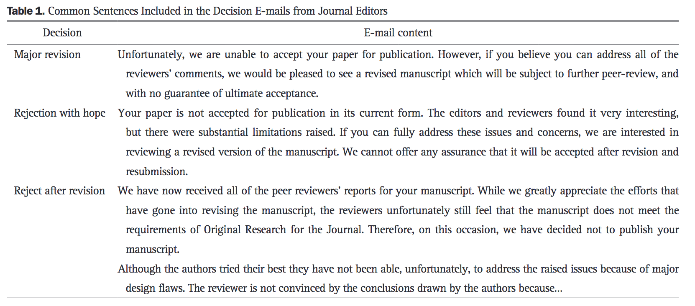
Editor’s view of non-responsive Revisions
Tips for Responding to Reviewers' Comments-from an Editor's or Reviewer's Points of View, G. Wong, Gut and liver, 13(1):7–10. 2019 (doi: 10.5009/gnl18361 )
Q? Predict Editor’s decisions associated with their view of revisions:

Slide 7
Outline for LO1: Research Skill: Responsive Revision
Learning Objective
Motivating Exercise
Editor’s view of non-responsive Revisions
Reviewing Papers vs. Reviewing Proposals
Best Practices
A Taxonomy of Review Comments
Examples
Spatial Dimensions of Algorithmic Transparency
Spatial computing, Communications of the ACM, Jan. 2016.
NSF Proposal

Slide 8
Best Practices
Source:
Ten simple rules for writing a response to reviewers, W. Noble, PLOS Computational Biology, Oct. 12th, 2017, (https://doi.org/10.1371/journal.pcbi.1005730 )
Desired mindset and attitude
Reviewers are on your side, even when critical
They want to help you improve the paper to make a contribution to the field.
An example
reviewer comments and responses for the article titled Spatial Computing

Slide 9
Outline for LO1: Research Skill: Responsive Revision
Learning Objective
Motivating Exercise
Editor’s view of non-responsive Revisions
Best Practices
A Taxonomy of Review Comments
Examples
Spatial Dimensions of Algorithmic Transparency
Spatial computing, Communications of the ACM, Jan. 2016.
NSF Proposal

Slide 10
A Taxonomy of Review Comments
Taxonomy
Minor Comments
Major Comments
Minor Comments Examples
Complements, e.g. "Great job." "Excellent work."
Low Effort Actionable constructive comments
Ex. Grammatical errors, minor inconsistencies
Ex. Literature survey is missing following papers …
Action: Take Care of these without debating
Major Comments
Decide if it is critical success factor or a show-stopper
If so, invest time and effort to address it
Else delegate to Future Work, declare it out of scope

Slide 11
Major Comments
Major effort actionable comments
Evidence inadequate to support contribution claims
Options: Expand evidence or use narrower claims
Expanding Evidence
Expand validation with additional experiments,
Use bigger dataset for scalability claims
Use sampling theory aware datasets for generalizability claims
Sensitivity analysis with synthetic datasets allowing parameter variation
Ex. Analyze problem hardness
Prove that the problem is NP-hard
Ex. Characterize solution quality
Relative to optimal, accuracy, statistical significance
Provide approximation algorithms

Slide 12
Outline for LO1: Research Skill: Responsive Revision
Learning Objective
Motivating Exercise
Editor’s view of non-responsive Revisions
Best Practices
A Taxonomy of Review Comments
Examples
Spatial Dimensions of Algorithmic Transparency
Spatial computing, Communications of the ACM, Jan. 2016.
NSF Proposal

Slide 13
Example: Spatial Dimensions of Algorithmic Transparency
Example: Jayant Gupta, Alexander Long, Corey Kewei Xu, Tian Tang, and Shashi Shekhar. "Spatial Dimensions of Algorithmic Transparency: A Summary." In 17th International Symposium on Spatial and Temporal Databases, pp. 116-125. 2021.

Slide 14
Responsive Revision
Easy to interpret
 | Comment | Interpretation | Action | Text
2 | The paper focuses on inequality and segregation. The way that extends to other measures in a similar study is not clear and not discussed.idnsiofns | How does the proposed approach generalize to other measures ? Does the approach (i.e., the dimension of transparency) only affects the measures of inequality and segregation or do they generalize to other types of measures as well. | Acknowledge in scope and future work. Revisit for Journal extension. | We limit our mathematical analysis to two types of inequality measures and one type of segregation measure: an entropy- based inequality measure (Gini index), a ratio-based inequality measure (IQSR), and a ratio-based segregation measure (Index of Dissimilarity). Mathematical analysis of other types or variants of inequality measure and segregation measure is outside the scope of this work.

Slide 15
Responsive Revision
Hard to interpret
 | Comment | Interpretation | Action | Text
2 | With an eye to practical decision support based on census data, would it not be meaningful to perform a "smarter" more suitable kind of partitioning first? Like for example, perform some form of clustering and then form partitions based on the clusters formed? This could lead to partitions of an adaptive granularity that may offer more insightful analyses. What I mean is that I am not certain the approach assumed here is advisable, because it treats the partitioning methodology as a black-box. To me, it appears that the best analyses would be possible by first defining appropriate case-specific partitions. | Reviewer is unaware of 100 year long (extensive) literature MAUP dilemma. | Add Section: Implications of MAUP Output is unstable, sensitive to partitioning. MAUP dismisses the idea of creating new partitions. | There may be situations where the base data is given and the space partitions can be changed, we can consider some form of data clustering and then form the partitions. However, in many cases (e.g., census) the partitioning is given and cannot be altered.

Slide 16
Responsive Revision
Harder to interpret
 | Comment | Interpretation | Action | Text
2 | I have mixed feelings regarding this paper. On the one hand, it provides a new perspective on an area that we do not pay enough attention to (transparency of spatial analysis). It is eye opening, and I learned from it about the importance of the spatial partition when conducting spatial analysis. On the other hand, this paper does not feel like a Computer Science paper -- there are no algorithms (except for a brief mention of an algorithm in Section 6.3, without details), no data structures, no comparison of techniques. The results in this paper merit publication and I enjoyed reading it, but I am not sure if it is suitable for SSTD when considering its focus and the type of contributions it makes. | Paper is not relevant to the conference due to low computer science contributions. | Relevance to the conference: Why this topic is important? | Relevance to SSTD: The work in this paper aligns with the call for contributions, particularly to the topic of Fairness, Accountability, and Transparency. The paper provides a perspective on the transparency of spatial analysis showing its implications for the policymakers. The case studies on fine-scale census and census like dataset show how space partitioning can affect the understanding of the societal inequality and segregation.

Slide 17
Example: Spatial Computing
Shekhar, Shashi, Steven K. Feiner, and Walid G. Aref. "Spatial computing."
Communications of the ACM 59, no. 1 (2015): 72-81.

Slide 18
Responsive Revision
Positive reviews
Review | Response
I am satisfied with the diligence of the authors under the limitations of a contributed paper. This paper makes a contribution to the broad field of computer science which may not be so aware of the advances in all the disciplines of spatial sciences/spatial computing. | Thank you for such insightful comments to help improve the manuscript.
I like the changes and additions to the paper. I think this will be an excellent article for CACM. | Thank you for such insightful comments to help improve the manuscript.

Slide 19
Responsive Revision
Negative reviews
Review | Response
The article entitled “Spatial Computing: Accomplishments, Opportunities, and Research Needs” is based upon the assumption that “spatial computing” (a recent and little used term) exists and that it has somehow become composed of all computing activities that have some relation to anything to do with all activities with any spatial context. In my mind, this is about as reasonable an approach as defining “money computing” as containing all computing activities that have some relation to money. The article makes no clear attempt to explain why “spatial computing” should exist (it is a new term) or why it [spatial computing] now claims ownership of so many other activities (some of which have been with us for nearly half a century). All that is provided here is a single sentence in the opening text and a single unhelpful footnote, following which the authors throw up a handful of random examples of how computing in a spatial context can be highly useful (indeed, this fact was pretty well known by quite a substantial number of people at least three decades ago). | Thank you so much for suggesting the need to clarify the term spatial computing. We have revised the footnote on the first page as follows: “Computing Community Consortium (CCC) workshop participants used the term “Spatial Computing” as …” In addition we included a scope paragraph at the end of the introduction section. The new text is reproduced below: “Work in spatial computing has been extensive over the past decades, particularly in the geographic context. It is hard to convey the breadth and depth of this large interdisciplinary body of work…”

Slide 20
Responsive Revision
Negative reviews
Review | Response
The second section of the paper addresses “Transformative Accomplishments” (ah, that lovely catch word - transformative) and sets forth four examples (GIS, SDBMS, spatial statistics and GPS). Clearly, GIS and GPS can easily be labeled “Transformative” but SDBMS structures of increasing sophistication have been a major, internal component of every GIS developed in the last half century, and it would be…. | Thank you for pointing out that GIS include a database management system. Having co-authored a book on spatial database [41], we completely agree and have acknowledged it in the second last sentence of GIS paragraph: “GIS can also join tables based on geometry to support spatial querying and statistical analysis …” [41] Shashi Shekhar and Sanjay Chawla. Spatial Databases: A Tour. Prentice Hall, (ISBN 013-017480-7), 2003. CCC workshop participants felt that SDBMS have transformed mainstream relational DBMS, a topic of great interest to CACM readers, by introducing R-tree indexing methods and OGIS simple feature types. SDBMS have also grown from their roots in GIS to support spatial queries in non-geographic spaces such as sky catalogues. Thus, we felt CACM readers would be interested in a discussion of SDBMS separately. We have also included a sample query from a nongeographic domain, e.g., sky catalogue, in the first sentence of SDBMS paragraph on page 3 of the new version: “Within the Sloan Digital Sky Survey, find galaxy pairs which are within 30 arc-seconds of each other.”

Slide 21
Responsive Revision
The following material is prepared based on a paper currently under review.
Review | Interpretation
Divide the introduction section into subsections. | 1. Take it literally. 2. ?

Slide 22
Responsive Revision
The following material is prepared based on a granted NSF proposal.
Spatial Temporal Informatics for Transportation Science (NSF 1901099)

Slide 23
Responsive Revision
 | Comment
1 | It is not clear how to evaluate the usefulness of the identified patterns in terms of advancing transportation science, and how the identified patterns can be incorporated into the emission prediction models.
2 | There is not much discussion on the scalability of the proposed techniques.

Slide 24
Responsive Revision
 | Comment | Interpretation
1 | It is not clear how to evaluate the usefulness of the identified patterns in terms of advancing transportation science, and how the identified patterns can be incorporated into the emission prediction models. | Motivation: the application of the identified patterns. Evaluation plan: after detecting patterns, how to incorporate them into transportation science, and how to evaluate the improvement. section 2.2.1 show revision of EINOx formula to accommodate the patterns in Table 1 to improve the modeling for NOx data in figure 4. Table 1 should include patterns which are not known to vehicle research community. (Reem, Northrop) ? Did SSTD or Geoinformatica paper already include such a discussion?
2 | There is not much discussion on the scalability of the proposed techniques. | section 3.2 (simple path enumeration needs preliminary results on scalability as well as newer algorithms beyond filter and refine. We explored divide and conquer in the previous version. show the problem is APX-Hard to justify use of heuristics. leverage Prof. Janardan's suggestion during xun's proposal exam on reducing redundant computation. leverage Prof. Karypis' suggestion during xun's proposal exam on enumerating simple path without redundancy. Check if that enumeration is computational scalable. use a new name for the algorithm in section 3.2 to distinguish the proposed method against dynamic programming.

Slide 25
Responsive Revision
 | Comment | Interpretation | Action
1 | It is not clear how to evaluate the usefulness of the identified patterns in terms of advancing transportation science, and how the identified patterns can be incorporated into the emission prediction models. | Motivation: the application of the identified patterns. Evaluation plan: after detecting patterns, how to incorporate them into transportation science, and how to evaluate the improvement. section 2.2.1 show revision of EINOx formula to accommodate the patterns in Table 1 to improve the modeling for NOx data in figure 4. Table 1 should include patterns which are not known to vehicle research community. (Reem, Northrop) ? Did SSTD or Geoinformatica paper already include such a discussion? | Figure 3 and paragraphs 2-3 in Sec. 2.2.1 details the steps (top half of Figure 3) to incorporate the patterns into emission (e.g., NOx) models and provides preliminary result (lower half of Figure 3) showing that mean-relative error reduced from 49.8% to 32.8% using the patterns Evaluation plan (Sec. 5) provides and defines a measure (mean-relative error) to evaluate the usefulness of identified patterns.

Slide 26
Responsive Revision
 | Comment | Interpretation | Action
2 | There is not much discussion on the scalability of the proposed techniques. | section 3.2 (simple path enumeration needs preliminary results on scalability as well as newer algorithms beyond filter and refine. We explored divide and conquer in the previous version. show the problem is APX-Hard to justify use of heuristics. leverage Prof. Janardan's suggestion during xun's proposal exam on reducing redundant computation. leverage Prof. Karypis' suggestion during xun's proposal exam on enumerating simple path without redundancy. Check if that enumeration is computational scalable. use a new name for the algorithm in section 3.2 to distinguish the proposed method against dynamic programming. | Revised task STI-3 provides preliminary result scaling up to over 100,000 time-points. Task STI-1 added discussion about the limit of theoretical scalability. New task STI-2 lists additional strategies beyond the pruning strategies explored in tasks STI-1, STI-4, STI-5.

Slide 27
Ten Commandments
Source:
Ten simple rules for writing a response to reviewers, W. Noble, PLOS Computational Biology, Oct. 12th, 2017, (https://doi.org/10.1371/journal.pcbi.1005730 )
Provide an overview, then quote the full set of reviews
Be polite and respectful of all reviewers
Accept the blame
Make the response self-contained
Respond to every point raised by the reviewer
Use typography to help the reviewer navigate your response
Whenever possible, begin response to each comment with a direct answer to the point being raised
When possible, do what the reviewer asks
Be clear about what changed relative to the previous version
If necessary, write the response twice

Slide 28
Learning Objectives
After this segment, students will be able to
LO1: Research Skill: Responsive Revision
LO2: Describe Spatial Networks
LO3: List main contributions and organize literature of following papers:
Tang, Xun, Emre Eftelioglu, Dev Oliver, and Shashi Shekhar. "Significant linear hotspot discovery." IEEE Transactions on Big Data 3, no. 2 (2017): 140-153.
George, Betsy, Sangho Kim, and Shashi Shekhar. "Spatio-temporal network databases and routing algorithms: A summary of results." In Advances in Spatial and Temporal Databases: 10th International Symposium, SSTD 2007, Boston, MA, USA, July 16-18, 2007. Proceedings 10, pp. 460-477. Springer Berlin Heidelberg, 2007.

Slide 29
Weekly Topic: Spatial Network
Genre | Use cases | Building Blocks | Algorithms
Spatial network | Shortest path for visiting a set of points, Linear hotspots | Graph partitioning, Pairwise shortest path, Spatial statistics, Path enumeration | CCAM, Dijkstra’s algorithm A*, Hierarchical, Tree pruning
Spatial flow network | Evacuation routes | Evacuation planning optimization | CCNVD, Max flow
Spatiotemporal network | Best start time | Lagrangian | Critical-point algorithm
Spatiotemporal flow network

Slide 30

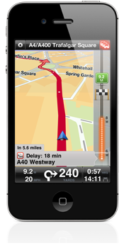

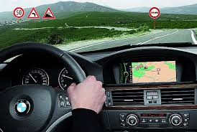

Spatial Network Applications
Navigation Systems
Location-based services

Slide 31
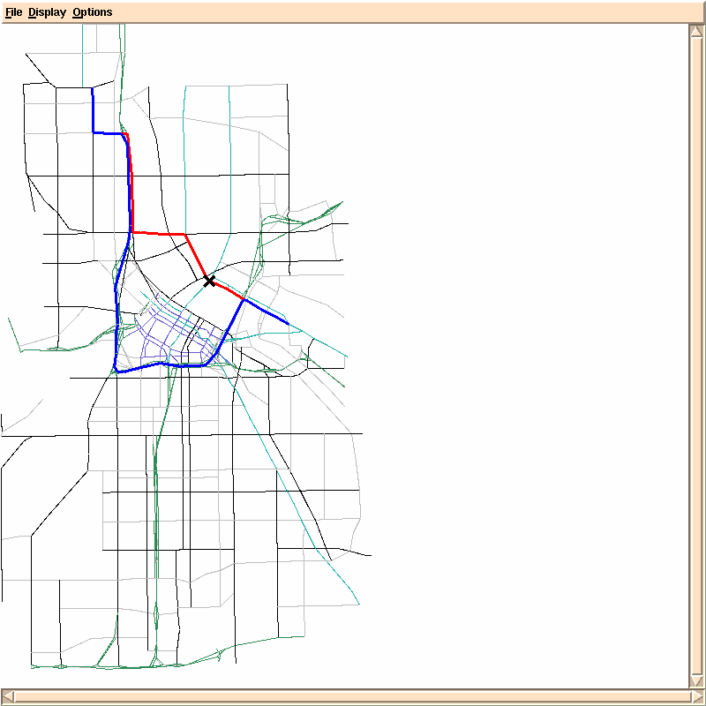
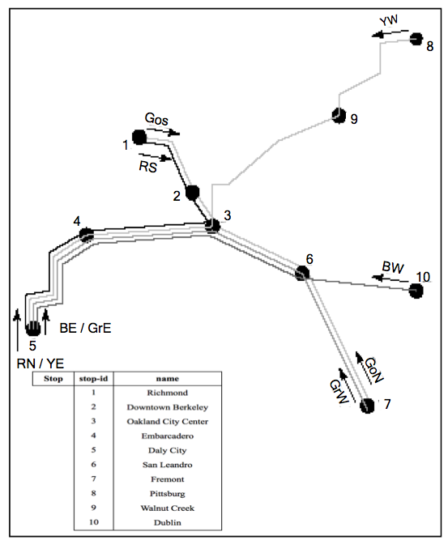
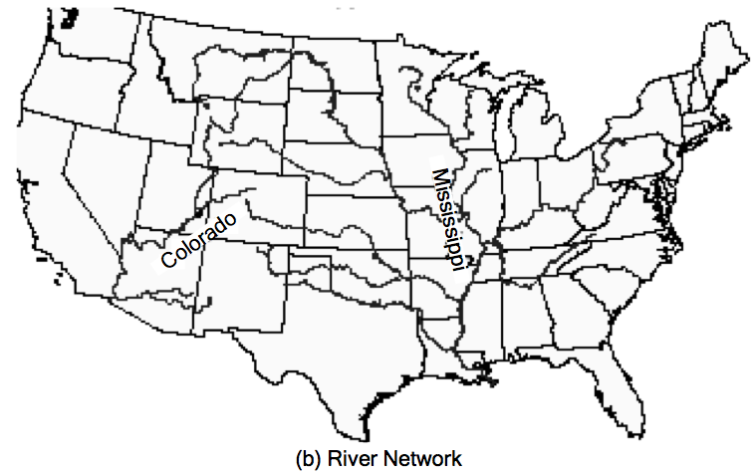
Spatial Network Examples
A Road
Network
A Railway
Network
A River
Network

Slide 32
Data Models of Spatial Networks
Conceptual Model
Information Model: Entity Relationship Diagrams
Mathematical Model: Graphs
Logical Data Model
Abstract Data types
Custom Statements in SQL
Physical Data Model
Storage-Structures
Algorithms for common operations

Slide 33
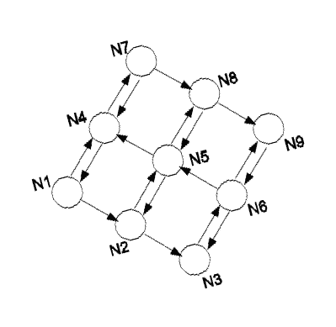
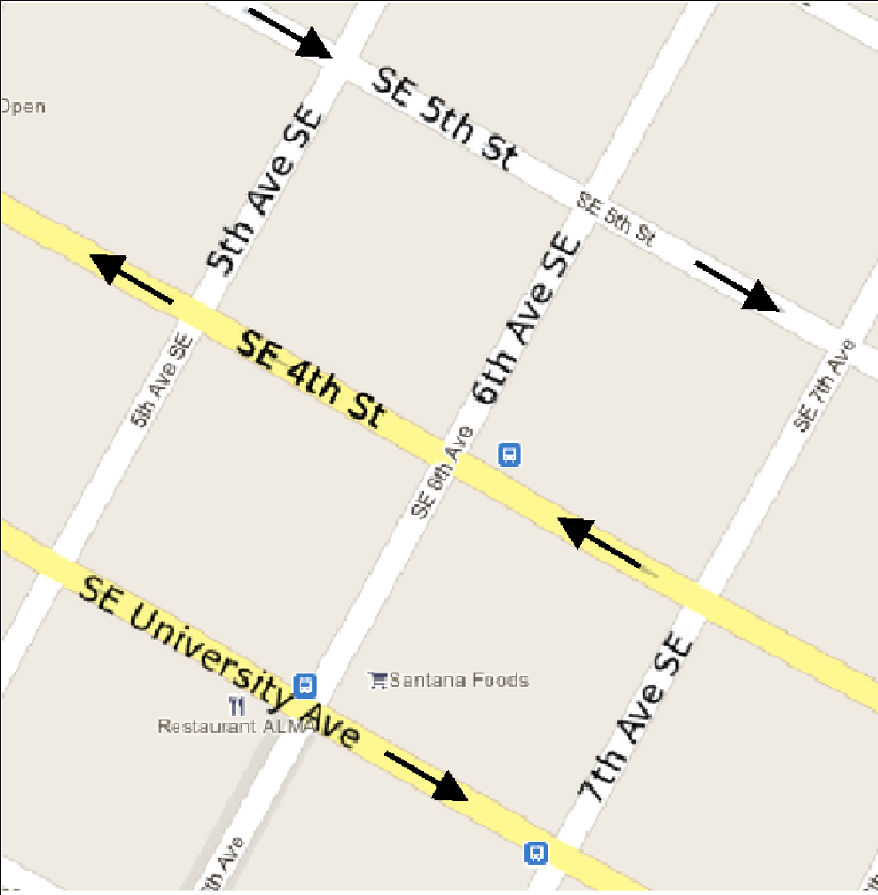
Graph Models
A Simple Mathematical Model
A graph G = (V,E)
V = a finite set of vertices
E = a set of edges model a binary relationship between vertices
Example

Slide 34
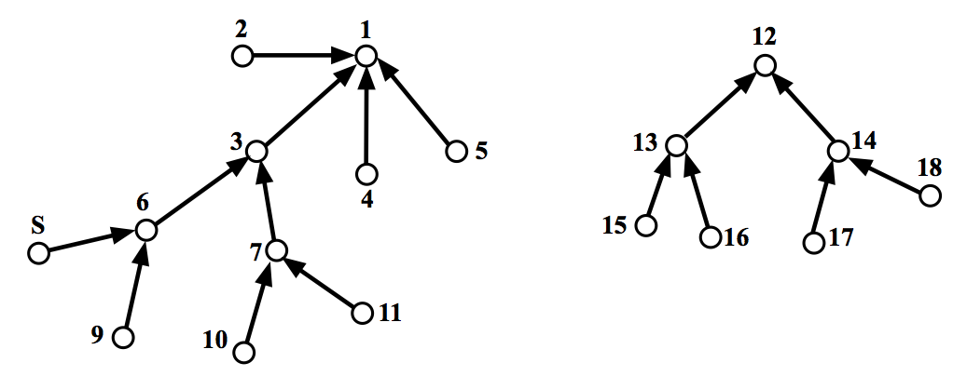
A Graph Model of River Network
Nodes = rivers
Edges = A river falls into another river

Slide 35



Pros and Cons of Graph Models
Strength
Well developed mathematics for reasoning
Rich set of computational algorithms and data-structures
Weakness
Models only one binary relationship
Implications
A. Difficult to model multiple relationships, e.g., turn
B. Multiple graph models possible for a spatial network

Slide 36
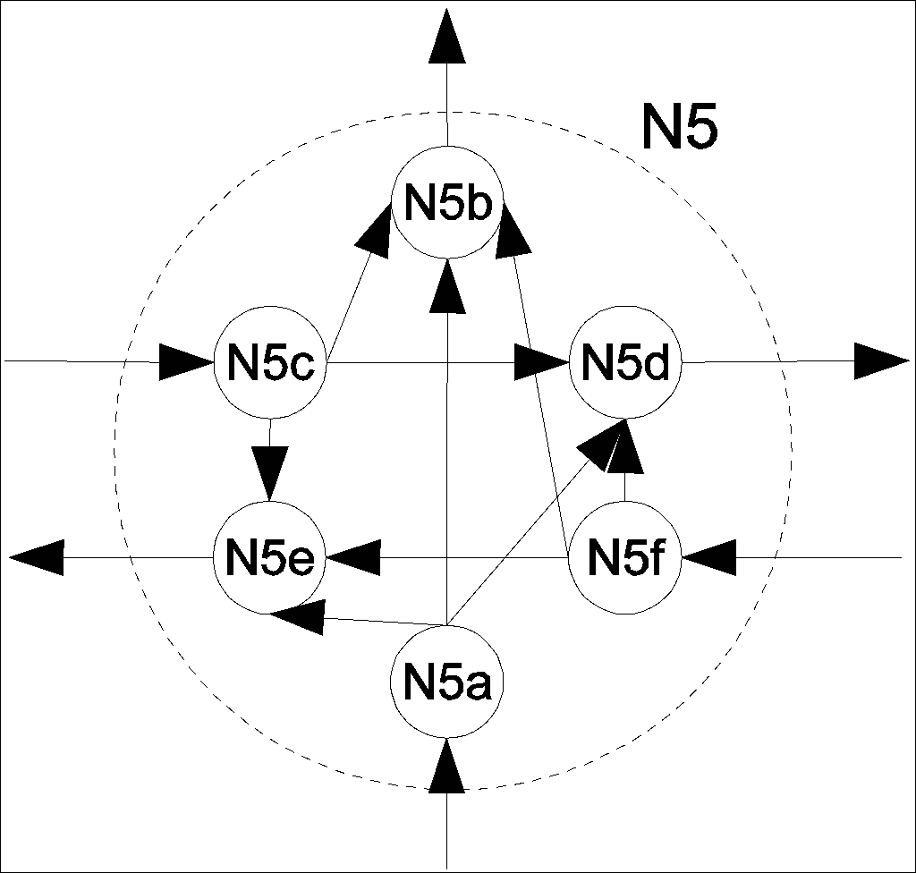
Modeling Turns in Roadmaps
Approach 1: Model turns as a set of connects
Approach 2: Use hyper-edges (and hyper-graphs) where one edge can connect multiple nodes
Approach 3: Annotate graph node with turn information

Slide 37
Alternative Graph Models for Roadmaps
Choice 1 (most popular):
Nodes = road-intersections
Edge (A, B) = road-segment connects adjacent road-intersections A, B
Choice 2:
Nodes = (directed) road-segments
Edge (A,B) = turn from road-segment A to road-segment B
Choice 3:
Nodes = roads
Edge(A,B) = road A intersects_with road B

Slide 38
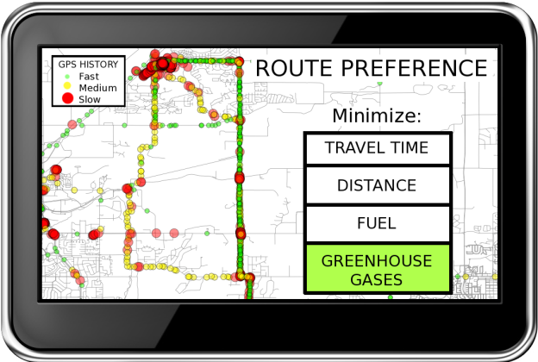
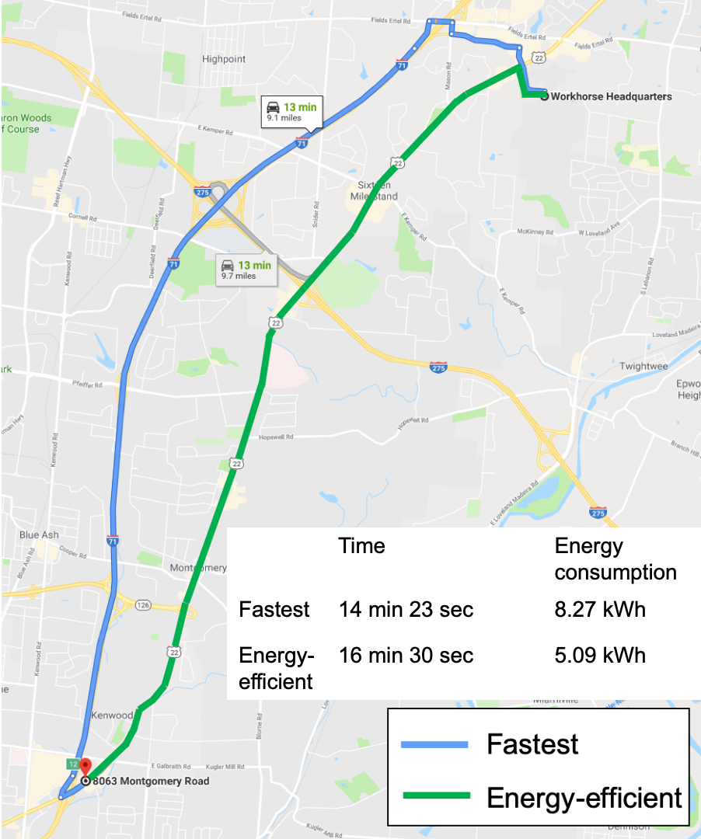
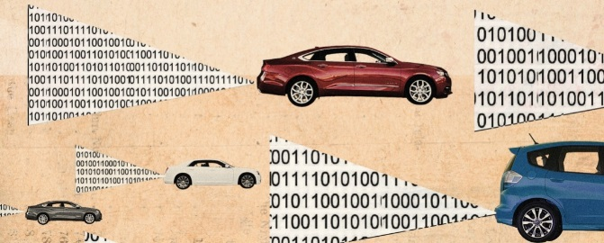
Eco routing to Reduce Emission, Energy use
Spatially oriented datasets exceeding capacity of current routing systems
Due to Volume, Velocity (Update-rate) and, Variety
GPS Tracks + On Board Diagnostics Data
Details: Y. Li, P. Kotwal, P. Wang, Y. Xie, S. Shekhar, and W. Northrop, Physics-guided Energy-efficient Path Selection Using On-board Diagnostics Data, ACM/IMS Trans. Data Sc. 1(3):1-28, Article 22, Oct. 2020.

Slide 39
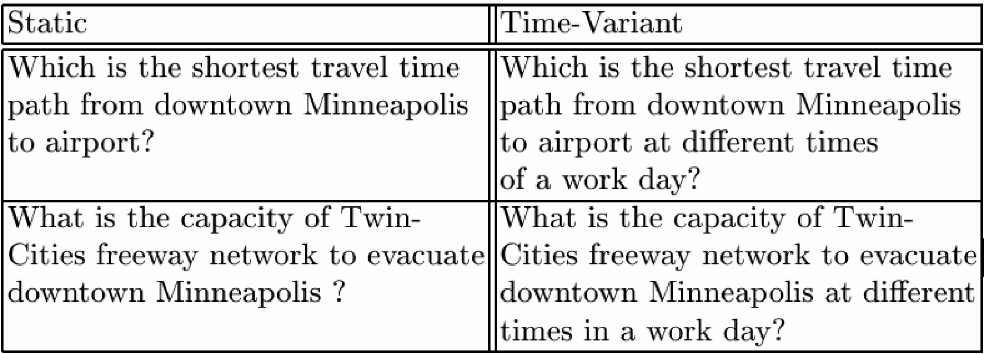
Next Generation Navigation Services
Best start time
Road-capacity aware

Slide 40
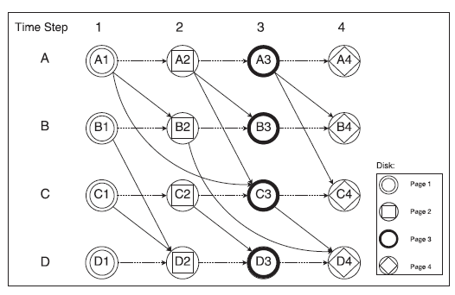
Data Models of Spatiotemporal Networks
Time Aggregated Graph
Time Expanded Graph
B
Cost = [1, 2, 2, 1]
Cost = [3, 3, 1, 1]
A
D
Cost = [3, 1, 2, 1]
Cost = [1, 2, 3, 4]
C

Slide 41
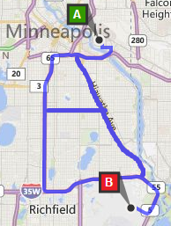
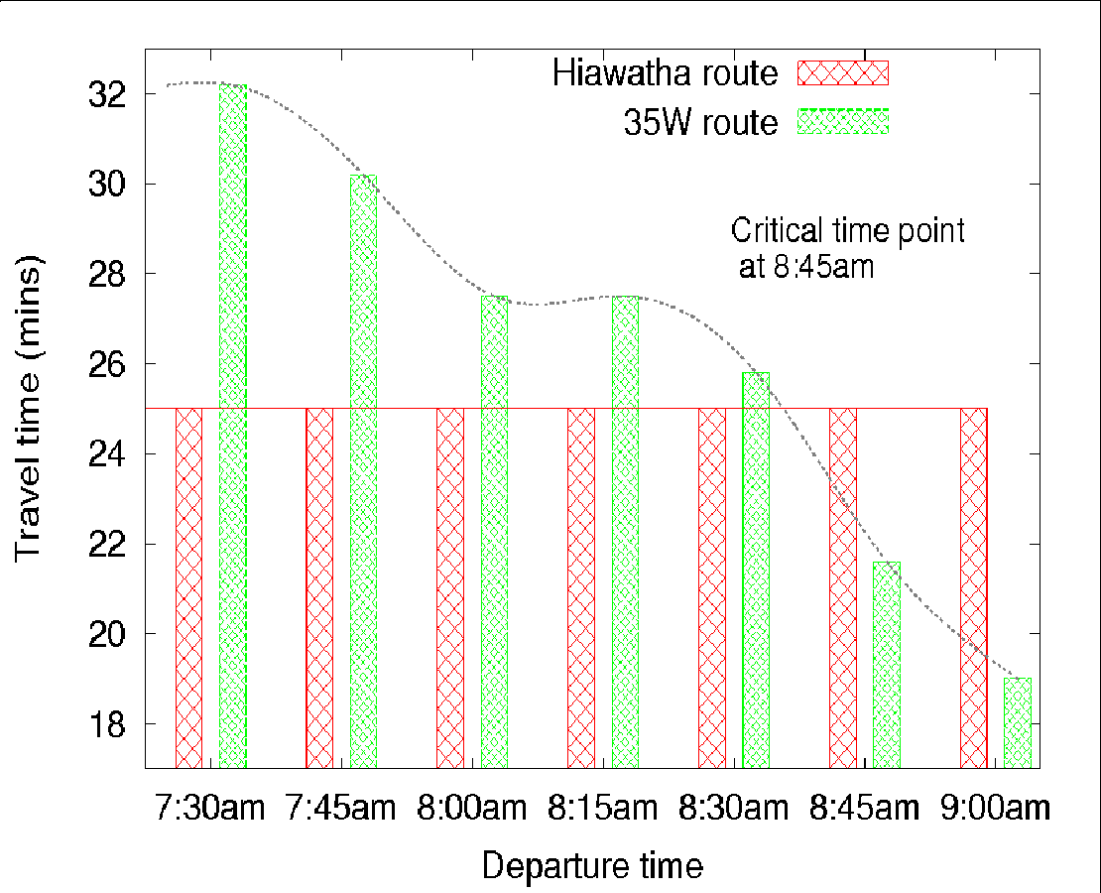
Spatial Big Data: All Start-time Lagrangian Shortest Paths
Problem Statement:
Input: Road network; a source and destination; a time interval
Output: A path between source and destination for each departure-time
Objective: Earliest arrival time at destination; traveler’s perspective
Time | Preferred Route
7:30am | Via Hiawatha
7:45am | Via Hiawatha
8:30am | Via Hiawatha
8:45am | Via I-35W
9:00am | Via I-35W
9:15am | Via I-35W
…. | ……
Challenges:
A naïve approach:
Repeatedly re-compute shortest path for each departure time
Close multiple nodes 🡪 Dynamic programming not applicable!
Contributions:
Critical-time-points (CTP)
Departure times at which ranking changes
CTPs inspire a divide and conquer approach
Gunturi, Venkata MV, Shashi Shekhar, and KwangSoo Yang. "A critical-time-point approach to all-departure-time Lagrangian shortest paths." IEEE Transactions on Knowledge and Data Engineering 27.10 (2015): 2591-2603.

Slide 42
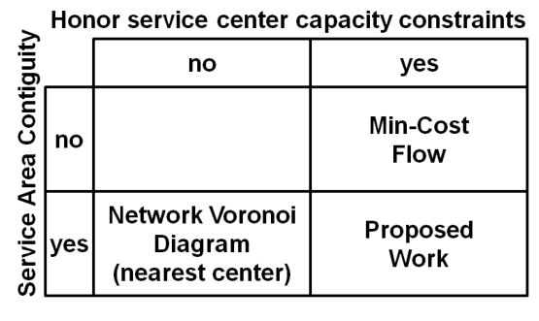
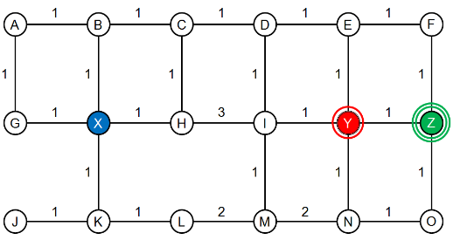
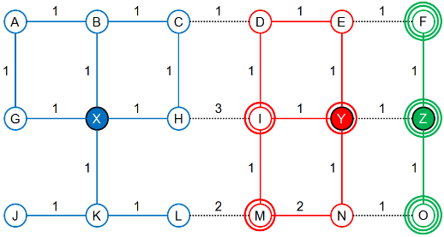
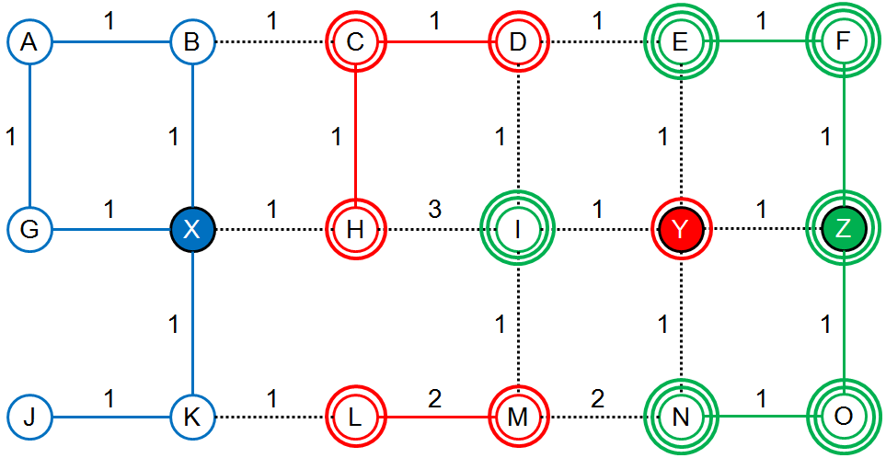
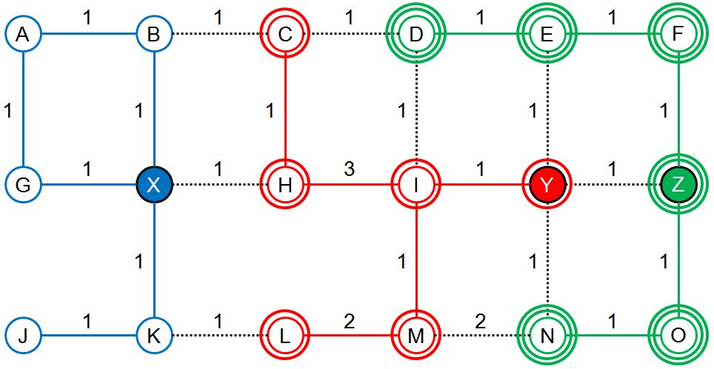
Capacity-Constrained Network-Voronoi Diagram
Problem definition
Given
A transportation network G with graph-nodes N and edges E,
a set of service centers
a set of positive integer capacities of service centers,
a set of non-negative distances of edges
Output
Capacity Constrained Network Voronoi Diagram (CCNVD)
Objective
Min-Sum: Minimize the sum of distances from graph-nodes to their allotted service centers.
Constraints
Capacity constraint: The number of nodes in a SA does not exceed the pre-defined capacity of its service center.
Continuity constraint: Each service area should be a connected sub-graph of G.
Related Work
(a) Input
(b) NVD (Output)
(c) Min-Cost Flow without SA contiguity (min-sum=30)(Output)
(d) CCNVD (min-sum=30) (Output)

Slide 43
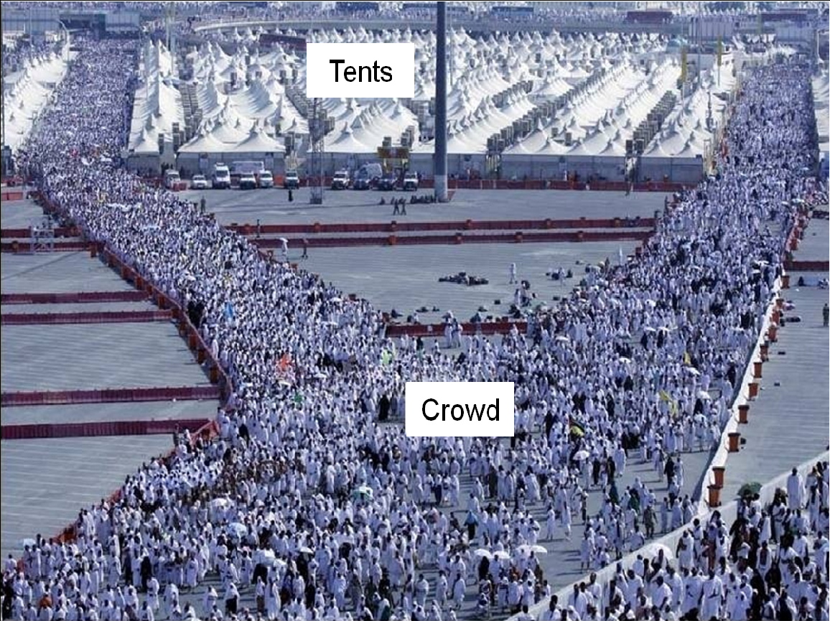
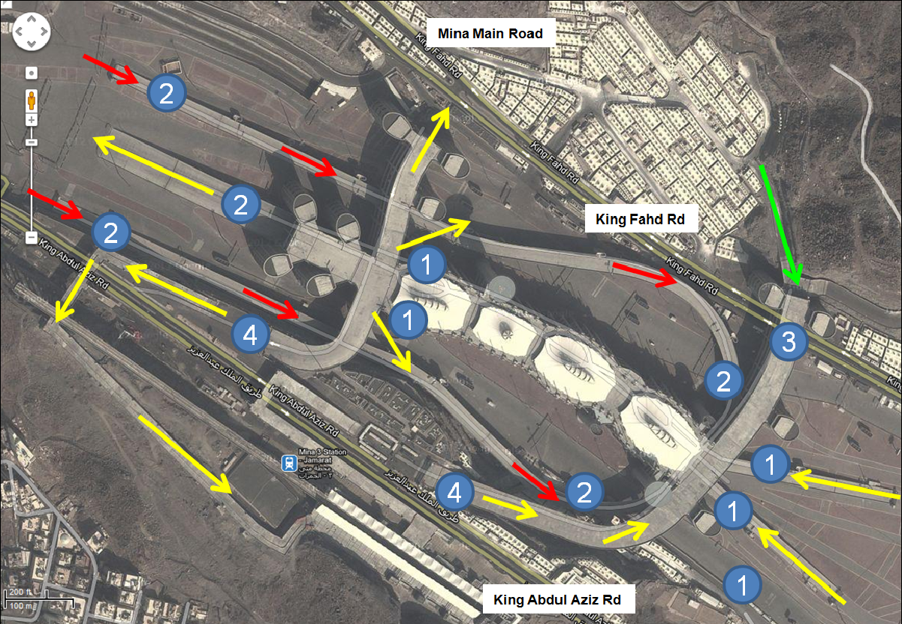
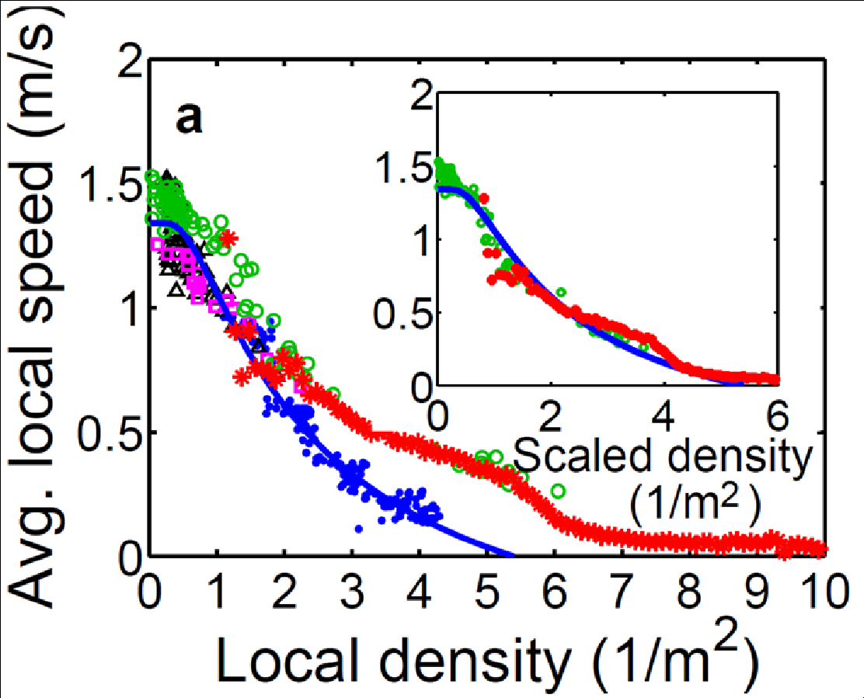
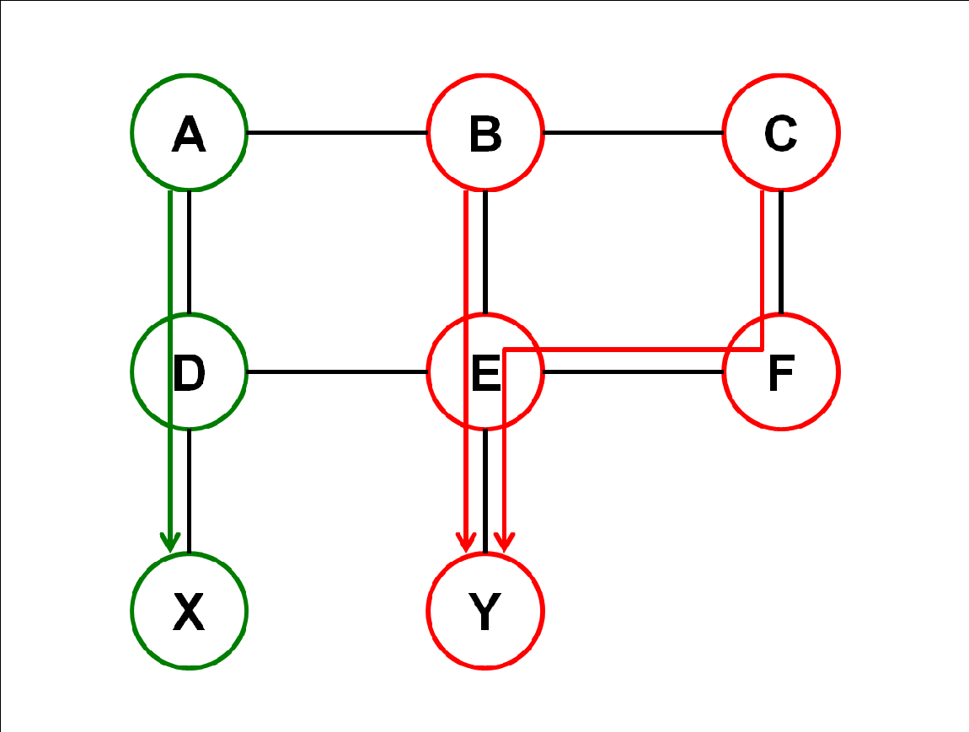
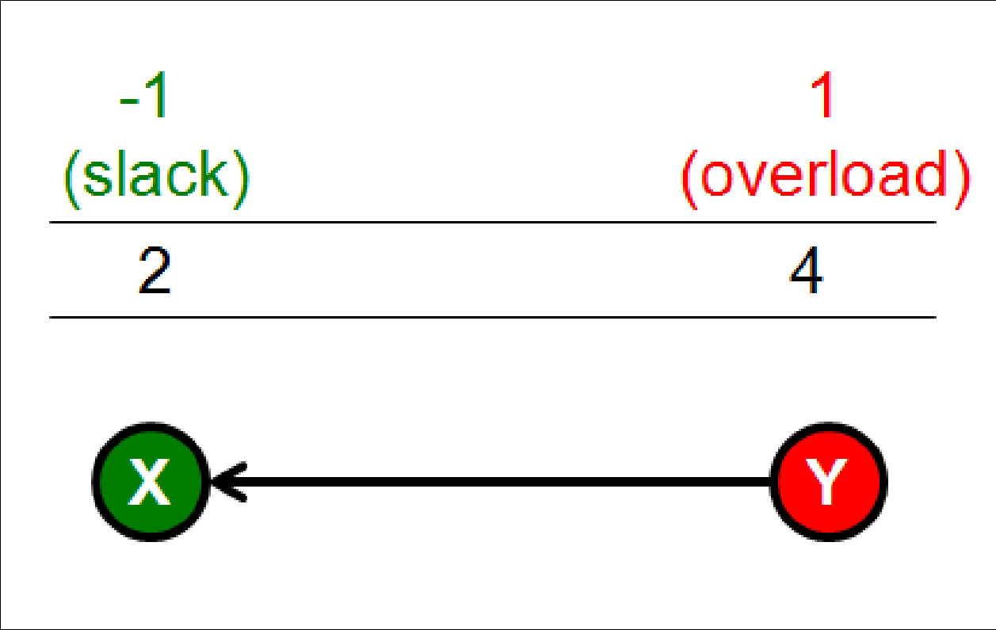
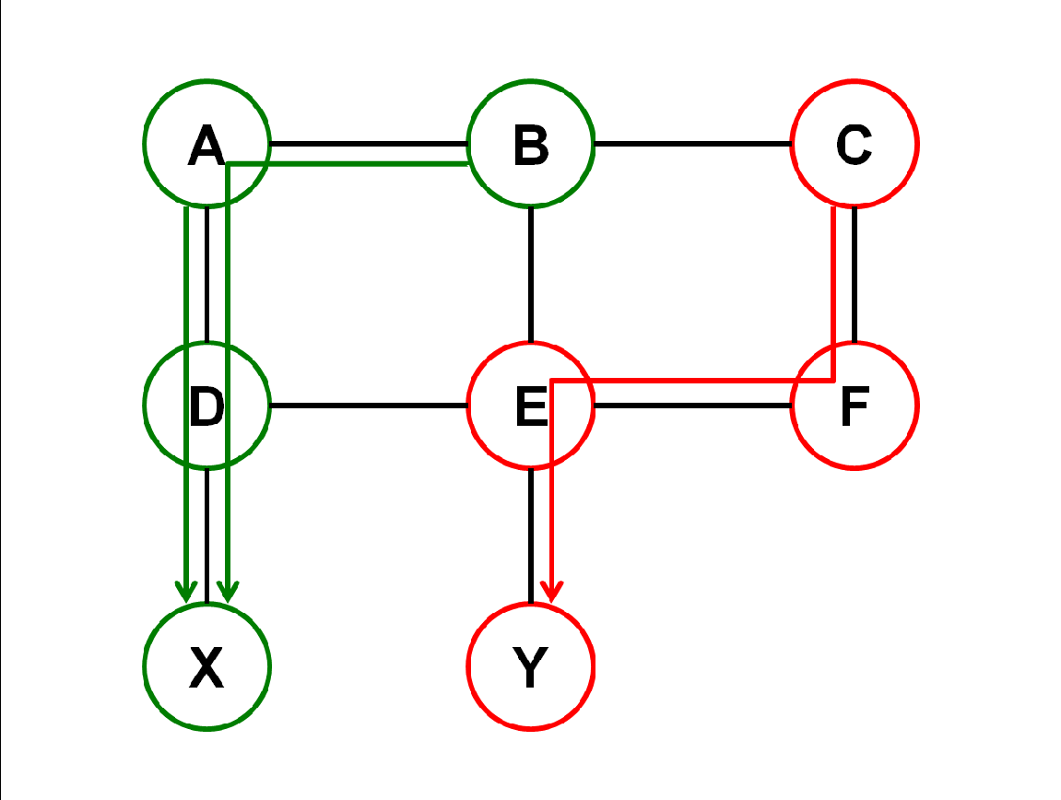
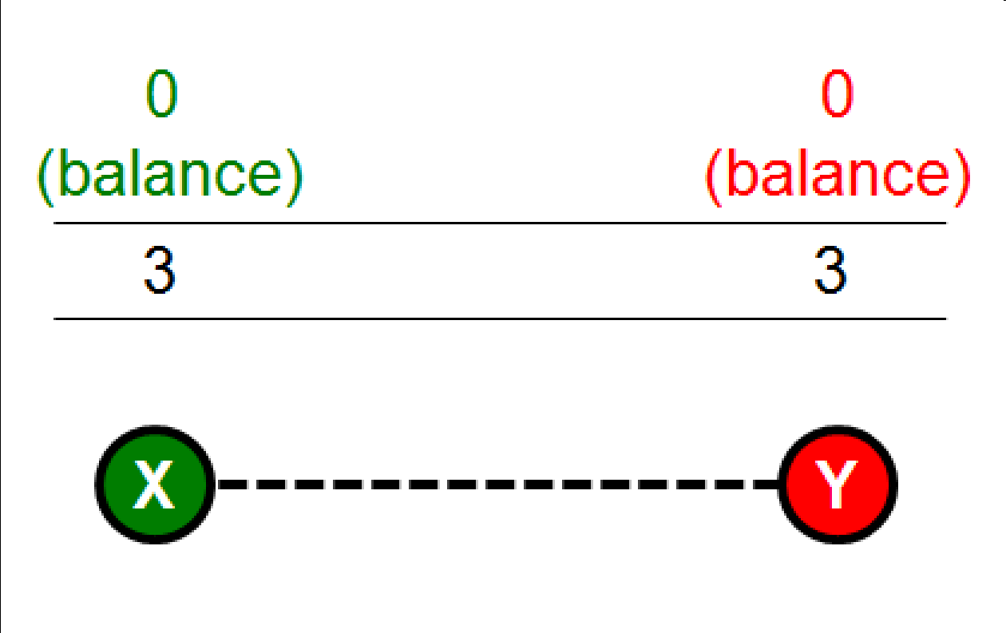
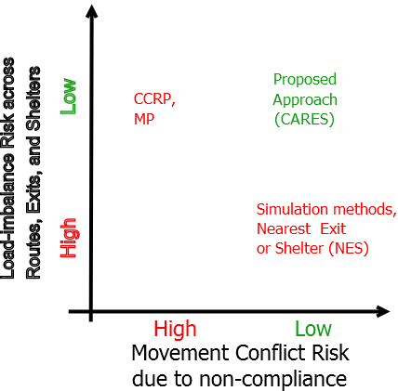
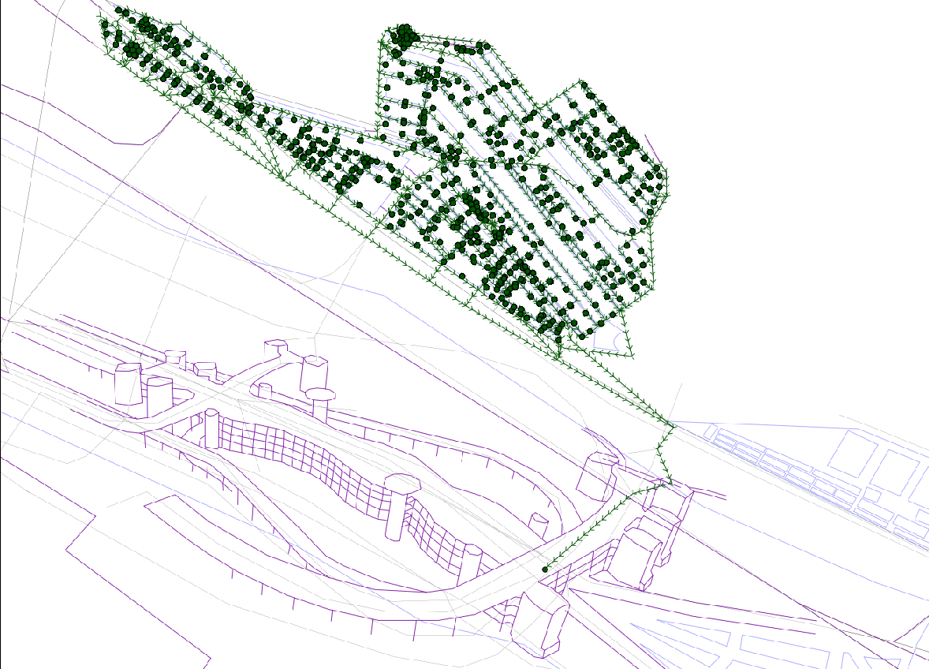
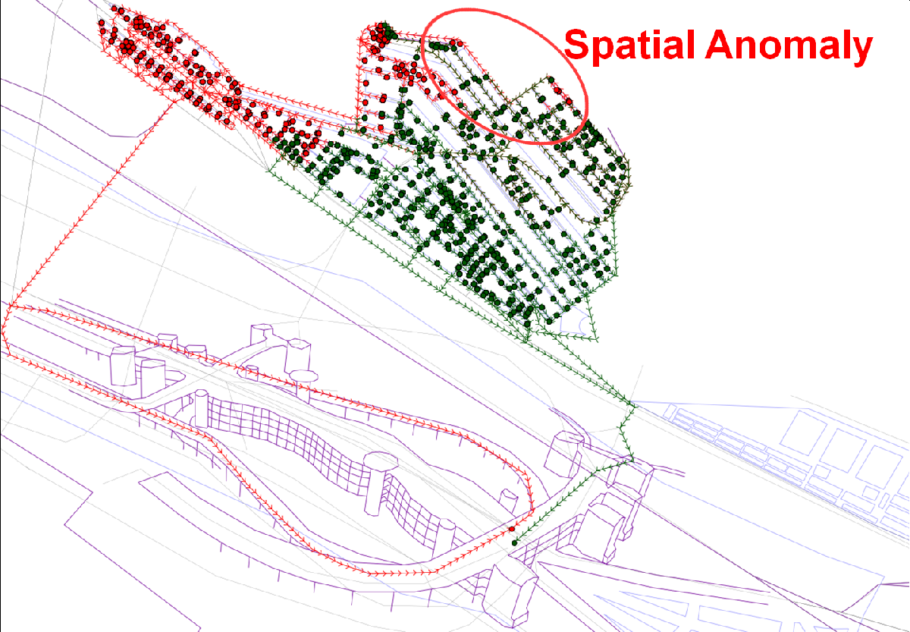
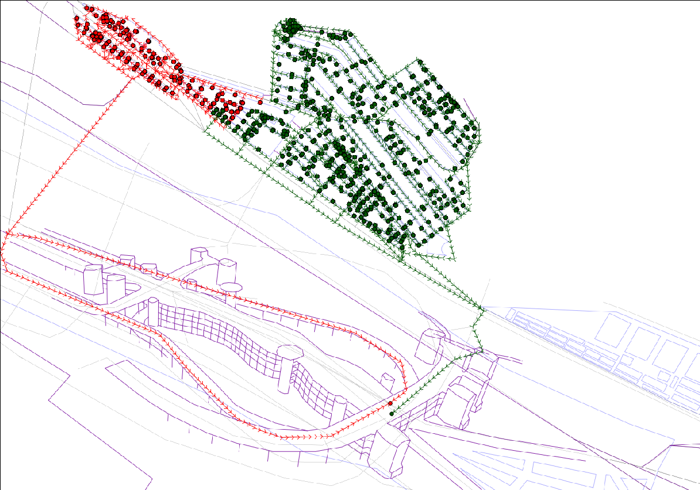
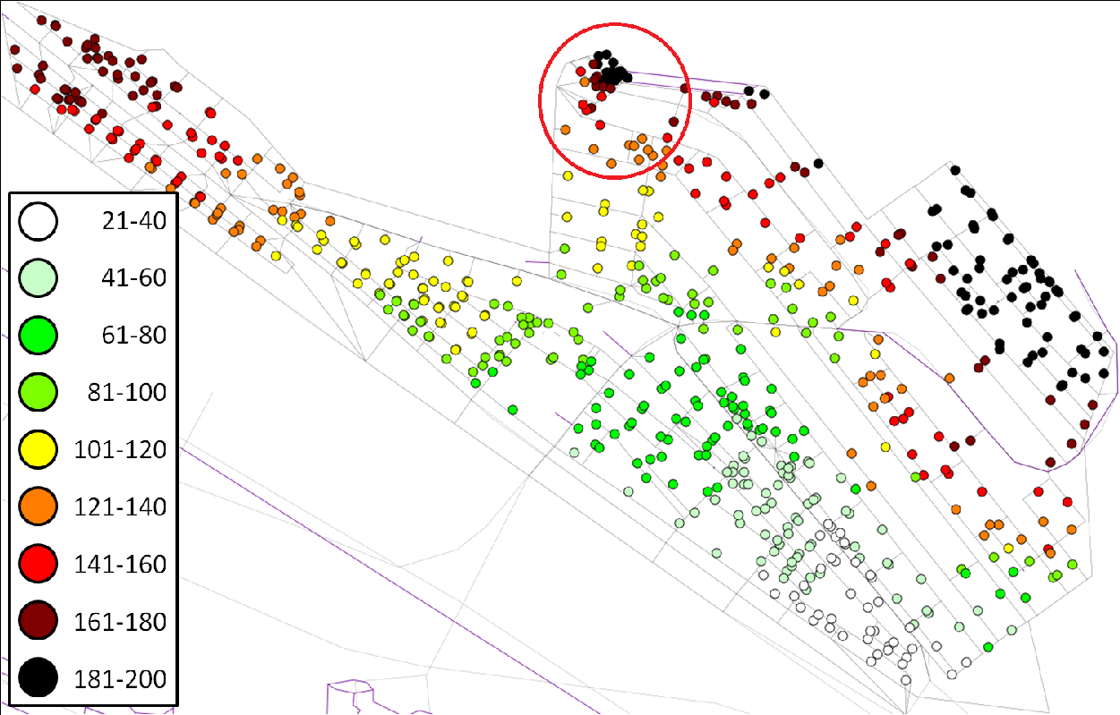
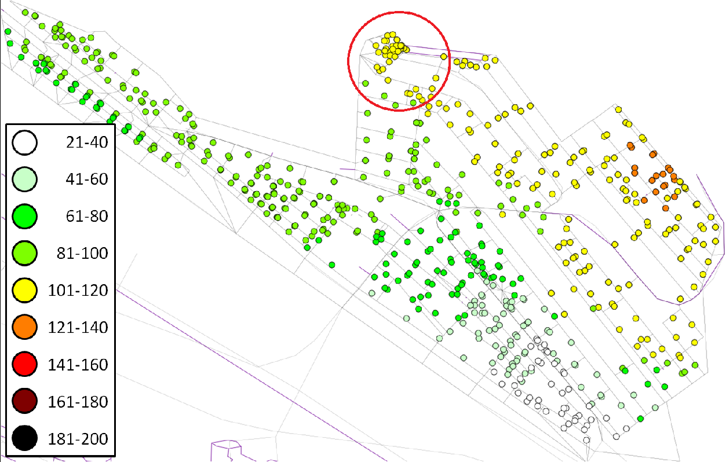
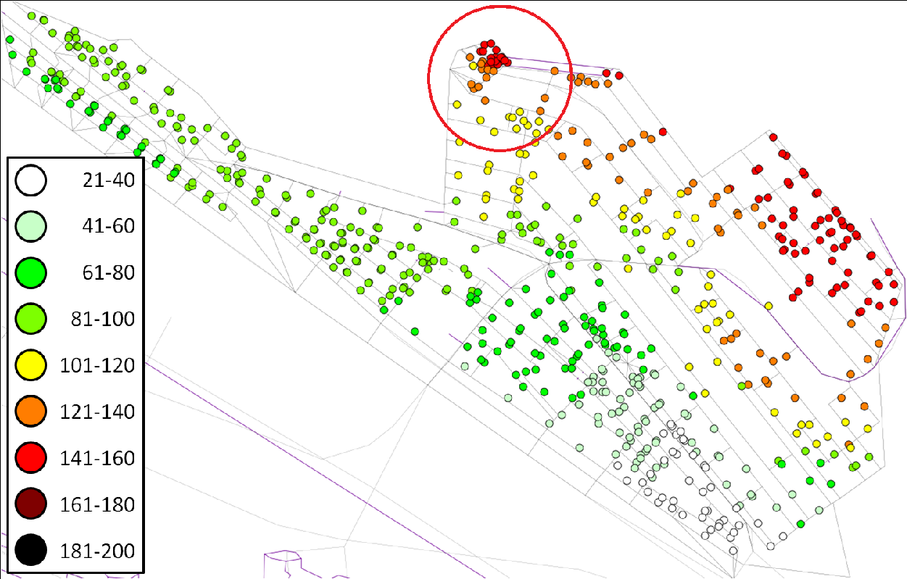
Intelligent Shelter Allotment for Emergency Evacuation Planning: A Case Study of Makkah
Problem statement
Given:
An undirected graph G = (V, E), where V is a set of nodes, and E is a set of edges
Edge travel-time t : E 🡪 Z⁺
EdgeCapacity/unit-time, ec : E 🡪 Z⁺
Shelters x ∈ S subset of V
Shelter capacity: sc : S 🡪 Z⁺
Find: Allotment A: V 🡪 S
Objective: Minimize the maximum travel time for any evacuee to reach allotted shelter
Constraints:
Shelter service area contiguity
Edge capacity constraints
Shelter capacity constraints
Crowd walking from tent city to Jamarat complex
Jamarat complex has multiple levels shown as 1, 2, 3 and 4 on associated ramps. Every level is a distinct shelter destination.
Crowd density and walking speed model of Hajj pilgrims
Shelter Allotment
(1st iteration)
(b) Shelter Graph (SG)
(1st iteration)
(c) Shelter Allotment
(2nd iteration)
(d) Shelter Graph (SG)
(2nd iteration)
Theorem 1: The ISA problem is NP-hard.
(a) NES Allotment
(b) CCRP Allotment
(c) CARES Allotment
The CARES algorithm is based on the core idea of spatial anomaly avoidance.
(d) NES arrival time
(e) CCRP arrival time
(f) CARES arrival time
Yang, KwangSoo, Apurv Hirsh Shekhar, Faizan Ur Rehman, Hatim Lahza, Saleh Basalamah, Shashi Shekhar, Imtiaz Ahmed, and Arif Ghafoor. "Intelligent shelter allotment for emergency evacuation planning: A case study of makkah." IEEE Intelligent Systems 30, no. 5 (2015): 66-76.

Slide 44
Weekly Topic: Spatial Network
Genre | Use cases | Building Blocks | Algorithms
Spatial network | Shortest path for visiting a set of points, Linear hotspots | Graph partitioning, Pairwise shortest path, Spatial statistics, Path enumeration | CCAM, Dijkstra’s algorithm A*, Hierarchical, Tree pruning
Spatial flow network | Evacuation routes | Evacuation planning optimization | CCNVD, Max flow
Spatiotemporal network | Best start time | Lagrangian | Critical-point algorithm
Spatiotemporal flow network

Slide 45
Learning Objectives
After this segment, students will be able to
LO1: Research Skill: Responsive Revision
LO2: Describe Spatial Networks
LO3: List main contributions and organize literature of following papers:
Tang, Xun, Emre Eftelioglu, Dev Oliver, and Shashi Shekhar. "Significant linear hotspot discovery." IEEE Transactions on Big Data 3, no. 2 (2017): 140-153.
George, Betsy, Sangho Kim, and Shashi Shekhar. "Spatio-temporal network databases and routing algorithms: A summary of results." In Advances in Spatial and Temporal Databases: 10th International Symposium, SSTD 2007, Boston, MA, USA, July 16-18, 2007. Proceedings 10, pp. 460-477. Springer Berlin Heidelberg, 2007.

Slide 46
Outline
Problem Significance, Key Concepts and Formulation
Related Work and Novelty
Contributions
Validation
Assumptions
Revisions

Slide 47
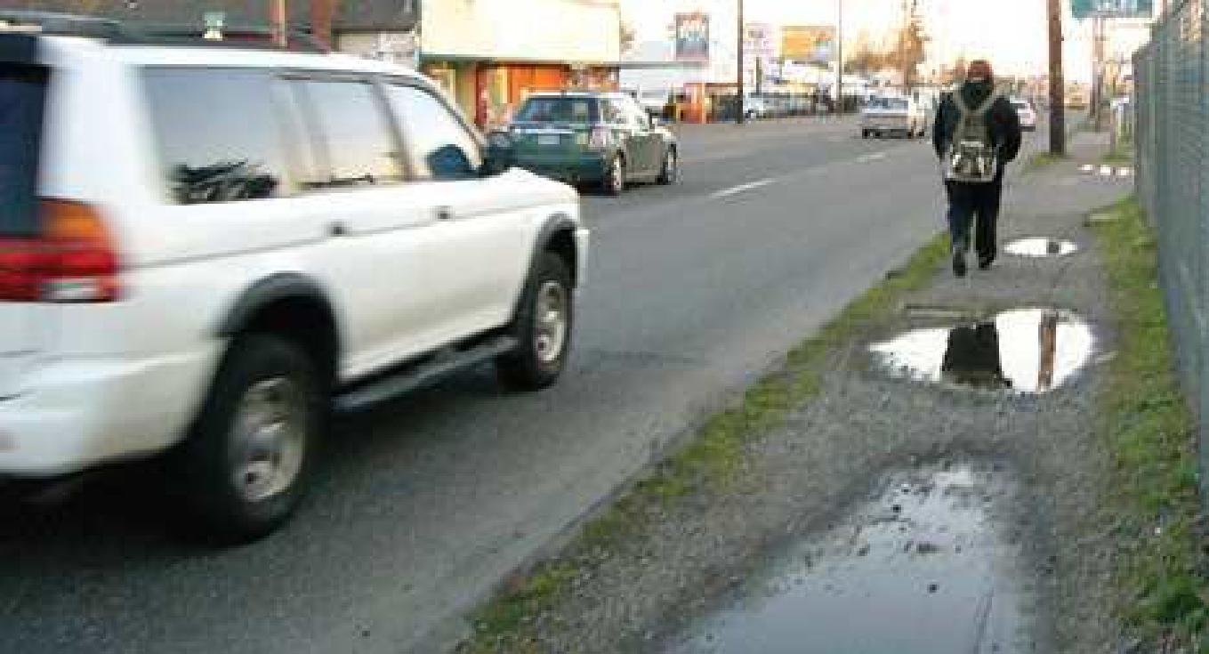
Significance
Transportation, Safety
47,700 pedestrians killed in US from 2000-2009
Streets designed for traffic, not pedestrians
High speed arterial roads account for majority of deaths
Arterial roads lack sidewalks, crosswalks, pedestrian refuges, street lights, etc.
Provide planners tools to in identifying dangerous roads for pedestrians.
Another applications: identify crime (e.g., street robberies) hotspots
Pedestrian at risk on a road without proper sidewalks

Slide 48
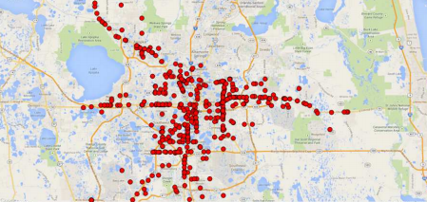
Significance: Other Spatial Network
Spatial networks
Transportation (highways, airlines, etc.)
Oil pipelines, Electric Grid, Gas lines, water mains, …
Many human activities are centered around spatial networks
Traffic accidents
Crimes
Pedestrian fatalities occurring
on arterial roads in Orange
County, FL

Slide 49
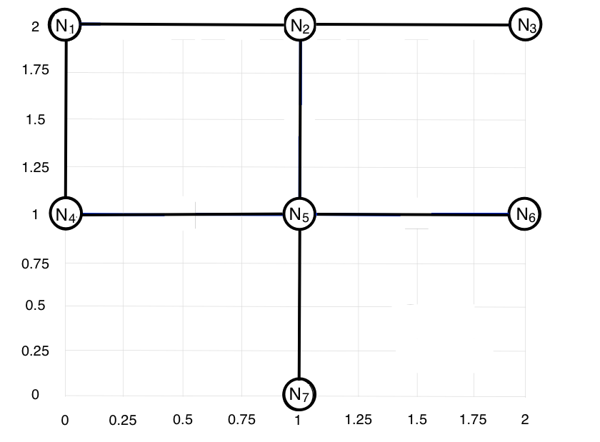
Concepts: Input Data
Spatial network
Nodes: road intersections)
Edges : road segments

Slide 50
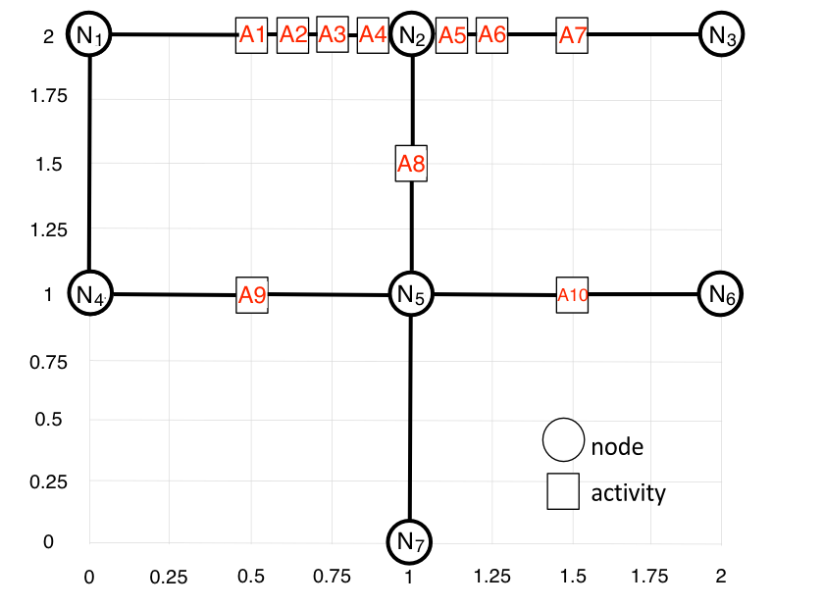
Concepts: Input Data
Spatial network
Network nodes
Edges
Activities

Slide 51
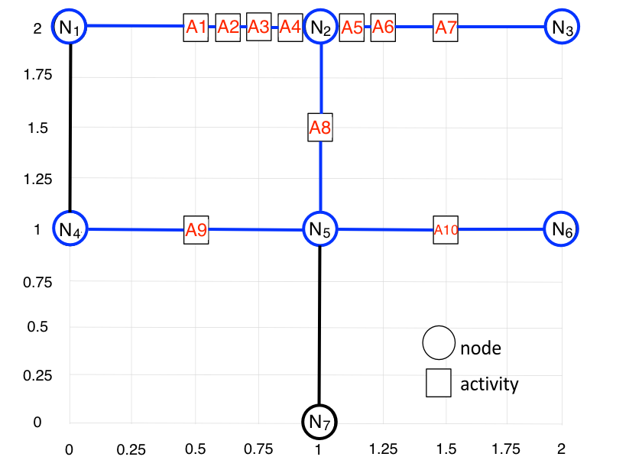
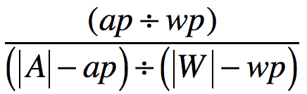
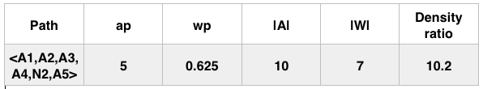
Concepts: Interest measure for Paths
Given a path p on a spatial network,
ap: the number of activities on p,
wp: the length of p,
|A|: the total number of activities on the spatial
network,
|W|: the total length of the spatial network
Interest measure:
Density ratio^{[1]}:
An example:
Janeja, V. P., & Atluri, V. (2005, March). LS 3: A linear semantic scan statistic technique for detecting anomalous windows, Proc. 2005 ACM symposium on Applied computing (pp. 493-497).
‹#›

Slide 52
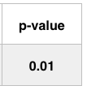
Concepts: Statistical Significance
Lower p-value => higher confidence
Challenges:
Distribution of density ratio are unknown.
Approach:
Monte Carlo simulation to determine p.
‹#›

Slide 53

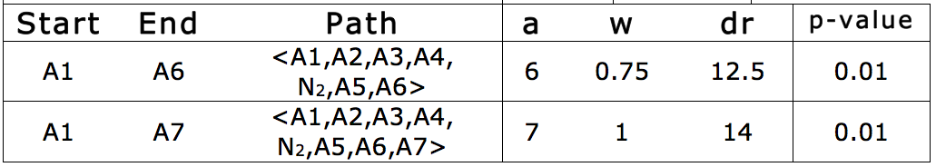
Problem Statement
Given
A spatial network G = (N, E) with a
set of activities A.
A density ratio threshold θ_{d}
A p-value threshold θ_{p,} and number of
Monte Carlo simulation trials m
Find
All shortest path R with density ratio ≥ θ_{d}
and p-value ≤ θ_{p}
Objective
Computational efficiency
Constraints
Correctness, completeness
Any r_{i} ϵ R is longer than or equal to θ_{dis}.
p
p
‹#›

Slide 54
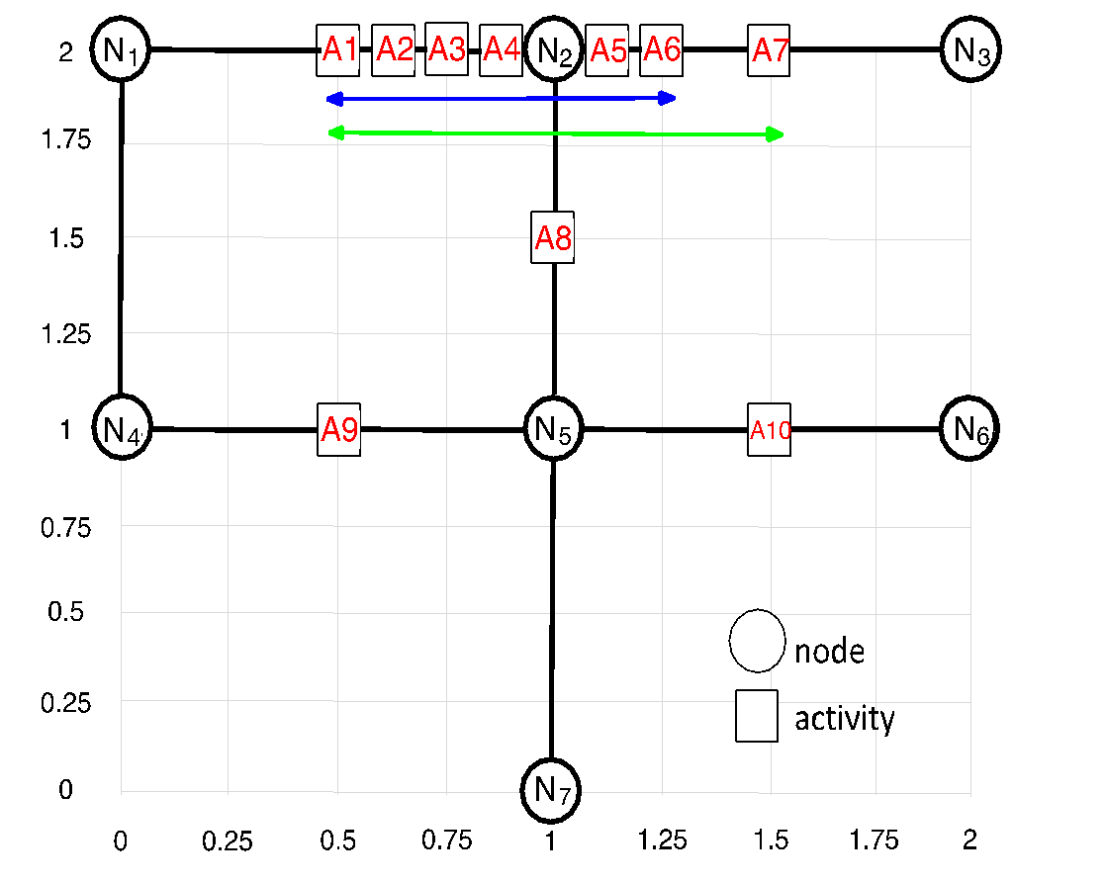
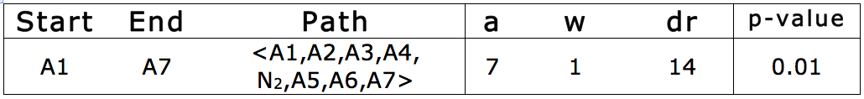
Problem Statement
Given
A spatial network G = (N, E) with a
set of activities A.
A density ratio threshold θ_{d}
A p-value threshold θ_{p,} and number of
Monte Carlo simulation trials m
Find
All shortest path R with density ratio ≥ θ_{d}
and p-value ≤ θ_{p}
Objective
Computational efficiency
Constraints
Correctness, completeness
r_{i} ϵ R is longer than or equal to θ_{dis}.
r_{i} ϵ R not a proper subset of r_{j} ϵ R,
p
p
p
p
‹#›

Slide 55
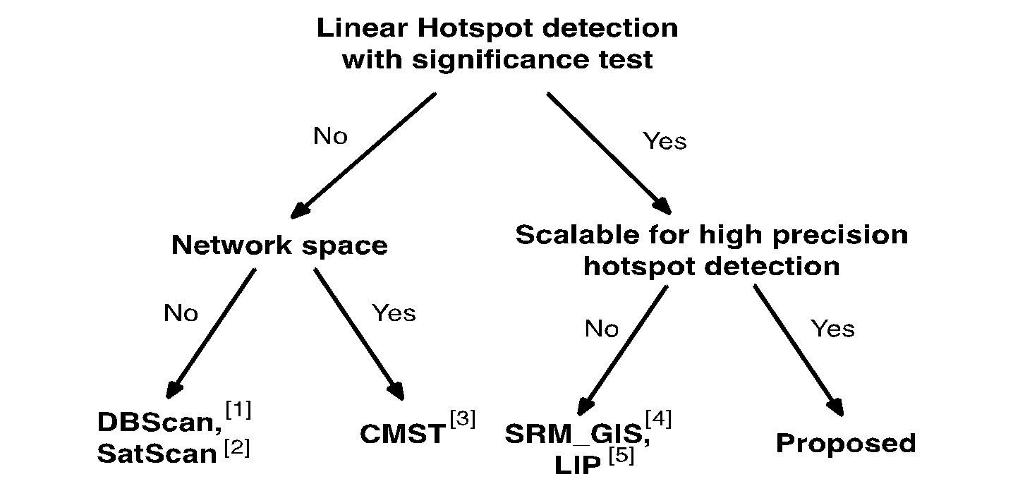
Related Work – A Taxonomy
[1] M. Ester, H.-P. Kriegel, J. Sander, and X. Xu. A density-based algorithm for discovering clusters in large spatial databases with noise.
In KDD, volume 96, pages 226–231, 1996
[2] M. Kulldorff. Satscan user guide for version 9.4. http://www.satscan.org/
[3] M. A. Costa, R. M. Assunc ̧a ̃o, and M. Kulldorff, “Constrained spanning tree algorithms for irregularly-shaped spatial cluster- ing,”
Computational Statistics & Data Analysis, vol. 56, no. 6, pp. 1771–1783, 2012.
[4] Oliver, Dev, et al. "Significant route discovery: A summary of results." Geographic Information Science. Springer
International Publishing, 2014. 284-300.
[5] L. Shi and V. P. Janeja, “Anomalous window discovery for linear intersecting paths,” Knowledge and Data Engineering, IEEE
Transactions on, vol. 23, no. 12, pp. 1857–1871, 2011.

Slide 56
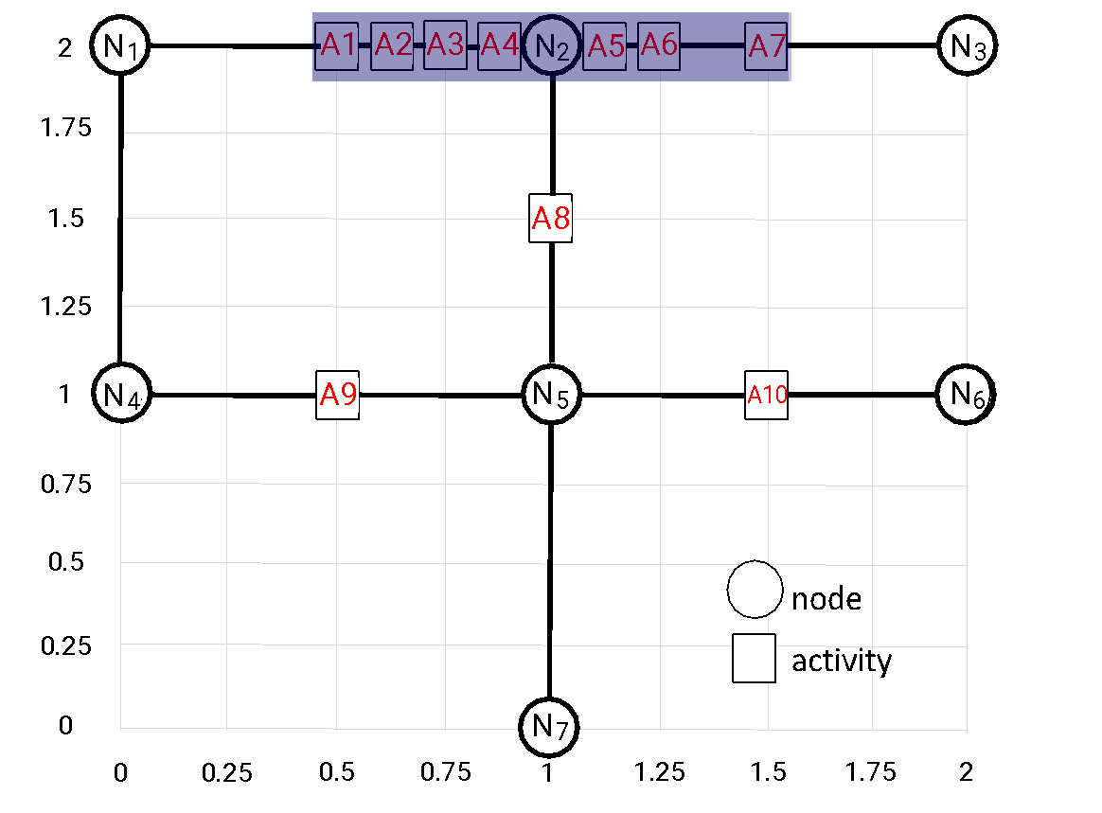
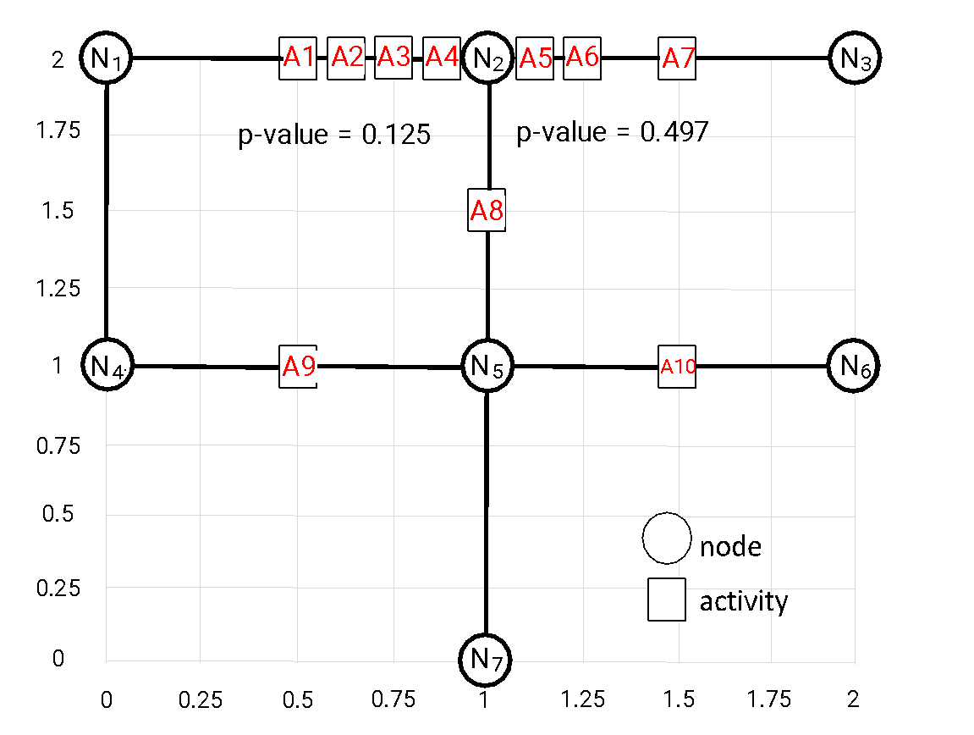


Comparison with Related Work
minPts = 4,
eps = 0.75
DBScan
SatScan
Activity percentage threshold: 40%
LIP
CMST

Slide 57




Case Study (1)
43 pedestrian fatalities happen in Orlando, Florida
p-value threshold = 0.04, minimum distance = 1km
(a) Input
(b) SatScan
(c) SRM_GIS (no dynamic segmentation)
(d) SRM_TBD

Slide 58
Contributions
Introduce the problem of high-resolution significant linear hotspot discovery (SLHD).
Two new algorithmic refinements which reduce the cost without losing completeness and correctness.
Neighbor node filter
Shortest path tree pruning (SPTP)
Validation:
Two case studies on real pedestrian fatality and street robbery data
Self analysis experiments that show the effect of each of the proposed algorithms
Comparative experiments that compare SRM_TBD with previous algorithms (i.e., SRM_Naïve and SRM_GIS).

Slide 59

Proposed Algorithm 1: Neighbor Node Filter (SRM_NN)
Motivation: reuse the all-pair shortest path of the original spatial network.
Notes:
so, re use the shortest path from original network

Slide 60

Proposed Algorithm 1: Neighbor Node Filter (SRM_NN)
Motivation: reuse the all-pair shortest path of the original spatial network.
A1 is between N1 and N2,
A10 is between N5 and N6.
Shortest path between A1 and A10
must pass through one of the following
shortest paths between nodes:
(1) SP<N1, N5>
(2) SP<N1, N6>
(3) SP<N2, N5>
(4) SP<N2, N6>
The shortest one among the following
paths is the shortest path between
A1 and A10:
(1) <A1,N1> + SP(N1,N5) + <N5,A10>
(2) <A1,N1> + SP(N1,N6) + <N6,A10>
(3) <A1,N2> + SP(N2,N5) + <N5,A10>
(4) <A1,N2> + SP(N2,N5) + <N5,A10>
Lemma: all shortest paths between activities are enumerated by the neighbor node filter
Notes:
this lemma shows the completeness of the algorithm

Slide 61

Proposed Algorithm 1: Neighbor Node Filter (SRM_NN)
Given a spatial network that contains |N| road intersections, |E| network edges,
and |A| activities
Step 1: Compute all-pair-shortest path between intersections
O ( |N|² * log(|N|) )
Step 2: Compute density ratio of shortest path between activities
O ( |A|²)
Step 3: Monte Carlo simulation, repeat step 2 for m times
O ( m * |A|² )
Check sub-path constraint

Slide 62

Reduce the Cost Further: Intuition
Number of activity pairs: |A|² Number of intersection pairs 4*|A|²
Some activity pairs can be pruned using upper-bound of density ratio
Reversely think the process:
Find a list of intersection pairs (and path between them)
Only consider activity pairs that are neighbors of the intersection pairs in the list
If only {N1,N5} is in the list, each neighbor activity of N1 is paired with each neighbor activity of N5:
{A1,A8}, {A1,A9}, {A1,A10}
{A2,A8}, {A2,A9}, {A2,A10}
{A3,A8}, {A3,A9}, {A3,A10}
{A4,A8}, {A4,A9}, {A4,A10}
Notes:
reversely think: each path will pass through the path between a pair of intersections

Slide 63

Reduce the Cost Further: Find the Upper-bounds Efficiently
Find the upper-bound of density ratio of any path passing through each path.
“Shortest Path Tree Pruning” evaluates a collection of paths at the same time.
Notes:
each path: stll A square

Slide 64
Case Study (1)
43 pedestrian fatalities happen in Orlando, Florida
p-value threshold = 0.04, minimum distance = 1km
(a) Input
(b) SatScan
(c) SRM_GIS (no dynamic segmentation)
(d) SRM_TBD

Slide 65

Case Study (2)
493 street robberies in Denver, Colorado in 2015
p-value threshold = 0.01, minimum distance = 1km
(d) SRM_TBD
(c) SRM_GIS (no dynamic segmentation)
Notes:
more complete results

Slide 66




Case Study (2)
493 street robberies in Denver, Colorado in 2015
p-value threshold = 0.01, minimum distance = 1 km
SRM_GIS (no dynamic segmentation)
(b) SRM_TBD
Notes:
more complete results

Slide 67

Experimental Evaluation
Overall Objective: Evaluate the performance of the proposed algorithms
On a real spatial network of Orlando, FL of 500 road intersections and 1000 road segments
Activities are randomly put on the network
Implemented using Java on a Macbook Pro with a Intel Core i7 2.2GHz CPU, 16GB RAM.

Slide 68
Experimental Evaluation – Sensitivity Analysis
How is the effect of each of the proposed algorithmic refinements?
Parameter varied: Number of activities
Algorithms taken into comparison:
Naïve approach
Neighbor node filter without Monte Carlo simulation
Neighbor node filter with Monte Carlo simulation
Shortest path tree pruning
Monte Carlo simulation speedup (early termination)

Slide 69




Evaluation of Algorithmic Refinements
Trend: Each algorithmic refinements provides speedup

Slide 70
Experiments– Comparative Evaluation
How is the performance of proposed algorithms compared with existing algorithms?
Parameters varied:
Number of activities
Density ratio threshold
Size of the network (number of nodes)
Algorithms taken into comparison:
1. Naïve Significant Route Miner (SRM_Naïve)
Significant Route Miner with published in GIScience (SRM_GIS)
Significant Route Miner with Neighbor Node Filter + Shortest Path Tree Pruning + Monte Carlo speed up (SRM_TBD)

Slide 71



Effect of Neighbor Node Filter without MC Simulations?
Trend: SRM_TBD provides 10x to 100x speedup from SRM_Naive and SRM_GIS

Slide 72
Assumptions
Data is temporally static
Density ratio is a robust test statistic
Objects always travel along shortest paths (or phenomenons form along shortest paths)

Slide 73
Revisions
Instead of using aggregated data, we plan to consider:
temporal information
factor of delay when objects move along roads
Instead of density ratio, we plan to use log likelihood ratio as the interest measure.
Instead of shortest path, we plan to investigate more paths
E.g., commute path may not be the shortest

Slide 74
Quiz
Q1: What is the primary motivation behind the "Significant Linear Hotspot Discovery" study?
Trajectory have gaps
Computation Cost
Reducing Manual Effort by Analyst
All of the Above
Q2: What novel approach does the "Significant Linear Hotspot Discovery" introduce for analyzing spatial networks?
A new encryption method for securing spatial data
A dynamic segmentation model for discovering multiple significant linear hotspots.
An advanced GPS tracking system for real-time monitoring.
A method for reducing the computational complexity of spatial data analysis.
Q3: Which assumption is specifically addressed by the "Significant Linear Hotspot Discovery" to enhance hotspot detection?
Spatial data can only be analyzed using traditional geometric shapes.
Hotspots are uniformly distributed across the spatial network.
Traditional network-based techniques capture the density and significance of hotspots.
Linear concentrations of activities, such as pedestrian fatalities, cannot be effectively identified with existing techniques.

Slide 75
Learning Objectives
After this segment, students will be able to
LO1: Research Skill: Responsive Revision
LO2: Describe Spatial Networks
LO3: List main contributions and organize literature of following papers:
Tang, Xun, Emre Eftelioglu, Dev Oliver, and Shashi Shekhar. "Significant linear hotspot discovery." IEEE Transactions on Big Data 3, no. 2 (2017): 140-153.
George, Betsy, Sangho Kim, and Shashi Shekhar. "Spatio-temporal network databases and routing algorithms: A summary of results." In Advances in Spatial and Temporal Databases: 10th International Symposium, SSTD 2007, Boston, MA, USA, July 16-18, 2007. Proceedings 10, pp. 460-477. Springer Berlin Heidelberg, 2007.

Slide 76
Outline
Problem Significance, Key Concepts and Formulation
Related Work and Novelty
Contributions
Validation
Assumptions
Revisions

Slide 77



Motivation
Transportation network Routing
Delays at signals, turns, Varying Congestion Levels ⇒ travel time changes.
U.P.S. Embraces High-Tech Delivery Methods (July 12, 2007) By Claudia H. Deutsch
“The research at U.P.S. is paying off. ……..— saving roughly three million gallons of fuel in good part by mapping routes that minimize left turns.”
9 PM, November 19, 2007
4 PM, November 19, 2007
7 PM, November 19, 2007
Crime Analysis
Identification of frequent routes (i.e.) Journey to Crime
Sensors on Minneapolis Highway Network periodically report time varying traffic
Knowledge Discovery from Sensor Data
Spreading Hotspot

Slide 78


Motivation
Non-FIFO Travel times:
Arrivals at destination are not ordered by the start times.
Can occur due to delays at left turns, multiple lane traffic..
Signal delays at left turns can cause non-FIFO travel times.
Different congestion levels in different lanes can lead to non-FIFO travel times.
Pictures Courtesy: http://safety.transportation.org

Slide 79
Problem Statement
Input :
A Spatial Network
Temporal changes of the network topology and parameters.
Output:
A model that supports efficient correct algorithms for computing the query results.
Objective:
Minimize storage and computation costs.
Constraints:
Predictable future
Changes occur at discrete instants of time,
Logical & Physical independence,

Slide 80
Challenges
Conflicting Requirements
Expressive Power
Storage Efficiency
New and alternative semantics for common graph operations.
Ex., Shortest Paths are time dependent.Storage Efficiency
Ex., Prefix optimality of shortest paths (greedy property behind Dijkstra’s algorithm..)

Slide 81
Related Work in Representation
(1) Snapshot Model
[Guting04]
N2
1
1
N2
N2
1
1
1
N1
N4
2
N5
N1
N4
N5
N4
N5
N1
2
2
2
2
2
2
N3
N3
N3
t=1
t=2
t=3
1
N2
1
1
N2
1
Node:
N4
N4
2
N5
N..
N1
N5
N1
2
2
Edge:
Travel time
N3
2
N3
2
t=4
t=5
(2) Time Expanded Graph (TEG)
[Kohler02, Ford65]
N1
N1
N1
N1
N1
N1
N1
N2
N2
N2
N2
N2
N2
N2
Holdover Edge
N3
N3
N3
N3
N3
N3
N3
N4
N4
N4
N4
N4
N4
N4
Transfer Edges
N5
N5
N5
N5
N5
N5
N5
t=1
t=2
t=3
t=4
t=5
t=6
t=7

Slide 82
Limitations of Related Work
High Storage Overhead
Redundancy of nodes across time-frames
Additional edges across time frames in TEG.
Computationally expensive Algorithms
Increased Network size due to redundancy.
Inadequate support for modeling non-flow parameters on edges in TEG.
Lack of physical independence of data in TEG.

Slide 83
Proposed Approach
Snapshots of a Network at t=1,2,3,4,5
N2
N2
N2
1
1
1
1
1
N1
N4
2
N5
N1
N4
N5
N1
N4
N5
2
2
2
2
2
2
N3
N3
N3
t=1
t=2
t=3
N2
N2
1
1
1
1
Node:
N..
N1
N4
N5
N1
N4
2
N5
2
2
2
2
Edge:
Travel time
N3
N3
t=4
t=5
Time Aggregated Graph
Attributes are aggregated over edges and nodes.
Node
N2
N..
[∞,1,1,1,1]
[1,1,1,1,1]
Edge
N1
N4
[2,∞, ∞, ∞,2]
N5
[m₁,…..,(m_{T}]
m_{i}- travel time at t=i
[2,2,2,2,2]
[2,2,2,2,2]
N3

Slide 84
Time Aggregated Graph
TAG = (N,E,T,
[nw₁…nw_{T} ],
[ew₁,..,ew_{T} ] |
nw_{i} : N→ R^{T},
ew_{i} : E→ R^{T}
N : Set of nodes
E : Set of edges
T : Length of time interval
nw_{i}: Time dependent attribute on nodes for time instant i.
ew_{i}: Time dependent attribute on edges for time instant i.
On edge N4-N5
* [2,∞,∞,∞,2] is a time series of attribute;
N2
[∞,1,1,1,1]
[1,1,1,1,1]
N1
N4
[2,∞, ∞, ∞,2]
N5
* At t=1, the edge has an attribute value of 2.
* At t=2, the ‘∞’ can indicate the absence of connectivity between the nodes at t=2.
[2,2,2,2,2]
[2,2,2,2,2]
N3

Slide 85

Performance Evaluation: Dataset
Minneapolis CBD [1/2, 1, 2, 3 miles radii]
Dataset | # Nodes | # Edges
1. (MPLS -1/2) | 111 | 287
2. (MPLS -1 mi) | 277 | 674
3. (MPLS - 2 mi) | 562 | 1443
4. (MPLS - 3 mi) | 786 | 2106
Road data
Mn/DOT basemap for MPLS CBD.

Slide 86

TAG: Storage Cost Comparison
For a TAG of n nodes, m edges and time interval length T,
If there are k edge time series in the TAG , storage required for time series is O(kT). (*)
Storage requirement for TAG is O(n+m+kT)
For a Time Expanded Graph,
Storage requirement is O(nT) + O(n+m)T (**)
Experimental Evaluation
Storage cost of TAG is less than that of TEG if k << m.
TAG can benefit from time series compression.
(*) All edge and node parameters might not display time-dependence.
(**) D. Sawitski, Implicit Maximization of Flows over Time, Technical Report (R:01276),University of Dortmund, 2004.

Slide 87
Routing Algorithms- Challenges
Violation of optimal prefix property
Not all optimal paths show optimal prefix property.
New and Alternate semantics
Termination of the algorithm: an infinite non-negative cycle over time

Slide 88
Routing Algorithms- Challenges
Q? What is the shortest travel time path from N1 to N5 for start time t = 1.
Q? Which path will Dijkstra’s algorithm find from N1 to N5 for start time t = 1.
N2
N2
N2
1
1
1
1
1
1
N1
N4
1
N5
N1
N4
2
N5
N4
5
N5
N1
2
2
2
2
2
2
N3
N3
N3
t=1
t=2
t=3
N2
N2
N1
N2
N3
N4
N5
1
1
1
1
N1
N4
2
N5
N1
N4
1
N5
1
1
∞
∞
∞
∞
2
2
2
2
2
1
2
3
∞
∞
N3
N3
3
1
2
3
3
∞
t=4
t=5
4
1
2
3
3
∞
Solution: Reaches N5 at t=8.
Total time = 7
Optimal path: Reach N4 at t=3;
Wait for t=4;
Reach N5 at t=6
Total time = 5
5
1
2
3
3
8

Slide 89
Routing Algorithms – Related Work
Stationary
Dijkstra’s, A*….
Predictable Future
Special case (FIFO)
SP-TAG, SP-TAG*,CapeCod
[Kanoulas07]
Non-stationary
Unpredictable Future
General Case
LP, Label-correcting Alg. on TEG
[Orda91, Kohler02, Pallotino98]
Limitations:
Label correcting algorithm over long time periods and large networks is computationally expensive.
LP algorithms are costly.

Slide 90
Proposed Work – Key Idea
When start time is fixed, earliest arrival ⇒ least travel time
(Shortest path)
Arrival Time Series Transformation (ATST) the network:
travel times → arrival times at end node → Min. arrival time series
N2
[1,1,1,1,1]
N2
[1,1,1,1,1]
[2,3,4,5,6]
[2,3,4,5,6]
[2,4,8,6,7]
[1,2,5,2,2]
N1
N4
N5
N1
N4
N5
[2,2,2,2,2]
[3,4,5,6,7]
[3,4,5,6,7]
[2,2,2,2,2]
N3
N3
N2
[2,3,4,5,6]
[2,3,4,5,6]
Result is a Stationary TAG.
[2,4,6,6,7]
N1
N4
N5
Greedy strategy (on cost of node, earliest arrival) works!!
[3,4,5,6,7]
[3,4,5,6,7]
N3

Slide 91
SP Algorithm in Non-FIFO Networks (NF-SP-TAG)
Greedy strategy on transformed TAG:
Cost of a node = Arrival time at the node
N2
Expand the node with least cost.
[2,3,4,5,6]
[2,3,4,5,6]
[2,4,8,6,6]
N1
N4
N5
Update costs of adjacent nodes.
[3,4,5,6,7]
[3,4,5,6,7]
Select Minimum {Cost of edge ij }
N3
t ≥ arrival at i
Trace of NF-SP-TAG Algorithm
N1
N2
N3
N4
N5
1
1
∞
∞
∞
∞
2
1
2
3
∞
∞
3
1
2
3
3
∞
4
1
2
3
3
∞
5
1
2
3
3
6

Slide 92
Conclusions
Time Aggregated Graph (TAG)
Time series representation of edge/node properties
Non-redundant representation
Often less storage, less computation time
Routing Algorithms
Faster shortest path for fixed start time in general (FIFO & non-FIFO networks).

Slide 93
Routing Algorithms – Alternate Semantics
N2
N2
N2
1
1
1
1
1
N1
N4
2
N5
N1
N4
N5
N1
N4
N5
2
2
2
2
2
2
N3
N3
N3
t=1
t=2
t=3
N2
N2
1
1
1
1
Node:
N..
N1
N4
N5
N1
N4
2
N5
2
2
2
2
Edge:
Travel time
N3
N3
t=4
t=5
Finding the shortest path from N1 to N5..
Start at t=3:
Start at t=1:
Shortest Path is N1-N2-N4-N5; Travel time is 4 units.
Shortest Path is N1-N3-N4-N5; Travel time is 6 units.
Fixed Start Time Shortest Path
Least Travel Time (Best Start Time)
Shortest Path is dependent on start time!!

Slide 94
Contributions (Broader Picture)
Time Aggregated Graph (TAG)
Routing Algorithms
 | FIFO | Non-FIFO
Fixed Start Time | (1) Greedy (SP-TAG) (2) A* search (SP-TAG*) | (4) NF-SP-TAG
Best Start Time | (3) Iterative A* search (TI-SP-TAG*) | (5) Label Correcting (BEST) (6) Iterative NF-SP-TAG

Slide 95

Future Work
Formulate new algorithms.
Incorporate time-dependent turn restrictions in shortest path computation.
Develop ‘frequent route discovery’ algorithms based on TAG framework.

Slide 96
Revisions
Instead of using aggregated data, we plan to consider:
temporal information
factor of delay when objects move along roads
Instead of density ratio, we plan to use log likelihood ratio as the interest measure.
Instead of shortest path, we plan to investigate more paths
E.g., commute path may not be the shortest

Slide 97
Quiz
Q1: What motivated the development of the algorithms and model proposed in the paper?
The need for a more efficient real-time traffic monitoring system.
The high storage overhead of time expanded networks
The limitations of existing spatial databases in handling time-varying attributes
The complexity of dynamic programming techniques for spatio-temporal graphs
Q2: What is a novel aspect of the "time aggregated graph" model introduced in the paper?
It supports the dynamic programming approach for shortest path computation.
It eliminates the need for replication of nodes and edges across time.
It relies on a static representation of networks for simplified computation.
It introduces a new encryption method for secure data transmission.
Q3: What assumption does the paper challenge or seek to address with its proposed model and algorithms?
Spatio-temporal networks are best modeled using a static graph representation.
Existing algorithms efficiently handle the time-varying nature of spatio-temporal networks.
Time-expanded networks are the most memory-efficient way to model dynamic networks.
The FIFO (First In, First Out) property always applies to edge travel times in spatio-temporal graphs.

