Slide 1
Spatial Query Processing: State of the Art and New Developments
Csci – 8715 Spatial Data Science Research
Acknowledgement: Yan Li
Notes:
Cover page

Slide 2
Learning Objectives
After this segment, students will be able to
LO1: Research Skill: Constructive Critique
LO2: Describe Spatial Query Processing
LO3: List main contributions and organize literature of following papers:
Sharma, Arun, and Shashi Shekhar. "Analyzing trajectory gaps to find possible rendezvous region." ACM Transactions on Intelligent Systems and Technology (TIST) 13, no. 3 (2022): 1-23.
Kazemi, Leyla, and Cyrus Shahabi. "Geocrowd: enabling query answering with spatial crowdsourcing."Proceedings of the 20th international conference on advances in geographic information systems. ACM, 2012.

Slide 3
Exercise: Constructive vs. Non-constructive
Exercise: Classify following comments into constructive and non-constructive
C1. Some of the concept in the paper is not intuitive or well presented For example the density ratio, it is described very early in the introduction, without any proper definition, which raises a lot of confusion for me. Suggest to provide definition of the terms as early as possible and as clear as possible
C2. This paper claims that statistical significance is important. I am not sure why it is true since people can always use DBScan to find some dense area.
C3. The efficiency experiments are evaluated on tiny datasets, e.g., the road network only contains 500 nodes and 1000 edges; while the activities are generated randomly with the maximum size equals to 1600. I would suggest the authors to evaluate the scalability of the proposed methods by using more large datasets.
C4. Why does this paper use p-value for significance test as it is under debate.
C5. Moreover, besides the response time, memory consumption of the proposed methods should be included.
C6. The paper argues it can provide segmentation on the sub-edge level. I'm not sure why this function is very important here.
C7. How does the proposed approach work if the underlying network is not given?

Slide 4
1. Outline for LO1: Research Skill: Constructive Critique
Constructive Criticism Overview
Research Paper Evaluation
Purpose, Relevance, Significance,
Evaluation of Approach, Execution, Conclusions, Evaluation, Presentation
Community Variability
Reviewing Papers vs. Reviewing Proposals
Responsibility and Structure
Responsibility to readers, journal, editor
Responsibility to authors
Structure
Identify constructive criticism
How not to review a paper
Read the raw review and summary of review of ”Linear hotspots Discovery”
Identify ”good” and “bad” comments

Slide 5
2. Outline for LO1: Research Skill: Constructive Critique
Constructive Criticism Overview
Research Paper Evaluation
Purpose, Relevance, Significance,
Evaluation of Approach, Execution, Conclusions, Evaluation, Presentation
Community Variability
Reviewing Papers vs. Reviewing Proposals
Responsibility and Structure
Identify constructive criticism

Slide 6
Research paper - Evaluation
Source: A. J. Smith, The task of the referee. IEEE computer, 23(4), pp.65-71, 1990.
evaluate papers for Novelty, Significance, Correctness ,Readability.
These are decomposed into following questions:
What is the purpose of the paper?
Is the goal significant?
Is the method of approach valid?
Is the actual execution of the research correct?
Are the correct conclusions drawn from the results?
Is the presentation satisfactory?
What did you learn?
Is the paper appropriate?
Ex. Map above questions to Critical Reading questions.

Slide 7
Purpose, Relevance, Significance
What is the purpose of the paper?
What is the problem? Are the input, output, objective, constraint clearly stated?
Does it make the important issues clear? Ex. Why is the problem hard?
Does it tell you … what paper has accomplished? Contribution claim.
Is the paper appropriate?
Does this paper have anything to do with computer science or engineering ?
If so, is the research relevant for this forum?
Is the goal significant?
Is there any reason to care about the paper s results, assuming they are correct? In other words, is the problem or goal major, minor, trivial, or nonexistent?
Is the problem, goal, or intended result new?
Is the problem real? Is the problem obsolete?

Slide 8
Evaluation of Approach and Execution
Is the method of approach valid?
Is there something about the approach that invalidates the results? Ex. contradicts physical laws (e.g., perpetual motion machines) or widely reported measurements?
Does paper describe the method? or does one have to guess it from mathematical formulas?
What are the assumptions?
How realistic are they? If they are not realistic, does it matter?
How sensitive are the results to the assumptions?
Is the actual execution of the research correct?
Are the mathematics correct?
Are the proofs convincing?
Do controlled experiments use synthetic data to control parameter values?
…

Slide 9
Paper Conclusion, Evaluation, Presentation
Are the correct conclusions drawn from the results?
Are contribution claims supported by evidence?
Ex. Match claim types with evidence type
Is the presentation satisfactory?
Clearly presented? Proper length? Enough Details? …
What did you learn?
If you did not learn anything,
if intended reader will not learn anything, the paper is not publishable.
Claim | Evidence
C1. Correctness, e.g., termination | E1. Controlled Experiments
C2. Association(smoking, lung cancer) | E2. Theorems, Proofs
C3. Cause-effect mechanistic theory (e.g., smoking causes lung cancer) | E3. Statistics, Data Mining, Machine Learning

Slide 10

Community Variability in Review criteria
Scientific criteria “The task of the referee” may not be applicable to some fields.
Q? What fraction of AI papers (e.g., AAAI ) meet Smith’s criteria in “The task of the referee”?
Source: P. Cohen, Slide 4 in talk titled “Empirical methods for artificial intelligence”, USC ISI, 2006.
( http://www.eecs.harvard.edu/cs286r/courses/spring08/reading6/CohenTutorial.pdf )

Slide 11
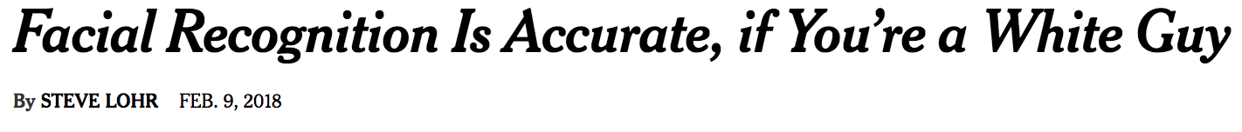

Community Variability in Review criteria - 2
Scientific criteria “The task of the referee” may not be applicable to all fields.
Q? How far has it come in 30 years?
They use benchmarks , which risks generalization and bias.
Source: S. Lohr, Facial Recognition Is Accurate, if You’re a White Guy, New York Times, Feb. 9th, 2018.
(https://www.nytimes.com/2018/02/09/technology/facial-recognition-race-artificial-intelligence.html)

Slide 12



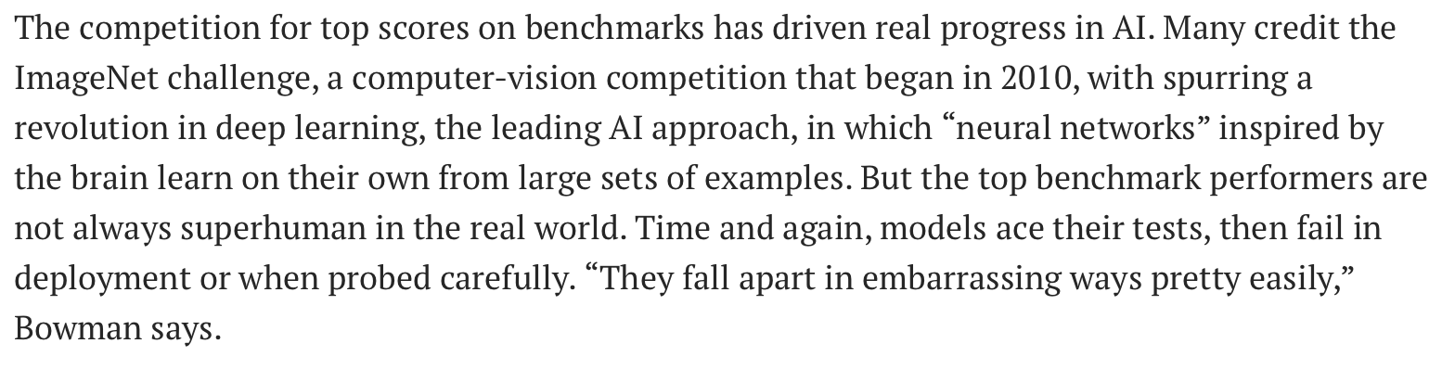

AI Limitations: An Example
AI Institute For Land, Economy, Agriculture and Forestry (6/2023 - …)
Notes:
Outline
7 EWD projects:
SNA - Candace/Allison
Undergrad - Natalie
Grad - David Mulla
Professional education - Bruce
Extension farmers and forestsers - Allison
K-12 - Natalie M.
Working lands CC

Slide 13
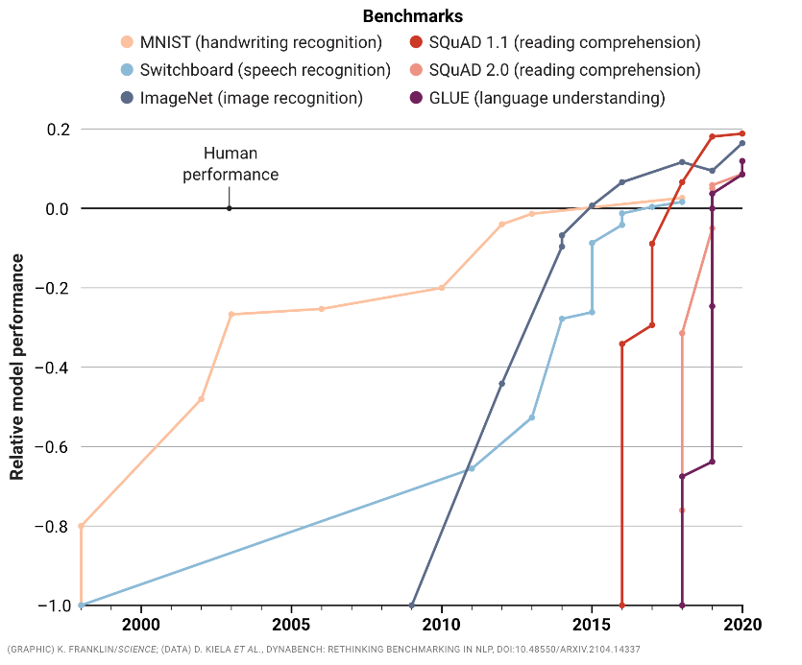
Taught to Test
AI software clears high hurdles on IQ tests but still makes dumb mistakes.
Can better benchmarks help?
Emphasis on being “state of the art” (SOTA)—sitting on top of a leaderboard—and says “SOTA chasing” is stifling innovation ...
Source: M. Hutson, Taught to the Test, Science, Vol 376, Issue 6593, AAAS, May 2022..
(https://www.science.org/content/article/computers-ace-iq-tests-still-make-dumb-mistakes-can-different-tests-help)

Slide 14
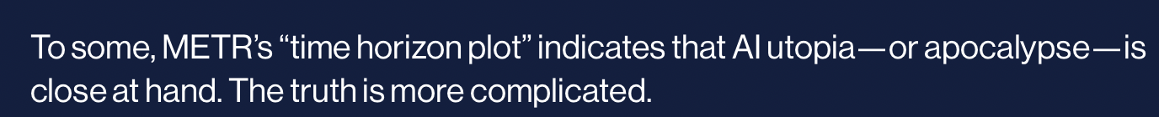
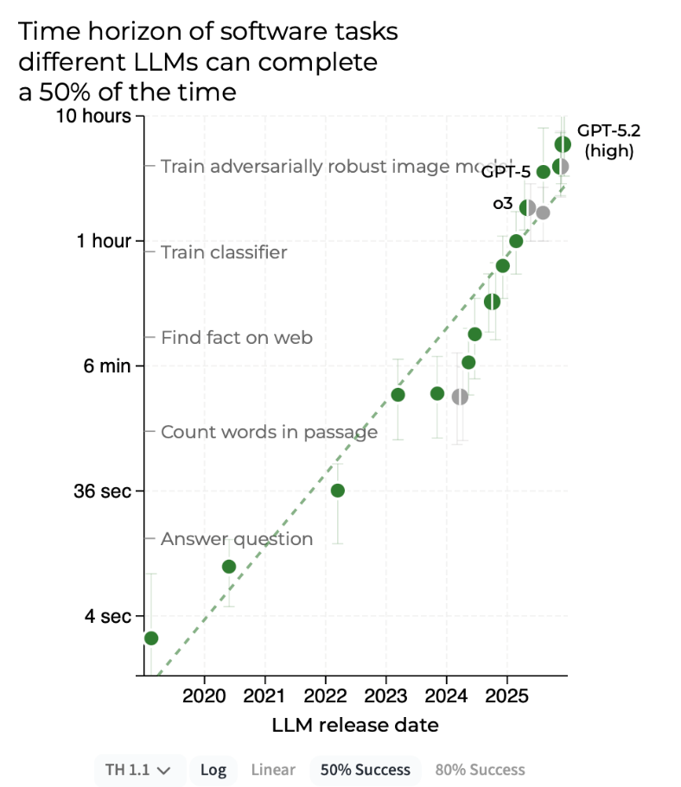


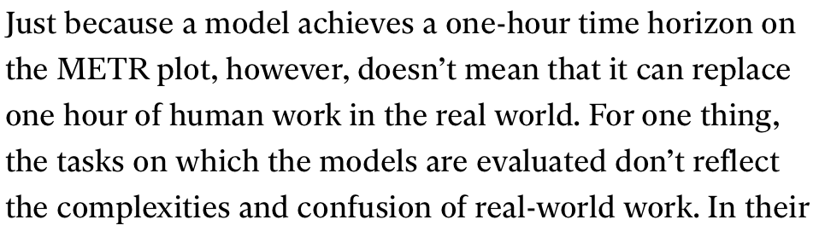
Source: This is the most understood graph in AI, MIT Technology Review, Feb. 5th, 2005.

Slide 15
Reviewing Proposals vs. Reviewing Papers
 | Paper | Proposal
Audience | Experts in a specific area | Experts from a broad inter-disciplinary range
Problem Statement | Focus on a formally defined problem that has already probed | A problem from that benefit broader field that will be solved in the proposed project
Significance | Benefit a focused area | Promote entire field even entire science as transformative research
Challenges | Challenges for one specific problem that are already overcome by proposed approaches | Challenges for solving the entire problem which requires a new framework and paradigm to overcome.
Literature Review / Novelty | Related work for one problem. Typically 10-30 related works | Related work for entire field. Typically hundreds of related works
Contribution | What he/she has done | What he/she has done and plans to do
Validation | Detailed theoretical and experimental validation for proposed approaches | A high-level plan of how to validate the solutions of proposed tasks in the future.
Others | No | Budget, Timeline, Milestone intellectual merit, Broader Impact, investigator qualification, etc..

Slide 16
Outline for LO1 : Research Skill: Constructive Critique
Constructive Criticism Overview
Responsibility and Structure
Responsibility to readers, journal, editor
Responsibility to authors
Structure
Identify constructive criticism

Slide 17
Responsibilities to Readers, Journal, Editor
Does the paper make sufficient contribution to the field?
New and interesting research results
New and insightful synthesis of existing results
A useful survey or tutorial on a field, a combination of these
Is this good science? What is the impact of this work?
Reproducibility of results, evidence supporting contribution claims,
Identify errors, misinterpretations, “crimes of passion”
Balance between “too restrictive” and “too permissive”
Need not check grammar line by line

Slide 18
Responsibility to Authors
Focus on the paper not the authors
Specific actionable suggestions to improve the work
Support your comments with examples, references, etc.
Consider Timeliness
Try to be objective and fair
Psychologically acceptable reviews are more useful
Examples from comments of the ”Linear Hotspot Detection” paper:
To utilize the neighbor node filter, it needs to store the information for all the shortest path pairs with the cost of O(NS²) wonder this method maybe memory infeasible for road network with massive vertices.
I would say it would be the best if the data could be shared, as it does include some unique spatio-temporal activities. However, my main concern here is that the data used in the paper is very small 43 fatal pedestrians and 493 robberies.
Besides the response time, memory consumption of the proposed methods should be included.

Slide 19
Structure of a referee report - 1
Overall recommendation and reasons for it
A summary of the papers (A few lines)
Validity and significance of results
Quality of work : Methodology, technique, accuracy, presentation
List necessary and suggested changes
General comments
Specific comment should identify paragraphs, figures, tables etc.
Examples from reviews of the ”Linear Hotspot Detection” paper:
Recommendation: Major Revision (Authors have two months to revise their papers)
Summary:
This paper addresses the problem of discovering the significant linear hotspots. The authors propose several methods to reduce the computation cost, including a neighbor node filter and a shortest path tree pruning. Two case studies are performed to show the effectiveness of the problem. Also experimental results on real datasets shows the performance improvement of their proposed methods.
Continued in next slide

Slide 20
Structure of a referee report – Example
Strong points:
The authors present an interesting problem, i.e., discovering the statistically significant linear hotpots on road network, which can be very useful in transportation planning and public safety and security.
Several methods are proposed to reduce the computation cost of the discovery. The neighbor node filter is proposed to reduce the computation cost of shortest path; the shortest path tree pruning is proposed to avoid examine some unpromising shortest paths. The authors also provided performance analysis of their proposed methods.
Experiments on real datasets are performed to show the effectiveness and efficiency of their proposed methods.
Weak points:
The efficiency experiments are evaluated on tiny datasets, e.g., the road network only contains 500 nodes and 1000 edges; while the activities are generated randomly with the maximum size equals to 1600. I would suggest the authors to evaluate the scalability of the proposed methods by using more large datasets. Moreover, besides the response time, memory consumption of the proposed methods should be included.
To utilize the neighbor node filter, it needs to store the information for all the shortest path pairs with the cost of $O(|N_S|^2)$. I wonder this method maybe memory infeasible for road network with massive vertices.
Regarding to the computation of p-value, it is not clear that why we need to re-compute the shortest paths for "the paths in the original graph" in the simulated graph. According to my understanding, it is unnecessary and very time consuming, c.f., Section 2.2.1 and Section 3.2.2.
There are some presentation problems, which I have detailed, and also some information are missing from the experiments section.

Slide 21
Structure of a referee report – Example Continued
[Relevancy] How relevant is this manuscript to the readers of IEEE TBD? Please explain your rating in the Detailed Comments section. : Somewhat Relevant
[Audience] What audience would benefit most from this work?: Practitioners
[Contribution] What do you see as this manuscript's main contribution to the literature in the Big Data field? Summarize in a few sentences.: This paper addresses the problem of discovering the significant linear hotspots. The authors propose several methods to reduce the computation cost. Experimental results on real datasets shows the performance improvement of their proposed methods.
[Novelty] Is the paper novel? Please explain your answer in the Detailed Comments section. : Partially
[Improvement] Do you have other suggestions for improvement? :
[Clarity and Focus] Is the paper clear and focused in its presentation? Please explain your answer in the Detailed Comments section. : Could be improved
[Length] Is the length of the manuscript appropriate for the topic? Please elaborate in the Detailed Comments section. : Satisfactory
[References] Does the manuscript contain sufficient and appropriate references? Please elaborate in the Detailed Comments section.: References are sufficient and appropriate

Slide 22
3. Outline for LO1: Research Skill: Constructive Critique
Constructive Criticism Overview
Responsibility and Structure
Identify constructive criticism
How not to review a paper
Read the raw review and summary of review of ”Linear hotspots Discovery”
Identify ”good” and “bad” comments

Slide 23
How not to evaluate a paper – Do not do
Do not be an adversarial reviewer who
Has an attitude of irritation at being given a paper to review
Believes: better to reject ten adequate papers than to allow a subpar paper to be accepted
Has the ability to find fault with all manner of common practices,
such as giving references to Wikipedia
Claims with certainty that their opinion is correct, and final.
Adversarial reviewing techniques
Details: G. Cormode, How not to review a paper: The tools and techniques of the adversarial reviewer. ACM SIGMOD Record, 37(4), pp.100-104, 2009.

Slide 24
Note: Comments in blue color are not from the raw review
Examples of non-constructive / neutral comments
1. The paper argues it can provide segmentation on the sub-edge level. I'm not sure why this function is very important here.
2. This paper claims that statistical significance is important. I am not sure why it is true since people can always use DBScan to find some dense area.
3. Why does this paper use p-value for significance test as it is under debate.
4. How does the proposed approach work if the underlying network is not given?
Exercise: Do you think these comments are non-constructive? Why?

Slide 25
Review of CACM Article “Spatial Computing”
Exercise: Classify following comments into constructive and non-constructive
C1: And where does remote sensing come in? Not part of “spatial computing” for some strange, unexplained, reason? But it has certainly been far more transformative to date than has spatial statistics.
C2: The article entitled “Spatial Computing: Accomplishments, Opportunities, and Research Needs” is based upon the assumption that “spatial computing” (a recent and little used term) exists and that it has somehow become composed of all computing activities that have some relation to anything to do with all activities with any spatial context. In my mind, this is about as reasonable an approach as defining “money computing” as containing all computing activities that have some relation to money.
C3: The article makes no clear attempt to explain why “spatial computing” should exist (it is a new term) or why it [spatial computing] now claims ownership of so many other activities (some of which have been with us for nearly half a century). All that is provided here is a single sentence in the opening text and a single unhelpful footnote, following which the authors throw up a handful of random examples of how computing in a spatial context can be highly useful (indeed, this fact was pretty well known by quite a substantial number of people at least three decades ago).

Slide 26
1. Learning Objectives
After this segment, students will be able to
LO1: Research Skill: Constructive Critique
LO2: Describe Spatial Query Processing
LO3: List main contributions and organize literature of following papers:
Sharma, Arun, and Shashi Shekhar. "Analyzing trajectory gaps to find possible rendezvous region." ACM Transactions on Intelligent Systems and Technology (TIST) 13, no. 3 (2022): 1-23.
Kazemi, Leyla, and Cyrus Shahabi. "Geocrowd: enabling query answering with spatial crowdsourcing."Proceedings of the 20th international conference on advances in geographic information systems. ACM, 2012.

Slide 27
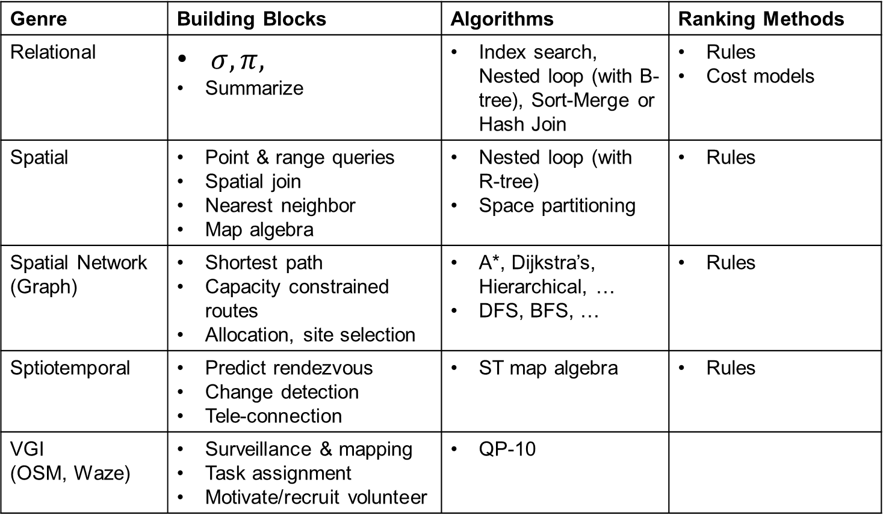
State of the Art in Spatial Query Processing
Genre | Building Blocks | Algorithms | Ranking Methods
Relational | $σ, π,$ Summarize | Index search, Nested loop (with B-tree), Sort-Merge or Hash Join | Rules Cost models
Spatial | Point & range queries Spatial join Nearest neighbor Map algebra | Nested loop (with R-tree) Space partitioning | Rules
Spatial Network (Graph) | Shortest path Capacity constrained routes Allocation, site selection | A*, Dijkstra’s, Hierarchical, … DFS, BFS, … | Rules
Sptiotemporal | Predict rendezvous Change detection Tele-connection | ST map algebra | Rules
VGI (OSM, Waze) | Surveillance & mapping Task assignment Motivate/recruit volunteer | QP-10

Slide 28
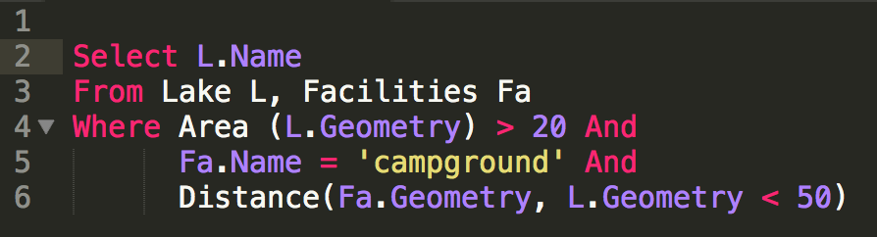
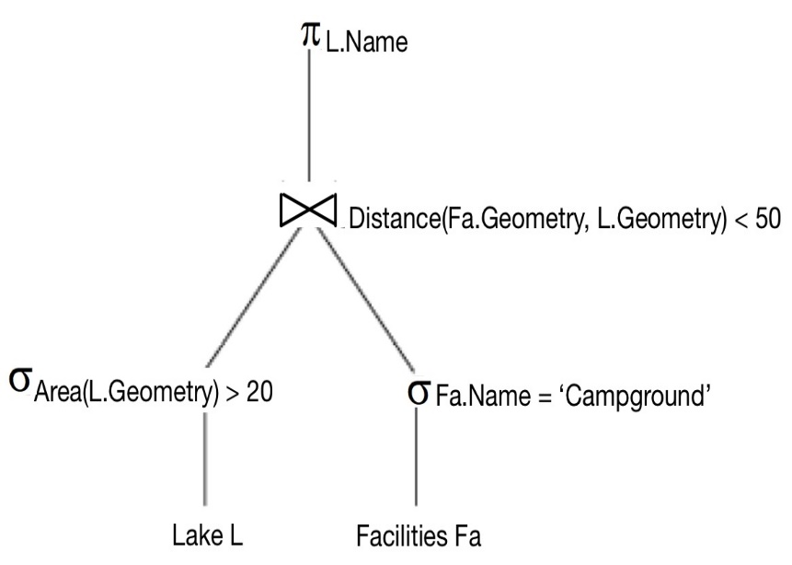

What is Query Processing and Optimization (QPO)?
Translate a SQL query to an execution plan
using operations on file-structures, indices
Goal: reduce run-time of execution plan
answers query in as little time as possible
Constraints: QPO overheads are small
Optimization time << plan execution time
Query tree
Space-partitioning join
Scan
Index

Slide 29
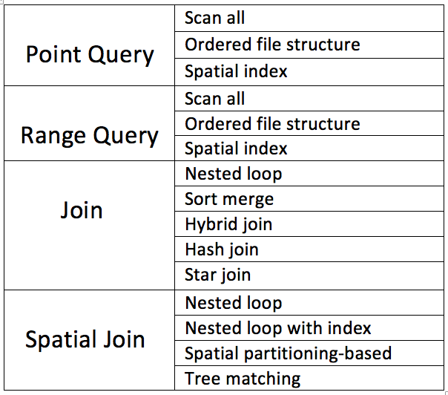
QPO Key Concepts:1. Building Blocks, 2. Strategies
1. Building blocks
Most cars have few motions, e.g. forward, reverse
Similar most DBMS have few building blocks:
select (point query, range query), join, sorting, ...
A SQL queries is decomposed in building blocks
2. Query processing strategies for building blocks
Cars: few gears for forward motion: 1st, 2nd, 3rd, …
DBMS: a few strategies for each building block
e.g. a point query: an index, linear search

Slide 30
QPO Key Concept 3 – Query Optimization
3. Query optimization
Automatic transmission tries to picks best gear given motion parameters
For each building block of a given query, DBMS QPO tries to choose
“Most efficient” strategy given database parameters
Parameter examples: Table size, available indices, …

Slide 31
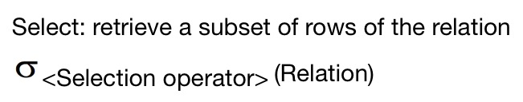
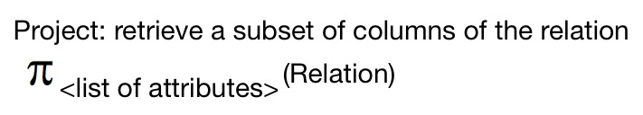
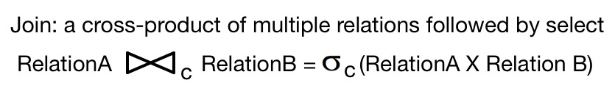
QPO Challenges
Choice of building blocks
SQL Queries are based on relational algebra (RA)
Building blocks of RA are Select, Project, Join
SQL3 adds new building blocks like transitive closure (not discussed)
Choice of processing strategies for building blocks
Constraints: Too many strategies=> higher complexity
Commercial DBMS have a total of a few dozen strategies
2 to 4 strategies for each building block

Slide 32
1. QPO Challenges in SDBMS
Building Blocks for spatial queries
Rich set of spatial data types, operations
A consensus on “building blocks” is lacking
Current choices spatial select
, spatial join
, nearest neighbor
Spatial select:
Return the boundary of Minnesota
Spatial join:
List the countries sharing boundary with Germany
Nearest neighbor:
Find the nearest library from a given apartment

Slide 33
2. QPO Challenges in SDBMS
Choice of strategies
Limited choice for some building blocks, e.g. nearest neighbor
Choosing best strategies
Cost models are more complex since
Spatial Queries are both CPU and I/O intensive
While traditional queries are I/O intensive
Cost models of spatial strategies are in not mature.

Slide 34
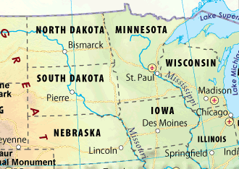
Example: Strategies for Point Queries
Point Query
Given a location
Return a property (e.g., place name) of the location
List of strategies
Linear Search
Binary Search
If records ordered by a space filling curve
Index Search
If a spatial index is available

Slide 35
Candidate Storage & Indexing Methods
C. R-tree (primary index)
root
a
b
A. Unordered
B. Z-order (Y-major)
c
d
e
f
g
h
i
Sorting number (Z-order index)
25

Slide 36
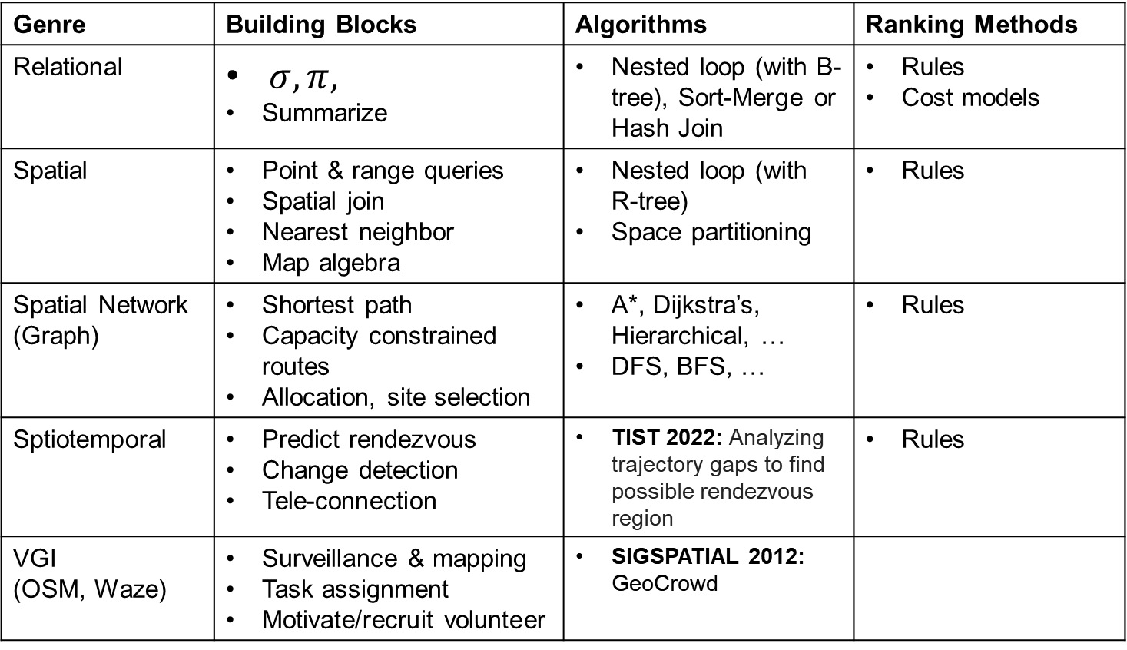
State of the Art and Trends in Spatial Query Processing
Genre | Building Blocks | Algorithms | Ranking Methods
Relational | $σ, π,$ Summarize | Nested loop (with B-tree), Sort-Merge or Hash Join | Rules Cost models
Spatial | Point & range queries Spatial join Nearest neighbor Map algebra | Nested loop (with R-tree) Space partitioning | Rules
Spatial Network (Graph) | Shortest path Capacity constrained routes Allocation, site selection | A*, Dijkstra’s, Hierarchical, … DFS, BFS, … | Rules
Sptiotemporal | Predict rendezvous Change detection Tele-connection | TIST 2022: Analyzing trajectory gaps to find possible rendezvous region | Rules
VGI (OSM, Waze) | Surveillance & mapping Task assignment Motivate/recruit volunteer | SIGSPATIAL 2012: GeoCrowd

Slide 37
[ Learning Objectives ]
After this segment, students will be able to
LO1: Research Skill: Constructive Critique
LO2: Describe Spatial Query Processing
LO3: List main contributions and organize literature of following papers:
Sharma, Arun, and Shashi Shekhar. "Analyzing trajectory gaps to find possible rendezvous region." ACM Transactions on Intelligent Systems and Technology (TIST) 13, no. 3 (2022): 1-23.
Kazemi, Leyla, and Cyrus Shahabi. "Geocrowd: enabling query answering with spatial crowdsourcing."Proceedings of the 20th international conference on advances in geographic information systems. ACM, 2012.

Slide 38
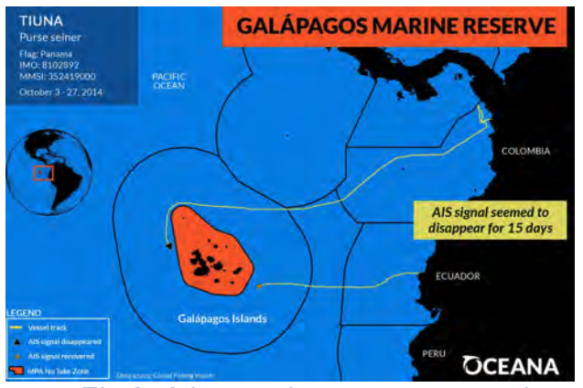
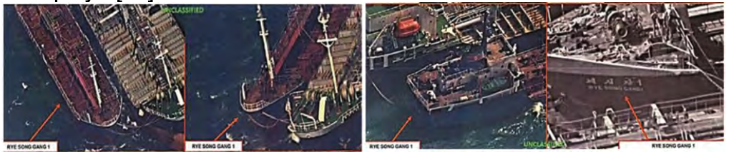
Significance
Global Security: Marine Safety and Regulation Enforcement
Offenders tend to switch off GPS transponders to hide movements
Transshipment: Avoiding higher tariffs while shipping goods between international subsidiaries.
Beyond Global Security: Illegal Fishing
Fishing vessels switched off AIS (Automatic Identification System) for 15 days.
near the Galapagos Marine Reserve [Sources 2, 3], and Oman [Source 3]
Ships in an allegedly illegal oil transfer in international waters [Source 1: Oil Backed Up, Iranians Put It on Idled Ships, New York Times, 7/4/2012.]
[Source 2: How Illegal Fishing Is Being Tracked From Space, Natl. Geographic, 3/12/2018].
[Source 3: Intelligence Agencies Pushed to Use More Commercial Satellites, New York Times, 9/27/2021]

Slide 39
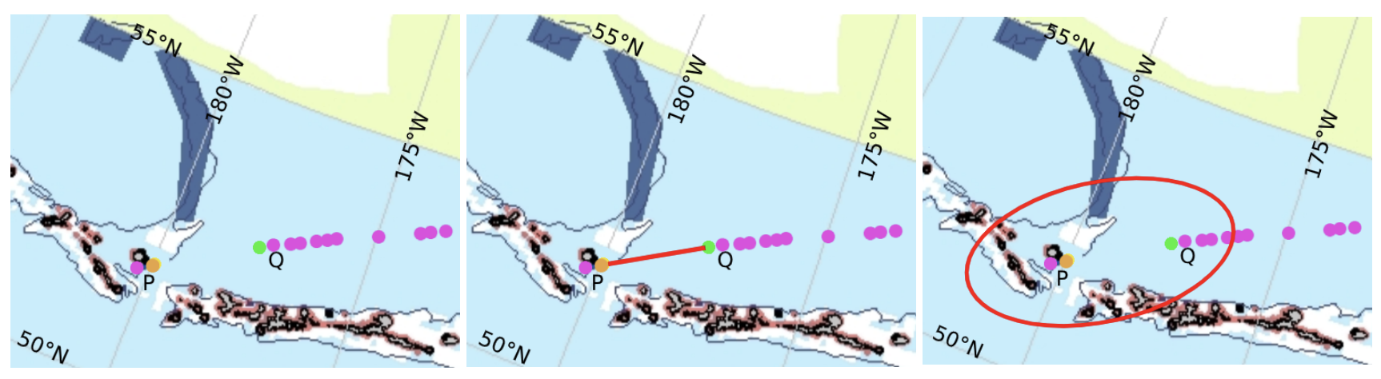
Challenges: Tradeoff Computational Cost vs Manual Effort
Gaps in trajectory data.
Large Data Volume (600 GB)
Manual Effort Reduction Metric:
Computational Filter methods reduces manual effort
Reduce the area needing manual scan and analysis.
Computational Filter choices:
Traditional Spatial Filters: Minimum Bounding Rectangle (MBR) or Minimum Orthogonal Bounding Rectangle (MOBR)
Proposed Spatial Filters based on Time Slicing
Proposed Filter
APE
Traditional
Filter
Manual Effort

Slide 40
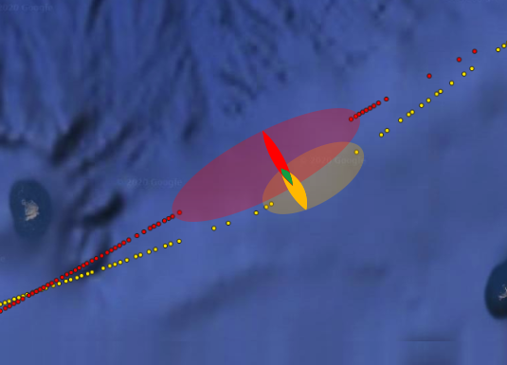
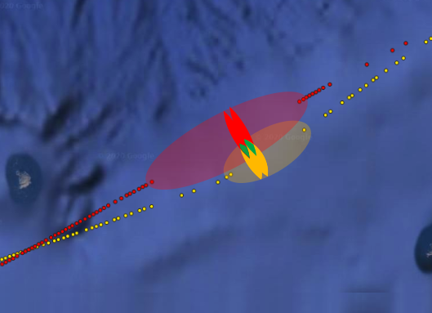
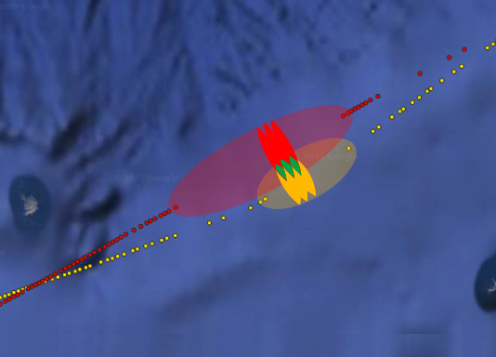
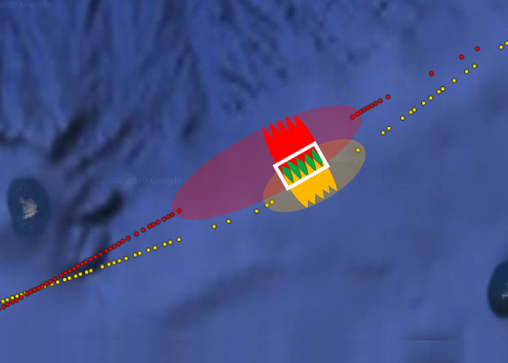
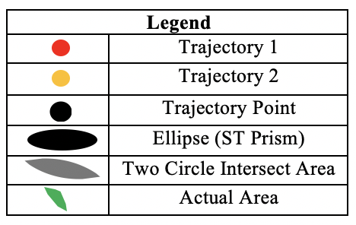
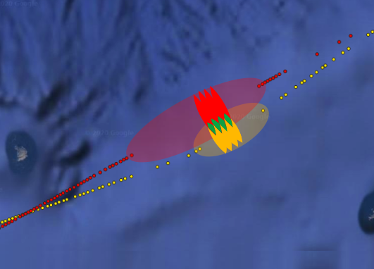
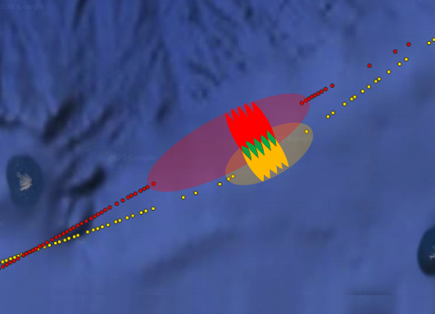
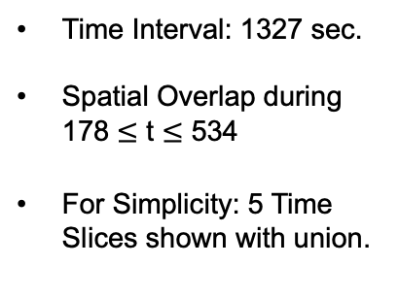
Time Slicing Animation
Time t = 178 sec.
Time t = 267 sec.
Time t = 356 sec.
Time Interval: 1327 sec.
Spatial Overlap during 178 $≤$ t $≤$ 534
For Simplicity: 5 Time Slices shown with union.
Union of other 5 snapshots
Time t = 445 sec.
Time t = 534 sec.

Slide 41
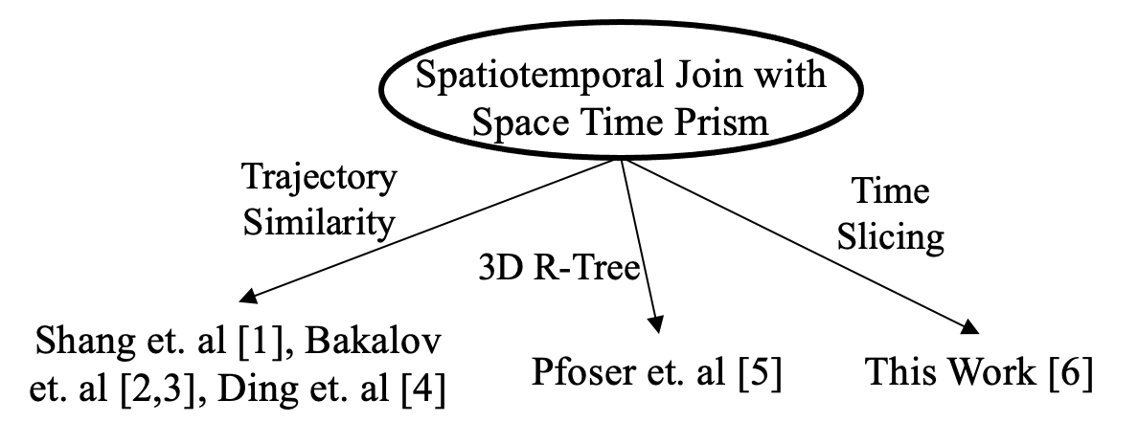
Limitation of Related Work
[1] Shang, Shuo, Lisi Chen, Zhewei Wei, Christian Søndergaard Jensen, Kai Zheng, and Panos Kalnis. "Trajectory similarity join in spatial networks." Proceedings of the VLDB Endowment 10, VLDB Endowment Inc, no. 11, (2017).
[2] Bakalov, Petko, Marios Hadjieleftheriou, Eamonn Keogh, and Vassilis J. Tsotras. "Efficient trajectory joins using symbolic representations." In Proceedings of the 6th international conference on Mobile data management, IEEE, pp. 86-93, 2005.
[3] Bakalov, Petko, and Vassilis J. Tsotras. "Continuous spatiotemporal trajectory joins." In International conference on GeoSensor Networks, pp. 109-128. Springer, Berlin, Heidelberg, 2006.
[4] Ding, Hui, Goce Trajcevski, and Peter Scheuermann. "Efficient similarity join of large sets of moving object trajectories." In 2008 15th International Symposium on Temporal Representation and Reasoning, IEEE, pp. 79-87., 2008.
[5] Pfoser, Dieter, Christian S. Jensen, and Yannis Theodoridis. "Novel approaches to the indexing of moving object trajectories." In VLDB, Very Large Data Base Endowment Inc., pp. 395-406. 2000.
[6] Arun Sharma, Xun Tang, Jayant Gupta, Majid Farhadloo, and Shashi Shekhar. "Analyzing Trajectory Gaps for Possible Rendezvous: A Summary of Results." In 11th International Conference on Geographic Information Science (GIScience 2021)-Part I. Schloss Dagstuhl-Leibniz-Zentrum für Informatik, 2020.

Slide 42
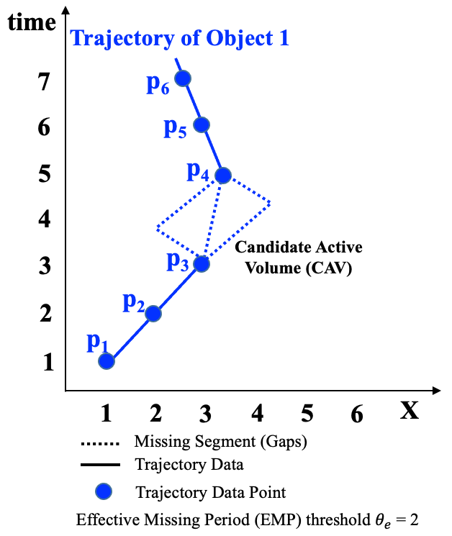
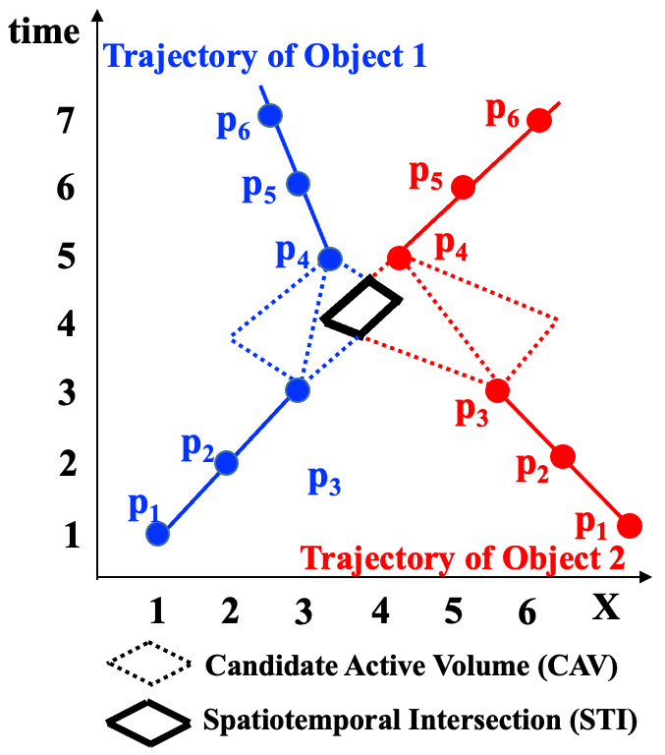
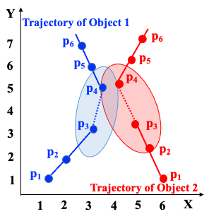
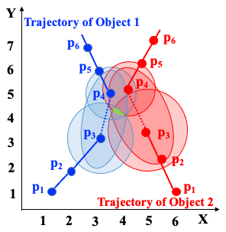
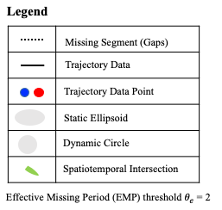
Key Concepts: Terminology
Spatial trajectory: Chronologically sorted points generated by a moving object.
Effective Missing Period (EMP): Time period when the signal is missing.
Maximum speed (S_{max}): the maximum speed of an object.
Candidate Active Volume (CAV): Spatiotemporal volume where an object is possibly located during an EMP.
Fig 1. A 1D illustration of CAV and Rendezvous Region
Fig 2. A 2D illustration of rendezvous region detection

Slide 43
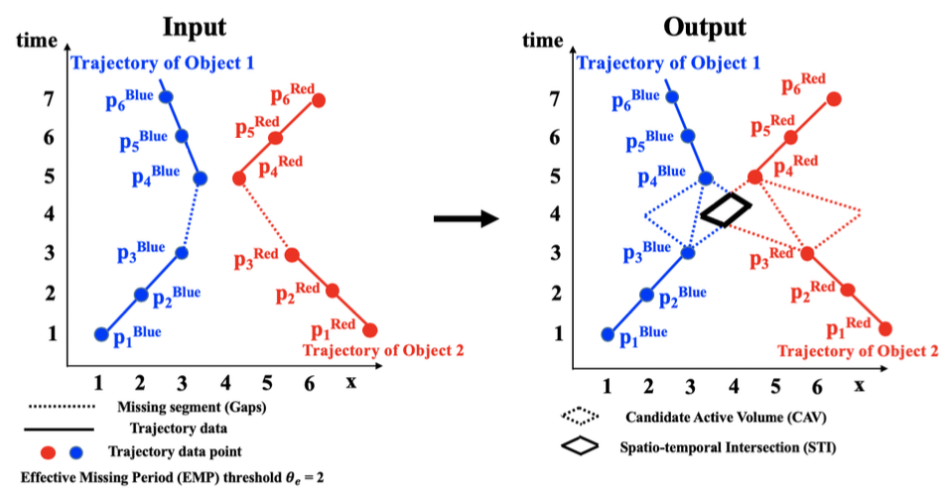
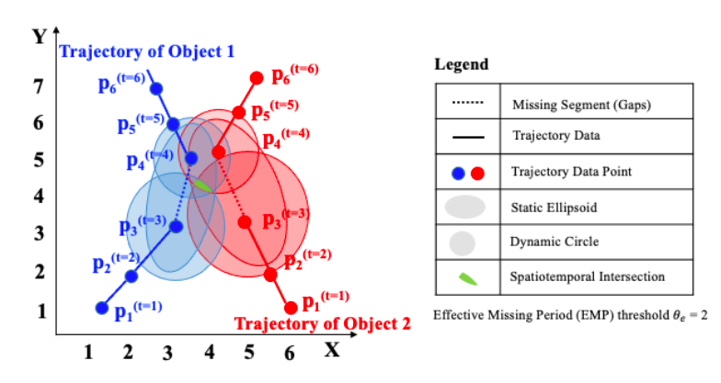
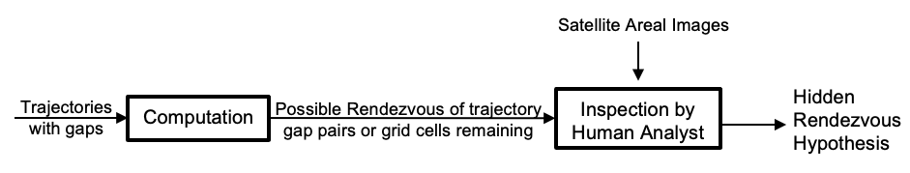
Problem Statement
Input:
A study area S
A set of |N| trajectories T = t₁ … t_{|N|},
Maximum speed S_{max_i} for each object
An effective missing period threshold
Output: An upper bound on possible-rendezvous area.
A proxy for post-processing human effort (e.g., review satellite imagery).
Objective: Reduce upper-bound area in a computationally efficient manner.
Constraints: (a) Trajectories have gaps, (b) Maximum acceleration not available.

Slide 44
Major Contribution
Space-Time partitioning approach to detect rendezvous regions.
Baseline: Linear Temporal Scan (LTS)
Baseline technique to filter rendezvous region via spatial approximations and time slicing approach.
Proposed: Temporal Selection Scan (TSS).
Refined technique for effective filtering via elliptical spatial approximation and pruning with time prioritization.
Experimental evaluation and case-study with ship trajectory data from the Bering Sea
Evaluate the effectiveness of the proposed approach on a real-world dataset.
Results:
Reduce manual effort of scanning satellite imagery to verify possible rendezvous.
Speedup the process the narrowing the area of possible rendezvous.

Slide 45
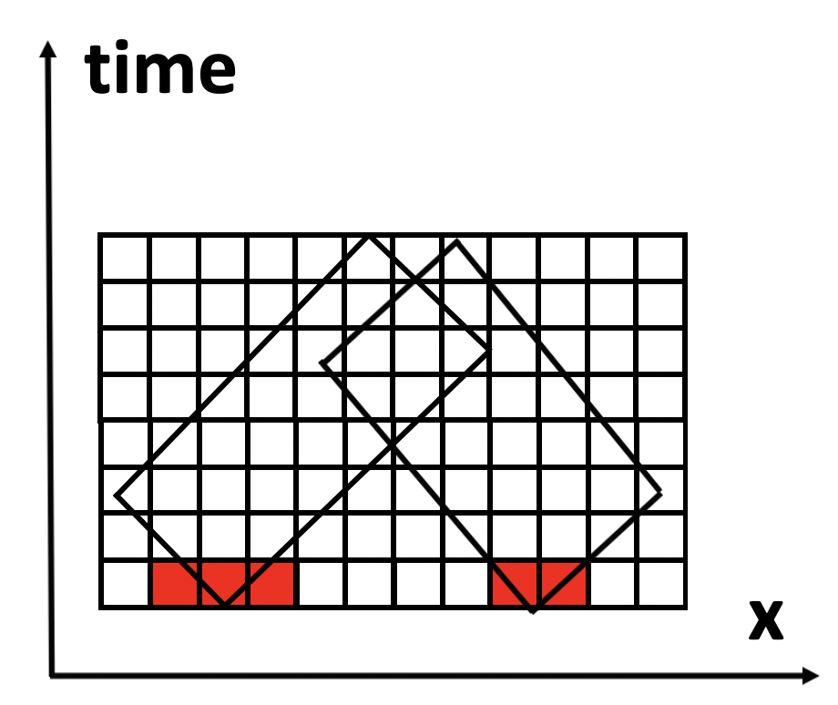
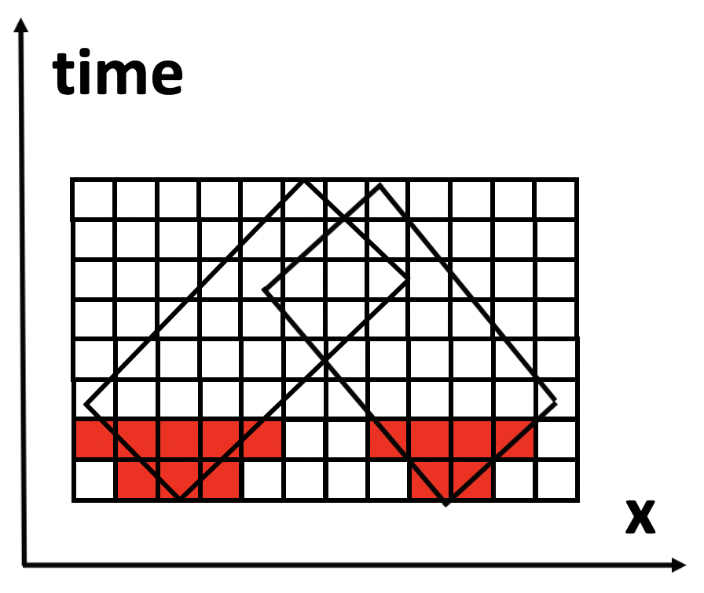
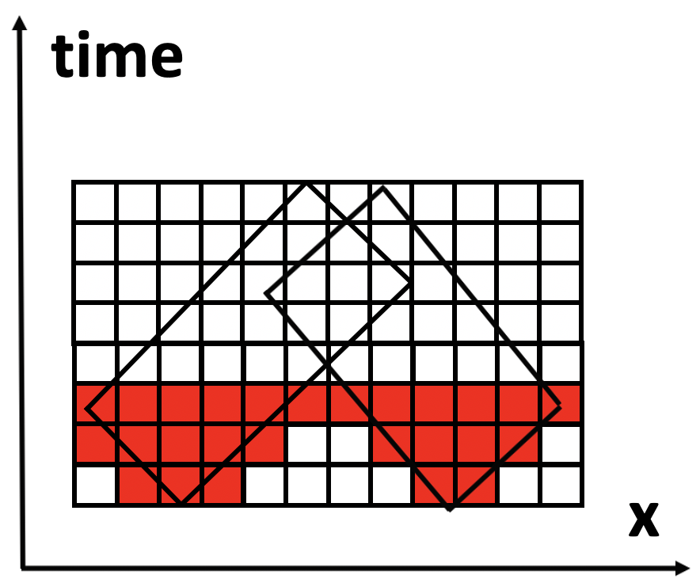
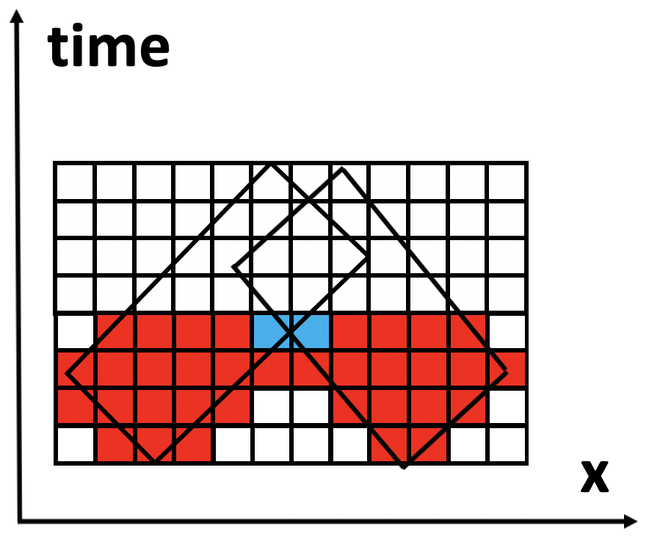
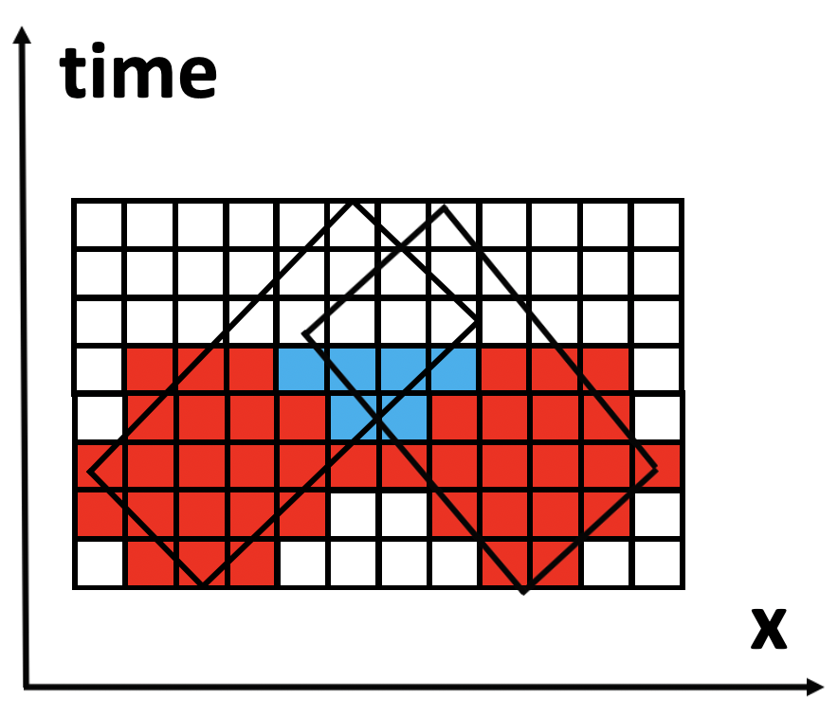
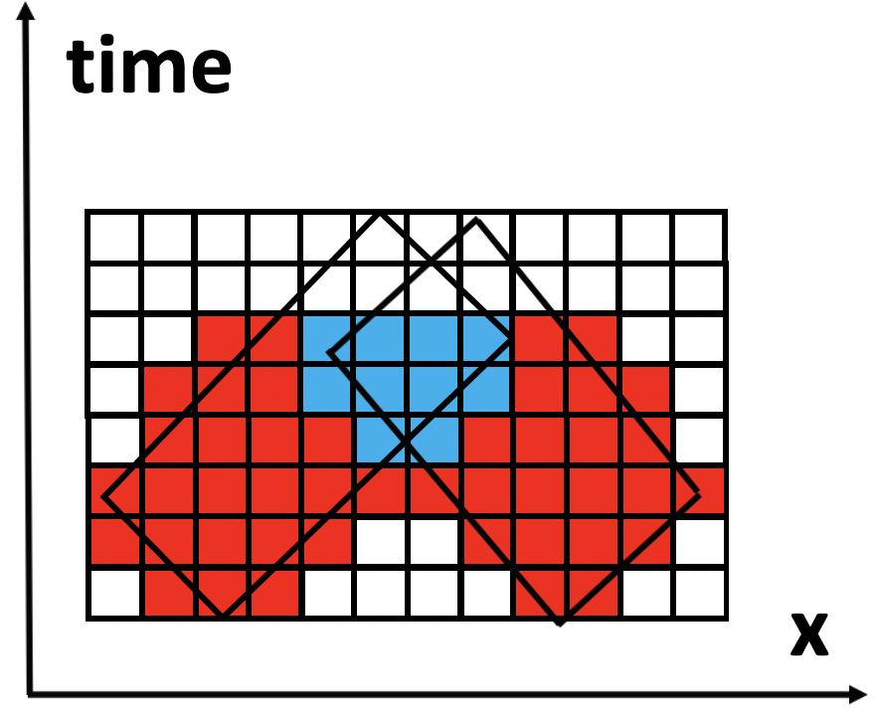
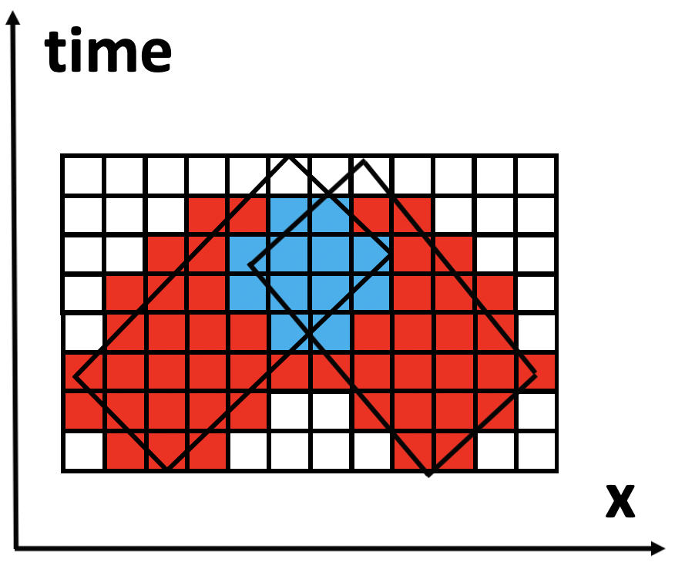
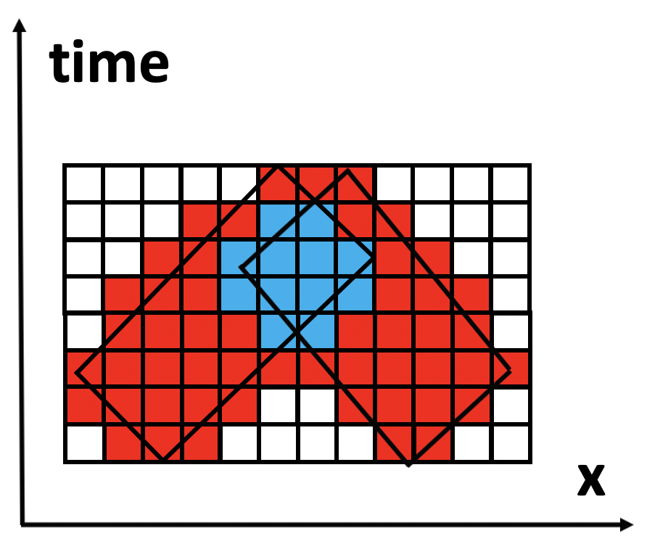
1. Baseline: Linear Temporal Scan Search Pruning (LTS)
t = 3
t = 4
t = 2
t = 1
t = 7
t = 8
t = 5
t = 6
Fig 3. Execution Trace of Linear Temporal Scan : Blue cells selected for post-processing
Notes:
The LCP-G∀S method is the most significant contribution. As we all know, traditional orthogonal-based storage approaches of STN data produce significant I/O costs when performing spatio-temporal network queries.

Slide 46
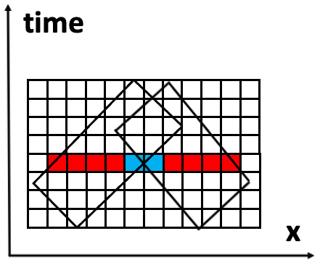
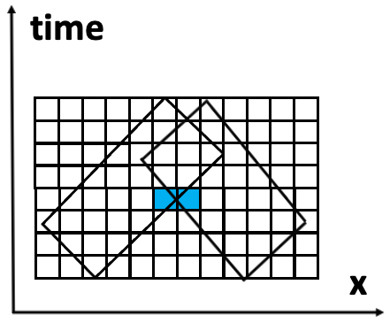
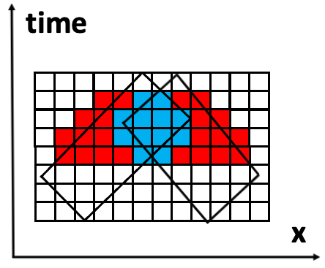
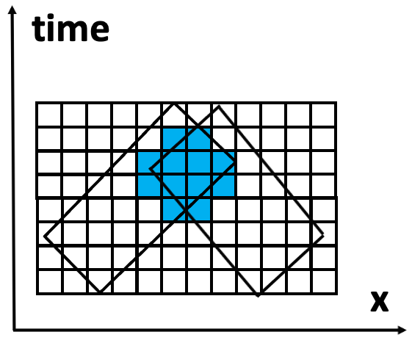
2. Baseline: Linear Temporal Scan Search Pruning (LTS)
Limitations of Linear Temporal Scan Algorithm:
Inefficient in terms of computational time at finer temporal scale.
Increase computation cost based on grid cell comparisons.
Basic Intuition:
Prior information of space time prism actual intersection.
Reduce grid cell comparison via accurate spatial approximation.
t = 7
t = 7
t = 4
t = 4
Fig 4. Execution Trace of Temporal Selection Search Pruning : Blue cells selected for post-processing
Notes:
The LCP-G∀S method is the most significant contribution. As we all know, traditional orthogonal-based storage approaches of STN data produce significant I/O costs when performing spatio-temporal network queries.

Slide 47


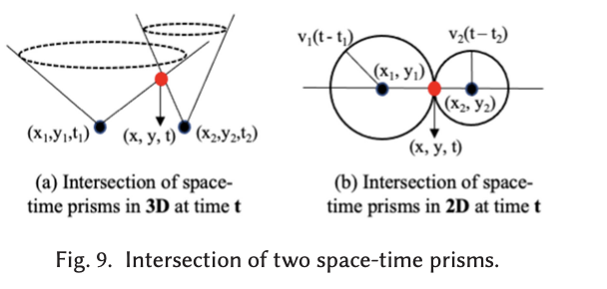
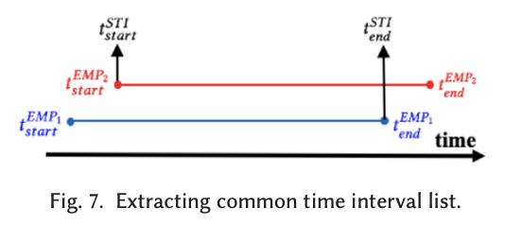
Proposed Optimization: Time Prioritizer
Prior information of space time prism actual intersection..
Notes:
The LCP-G∀S method is the most significant contribution. As we all know, traditional orthogonal-based storage approaches of STN data produce significant I/O costs when performing spatio-temporal network queries.

Slide 48
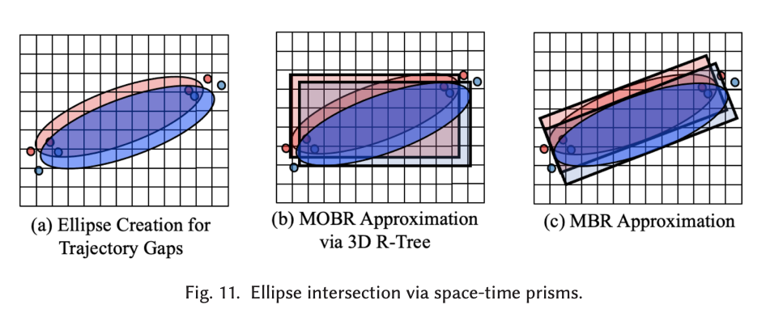

Proposed Optimization: Spatial Filters
Reduce grid cell comparison via accurate spatial approximation.
Notes:
The LCP-G∀S method is the most significant contribution. As we all know, traditional orthogonal-based storage approaches of STN data produce significant I/O costs when performing spatio-temporal network queries.

Slide 49




Proposed: Time Prioritized Scan Search Pruning (TSS)
t = 5
t = 5
t = 4
t = 4
t = 7
t = 7
t = 6
t = 6
Fig 4. Execution Trace of Temporal Selection Search Pruning: Blue cells selected for post-processing
Notes:
The LCP-G∀S method is the most significant contribution. As we all know, traditional orthogonal-based storage approaches of STN data produce significant I/O costs when performing spatio-temporal network queries.

Slide 50
Comparison of Baseline with Proposed Method
Criteria | Linear Temporal Scan | Temporal Selection Scan
Time Period | Union of time stamps of start and end points for two objects involved in rendezvous | Space-time intersection of two objects involved in rendezvous
Grid Cell Comparisons | Consider study area via union of global spatial approximation. | Consider study area via intersection of geometric approximation (i.e., ellipse and circle intersection)
1 Dimensional Representation Comparison
t = 8
t = 7
t = 7
Table 1: Comparison of Baseline With Proposed Method
Notes:
The LCP-G∀S method is the most significant contribution. As we all know, traditional orthogonal-based storage approaches of STN data produce significant I/O costs when performing spatio-temporal network queries.

Slide 51

Validation Methodology
Experiment Goal:
Compare Temporal Selection Search against the baseline Linear Temporal Scan
Perform Sensitivity Analysis of Temporal Selection Search against the baseline Linear Temporal Scan
Parameters :
Effective Missing Period (EMP): 60 mins to 180 mins at 2.5x10⁴ points.
GPS Points: 2.5x10⁴ to 1.5x10⁵ at EMP of 60 mins
Evaluation Metrics :
Computation Time
Area Pruning Effectiveness
Accuracy
Precision
Fig 5: Experiment Design
Dataset :
Synthetic Data: Recalibrate real world data for certain cases.
Real World Data: Marine Cadastre dataset
Notes:
The LCP-G∀S method is the most significant contribution. As we all know, traditional orthogonal-based storage approaches of STN data produce significant I/O costs when performing spatio-temporal network queries.

Slide 52


Comparative Analysis: TSS vs LTS in Computational Efficiency
Computation Time:
Temporal Selection Scan proves efficient in terms of computation time in filter phase.
Fixed Parameters: EMP 60 mins, GPS Points: 25000
Fig 6: Effect of varying parameters on Time
Trends:
Temporal Selection Search method outperforms the Linear Temporal Scan.
EMP: Longer EMP increase in the overlap between candidate pairs.
Number of GPS Points: Large potential candidate pairs to analyze.
Notes:
The LCP-G∀S method is the most significant contribution. As we all know, traditional orthogonal-based storage approaches of STN data produce significant I/O costs when performing spatio-temporal network queries.

Slide 53


Comparative Analysis: TSS vs LTS in Area Pruning Effectiveness
Baseline base-filter: 3D R-Trees
Proposed base-filter: Ellipse bounded MBR respectively.
Fixed Parameters: EMP 60 mins, GPS Points: 25000
Fig 7: Effect of varying parameters on APE
Trends:
Temporal Selection Search method outperforms the baseline LTS
Shorter the Effective Missing Period, the less likely an overlap will occur.
Greater the number of potential gap pairs, resulting in a larger average rendezvous area.
Notes:
The LCP-G∀S method is the most significant contribution. As we all know, traditional orthogonal-based storage approaches of STN data produce significant I/O costs when performing spatio-temporal network queries.

Slide 54




Sensitivity Analysis: Accuracy
Fixed Parameters: EMP 60 mins, GPS Points: 25000
Accuracy = $\frac{TP+TN}{TP+FN+FP+TN}$
Fig 9: Effect of varying parameters on Accuracy
Trends:
Effective Missing Period: Larger size of the MOBR in LTS as compared to MBR in TSS
Higher potential Interaction resulting in large false positives
GPS Points: Higher number of Potential Interactions
Notes:
The LCP-G∀S method is the most significant contribution. As we all know, traditional orthogonal-based storage approaches of STN data produce significant I/O costs when performing spatio-temporal network queries.

Slide 55



Sensitivity Analysis: Precision
Fixed Parameters: EMP 60 mins, GPS Points: 25000
Precision = $\frac{TP}{TP+FP}$
Fig 10: Effect of varying parameters on Precision
Trends:
Effective Missing Period: Larger size of the MOBR in LTS as compared to MBR in TSS
Higher potential Interaction resulting in large false positives
GPS Points: Higher number of Potential Interactions
Notes:
The LCP-G∀S method is the most significant contribution. As we all know, traditional orthogonal-based storage approaches of STN data produce significant I/O costs when performing spatio-temporal network queries.

Slide 56
Assumptions
Maximum speed of each object is known
Acceleration information is unavailable
GPS signal is sufficiently accurate when available
Objects physically pass by one another at the same time to rendezvous
i.e. items cannot be dropped off for later pickup by another ship
Objects are homogeneous
i.e. no smaller boats, helicopters, etc. used to rendezvous
2D area is sufficient to pinpoint rendezvous regions
i.e. applications involving 3D space (e.g. astronomical objects) not covered

Slide 57
Conclusion and Revisions
Conclusion
Proposed and evaluated Linear Temporal Scan and Temporal Selection Scan as using time slicing operations.
Temporal Selection Scan outperforms Linear Temporal Scan in computation cost and result quality (APE).
Revision
Provide ground truth verification for evaluation metrics on a real-world dataset.
Refine the process of finding the exact geometry of a spatiotemporal intersection.
Additional metrics, e.g., recall, draft.
Rendezvous of more than two objects.
Real Time Problem formulation for identifying anomalous and rendezvous region.
Notes:
The LCP-G∀S method is the most significant contribution. As we all know, traditional orthogonal-based storage approaches of STN data produce significant I/O costs when performing spatio-temporal network queries.

Slide 58
Comments to Author(s) by Reviewer(s):
Exercise: Classify following comments into constructive and non-constructive
C1: The technological innovation of the proposed method is limited. Time Prioritized based Temporal Selection Pruning narrows the search scope of time by finding the intersection of space-time prisms, and the spatial filter is optimized by leveraging the geometric properties of the prisms. In general, the optimized Spatio-temporal filtering methods are straightforward.
C2: Experimental evaluation should be added. The proposed optimized methods reduce the space-time range, is the accuracy also improved? Therefore, the accuracy in terms of widely used metrics (i.e., accuracy, precision, recall) needs to be evaluated in the experiment section. This work is an extension of their previous work, so evaluating the performance with precision and recall metrics with ground truth is important, necessary, and convincing. Besides, more real-world datasets should be used to demonstrate the effectiveness of the proposed method.
C3:The writing should be improved. For example, (a) In Page 1, Object 2s >> Object 2's, and the example description is not consistent with Figure 1. Moreover, I do not think the example in one-dimensional space is appropriate to tell the story. (b) In Page 2, "The problem is challenging because traditional trajectory mining approaches assume that trajectories are both available and precis...", This challenge is crucial for this paper, thus more examples and explanations should be added. (c) Inconsistent symbols: In Fig.~4 and Fig.~5, EMP_1 is inconsistent with $EMP_1$ in the text. In Fig.~7, the symbols are inconsistent with the counterparts in the text. In Page 9, there are many cases of misuse of superscripts and subscripts. In Page 9, the symbol 𝑆𝑇𝐼 is not explained. (d) The figures are not clear enough, it is recommended to use vector graphics

Slide 59
Quiz (1)
Q1: What were the key challenges addressed by the problem?
Trajectory have gaps
Computation Cost
Reducing Manual Effort by Analyst
All of the Above
Q2: Which of the following optimization applied on the proposed approach?
Prior information of space time prism actual intersection.
Reduce grid cell comparison via accurate spatial approximation.
Both A and B
None of the Above
Q3: In what cases could TSS return a false positive?
(False positive: A rendezvous region was returned, but no rendezvous occurred).
When objects come close together but do not meet
When objects have small overlapping time range
A and B. The spatial filter intersect in both cases.
None of the above, but in some cases.

Slide 60
[ Learning Objectives ]
After this segment, students will be able to
LO1: Research Skill: Constructive Critique
LO2: Describe Spatial Query Processing
LO3: List main contributions and organize literature of following papers:
Sharma, Arun, and Shashi Shekhar. "Analyzing trajectory gaps to find possible rendezvous region." ACM Transactions on Intelligent Systems and Technology (TIST) 13, no. 3 (2022): 1-23.
Kazemi, Leyla, and Cyrus Shahabi. "Geocrowd: enabling query answering with spatial crowdsourcing."Proceedings of the 20th international conference on advances in geographic information systems. ACM, 2012.

Slide 61



[ Significance ]
Ubiquity of sensors and mobile phones (e.g., picture, video, audio, location, time, speed, direction, acceleration) and estimated significant future growth.
Need to fully utilize this new platform for spatial crowdsourcing.
e.g. Mobile Millennium Project [10],
CarTel [21], Nericell [26], CycleSense [2]
Examples:
OpenStreetMap Haiti earthquake map
Amazon Turk
Uber
Haiti earthquake damage map

Slide 62



[ Problem Statement ]
…
Tasks
Inputs:
A time interval $φ = \{s1, s2, …, sn\}$
A set of available workers $<loc, R, maxT>$for every $s_{i}$
A set of tasks $<loc, query, start, expiration>$for every $s_{i}$
Output:
Task assignment instance sets $I_{i}$ for all $s_{i}$
Objective:
Total (both current and future) number of assigned tasks (i.e., $Σ |Ii|$) is maximized.
Constraints:
Tasks assigned to a worker lie in its accepting region $R$
No worker is assigned more than his specified $maxT$
$s_{i}$:
Available workers
Task assignment
…
Tasks
$s_{j}$:
Available workers
Task assignment
…

Slide 63

Volunteered Geographic Information System Framework

Slide 64
Major Contributions
Introduce a taxonomy of spatial crowdsourcing
Propose three approaches to solve the MTA problem:
(1) Greedy Strategy (GR).
(2) Least Location Entropy Priority (LLEP) (3) Nearest Neighbor Priority (NNP).
Notes:
The LCP-G∀S method is the most significant contribution. As we all know, traditional orthogonal-based storage approaches of STN data produce significant I/O costs when performing spatio-temporal network queries.

Slide 65
Key Concepts
Spatial Task $t = <q,l,s,δ>$: A query $q$ to be answered at location $l$. The query is asked at time $s$ and will be expired at time $s + δ$.
Spatial Crowdsourced Query $(<t1,t2,..t_{i}>,k)$: A set of spatial tasks $ti$ each to be answered $k$ times
Example:
A task: A query to pick up a package at Keller Hall 5-202 is asked at 4:00 PM, and will be expired at 4:30 PM.
A spatial crowdsourced query: The abovementioned task need to be answered 5 times.
Notes:
Consider a Lagrangian Path: A -> C -> D. When starting at t = 1 from A, it takes 3 time steps to reach D. When starting at t = 2 from A, it takes 2 time steps to reach D.

Slide 66
Key Concepts (2)
Worker’s query$(TI = <l,R,maxT>)$: A worker’s request for work sent to the server. Includes location $l$, a spatial region of task acceptance $R$ and maximum number of tasks $maxT$
Task Assignment Instance Set at time instance $i$: The set of tuples of the form $<worker, task>$, where a spatial task is assigned to a worker, while satisfying the workers’ constraints.
Example:
A worker’s query: A worker is at Keller Hall 5-212, and can accept at most 2 tasks within one mile.
A task assignment: Assign the aforementioned task to the worker at 4:00 PM.
Notes:
Consider a Lagrangian Path: A -> C -> D. When starting at t = 1 from A, it takes 3 time steps to reach D. When starting at t = 2 from A, it takes 2 time steps to reach D.

Slide 67

Taxonomy of Spatial Crowdsourcing
 | Reward-based | Self-incentivized
Worker selected | Single | Single
 | Redundant | Redundant
Server assigned | Single | Single
 | Redundant | Redundant
Note: Gray leaf represents focus of this paper.
Ex. Draw decision table (cross-tabulation) for above taxonomy.
Leading Q? To bolster the novelty argument, redraw following classification tree to make the proposed work a direct descendant of root.

Slide 68
Exercise
Q? Which decision tree provides stronger articulation of novelty of proposed approach?
One on the left
One on the right
Independent-task VGI, e.g., OpenStreetMap
(Self-Incented, server assigned single) crowd-sourcing
No
Yes
Self-incentivised?
Proposed work
No
Yes
Server assigned?
Server assigned?
No
Yes
No
Yes
Redundant;
Single
Redundant;
Single
Redundant;
Single
Redundant;
Single

Slide 69

Greedy Strategy (2) – Max Flow
The maximum task assignment instance problem (at each time interval) is reducible to the maximum flow problem.
But, it does not guarantee globally optimal answer over a time-interval

Slide 70
1. Validation Methodology
Proofs
Showed that the MTA problem can be reduced to the maximum flow problem.
Experimental Evaluation
Candidates to be evaluated
Greedy strategy
Least location entropy priority (LLEP): Priorities tasks in worker-sparse areas.
Nearest neighbor priority (NNP): reduce travel cost for workers
Metrics of comparison
The total number of assigned tasks
The average travel cost for a worker to perform a task
Benchmark Data
Gowalla social network check-ins (100 days, 2010), 1 day, tasks randomly generated
Synthetic data: uniformly distributed workers and tasks in a 50km x 50km region

Slide 71

Comparative Analysis: Scalability to large number of tasks
Varying parameter: number of tasks
Fixed parameter：maximum acceptable tasks, spatial region constraint
Findings:
The assignment increases as the number of tasks grows.
LLEP is superior compared with GR and NNP in all cases.
The average travel cost decreases in all cases.

Slide 72

Sensitivity Analysis: Effect of maximum acceptable tasks constraint
Goal: Effect of maximum acceptable tasks constraint
Varying parameter: maximum acceptable tasks
Fixed parameter： number of tasks, spatial region constraint
Findings:
No. of assigned tasks and average travel cost increases as $maxT$ grows
According to the No. of assigned tasks, LLEP is superior over GR and NNP
According to the average travel cost, NNP outperforms GR and LLEP

Slide 73


Sensitivity Analysis: Effect of spatial region constraint
Varying parameter: spatial region constraint
Fixed parameter： number of tasks, maximum acceptable tasks
Findings:
No. of assigned tasks and average travel cost increases as $R$ grows
According to the No. of assigned tasks, LLEP is superior over GR and NNP
According to the average travel cost, NNP outperforms GR and LLEP

Slide 74
[ Assumptions ]
Disjoint task assignment: A task is assigned to only one user.
Supply > Demand at each instant
Homogeneous tasks
All tasks take the same amount of time to finish
All workers can perform any task regardless of its execution time.
Fixed location tasks (to estimate location entropy)
Mobile workers, fixed location tasks
GPS accuracy

Slide 75
Revisions
Problem Formulation:
Every worker specifies max. amount of time he can spend
Every task carries estimated execution time.
Problem is reduced to a budgeted maximum flow problem
Goal: maximize assigned tasks while respecting workers time budget constraints
Validation
Effect of number of workers
Execution time as performance measure
Generate tasks and workers with non-uniform distributions (using population, points of interest)
Propose an approach to handle worker queries at real time
(i.e. online problem)

Slide 76
Quiz (2)
Q? What is the supply/demand ratio discussed in the experiment?
A. $<1$
B. $=1$
C. $>1$
D. None of the above
Q? What class of sharing economy does the proposed framework deal with?
Consumers
 |  | Service Providers
 |  | Stationary | Moving
Consumers | Stationary | A | B
 | Moving | C | D

Slide 77
Recent Works
Ali, Reem Y., et al. "Supply-demand ratio and on-demand spatial service brokers: a summary of results." Proceedings of the 9th ACM SIGSPATIAL International Workshop on Computational Transportation Science. ACM, 2016.

Slide 78




1. Toy Example
Example Input:
K=1, t_{timeout}=1 time unit, & unit edge costs
Assume that both providers are valid candidates for each consumer request
X
Y
Example Output:
Heuristic | Final Match | # matched requests | # matched providers | Utilization
 |  |  |  | u_{X} | u_{Y} | σ
Least Travel Cost (LTC) |  | 6 | 1 | 6/8 = 0.75 | 0 | 0.53
X | A | B | C | D | E | F
Y
78

Slide 79
Limitations of Related Work
Balances provider assignments to keep provider eco-system functioning?
No
Yes
Least Travel Cost (LTC)
(ridesharing ^{[1,2,3,4,5,6,]}, spatial crowdsourcing ^{[7, 8,9,10]})
Least Location Entropy Priority (LLEP)
(spatial crowdsourcing ^{[7]})
Utilization Aware?
No
Yes
Preliminary work
Least Accepted First (LAF)
Least Appearance as Candidate First (LCF)
Proposed work
Least Utilized First (UA-LUF)
X | A | B | C | D | E | F
Y
X | A | B | E | F
Y | C |  | D
X | A | B | E
Y | C |  | D |  | F
79
Notes:
Ridesharing references: 1, 2 ,3 4, 5, 6
Spatial crowdsourcing references: 7, 8, 9, 10
Related Work assumes balanced supply and demand so we maximize the matching while not caring for which workers/drivers are not assigned
Therefore, if demand is much less than supply, we may not be able to keep the eco-system alive since many providers may not be assigned.
Similarly, if demand is much higher than supply, nearest neighbor heuristics may not maximize the matching since the historical spatio-temporal variation of demand and supply is not taken into account (e.g. trying to send users to further locations with incentives/discounts OR considering the service times and expected demand near each provider in the assignment).

Slide 80
2. Toy Example
Example Input:
X
Y
K=1, t_{timeout}=1 time unit, & unit edge costs
Assume that both providers are valid candidates for each consumer request
Possible Outputs:
Heuristic | Final Match | # matched requests | # matched providers | Utilization
 |  |  |  | u_{X} | u_{Y} | σ
Least Travel Cost (LTC) |  | 6 | 1 | 6/8 | 0 | 0.53
X | A | B | C | D | E | F
Y
Least Location Entropy Priority (LLEP) |  | 6 | 1 (arbitrary) | 6/8 | 0 | 0.53
X | A | B | C | D | E | F
Y
Least Accepted First (LAF) |  | 6 | 2 | 3/8 | 3/4 | 0.265
X | A | B | E
Y | C |  | D |  | F
Least Appearance as Candidate First (LCF) |  | 6 | 1 (arbitrary) | 6/8 | 0 | 0.53
X | A | B | C | D | E | F
Y
80

Slide 81
Quiz (3)
Redraw the classification tree to make the proposed work a direct descendant of root to bolster the novelty argument.
Balances provider assignments to keep provider eco-system functioning?
No
Yes
Least Travel Cost (LTC)
(ridesharing ^{[1,2,3,4,5,6,]}, spatial crowdsourcing ^{[7, 8,9,10]})
Least Location Entropy Priority (LLEP)
(spatial crowdsourcing ^{[7]})
Utilization Aware?
No
Yes
Preliminary work
Least Accepted First (LAF)
Least Appearance as Candidate First (LCF)
Proposed work
Least Utilized First (UA-LUF)
X | A | B | C | D | E | F
Y
X | A | B | E | F
Y | C |  | D
X | A | B | E
Y | C |  | D |  | F

Slide 82
[ Limitations of Related Work ]
Utilization-aware & provider-balanced assignments
No
Yes
Proposed work
Least Utilized First (UA-LUF)
provider-balanced
No
X | A | B | E | F
Y | C |  | D
Yes
Least Travel Cost (LTC)
(ridesharing ^{[1,2,3,4,5,6,]}, spatial crowdsourcing ^{[7, 8,9,10]})
Least Location Entropy Priority (LLEP)
(spatial crowdsourcing ^{[7]})
Preliminary work
Least Accepted First (LAF)
Least Appearance as Candidate First (LCF)
X | A | B | C | D | E | F
Y
X | A | B | E
Y | C |  | D |  | F
82
Notes:
Ridesharing references: 1, 2 ,3 4, 5, 6
Spatial crowdsourcing references: 7, 8, 9, 10
Related Work assumes balanced supply and demand so we maximize the matching while not caring for which workers/drivers are not assigned
Therefore, if demand is much less than supply, we may not be able to keep the eco-system alive since many providers may not be assigned.
Similarly, if demand is much higher than supply, nearest neighbor heuristics may not maximize the matching since the historical spatio-temporal variation of demand and supply is not taken into account (e.g. trying to send users to further locations with incentives/discounts OR considering the service times and expected demand near each provider in the assignment).

Slide 83
Quiz (4)
Q1: What primarily motivated the development of the GeoCrowd framework? problem?
The need to improve GPS navigation accuracy
The ubiquity of mobile devices and the potential for spatial tasks
The lack of spatial data for urban planning
The challenge of real-time traffic monitoring
Q2: What is a novel contribution of the GeoCrowd framework compared to traditional crowdsourcing approaches?
Introduction of a reward system for task completion.
Utilization of a centralized server for task distribution.
Development of a taxonomy for spatial crowdsourcing.
Implementation of a real-time data analysis model.
Q3: Which assumption does GeoCrowd address to optimize the spatial task assignment process?
Workers are willing to travel long distances for task completion.
Spatial tasks require real-time completion by workers.
Workers' locations and availability can improve task assignment efficiency.
All spatial tasks have the same level of complexity and duration.

