Slide 1
C++ Coroutines
a negative overhead abstraction
gorn@microsoft.com

Slide 2


Slide 3
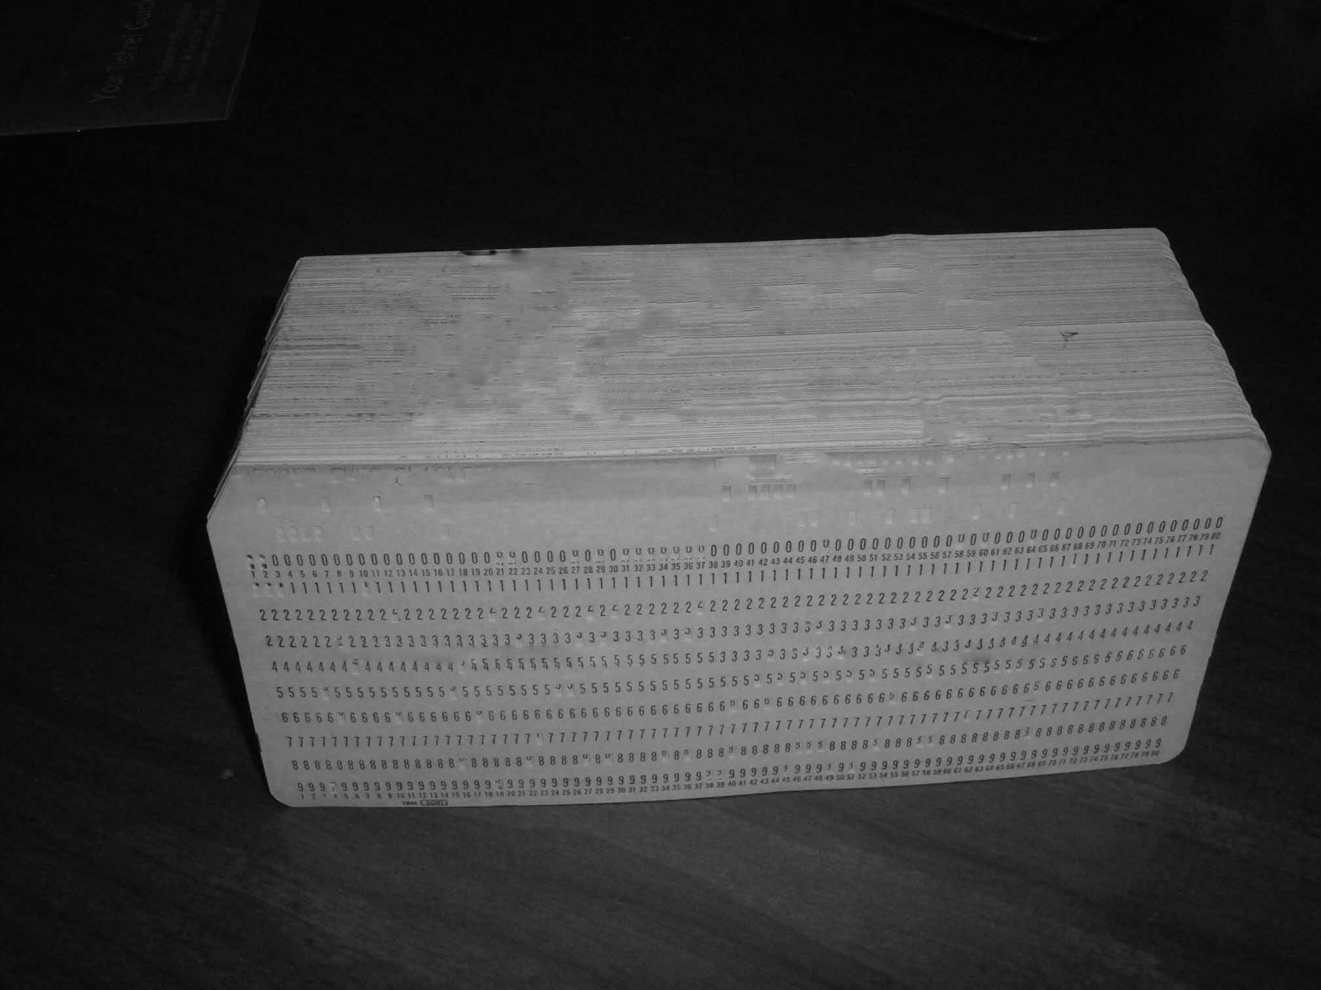
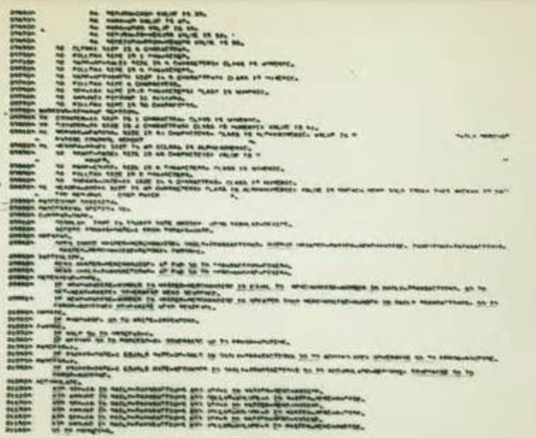
000100 IDENTIFICATION DIVISION.
000200 PROGRAM-ID. HELLOWORLD.
000300*
000400 ENVIRONMENT DIVISION.
000500 CONFIGURATION SECTION.
000600 SOURCE-COMPUTER. RM-COBOL.
000700 OBJECT-COMPUTER. RM-COBOL.
000800
001000 DATA DIVISION.
001100 FILE SECTION.
001200
100000 PROCEDURE DIVISION.
100100
100200 MAIN-LOGIC SECTION.
100300 BEGIN.
100400 DISPLAY " " LINE 1 POSITION 1 ERASE EOS.
100500 DISPLAY "Hello world!" LINE 15 POSITION 10.
100600 STOP RUN.
100700 MAIN-LOGIC-EXIT.
100800 EXIT.

Slide 4
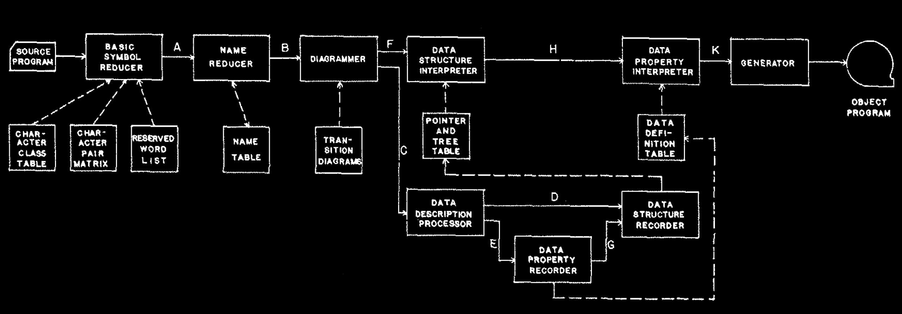

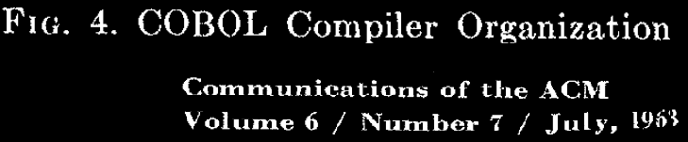

Slide 5
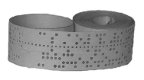

Slide 7




Slide 8
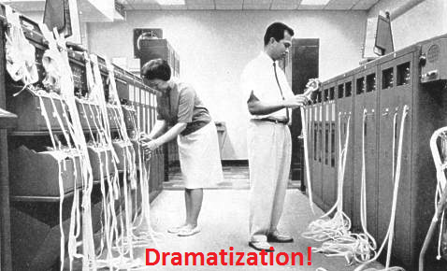
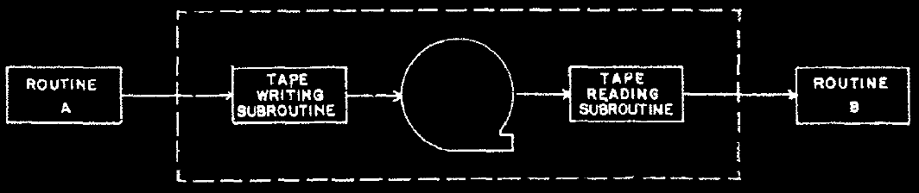
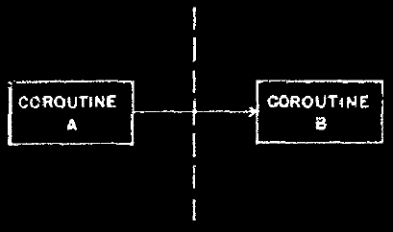
☹
☺
Melvin Conway
Joel Erdwinn
image credits: wikipedia commons, Communication of the ACM vol.6 No.7 July 1963

Slide 9
Subroutine
Coroutine
1
1
S
A
S
A
Basic Symbol
Reducer
Basic Symbol
Reducer
Basic Name
Reducer
2
C
Y
2
C
Y
S
A
3
A
read token
A
S
Y
Write to
Tape
S
Y
output token
S
A
S
A
read token
S
A
S
Y
output token
C
Y
read token
S
A
C
Y
output token (EOF)
Subroutine
C
Y
C
Subroutine
Coroutine
Subroutine
Subroutine

Slide 10
100 cards per minute!

Slide 11
1958
1965
1975
1985
1995
2005
2015

Slide 12
Async state machine
Connecting
Reading
Failed
Completed

Slide 13
Trivial if synchronous
int tcp_reader(int total)
{
char buf[4 * 1024];
auto conn = Tcp::Connect("127.0.0.1", 1337);
for (;;)
{
auto bytesRead = conn.Read(buf, sizeof(buf));
total -= bytesRead;
if (total <= 0 || bytesRead == 0) return total;
}
}

Slide 14
std::future<T> and std::promise<T>
shared_state<T>
atomic<long> refCnt;
mutex lock;
variant<empty, T, exception_ptr> value;
conditional_variable ready;
promise<T>
future<T>
intrusive_ptr<shared_state<T>>
set_value(T)
set_exception(exception_ptr)
intrusive_ptr<shared_state<T>>
wait()
T get()

Slide 15
future<int> tcp_reader(int64_t total) {
struct State {
char buf[4 * 1024];
int64_t total;
Tcp::Connection conn;
explicit State(int64_t total) : total(total) {}
};
auto state = make_shared<State>(total);
return Tcp::Connect("127.0.0.1", 1337).then(
[state](future<Tcp::Connection> conn) {
state->conn = std::move(conn.get());
return do_while([state]()->future<bool> {
if (state->total <= 0) return make_ready_future(false);
return state->conn.read(state->buf, sizeof(state->buf)).then(
[state](future<int> nBytesFut) { auto nBytes = nBytesFut.get()
if (nBytes == 0) return make_ready_future(false);
state->total -= nBytes;
return make_ready_future(true);
});
});
});
}
N4399 Working Draft, Technical Specification for C++ Extensions for Concurrency
.then
future<void> do_while(function<future<bool>()> body) {
return body().then([=](future<bool> notDone) {
return notDone.get() ? do_while(body) : make_ready_future(); });
}

Slide 16
Forgot something
int tcp_reader(int total)
{
char buf[4 * 1024];
auto conn = Tcp::Connect("127.0.0.1", 1337);
for (;;)
{
auto bytesRead = conn.Read(buf, sizeof(buf));
total -= bytesRead;
if (total <= 0 || bytesRead == 0) return total;
}
}

Slide 17
future<int> tcp_reader(int64_t total) {
struct State {
char buf[4 * 1024];
int64_t total;
Tcp::Connection conn;
explicit State(int64_t total) : total(total) {}
};
auto state = make_shared<State>(total);
return Tcp::Connect("127.0.0.1", 1337).then(
[state](future<Tcp::Connection> conn) {
state->conn = std::move(conn.get());
return do_while([state]()->future<bool> {
if (state->total <= 0) return make_ready_future(false);
return state->conn.read(state->buf, sizeof(state->buf)).then(
[state](future<int> nBytesFut) { auto nBytes = nBytesFut.get()
if (nBytes == 0) return make_ready_future(false);
state->total -= nBytes;
return make_ready_future(true);
}); // read
}); // do_while
}); // Tcp::Connect
}
.then

Slide 18
future<int> tcp_reader(int64_t total) {
struct State {
char buf[4 * 1024];
int64_t total;
Tcp::Connection conn;
explicit State(int64_t total) : total(total) {}
};
auto state = make_shared<State>(total);
return Tcp::Connect("127.0.0.1", 1337).then(
[state](future<Tcp::Connection> conn) {
state->conn = std::move(conn.get());
return do_while([state]()->future<bool> {
if (state->total <= 0) return make_ready_future(false);
return state->conn.read(state->buf, sizeof(state->buf)).then(
[state](future<int> nBytesFut) { auto nBytes = nBytesFut.get()
if (nBytes == 0) return make_ready_future(false);
state->total -= nBytes;
return make_ready_future(true);
}); // read
}); // do_while
}).then([state](future<void>){return make_ready_future(state->total)});
}
.then

Slide 19
Hand-crafted async state machine (1/3)
class tcp_reader
{
char buf[64 * 1024];
Tcp::Connection conn;
promise<int> done;
int total;
explicit tcp_reader(int total): total(total) {}
void OnConnect(error_code ec, Tcp::Connection newCon);
void OnRead(error_code ec, int bytesRead);
void OnError(error_code ec);
void OnComplete();
public:
static future<int> start(int total);
};
③
①
Connecting
②
Reading
④
⑤
Failed
Completed
②
③
④
⑤
①
int main() {
cout << tcp_reader::start(1000 * 1000 * 1000).get(); }

Slide 20
Hand-crafted async state machine (2/3)
future<int> tcp_reader::start(int total) {
auto p = make_unique<tcp_reader>(total);
auto result = p->done.get_future();
Tcp::Connect("127.0.0.1", 1337,
[raw = p.get()](auto ec, auto newConn) {
raw->OnConnect(ec, std::move(newConn));
});
p.release();
return result;
}
void tcp_reader::OnConnect(error_code ec,
Tcp::Connection newCon)
{
if (ec) return OnError(ec);
conn = std::move(newCon);
conn.Read(buf, sizeof(buf),
[this](error_code ec, int bytesRead)
{ OnRead(ec, bytesRead); });
}

Slide 21
Hand-crafted async state machine (3/3)
void tcp_reader::OnRead(error_code ec, int bytesRead) {
if (ec) return OnError(ec);
total -= bytesRead;
if (total <= 0 || bytesRead == 0) return OnComplete();
conn.Read(buf, sizeof(buf),
[this](error_code ec, int bytesRead) { OnRead(ec, bytesRead); });
}
void OnError(error_code ec) {
auto cleanMe = unique_ptr<tcp_reader>(this);
done.set_exception(make_exception_ptr(system_error(ec)));
}
void OnComplete() {
auto cleanMe = unique_ptr<tcp_reader>(this);
done.set_value(total);
}

Slide 22
Async state machine
Connecting
Reading
Failed
Completed

Slide 23
Trivial
auto tcp_reader(int total) -> int
{
char buf[4 * 1024];
auto conn = Tcp::Connect("127.0.0.1", 1337);
for (;;)
{
auto bytesRead = conn.Read(buf, sizeof(buf));
total -= bytesRead;
if (total <= 0 || bytesRead == 0) return total;
}
}

Slide 24
Trivial
auto tcp_reader(int total) -> future<int>
{
char buf[4 * 1024];
auto conn = await Tcp::Connect("127.0.0.1", 1337);
for (;;)
{
auto bytesRead = await conn.Read(buf, sizeof(buf));
total -= bytesRead;
if (total <= 0 || bytesRead == 0) return total;
}
}

Slide 25
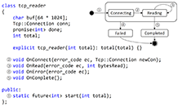
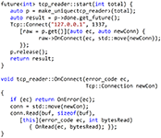
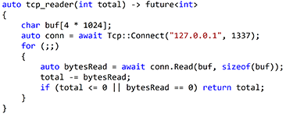
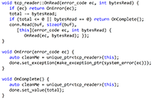
What about perf?
int main() {
printf("Hello, world\n");
}
MB/s
Binary size (Kbytes)
Coroutines
Hand-Crafted
Hello
495 (1.3x)
380
0
25 (0.85x)
30
9
Visual C++ 2015 RTM. Measured on Lenovo W540 laptop. Transmitting & Receiving 1GB over loopback IP addr

Slide 26
What about perf?
Mbps
Binary size (Kbytes)
Allocations
Coroutines
Hand-Crafted
495 (1.3x)
380
25.5 (0.85x)
30
1
488307
Visual C++ 2015 RTM. Measured on Lenovo W540 laptop. Transmitting & Receiving 1GB over loopback IP addr

Slide 27
Coroutines are closer to the metal
Handcrafted
State
Machines
I/O Abstractions
(Callback based)
Coroutines
I/O Abstraction
(Awaitable based)
OS / Low Level Libraries
Hardware

Slide 28
How to map high level call to OS API?
conn.Read(buf, sizeof(buf),
[this](error_code ec, int bytesRead)
{ OnRead(ec, bytesRead); });
template <class Cb>
void Read(void* buf, size_t bytes, Cb && cb);
Windows: WSARecv(fd, ..., OVERLAPPED*)
Posix aio: aio_read(fd, ..., aiocbp*)
OVERLAPPED
aiocbp
Function
Object
Function Object

Slide 29
os_async_ctx
OVERLAPPED/aiocbp
struct OverlappedBase : os_async_context {
virtual void Invoke(std::error_code, int bytes) = 0;
virtual ~OverlappedBase() {}
static void io_complete_callback(CompletionPacket& p) {
auto me = unique_ptr<OverlappedBase>(static_cast<OverlappedBase*>(p.overlapped));
me->Invoke(p.error, p.byteTransferred);
}
};
Function
Object
After open associate a socket handle with a threadpool and a callback ThreadPool::AssociateHandle(sock.native_handle(), &OverlappedBase::io_complete_callback);
template <typename Fn> struct CompletionWithCount : OverlappedBase, private Fn
{
CompletionWithCount(Fn fn) : Fn(std::move(fn)) {}
void Invoke(std::error_code ec, int count) override { Fn::operator()(ec, count); }
};
template <typename Fn> unique_ptr<OverlappedBase> make_handler_with_count(Fn && fn) {
return std::make_unique<CompletionWithCount<std::decay_t<Fn>>(std::forward<Fn>(fn));
}

Slide 30
conn.Read(buf, sizeof(buf),
[this](error_code ec, int bytesRead)
{ OnRead(ec, bytesRead); });
template <typename F>
void Read(void* buf, int len, F && cb) {
return Read(buf, len, make_handler_with_count(std::forward<F>(cb)));
}
void Read(void* buf, int len, std::unique_ptr<detail::OverlappedBase> o)
{
auto error = sock.Receive(buf, len, o.get());
if (error) {
if (error.value() != kIoPending) {
o->Invoke(error, 0);
return;
}
}
o.release();
}

Slide 31
await conn.Read(buf, sizeof(buf));
?

Slide 32
Awaitable – Concept of the Future<T>
Present
T
.await_ready() F<T> → bool
Present
T
.await_suspend(cb) F<T> x Fn → void
Present
.await_resume() F<T> → T
T
await expr-of-awaitable-type

Slide 33
await <expr>
Expands into an expression equivalent of
{
auto && tmp = <expr>;
if (!await_ready(tmp)) {
await_suspend(tmp, <coroutine-handle>);
}
return await_resume(tmp);
}
suspend
resume

Slide 34
Overlapped Base from before
REMEMBER THIS?
struct OverlappedBase : os_async_context
{
virtual void Invoke(std::error_code, int bytes) = 0;
virtual ~OverlappedBase() {}
static void io_complete_callback(CompletionPacket& p) { auto me = static_cast<OverlappedBase*>(p.overlapped);
auto cleanMe = unique_ptr<OverlappedBase>(me);
me->Invoke(p.error, p.byteTransferred);
}
};

Slide 35
Overlapped Base for awaitable
struct AwaiterBase : os_async_context
{
coroutine_handle<> resume;
std::error_code err;
int bytes;
static void io_complete_callback(CompletionPacket& p) {
auto me = static_cast<AwaiterBase*>(p.overlapped);
me->err = p.error;
me->bytes = p.byteTransferred;
me->resume();
}
};
sizeof(void*)
no dtor
mov rcx, [rcx]
jmp [rcx]

Slide 36
await conn.Read(buf, sizeof(buf));
?

Slide 37
auto Connection::Read(void* buf, int len) {
struct awaiter: AwaiterBase {
Connection* me; void* buf;
awaiter(Connection* me, void* buf, int len) : me(me), buf(buf) { bytes = len; }
bool await_ready() { return false; }
void await_suspend(coroutine_handle<> h) {
this->resume = h;
auto error = me->sock.Receive(buf, bytes, this);
if (error.value() != kIoPending) throw system_error(err); }
int await_resume() { if (this->err) throw system_error(err); return bytes;
}
};
return awaiter{ this, buf, len };
}
struct AwaiterBase : os_async_context {
coroutine_handle<> resume;
std::error_code err;
int bytes;
static void io_complete_callback(CompletionPacket& p){
auto me = static_cast<AwaiterBase*>(p.overlapped);
me->err = p.error;
me->bytes = p.byteTransferred;
me->resume();
}
};

Slide 38
Trivial
auto tcp_reader(int total) -> future<int>
{
char buf[4 * 1024];
auto conn = await Tcp::Connect("127.0.0.1", 1337);
for (;;)
{
auto bytesRead = await conn.Read(buf, sizeof(buf));
total -= bytesRead;
if (total <= 0 || bytesRead == 0) return total;
}
}

Slide 39
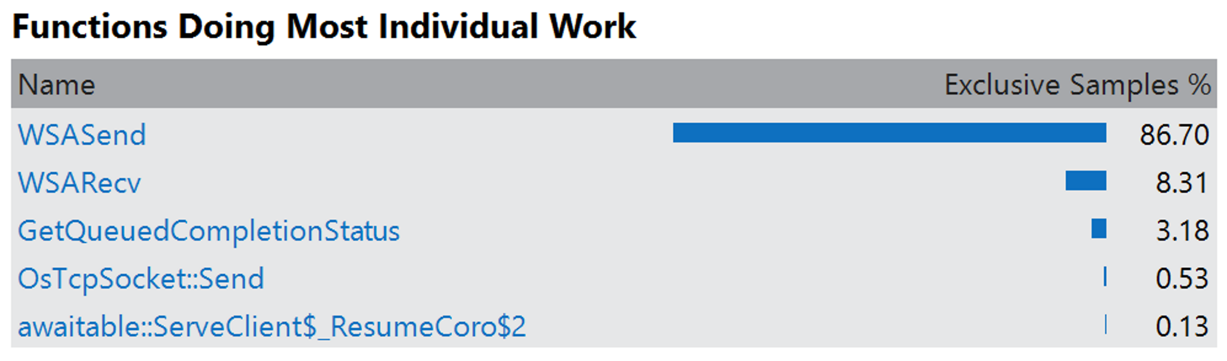
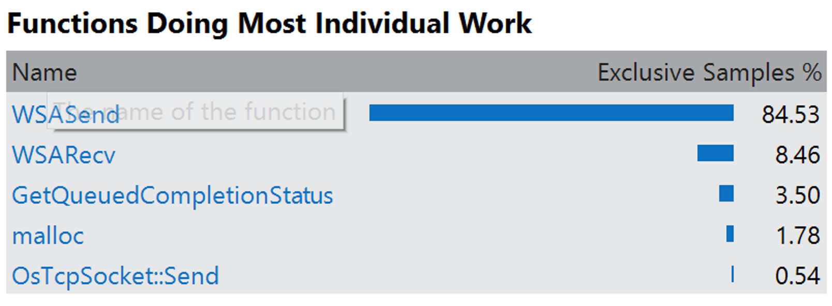
Can we make it better?
50% I/O completes synchronously
50% I/O with I/O pending error
SetFileCompletionNotificationModes(h,
FILE_SKIP_COMPLETION_PORT_ON_SUCCESS);

Slide 40
Take advantage of synchronous completions
SetFileCompletionNotificationModes(h,
FILE_SKIP_COMPLETION_PORT_ON_SUCCESS);
void Read(void* buf, int len, std::unique_ptr<detail::OverlappedBase> o)
{
auto error = sock.Receive(buf, len, o.get());
if (error) {
if (error.value() != kIoPending) {
o->Invoke(error, 0);
return;
}
}
o.release();
}

Slide 41
Take advantage of synchronous completions
SetFileCompletionNotificationModes(h,
FILE_SKIP_COMPLETION_PORT_ON_SUCCESS);
void Read(void* buf, int len, std::unique_ptr<detail::OverlappedBase> o)
{
auto error = sock.Receive(buf, len, o.get());
if (error.value() != kIoPending) {
o->Invoke(error, len);
return;
}
o.release();
}

Slide 42
Take advantage of synchronous completions
SetFileCompletionNotificationModes(h,
FILE_SKIP_COMPLETION_PORT_ON_SUCCESS);
SuperLean.exe!improved::tcp_reader::OnRead(std::error_code ec, int bytesRead) Line 254
SuperLean.exe!improved::detail::CompletionWithSizeT<<lambda_ee38b7a750c7f550b4ee1dd60c2450c1> >::Invoke(std::error_code ec, int count) Line 31
SuperLean.exe!improved::tcp_reader::OnRead(std::error_code ec, int bytesRead) Line 254
SuperLean.exe!improved::detail::CompletionWithSizeT<<lambda_ee38b7a750c7f550b4ee1dd60c2450c1> >::Invoke(std::error_code ec, int count) Line 31
SuperLean.exe!improved::tcp_reader::OnRead(std::error_code ec, int bytesRead) Line 254
SuperLean.exe!improved::detail::CompletionWithSizeT<<lambda_ee38b7a750c7f550b4ee1dd60c2450c1> >::Invoke(std::error_code ec, int count) Line 31
SuperLean.exe!improved::tcp_reader::OnRead(std::error_code ec, int bytesRead) Line 254
SuperLean.exe!improved::detail::CompletionWithSizeT<<lambda_ee38b7a750c7f550b4ee1dd60c2450c1> >::Invoke(std::error_code ec, int count) Line 31
SuperLean.exe!improved::tcp_reader::OnRead(std::error_code ec, int bytesRead) Line 254
SuperLean.exe!improved::detail::CompletionWithSizeT<<lambda_ee38b7a750c7f550b4ee1dd60c2450c1> >::Invoke(std::error_code ec, int count) Line 31
SuperLean.exe!improved::tcp_reader::OnRead(std::error_code ec, int bytesRead) Line 254
SuperLean.exe!improved::detail::CompletionWithSizeT<<lambda_ee38b7a750c7f550b4ee1dd60c2450c1> >::Invoke(std::error_code ec, int count) Line 31
SuperLean.exe!improved::tcp_reader::OnRead(std::error_code ec, int bytesRead) Line 254
SuperLean.exe!improved::detail::CompletionWithSizeT<<lambda_ee38b7a750c7f550b4ee1dd60c2450c1> >::Invoke(std::error_code ec, int count) Line 31
SuperLean.exe!improved::tcp_reader::OnRead(std::error_code ec, int bytesRead) Line 254
SuperLean.exe!improved::detail::CompletionWithSizeT<<lambda_ee38b7a750c7f550b4ee1dd60c2450c1> >::Invoke(std::error_code ec, int count) Line 31
SuperLean.exe!improved::tcp_reader::OnRead(std::error_code ec, int bytesRead) Line 254
SuperLean.exe!improved::detail::CompletionWithSizeT<<lambda_ee38b7a750c7f550b4ee1dd60c2450c1> >::Invoke(std::error_code ec, int count) Line 31
SuperLean.exe!improved::tcp_reader::OnRead(std::error_code ec, int bytesRead) Line 254
SuperLean.exe!improved::detail::CompletionWithSizeT<<lambda_ee38b7a750c7f550b4ee1dd60c2450c1> >::Invoke(std::error_code ec, int count) Line 31
SuperLean.exe!improved::tcp_reader::OnRead(std::error_code ec, int bytesRead) Line 254
SuperLean.exe!improved::detail::CompletionWithSizeT<<lambda_ee38b7a750c7f550b4ee1dd60c2450c1> >::Invoke(std::error_code ec, int count) Line 31
SuperLean.exe!improved::tcp_reader::OnRead(std::error_code ec, int bytesRead) Line 254
SuperLean.exe!improved::detail::CompletionWithSizeT<<lambda_ee38b7a750c7f550b4ee1dd60c2450c1> >::Invoke(std::error_code ec, int count) Line 31
SuperLean.exe!improved::tcp_reader::OnRead(std::error_code ec, int bytesRead) Line 254
SuperLean.exe!improved::detail::CompletionWithSizeT<<lambda_ee38b7a750c7f550b4ee1dd60c2450c1> >::Invoke(std::error_code ec, int count) Line 31
SuperLean.exe!improved::tcp_reader::OnRead(std::error_code ec, int bytesRead) Line 254
SuperLean.exe!improved::detail::CompletionWithSizeT<<lambda_ee38b7a750c7f550b4ee1dd60c2450c1> >::Invoke(std::error_code ec, int count) Line 31
SuperLean.exe!improved::tcp_reader::OnRead(std::error_code ec, int bytesRead) Line 254
SuperLean.exe!improved::detail::CompletionWithSizeT<<lambda_ee38b7a750c7f550b4ee1dd60c2450c1> >::Invoke(std::error_code ec, int count) Line 31
SuperLean.exe!improved::tcp_reader::OnRead(std::error_code ec, int bytesRead) Line 254
SuperLean.exe!improved::detail::CompletionWithSizeT<<lambda_ee38b7a750c7f550b4ee1dd60c2450c1> >::Invoke(std::error_code ec, int count) Line 31
SuperLean.exe!improved::detail::io_complete_callback(CompletionPacket & p) Line 22
SuperLean.exe!CompletionQueue::ThreadProc(void * lpParameter) Line 112 C++
void Read(void* buf, int len, std::unique_ptr<detail::OverlappedBase> o)
{
auto error = sock.Receive(buf, len, o.get());
if (error.value() != kIoPending) {
o->Invoke(error, len);
return;
}
o.release();
}
Stack
Overflow

Slide 43
Need to implement it on the use side
void tcp_reader::OnRead(std::error_code ec, int bytesRead) {
if (ec) return OnError(ec);
total -= (int)bytesRead;
if (total <= 0 || bytesRead == 0) return OnComplete();
bytesRead = sizeof(buf);
conn.Read(buf, bytesRead,
[this](std::error_code ec, int bytesRead) {
OnRead(ec, bytesRead); }) ;
}

Slide 44
Now handling synchronous completion
void tcp_reader::OnRead(std::error_code ec, int bytesRead) {
do {
if (ec) return OnError(ec);
total -= (int)bytesRead;
if (total <= 0 || bytesRead == 0) return OnComplete();
bytesRead = sizeof(buf);
} while (
conn.Read(buf, bytesRead,
[this](std::error_code ec, int bytesRead) {
OnRead(ec, bytesRead); }));
}

Slide 45
Let’s measure the improvement (handwritten)
 | MB/s | Executable size
 | Handcrafted | Coroutine | Handcrafted | Coroutine
Original | 380 | 495 | 30 | 25
Synchr Completion. Opt
25
485
30

Slide 46
Let’s measure the improvement (handwritten)
Before: 380 MBps
After: 485 MBps
(nearly as good as coroutine version)
(without the same optimization)

Slide 47
SetFileCompletionNotificationModes(h,
FILE_SKIP_COMPLETION_PORT_ON_SUCCESS);
auto Connection::Read(void* buf, int len) {
struct awaiter: AwaiterBase {
Connection* me; void* buf;
awaiter(Connection* me, void* buf, int len) : me(me), buf(buf) { bytes = len; }
bool await_ready() { return false; }
void await_suspend(coroutine_handle<> h) {
this->resume = h;
auto error = me->sock.Receive(buf, bytes, this);
if (error.value() == kIoPending) return; if (error) throw system_error(err); return; }
int await_resume() { if (this->err) throw system_error(err); return bytes;
}
};
return awaiter{ this, buf, len };
}
struct AwaiterBase : os_async_context {
coroutine_handle<> resume;
std::error_code err;
int bytes;
static void io_complete_callback(CompletionPacket& p){
auto me = static_cast<AwaiterBase*>(p.overlapped);
me->err = p.error;
me->bytes = p.byteTransferred;
me->resume();
}
};

Slide 48
auto Connection::Read(void* buf, int len) {
struct awaiter: AwaiterBase {
Connection* me; void* buf;
awaiter(Connection* me, void* buf, int len) : me(me), buf(buf) { bytes = len; }
bool await_ready() { return false; }
bool await_suspend(coroutine_handle<> h) {
this->resume = h;
auto error = me->sock.Receive(buf, bytes, this);
if (error.value() == kIoPending) return true; if (error) throw system_error(err); return false; }
int await_resume() { if (this->err) throw system_error(err); return bytes;
}
};
return awaiter{ this, buf, len };
}
struct AwaiterBase : os_async_context {
coroutine_handle<> resume;
std::error_code err;
int bytes;
static void io_complete_callback(CompletionPacket& p){
auto me = static_cast<AwaiterBase*>(p.overlapped);
me->err = p.error;
me->bytes = p.byteTransferred;
me->resume();
}
};

Slide 49
await <expr>
Expands into an expression equivalent of
{
auto && tmp = <expr>;
if (!await_ready(tmp)) {
await_suspend(tmp, <coroutine-handle>);
}
return await_resume(tmp);
}
suspend
resume

Slide 50
await <expr>
Expands into an expression equivalent of
{
auto && tmp = <expr>;
if (!await_ready(tmp) &&
await_suspend(tmp, <coroutine-handle>) {
}
return await_resume(tmp);
}
suspend
resume

Slide 51
Let’s measure the improvement (coroutine)
 | MB/s | Executable size
 | Handcrafted | Coroutine | Handcrafted | Coroutine
Original | 380 | 495 | 30 | 25
Synchr Completion. Opt | 485 |  | 30
25
1028
25

Slide 52
Let’s measure the improvement (awaitable)
Before: 495 MBps
After: 1028 MBps

Slide 53
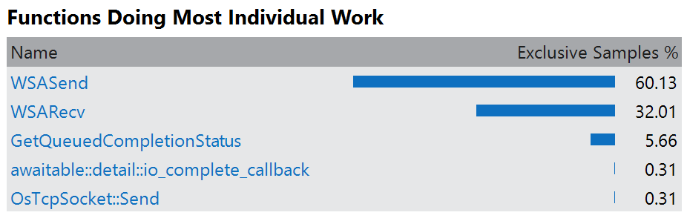
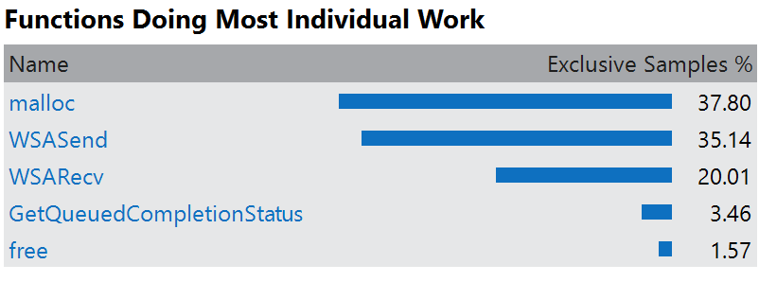
Can we make it better?

Slide 54
Getting rid of the allocations
class tcp_reader {
std::unique_ptr<detail::OverlappedBase> wo;
…
tcp_reader(int64_t total) : total(total) {
wo = detail::make_handler_with_count(
[this](auto ec, int nBytes) {OnRead(ec, nBytes); });
… }
void OnRead(std::error_code ec, int bytesRead) {
if (ec) return OnError(ec);
do {
total -= (int)bytesRead;
if (total <= 0 || bytesRead == 0) return OnComplete();
bytesRead = sizeof(buf);
} while (conn.Read(buf, bytesRead, wo.get()));
}

Slide 55
Let’s measure the improvement (handcrafted)
 | MB/s | Executable size
 | Handcrafted | Coroutine | Handcrafted | Coroutine
Original | 380 | 495 | 30 | 25
Synchr Completion. Opt | 485 | 1028 | 30 | 25
Prealloc handler |  | 1028 |  | 25
25
690
28

Slide 56
Let’s measure the improvement (no allocs)
Before: 485 MBps
After: 690 MBps

Slide 57
Coroutines are popular!
Python: PEP 0492
async def abinary(n): if n <= 0: return 1 l = await abinary(n - 1) r = await abinary(n - 1) return l + 1 + r
DART 1.9
Future<int> getPage(t) async {
var c = new http.Client();
try {
var r = await c.get('http://url/search?q=$t');
print(r);
return r.length();
} finally {
await c.close();
}
}
C#
async Task<string> WaitAsynchronouslyAsync()
{ await Task.Delay(10000);
return "Finished";
}
HACK (programming language)
async function gen1(): Awaitable<int> { $x = await Batcher::fetch(1); $y = await Batcher::fetch(2);
return $x + $y; }
C++17
future<string> WaitAsynchronouslyAsync()
{ await sleep_for(10ms);
return "Finished“s;
}

Slide 58
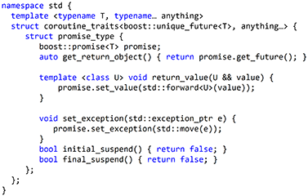

Generalized Function
POF
Coroutine
Designer
Monadic* await - suspend
User
Task await
Generator yield
Async
Generator await + yield
Compiler
does not care
image credits: Три богатыря и змей горыныч

Slide 59
Design Principles
Scalable (to billions of concurrent coroutines)
Efficient (resume and suspend operations comparable in cost to a function call overhead)
Seamless interaction with existing facilities with no overhead
Open ended coroutine machinery allowing library designers to develop coroutine libraries exposing various high-level semantics, such as generators, goroutines, tasks and more.
Usable in environments where exceptions are forbidden or not available

Slide 60
Coroutines – a negative overhead abstraction
Proposal is working through C++ standardization committee (C++17?)
Experimental implementation in VS 2015 RTM
Clang implementation is in progress
more details:
CppCon 2014 presentation on coroutines http://github.com/cppcon
http://www.open-std.org/jtc1/sc22/wg21/docs/papers/2015/p0057r1.pdf

Slide 61
Thank you!
Kavya Kotacherry, Daveed Vandevoorde, Richard Smith, Jens Maurer, Lewis Baker, Kirk Shoop, Hartmut Kaiser, Kenny Kerr, Artur Laksberg, Jim Radigan, Chandler Carruth, Gabriel Dos Reis, Deon Brewis, Jonathan Caves, James McNellis, Stephan T. Lavavej, Herb Sutter, Pablo Halpern, Robert Schumacher, Viktor Tong, Geoffrey Romer, Michael Wong, Niklas Gustafsson, Nick Maliwacki, Vladimir Petter, Shahms King, Slava Kuznetsov, Tongari J, Lawrence Crowl, Valentin Isac and many more who contributed

Slide 62
Questions?

Slide 63
Defining Coroutine Promise for boost::future
namespace std {
template <typename T, typename… anything>
struct coroutine_traits<future<T>, anything…> {
struct promise_type {
promise<T> promise;
auto get_return_object() { return promise.get_future(); }
template <class U> void return_value(U && value) {
promise.set_value(std::forward<U>(value));
}
void set_exception(std::exception_ptr e) { promise.set_exception(std::move(e));
}
bool initial_suspend() { return false; }
bool final_suspend() { return false; }
};
};
}

Slide 64
Call
x86_x64 Windows ABI
future<int> tcp_reader(int n)
Suspend!!!!
future<int> __fut; // raw tcp_reader(&__fut, 1’000’000’000);
tcp_reader(1’000’000’000);
RSP
Stack
ret-addr
__range
RCX = &__fut
slot1
savedRDI
RDX = 35
&__fut
slot2
Heap
slot3
savedRSI
slot4
savedRBX
RDI = n
RSI = a
RBX = b
RBP = $fp
ret-main
savedRBP
Coroutine
Promise
slot1
slot2
saved RDI
slot3
slot4
RDI slot
Coroutine Frame
saved RSI
RSI slot
saved RBX
RAX = &__fut
RBX slot
saved RIP
RIP slot

Slide 65
Resume
x86_x64 Windows ABI
generator<int>::iterator::operator ++()
struct iterator {
iterator& operator ++() {
coro.resume(); return *this; }
…
coroutine_handle<Promise> coro;
};
RSP
for(…;…; ++__begin)
Stack
ret-addr
__range
RCX = $fp
slot1
savedRDI
slot2
slot3
Heap
savedRSI
slot4
savedRBX
RDI = n
RSI = a
RBX = b
ret-main
savedRBP
Coroutine
Promise
slot1
slot2
RBP = $fp
saved RDI
slot3
slot4
RDI slot
Coroutine Frame
saved RSI
RSI slot
RBX slot
saved RBX
saved RIP
RIP slot

Slide 66
Coroutines are closer to the metal
Handcrafted
State
Machines
I/O Abstractions
(Callback based)
Coroutines
Previous
Slides
I/O Abstraction
(Awaitable based)
OS / Low Level Libraries
Hardware

Slide 67
Why SG14 should care about coroutines?
It might not mean what you think it means.
Keep clean happy path while enabling error propagation WITHOUT exceptions
Explicit support for preallocate (can fail) and do work (cannot fail)
Avoids allocations altogether
Enables no fail operations
Can control allocation of coroutine frames

Slide 68
Look. No exceptions. Honest!
Common pattern for Async and sync i/o
async
future<int> tcp_reader(int total)
{
char buf[64 * 1024];
auto conn = await Tcp::Connect("127.0.0.1", 1337);
for (;;)
{
auto bytesRead = await conn.read(buf, sizeof(buf));
total -= bytesRead;
if (total <= 0 || bytesRead == 0) return total;
}
}
SNEAK PEEK
(more later)
sync
expected<int> tcp_reader(int total)
{
char buf[64 * 1024];
auto conn = await Tcp::Connect("127.0.0.1", 1337, block);
for (;;)
{
auto bytesRead = await conn.read(buf, sizeof(buf), block);
total -= bytesRead;
if (total <= 0 || bytesRead == 0) return total;
}
}
e-mail: gorn with answers, complaints, corrections, suggestions and new material

Slide 69
Generalized Function
POF
Coroutine
Designer
Monadic* await - suspend
User
Task await
Generator yield
Async
Generator await + yield
Compiler
does not care

Slide 70
Design Principles
Scalable (to billions of concurrent coroutines)
Efficient (resume and suspend operations comparable in cost to a function call overhead)
Seamless interaction with existing facilities with no overhead
Open ended coroutine machinery allowing library designers to develop coroutine libraries exposing various high-level semantics, such as generators, goroutines, tasks and more.
Usable in environments where exceptions are forbidden or not available

Slide 71
Coroutines – a negative overhead abstraction
Proposal is working through C++ standardization committee (C++17?)
Experimental implementation in VS 2015 RTM
Clang implementation is in progress
more details:
CppCon 2014 presentation on coroutines http://github.com/cppcon
http://www.open-std.org/jtc1/sc22/wg21/docs/papers/2015/p0057r1.pdf

