Slide 1
Transforming and Reducing Workloads
C++17 Parallel Algorithms for Rapid Prototyping
Louis Tan
Notes:
Hi, I’m Louis and I’m here to talk to you about transforming and reducing workloads using C++17 parallel algorithms for rapid prototyping.

Slide 2
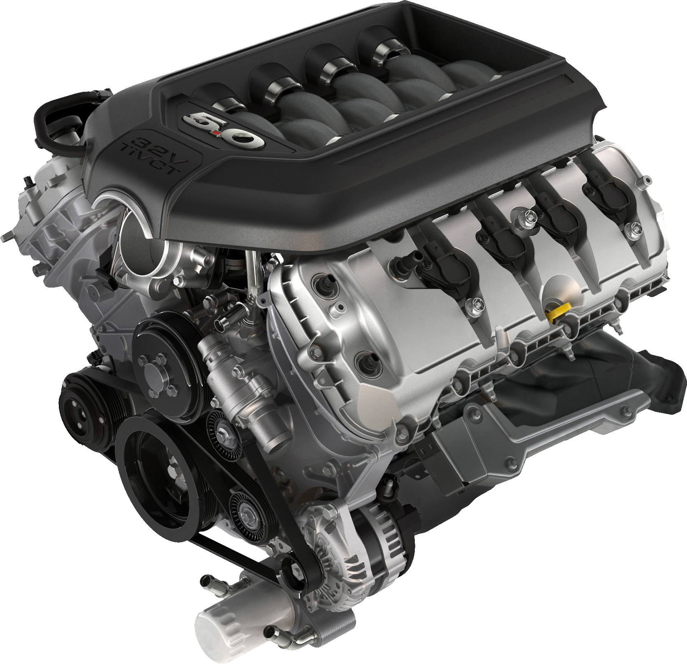
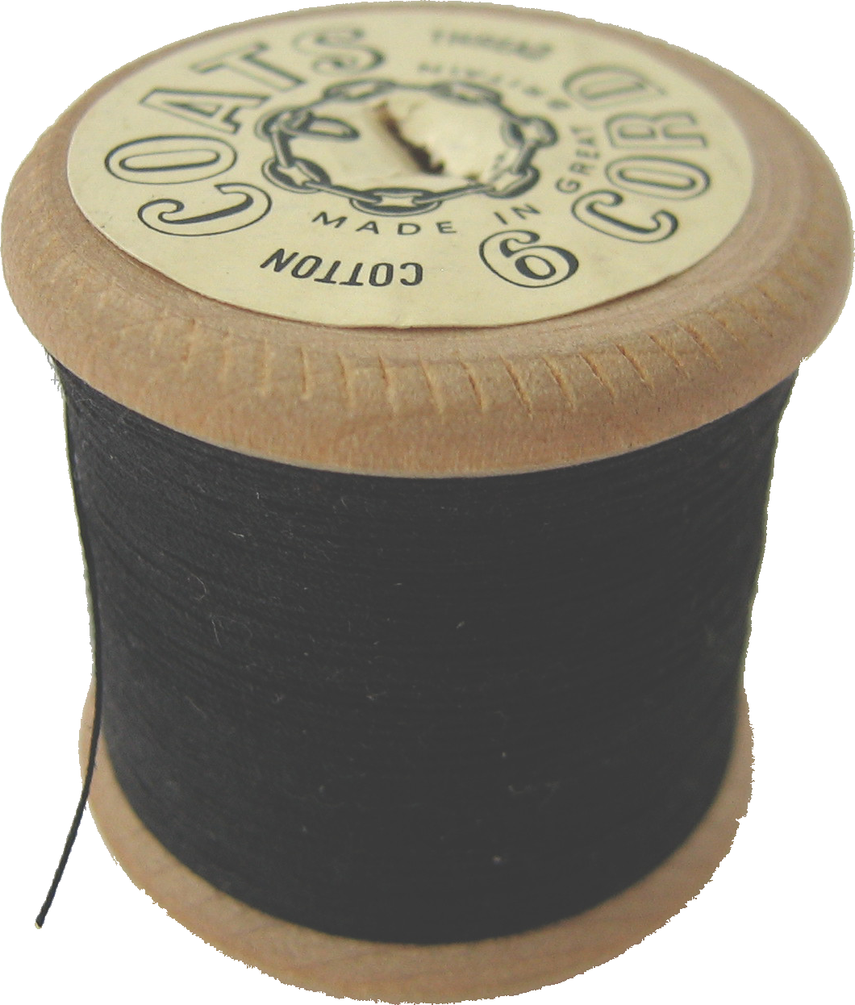
Project Overview
Notes:
First, a project overview. I had a [click] game engine I’d been working on that was [click] single threaded, and I wanted to explore making it [click] multi-threaded for performance reasons given an ever-increasing demand for that sort of experience, especially since [click] it can scale well on the right hardware if implemented correctly. So what I had was… Copyright information: “2011 Ford F-150 5L V8 Engine” by Ford Motor Company [https://www.flickr.com/photos/fordmotorcompany/5014149471/] licensed under CC BY-NC 2.0 [https://creativecommons.org/licenses/by-nc/2.0/], background removed “thread” by ben Dalton [https://flickr.com/photos/noii/3780837258/] licensed under CC BY 2.0 [https://creativecommons.org/licenses/by/2.0/], background removed

Slide 3


Notes:
… an OpenGL renderer that is [click] inherently single-threaded due to the API basically showing its age, and [click] a physics engine that was [click] single-threaded as well. To achieve my goal, I [click] ported the renderer to Vulkan, which [click] supports parallel submit of draw commands, and then [click] parallelized the physics engine. [click] This last bit will be the focus of the talk. To focus on the actual parallelization and not worry too much about system-level implementation details, what I ended up using was…
Copyright information: OpenGL® and the oval logo are trademarks or registered trademarks of Hewlett Packard Enterprise in the United States and/or other countries worldwide.
Vulkan and the Vulkan logo are registered trademarks of the Khronos Group Inc.

Slide 4
C++17 Parallel Algorithms
Algorithms
Execution Policies
std::reduce
std::inclusive_scan
std::exclusive_scan
std::transform_reduce
std::transform_inclusive_scan
std::transform_exclusive_scan
std::for_each_n
std::reduce
std::inclusive_scan
std::exclusive_scan
std::transform_reduce
std::transform_inclusive_scan
std::transform_exclusive_scan
std::for_each_n
std::execution::seq
std::execution::par
std::execution::par_unseq
std::execution::seq
std::execution::par
std::execution::par_unseq
std::execution::unseq
std::execution::seq
std::execution::par
std::execution::par_unseq
std::execution::unseq
std::execution::seq
std::execution::par
std::execution::par_unseq
std::execution::unseq
Notes:
… the parallel algorithms introduced in C++17, which added [click] new algorithms designed for parallel workloads since they parallelize well, and [click] execution policies for use with both these as well as most existing algorithms, with [click] a new one coming in C++20. For this use case we’ll focus on [click] std::transform_reduce and the [click] parallel unsequenced policy, and to understand what this does, let’s look at the two halves of the name.

Slide 5
std::transform
Notes:
std::transform takes [click] multiple inputs and [click] performs a unary op to produce [click] an output for each input, which is trivial to run in parallel…

Slide 6
std::reduce
Notes:
… while std::reduce takes [click] multiple inputs and [click] performs a binary op on all available pairs [click] multiple times to [click] produce single output, which can be run in parallel if you assume associativity and commutativity to rearrange the pair choices at runtime. Combining these, we get…

Slide 7
std::transform_reduce
std::transform_reduce
std::transform_reduce
Notes:
std::transform_reduce, which [click] takes multiple inputs, [click] transforms them, then [click] takes the results and [click] reduces them to [click] produce a single output. This is basically the MapReduce model popularized by Google.

Slide 8
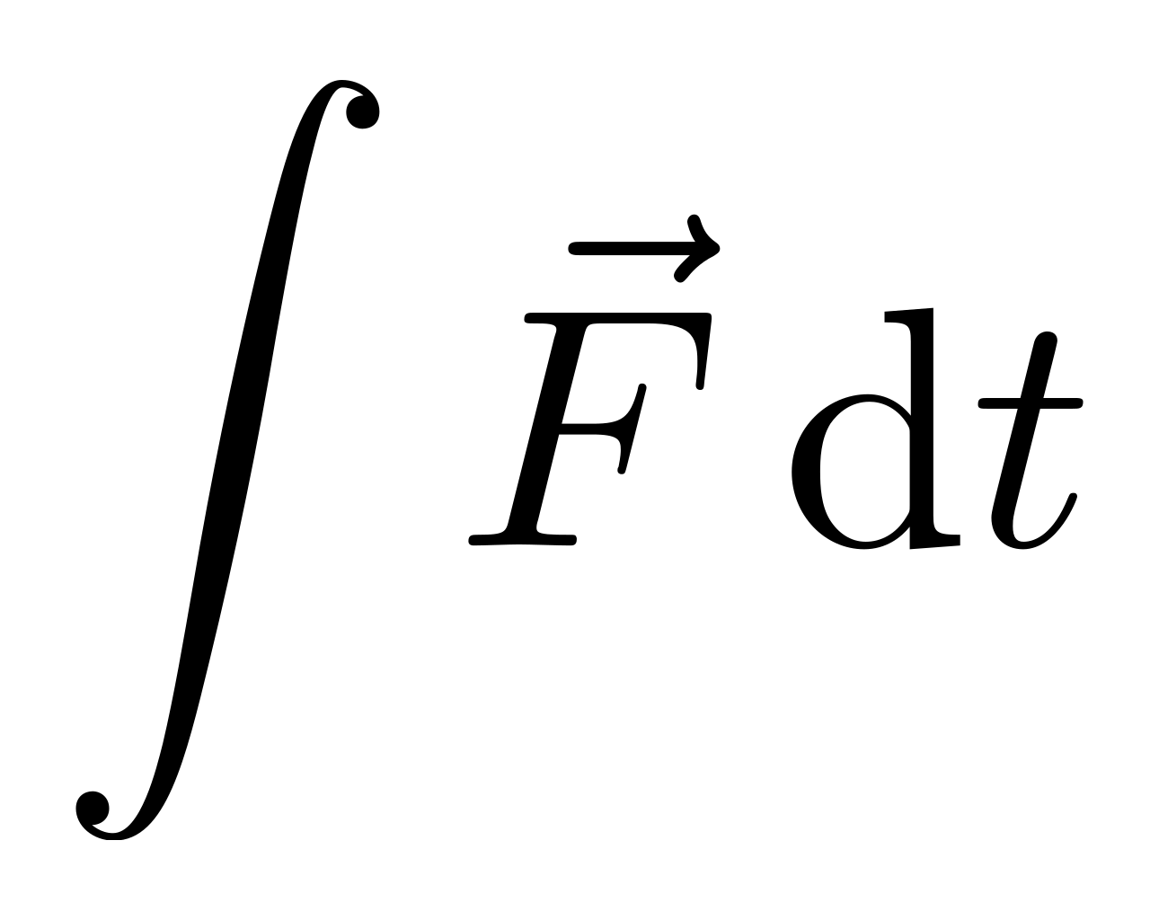
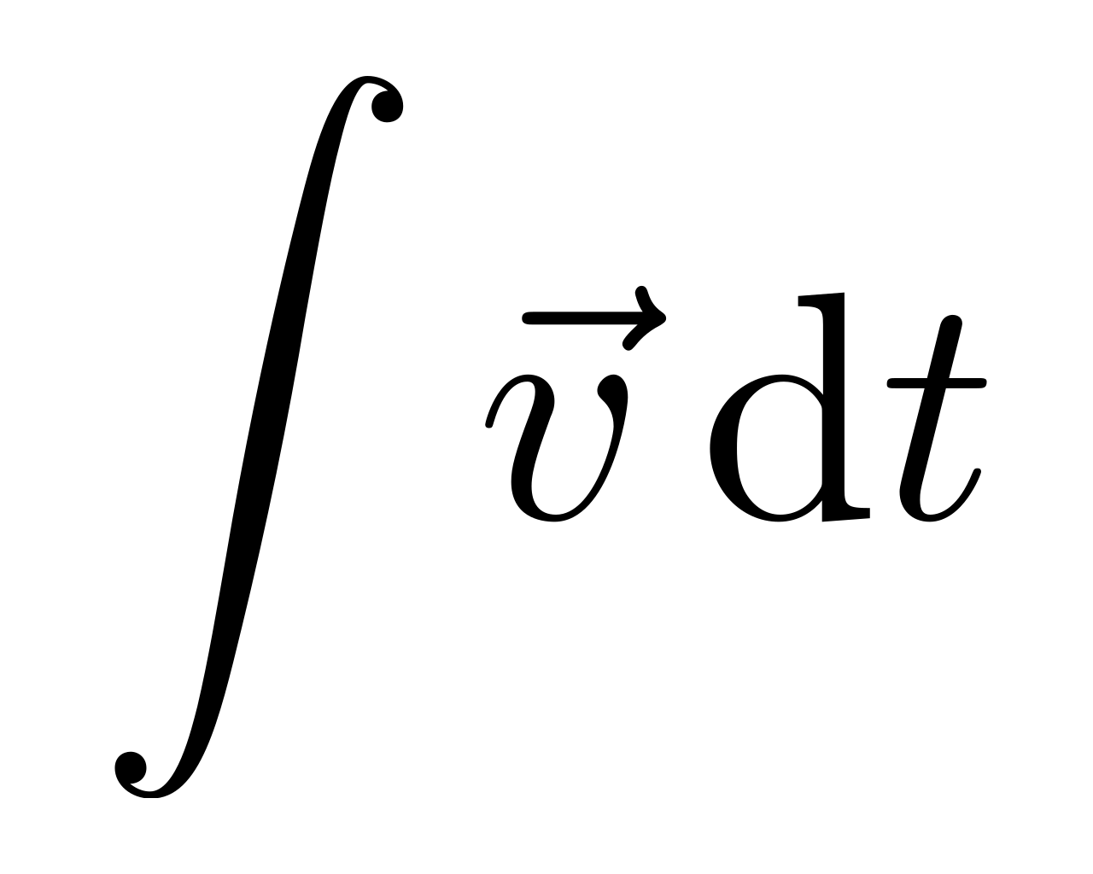
Physics Flow
Broad Phase
Narrow Phase
Narrow Phase
Force Integration
Constraint Solve
Constraint Solve
Velocity Integration
Position Update
Notes:
Each frame in the physics engine involves [click] a broad phase for early rejection tests using a bounding volume hierarchy, [click] a narrow phase for actual collision tests on object pairs with overlapping bounding volumes, [click] a force integration step to update velocities, [click] a constraint solve to resolve collisions and other constraints, and finally [click] a velocity integration step which produces [click] the final position update. The parallel portions are [click] the narrow phase and constraint solver, since the rest don’t parallelize well due to extremely short tasks, except for the broad phase, which involves updating a binary tree and is something that’s hard to parallelize well.

Slide 9
Narrow Phase
Notes:
The narrow phase for a [click] scene containing [click] multiple objects starts by taking the [click] bounding volumes that are overlapping during the current frame and…

Slide 10
Notes:
… transforming each pair to produce a [click] list of zero or one elements depending on whether the objects collide, and [click] merging these into a [click] single list of all collision pairs. This is a relatively trivial parallelization case.

Slide 11
Constraint Solver
Notes:
The constraint solver is a bit more involved, so let’s start with a simple case involving [click] some objects, and let’s [click] mark them to tell them apart. The solver is an iterative solver that minimizes corrective impulses using…

Slide 12
Notes:
… a sparse linear system, with [click] each pairwise constraint forming a row in the matrix that is solved individually, and [click] each subsequent row having [click] potential dependencies on [click] the results of previous rows. This requires ordering to remain mostly consistent between iterations, but not quite.

Slide 13
Notes:
For a more complicated system like this one we can apply…

Slide 14
Notes:
… an edge coloring algorithm to the constraint graph such that…

Slide 15
Notes:
… no two constraints…

Slide 16
Notes:
… of the same color…

Slide 17
Notes:
… depend on…

Slide 18
Notes:
… each other, and…

Slide 19
Notes:
… if we use this to…

Slide 20
Notes:
… rearrange the rows, we can…

Slide 21
Notes:
… group these constraints such that… [slide advances automatically]

Slide 22
Notes:
[slide advances automatically]

Slide 23
Notes:
[slide advances automatically]

Slide 24
Notes:
… each group can be solved in parallel, with [click] the entire process repeated until equilibrium is reached or the iteration limit is exceeded. Before looking at the code, let’s have a quick look at the prototype for one of the overloads for std::transform_reduce.

Slide 25
template<class ExecutionPolicy, class ForwardIt, class T, class BinaryOp, class UnaryOp> T transform_reduce(ExecutionPolicy&& policy, ForwardIt first, ForwardIt last, T init, BinaryOp binary_op, UnaryOp unary_op);
Notes:
We pass in one of the execution policies mentioned earlier, defaulting to the non-parallel sequenced policy if omitted, as well as the input range, the initial value for the reduce op, the binary reduce op and the unary transform op.

Slide 26
Narrow Phase
using list_type = std::list<std::pair<Handle, Handle>>; auto result = std::transform_reduce( std::execution_policy::par_unseq, std::begin(broad_phase_outputs), std::end(broad_phase_outputs), list_type{}, [](auto&& lhs, auto&& rhs) { lhs.splice(std::end(lhs), std::move(rhs)); return lhs; }, [](auto&& object_pair) { return colliding(object_pair) ? list_type{ object_pair } : list_type{}; } );
Notes:
Here’s a simplified version of the narrow phase code. We work with a std::list of object handle pairs, and std::transform_reduce is called using a parallel unsequenced policy over the broad phase results with a unary transform op performing a collision test to return a list with either zero or one elements as mentioned before, and a binary reduce op using the splice method of std::list to efficiently merge two lists without additional reallocation overhead.

Slide 27
Constraint Solver
constexpr auto max_lambda = [](auto lhs, auto rhs) { return std::max(lhs, rhs); }; for (int iter = 0; iter < max_iter; ++iter) { auto max = std::transform_reduce( std::begin(constraint_groups), std::end(constraint_groups), 0.0f, max_lambda, [](const auto& group) { return std::transform_reduce( std::execution::par_unseq, std::begin(group), std::end(group), 0.0f, max_lambda, [](auto& constraint) { return solve(constraint); } ); } ); if (max < tol) break; }
Notes:
Meanwhile, the constraint solver loops over multiple nested calls to std::transform_reduce, with the outer call using the default non-parallel sequenced policy over groups of constraints with a unary transform op that performs a parallel unsequenced call over the constraints in each group, using a unary transform op that returns the corrective impulse from solving each constraint. The binary reduce op for both calls is a helper lambda for overload resolution of std::max, and we exit the loop early if the maximum corrective impulse falls under a predefined tolerance.

Slide 28
Conclusion
Less to implement
Good for prototyping
Portable with target support
Some abstraction overhead
Tune later with own scheduler
Notes:
In conclusion, [click] use of parallel algorithms gives you less to implement in terms of system-level details, which is [click] good for prototyping potential parallelization strategies, and [click] can be portable to other target platforms given library support, though [click] there is some abstraction overhead, and [click] you’ll probably have to tune it later using your own scheduler implementation for better control over task distribution.

Slide 29
Thank you!

