Slide 1
Take charge of your C++ dependencies with vcpkg
Augustin Popa
@augustin_popa
Program Manager
Microsoft C++ Team

Slide 2
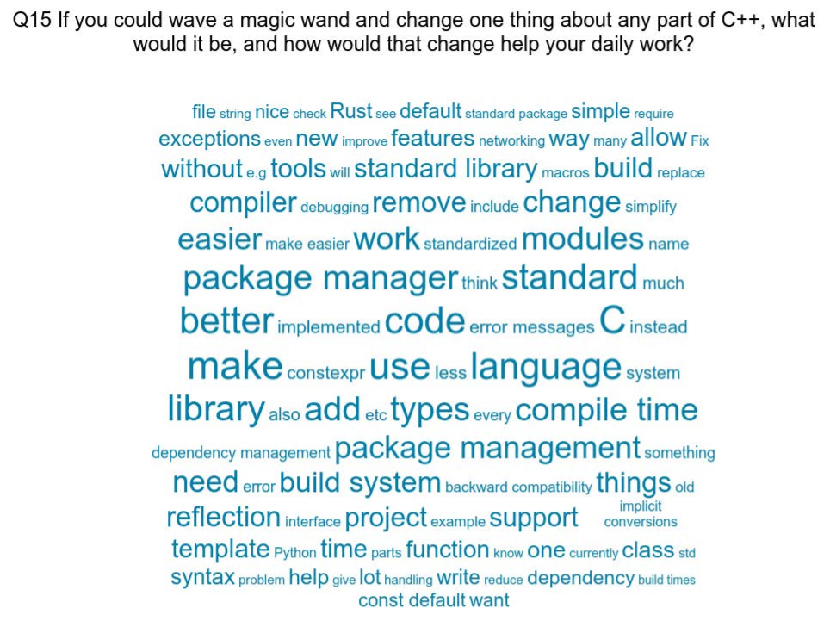
Growing interest in C++ package management
Source: ISO C++ 2019 Developer Survey

Slide 3
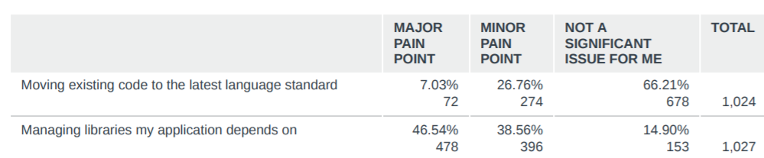
Managing libraries = top pain point for C++ devs
Source: ISO C++ 2020 Developer Survey

Slide 4
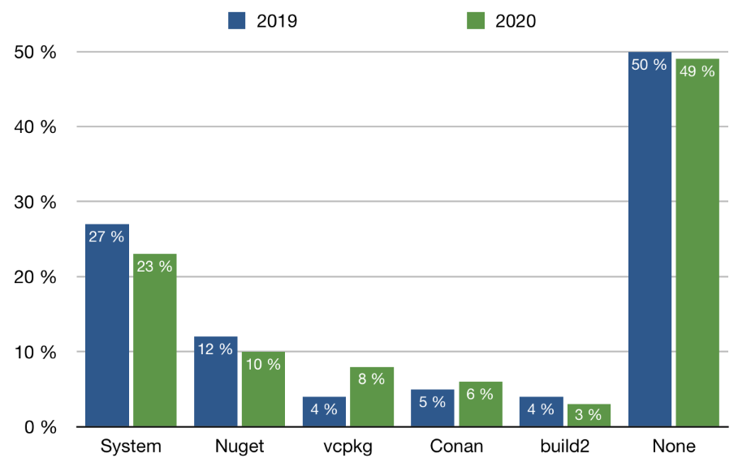
“Language” package managers are on the rise
Source: JetBrains “State of the Developer Ecosystem 2020” – C++

Slide 5
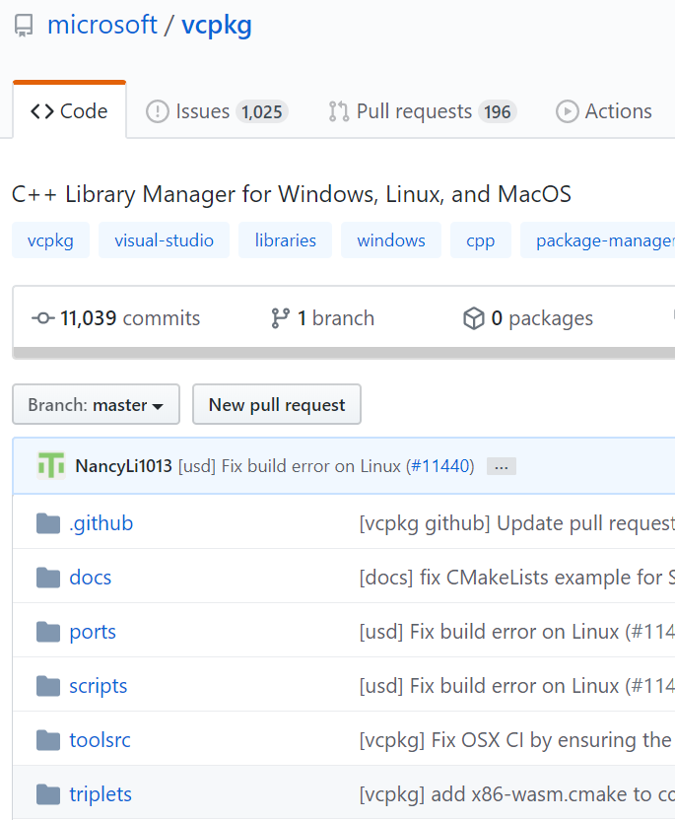
What is vcpkg?
Open source C++ library manager for Windows, Linux, and macOS
1400+ popular open source libraries available as recipes (ports):
Built from source on-demand
Centralized, tested catalog
https://github.com/microsoft/vcpkg

Slide 6
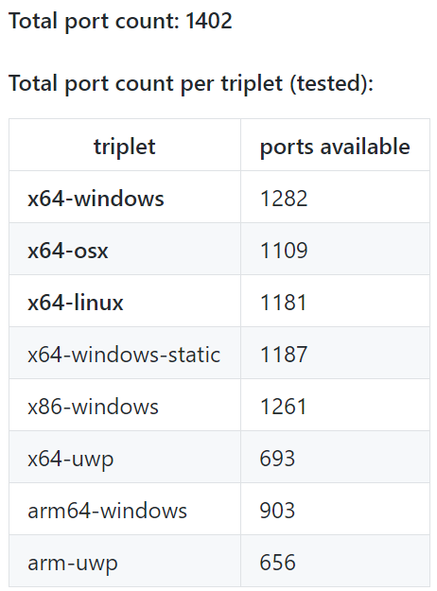
vcpkg catalog count
Terminology:
A port is a recipe for building a library
A triplet describes the build requirements (target architecture, OS, etc)
The triplets on the right are provided by default – but custom ones can also be defined

Slide 7
Why vcpkg?
Automate the process of building your dependencies to save time
No need to worry about dependencies of dependencies – vcpkg will acquire them automatically
Regardless of which libraries you install, they will work together – vcpkg routinely builds the entire catalog to test it
Provides a simple, repeatable way to acquire dependencies across multiple environments (developer machines, CI, containers)

Slide 8
How to get started
git clone https://github.com/microsoft/vcpkg
cd vcpkg
Run bootstrap-vcpkg.bat (Windows) or bootstrap-vcpkg.sh (Linux/macOS)
(Optional) If using with Visual Studio or Visual Studio Code
vcpkg integrate install
vcpkg install <lib1> <lib2> <lib3>

Slide 9
Demo
Getting started with vcpkg

Slide 10
Integrating vcpkg with a build system
MSBuild – run vcpkg integrate install
Makes vcpkg installed libraries available to MSBuild automatically
CMake – reference vcpkg CMake toolchain file
[vcpkg-install-path]/vcpkg/scripts/buildsystems/vcpkg.cmake
If you run vcpkg integrate install and are using Visual Studio, the toolchain file is referenced automatically for you

Slide 11
Working with triplets – Examples
vcpkg install openssl:x64-windows-static
Installs static version of OpenSSL for Windows x64 architectures
vcpkg install sqlite3:x64-linux-dynamic
-–overlay-triplets=custom-triplets
Installs sqlite3 by following a user-defined build recipe located in the custom-triplets subfolder. The triplet file looks like this:
# ~/git/custom-triplets/x64-linux-dynamic.cmake set(VCPKG_TARGET_ARCHITECTURE x64)
set(VCPKG_CRT_LINKAGE dynamic)
set(VCPKG_LIBRARY_LINKAGE dynamic) set(VCPKG_CMAKE_SYSTEM_NAME Linux)

Slide 12
Exporting vcpkg libraries
vcpkg export <pkg1> <pkg2> … --[options]
Available options:
--zip
--7zip
--nuget
--raw [uncompressed folder]
Example: vcpkg export cpprestsdk zlib –nuget
Produces a NuGet package containing cpprestsdk, zlib, and their dependencies that can be used with MSBuild projects/Visual Studio

Slide 13
New and upcoming features

Slide 14
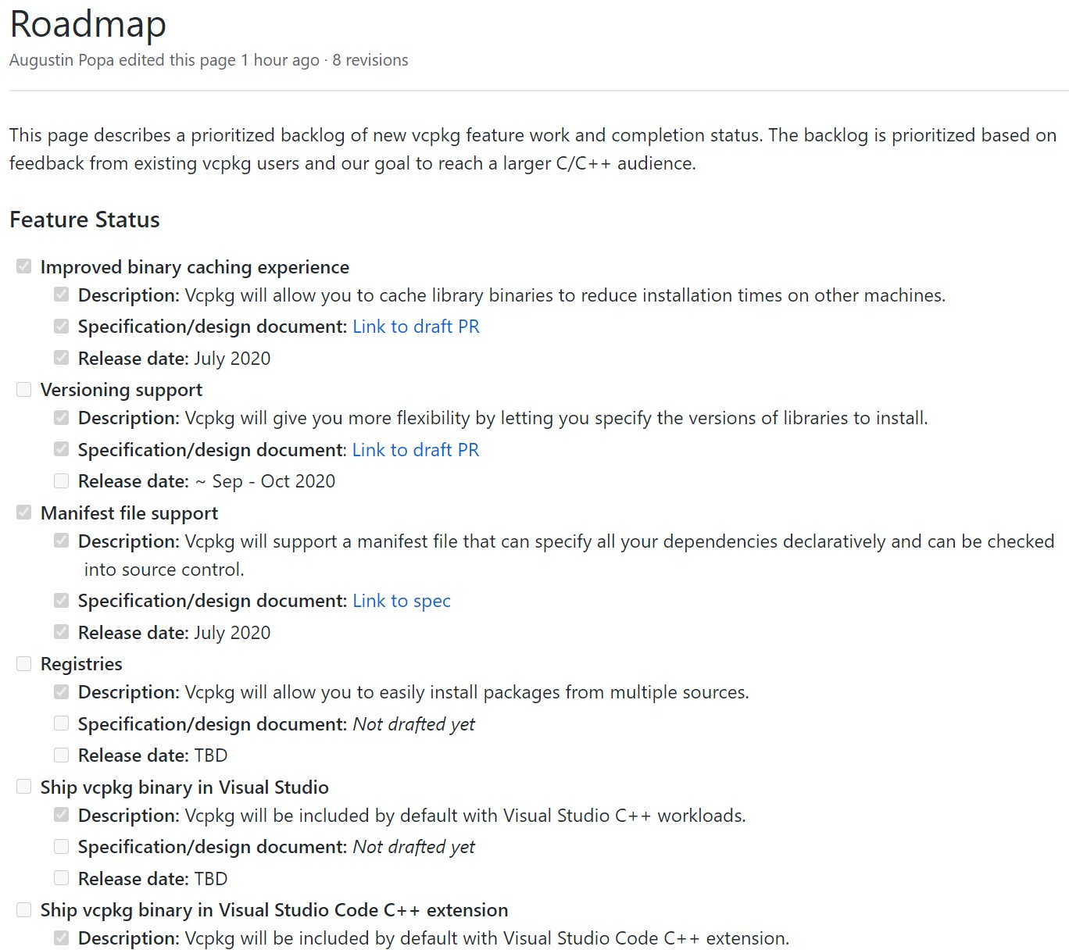
Product roadmap and feature specifications https://aka.ms/vcpkg/roadmap We want your input!

Slide 15
Binary caching (learn more)
The good: vcpkg builds from source, so it can produce tailored, compatible binaries for consumption
The bad: builds from source take time
Solution: Binary caching
The first time a library is built & installed, cache binaries in a known location that can be shared across machines/environments
Basic example: .zip files in a file-based archive

Slide 16
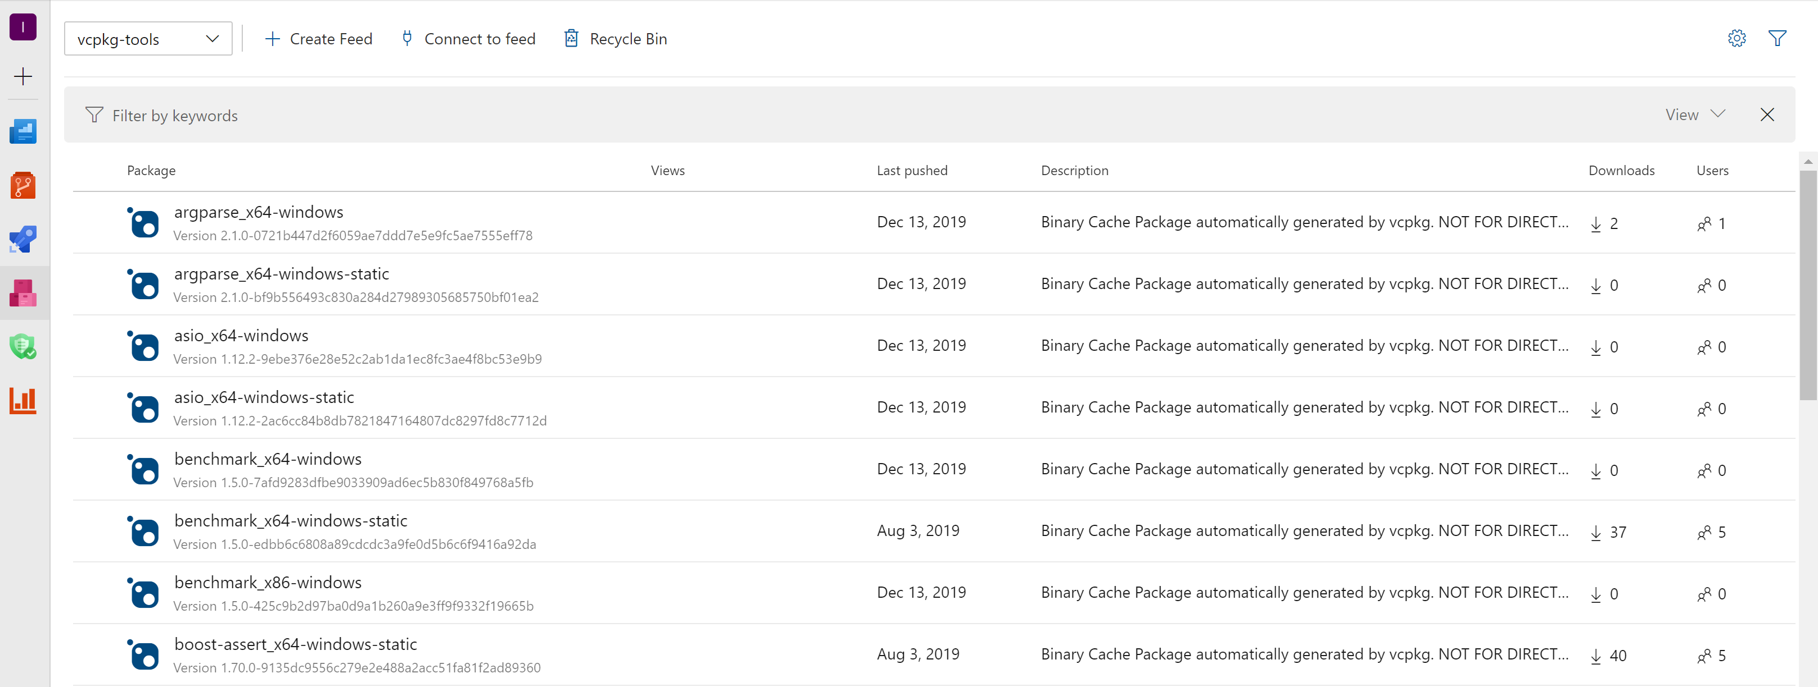
Binary caching on a NuGet server
Binary caching can also be used with existing NuGet servers like Azure Artifact Storage
Note: though storage format is NuGet, packages cannot be consumed directly into MSBuild projects (use vcpkg export command instead)

Slide 17
Versioning (learn more)
The good: vcpkg gives you a set of libraries that will work together without the user having to know which versions are compatible
The bad: the user doesn’t easily control the version of a library vcpkg gives them
Solution: Versioning support
Allows developers to request specific library versions
vcpkg install package zlib@1.2.11:x64-windows

Slide 18
Package search by version
vcpkg search zlib --show-versions
zlib 1.2.11 A compression library
zlib 1.2.10 A compression library
zlib 1.2.8 A compression library
Search feature will be able to show available package versions

Slide 19
Manifest file: vcpkg.json (learn more)
Problem: How to achieve consistency?
Multiple developers on a team need the same dependencies acquired exactly the same way
CI builds need to happen exactly the same way as local developer machine builds
Consumers of open source software need to rebuild it the same way as the maintainers
Solution: vcpkg now supports a manifest file called vcpkg.json
Allows developers to specify libraries in a declarative format; in the future, will support library versions and more

Slide 20
vcpkg.json example
{
"name": "pango",
"version": "1.40.11",
"port-version": 6,
"homepage": "https://ftp.gnome.org/pub/GNOME/sources/pango/",
"description": "Text and font handling library.",
"dependencies": [
"glib",
"gettext",
"cairo",
"fontconfig",
"freetype",
{
"name": "harfbuzz",
"features": [ "glib" ],
"platform": {
"and": [
{ "not": { "and": [ "windows", "static" ] } },
{ "not": "osx" } ] } } ]
}

Slide 21
Bring your own libraries to vcpkg – Registries
Eventually, vcpkg.json will allow the user to specify other libraries not found in the vcpkg catalog
This can include private/internal libraries and custom forks
Developers will be able to define their own vcpkg ports for use across their organization

Slide 22
Visual Studio / Visual Studio Code integration
We will ship vcpkg inside the Visual Studio IDE (if a C++ workload is installed)
We will ship vcpkg inside the Visual Studio Code C++ extension
More integration with these tools will be considered over time

Slide 23
Learn more
vcpkg product roadmap & specs: https://aka.ms/vcpkg/roadmap
We are looking for feedback!
Get started with vcpkg: https://github.com/microsoft/vcpkg

