Slide 1
beyond threads
Rick Molloy
Senior Developer
Microsoft Startup Business Group

Slide 2
agenda
thread safety & documentation
synchronization examples
structure of parallelism
actors & state machine example

Slide 3
thread-safety
wiki says:
“A piece of code is thread-safe if it only manipulates shared datastructures in a thread-safe manner, which enables safe execution by multiple threads at the same time. There are various strategies for making thread-safe datastructures.”
http://en.wikipedia.org/wiki/Thread_safety

Slide 4
thread safety
Thread Ownership & Object Lifetimes
Synchronization
Atomicity & Order dependencies
Synchronicity & Blocking

Slide 5
thread safety: xmllite
XmlLite is not thread-safe. If you are writing a multi-threaded application, it is up to you to make sure that you use XmlLite in a thread-safe manner.
For example, if one of your threads has called the method to retrieve the next node, and that method has not returned, you must … prevent another thread from attempting to retrieve a node.
http://msdn.microsoft.com/en-us/library/ms753140.aspx

Slide 6
thread safety: SendMessage
Sends the specified message to a window or windows. The SendMessage function calls the window procedure for the specified window and does not return until the window procedure has processed the message.
To send a message and return immediately, use the SendMessageCallback or SendNotifyMessage function. To post a message to a thread's message queue and return immediately, use PostMessage or PostThreadMessage.
http://msdn.microsoft.com/en-us/library/ms644950.aspx

Slide 7
thread safety: GetLastError
Retrieves the calling thread's last-error code value.The last-error code is maintained on a per-thread basis.Multiple threads do not overwrite each other's last-error code.
http://msdn.microsoft.com/en-us/library/ms679360.aspx

Slide 8
thread safety: concurrent_vector
concurrent_vector::push_back Method
Appends the given item to the end of the concurrent vector. This method is concurrency-safe.
concurrent_vector::resize Method
Overloaded. Changes the size of the concurrent vector to the requested size, deleting or adding elements as necessary. This method is not concurrency-safe.
http://msdn.microsoft.com/en-us/library/ee355343.aspx

Slide 9
Synchronizing objects
widget studies

Slide 10
atomicity
wiki says:
In concurrent programming, an operation (or set of operations) is atomic, linearizable, indivisible or uninterruptible if it appears to the rest of the system to occur instantaneously…
Atomicity is commonly enforced by mutual exclusion, whether at the hardware level building on a cache coherency protocol, or the software level using semaphores or locks. Thus, an atomic operation does not actually occur instantaneously.
The benefit comes from the appearance: the system behaves as if each operation occurred instantly, separated by pauses.
http://en.wikipedia.org/wiki/Atomic_operation

Slide 11
synchronizing widgets
think about the interface…
- Who owns the widget
- Are there ordering issues
- How do you want to protect the data?
- Is there a need for synchronous?

Slide 12
structure of parallelism
System.Threading.Tasks.Task
task<t>
agent
task_group

Slide 13
structure of parallelism
System.Threading.Tasks.Task
task<t>
agents & messages
task_group
pipelines & tasks

Slide 14
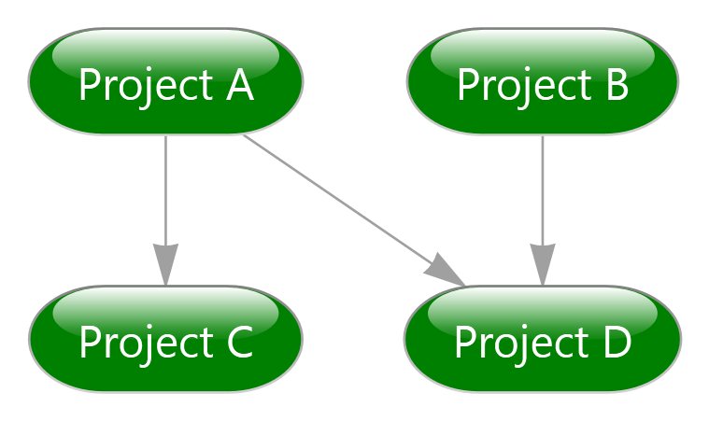
structure of parallelism
control flow & data flow

Slide 15
structure of parallelism
what is the control flow?
nested parallelism (loops)
continuations & dependencies
pipeline or a directed graph
when do you know the structure?
design time / compile time
at construction time
is it truly dynamic

Slide 16
actor model
wiki says:
..the Actor model is a mathematical model of concurrent computation that treats "actors" as the universal primitives of concurrent digital computation: in response to a message that it receives, an actor can make local decisions, create more actors, send more messages, and determine how to respond to the next message received.
http://en.wikipedia.org/wiki/Actor_(programming)

Slide 17
actors & agents
actor-based programming model
Receive messages
perform local work
sends messages
agents are isolated
can have state
but not share it with others
communication explicitly through message-passing
Agent
message
message
input port
output port
run

Slide 18
actors & agents
class Actor: public agent {
overwrite_buffer<int> out;
transformer<int,int> trans;
public:
ISource<int>* output_buf;
ITarget<int>* input_buf;
…
void run(){
//initialize source and target trans.link_target(&out);
… } }

Slide 19
actors

Slide 20
THANK YOU!

