Slide 1
Building a Python/C++ Package Vision, Transformation, Documentation, Scale, Portability, and Tools
Robert P. Goddard University of Washington, Seattle
Northwest C++ Users Group 16 March 2022

Slide 2
Acknowledgments and Restrictions
The Sonar Simulation Toolset (SST) was developed starting in 1989 by a sequence of teams at the Applied Physics Laboratory of the University of Washington (APL-UW), funded through a sequence of contracts with various arms of the U. S. Department of Defense (DoD), primarily the Office of Naval Research (ONR).
I am the architect and team leader. I have had great team members, from whom I learned a lot, and without whom SST would not have been possible. SST users have also contributed substantially. Remaining weaknesses are mine.
UW owns the SST copyright. DoD holds a perpetual license to SST. ONR controls distribution of SST. Currently SST is not approved for public release, except for a few documents. This talk contains only publicly releasable information.
The work described here is my own project, NOT funded by DoD. APL-UW provided a computer, software, technical support, and encouragement. UW holds the copyright to the software.

Slide 3
Outline
Starting point: Sonar Simulation Toolset (SST)
Ending point: C++ Library + Python Binding (+ SST)
Why?
Tools: SWIG vs. pybind11 vs. ??
Constructors
Documentation
Shared Libraries
Packaging

Slide 4
Starting point: Sonar Simulation Toolset (SST)
Ambient Noise
& CM Clutter

Slide 5
SST Control Architecture
To be replaced by Python
Working
Classes
Parser
calls methods
maintains
Symbol
Table
how to
parse
instance
Descriptor
Working
Objects
manipulates
type
attributes
creates,
sets
attributes
Symbol
- name
contains
address

Slide 6
SST Script Language
# Variable Delay Example insig = HarmonicFamily{ isComplex = false times = UniformGrid:{ first=-2; last=5; rate=8000 } fundamental = 220 #Hz harmonics = ( # number ampDB phaseDeg 1 -3 0.0 2 -6. 90.0 ) } delay = InternalSignal{ isComplex = false times = UniformGrid:{ first=0; last=5; interval=1 } buf = ( 1.00 1.10 1.25 1.45 1.7 2.0 ) } outsig = SoundSignal{ file = "myDelayedSignal.snd" } delayGenerator = VarDelay { isComplex = false times = UniformGrid:{ first=0; last=5; rate=8000 } inSignal = insig commonDelayBuf = delay } CopySignal delayGenerator outsig
Object based: Language creates named objects of pre-defined classes
Mostly describes data: Ocean, receiver, sources, scatterers, signal generators (e.g. TargetEcho)
Scripts consist mostly of “constructor calls” defining a scenario
One important verb: CopySignal
Incomplete: No decisions, no loops, no arithmetic, single scope,
Recursive descent parser is brittle

Slide 7
Usage Pattern 1: Original Conception
Editor
SST Commands
file
SST
Analyze & Plot
(Matlab)
log
file
listen
Received Signals

Slide 8
Usage Pattern 2: Script Generation
Generate
(Matlab)
Edit Parameters
Necessary for
Computed parameters
Large receivers
Complex trajectories
Many scenario versions
SST Commands
Source
Signals
files
SST
Analyze & Plot
(Matlab)
log
files
listen
Received Signals

Slide 9
Usage Pattern 3: Closed Loop
Useful for
Autonomous systems
Behavioral models
Scenario Generator
Dynamics
SST Commands
Control
Source
Signals
SST
Detection Classification Localization
Analyze & Plot
log
file
listen
Received Signals
Signal Processing

Slide 10

Usage Pattern 4: Human in the Loop
Scenario Generator
Dynamics
SST Commands
Source
Signals
Duty Station Simulator
SST
Useful for
Training
Tactics Development
Evaluating system changes
BUT: Need nearly real time performance
Detection Classification Localization
log
file
Received Signals
Signal Processing

Slide 11
Desired Pattern 4: Human in the Loop
Specific Simulator
(C++ or
Python)
Simulation Control
Duty Station Simulator
Events (push)
Function Calls
Detection Classification Localization
Dynamics
SST Libraries
Logging
Signal Processing
Signals (pull)
Simpler
Faster
Cheaper

Slide 12
Desired End Point: C++ Libraries + Python Binding (+ SST)
C++ shared libraries & headers: Public interfaces include most of the classes exposed by the SST language, but exposing functions as well as object creation
Python binding for the same public classes
Extensible: Users can add subclasses of existing base classes, in either C++ or Python, by writing extension modules.
Documentation: Sphinx-based, combining elements from SST Web, Doxygen, the SST Science Report, Examples, and new tutorial material.
Transition: Use existing SST scripts in Python environment. Maybe provide a translator from SST language to Python constructor calls.
Packaging: Wheels, probably in a Conda environment
SST main program will remain, at least for a while

Slide 13
Why?
Personal reason: To preserve my professional legacy. I want SST to be useful and improving after I am gone. No one can or will maintain the SST parser, so it should be gone. Publishing and documenting the underlying working classes will enable my successors to carry on.
APL-UW reason: To expand the user community beyond the Navy – especially to education and non-defense research.
Navy reason: To reduce the cost of applying realistic undersea sound simulation to existing and proposed Navy systems.

Slide 14
Binding Tools: SWIG vs. pybind11
SWIG: (Simplified Wrapper and Interface Generator):
Pybind11:
Executable + SWIG interfaces for standard library etc.
Input:
Interface files (*.i), which import:
C/C++ header files (LLVM parser)
Other SWIG interfaces
Output:
C++ interface code
Compiles to shared library (Python extension module)
Python wrapper (proxy classes,…)
Also C#, D, Go, Guile, Java, Javascript, Lua, Octabe, Perl5, PHP, R, Ruby, Scilab, TCL, Ocaml …
C++ header-only library
Input:
C++ interface code, which #includes:
C/C++ header files
pybind11.h
Output:
Compiles to shared library (Python extension module)
SEE Leonard Mosescu’s presentation, August 2021, at nwcpp.org
MUCH simpler, but…

Slide 15
Minimal Binding Code to Write Module mymod defines MyClass with constructor MyClass(), func1(int), func2(int), Doxygen comments (unrealistically simple)
SWIG mymod.i
Pybind11 mymod.cpp
%module mymod %{ #include “myclass.hpp” %} %include “myclass.hpp”
SWIG parses the C++ header, so it can use C++ names and default values.
Changing a name adds a line to .i file.
SWIG puts Doxygen comments into the Python docstrings with Sphinx markup.
#include “myclass.hpp” #include <pybind11/pybind11.h> namespace py = pybind11; PYBIND11_MODULE(mymod, m) { m.doc() = ”mymod is for …"; py::class_<MyClass>(m,”MyClass”) .doc(“MyClass is …”) .def(py::init<int>()) .def(”func1", &MyClass::func1, ”func1 does …”, py::arg(“i”)=1) .def (”func2", &MyClass::func2, ”func2 does …”, py::arg(“j”)=2); }
Pybind11 binding code must name all classes, functions, keyword arguments, default values. C++ names & defaults are irrelevant.
Pybind11 docstrings must be supplied in binding code.

Slide 16
Issue: Naming Conventions
The SST C++ code uses CapitalCamelCase for classes and camelCase for attributes (data members).
The SST command language uses the same. Most SST interface code is generated from header files (with intrusive special comments) using my parser for a small subset of C++ (flex/bison).
The Python convention for everything is lower_case_with_underscores.
Decision: Use C++/SST names in Python to ease the transition for existing SST users, and to simplify documentation. It also simplifies SWIG binding code.
Precedent: wxPython, which is based on C++ wxWidgets library, uses the same convention as SST’s C++ code.

Slide 17
Constructors 1
Old Way
The SST front end uses the default constructor, sets attributes, and calls Init():
Snapshot(); // set default values void Position( Vector pos); //etc virtual int Init(); // check them
The full constructor is for internal use and testing:
Snapshot( double time, const Vector& pos, const Vector& vel, const Orientation& orient, const Orientation& oRate );
New Way
The Python interface AND a complete C++ library interface need a full constructor with default values exposed in the interface.
/// Full and Default Constructor Snapshot( double time=0.0, Vector pos=Vector(), Vector vel=Vector(), Orientation orient=Orientation(), Orientation oRate=Orientation() );
A constructor like this must be added to each public class to be wrapped.
Improves both C++ and Python.

Slide 18
Constructors 2
Most of the SST command language will map to Python constructors.
SST script:
snap3 = Snapshot{ time=0.0; position=Vector(1.0, 2.0, 3.0) velocity=Vector(4.0, 5.0, 6.0); orientation=Orientation(7.0, 8.0, 9.0) orientationRate=Orientation(10.0, 11.0, 12.0) }
Python:
import sstpy.geometry as g snap3 = g.Snapshot(time=0.0, position=g.Vector(1.0, 2.0, 3.0), velocity=g.Vector(4.0, 5.0, 6.0), orientation=g.Orientation(7.0, 8.0, 9.0), orientationRate=g.Orientation(10.0, 11.0, 12.0))
Python’s keyword arguments map well to SST’s member assignment syntax
SWIG provides that directly from the new C++ constructors. But:

Slide 19
Constructors 3
Simpler constructor syntax (without class names Vector and Orientation) is harder to achieve:
SST Script:
snap3 = Snapshot{time=0.0; position=(1.0, 2.0, 3.0) velocity=(4.0, 5.0, 6.0); orientation=(7.0, 8.0, 9.0) orientationRate=(10.0, 11.0, 12.0) }
Python:
import sstpy.geometry as g snap3 = g.Snapshot(time=0.0, position=(1.0, 2.0, 3.0), velocity=(4.0, 5.0, 6.0), orientation=(7.0, 8.0, 9.0), orientationRate=(10.0, 11.0, 12.0))
Making that happen requires SWIG typemaps for Vector and Orientation:

Slide 20
SWIG Typemap example (Vector) (in file geometry.i):
// Allow any Vector input argument to be given either as Vector // or as a Python sequence (tuple or list) %typemap(in) Vector { // First check for a Vector void *argp1 = nullptr; int res1 = SWIG_ConvertPtr( $input, &argp1, SWIGTYPE_p_Vector, 0 ); if ( SWIG_IsOK(res1) && argp1 ) { auto vecp = reinterpret_cast< Vector * >(argp1); $1 = *vecp; } else { float temp[3]; bool ok = floatsFromPy(temp, $input, 3); if ( ok ) { $1 = Vector(temp[0], temp[1], temp[2]); } else { PyErr_SetString(PyExc_ValueError, "Expected a Vector or a sequence"); SWIG_fail; } } }
SWIG provides typemaps for standard library, e.g. vector<T>, complex<T>.
Only a few custom typemaps have been necessary so far.

Slide 21
Other SWIG Transformations
Some class members are not exposed to Python:
%ignore Snapshot::Init();
Some operations are replaced by standard Python operators:
%ignore operator<<( std::ostream& os, const Snapshot& s ); %extend Snapshot { /// Representation as a Python string; SWIG knows about std::string. std::string __repr__() const { std::ostringstream oss; oss << "Snapshot" << *$self; return oss.str(); } };
Template specializations are mapped to plain classes:
%template(SnapshotList) std::vector<Snapshot>;
Setters and getters are wrapped as attributes:
%attributeval(Snapshot, Vector, position, Position, Position)

Slide 22
Doxygen Comments
Most SST source code has looked like this for many years:
/// Relationship between two coordinate systems at a given time class Snapshot { public: /// Full and Default Constructor (defaults are 0.0) Snapshot( double time=0.0, ///< Time at which snapshot occurs in trajectory [sec] Vector position=Vector(), ///< Position [m] Vector velocity=Vector(), ///< Velocity [m/s], default zeroes Orientation orientation=Orientation(), ///< Orientation angles [deg], default zeroes Orientation orientationRate=Orientation(), ///< Time derivatives of orient [deg/s], default zeroes ); … }
Doxygen output is here (and next slide)

Slide 23
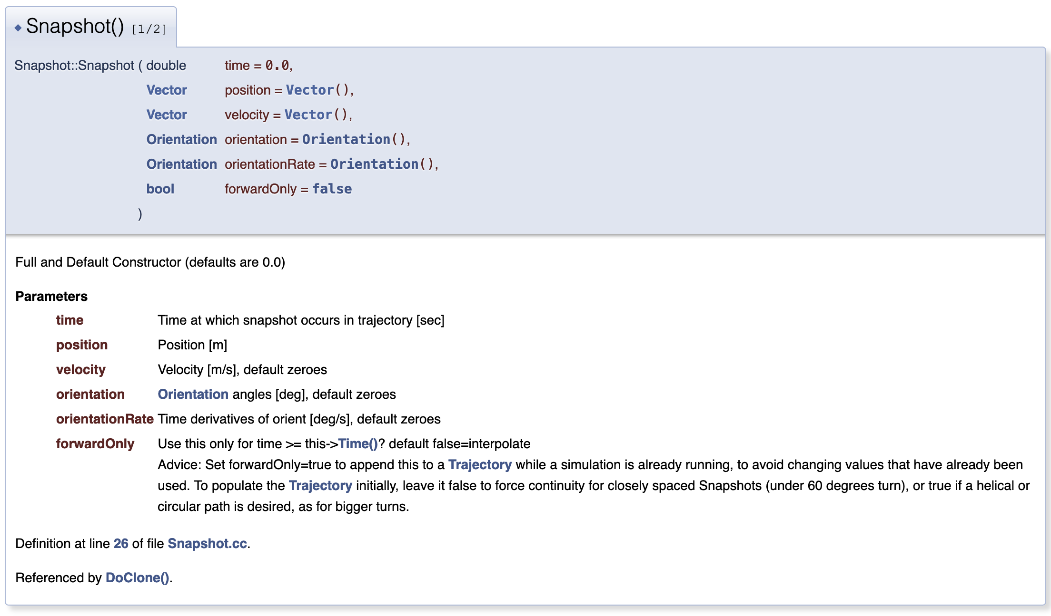
Doxygen HTML output (screen capture)

Slide 24
Python Docstring from Doxygen Comments via SWIG
class Snapshot(object): r""" Relationship between two coordinate systems at a given time""" def __init__(self, *args, **kwargs): r""" Full and Default Constructor (defaults are 0.0) :type time: float, optional :param time: Time at which snapshot occurs in trajectory [sec] :type position: :py:class:`Vector`, optional :param position: Position [m] :type velocity: :py:class:`Vector`, optional :param velocity: Velocity [m/s], default zeroes :type orientation: :py:class:`Orientation`, optional :param orientation: Orientation angles [deg], default zeroes :type orientationRate: :py:class:`Orientation`, optional :param orientationRate: Time derivatives of orient [deg/s], default zeroes ”””
Sphinx output is here (and next slide)

Slide 25
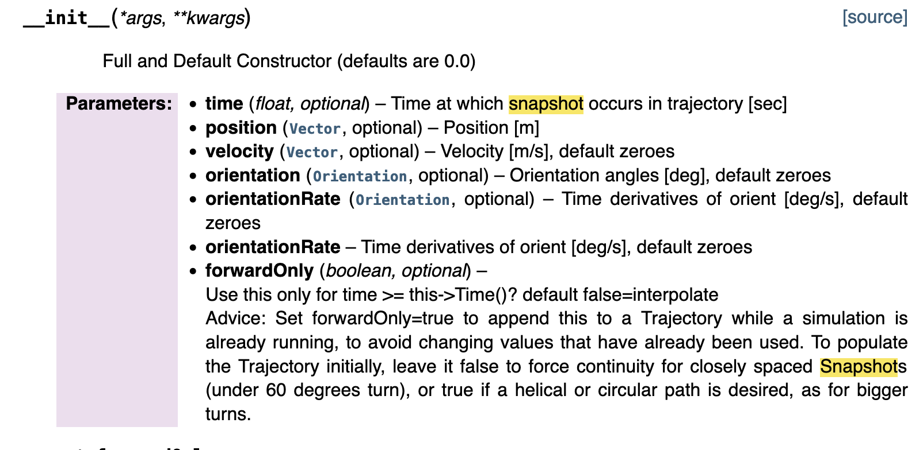
Sphinx HTML output from docstring (screen capture)

Slide 26
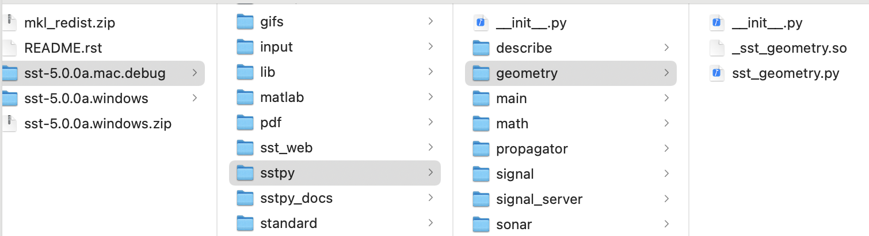
Shared Libraries
Before this project, the SST executable was statically linked. Now it is a small main program and a large shared library, SstServer.(so|dylib|dll).
sstpy is a Python package: a directory tree like this (on a Mac):
The “module” shared libraries must be linked to SstServer.dylib and to third-party shared libraries from Boost, MKL, and others.
Managing shared libraries at run time is a pain, especially on Windows. I am still working on that.

Slide 27
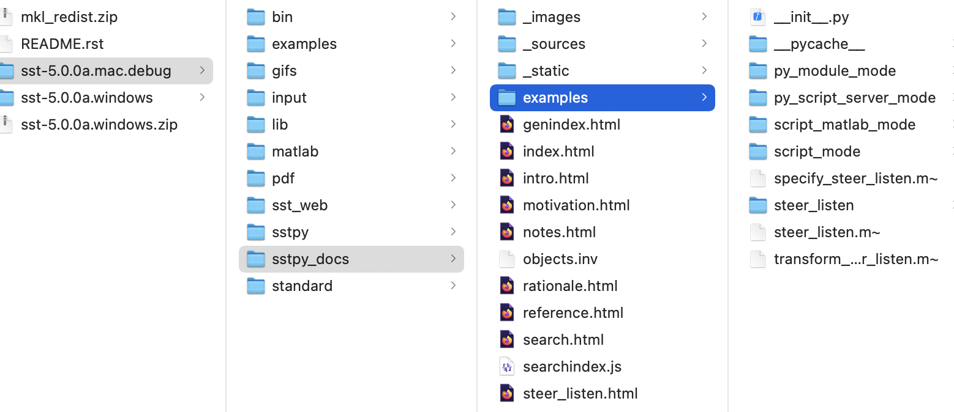
Documentation
Sphinx is a GREAT tool! So far, it looks like this.
The links to SST’s original HTML documentation don’t work yet. I would like to move them into Sphinx – a big project, I’m afraid.
There is a lot more writing to be done.

Slide 28
Packaging
I think the sstpy package, and eventually all of SST, should be packaged as a Wheel and distributed via a Conda environment, with the third-party Python packages and other resources it needs.
This is in its “think and learn about it” stage. Suggestions are welcome.

Slide 29
Questions?

