Slide 1
The Phoenix Compiler and Tools Framework:
Built From, Building, and Building On C++/CLI
Andy Ayers
Microsoft VC++
AndyA@microsoft.com

Slide 2
What is C++/CLI?
[ECMA] An extension of the C++ programming language as described in ISO/IEC 14882:2003 , Programming languages — C++. In addition to the facilities provided by C++, C++/CLI provides additional keywords, classes, exceptions, namespaces, and library facilities, as well as garbage collection.
[Wikipedia] C++/CLI is the newer language specification due to supersede Managed Extensions for C++. Completely reviewed to simplify the older Managed C++ syntax, it provides much more clarity over code readability than Managed C++. Like Microsoft .NET, C++/CLI is standardized by ECMA. It is currently only available on Visual C++ 2005.
[Stan Lippman] So, a first approximation of an answer to what is C++/CLI is that it is a binding of the static C++ object model to the dynamic component object model of the CLI. In short, it is how you do .NET programming using C++. As a second approximation of an answer, I would say that C++/CLI integrates the .NET programming model within C++ in the same way as, back at Bell Laboratories, we integrated generic programming using templates within the then existing C++. In both of these cases your investment in an existing C++ codebase and in your existing C++ expertise are preserved. This was an essential baseline requirement of the design of C++/CLI.
However, this talk is mainly about Phoenix…we’ll show plenty of C++/CLI code examples but not say much else about the language itself.

Slide 3

What is Phoenix?
Phoenix is Microsoft’s next-generation, state of the art infrastructure for program analysis and transformation

Slide 4
Phoenix Goals
Develop an industry leading compilation and tools framework
Foster a rich ecosystem for
  academic,
  research
  and industrial users
with an infrastructure that is
  robust
  retargetable
  extensible
  configurable
  scalable

Slide 5
Rationale
Code generation technology now appears in several different “form factors”
  Large-scale optimizer (PREJIT, /LTCG)
  Fast code generator (JIT)
  Custom code generators (fast conditional breakpoints, AOP, SQL expression optimizers, …)
And on many different machine targets
  PC (x86, x64, ia64)
  Game Console (x86, ppc)
  Handheld (arm, …)

Slide 6
Rationale, continued…
Sophisticated analysis tools are increasingly important in development
  VS 2005’s /analyze and FxCop
  Defect, security and race detection
Such tools are too often developed in technology silos that limit
  applicability
  ability to adopt best-of-breed technology
  ability to move forward

Slide 7
Rationale, continued…
Research
  Impact of results often blunted because research infrastructure can’t handle real world examples
  Wasted effort expended on the non-novel parts of systems
Industry
  Much effort spent deciphering undocumented or poorly documented formats and interfaces (eg MS C++’s CIL, PE file format)
  Inherent fragility of working without specs or promises of future compatibility
Academia
  Attempts to provide common infrastructures have had limited success (SUIF, NCI)

Slide 8
Infrastructure
AST Tools
.Net CodeGen
Static Analysis Tools
Next Gen Front-Ends
R/W Global Program Views
MSR Adv Lang
Runtime JITs
Pre-JIT
OO and .Net optimizations
Language Research
Direct xfer to Phoenix
Research Insulated from code generation
Phoenix
Infrastructure
Native CodeGen
MSR & Partner Tools
Advanced C++/OO Optimizations
FP optimizations
OpenMP
Built on Phoenix API’s
Both HL and LL API’s
Managed API’s
Program Analysis
Program Rewrite
Retargetable
Academic RDK
“Machine Models”
~3 months: -Od
~3 months: -O2
Chip Vendor CDK
Managed API’s
IP as DLLs
Docs
~6 month ports
Sample port + docs

Slide 9
Challenges
Many product deliverables from a common framework:
  Compiler backend
  Jit/Prejit
  Static analysis tools
  Binary analysis and manipulation
  Pluggable, extensible architecture
Many competing/conflicting requirements

Slide 10
The Big Picture
The Phoenix Building Blocks
Machine
Abstractions
Core Structures
And Utilities
High Level
Optimizations
Low Level
Optimizations
CLR
CLR
VC++
Dynamic Tools
Static Tools
PreJITer
Locaity
opts
VC++ BE
Analysis
JIT

Slide 11
Why is Phoenix Built in C++/CLI?
We needed a language that could:
  Scale from a fast/light client (JIT) to a large/thorough client (whole program optimizer or application analyzer)
  Provide ready support for extensibility, plugins, security, versioning
  Leverage our existing expertise in C/C++ coding

Slide 12
Key C++/CLI Benefits
C++ expertise directly applies
Easily adjust boundary between managed/unmanaged as needed to match performance and configuration goals
Easy interface to legacy code and libraries
Full managed API surface for tools

Slide 13
C++/CLI and Phoenix
For these reasons, we decided to build Phoenix in C++/CLI
Phoenix is the largest C++/CLI code base we know of:
  ~400K LOC written by hand
  ~1.8M LOC written by tools
Initially written in MC++ 1.0 syntax, now converting to C++/CLI

Slide 14
Phoenix Architecture
Core set of extensible classes to represent
  IR, Symbols, Types, Graphs, Trees
Layered set of analysis and transformations components
  Data Flow Analysis, Loops, Aliasing, Dead Code, Redundant Code, …
Common input/output library for binary formats
  PE, LIB, OBJ, CIL, MSIL, PDB

Slide 15
Compilers
Tools
Browser
Visualizer
Lint
HL Opts
HL Opts
HL Opts
LL Opts
LL Opts
LL Opts
Code Gen
Code Gen
Formatter
Obfuscator
Refactor
Xlator
Profiler
Security
Checker
Phx APIs
Phoenix Core
AST IR Syms Types CFG SSA
assembly
Native
Image
C++ IL
C++AST
Phx AST
Profile
C#
VB
C++
C++
PreFast
Lex/Yacc
Delphi
Cobol
Eiffel
Tiger

Slide 16
Building C++/CLI
Microsoft C++ compiler
  Input: program text
  Output: COFF object file
We’ll demo a Phoenix-based c2
Driver (CL)
C++
Source
Frontend
(C1)
Backend
(C2)
Obj
File

Slide 17
Roles of C1 and C2
C1 does
  Preprocessing
  Tokenizing
  Parsing
  Semantic processing
  CIL Emission
  Types and symbols debug info
  Metadata
C2 does
  CIL reading
  Code generation
  Optimization
  COFF emission
  Source level debug info

Slide 18
View inside Phoenix-Based C2
S
O
U
R
C
E
C
I
L
O
B
J
E
C
T
AST
HIR
MIR
LIR
EIR
CIL Reader
Type Checker
MIR Lower
SSA Const
SSA Dest
Canon
Addr Modes
Lower
Reg Alloc
EH Lower
Stack Alloc
Frame Gen
Switch Lower
Block Layout
Flow Opts
Encode
Lister
C1
C2

Slide 19
IR States
Abstract
Concrete
AST
HIR
MIR
LIR
EIR
Lowering
Raising
Phases transform IR, either within a state
or from one state to another.
For instance, Lower transforms MIR into LIR.

Slide 20
Demo 1: Phoenix-based C2
C2 is ~6K of client LOC on top of the Phoenix core library
In other words, Phoenix supplies almost everything needed to build a compiler back end.
Notes:
Show Phx compiling something /clr. Enable dumps and show the IR. Display the resulting output file.

Slide 21
Simple Example
void main(int argc, char** argv)
{
char * message;
if (argc > 1)
message = "Hello, World\n";
else
message = "Goodbye, World\n";
printf(message);
}

Slide 22
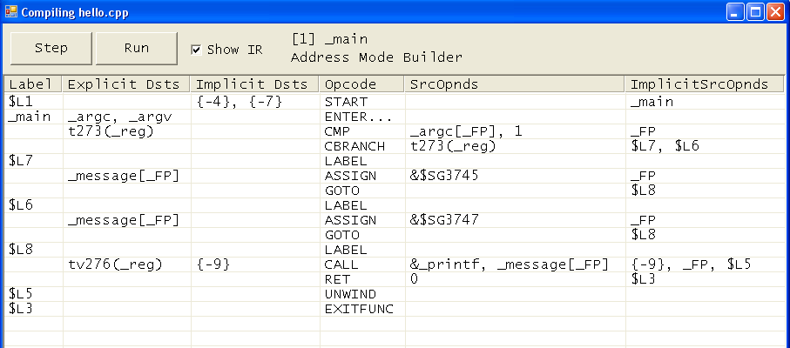
Resulting Phoenix IR

Slide 23
Extending Phoenix
All Phoenix clients can host plug-ins
Plug-ins can
  Add new components
  Extend existing components
  Reconfigure clients
Extensibility relies on
  Reflection
  Events & Delegates

Slide 24
Component Extensibility
Most objects in the system support observers by deriving from the Phoenix class ExtensibleObject.
Observer classes can register delegates so that they are notified when the host object undergoes certain events, for instance when the host object is copied

Slide 25
Extensibility Example
Instruction birthpoint tracking – attach note to each instruction with the birth phase.
PlugIn::NewInstrEventHandler
(
Phx::IR::Instr ^ instr
)
{
InstrBirthExtensionObject ^ extObj = gcnew InstrBirthExtensionObject();
extObj->BirthPhase =
instr->FuncUnit->Phase;
instr->AddExtensionObject(extObj);
}
void
PlugIn::DeleteInstrEventHandler
(
Phx::IR::Instr ^ instr
)
{
InstrBirthExtensionObject ^ extObj = InstrBirthExtensionObject::Get(instr);
instr->RemoveExtensionObject(extObj);
}
public
ref class InstrBirthExtensionObject : public Phx::IR::InstrExtensionObject
{
public:
property Phx::Phases::Phase ^ BirthPhase;
property System::String ^ BirthPhaseText
{
System::String ^ get ()
{
if (BirthPhase != nullptr)
{
return BirthPhase->NameString;
}
return "";
}
}
};

Slide 26
Plug-Ins
Phoenix supplies a standard plug-in discovery and registration mechanism.
All Phoenix clients can trivially host plugins.
Plugins can supply new components and extend existing ones.
Plugins can also reconfigure the client (eg replacing the register allocator)

Slide 27
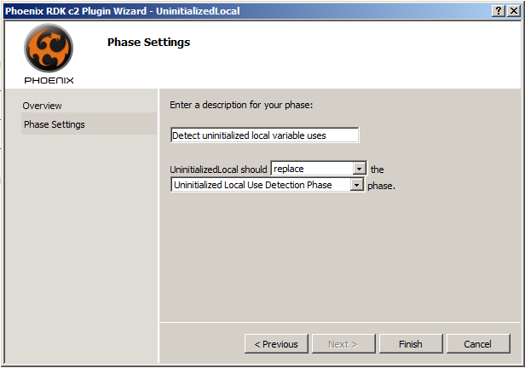
Plug-In VS Integration
Plug-Ins can be created via Visual Studio Wizards

Slide 28
Example: Uninitialized Local Detection
Would like to warn the user that ‘x’ is not initialized before use
To do this we need to perform a dataflow analysis within the compiler
We’ll add a phase to C2 to do this, via a plug-in
int foo()
{
int x;
return x;
}

Slide 29
May and Must Examples
void main(…)
{
char * message;
if (…)
message = "Hello”;
printf(message);
}
message may be used before it is defined
void main(…)
{
char * message;
char * other;
if (…)
other = Hello”;
printf(message);
}
message must be used before it is defined.

Slide 30
Detecting an Uninitialized Use
For each local variable v
  Examine all paths from the entry of the method to each use of v
  If on every path v is not initialized before the use:
    v must be used before it is defined
  If there is some path where v is not initialized before the use:
    v may be used before it is defined

Slide 31
Classic Solution
Build control flow graph, solve data flow problem
Unknown is the “state of v” at start of each block:
Transfer function relates
output of block to input:
Meet combines outputs from
predecessor blocks
Undefined
Defined
Mixed
If block contains v=
Else output = input
start
start
v =
v =
must
= v
may
=v

Slide 32
Code sketch using dataflow
bool changed = true;
while (changed)
{
for each (Phx::Graphs::BasicBlock block in func)
{
STATE ^ inState = inStates[block];
bool firstPred = true;
for each(Phx::Graphs::BasicBlock predBlock in block->Predecessors)
{
STATE ^ predState = outStates[predBlock];
inState = meet(inState, predState);
}
inStates[id] = inState;
STATE ^ newOutState = gcnew STATE(inState);
for each(Phx::IR::Instr ^ instr in block->Instrs)
{
for each (Phx::IR::Opnd ^ opnd in instr->DstOpnds)
{
Phx::Syms::LocalVarSym ^ localSym = opnd->Sym->AsLocalVarSym;
newOutState[localSym] = dst(newOutState[localSym]);
}
}
STATE ^ outState = outStates[id];
bool blockChanged = ! equals(newOutState, outState);
if (blockChanged)
{
changed = true;
outStates[id] = newOutState;
}
}
}
Update input state
Compute output state
Check for convergence

Slide 33
Drawbacks & Alternatives
Dataflow solution computes state for entire graph, even places where v is never referenced.
Alternate model known as “Static Single Assignment” or SSA directly connects definitions and uses.

Slide 34
Code Sketch using SSA…
for each (Phx::IR::Opnd ^ dstOpnd in Phx::IR::Opnd::IterDst(firstInstr))
{
if (dstOpnd->IsMemModRef)
{
for each (Phx::IR::Opnd ^ useOpnd in Phx::Ir::Opnd::IterUse(dstOpnd))
{
if (useOpnd->Instr->Opcode != Phx::Common::Opcode::Phi
&& useOpnd->IsVarOpnd)
{
Phx::Syms::Sym ^ symUse = useOpnd->AsVarOpnd->Sym;
if (symUse != nullptr && !mustList.Contains(symUse))
{
mustList.Add(symUse);
}
}
}
}
}

Slide 35
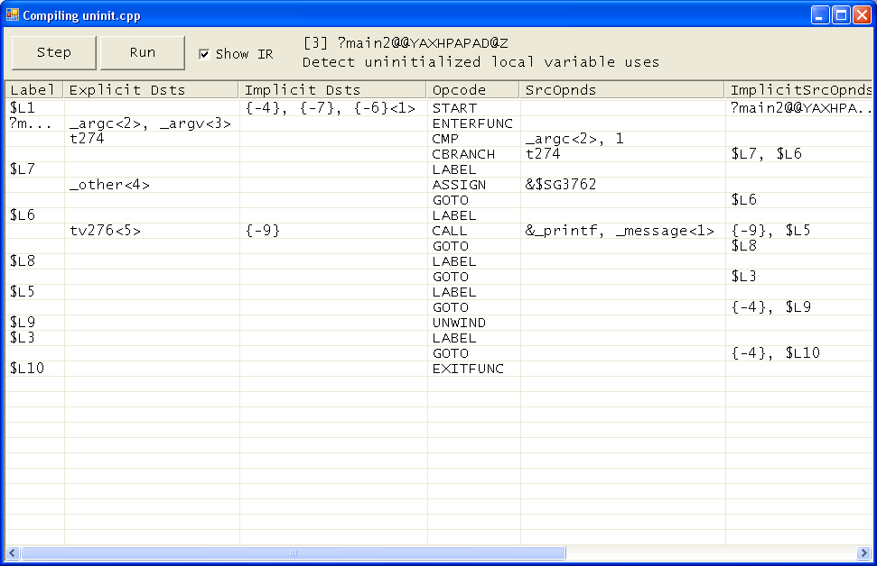

Slide 36
Unintialized Local Plug-In
UninitializedLocal.cpp
Test.cpp
C++/CLI
C1
UninitialzedLocal.dll
Phx-C2
Test.obj
To Run:
cl -d2plugin: UninitializedLocal.dll -c Test.cpp

Slide 37
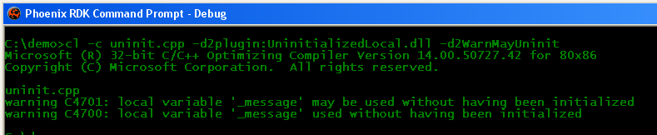
Demo 2: Phoenix C2 with Plug-In
Complete Plug-In code supplied as sample in the RDK
~400 LOC to add a key warning phase to the compiler
Other types of checking can be added with similar cost and complexity
Notes:
Run same demo as before, but include the uninitialized local plugin. Break into the plugin via debugger and show basic data structures.

Slide 38
Demo 3: Phoenix PE Explorer
Phoenix can also read and write PE files directly
  Implement your own compiler or linker
  Create post link tools for analysis, instrumentation or optimization
Phx-Explorer is only ~800 LOC client code on top of Phoenix core library
Notes:
Or possibly the control flow graph plugin into visual studio…

Slide 39
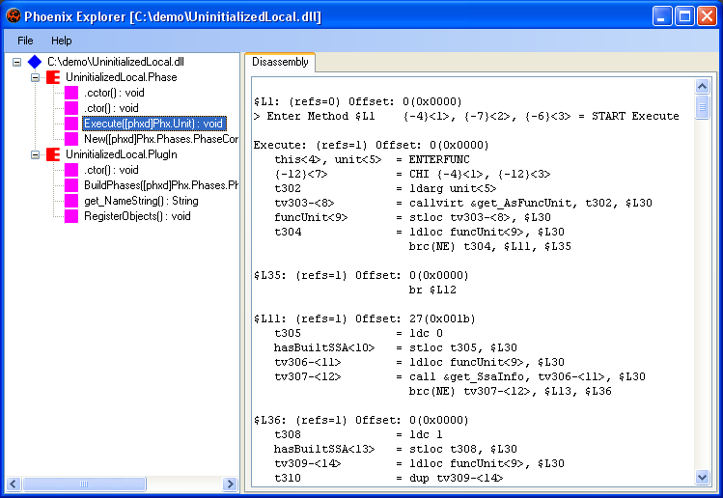

Slide 40
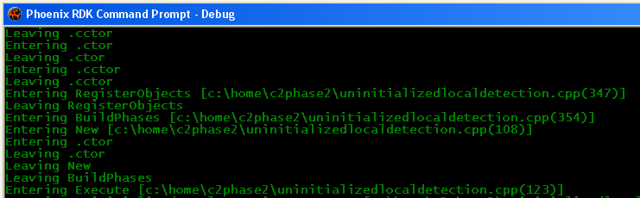
Demo 4: Binary Rewriting
mtrace injects tracing code into managed applications

Slide 41
Recap
Phoenix is a powerful and flexible framework for compilers & tools
  C2 backend
  PE file read/write
  jit (not shown)
  Universal plugins on a common IR
C++/CLI gives us ready access to benefits of .Net while retaining power of C++

Slide 42
Phoenix: Status
Early access RDKs available to selected universities; sample projects include
  AOP
  Obfuscation
  Profiling
Contact phxap@microsoft.com for Academic early access requests

Slide 43
Phoenix: Status
Early Access CDK also available to selected industry partners
Contact phxcp@microsoft.com for Commercial early access requests
Ongoing development within Microsoft Stay tuned for more information…

Slide 44
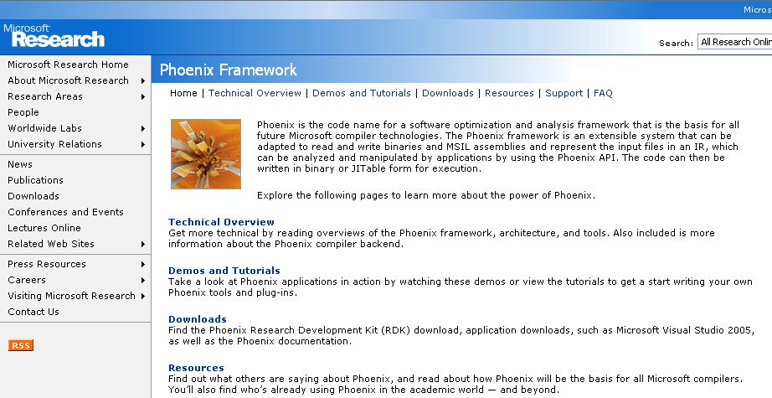
More Info
http://research.microsoft.com/phoenix

Slide 45
Summary
Phoenix is Microsoft’s next-generation tools and code generation framework
It’s written entirely in C++/CLI
C++/CLI gives Phoenix the best of both worlds:
  Power and performance of C++
  Rich extensibilitiy model via managed implementation

Slide 46
Questions?
http://research.microsoft.com/phoenix
andya@microsoft.com

Slide 47
Backup Slides

Slide 48
Phoenix Architectural Layering
Phoenix uses events and delegates internally to minimize coupling between components
For instance, the flow graph and region graph are views of the IR and are notified of IR changes via events.

Slide 49
Phoenix IR
Key internal representation for code and data
Appears in several forms or states:
  (AST) – Abstract Syntax Trees: not covered in this talk
  HIR – High-level IR: Architecture and Runtime Independent
  MIR – Mid-level IR: Architecture Independent, Runtime Dependent
  LIR – Low-level IR: Architecture and Runtime dependent
  (EIR) – Encoded IR: binary format

Slide 50
IR Views
Instruction
Stream
Enter
Flow Graph
Enter
Regions
IF
IF
LOOP
LOOP
Exit
Exit

