Slide 1

Free C++ Static Analysis Tools
Lloyd Moore, President
Lloyd@CyberData-Robotics.com
www.CyberData-Robotics.com

Slide 2
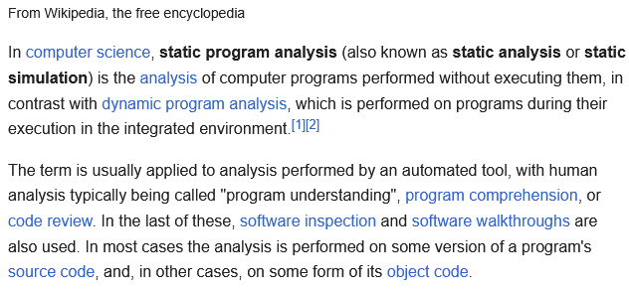
Introduction:
What is static analysis?
Both free / open source and proprietary tools exist.
Proprietary tools can be quite expensive, $25K/year/repo in one case.
This presentation will survey several free options and then deep dive setting up and running one of them.

Slide 3
Free Static Analysis Tools
Clang Static Analyzer
CppCheck
CppLint
OCLint
SonarQube Community Edition
Note: Other options exist, these appeared to be the most common.

Slide 4
Clang Static Analyzer
Website:
https://clang-analyzer.llvm.org
Type / Depth of Analysis:
Excellent
Integration / Usability:
Excellent, integrated with various IDEs
Customization / Extensibility:
Excellent
https://clang.llvm.org/docs/analyzer/user-docs/Options.html
Performance:
Fast
License:
Apache 2.0 (via LLVM)
Notes:
Part of and integrated with the Clang and LLVM toolchain.

Slide 5
CppCheck
Website:
Open Source: http://cppcheck.net, https://github.com/danmar/cppcheck
Premium / Proprietary : https://www.cppcheck.com
Type / Depth of Analysis:
Excellent
https://sourceforge.net/p/cppcheck/wiki/ListOfChecks
Integration / Usability:
Excellent, plugins for common IDEs
Supports non-standard syntax
Customization / Extensibility:
Excellent
Supports Python based add on scripts
Performance:
Fast
License:
GPL-3.0
Notes:
Has a premium version supporting MISRA and Cert coding standards.

Slide 6
CppLint
Website:
https://github.com/cpplint/cpplint
Type / Depth of Analysis:
Limited, appears to be style focused
Integration / Usability:
CLI only
Customization / Extensibility:
Limited
Performance:
Likely slow, written in Python
License:
Google
https://github.com/cpplint/cpplint/blob/develop/LICENSE
Notes:
Doesn’t appear to have a web site beyond the GitHub repository.
Was originally developed by Google, no longer maintained

Slide 7
OCLint
Website:
https://oclint.org/
Type / Depth of Analysis:
Excellent (builds on Clang Static Analyzer)
Integration / Usability:
Medium
CLI only
Can integrate with Clang Static Analyzer
Customization / Extensibility:
Excellent
Can load rules from a directory at run time
Performance:
Slow (reported)
License:
Modified BSD 3
https://github.com/oclint/oclint/blob/master/LICENSE
Notes:
Last release: October 26, 2021
Works via an AST
Linux and MacOS X only

Slide 8
SonarQube Community Edition
Website:
https://www.sonarsource.com/open-source-editions/sonarqube-community-edition
Type / Depth of Analysis:
Limited
50K lines of code per project
Integration / Usability:
Excellent
Customization / Extensibility:
Limited
Performance:
Fast (reported)
Is a cloud based solution
License:
Proprietary
Notes:
Appears to be a “gateway” to the full/proprietary version ($500/yr)

Slide 9
Summary
Tool | Analysis | Integ. | License | MISRA | Extens. | Support | Perf
Clang | Excellent | Excellent | Apache 2 | No | Excellent | Excellent | Fast
CppCheck | Excellent | Excellent | GPL-3.0 | Via Addon | Excellent | Excellent | Fast
CppLint | Limited | CLI Only | Google | No | Limited | Limited | Slow
OCLint | Excellent | CLI Only | BSD 3 | No | Excellent | Limited | Slow
Sonar C. | Limited | Excellent | Proprietary | No | Limited | Limited | Fast

Slide 10
Summary
Tool | Analysis | Integ. | License | MISRA | Extens. | Support | Perf
Clang | Excellent | Excellent | Apache 2 | No | Excellent | Excellent | Fast
CppCheck | Excellent | Excellent | GPL-3.0 | Via Addon | Excellent | Excellent | Fast
CppLint | Limited | CLI Only | Google | No | Limited | Limited | Slow
OCLint | Excellent | CLI Only | BSD 3 | No | Excellent | Limited | Slow
Sonar C. | Limited | Excellent | Proprietary | No | Limited | Limited | Fast
Selection Criteria (for my project):
Analysis: Excellent
Integration: CLI good enough
License: Any open source
Performance: Fast
Other: At least allow CUDA code to be present

Slide 11
Summary
Tool | Analysis | Integ. | License | MISRA | Extens. | Support | Perf
Clang | Excellent | Excellent | Apache 2 | No | Excellent | Excellent | Fast
CppCheck | Excellent | Excellent | GPL-3.0 | Via Addon | Excellent | Excellent | Fast
CppLint | Limited | CLI Only | Google | No | Limited | Limited | Slow
OCLint | Excellent | CLI Only | BSD 3 | No | Excellent | Limited | Slow
Sonar C. | Limited | Excellent | Proprietary | No | Limited | Limited | Fast
Selection Criteria (for my project):
Analysis: Excellent
Integration: CLI good enough
License: Any open source
Performance: Fast
Other: At least allow CUDA code to be present

Slide 12

Installing CppCheck
Windows, Linux and Mac are supported, web site and documentation has all the details.
Very easy on Debian based Linux:
sudo apt install cppcheck

Slide 13
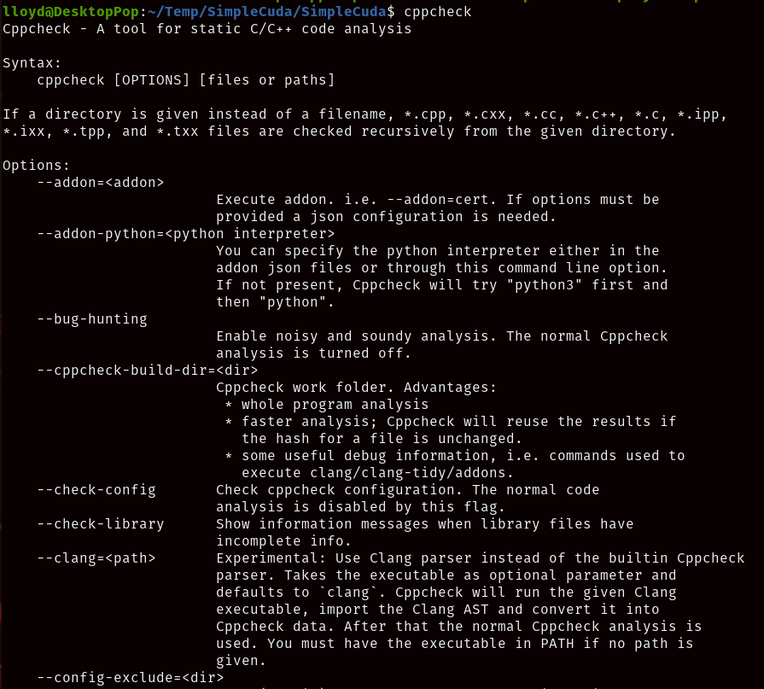
Running CppCheck
For a test run we’ll use the SimpleCuda code base from my prior talk:
Simple C++ code base
Incorporates CUDA code which is something I’m interested in
Code that at least some of you have seen before
Running “cppcheck” without any parameters provides help, as does the manual!

Slide 14
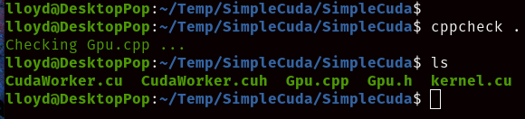
Running CppCheck
To check a folder simply run “cppcheck <path>”.
Note: This will only check files ending with .cpp, the CUDA files don’t get checked!

Slide 15
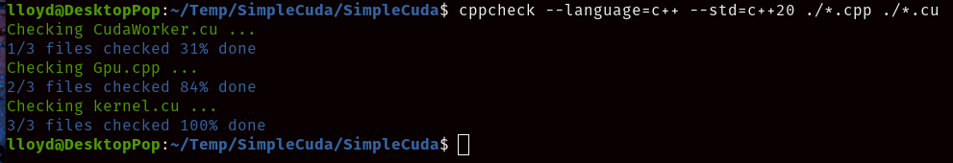
Running CppCheck
A few more command line parameters and now everything is gets checked!
Note: Both the language and the standard needed to be specified.

Slide 16
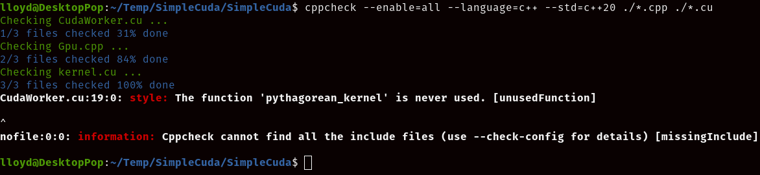
Running CppCheck
Next, “--enable=all” to do more detailed checking:
Note this gives us a false positive: ‘pythagorean_kernel’ is actually used, it is the CUDA kernel and is called indirectly by CUDA. There are configuration settings to suppress errors.

Slide 17
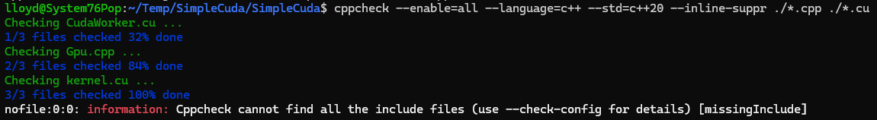
Running CppCheck
Finally , “--inline-suppr” and a suppression statement to handle the false positive:
Note that suppression statements can also be specified in various file formats.

Slide 18
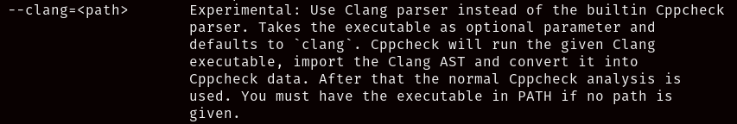
Running CppCheck
There is an option to use the Clang parser:
I didn’t actually try this as it would break my use case of being able to check CUDA code. The parser in CppCheck is designed specifically for non-standard extensions.
I’ve used Clang Analyzer in the past, and it works very well!

Slide 19
General Recommendations
No single tool is going to cover everything, use multiple tools when you can
Many professional projects build with multiple compilers, and versions
Catch portability issues early
Different compilers will flag different warnings
Static analysis can be time consuming
Generally don’t run static analysis for debug builds
Generally DO have a dedicated build where deep analysis is done
“make check”
Integrate the “make check” into your CI build and block commits which don’t pass
Flag any “disable check” type statements
Most developers won’t overtly try to bypass the system, but I won’t say it hasn’t happened!
Place configuration files used to control the analysis under version control
In regulated environments save the analysis logs generated for release builds

Slide 20
Questions?

