Slide 1
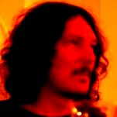
Dealing with Software Complexity
Bartosz Milewski
The Discovery of Structure in Programs

Slide 2
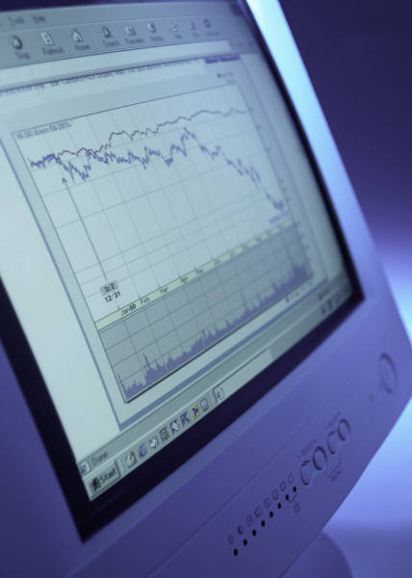
Software Development
Designing new code
Understanding old code
  Written by others
  Written by current developer some time ago
Maintenance starts from day two
Code understanding—the most important and least automated part of development

Slide 3

Software Understanding
The trivial structure
  Lexical
  Grammatical
  Alphabetical list of classes and functions
  Diagrams (Booch, etc.)
High-level structure
  Relationships between classes (next slide)
  Design ideas, patterns
  Emerging structure

Slide 4

Class Dependencies
Class A uses class B
  Strongly: it requires #include B.h
  Weakly: it requires forward declaration of B
Dependency graph analysis
Levels of abstraction
  Tree-like structure (next slide)
  Cycles and how to break them

Slide 5
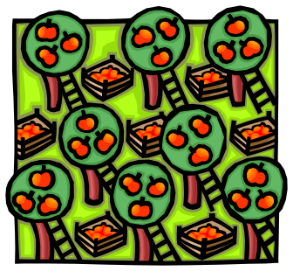
Hierarchy of Classes
Controller
ViewManager
IpcQueue
CmdVector
CmdVector
Cmd::Table
Commander
Commander
Commander
DisplayManager
SelectionManager
SelectionManager
DisplayManager

Slide 6
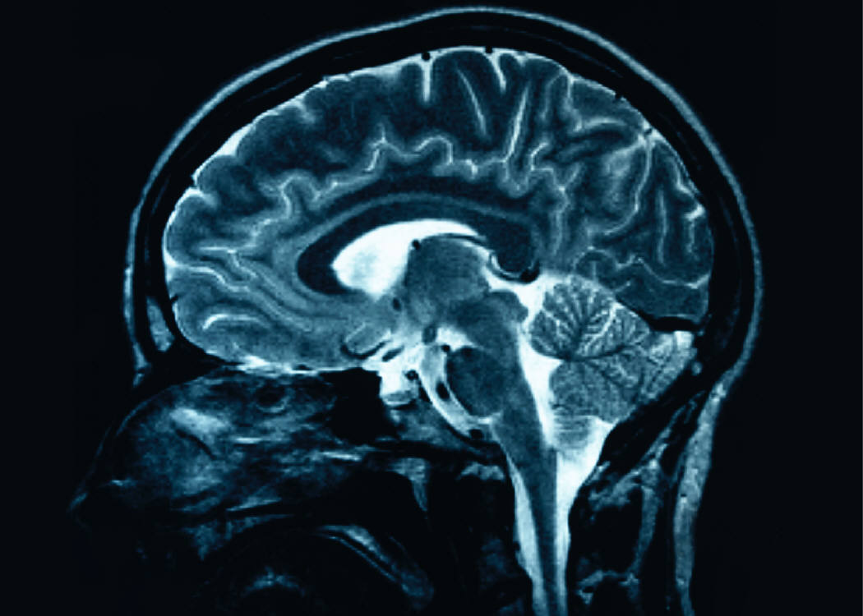
Neurology
Brain can only work on tree-like structures
  There are 7 +/- 2 “registers”
  There is a cache that must be pre-loaded
  There is long-term, slow-search, memory
Reality is infinite, brain is finite. Something must be discarded.
Abstracting—creating an item that can fit in a register

Slide 7
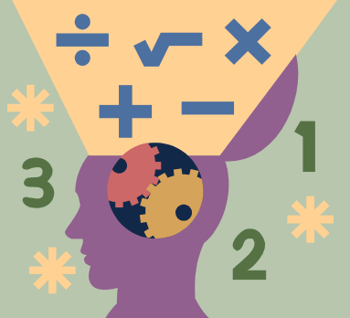
Programmer’s Brain
Context switching—re-loading the brain cache (multitasking is expensive)
Small program, easy to restart the brain
Maintenance requires code understanding—can take hours or days to fill the cache + a lot is left to debugging and testing
Few tools to speed up cache loading
Needed: ready-made abstractions that fit the registers

Slide 8

Abstractions
Subtracting “irrelevant” features
  What are features?
  Which features are irrelevant?
Abstracting and Categorizing
Biology and evolution (next slide)

Slide 9
The Origin of Abstraction
Primitive organism has access to a featureless input stream—”reality stream”
  Some things in the stream influence metabolism—selection for primitive detectors
  Data from detectors are “features”—evolution decides which features are relevant
First abstractions: food and danger.
  Particular combinations of features

Slide 10
Imitating Life
Cellular automata
  Image processing, discovering features (lines, squares, faces)
  Genetic algorithms, training
Automata feeding on source code
  Lexing automata
  Parsing automata—require infinite number of states

Slide 11
Scope Discovery
Cellular automata that can count
2-d state space
  Vertical counts parentheses
  Horizontal counts braces
Foo::Foo (Bar bar) : _bar (bar) { … { … g ( x ) …} … }

Slide 12
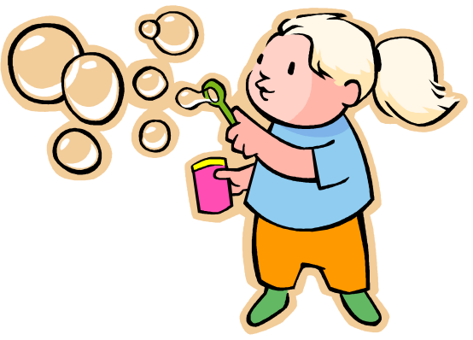
Bubble Diagrams
Glue together matching parentheses
Glue together matching braces
Foo::Foo (Bar bar) : _bar (bar) { … { … g ( x ) …} … }
Bar bar
bar
Foo::Foo
: _bar
{}
()
()
Shows nesting complexity
Bird’s-eye view
(indentation level)
{}
x
g
()

Slide 13

Document Processing
Pre-defined features: documents and words (word breakers)
Statistics: distribution of words among documents
Relevant words: words that occur more often in a given document than in the rest of the corpus

Slide 14

Clustering
Documents with similar relevant word profiles form clusters
Categorization of documents based of statistical features
Categorization—automatic generation of abstractions

Slide 15
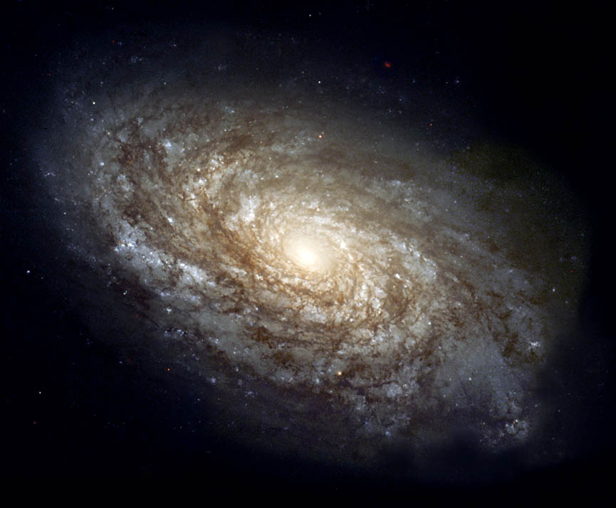
Clustering
Pick a representative set of N relevant words/phrases from the whole corpus
Each document is a point in N-dim space
Distance between documents in N dim
Add gravitational attraction (potential)
Documents will start clustering just like galaxies in the early universe

Slide 16
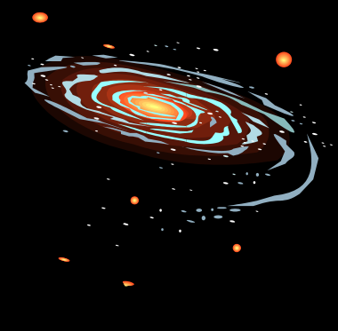
Example of Clustering
music, composer, dance, ballet, dancer, choreographer, musical, piano, opera, folk. Orchestra, Russian, French, New York City, jazz, company, ballerina, song, melody, Italian
English, poetry, poet, verse, volume, literature, poem, England, circle, prose, century, London, life, lyric, novel, language, love, author, john, romanticism
god, philosopher, philosophy, mythology, Greek, goddess, old testament, human, existence, knowledge, new testament, theology, Jesus Christ, Immanuel Kant, evil, mind, book, son, Apollo, religion

Slide 17
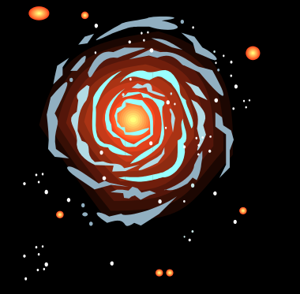
Statistics & Abstractions
Nature gathers statistics in a very slow process
Science is based on statistics
  Physics
  Math
Statistical methods (clustering) in program analysis

Slide 18

Programs as Documents
High-level structure of program
  Reflects programmers’ ideas
  Information encoded in vocabulary: names, comments
  Strong influence of problem domain
  Depends on personal style
Can be processed like document corpus
  Relevant words, clusters

Slide 19
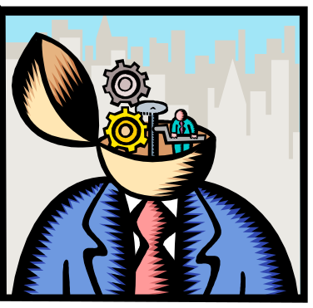
Statistical Discovery
Intended structures, for instance Model, View, Controller
Hidden structures, for instance separation of UI from the “model”
Horizontal structures, aspects
Vertical structures, exceptions, exception specification
Copy and paste programming, code reuse

Slide 20
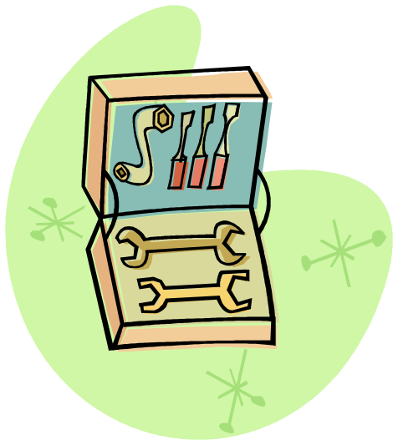
Integration with Tools
Overnight automatic program analysis
  Creating a map of abstractions
  Creating various views (bubble diagrams, trees, layers)
  Discovering hidden structures
The ecosphere of a program
  Evolving automata, feeding on code and on statistical abstractions
Maintenance by programmer
  Encapsulating hidden structures
  Improving existing abstractions
  Adding new abstractions

