Slide 1
Metaprogramming in D: Real world examples
Bill Baxter
Northwest C++ Users Group
November 18, 2009
Notes:
This isn’t really what I do for a living these days.
I’m not a PL guru by any means, but I enjoy learning about new languages.
I used D to write research systems for at my previous job at OLM Digital R&D in Tokyo.
I’m here because… Bartoz asked nicely, and I think D is pretty neat.

Slide 2
What is D?
Systems programming language
Development led by Walter Bright
Compiles to native code
Garbage collected
Under continuous development for 10 years
“C++ without the mistakes”
Open source
Some very nice metaprogramming features
Notes:
Open source with a only few caveats these days.

Slide 3
What is metaprogramming?
“Metaprogramming is the writing of computer programs that write or manipulate other programs (or themselves) as their data, or that do part of the work at compile time that would otherwise be done at runtime.”
(Wikipedia definintion)

Slide 4
Metaprogramming use cases
Compile time constants
Static checking
Code specialization using introspection
Code generation

Slide 5
D Metaprogramming: Dramatis Personae
templates
static assert
static if
Compile time function evaluation (CTFE)
pragma(msg, …)
.stringof
is()
string mixin
__traits

Slide 6
D Templates
Much like C++ templates
C++:
template<class T> T add(T a, T b)
{ return a+b; }
D:
template T add(T)(T a, T b)
{ return a+b; }
or
T add(T)(T a, T b) { return a+b; }
C++ call syntax:
add<int>(2,3)
D Call syntax:
add!(int)(2,3)
add!int(2,3)
add(2,3)

Slide 7
Use case: Compile-time Constants
Classic C++ functional-style definition
template <int i>
struct factorial {
static const int value = i*factorial<i-1>::value;
};
template <>
struct factorial<0> {
static const int value = 1;
};
static const int X = factorial<5>::value;
Notes:
There’s a much nicer way to do it in D using “CTFE”

Slide 8
Factorial – D template version
struct factorial(int i) {
static const value = i*factorial!(i-1).value;
}
struct factorial(int i : 0) {
static const value = 1;
}
static const X = factorial!(5).value;
OR
struct factorial(int i) {
static if(i==0) {
static const value = 1;
}
else {
static const value = i*factorial!(i-1).value;
}
}
Notes:
In D we can write it pretty much the same way if we wish.
Or we can use a static conditional instead of the functional pattern-matching style.
Or…

Slide 9
Factorial – D template version(2)
Or better, eliminate unnecessary struct using the eponymous template member trick
template factorial(int i) {
static if (i==0) {
enum factorial = 1;
}
else {
enum factorial = i*factorial!(i-1);
}
}
enum X = factorial!(5);
Notes:
And thankfully we can get rid of the grubbish .value nonsense.
Using the eponymous template member trick, you can get rid of value altogether.
But we can actually do even better in D,

Slide 10
Factorial – D CTFE
int factorial(int i) {
return (i==0)? 1 : i*factorial(i-1);
}
enum X = factorial(5);
auto y = factorial(5);
Plain functions can be evaluated at compile time! (Or runtime, of course)
Ok, classic example. Check. But have you ever really needed to do this in real-world code? Yeh, me neither.
Notes:
Ok great. But have you ever needed something like this? No, I haven’t either.

Slide 11
A possibly more useful example
enum string url = urlencode(“a url with spaces”)
assert(url==“a%20url%20with%20spaces”)

Slide 12
Use case: Static checking
Check template parameter values
for non-trivial condition
At compile-time
Three examples:
(values) checking if token in grammar
(values) proper linear congruential parameters
(types) checking if type supports concept

Slide 13
Example: Static checking of grammar tokens
Want statically checked representation for grammar tokens
Could make them be identifiers : TOK_if
But some tokens are not valid identifiers
TOK_plus instead of TOK_+
Solution: Statically checked template Tok!"+"
Idea thanks to Nick Sabalausky & his Goldie parser
http://www.dsource.org/projects/goldie

Slide 14
enum ValidTokens = ["+", "-", "sin", "cos”];
bool isValidToken(string tok) {
foreach(t; ValidTokens) {
if (t==tok) return true;
}
return false;
}
struct Token(string Name) {
static assert(isValidToken(Name), "Invalid token: "~Name);
// ...
}
Token!(Name) Tok(string Name)() { return Token!(Name)(); }
auto O = Tok!"cos";
auto M = Tok!"+";
auto Y = Tok!"-";
auto X = Tok!"*"; // Error: static assert "Invalid token: *”

Slide 15
Example 2: Static checking proper linear congruential parameters
A simple kind of pseudorandom number generator based on three parameters: a, c, m
Good parameters satisfy:
c and m are relatively prime;
a−1 is divisible by all prime factors of m; and
if a−1 is multiple of 4, then m is a multiple of 4 too.
Thanks to Andrei Alexandrescu for this one (used in D’s std.random)

Slide 16
bool properLinConParams(ulong m, ulong a, ulong c)
{
// Bounds checking
if (m == 0 || a == 0 || a >= m || c == 0 || c >= m) return false;
// c and m are relatively prime
if (gcd(c, m) != 1) return false;
// a - 1 is divisible by all prime factors of m
if ((a - 1) % primeFactorsOnly(m)) return false;
// if a - 1 is multiple of 4, then m is a multiple of 4 too.
if ((a - 1) % 4 == 0 && m % 4) return false;
// Passed all tests
return true;
}
// Example bad input
static assert(!properLinConParams(1UL<<32, 210, 123));
// Example from Numerical Recipes
static assert(properLinConParams(1UL<<32, 1664525, 1013904223));
));

Slide 17
Usage example
struct LinearCongruentialEngine(
UIntT, UIntT a, UIntT c, UIntT m)
{
static assert(properLinConParams(m, a, c),
"Incorrect instantiation of LinearCongruentialEngine");
...
}
Creating one of these with bad parameters is now impossible, and results in a compile-time error

Slide 18
Example 3: Concept checking
Do introspection on types
Make sure they support a particular interface concept.
E.g. does this type have .length and allow indexing?
Elaborate Concept support planned for C++0X but collapsed under own weight at the end.
D offers some similar capabilities

Slide 19
Vector example
Say we want to create a Vector. It should accept a scalar type which is closed under:
Addition
Subtraction
Multiplication
Division
struct Vector(S) {
static assert(isScalarType!(S),
S.stringof ~ " is not a proper scalar type");
//...
}
Now, to define isScalarType…

Slide 20
Take Zero
Just enumerate the allowable types
In C++ a bunch of specializations, or some funky typelist thing.
Doesn’t extend to user types.
Call out the ducks!
template isScalarType(S)
{
enum isScalarType =
is(S == float) ||
is(S == double) ||
is(S == real) ||
is(S == int) ||
is(S == long);
};
Vector!(float) a; // ok!
Vector!(string) b; /* nope:
Error: static assert "string is not a proper scalar type"
*/

Slide 21
Take One
template isScalarType(S)
{
enum isScalarType =
is(typeof(S.init + S.init) == S) &&
is(typeof(S.init * S.init) == S) &&
is(typeof(S.init - S.init) == S) &&
is(typeof(S.init / S.init) == S);
}
Looking much more ducky now
We can clean it up a bit more with a small trick…

Slide 22
Take Two
{ …code } is a delegate literal in D
is(typeof(…)) returns false if the arg is not valid.
Main drawback to this kind of static concept checking is lack of specific error messages. (E.g. “Not a scalar because it doesn’t support addition”)
See also: __traits(compiles, expr)
template isScalarType(S)
{
enum isScalarType = is(typeof({
S v,r;
r = v+v;
r = v-v;
r = v*v;
r = v/v;
}));
}

Slide 23
Template constraints
D allows this kind of “constraint syntax” too:
Can overload templates on different if(…) constraints
Problem is still error messages:
“Error: Template instance Vector!(string) does not match template declaration Vector(S) if (isScalarType!(S))” -- well? why not?
struct Vector(S) if(isScalarType!(S)) {
//...
}

Slide 24
A cumbersome solution
template checkScalarType(S)
{
static if(!is(typeof(S.init + S.init) == S))
pragma(msg, S.stringof ~ "Error: is not closed under addition");
static if(!is(typeof(S.init - S.init) == S))
pragma(msg, S.stringof ~ "Error: is not closed under subtraction");
static if(!is(typeof(S.init * S.init) == S))
pragma(msg, S.stringof ~ " is not closed under multiplication");
static if(!is(typeof(S.init / S.init) == S))
pragma(msg, S.stringof ~ " is not closed under division");
enum isScalarType = is(typeof({
S v,r;
r = v+v;
r = v-v;
r = v*v;
r = v/v;
}));
}

Slide 25
Compare with
Go:
Er… except Go doesn’t have operator overloading
or generics.
interface ScalarType<T>
{
T operator+(T,T);
T operator-(T,T);
T operator*(T,T);
T operator/(T,T);
}
struct Vector {
ScalarType x;
}

Slide 26
Ok.. Compare with
C++1X concepts -- not going in C++0x, but probably will some day
Here compiler will do the line-by-line checking of the concept against input, and give decent errors.
concept ScalarType<typename S>
{
Var<S> v,r;
r = v+v;
r = v-v;
r = v*v;
r = v/v;
};
template<typename S>
where ScalarType<S>
struct Vector {
...
};

Slide 27
Code specialization w/ introspection
Erroring if type doesn’t support concept is often not as useful as working around the missing functionality.
Example – just omit Vector ops if underlying scalar op not defined.
struct Vector(S)
{
S[3] values;
static if (is(typeof(S.init + S.init)==S)) {
Vector opAdd(ref Vector o) {
Vector ret;
foreach(i; 0..3) {
ret.values[i] = values[i] + o.values[i];
}
return ret;
}
}
}
Vector!(float) a;
Vector!(char) b;
a+a; // ok
b+b; // error
Notes:
Related to C++0x proposed type maps, but a bit more manual.

Slide 28
Code Generation
Examples: loop unrolling, vector swizzles
Key enabling feature: string mixin.
Simple example from documentation:
Now the one-two punch: The strings themselves can come from CTFE:
string s = "int y;";
mixin(s); // ok
y = 4; // ok, mixin declared y
string declareInt(string name) {
return "int " ~ name ~ ";";
}
mixin(declareInt("y"));
y = 4;

Slide 29
Codegen example: Loop unrolling
Handy in a Vector(T, int N) type.
string unroll(int N,int i=0)(string expr) {
static if(i<N) {
string subs_expr = ctReplace(expr, "%s", toStringNow!i);
return subs_expr ~ "\n" ~ unroll!(N,i+1)(expr);
}
return "";
}
Example use
enum string expr = "values_[%s] += _rhs[%s];";
pragma(msg, unroll!(3)(expr));
Compile-time output:
values_[0] += _rhs[0];
values_[1] += _rhs[1];
values_[2] += _rhs[2];

Slide 30
Typical use:
struct Vector(T, int N) {
T[N] values_;
...
/// this += rhs
ref Vector opAddAssign(/*const*/ ref Vector rhs) {
const string expr = "values_[%s] += rhs.values_[%s];";
mixin( unroll!(N)(expr) );
return this;
}
...
}

Slide 31
Codegen example: Swizzle functions
Modern GPU shading languages support special “swizzle” syntax for shuffling values in a vector
Examples:
float4 A(1,2,3,4);
float4 B = A.xxwz;
assert( B == float4(1,1,4,3) );
float2 C = A.yz;
assert( C == float2(2,3) );
Notes:
I have seen a popular graphics library (G3D) where these were all written out by hand in a source file.

Slide 32
/** Generate a swizzling function.
Example: _gen_swizzle("xyzzy") returns
"""
VectorT!(T,6) xyzzy() const
{
return VectorT!(T,6)(x,y,z,z,y);
}
"""
*/
string _gen_swizzle(string swiz) {
string args = ""~swiz[0];
foreach(c; swiz[1..$]) args ~= ", " ~ c;
string code =
ctFormat(q{
VectorT!(T,%s) %s() const
{
return VectorT!(T,%s)(%s);
}
},
swiz.length, swiz, swiz.length, args);
return code;
}

Slide 33
But we need to generate all the swizzles up to a given length:
string _gen_all_swizzles(int len, int srcdig)
{
if (len <= 0) return "";
string elem = "xyzw"[0..srcdig];
string code;
foreach (int genlen; 2..len+1)
{
int combos = 1;
foreach(a; 0..genlen) { combos *= srcdig; }
foreach(i; 0..combos) {
string swiz;
int swizcode = i;
foreach(j; 0..genlen) {
swiz ~= elem[swizcode % srcdig];
swizcode /= srcdig;
}
code ~= _gen_swizzle(swiz);
}
}
return code;
}

Slide 34
VectorT!(T,2) xx()
{
return VectorT!(T,2)(x, x);
}
VectorT!(T,2) yx()
{
return VectorT!(T,2)(y, x);
}
VectorT!(T,2) xy()
{
return VectorT!(T,2)(x, y);
}
VectorT!(T,2) yy()
{
return VectorT!(T,2)(y, y);
}
VectorT!(T,3) xxx()
{
return VectorT!(T,3)(x, x, x);
}
VectorT!(T,3) yxx()
{
return VectorT!(T,3)(y, x, x);
}
...

Slide 35
Are there limits to the possibilities?
Almost no.
Which is to say, yes.
CTFE limitations: no structs/classes, no C funcs
Compiler bugs: massive memory leak in CTFE
However, these have been demonstrated:
Compile-time raytracer (Tomasz Stachowiak)
Wrapper generation (PyD, Kirk McDonald)
Compile-time regular expression parsing (meta.regexp, Eric Anderton).
Compile-time parsing DSL parsing (???, BCS?)

Slide 36
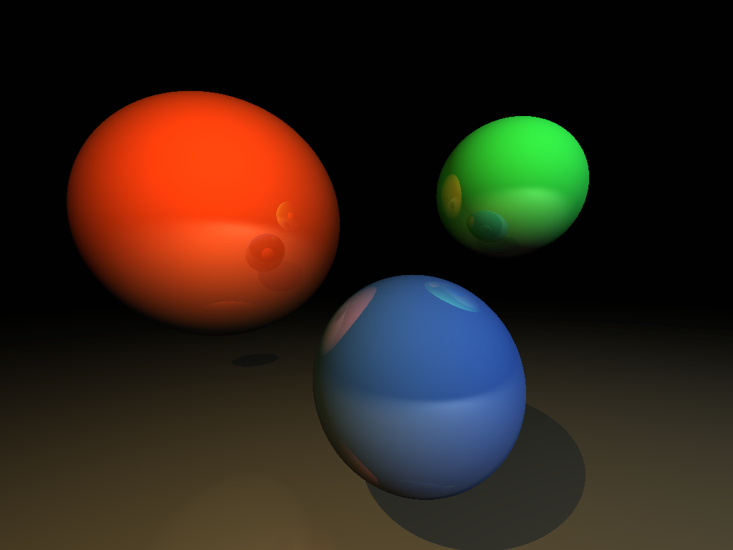
Total rendering/compilation time: 26148 seconds (on a 1.7GHz laptop)
Notes:
Actually the raytracer is done without CTFE. Tom says redoing it with CTFE would make it much faster, but “that wouldn’t be fun”

Slide 37
Misc observations

Slide 38
CTFE vs Templates
CTFE calc vs Template calc:
Templates can do calculations on Types or Values
CTFE can only do Value calculations
Template → CTFE is OK
But not CTFE → Template
CTFE supports richer syntax
Also Templates instantiate symbols and cause bloat
Conclusion
If doing value calcs, always prefer CTFE.

Slide 39
CTFE vs AST macros
Nemerle macro:
macro m () {
Nemerle.IO.printf ("compile-time\n");
<[ Nemerle.IO.printf ("run-time\n") ]>;
}
m ();
D “macro”:
string m() {
pragma(msg, "compile-time");
return q{writefln("run-time");}
}
mixin(m());
Notes:
So nemerle uses the exact same syntax at runtime as compile time.
Actually Nemerle macros run as compiler plugins.
At first glance this seems like a great way to economize – no complex CTFE engine needed.

Slide 40
About CTFE
CTFE is constant folding on steroids.
“Simply taking constant folding to its logical conclusions” – Don Clugston
const int x = 2+4; // many compilers will fold this
int add(int a, int b){return a+b;} const int x = add(2,4); // some may inline/fold this
const int x = factorial(5); // does any but DMD do this? // maybe some functional languages?
In general, why not evaluate as much as you can up front?
Notes:
But CTFE is actually just a kind of hyperactive constant folding.
Like mutated neutrinos that have become new elementary particles.

Slide 41
D Vs Nemerle #2
macro For (init, cond, change, body) {
<[$init;
def loop () : void {
if ($cond) { $body; $change; loop() }
else ()
};
loop ()
]>
}
For(mutable i = 0, i < 10, i++, printf ("%d", i))
Nemerle
string For(string init, string cond, string change, string bod)
{
return ctFormat(q{
%s;
void loop() {
if (%s) { %s; %s; loop(); }
};
loop();
}, init, cond, bod, change);
}
void main() {
mixin(For("int i = 0", "i < 10", "i++",
q{writefln("%d", i)}));
}
D
Notes:
D almost has nice macros.
Just get rid of “string” everywhere in definition.
Get rid of “return” in definition.

Slide 42
macro For (init, cond, change, body) {
<[$init;
def loop () : void {
if ($cond) { $body; $change; loop() }
else ()
};
loop ()
]>
}
For(mutable i = 0, i < 10, i++, printf ("%d", i))
Nemerle
D Vs Nemerle #2
string For(string init, string cond, string change, string bod)
{
return mixin(ctInterpolate(q{
$init;
void loop() {
if ($cond) { $bod; $change; loop(); }
});
loop();
});
}
void main() {
mixin(For("int i = 0", "i < 10", "i++",
q{writefln("%d", i)}));
}
D

Slide 43
Acknowledgements
Nick Sabalausky – encode/decode, tokens examples
Andrei Alexandrescu – std.random example
Tom Stachowiak – swizzle example and ctrace
Walter Bright – for D

Slide 44
References
Reis, Stroustrup, "Specifying C++ Concepts"
Annual Symposium on Principles of Programming Languages, 2006.
meta.regexp: http://www.dsource.org/meta
Ctrace raytracer: http://h3.team0xf.com/ctrace/
std.random: http://www.digitalmars.com/d/2.0/phobos/std_random.html
An excerpt from Andrei’s upcomming TDPL book: http://erdani.com/tdpl/excerpt.pdf

