Slide 2
Introduction to the Ranges TS
Concepts, Classes, and Algorithms, with a look to what’s beyond
Eric Niebler

Slide 3
What’s In The Ranges TS?
Concept Definitions
Primitive (e.g., DefaultConstructible, Regular)
Iterator (e.g., InputIterator)
Callables (e.g., Invocable, Predicate)
Range (e.g., Range, View)
Iterators:
E.g., move_iterator, common_iterator, counted_iterator
Algorithms:
Iterator-based
Range-based

Slide 4
What’s Not (yet) In The Ranges TS?
Range Adaptors (aka Views):
Lazily evaluated, non-mutating algorithms over ranges.
E.g.:
Range Actions:
Eagerly evaluated, mutating algorithms that operate on containers
E.g.:
See “Ranges for the Standard Library” for more:
https://www.youtube.com/watch?v=mFUXNMfaciE
vec | view::transform(atoi) | view::filter(evens)
move(vec) | action::sort | action::unique

Slide 5
Where Is The Ranges TS in Standardization?
Urbana, Nov 2014: Ranges Position Paper (http://wg21.link/n4128)
Lenexa, May 2015: First Draft of the TS-to-be (http://wg21.link/n4382)
… many revisions later …
Issaquah, Nov 2016: Ranges PDTS
Toronto, July 2017: Final TS (?)

Slide 6
Where Can I Find The Latest Draft?
“Working Draft, C++ Extensions for Ranges”
Eric Niebler, Casey Carter
2017-03-15
http://wg21.link/N4651

Slide 7
When Will My Vendor Start Shipping An Implementation?
?

Slide 8
OK, Fine. Then How Can I Get An Implementation Today?
Range-v3
https://github.com/ericniebler/range-v3
C++11 implementation for clang & gcc
Ranges TS and much more [*] not 100% to spec
CMCSTL2
http://github.com/CaseyCarter/cmcstl2
Concepts-based implementation for recent gcc releases (-fconcepts)
High fidelity to the Ranges TS working draft + proposed resolutions
Range-V3-VS2015
https://github.com/Microsoft/Range-V3-VS2015
Very out-of-date port of range-v3 to VS2015
Send complaints/bug reports to Microsoft ☺

Slide 9
Philosophy of the Ranges TS
Iterators must go!
(Sorry, Andrei)

Slide 10
Philosophy of the Ranges TS
Ranges are an abstraction over Iterators
“Position” is fundamental
Operations on Iterators form a more powerful basis
C++ is too invested in the Iterator abstraction
Extra complexity can mostly hidden at the library level

Slide 11
Range Concept Heirarchy
Range
Container
View
SizedRange
ranges::begin(rng)
ranges::end(rng)
ranges::size(rng)
O(N) copy
O(1) copy

Slide 12
Hello, Ranges TS!
// Assumed in all future examples:
// from: git clone https://https://github.com/CaseyCarter/cmcstl2.git
// with: g++ -std=gnu++1z –I cmcstl2/include -fconcepts
#include <experimental/ranges/algorithm>
#include <experimental/ranges/concepts>
#include <experimental/ranges/functional>
#include <experimental/ranges/iterator>
#include <experimental/ranges/memory>
#include <experimental/ranges/random>
//#include <experimental/ranges/range> // Soon
#include <experimental/ranges/tuple>
#include <experimental/ranges/type_traits>
#include <experimental/ranges/utility>
using ranges = std::experimental::ranges;

Slide 13
Migrating From STL Algorithms to the Ranges TS

Slide 14

Range-based algorithm overloads
Example: sorting a vector:
vector<int> vec;
std::sort(vec.begin(), vec.end());
All std algorithms have range-based overloads that dispatch to the iterator overloads
ranges::sort(vec);

Slide 15
Invocables
Example: checking all elements in a range are valid:
struct Data {
bool valid() const;
};
vector<Data> vec;
bool r = std::all_of(vec.begin(), vec.end(),
[](auto& a) { return a.valid();});
bool r = ranges::all_of(vec, &Data::valid);
Member pointers are ok as function objects

Slide 16
Projections
Example: find an element with a certain property:
struct Pair {
int first, second;
};
vector<Pair> vec;
auto it = std::find_if(vec.begin(), vec.end(),
[](auto& a) { return a.first == 42; });
auto it = ranges::find(vec, 42, &Pair::first);
Projections transform the input sequence

Slide 17
Why Projections?
Increase interface symmetry of the STL algorithms
std::sort(a.begin(), a.end(), [](const employee& x, const employee& y) {
return x.last < y.last; });
auto p = std::lower_bound(a.begin(), a.end(), "Parent",
[](const employee& x, const string& y) {
return x.last < y; });
ranges::sort(a, ranges::less<>(), &employee::last);
auto p = ranges::lower_bound(a, "Parent", ranges::less<>(), &employee::last);
(Example stolen shamelessly from Sean Parent)

Slide 18
Why Projections? Part 2
Increase mathematical soundness of the STL algorithms
std::equal(employees.begin(), employees.end(), ids.begin(),
[](employee& e, int i) { return e.id == i; });
OK!
ranges::equal(employees, ids,
[](employee& e, int i) { return e.id == i; });
ERROR!

Slide 19
Cross-type Relations
A function of two arguments that returns a Boolean and establishes a mathematical relationship between them. | E.g. less-than, equal-to
Must be symmetric: | r(a, b) and r(b, a)
Must exhibit a common type: | r(a, b) ≅ r(true ? a : b, false? a : b)

Slide 20
Cross-type Relations
“These are strong requirements, but we feel that they are justified. The additional requirements make it possible to reason about the semantics of cross-type relations; they make it possible to describe such relations as equivalence relations or strict weak orderings.”
-- N3351, the “Palo Alto Report”

Slide 21
Why Projections? Part 2
Increase mathematical soundness of the STL algorithms
std::equal(employees.begin(), employees.end(), ids.begin(),
[](employee& e, int i) { return e.id == i; });
OK!
ranges::equal(employees, ids,
[](employee& e, int i) { return e.id == i; });
ERROR!
ranges::equal(employees, ids, std::equal_to<>(), &Employee::id);
OK!

Slide 22
Sentinels

Slide 23
Sentinels
decltype(rng.begin()) decltype(rng.end())

Slide 24
Mission:Possible
Write an iterator over a C-style null-terminated string

Slide 25
Mission:Possible -- STL
class c_str_iter : public std::iterator<
std::forward_iterator_tag, char, std::ptrdiff_t, char const*, char const&> {
char const* p = nullptr;
public:
c_str_iter() = default;
explicit c_str_iter(char const* q) : p(q) {}
bool operator==(c_str_iter that) {
return p ? (that.p == p || (!that.p && !*p)) : (!that.p || !*that.p); }
bool operator!=(c_str_iter that) { return !(*this == that); }
char const& operator*() const { return *p; }
char const* operator->() const { return p; }
c_str_iter& operator++() { ++p; return *this; }
c_str_iter operator++(int) { return std::exchange(*this, std::next(*this)); }
};
p == nullptr means “end of string”

Slide 26
Mission:Possible, Benchmark!
int c_strlen( char const *sz ) {
int i = 0;
for(; *sz; ++sz)
++i;
return i;
}
int range_strlen( c_str_iter begin, c_str_iter end ) {
int i = 0;
for(; begin != end; ++begin)
++i;
return i;
}
C-style, badness
STL-style, goodness (?)

Slide 27
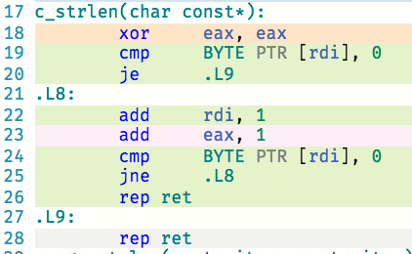
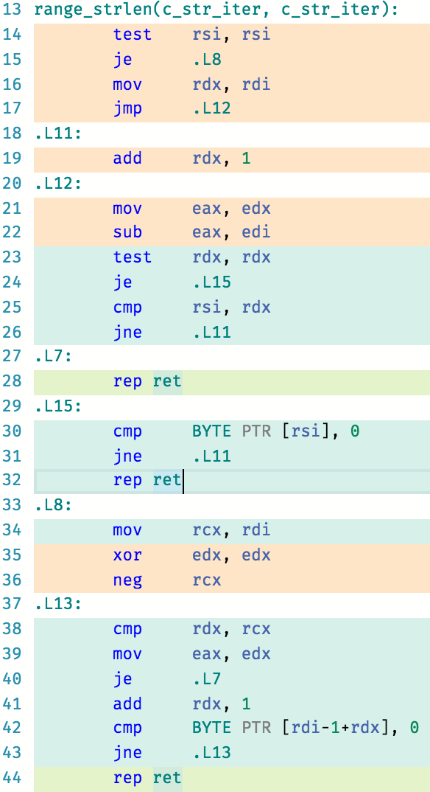
Mission:Possible, but Awful
c_strlen
range_strlen
☹
gcc-snapshot, -O3
godbolt.org

Slide 28
Mission:Possible – Ranges TS
class c_str_iter2 : public std::iterator<
ranges::forward_iterator_tag, char, std::ptrdiff_t, char const*, char const&> {
char const* p = nullptr;
public:
c_str_iter2() = default;
explicit c_str_iter2(char const* q) : p(q) {}
bool operator==(c_str_iter2 that) { return p == that.p; }
bool operator!=(c_str_iter2 that) { return p != that.p; }
char const& operator*() const { return *p; }
char const* operator->() const { return p; }
c_str_iter2& operator++() { ++p; return *this; }
c_str_iter2 operator++(int) { return std::exchange(*this, std::next(*this)); }
};
bool operator==(c_str_iter2 a, ranges::default_sentinel) { return !*a; }
bool operator==(ranges::default_sentinel, c_str_iter2 a) { return !*a; }
bool operator!=(c_str_iter2 a, ranges::default_sentinel) { return *a; }
bool operator!=(ranges::default_sentinel, c_str_iter2 a) { return *a; }

Slide 29
Mission:Possible, String Algorithms
int c_strlen( char const *sz ) {
int i = 0;
for(; *sz; ++sz)
++i;
return i;
}
int range_strlen2( c_str_iter2 begin, ranges::default_sentinel end ) {
int i = 0;
for(; begin != end; ++begin)
++i;
return i;
}
C-style, badness
Ranges TS-style, goodness (!)

Slide 30
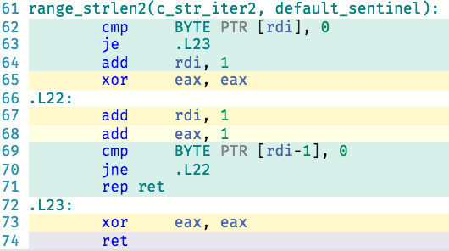
Mission:Possible, and Awesome!
c_strlen
range_strlen2
☺
gcc-snapshot, -O3
godbolt.org

Slide 31
Sentinels: Summary
By allowing the type of the end iterator to differ from the begin we:
Give the optimizer more context, resulting in better codegen
Make it easier to write correct iterators

Slide 32
Defining Your Own Algorithms

Slide 33
Range TS-ify an algorithm
template <typename I>
void insertion_sort(I first, I last)
{
for (I i = first; i != last; ++i)
std::rotate(std::upper_bound(first, i, *i), i, std::next(i));
}

Slide 34
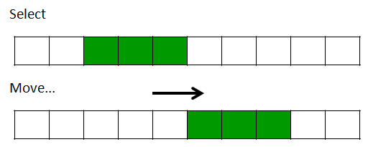
Range TS-ify an algorithm
template <typename I>
void insertion_sort(I first, I last)
{
for (I i = first; i != last; ++i)
std::rotate(std::upper_bound(first, i, *i), i, std::next(i));
}
template <typename I>
void insertion_sort(I first, I last)
{
for (I i = first; i != last; ++i)
ranges::rotate(ranges::upper_bound(first, i, *i), i, ranges::next(i));
}
Prefer the components in the Ranges TS because they are properly constrained with Concepts

Slide 35
Range TS-ify an algorithm
template <typename I>
void insertion_sort(I first, I last)
{
for (I i = first; i != last; ++i)
ranges::rotate(ranges::upper_bound(first, i, *i), i, ranges::next(i));
}
template <ranges::ForwardIterator I>
void insertion_sort(I first, I last)
{
for (I i = first; i != last; ++i)
ranges::rotate(ranges::upper_bound(first, i, *i), i, ranges::next(i));
}
Constrain your algorithms with concepts from the Ranges TS

Slide 36
Range TS-ify an algorithm
template <ranges::ForwardIterator I>
void insertion_sort(I first, I last)
{
for (I i = first; i != last; ++i)
ranges::rotate(ranges::upper_bound(first, i, *i), i, ranges::next(i));
}
template <ranges::ForwardIterator I, ranges::Sentinel<I> S>
void insertion_sort(I first, S last)
{
for (I i = first; i != last; ++i)
ranges::rotate(ranges::upper_bound(first, i, *i), i, ranges::next(i));
}
Use iterator/sentinel pairs to denote ranges.

Slide 37
Range TS-ify an algorithm
template <ranges::ForwardIterator I, ranges::Sentinel<I> S>
void insertion_sort(I first, S last)
{
for (I i = first; i != last; ++i)
ranges::rotate(ranges::upper_bound(first, i, *i), i, ranges::next(i));
}
template <ranges::ForwardIterator I, ranges::Sentinel<I> S>
I insertion_sort(I first, S last)
{
I i = first;
for (; i != last; ++i)
ranges::rotate(ranges::upper_bound(first, i, *i), i, ranges::next(i));
return i;
}
If your algorithm computes the end iterator position, return it.

Slide 38
Range TS-ify an algorithm
template <ranges::ForwardIterator I, ranges::Sentinel<I> S>
I insertion_sort(I first, S last)
{
I i = first;
for (; i != last; ++i)
ranges::rotate(ranges::upper_bound(first, i, *i), i, ranges::next(i));
return i;
}
template <ranges::ForwardIterator I, ranges::Sentinel<I> S>
I insertion_sort(I first, S last)
{
I i = first;
for (; i != last; ++i)
ranges::rotate(ranges::upper_bound(first, i, *i), i, ranges::next(i));
return i;
}
template <ranges::ForwardRange R>
ranges::safe_iterator_t<R> insertion_sort(R&& r)
{
return insertion_sort(ranges::begin(r), ranges::end(r));
}
Add an overload that takes a range (and constrain it!)

Slide 39
Range TS-ify an algorithm
// CppCon 2013: "C++ Seasoning" by Sean Parent
template <typename It>
auto slide(It first, It last, It pos) -> std::pair<It, It>
{
if (pos < first) return { pos, std::rotate(pos, first, last) };
if (last < pos) return { std::rotate(first, last, pos), pos };
return { first, last };
}

Slide 40
Range TS-ify an algorithm
// CppCon 2013: "C++ Seasoning" by Sean Parent
template <typename It>
auto slide(It first, It last, It pos) -> std::pair<It, It>
{
if (pos < first) return { pos, ranges::rotate(pos, first, last).begin() };
if (last < pos) return { ranges::rotate(first, last, pos).begin(), pos };
return { first, last };
}

Slide 41
Range TS-ify an algorithm
// CppCon 2013: "C++ Seasoning" by Sean Parent
template <typename It>
auto slide(It first, It last, It pos) -> std::pair<It, It>
{
if (pos < first) return { pos, ranges::rotate(pos, first, last).begin() };
if (last < pos) return { ranges::rotate(first, last, pos).begin(), pos };
return { first, last };
}
// CppCon 2013: "C++ Seasoning" by Sean Parent
template <ranges::RandomAccessIterator It>
auto slide(It first, It last, It pos) -> std::pair<It, It>
{
if (pos < first) return { pos, ranges::rotate(pos, first, last).begin() };
if (last < pos) return { ranges::rotate(first, last, pos).begin(), pos };
return { first, last };
}
template <ranges::RandomAccessIterator It>
requires ranges::Permutable<It>()
auto slide(It first, It last, It pos) -> std::pair<It, It>
{
if (pos < first) return { pos, ranges::rotate(pos, first, last).begin() };
if (last < pos) return { ranges::rotate(first, last, pos).begin(), pos };
return { first, last };
}

Slide 42
Range TS-ify an algorithm
template <ranges::RandomAccessIterator It>
requires ranges::Permutable<It>()
auto slide(It first, It last, It pos) -> std::pair<It, It>
{
if (pos < first) return { pos, ranges::rotate(pos, first, last).begin() };
if (last < pos) return { ranges::rotate(first, last, pos).begin(), pos };
return { first, last };
}

Slide 43
Range TS-ify an algorithm
template <ranges::Iterator It, ranges::Sentinel<It> S = It>
using iterator_range =
ranges::tagged_pair<ranges::tag::begin(It), ranges::tag::end(S)>;
template <ranges::RandomAccessIterator It>
requires ranges::Permutable<It>()
auto slide(It first, It last, It pos) -> std::pair<It, It>
{
if (pos < first) return { pos, ranges::rotate(pos, first, last).begin() };
if (last < pos) return { ranges::rotate(first, last, pos).begin(), pos };
return { first, last };
}
template <ranges::RandomAccessIterator It>
requires ranges::Permutable<It>()
auto slide(It first, It last, It pos) -> iterator_range<It>
{
if (pos < first) return { pos, ranges::rotate(pos, first, last).begin() };
if (last < pos) return { ranges::rotate(first, last, pos).begin(), pos };
return { first, last };
}

Slide 44
Beyond the Ranges TS: Ranges and Coroutines

Slide 45
Ranges and Coroutines
Coroutine: light-weight, cooperative multi-tasking
Coroutines TS: currently a PDTS
co_await, co_yield, co_return
A plausible addition for C++20

Slide 46
Building a Range with Coroutines and Range-v3
// A lazy range of all the integers[*]:
generator<int> infinite_sequence() {
for (int i = 0; ; ++i) {
co_yield i; // “Suspend” the coroutine!
}
}
// A lazy range of all the integers[*]:
generator<int> infinite_sequence() {
for (int i = 0; ; ++i) {
co_yield i; // “Suspend” the coroutine!
}
}
// Print the first 10 integers
ranges::for_each(
infinite_sequence() | view::take(10), // view::take from range-v3
[](int x) { std::cout << x; });
[*] Using generator from https://github.com/toby-allsopp/ranges-coroutines

Slide 47
Filtering a Range with Coroutines
// Filter out from a range all the elements that don’t satisfy
// a predicate:
using namespace ranges;
template <InputRange Rng, IndirectPredicate<iterator_t<R>> Pred>
auto filter_co( Rng && range, Pred pred )
-> generator<value_type_t<iterator_t<Range>>>
{
for (auto&& x : range)
if (pred(x))
co_yield x;
}
// Filter out from a range all the elements that don’t satisfy
// a predicate:
using namespace ranges;
template <InputRange Rng, IndirectPredicate<iterator_t<R>> Pred>
auto filter_co( Rng && range, Pred pred )
-> generator<value_type_t<iterator_t<Range>>>
{
for (auto&& x : range)
if (pred(x))
co_yield x;
}
auto evens = filter_co(infinite_sequence(),
[](int x) { return x % 2 == 0; });

Slide 48
Filtering a Range with Coroutines
template <class UnaryPredicate>
auto filter_co( UnaryPredicate pred )
{
return ranges::make_pipeable( // From range-v3
[=](InputRange && rng) {
using Rng = decltype(rng);
return filter_co(std::forward<Rng>(rng), pred);
});
}
template <class UnaryPredicate>
auto filter_co( UnaryPredicate pred )
{
return ranges::make_pipeable( // From range-v3
[=](InputRange && rng) {
using Rng = decltype(rng);
return filter_co(std::forward<Rng>(rng), pred);
});
}
auto x = infinite_sequence()
| filter_co([](int x) { return x % 2 == 0; })
| view::take(10); // From range-v3

Slide 49
Asynchronous Ranges
Hand-Wavy Future Directions for Ranges and Coroutines

Slide 50
Asynchronous Ranges
Coroutines TS defines an asynchronous range-based for loop.
for co_await ( auto&& x : rng ) {
do_something_with( x );
}
{
auto __begin = co_await ranges::begin(__range),
auto __end = ranges::end(rng);
for (; __begin != __end; co_await ++__begin ) {
auto&& x = *__begin;
do_something_with( x );
}
}
Asynchronously fetch the first element
Asynchronously fetch the next element

Slide 51
Asynchronous Range Concept
template <class T>
requires requires(T& t) { t.await_resume(); }
auto await_resume(T& t) {
return t.await_resume();
}
template <class I>
using await_resume_t = decltype(await_resume(std::declval<I&>()));
template <class T>
requires requires(T& t) { t.await_resume(); }
auto await_resume(T& t) {
return t.await_resume();
}
template <class I>
using await_resume_t = decltype(await_resume(std::declval<I&>()));
template <class I>
concept bool AsyncInputIterator() {
return Readable<I>() && // Readable means *i “reads” a value
Semiregular<I>() && // Semiregular means copyable and movable with “regular” semantics
requires(I i) {
typename difference_type_t<I>;
{ await_resume(++i) } -> Same<I&>;
i++;
};
}
template <class T>
requires requires(T& t) { t.await_resume(); }
auto await_resume(T& t) {
return t.await_resume();
}
template <class I>
using await_resume_t = decltype(await_resume(std::declval<I&>()));
template <class I>
concept bool AsyncInputIterator() {
return Readable<I>() && // Readable means *i “reads” a value
Semiregular<I>() && // Semiregular means copyable and movable with “regular” semantics
requires(I i) {
typename difference_type_t<I>;
{ await_resume(++i) } -> Same<I&>;
i++;
};
}
template <class R>
concept bool AsyncInputRange() {
return AsyncInputIterator<await_result_t<iterator_t<R>>() && // or, { await_resume(begin(rng)) } -> AsyncInputIterator
WeaklyEqualityComparable<await_resume_t<iterator_t<R>>, sentinel_t<R>>();
}

Slide 52
Asynchronous Algorithms
// Now define a set of algorithm overloads over asynchronous ranges, like…
template <AsyncInputIterator I, Sentinel<I> S, class T>
requires EqualityComparable<reference_t<await_resume_t<I>>, const T&>
I find(I first, S last, const T& value)
{
auto i = co_await first;
for (; i != last; co_await ++i)
if (*i == value)
break;
co_return i;
}
// Now define a set of algorithm overloads over asynchronous ranges, like…
template <AsyncInputIterator I, Sentinel<I> S, class T>
requires EqualityComparable<reference_t<await_resume_t<I>>, const T&>
I find(I first, S last, const T& value)
{
auto i = co_await first;
for (; i != last; co_await ++i)
if (*i == value)
break;
co_return i;
}
template <AsyncInputRange R, class T>
requires EqualityComparable<reference_t<await_resume_t<iterator_t<R>>>, const T&>
safe_iterator_t<R> find(R && r, const T& value)
{
return find(begin(r), end(r), value);
}

Slide 53
… and Then
Define a set of asynchronous views over asynchronous ranges
Filter and transform an infinite, asynchronous sequence of…
Network packets
User interface events (mouse movements, keyboard input)
File system notifications
Whatever!

Slide 54
Hello, reactive programming

Slide 55
Coroutines and Ranges
Coroutines make it trivial to define lazily-evaluated views of data sequences.
The Ranges TS provides algorithms that make operating on views easy.

Slide 56
Coroutines and Ranges
Ranges can also be asynchronous.
With algorithms and views that are async-aware, we can write generic code that is either imperative or reactive depending on input.

Slide 57
Questions?

