Slide 1

A Slice of Rust
Lloyd Moore, President
Lloyd@CyberData-Robotics.com
www.CyberData-Robotics.com

Slide 2
Agenda:
We are going to look at a collection of topics related to Rust programming that I have found interesting over the past year developing several projects.
In some cases I’ll compare and contrast to C++ and in others we’ll just look at the Rust topic.

Slide 3
Rust Development Environment:
Quite complete development “out of the box”:
Rustup: Tool chain management program, including cross compilation tools
Cargo: Top level build process management tool and package management
Rustfmt: Rust code formatter run with “cargo fmt”
Clippy: Rust linter – run with “cargo clippy”
Documents: Built in, generate docs with “cargo rustdoc” or “cargo doc”
Unit tests: Built in, run with “cargo test”
Performance testing: Built in, run with “cargo bench”
Rust language server: Editor support for many major editors
Vim
Emacs
Sublime Text
Atom
Visual Studio Code
IntelliJ / CLion

Slide 4
Rust Development Cycle
“Feels” VERY different from a C++ development cycle
Basic mechanics are the same: Edit, Compile, Run
Compiler messages will give suggestions as well as outright errors
Can also include code snip-its
Result is you feel more like you are having a “dialog” with the compiler to edit and build the code

Slide 5
Coding Style Idiom Based
When coding in Rust look for existing patterns that already solve your problem.
Similar to Design Patterns they are much smaller patterns to solve specific problems
This is typically referred to as “idomatic code” and is more important in Rust than other languages
In some cases the compiler and/or linter (clippy) will actually enforce an idomatic pattern

Slide 6
Rust Language Evolution
No formal language specification!
The compiler is the specification
Does place limits on where the language can be used – cannot use for some projects requiring DO-178x – will not be able to fully qualify the tool chain!
Allows for faster language iteration
Language is less “regular” than C++
Has “Editions” for language breaking changes, increment every 3 years so far
Has “stable” and “nightly” compiler versions
“Stable” compiler updated every 6 weeks!

Slide 7
Crates.io – The package registry
Packages are called “crates” in Rust
Registry is integrated with cargo for both package download and version management
Appears to be a rather blurry line between a “standard” library and what ends up in the registry
Most packages have a MIT or Apache style license
Not “curated” in any way, watch for:
Documentation quality
Number of recent downloads – some crates are defacto standards, ie: serde and rand
Last release and release cadance

Slide 8
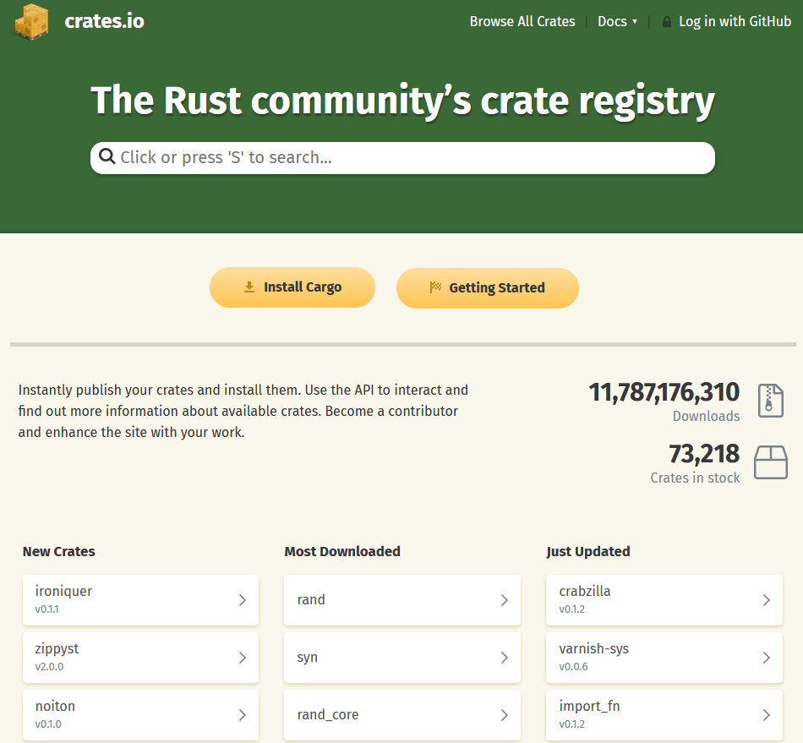
Crates.io – The Website

Slide 9
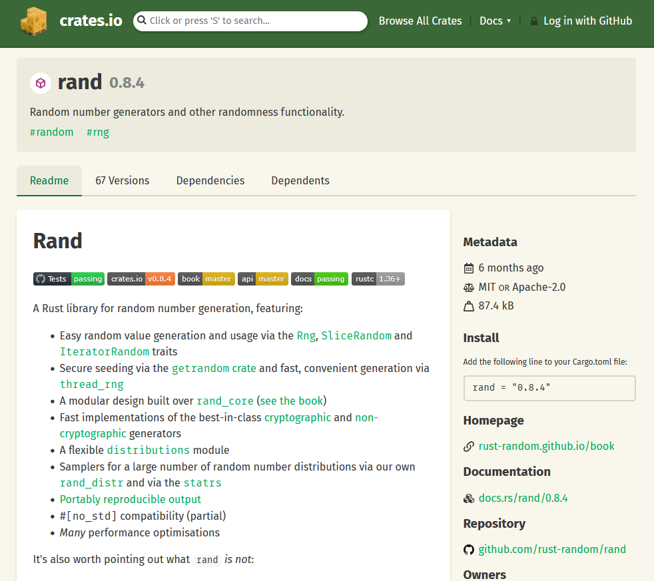
Crates.io – Typical Package Entry

Slide 10
Std::time::Duration vs chrono::Duration
Lloyd’s rule: If there are two similar things Lloyd has a 90% chance of finding the wrong one!
Std::time::Duration and chrono::Duration do basically the same thing but are not compatible.
Chrono is the more feature rich package, and seems to be usually what you want.
Frequently trips me up though, and error messages can be more confusing in the context of two packages with similar constructs.

Slide 11
Borrow Checker
Likely the most loved and hated feature of Rust!
Enforces compile time checks on variables:
Initialized before use
Not moved twice
Not moved while “borrowed”
Cannot be modified by more than one owner at a time
Etc….
Fundamentally responsible for enforcing the safety guarantees that make Rust unique.
Will FORCE you to use different and better patterns when writing code!

Slide 12
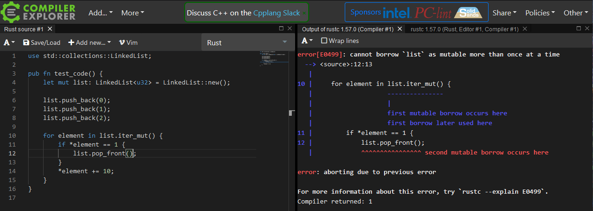
Borrow Checker : Modifying a list while iterating
This is a rather contrived example but shows the behavior of the borrow checker.
This check is done at compile time with ZERO run time overhead!
The error message is also quite helpful – once you get used to it.

Slide 13
Match Statement Efficiency
Match statement is much like C++ switch
Also includes much more advanced pattern matching.
Herb Sutter has proposed a similar construct for C++:
https://www.youtube.com/watch?v=raB_289NxBk
So just how efficient is this statement?
Note that Rust currently uses the LLVM back end compiler and benefits from the optimizations there.

Slide 14
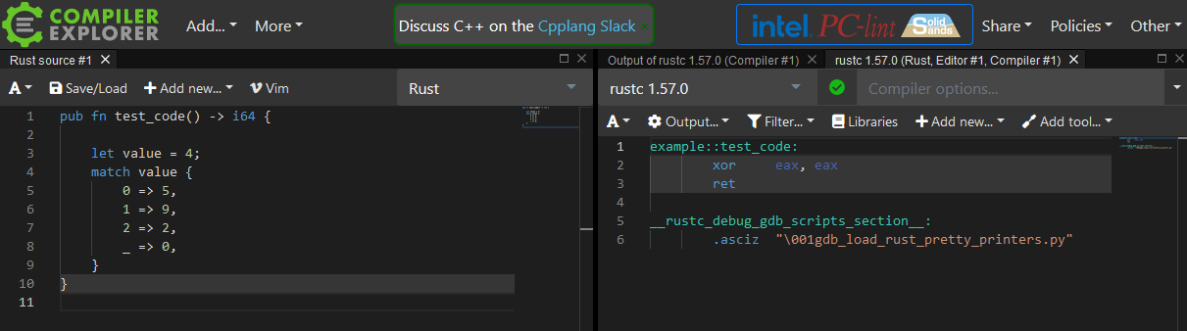
Match Statement Efficiency
This was an interesting case I just happened to try.
A constant result evaluates to basically no code even without specifying optimization.

Slide 15
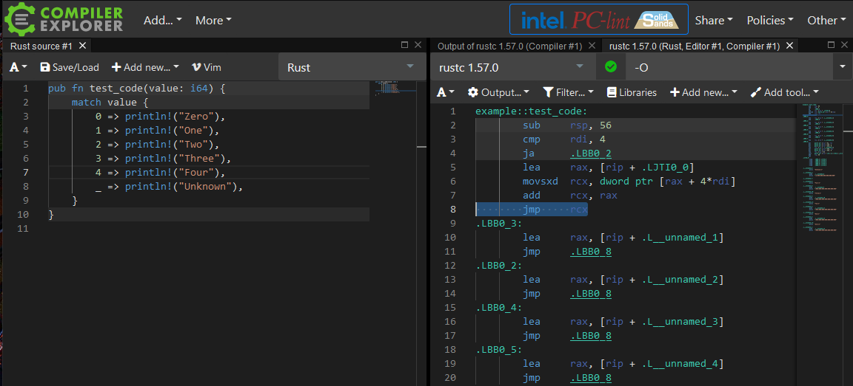
Match Statement Efficiency
Looking at the first part of the assembly code you can see a range check and then the calculations resulting in an indirect jump at line 8.
You do in fact get a jump table in this case.

Slide 16
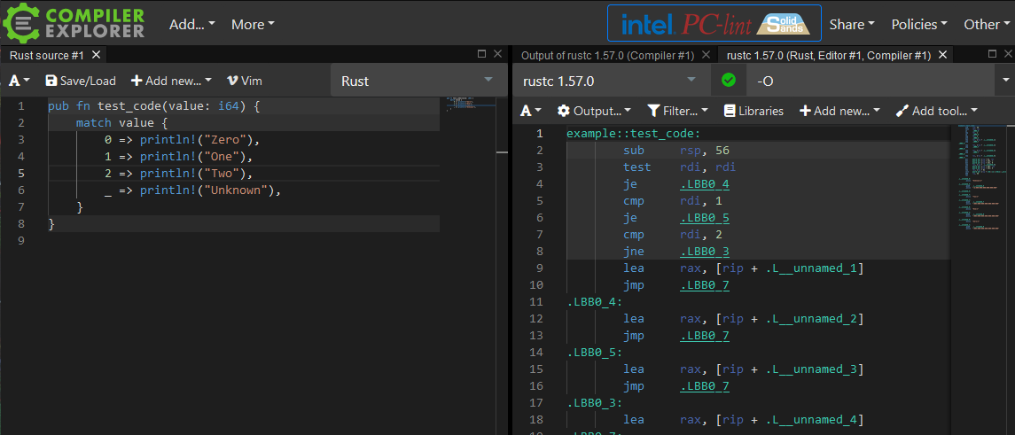
Match Statement Efficiency
A shorter case however (only 0...2) results in a branch chain.
Apparently the compiler decided this construct was more efficient in this case.

Slide 17
General Rust Efficiency
Overall Rust can be just as efficient as C++.
If you consider that additional compile time checks can replace run time checks Rust can be more efficient than C++ in some cases.
Rust pays for this with increased build times, however I’ve found this no worse than using C++ with a linter, such as clang-tidy.
Construction of code which does not copy values around is more difficult than in C++ owing to borrow checker restrictions.

Slide 18
No Inheritance
Rust promotes the composition pattern over inheritance.
In practice I’ve found this does result in either:
Duplicated code as each object must contain what would be in a base class
Need to use a different object model
Need to use generic functions
Need to use macros to generate a “family” of objects

Slide 19
Rust Macros
Macros are much more important and robust than C++.
Macro substitution happens in the abstract syntax tree – NOT textual substitution!
Parameters in macros can be restricted to specific syntactic elements (expression, block, etc.)
With this can build domain specific languages with Rust macros that intermix with normal Rust code.

Slide 20
Rust Macros
Two types of Rust Macros
macro_rules
Conceptually like enhanced C++ macros
Procedural macros – allows for creating full syntax extensions, and run code at compile time.
Conceptually allow you convert one AST into another AST
Have not had a chance to try these yet, but conceptually very powerful.

Slide 21
Resources
Rust Home Page
https://www.rust-lang.org
The Little Book of Rust Books
https://lborb.github.io/book/title-page.html
Rust Language Cheat Sheet
https://cheats.rs/#cargo

Slide 22
Questions?

