Slide 1
Using the power of Assembly to fine tune an application's performance
Brett Searles
brett.searles@attobotics.net

Slide 2
I Introduction to Series
II Background
III Inline Assembly
IV Construction
I Code
II Output
III Input
IV Clobber
V Pros
VI Cons
VII Conclusion
Notes:
Background - there has been a focus to move C++ away from its roots of C. However, there are functionalities in C that are useful to enhance in C++. Like (click)
C was basically developed from the inline comments used to describe the assembly language. Like the comparison and jump features of assembly were translated to if-then statements.
This will be a primer to inline assembly

Slide 3
Introduction of the Series
Discussions about Assembly
language
implementation for different protection layers
hardware architectures
hardware registers
Part I
Inline Assembly
Its construction
Examples
Things to consider when implementing
Notes:
Working on a couple of papers for C++ and woke up to the thought inline assembly

Slide 4
Background
Kernel
User
DPL = 0 or Supervisor mode
OS, Interrupts, Device Drivers
C language can be used here
DPL = 3 or user mode
Most Applications
C++ works in this space

Slide 5
Segment Descriptor
Segment Descriptor
63 56 | 55 52 | 51 48 | 47 40 | 39 32
Base 31 24 | Flags 3 0 | Limit 19 16 | Access Byte 7 0 | Base 23 16
31 16 |  |  | 15 0
Base 15 0 |  |  | Limit 15 0
Notes:
Tables like the Global Descriptor Table that store information about the location of tasks, interrupt handlers and other pertinent locations related to operating software on the CPU.

Slide 6
Access Byte
Access Byte
7 | 6 | 5 | 4 | 3 | 2 | 1 | 0
P | DPL |  | S | E | DC | RW | A
Notes:
P: Present bit. Allows an entry to refer to a valid segment. Must be set (1) for any valid segment.
DPL: Descriptor privilege level field. Contains the CPU Privilege level of the segment. 0 = highest privilege (kernel), 3 = lowest privilege (user applications).
S: Descriptor type bit. If clear (0) the descriptor defines a system segment (eg. a Task State Segment). If set (1) it defines a code or data segment.
E: Executable bit. If clear (0) the descriptor defines a data segment. If set (1) it defines a code segment which can be executed from.
DC: Direction bit/Conforming bit.
For data selectors: Direction bit. If clear (0) the segment grows up. If set (1) the segment grows down, ie. the Offset has to be greater than the Limit.
For code selectors: Conforming bit.
If clear (0) code in this segment can only be executed from the ring set in DPL.
If set (1) code in this segment can be executed from an equal or lower privilege level. For example, code in ring 3 can far-jump to conforming code in a ring 2 segment. The DPL field represent the highest privilege level that is allowed to execute the segment. For example, code in ring 0 cannot far-jump to a conforming code segment where DPL is 2, while code in ring 2 and 3 can. Note that the privilege level remains the same, ie. a far-jump from ring 3 to a segment with a DPL of 2 remains in ring 3 after the jump.
RW: Readable bit/Writable bit.
For code segments: Readable bit. If clear (0), read access for this segment is not allowed. If set (1) read access is allowed. Write access is never allowed for code segments.
For data segments: Writeable bit. If clear (0), write access for this segment is not allowed. If set (1) write access is allowed. Read access is always allowed for data segments.
A: Accessed bit. Best left clear (0), the CPU will set it when the segment is accessed.

Slide 7
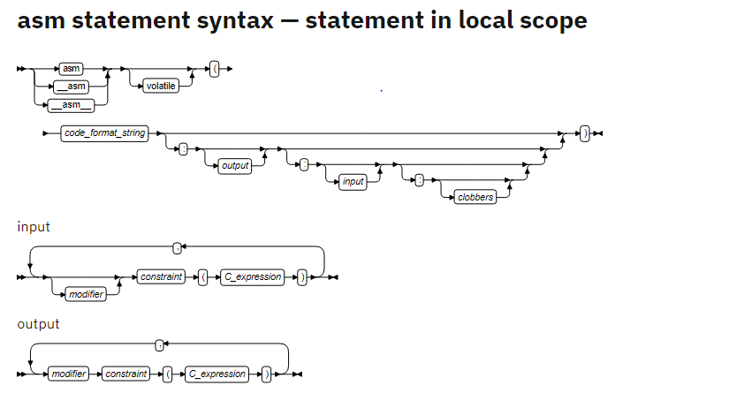
Inline Assembly

Slide 8

Construction
Declaration
asm
__asm
__asm__
asm volatile

Slide 9
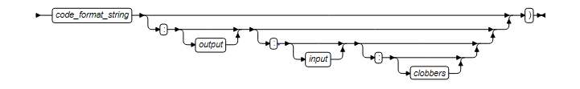
Format
blocks
code format string
output*
input*
clobber*
* optional

Slide 10
Code Format String
code format string is similar to the printf statement
asm(“
movl $1,%%eax; /* SYS_exit is 1 */
xorl %%ebx,%%ebx; /* Argument is in ebx, it is 0 */
int $0x80" /* Enter kernel mode */
);
volatile can be used to minimize compiler optimizations
Notes:
GCC inline assembly

Slide 11
uint64_t msr;
asm volatile ( "rdtsc\n\t" // Returns the time in EDX:EAX.
"shl $32, %%rdx\n\t" // Shift the upper bits left.
"or %%rdx, %0" // 'Or' in the lower bits.
: "=a" (msr)
:
: "rdx");
printf("msr: %llx\n", msr);
// Do other work...
// Reprint the timestamp
asm volatile ( "rdtsc\n\t" // Returns the time in EDX:EAX.
"shl $32, %%rdx\n\t" // Shift the upper bits left.
"or %%rdx, %0" // 'Or' in the lower bits.
: "=a" (msr)
:
: "rdx");
printf("msr: %llx\n", msr);
Notes:
If the keyword “volatile” is not used, the optimizer may remove the second asm code block It is the same code, yet used in two different places.

Slide 12
Modifiers
"=" : Indicates that this operand is write-only for this instruction
"&" : Indicates that the variable is an earlyclobber operand
“+”: Indicates that the operand is both read and write
Notes:
= means the previous value is discarded and replaced by output data.
& means the register is modified before the instruction is finished using the input operands.
Therefore, this operand may not lie in a register that is used as an input operand or as part of any memory address. An input operand can be tied to an earlyclobber operand if its only use as an input occurs before the early result is written.

Slide 13
Constraints
r | registers
a | %rax | %eax | %ax | %al
b | %rbx | %ebx | %bx | %bl
c | %rcx | %ecx | %cx | %cl
d | %rdx | %edx | %dx | %dl
S | %rsi | %esi | %si
D | %rdi | %esi | %di

Slide 14
Register Operands
static inline uint32_t farpeekl(uint16_t sel, void* off)
{
uint32_t ret;
asm ( "push %%fs\n\t"
"mov %1, %%fs\n\t"
"mov %%fs:(%2), %0\n\t"
"pop %%fs"
: "=r"(ret) : "g"(sel), "r"(off) );
return ret;
}
int main(void)
{
int foo = 10, bar = 15;
__asm__ __volatile__("addl
%%ebx,%%eax"
:"=a"(foo)
:"a"(foo), "b"(bar)
);
printf("foo+bar=%d\n", foo);
return 0;
}

Slide 15
More Constraints
m : memory operand
o : address is offsetable (eg array index)
V : memory, yet not offsetable
i : immediate integer (usually has a constant value)
n : numeric
g : general register or memory operand
Many more based on the hardware architecture

Slide 16
“r” constraint
int src = 1; int dst; asm ("mov %1, %0\n\t" "add $1, %0" : "=r" (dst) : "r" (src)); printf("%d\n", dst);
int src = 1;
int dst;
asm ("mov %1, %0\n\t"
"add $1, %0"
: "=r" (dst)
: "r" (src));
printf("%d\n", dst);
Notes:
This is just the plain asm statement that will be executed

Slide 17
Memory Operand
__asm__ __volatile__(
" lock ;\n"
" addl %1,%0 ;\n"
: "=m" (my_var)
: "ir" (my_int), "m" (my_var)
: /* no clobber-list */
);
Notes:
In the output field, "=m" says that my_var is an output and it is in memory. Similarly, "ir" says that, my_int is an integer and should reside in some register (recall the table we saw above).

Slide 18
Offsetable Operand
static uint16_t swapvals[8];
uint8_t some_function(int index, uint8_t value)
{
__asm__ __volatile__
(
"mov.b %[val], 1(%[dst])\n"
"swpb 0(%[dst])\n"
"mov.b 1(%[dst]), %[val]\n"
: [val] "+g" (value), [dst] "+o" (swapvals[index])
);
return value;
}

Slide 19
Clobbers
Indicates that registers inside the inline assembly may be overwritten
Each item in the list is surrounded by “” marks and separated by a ,
Special clobbers
cc
memory
Notes:
cc clobbers the flag’s register because the code did modify it.
memory tells the compiler that the code performed read or writes to the operands. So the compiler needs to flush register values to memory before executing the asm code. Also the compiler does not assume that the memory is unchanged during execution of the code.

Slide 20
Special Clobber: cc
Clear/set a bit in a register
__asm__ __volatile__( "btsl %1,%0"
: "=m" (ADDR)
: "Ir" (pos)
: "cc"
);
Notes:
cc: means to clear flags once the code is finished executing
The code may affect overflow or negative flags

Slide 21
Early Clobber (&) with Special Clobber “memory”
strcpy
static inline char * strcpy(char * dest,const char *src)
{
int d0, d1, d2;
__asm__ __volatile__( "1:\tlodsb\n\t"
"stosb\n\t"
"testb %%al,%%al\n\t"
"jne 1b"
: "=&S" (d0), "=&D" (d1), "=&a" (d2)
: "0" (src),"1" (dest)
: "memory");
return dest;
}
Notes:
& : means that the value will be changed during execution of the code
memory : to ensure memory contains the correct values, memory needs to be flush specific register values. So memory needs to be reloaded.

Slide 22
Pros
Performance will be optimized
not relying on the compiler’s interpretation
can modify how the code is executed
Allow the code to directly access device driver data
static inline uint8_t inb(uint16_t port)
{
uint8_t ret;
asm volatile ( "inb %1, %0"
: "=a"(ret)
: "Nd"(port)
: "memory");
return ret;
}
Notes:
Like strcpy on a GPU instead of a CPU

Slide 23
Cons
Need to make sure the code is written correctly
Not easy to debug
What is wrong with the following:?
asm("movl $1,%%eax; /* SYS_exit is 1 */
xorl %%ebx,%%ebx; /* Argument is in ebx, it is 0 */
int $0x80" /* Enter kernel mode */
);
Notes:
Written for att compiler, not Intel. Will not work on platforms other than the x86

Slide 24
Conclusion
Just scratched the surface of the power of inline assembly
Used to enhance the performance of a C++ type application
Can access low-level data where regular C++ applications can not
Need to know your environment
Since it is put in a string, must be written carefully
However, once you know the Assembly language, it opens the opportunity to improve many aspects of your code development and execution

Slide 25
Thank You
Questions or Comments

Slide 26
References
GCC-Inline-Assembly
Extended-Asm.html
OSDev Wiki
o constraint

