Slide 1

Building CUDA On Linux
Lloyd Moore, President
Lloyd@CyberData-Robotics.com
www.CyberData-Robotics.com

Slide 2
Overview:
This talk is a quick add on to the “CUDA Without a PhD” that I did last year to build the SimpleCuda project on Linux.

Slide 3
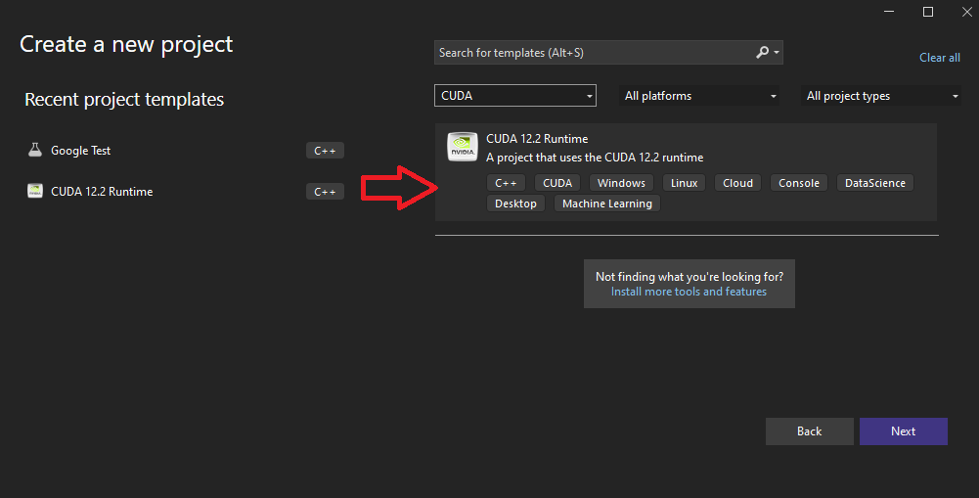
When we last left…….
When we last left our SimpleCuda project, it was a small simple project that was built with Visual Studio and ran on Windows.
This was done as CUDA setup on Windows is simpler than on Linux.

Slide 4
And Now For Linux…...
Overview of what needs to be done:
Backup the system configuration
Install / update CMake to at least version 4.0.x
Install the Nvidia CUDA Toolkit
Create the CMakeList.txt script
Build and run!

Slide 5
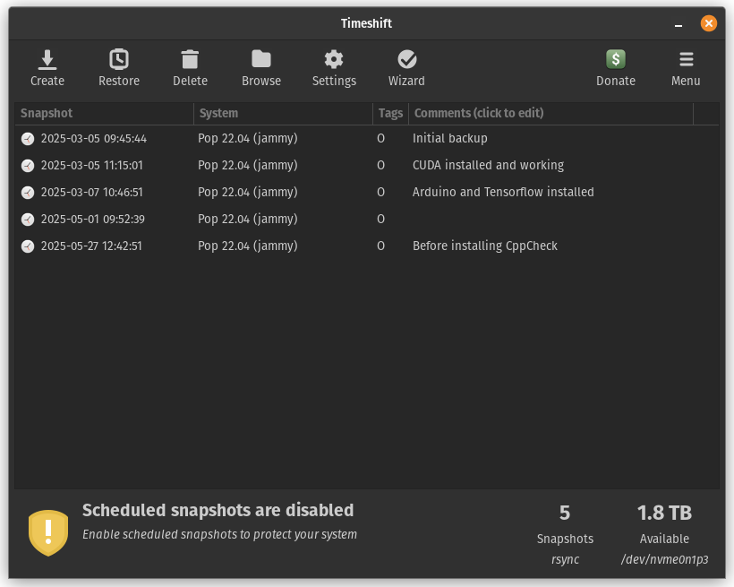
Backup The System Config!!!
Installing the Nvidia CUDA Toolkit may also update the Nivida drivers! Backup the system configuration just to be safe!
Timeshift works well for this and can be used very much like System Restore on Windows:

Slide 6
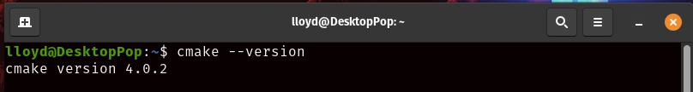
Update CMake
Current versions of CMake support CUDA builds directly and the latest versions of C++. We’ll use CMake 4.x, which currently is a manual install on some versions of Linux.
Remove the current cmake (if present): sudo apt remove cmake
Download script: https://github.com/Kitware/Cmake/releases/download/v4.0.2/cmake-4.0.2-linux-x86_64.tar.gz
Extract the file contents by whatever means you like
Copy the resulting directory to: /opt/
Create symbolic links: sudo ln -s /opt/<directory from above>/bin/* /usr/local/bin
Verify: cmake --version

Slide 7
Install Nvidia CUDA Tools
Depending on your system configuration this step may vary considerably, and errors can destabilize the system. Detailed instructions from Nvidia are given the link below.
If things go bad, simply restore the backup made earlier. This worked very well for me.
Install Nvidia CUDA
https://docs.nvidia.com/cuda/cuda-installation-guide-linux/index.html

Slide 8
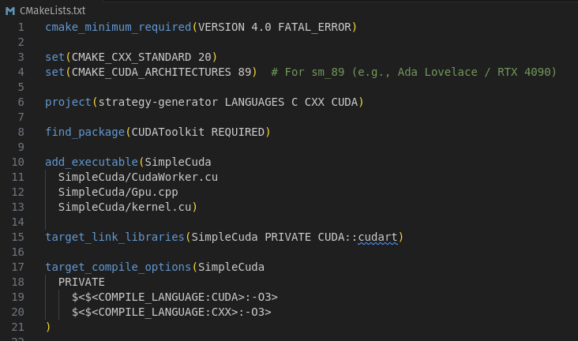
Create CMakeList.txt
<Add image capture here>

Slide 9
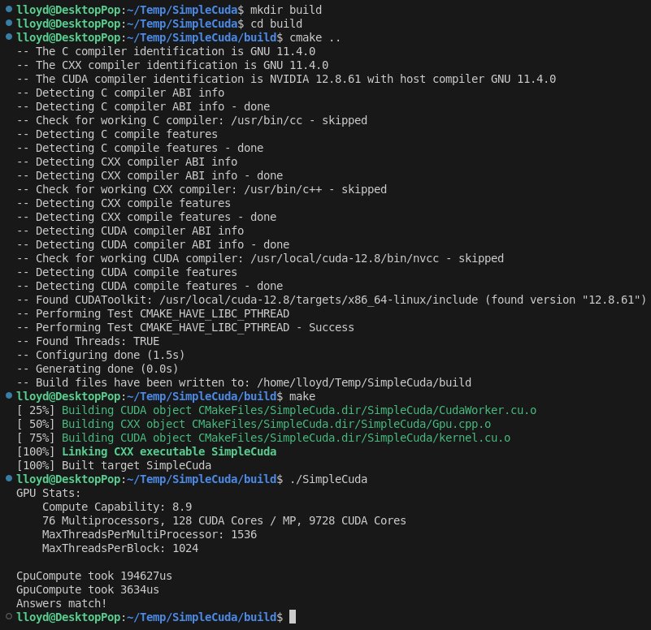
Build and Run!
Same as for any other CMake build at this point:
cd <project directory>
mkdir build
cd build
cmake ..
make
./SimpleCuda

Slide 10
Questions?

