Slide 1
LKRhash
The Design of a Scalable Hashtable
George V. Reilly
http://www.georgevreilly.com
Notes:
Much of this material is also available at http://www.google.com/patents/US6578131.pdf

Slide 2
Origin Story
LKRhash invented at Microsoft in 1997
Paul (Per-Åke) Larson — Microsoft Research
Murali R. Krishnan — (then) Internet Information Server
George V. Reilly — (then) IIS

Slide 3
LKRhash Design Techniques
Linear Hashing—smooth resizing
Cache-friendly data structures
Fine-grained locking

Slide 4
What is a Hashtable?
Unordered collection of keys (and values)
hash(key) → int
Bucket address ≡ hash(key) modulo #buckets
O(1) find, insert, delete
Collision strategies
23
24
25
26
foo
cat
the
nod
bar
ear
try
sap

Slide 5
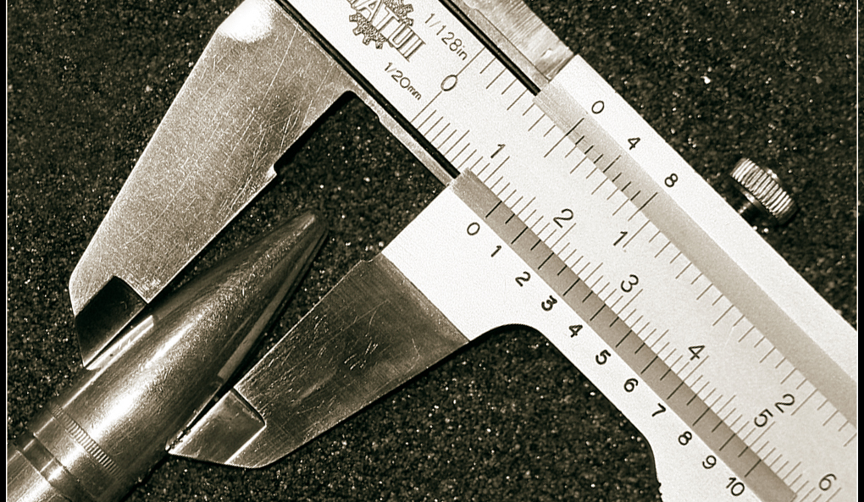
Size Does Matter
http://brechnuss.deviantart.com/art/size-does-matter-73413798

Slide 6
Fixed Size is Never the Right Size
Unless you already know cardinality
Too big—wastes memory
Too small—long chains degenerate to O(n) accesses

Slide 7
Degradation in Fixed-Size Table
20-bucket table, 400 insertions from random shuffle

Slide 8
Stop-the-World Resizing
4 buckets initially; doubles when load factor > 3.0
Horrible worst-case performance

Slide 9
Linear Hashing Resizing
4 buckets initially; load factor = 3.0
Grows to 400/3 buckets, 1 split every 3 insertions

Slide 10
Linear Hashing
Incrementally adjust table size as records are inserted and deleted
Fast and stable performance regardless of
actual table size
how much table has grown or shrunk
Original idea from 1978
Applied to in-memory tables in 1988 by Paul Larson in CACM paper

Slide 11
Linear Hashing Expansion, 1 of 3
p
h = K mod B (B = 4)
if h < p then h = K mod 2B
B = 2^{L}; here L = 2 ⇒ B = 2² = 4
0
1
2
3
p
8
1
2
3
0
1
2
3
4
C
5
A
7
4
E
⇒
8
1
2
3
C
0
6
0
5
A
7
4
E
B
Insert 0 into bucket 0
4 buckets, desired load factor = 3.0
p = 0, N = 12
6
Insert B₁₆ into bucket 3
Split bucket 0 into buckets 0 and 4
5 buckets, p = 1, N = 13
Keys are hexadecimal
Notes:
Initial:
[8, C, 4, 0] <-
[1, 5]
[2, A, E, 6]
[3, 7]
Insert B, splits bucket 0 => 0, 4
[8, 0]
[1, 5] <-
[2, A, E, 6]
[3, 7, B]
[C, 4]

Slide 12
Linear Hashing Expansion, 2 of 3
h = K mod B (B = 4)
if h < p then h = K mod 2B
p
p
0
1
2
3
4
8
1
2
3
C
0
1
2
3
4
0
5
A
7
4
8
1
2
3
C
D
E
B
⇒
0
5
A
7
4
6
D
E
B
9
6
Insert D₁₆ into bucket 1
p = 1, N = 14
Insert 9 into bucket 1
p = 1, N = 15
Notes:
Insert D
[8, 0]
[1, 5, D] <-
[2, A, E, 6]
[3, 7, B]
[C, 4]
Insert 9
[8, 0]
[1, 5, D, 9] <-
[2, A, E, 6]
[3, 7, B]
[C, 4]

Slide 13
Linear Hashing Expansion, 3 of 3
h = K mod B (B = 4)
if h < p then h = K mod 2B
p
p
0
1
2
3
4
8
1
2
3
C
0
1
2
3
4
5
0
5
A
7
4
8
1
2
3
C
5
D
E
B
⇒
0
9
A
7
4
D
9
6
E
B
6
F
As previously
p = 1, N = 15
Insert F₁₆ into bucket 3
Split bucket 1 into buckets 1 and 5
6 buckets, p = 2, N = 16
Notes:
Insert F, splits bucket 1 => 1, 5
[8, 0]
[1, 9]
[2, A, E, 6]
[3, 7, B, F] <-
[C, 4]
[5, D]

Slide 14
Growable Array of Buckets
HashTable
Directory
Array segments
Segment 0
Segment 1
Segment 2
s buckets per Segment
Bucket b ≡ Segment[ b / s ] → bucket[ b % s ]

Slide 15

Cache-friendliness

Slide 16
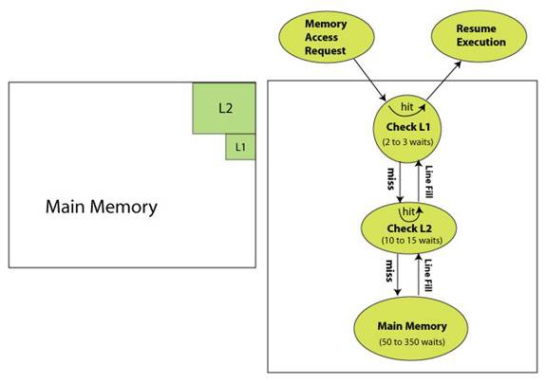
L1/L2 Cache Misses
http://developer.amd.com/documentation/articles/pages/ImplementingAMDcache-optimalcodingtechniques.aspx

Slide 17
Chasing Pointers ⇒ Cache Misses
1
2
3
43, Male
Fred
class User
{
int age;
Gender gender;
const char* name;
User* nextHashLink;
}
4
5
37, Male
Jim
6
7
47, Female
Sheila

Slide 18
Cache-friendly data structures
Extrinsic links
Hash signatures
Clump several pointer–signature pairs
Inline head clump

Slide 19
LKRhash buckets
Signature Pointer
Signature Pointer
Signature Pointer
1234
1253
3492
6691
5487
Jill, female, 1982
9871
0294
Jack, male, 1980
Bucket 0
Bucket 1
Bucket 2

Slide 20
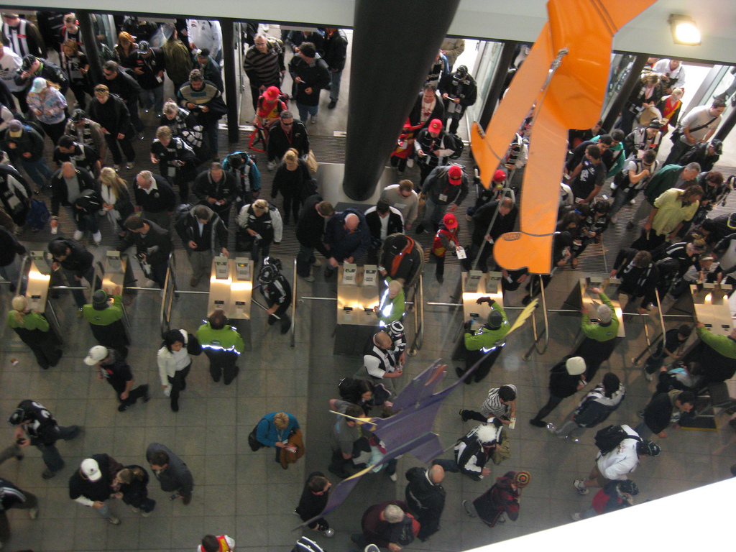
Lock Contention
http://www.flickr.com/photos/hetty_kate/4308051420/

Slide 21
Reducing Lock Contention
Spread records over multiple subtables (by hashing, of course)
One lock per subtable + one lock per bucket
Restructure algorithms to reduce lock time
Use simple, bounded spinlocks

Slide 22
Table with 4 subtables
0
0
1
. . .
. . .
2
3
. . .
. . .

Slide 23
Custom Reader-Writer Spin Locks
CRITICAL_SECTION much too large for per-bucket locks
Custom 4-byte lock
State, lower 16 bits: > 0 ⇒ #readers; -1 ⇒ writer
Writer Count, upper 16 bits: 1 owner, N-1 waiters
InterlockedCompareExchange to update
Spin briefly, then Sleep & test in a loop

Slide 24
Bucket = Lock + NodeClump
class ReaderWriterLock {
DWORD WritersAndState;
};
class NodeClump {
DWORD sigs[NODES_PER_CLUMP];
NodeClump* nextClump;
const void* nodes[NODES_PER_CLUMP];
};
// NODES_PER_CLUMP = 7 on Win32, 5 on Win64 => sizeof(Bucket) = 64 bytes
class Bucket {
ReaderWriterLock lock;
NodeClump firstClump;
};
class Segment {
Bucket buckets[BUCKETS_PER_SEGMENT];
};

Slide 25
Multiprocessor Scaling HP Axil, 8 x PPro 200MHz

Slide 26
Some Implementation Details
Typesafe template wrapper
Records (void*) have an embedded key (DWORD_PTR), which is a pointer or a number
Need user-provided callback functions to
Extract a key from a record
Hash a key
Compare two keys for equality
Increment/decrement record’s ref-count

Slide 27
InsertRecord pseudocode, 1 of 2
Table::InsertRecord(const void* pvRecord)
{
DWORD_PTR pnKey = userExtractKey(pvRecord);
DWORD signature = userCalcHash(pnKey);
size_t sub = Scramble(hashval) % numSubTables;
return subTables[sub].InsertRecord(pvRecord, signature);
}

Slide 28
InsertRecord pseudocode, 2 of 2
SubTable::InsertRecord(const void* pvRecord, DWORD signature)
{
TableWriteLock();
++numRecords;
Bucket* pBucket = FindBucket(signature);
pBucket->WriteLock();
TableWriteUnlock();
for (pnc = &pBucket->firstClump; pnc != NULL; pnc = pnc->nextClump) {
for (i = 0; i < NODES_PER_CLUMP; ++i) {
if (pnc->nodes[i] == NULL) {
pnc->nodes[i] = pvRecord; pnc->sigs[i] = signature;
break;
} } }
userAddRefRecord(pvRecord, +1);
pBucket->WriteUnlock();
while (numRecords > loadFactor * numActiveBuckets)
SplitBucket();
}

Slide 29
SplitBucket pseudocode
SubTable::SplitBucket()
{
TableWriteLock();
++numActiveBuckets;
if (++splitIndex == (1 << level)) {
++level; mask = (mask << 1) | 1; splitIndex = 0;
}
Bucket* pOldBucket = FindBucket(splitIndex);
Bucket* pNewBucket = FindBucket((1 << level) | splitIndex);
pOldBucket->WriteLock();
pNewBucket->WriteLock();
TableWriteUnlock();
result = SplitRecordClump(pOldBucket, pNewBucket);
pOldBucket->WriteUnlock();
pNewBucket->WriteUnlock();
return result
}

Slide 30
FindKey pseudocode
SubTable::FindKey(DWORD_PTR pnKey, DWORD signature, const void** ppvRecord)
{
TableReadLock();
Bucket* pBucket = FindBucket(signature);
pBucket->ReadLock();
TableReadUnlock();
LK_RETCODE lkrc = LK_NO_SUCH_KEY;
for (pnc = &pBucket->firstClump; pnc != NULL; pnc = pnc->nextClump) {
for (i = 0; i < NODES_PER_CLUMP; ++i) {
if (pnc->sigs[i] == signature
&& userEqualKeys(pnKey, userExtractKey(pnc->nodes[i])))
{
*ppvRecord = pnc->nodes[i];
userAddRefRecord(*ppvRecord, +1);
lkrc = LK_SUCCESS;
goto Found;
} } }
Found:
pBucket->ReadUnlock();
return lkrc;
}

Slide 31

Gotchas
Patent 6578131
Closed Source

Slide 32
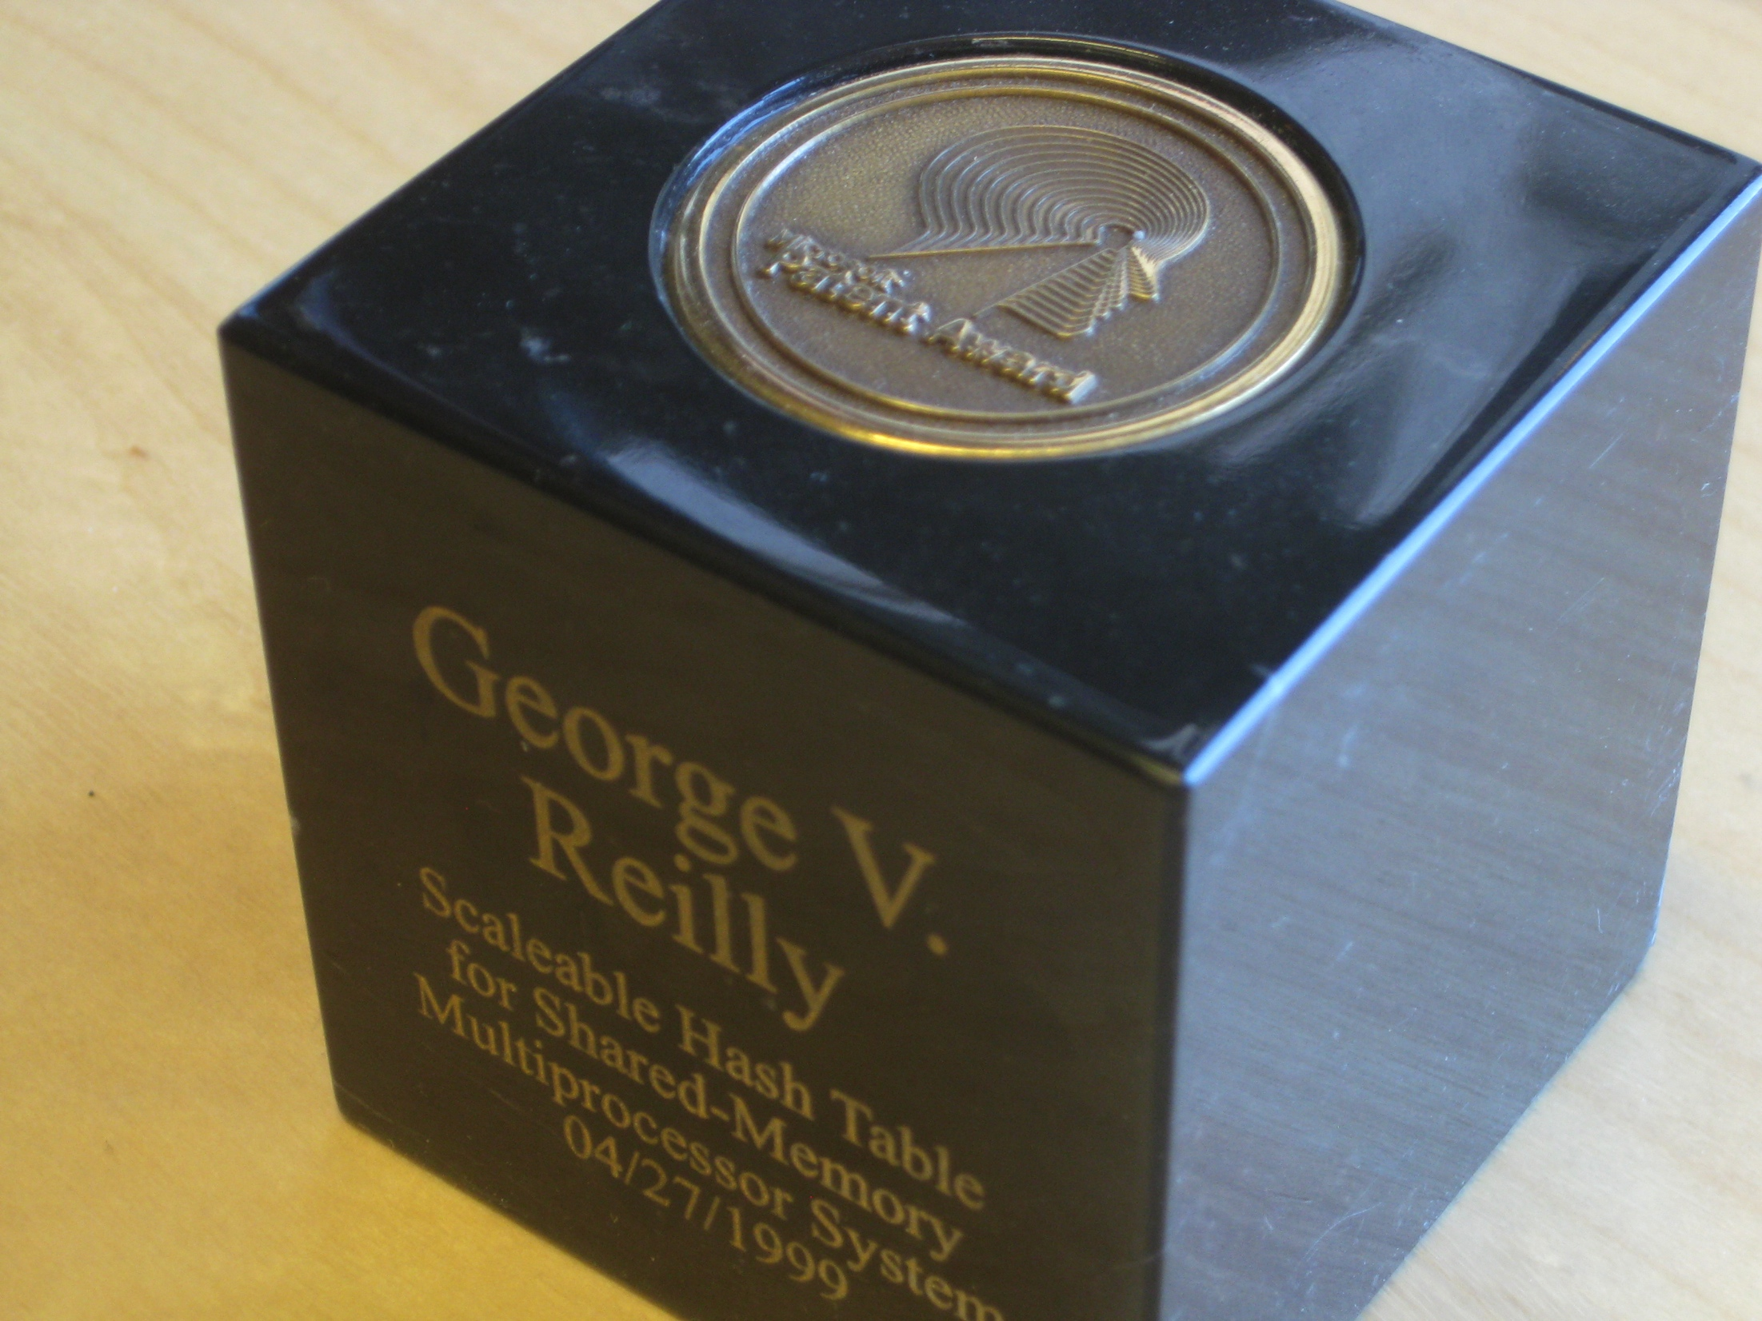
Patent 6578131
6578131
Scaleable hash table for shared-memory multiprocessor system

Slide 33

Closed Source
Hoping that Microsoft will make LKRhash available on CodePlex

Slide 34
References
P.-Å. Larson, “Dynamic Hash Tables”, Communications of the ACM, Vol 31, No 4, pp. 446–457
http://www.google.com/patents/US6578131.pdf

Slide 35
Other (Multithreaded) Hashtables
Cliff Click’s Non-Blocking Hashtable
Facebook’s AtomicHashMap: video, Github
Intel’s tbb::concurrent_hash_map
Hash Table Performance Tests (not MT)

