Slide 1

Algorithms Rule Supreme
Lloyd Moore
Notes:
ESC Minneapolis

Slide 2
Algorithms Rule Supreme
Lloyd Moore, Senior Embedded Systems Engineer
30 years of embedded and machine vision software experience
“
Code optimizations may get 2-4x improvement
Algorithm changes can get more than 10x
”
We are going to look at how to tailor an algorithm to best fit the problem definition and improve performance
Notes:
ESC Minneapolis

Slide 3
Agenda
Algorithm
analysis
“Traditional”
approach
Algorithm
analysis
“Wanderer”
approach
Algorithm
analysis
“Single pass”
approach
Definition of
connectivity
/blob analysis
Comparison
and
Summary
Notes:
ESC Minneapolis

Slide 4
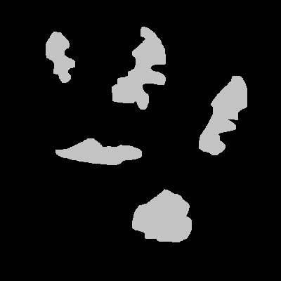
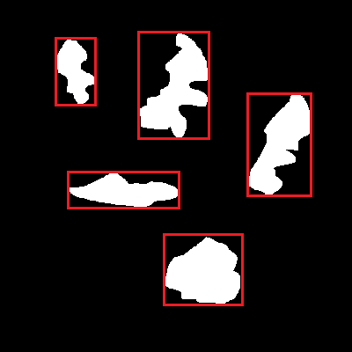
What is Connectivity Analysis
Also called Blob Analysis
Goal is to determine which pixels in an image are adjacent
Transforms a group of individual pixels into one “object”
For our discussion we will record a bounding box for the “object”
Notes:
ESC Minneapolis

Slide 5
Comparing Algorithms
Assume images are 100 x 100 pixels – simple math
Algorithms will be pseudo-code and we’ll count operations
Algorithms somewhat simplified for presentation
Will consider memory/cache friendliness separate from operations
Will consider advantages & disadvantages for image content
1
2
3
“Traditional” Algorithm
“Wanderer” Algorithm
“Single Pass” Algorithm
Consider 3 algorithm solutions:
Notes:
ESC Minneapolis

Slide 6
“Traditional” Algorithm - Problem
Will use a “text book”
approach to start
Won’t make any assumptions
about blobs in image
Serves as a baseline for
other algorithms
Likely wouldn’t want to
use this in real life
Notes:
ESC Minneapolis

Slide 7

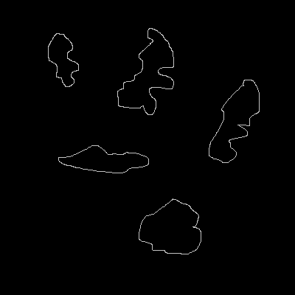

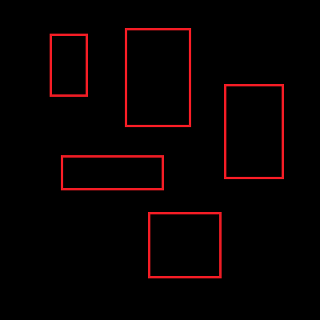
“Traditional” Algorithm - Outline
1
2
3
45
Threshold Image
Apply edge detection kernel
“Walk” image to find start of an outline
Follow the outline to find the blob, and update bounding box
Continue until all blobs found, end of the image
Notes:
ESC Minneapolis

Slide 8
“Traditional” Algorithm - Complexity
Threshold:
For each pixel in image 100 x 100 pixels = 10000 loops
read + inc + write + compare + test = 4 operations
If value > Threshold then read + compare + test + write = 4 operations
Value = 255
Else
Value = 0 (4 + 4) * 10000 = 80,000 Ops
Edge Detection Kernel:
Assume: 3x3 kernel, stride of 1,
kernel stays inside image
For each image position Ix (100 – 2) = 98 loops
read + inc + write + compare + test = 4 operations
For each image position Iy (100 – 2) = 98 loops
read + inc + write + compare + test = 4 operations
value = 0 write = 1 operation
For each kernel position Kx 3 loops
read + inc + write + compare + test = 4 operations
For each kernel position Ky 3 loops
read + inc + write + compare + test = 4 operations
value += image[Ix, Iy] * kernel[Kx, Ky] 6 read + 3 multiply + 3 add + 1 write = 13 operations
Target[Ix, Iy] = value 2 read + 1 multiply + 1 add + 1 write = 5 operations
((((4 + 13 + 5)*3 + 4) * 3 + 1 + 4) * 98 + 4) * 98 = 682,276 Ops
Notes:
ESC Minneapolis

Slide 9
“Traditional” Algorithm - Complexity
Walk Image, find outline start:
For each pixel in image 100 x 100 pixels = 10000 loops
read + inc + write + compare + test = 4 operations
If value == 255 then read + compare + test = 3 operations
Trace outline(); Happens “rarely”, ignore call overhead
(4 + 3) * 10000 = 70,000 Ops
Trace blob outline:
For each pixel in border:
If Image[x-1, y] == 255 then x-- (for 5 cases) 5 * (3 read + multiply + add + compare + test) = 25 operations
One will trigger if clause: read + add/sub + write = 3 operations
If x < min_x then min_x = x (for 4 cases) 4 * (2 read + compare + test) = 16 operations
Assume 25% trigger if clause: write = 0.25 operations
If x = starting_x && y == starting_y then break 4 reads + 2 compare + and + test = 8 operations
Image[x, y] = 0 (erase current pixel) 2 reads + multiply + add + write = 5 operations
(25 + 3 + 16 + 0.25 + 8 + 5) = 57.25 Ops per border pixel
Total = 80000 + 682276 + 70000 = 832,276 operations per image
+ 57.25 operations per border pixel of all blobs
Notes:
ESC Minneapolis

Slide 10
“Traditional” Algorithm – Strengths/Weakness
Strengths
Weakness
Simple to implement
Simple to understand
Mostly independent of image content
Pretty slow
Multiple passes over image
Multiple working images
Not cache friendly
Original image destroyed
Notes:
ESC Minneapolis

Slide 11
“Wanderer” Algorithm - Problem
Images consist of 50 to 200 very thin blobs
Imaging environment is controlled
No “large” blobs
Example comes from a real world optimization project
Blobs were actually fibers of a material
NOTE: Example images will show on a few blobs
Notes:
ESC Minneapolis

Slide 12
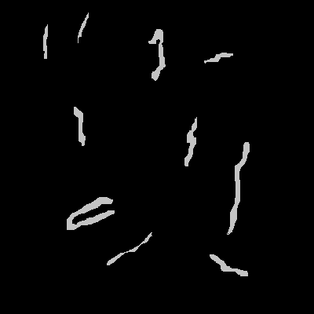

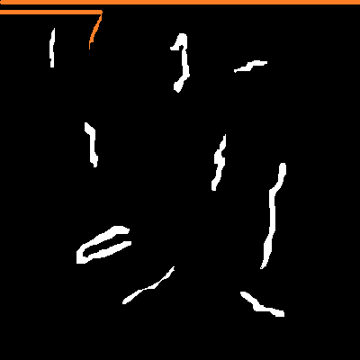
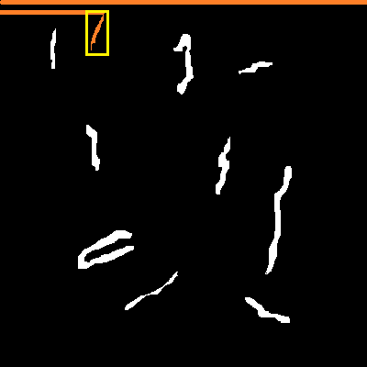
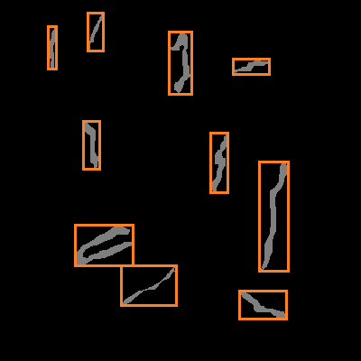
“Wanderer” Algorithm - Outline
Threshold Image
Find Blob Start
Explore Blob, Updating Bounding Box
Double Check Blob Fully Explored
Continue Until End of Image Reached
1
2
3
45
1
2
3
4
5
Notes:
ESC Minneapolis

Slide 13
“Wanderer” Algorithm - Complexity
Threshold: Same as “Traditional” 80,000 Ops
Find Blob Start: Same as “Traditional” 70,000 Ops
Explore Blob:
For each pixel in blob:
Explore adjacent the 8 adjacent pixels
explorer_pointer = cur_blob_start + fixed_offset read + write + add = 3 operations
if(*explorer_pointer == untouched_pixel) dereference + read + test = 3 operations
accumulate_pixel(this_x, this_y) Assume 75% of the time: 0.75 *(2 push + call) = 2.25 operations
*explorer = *explorer & constant_tag dereference + read + and + write = 4 operations
accumulate_pixel:
If x < min_x then min_x = x (for 4 cases) 4 * (2 read + compare + test) = 16 operations
Assume 25% trigger if clause: write = 0.25 operations
++pixel_count read + increment + write = 3 operations
return return = 1 operation
3 + 3 + 2.25 + 4 + 0.75 * (16 + 0.25 + 3 + 1) =
27.5 operations per blob pixel (approximately actual is 27.4375)
Notes:
ESC Minneapolis

Slide 14
“Wanderer” Algorithm - Complexity
Explore Blob:
For each pixel in blob:
Move to next pixel: explore right, down, down & right, down & left: 4 cases assume 50% hit so count 2 cases
explorer_pointer = explorer_pointer + fixed_offset read + write + add = 3 operations
if(*explorer_pointer > completed_pixel dereference + read + subtract + test = 4 operations
&& *explorer_pointer < untouched_pixel) and + subtract + test = 3 operations
cur_blob_start = explorer_pointer write = 1 operation
cur_coordinate += const_offset read + add + write = 3 operations
2 * (3 + 4 + 3 + 1 + 3) = 28 operations per blob pixel
Double Check Blob Fully Explored:
For each pixel current blob bounding box:
if(*explorer_pointer > completed_pixel dereference + read + subtract + test = 4 operations
&& *explorer_pointer < untouched_pixel) and + subtract + test = 3 operations
cur_blob_start = explorer_pointer write = 1 operation
cur_blob_x = cur_offset % width 2 reads + modulus + write = 4 operations
cur_blob_y = cur_offset / width 2 reads + divide + write = 4 operations
4 + 3 + 1 + 4 + 4 = 16 operations per current blob counted pixel
Notes:
ESC Minneapolis

Slide 15
“Wanderer” Algorithm - Complexity
Threshold: Same as “Traditional” 80,000 Ops
Find Blob Start: Same as “Traditional” 70,000 Ops
Explore Blob: 27.5 + 28 ops 55.5 Ops per Blob Pixel
Double Check: 16 ops, assume executes 3x 48 Ops per Blob Pixel
Total = 80,000 + 70,000 = 150,000 operations per image
+ 55.5 + 48 = + 103.5 operations per blob pixel
Notes:
ESC Minneapolis

Slide 16
Comparison and Summary
Algorithm:
Traditional
Pixel
Wanderer
Ops per Image:
832,276
150,000
Ops per Feature:
57.25 per blob border
103.5 per blob area pixel
OBSERVATIONS:
Performance GREATLY depends on image contents
Wanderer faster for empty image, worse for large blobs
This application had long thin blobs, most only 1 or 2 pixels in width; blob area approximated blob border pixels in practice
Notes:
ESC Minneapolis

Slide 17
“Wanderer” Algorithm – Strengths/Weakness
Strengths
Weakness
15 to 30x faster for target image content vs commercial library
Single copy of image
Image altered but available
Complex to implement
HIGHLY dependent on image content
Multiple passes over image
Not cache friendly
Notes:
ESC Minneapolis

Slide 18
“Single Pass” Algorithm - Problem
Track 5 to 10 small round objects per frame
Run on VERY small processors, including micro-controllers
Target processor need not hold full video frame, only current pixel
Example comes from a real world project
Image content mostly controlled via narrow band optical filter
Notes:
ESC Minneapolis

Slide 19
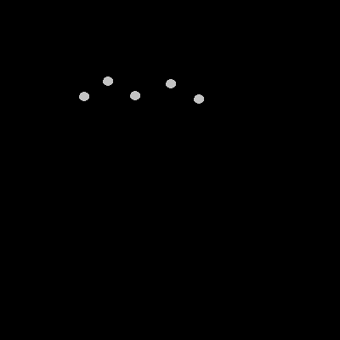
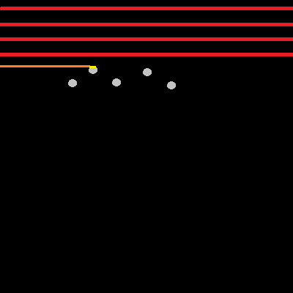
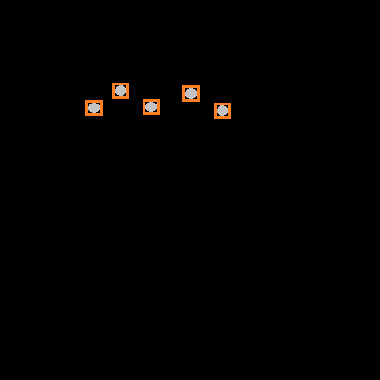
“Single Pass” Algorithm - Outline
1
2
3
For each pixel in the image
Threshold the pixel and detect segment start and ends
When a segment is complete add it to the connecting blob structure
Notes:
ESC Minneapolis

Slide 20
“Single Pass” Algorithm - Complexity
Setup variables:
forming_vector = false write = 1 operation
pixel_scanner = image_start read + write = 2 operations
current_x = current_y = 0; 2 writes = 2 operations
1 + 2 + 2 = 5 operations per image
Insert blob line:
For each blob Assume 10 blobs at all times (worst case)
if this_y == last_y + 1 2 read, add, compare, test = 5 operations
if min_x >= blob_min_x or 2 read, compare, test, or = 5 operations
max_x <= blob_max_x 2 read, compare, test = 4 operations
blob_last_y = this_y read + write = 2 operations <=Only for 1 blob
blob_min_x = min_x read + write = 2 operations <=Only for 1 blob
blob_max_x = max_x read + write = 2 operations <=Only for 1 blob
if min_x < box_min_x 2 read, compare, test = 4 operations <=Only for 1 blob
box_min_x = min_x read + write = 2 operations <=Only for 1 blob, 50%
if max_x > box_max_x 2 read, compare, test = 4 operations <=Only for 1 blob
box_max_x = max_x read + write = 2 operations <=Only for 1 blob, 50%
10 * (5 + 5 + 4) + (2 + 2 + 2 + 4 + 0.5 + 4 + 0.5) = 155 operations per blob line
Notes:
ESC Minneapolis

Slide 21
“Single Pass” Algorithm - Complexity
Walk the image:
For each pixel in the image: 100 x 100 pixels = 10000 loops
if *pixel_scanner > threshold dereference + read + compare + test = 4 operations
Assume: 1% hit image is mostly black
if not forming_vector read + compare + test = 3 operations <=Take worst case
starting_x = max_x = current_x read + 2 write = 3 operations
starting_y = current_y read + write = 2 operations
forming_vector = true write = 1 operation
else
max_x = current_x read + write = 2 operations <=Not worst case
else
if forming_vector read + compare + test = 3 operations <=Not worst case
insert_blob_line() from previous slide <=Counted per blob line
forming_vector = false write = 1 operation <=Not worst case
++pixel_scanner; ++current_x; ++current_y 3* (read + increment + write) = 9 operations
if current_x > image_width read + compare + test = 4 operations
if forming_vector insert_blob_line() read + compare + test = 3 operations <=Image Row
++current_y; current_x = 0; read + increment + 2 write = 4 operations <=Image Row
forming_vector = false write = 1 operation <=Image Row
10000 * 4 + 0.01 * (3 + 3 + 2 + 1) + (9 + 4) + 10 * (3 + 4 + 1) = 40093.09 => 40,093 + 5 setup =
40,098 ops per image + 155 ops per blob line
Notes:
ESC Minneapolis

Slide 22
“Single Pass” Algorithm – Strengths/Weakness
Strengths
Weakness
Extremely fast, though no direct benchmark
Single pass through image, and only need to have one pixel of the image at any time
Original image untouched
Simple to implement
Very cache friendly
Performance suffers with large number of blobs
Have to deal with combining blob fragments in some cases; did not address that here as didn’t need it for this particular case
Notes:
ESC Minneapolis

Slide 23
Comparison and Summary
Algorithm:
Traditional
Wonderer
Single Pass
Ops per Image:
832,276
150,000
40,098
Ops per Feature:
57.25 per blob border pixel
103.5 per blob pixel
155 per blob line
OBSERVATIONS:
Note ops per image constantly goes down, consider an empty image
Most blob lines will have many pixels so 155 ops per line isn’t that bad
Consider a completely white image: single pass still better
Actual implementation also had noise filter to consolidate blob lines
Notes:
ESC Minneapolis

Slide 24
Final Thoughts
Matching the algorithm to the expected use case and input can greatly improve performance
These gains are complimentary and additive to other optimization techniques
Consider radically different approaches – “Single Pass” cannot be clearly evolved from “Traditional” or “Wanderer” algorithms
ALWAYS measure actual performance and use a wide variety of input
Notes:
ESC Minneapolis

Slide 25
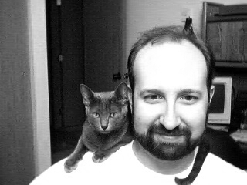
Speaker/Author Details
Http://FSStudio.com
LloydMoore@FSStudio.com

Slide 26
Thank You!
Questions?
@ESC_Conf
Notes:
ESC Minneapolis

