Slide 1
Coordinate Transformations in Three Dimensions
Robert P. Goddard
Northwest C++ Users Group Presented 18 October 2017 Additional material added 23 October 2017

Slide 2
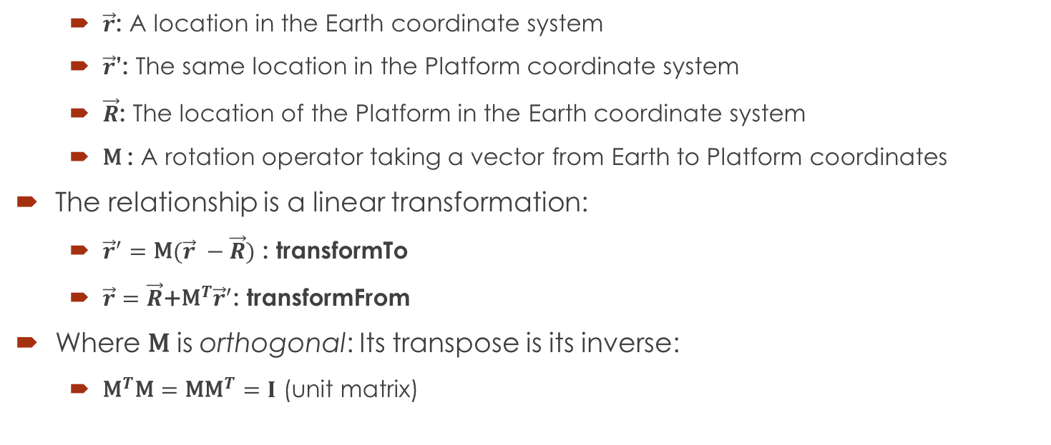
Transforming a Vector
$\vec{r}$: A location in the Earth coordinate system
$\vec{r}$’: The same location in the Platform coordinate system
$\vec{R}$: The location of the Platform in the Earth coordinate system
$\text{M}$: A rotation operator taking a vector from Earth to Platform coordinates
The relationship is a linear transformation:
${\vec{r}}^{′}=\text{M}(\vec{r} −\vec{R})$ : transformTo
$\vec{r}=\vec{R}\text{+}{\text{M}}^{T}{\vec{r}}^{′}$: transformFrom
Where $\text{M}$ is orthogonal: Its transpose is its inverse:
${\text{M}}^{T}\text{M}=\text{M}{\text{M}}^{T}=I$ (unit matrix)

Slide 3
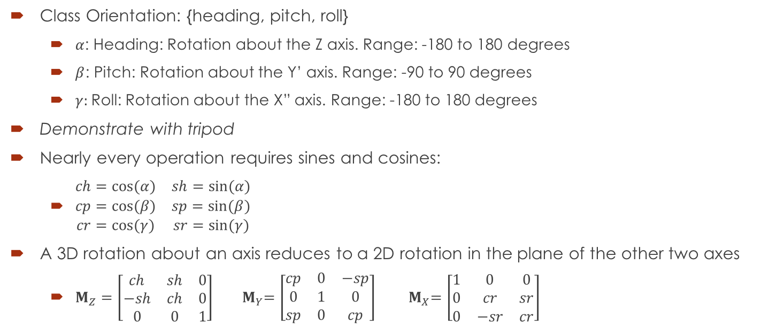
Rotation Inputs
Class Orientation: {heading, pitch, roll}
$α$: Heading: Rotation about the Z axis. Range: -180 to 180 degrees
$β$: Pitch: Rotation about the Y’ axis. Range: -90 to 90 degrees
$γ:$Roll: Rotation about the X” axis. Range: -180 to 180 degrees
Demonstrate with tripod
Nearly every operation requires sines and cosines:
$\begin{matrix}ch=cos⁡(α) & sh=sin⁡(α) \\ cp=cos⁡(β) & sp=sin⁡(β) \\ cr=cos⁡(γ) & sr=sin⁡(γ)\end{matrix}$
A 3D rotation about an axis reduces to a 2D rotation in the plane of the other two axes
$M_{Z}=\left[\begin{matrix}ch & sh & 0 \\ −sh & ch & 0 \\ 0 & 0 & 1\end{matrix}\right]$ ${ M}_{Y}=\left[\begin{matrix}cp & 0 & −sp \\ 0 & 1 & 0 \\ sp & 0 & cp\end{matrix}\right]$ ${ M}_{X}=\left[\begin{matrix}1 & 0 & 0 \\ 0 & cr & sr \\ 0 & −sr & cr\end{matrix}\right]$

Slide 4
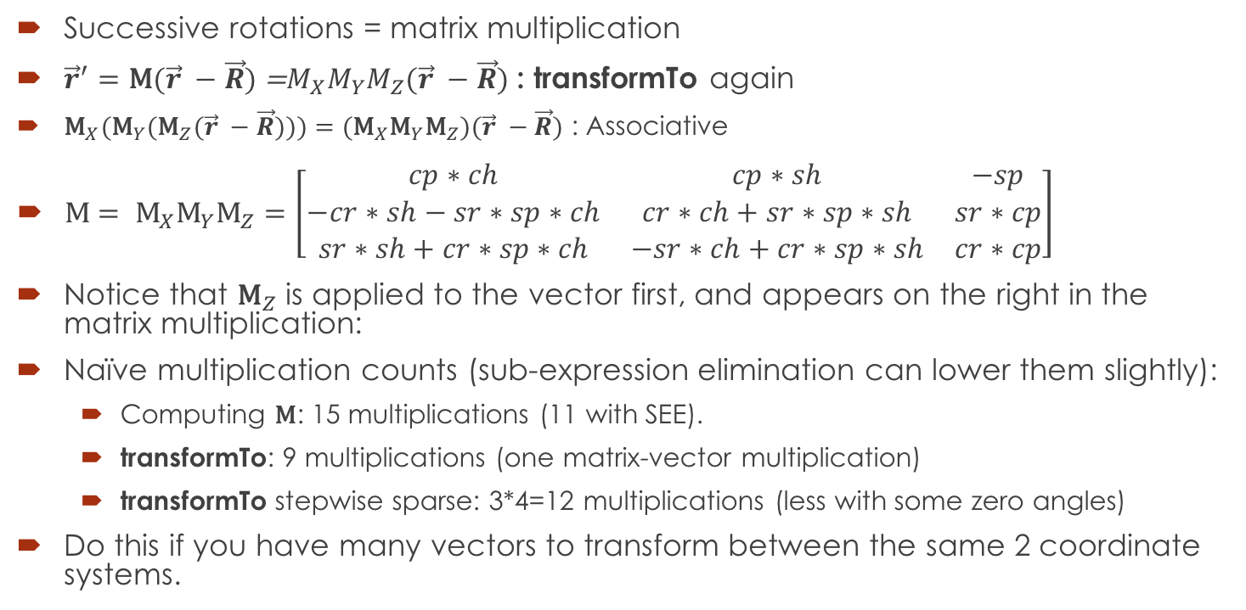
Rotation Matrix from Orientation
Successive rotations = matrix multiplication
${\vec{r}}^{′}=\text{M}(\vec{r} −\vec{R})$ =$M_{X}M_{Y}M_{Z}(\vec{r} −\vec{R})$ : transformTo again
${\text{M}}_{X}{(\text{M}}_{Y}{(\text{M}}_{Z}(\vec{r} −\vec{R})))={(\text{M}}_{X}{\text{M}}_{Y}{\text{M}}_{Z})(\vec{r} −\vec{R})$ : Associative
$\text{M}= {\text{M}}_{X}{\text{M}}_{Y}{\text{M}}_{Z}=\left[\begin{matrix}cp∗ch & cp∗sh & −sp \\ −cr∗sh−sr∗sp∗ch & cr∗ch+sr∗sp∗sh & sr∗cp \\ sr∗sh+cr∗sp∗ch & −sr∗ch+cr∗sp∗sh & cr∗cp\end{matrix}\right]$
Notice that ${\text{M}}_{Z}$ is applied to the vector first, and appears on the right in the matrix multiplication:
Naïve multiplication counts (sub-expression elimination can lower them slightly):
Computing $\text{M}$: 15 multiplications (11 with SEE).
transformTo: 9 multiplications (one matrix-vector multiplication)
transformTo stepwise sparse: 3*4=12 multiplications (less with some zero angles)
Do this if you have many vectors to transform between the same 2 coordinate systems.

Slide 5
Problem: Smooth Motion
Try to keep an airplane centered in camera image as it passes overhead.
Demonstrate with tripod. Roll doesn’t help.
With HPR rotations, it can’t be done continuously!
The problem occurs at the axis of the first rotation (heading).
Theorem: For every 3D rotation, there exists an axis such that vectors parallel to that axis are invariant under that rotation.
Proposed representation #3: Unit vector (axis) in the invariant direction, multiplied by a scalar giving the angle of rotation about that vector.
Advantage: Smooth rotation (interpolation) can be done by smoothly varying the angle (magnitude of vector) while keeping the axis constant.
New problem: Find that vector, given orientation (#1) or matrix (#2).

Slide 6
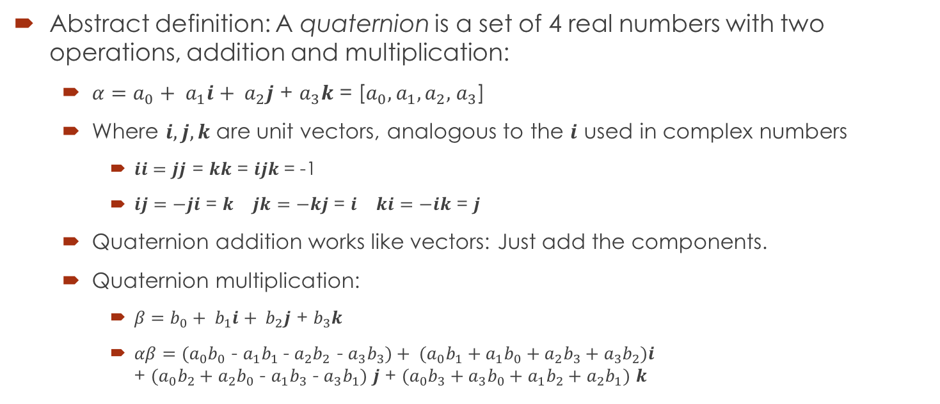
Quaternions
Abstract definition: A quaternion is a set of 4 real numbers with two operations, addition and multiplication:
$α=a_{0}+ a_{1}i+ a_{2}j$ + $a_{3}k$ = [$a_{0}, a_{1}, a_{2},$ $a_{3}$]
Where $i, j, k$ are unit vectors, analogous to the $i$ used in complex numbers
$ii=jj$ = $kk$ = $ijk$= -1
$\begin{matrix}ij=−ji\text{ = }k & jk=−kj\text{ = }i & ki=−ik\text{ = }j\end{matrix}$
Quaternion addition works like vectors: Just add the components.
Quaternion multiplication:
$β=b_{0}+ b_{1}i+ b_{2}j$ + $b_{3}k$
$αβ=(a_{0}b_{0}$ - $a_{1}b_{1}$- $a_{2}b_{2}$ - $a_{3}b_{3})+ (a_{0}b_{1}+a_{1}b_{0}+a_{2}b_{3}+a_{3}b_{2})i$ + $(a_{0}b_{2}+a_{2}b_{0}$ - $a_{1}b_{3}$ - $a_{3}b_{1})$ $j$ + $(a_{0}b_{3}+a_{3}b_{0}+a_{1}b_{2}+a_{2}b_{1})$ $k$

Slide 7
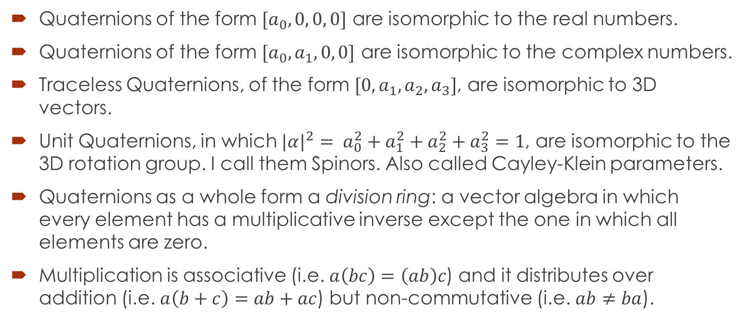
Quaternion Subspaces and Properties
Quaternions of the form $[a_{0}, 0, 0, 0]$ are isomorphic to the real numbers.
Quaternions of the form $[a_{0},a_{1}, 0, 0]$ are isomorphic to the complex numbers.
Traceless Quaternions, of the form $[0, a_{1},a_{2},a_{3}]$, are isomorphic to 3D vectors.
Unit Quaternions, in which ${|α|}^{2}= a_{0}^{2}+a_{1}^{2}+a_{2}^{2}+a_{3}^{2}=1$, are isomorphic to the 3D rotation group. I call them Spinors. Also called Cayley-Klein parameters.
Quaternions as a whole form a division ring: a vector algebra in which every element has a multiplicative inverse except the one in which all elements are zero.
Multiplication is associative (i.e. $a\left(bc\right)=\left(ab\right)c$) and it distributes over addition (i.e. $a\left(b+c\right)=ab+ac$) but non-commutative (i.e. $ab≠ba$).

Slide 8
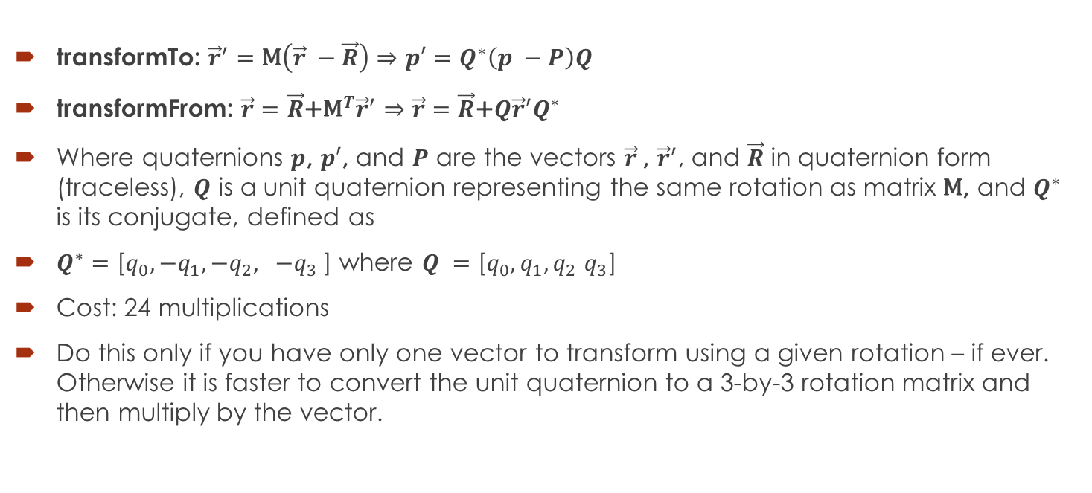
Quaternion Coordinate Transformation
transformTo: ${\vec{r}}^{′}=\text{M}\left(\vec{r} −\vec{R}\right)⇒p′=Q^{∗}\left(p −P\right)Q$
transformFrom: $\vec{r}=\vec{R}\text{+}{\text{M}}^{T}{\vec{r}}^{′}⇒\vec{r}=\vec{R}\text{+}Q{\vec{r}}^{′}Q^{∗}$
Where quaternions $p$, $p′$, and $P$ are the vectors $\vec{r}$, ${\vec{r}}^{′}$, and $\vec{R}$ in quaternion form (traceless), $Q$ is a unit quaternion representing the same rotation as matrix $\text{M}$, and $Q^{∗}$ is its conjugate, defined as
$Q^{∗}=\text{[}q_{0}, {−q}_{1}, {−q}_{2}, {−q}_{3}\text{]}$ where $Q =\text{[}q_{0}, q_{1}, q_{2} q_{3}\text{]}$
Cost: 24 multiplications
Do this only if you have only one vector to transform using a given rotation – if ever. Otherwise it is faster to convert the unit quaternion to a 3-by-3 rotation matrix and then multiply by the vector.

Slide 9
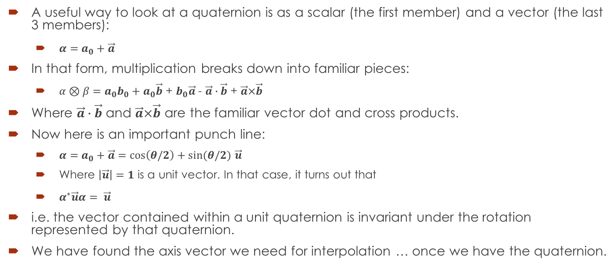
Quaternion Scalar-Vector Form
A useful way to look at a quaternion is as a scalar (the first member) and a vector (the last 3 members):
$α=a_{0}+\vec{a}$
In that form, multiplication breaks down into familiar pieces:
$α⊗β=a_{0}b_{0}+a_{0}\vec{b}$ + $b_{0}\vec{a}$ - $\vec{a}∙\vec{b}$ + $\vec{a}×\vec{b}$
Where $\vec{a}∙\vec{b}$ and $\vec{a}×\vec{b}$ are the familiar vector dot and cross products.
Now here is an important punch line:
$α=a_{0}+\vec{a}=cos\left(θ/2\right)+sin(θ/2)$ $\vec{u}$
Where $\left|\vec{u}\right|=1$ is a unit vector. In that case, it turns out that
$α^{∗}\vec{u}α= \vec{u}$
i.e. the vector contained within a unit quaternion is invariant under the rotation represented by that quaternion.
We have found the axis vector we need for interpolation … once we have the quaternion.

Slide 10
Unit Quaternion from Orientation
/// Compute the Spinor (unit quaternion) corresponding to the given orientation angles. /** Heading, pitch, and roll are right-handed rotations about z, y, and x * respectively, in that order, in radians. */ Spinor spinorFromOrient( Orientation orient ) { double ch = std::cos( 0.5*orient.heading ); double sh = std::sin( 0.5*orient.heading ); double cp = std::cos( 0.5*orient.pitch ); double sp = std::sin( 0.5*orient.pitch ); double cr = std::cos( 0.5*orient.roll ); double sr = std::sin( 0.5*orient.roll ); return Spinor( ch*cp*cr + sh*sp*sr, -ch*sp*sr + sh*cp*cr, ch*sp*cr + sh*cp*sr, ch*cp*sr + sh*sp*cr ); }
Cost: 6 trig functions + 16 multiplications, minus some for common sub-expression elimination.
Conclude: Do this only on input from human-readable form.

Slide 11
Added Material
Slides after this one were added after the talk.
Caveat: All code shown in this presentation is based on well-tested SST code, but it was heavily edited for this presentation and not subsequently tested. Don’t blindly depend on it.

Slide 12
Unit Quaternion to Rotation Matrix
/// Convert a Spinor (unit quaternion) to a 3-by-3 rotation matrix void spinorToMatrix( Spinor spinor, float matrix[3][3] ) { float q0 = spinor.R_component_1(); float q1 = spinor.R_component_2(); float q2 = spinor.R_component_3(); float q3 = spinor.R_component_4(); float p00 = q0*q0; float p01 = q0*q1; float p02 = q0*q2; float p03 = q0*q3; float p11 = q1*q1; float p12 = q1*q2; float p13 = q1*q3; float p22 = q2*q2; float p23 = q2*q3; float p33 = q3*q3;
// Continued from left column: matrix[0][0] = p00 - p11 - p01 - p01; matrix[0][1] = p01 + p01 + p23 + p23; matrix[0][2] = p13 + p13 - p02 - p02; matrix[1][0] = p23 + p23 - p01 - p01; matrix[1][1] = p00 - p11 + p01 + p01; matrix[1][2] = p03 + p12 + p03 + p12; matrix[2][0] = p02 + p02 + p13 + p13; matrix[2][1] = p12 + p12 - p03 - p03; matrix[2][2] = p00 + p11 - p22 - p33; }
Cost: 10 multiplications

Slide 13
Unit Quaternion to Rotation Vector
/// Convert a Spinor (unit quaternion) to the equivalent rotation vector. /** Return the Vector whose direction is that of the axis of the right-handed * rotation corresponding to the Spinor s, and whose magnitude is the * rotation angle in radians. */ Vector spinorToVector( Spinor s ) { Vector u = Unreal( s ); // Last 3 elements double sinHalfAngle = abs( u ); // 3 mults + sqrt if ( sinHalfAngle < AngleTolerance ) return Vector(); double cosHalfAngle = real( s ); // First element double halfAngle = ( cosHalfAngle >= 0.0 ) // Choose the smaller angle ? std::atan2( sinHalfAngle, cosHalfAngle ); : -std::atan2( sinHalfAngle, -cosHalfAngle ); return (2.0/sinHalfAngle) * u; }
Cost: 1 trig function + 1 square root + 6 multiplications + 1 division

Slide 14
Unit Quaternion From Rotation Vector
/// Convert a rotation vector to the equivalent Spinor (unit quaternion). /* Return the Spinor corresponding to a right-handed rotation about the * vector x by |x| radians. */ Spinor spinorFromVector( Vector x ) { double angle = abs( x ); if ( angle <= angleTolerance ) return Spinor(); // {1,0,0,0} double factor = std::sin( 0.5*angle ) / angle; return Spinor( std::cos( 0.5*angle ), factor * x[2], factor * x[1], factor * x[0] ); }
Cost: 2 trig functions + 4 multiplications

Slide 15
Interpolating a Rotation
/// Interpolate linearly between two Rotations /** Set *this to a Rotation that lies along a "minimal" path * between the two given Rotations. * The point along that path is computed using linear interpolation * with the given weight. */ void Rotation::Interpolate( const Rotation& prevRot, ///< Previous Rotation const Rotation& nextRot, ///< Next Rotation double weight ///< Interpolation weight, 0 at prev to 1 at next ) { Spinor fullSpinor = nextRot.spinor_ / prevRot.spinor_; // 4 mult Vector vecFull = spinorToVector( fullSpinor ); // 1 trig + 1 sqrt + 7 mult Vector vecDelta = weight*vecFull; // 3 mult Spinor spinDelta = spinorFromVector( vecDelta ); // 2 trig + 4 mult spinor_ = spinDelta * prevRot.spinor_; // 4 mult }
Simplified for presentation by omitting time derivatives.
Spinor spinor_ is a member of Rotation.
Cost: 3 trig functions + 1 square root+ 22 multiplications
Can be reduced if there are many interpolation points between the same 2 rotations

Slide 16
Summary: Representations of Rotations
Orientation angles (e.g. heading, pitch, roll)
Use only for human-readable I/O
Conversion to other representations require trig functions
Difficult to compute from the other forms (iterative nonlinear solver)
Matrix (3 by 3, orthogonal, 6 constraints)
Most efficient for transforming vectors
Difficult to convert to any other representation
Unit Quaternion (4 reals + 1 constraint)
Easy to compute compound rotation (multiply)
Reasonably easy to compute from orientation angles or rotation vector
Easy to convert to matrix or rotation vector
Rotation Vector (3 reals)
Required for interpolating rotations (and extrapolating, not shown)
Reasonably easy to convert to or from unit quaternions
All four are required for an efficient, full-featured 3D geometry library.

